Slide 1

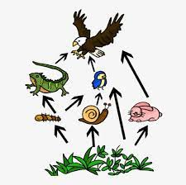
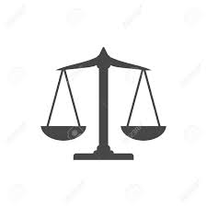
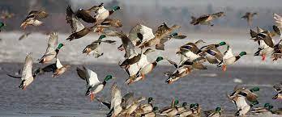
Keeping the Balance
Template by Eric Curts

Slide 2
JEOPARDY BOARD
FINAL JEOPARDY
Conservation History | Hunting and Trapping | Ecosystem Interactions | Balance and Biodiversity | Species Monitoring
$100 | $100 | $100 | $100 | $100
$200 | $200 | $200 | $200 | $200
$300 | $300 | $300 | $300 | $300
$400 | $400 | $400 | $400 | $400
$500 | $500 | $500 | $500 | $500

Slide 3

Conservation History - $100 Question
Who manages and protects wildlife populations and habitats in Rhode Island?
Click to see answer

Slide 4
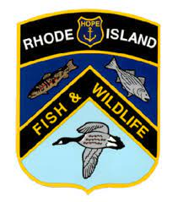

Conservation History - $100 Answer
The Rhode Island Division of Fish and Wildlife
Click to return to Jeopardy Board
Notes:
The Rhode Island Division of Fish and Wildlife is currently responsible for protecting, restoring and managing wildlife populations and their habitats.

Slide 5
Conservation History- $200 Question
Who is responsible for establishing both the Duck Stamp Act and the Pittman-Robertson Act?
Click to see answer

Slide 6
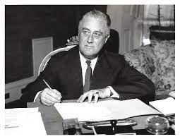
Conservation History - $200 Answer
President Franklin D. Roosevelt signed the Duck Stamp Act in 1934 and the Pittman-Robertson Act in 1937.
Click to return to Jeopardy Board
Notes:
The Duck Stamp Act established in 1934 makes it a requirement of all waterfowl hunters ages 16 and up to purchase a Federal Duck Stamp each year. The proceeds of Duck Stamp sales (98 cents out of every dollar), goes towards purchasing or leasing wetland habitat for the National Wildlife Refuge system.
The Pittman-Robertson Act places an excise tax on firearms and ammunition, with a later extension to archery equipment. The proceeds of this excise tax, paid by the manufacturers, are allocated to each state by the United States Fish and Wildlife Service. The funds acquired must be used for habitat acquisition, management, and restoration, research and monitoring of bird and mammal species, and hunter education.

Slide 7
Conservation History - $300 Question
Name a species that has successfully returned to Rhode Island.
Click to see answer

Slide 8
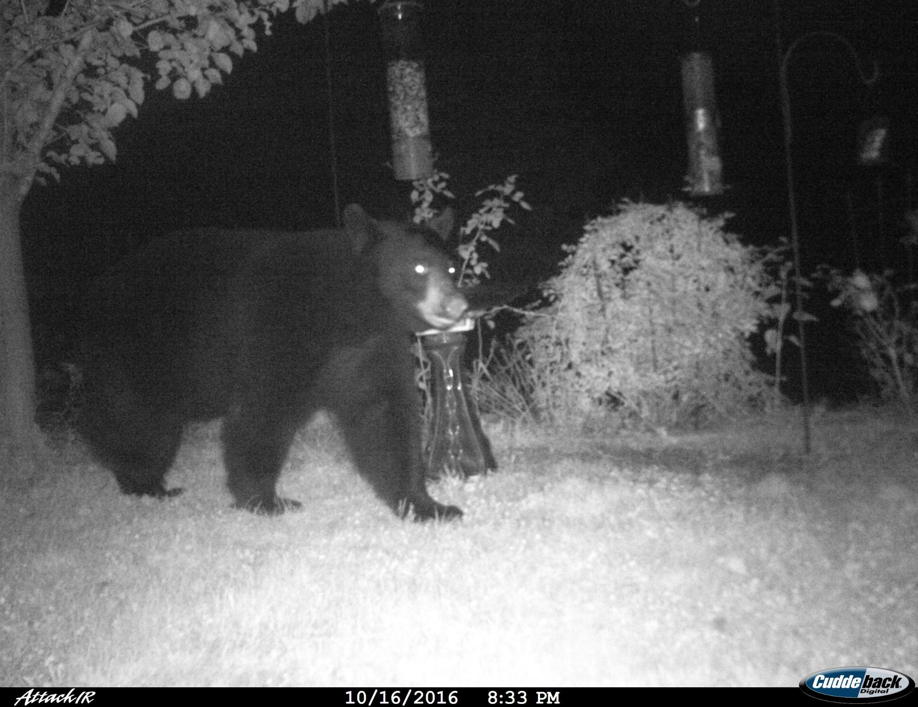
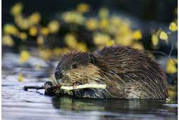
Conservation History- $300 Answer
Black Bears
Beavers
Click to return to Jeopardy Board
Notes:
In recent years, reports of black bear sightings have increased in RI. It can be assumed that we have a small resident population (a handful of bears).
In 1976, beavers were able to return to Rhode Island’s watersheds.

Slide 9
Conservation History - $400 Question
What process contributed to the overharvest of waterfowl and other birds in the 1800s?
Click to see answer

Slide 10
Conservation History - $400 Answer
Market hunting became popular in the 1830s and resulted in population declines for many bird species.
Click to return to Jeopardy Board
Notes:
There was no limit on the number of birds that could be harvested and as a result hunters were removing large quantities of individuals from the population.

Slide 11
Conservation History - $500 Question
What was the first federal legislation for wildlife?
Click to see answer

Slide 12
Conservation History - $500 Answer
The Lacey Act was established in 1900 and made it “unlawful to import, export, sell, acquire, or purchase fish, wildlife or plants that are taken, possessed, transported, or sold.”
Click to return to Jeopardy Board

Slide 13
Hunting and Trapping - $100 Question
True or False- Game species can be harvested in any amount at any time of year.
Click to see answer

Slide 14
Hunting and Trapping - $100 Answer
False! Bag limits and season lengths are used to limit the amount of individuals hunted from a population.
Click to return to Jeopardy Board
Notes:
Game species can only be harvested by hunters and trappers during set seasons, using designated, humane methods, and can only be harvested at a certain limit. Bag limits and season lengths can be adjusted based on data collected by wildlife biologists in response to population growth or decline.

Slide 15
Hunting and Trapping - $200 Question
Name a species whose populations are regulated with the help of hunting.
Click to see answer

Slide 16
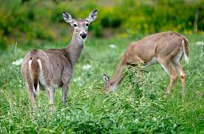
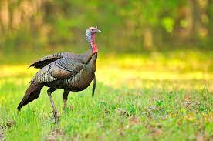
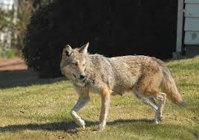
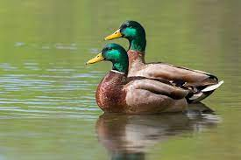
Hunting and Trapping - $200 Answer
Deer
Wild turkeys
Coyotes
Ducks
Raccoons
Foxes
Click to return to Jeopardy Board
Notes:
Sometimes a population can sustain a higher harvest rate, which may be needed to help keep the balance between biological carrying capacity and cultural carrying capacity (the population size humans are able to tolerate).

Slide 17
Hunting and Trapping - $300 Question
True or False- Hunting helps fund conservation.
Click to see answer

Slide 18
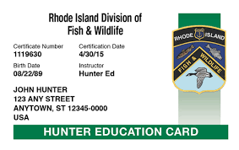
Hunting and Trapping - $300 Answer
True! A portion of the money from hunting licenses and purchase of firearms & archery equipment goes directly to conservation funding.
Click to return to Jeopardy Board

Slide 19
Hunting and Trapping - $400 Question
True or False- Modern hunting follows market hunting principles.
Click to see answer

Slide 20
Hunting and Trapping - $400 Answer
False- Market hunting occurred in the 1830s and resulted in the overharvest of many species. Today hunting is meant to be sustainable, ethical and guided by science.
Click to return to Jeopardy Board

Slide 21
Hunting and Trapping - $500 Question
Name one act or law that places regulations on hunting and trapping.
Click to see answer

Slide 22
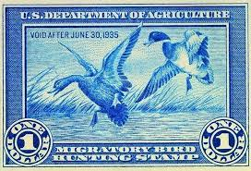
Hunting and Trapping - $500 Answer
Migratory Bird Treaty Act
The Lacey Act
Duck Stamp Act
Pittman-Robertson Act
Click to return to Jeopardy Board

Slide 23
Ecosystem Interactions - $100 Question
What is a food web?
Click to see answer

Slide 24
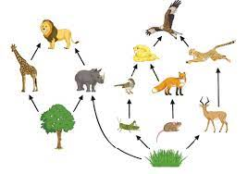
Ecosystem Interactions - $100 Answer
A food web is a diagram that represents energy transfers and interactions within an ecosystem.
Click to return to Jeopardy Board

Slide 25
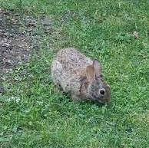
Ecosystem Interactions - $200 Question
A rabbit eats grass to get energy. What kind of consumer is the rabbit?
Click to see answer

Slide 26
Ecosystem Interactions - $200 Answer
A primary consumer
Click to return to Jeopardy Board

Slide 27
Ecosystem Interactions - $300 Question
An organism that gets energy directly from the sun is known as?
Click to see answer

Slide 28
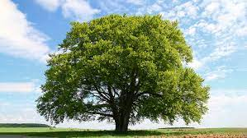
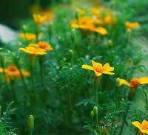
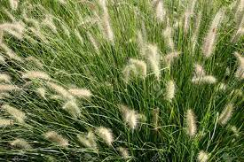
Ecosystem Interactions - $300 Answer
A producer!
Click to return to Jeopardy Board

Slide 29
Ecosystem Interactions - $400 Question
When a consumer dies, who helps recycle their nutrients back into the ecosystem?
Click to see answer

Slide 30
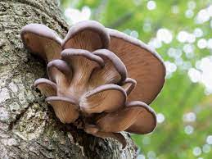
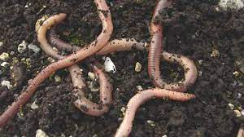
Ecosystem Interactions - $400 Answer
Decomposers
Click to return to Jeopardy Board

Slide 31
Ecosystem Interactions - $500 Question
What is the difference between a food web and a food chain?
Click to see answer

Slide 32
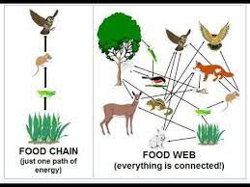
Ecosystem Interactions - $500 Answer
In a food chain energy only flows in one direction. In a food web, energy is transferred in multiple directions and multiple connections are represented.
Click to return to Jeopardy Board
Notes:
Why are there no frogs on Antarctica?-Too cold!

Slide 33
Balance and Biodiversity- $100 Question
What is a population?
Click to see answer

Slide 34
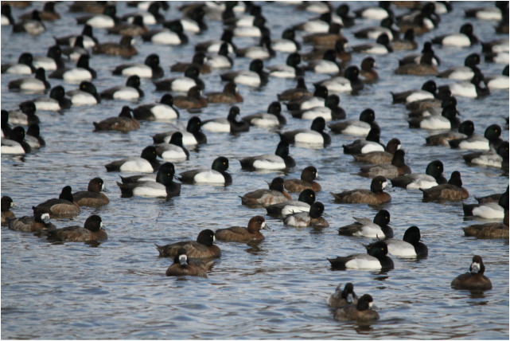
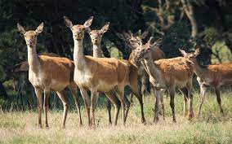
Balance and Biodiversity- $100 Answer
A population is a group of individuals of the same species living and interbreeding within a given area.
Click to return to Jeopardy Board

Slide 35
Balance and Biodiversity- $200 Question
Food, water, shelter and space are all examples of?
Click to see answer

Slide 36
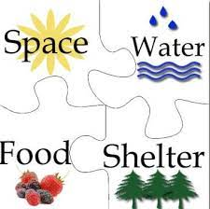
Balance and Biodiversity - $200 Answer
A resource
Click to return to Jeopardy Board
Notes:
These are all examples of resources that animals require. When a resource is limited there is competition between individuals that can limit population numbers in an environment.

Slide 37
Balance and Biodiversity- $300 Question
True or false: Balancing the needs of an ecosystem requires balancing the needs of people.
Click to see answer

Slide 38
Balance and Biodiversity- $300 Answer
True! Everything in nature is interconnected, keeping this balance is difficult and requires a lot of scientific research and patience.
Click to return to Jeopardy Board
Notes:
.

Slide 39
Balance and Biodiversity- $400 Question
What is biological carrying capacity?
Click to see answer

Slide 40
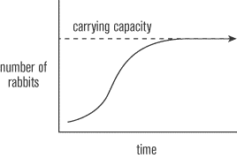
Balance and Biodiversity- $400 Answer
The maximum number of individuals of a species that a given environment can support
Click to return to Jeopardy Board

Slide 41
Balance and Biodiversity- $500 Question
What is biodiversity?
Click to see answer

Slide 42
Balance and Biodiversity- $500 Answer
Biodiversity is the amount of different species living in a particular area.
Click to return to Jeopardy Board
Notes:
Ecosystems are healthiest when there is a high amount of biodiversity. The goal of conservation and management is to support healthy populations of as many different species as possible.

Slide 43
Species Monitoring- $100 Question
True or False: Coyotes are rare in Rhode Island and are only found in deeply forested areas.
Click to see answer

Slide 44
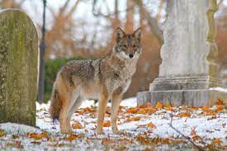
Species Monitoring - $100 Answer
False! Coyotes occupy most natural habitats and are present in most urban areas.
Click to return to Jeopardy Board
Notes:
In partnership with the Narragansett Bay Coyote Study, we are tracking coyotes in the Providence area, the suburbs of the East Bay, and rural southern and western Rhode Island. This variety of locations will illuminate the differences between the movements of coyotes that have to forage for food naturally versus coyotes that are taking advantage of subsidized food, or in some cases, direct feeding. Coyote populations are high and rapidly bounce back to levels sustainable by the food resources present. Lethal management has been used as an attempt to control coyote populations.

Slide 45
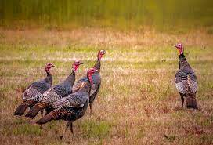
Species Monitoring- $200 Question
How can you help the RI DEM monitor wild turkey populations?
Click to see answer

Slide 46
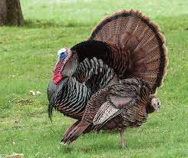
Species Monitoring - $200 Answer
Participate in the spring gobbler count
Citizen science observations
Click to return to Jeopardy Board
Notes:
Anyone can participate in spring gobbler counts as part of our volunteer program. This involves completing a driving route in the early morning and listening for the sounds of male turkeys gobbling to attract a mate. You can also simply download the Survey123 app and fill out a quick form any time you see a turkey during July and August for our citizen science survey. This is an easy way to contribute to a large data collection effort to keep an eye on our wild turkeys!

Slide 47
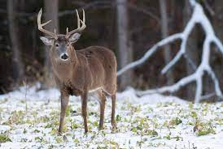
Species Monitoring - $300 Question
What disease threatens deer populations?
Click to see answer

Slide 48
Species Monitoring- $300 Answer
Chronic Wasting Disease (CWD)
Click to return to Jeopardy Board
Notes:
Chronic Wasting Disease (CWD) is a devastating neurological disease that affects deer, moose, and elk across North America. Monitoring and preventing the spread of CWD has become a major priority of deer biologists across the nation. Though CWD has not yet occurred in Rhode Island, we have taken monitoring measures in order to protect the health of our state’s deer population.

Slide 49
Species Monitoring - $400 Question
True or False: Bobcats and black bears are Species of Greatest Conservation Need in Rhode Island.
Click to see answer

Slide 50
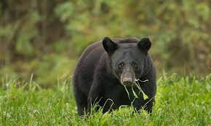
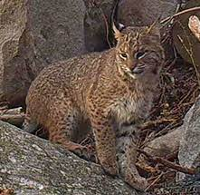
Species Monitoring- $400 Answer
True!
Click to return to Jeopardy Board
Notes:
The abundance of both species appears to be increasing but it is important for us to continue to monitor and collect information on their populations.

Slide 51
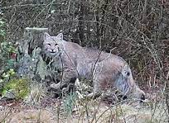
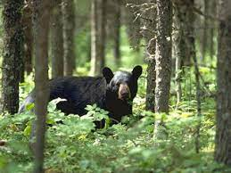
Species Monitoring- $500 Question
Name one way we study bobcat or black bear populations.
Click to see answer

Slide 52
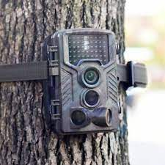
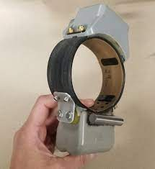
Species Monitoring - $500 Answer
Black bears:
Trail cameras
Hair samples
Bobcats:
Trail cameras
GPS collars
Click to return to Jeopardy Board

Slide 53
FINAL
Topic: Principles of Conservation
Click to see question

Slide 54
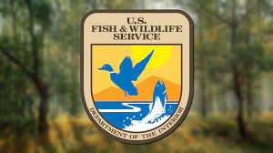
Final Jeopardy Question
Identify one of the seven principles of the North American Model of Wildlife Conservation.
Click to see answer

Slide 55
Final Jeopardy Answer
Wildlife is a public resource
Markets for game are eliminated
Allocation of wildlife by law
Wildlife can only be killed for a legitimate purpose
Wildlife species are considered an international resource
Science is the proper tool for discharge of wildlife policy
The democracy of hunting
Click to return to Jeopardy Board

