Slide 1
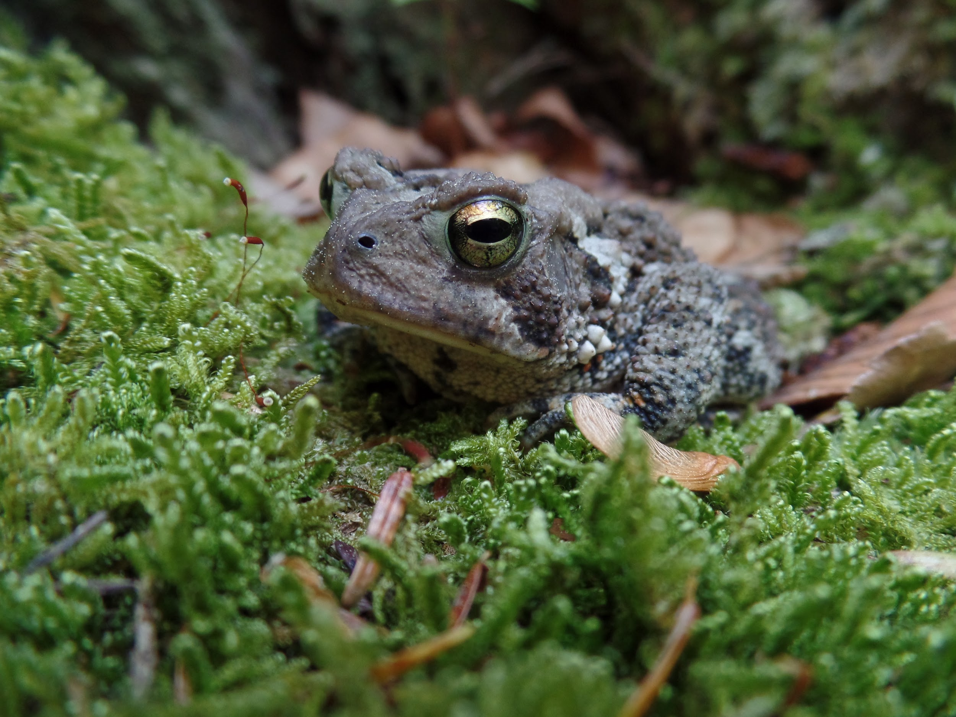
Ask Me About Amphibians
Rhode Island DEM Division of Fish and Wildlife
Rhody Critter Kits Program
Notes:
We designed this program using the arc of dialog to walk students throught the role they play in climate change. programs using the arc of dialog are mainly a discussisson that you as the educator will facilitate and fill in any information that is missing. me easy- me-hard us-hard- us easy

Slide 2
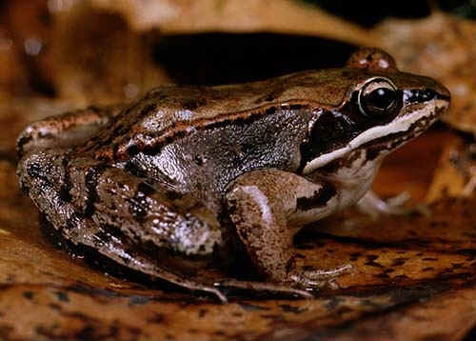
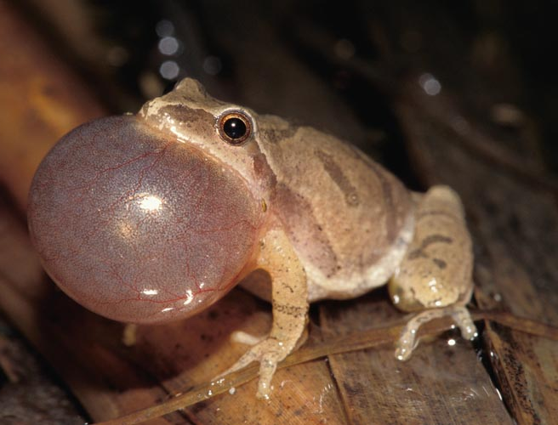
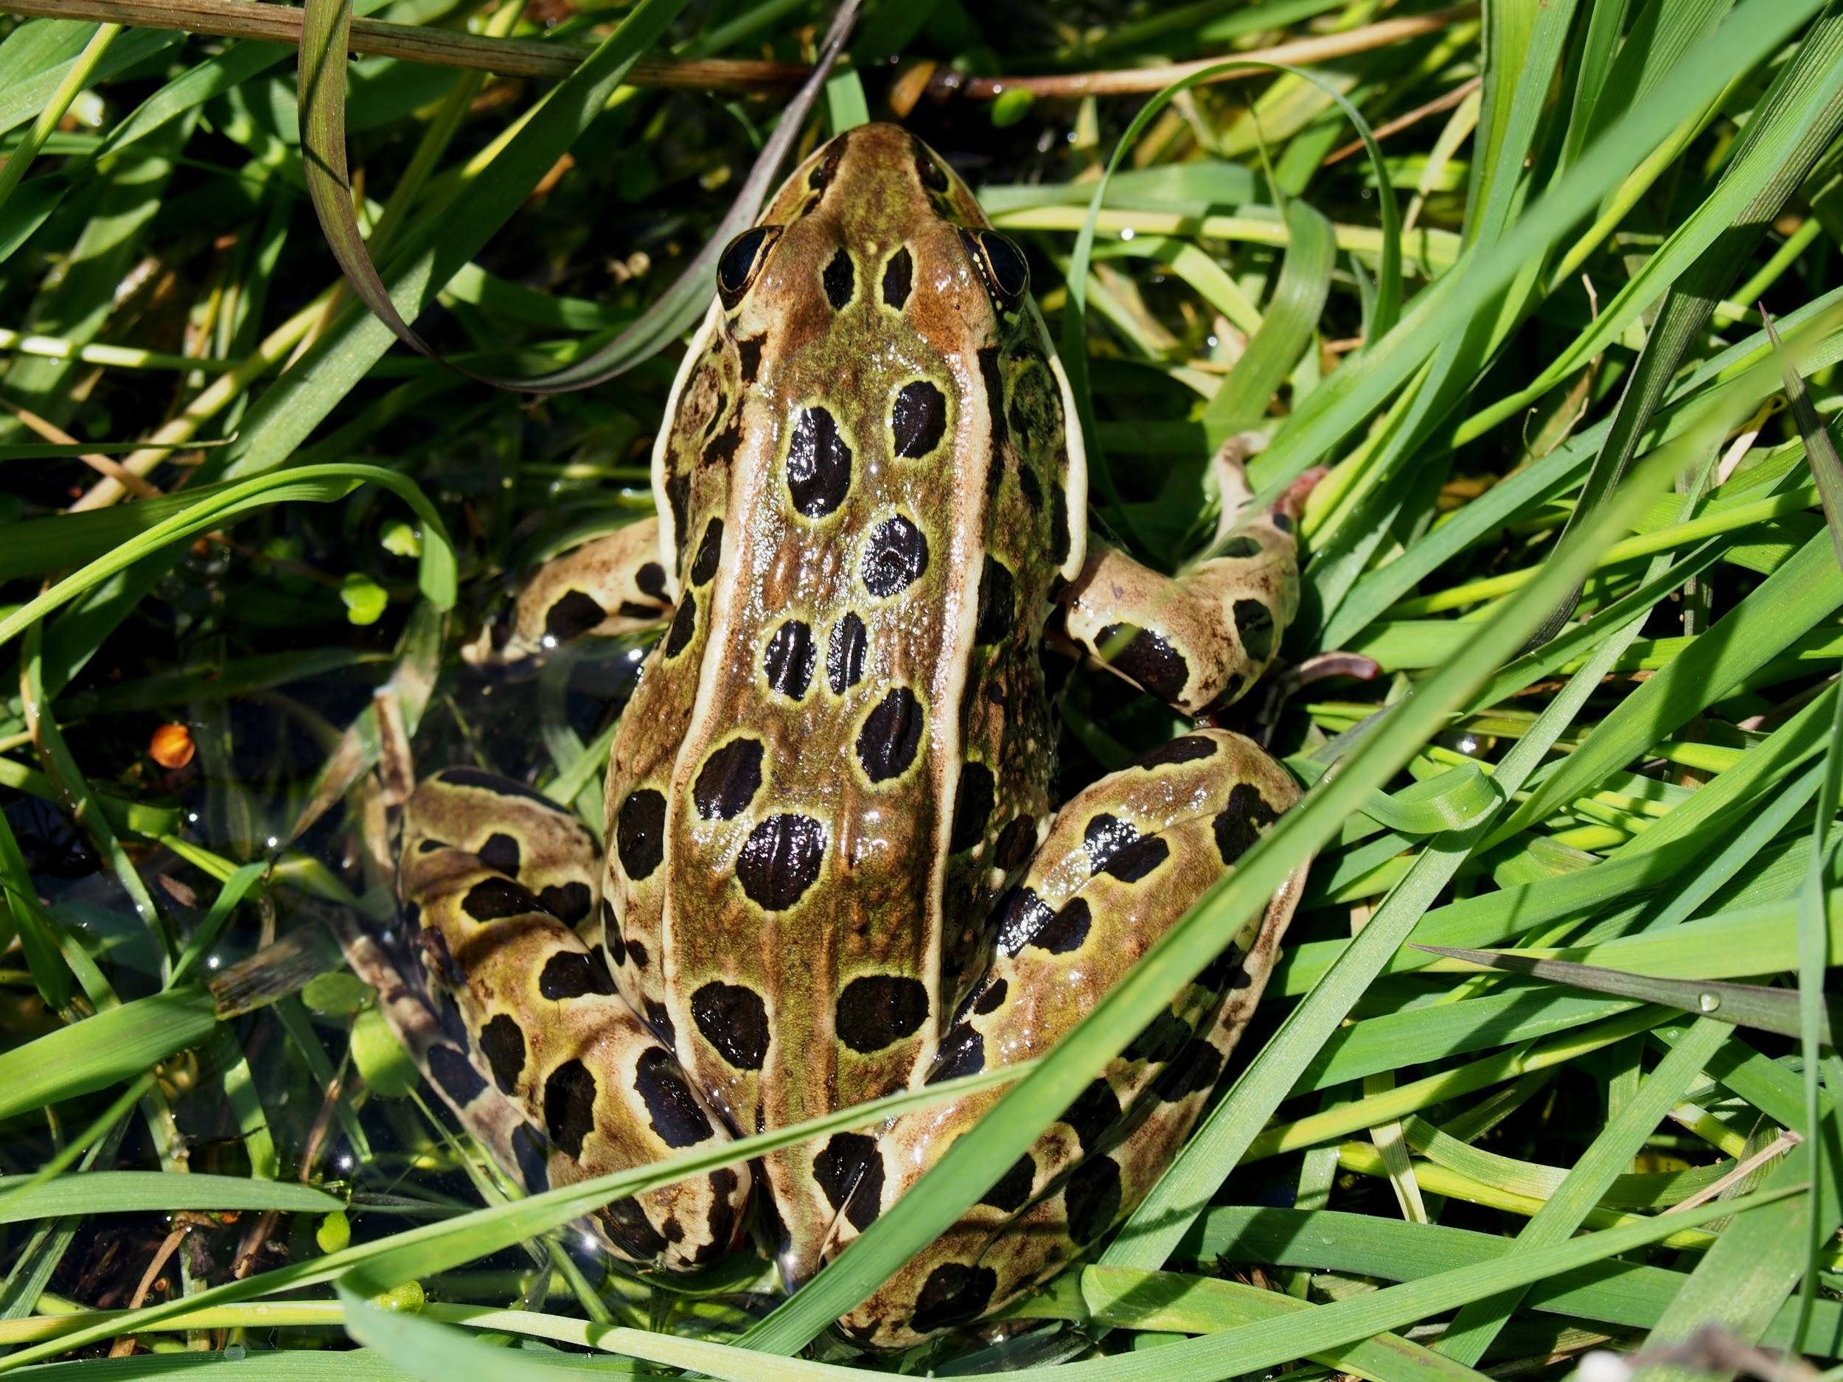
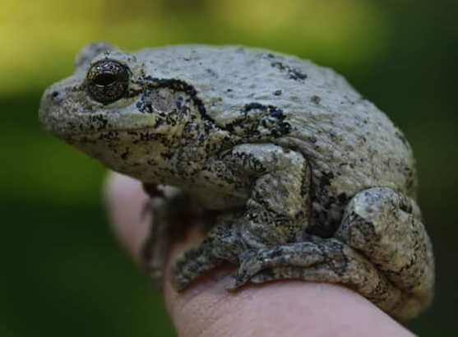
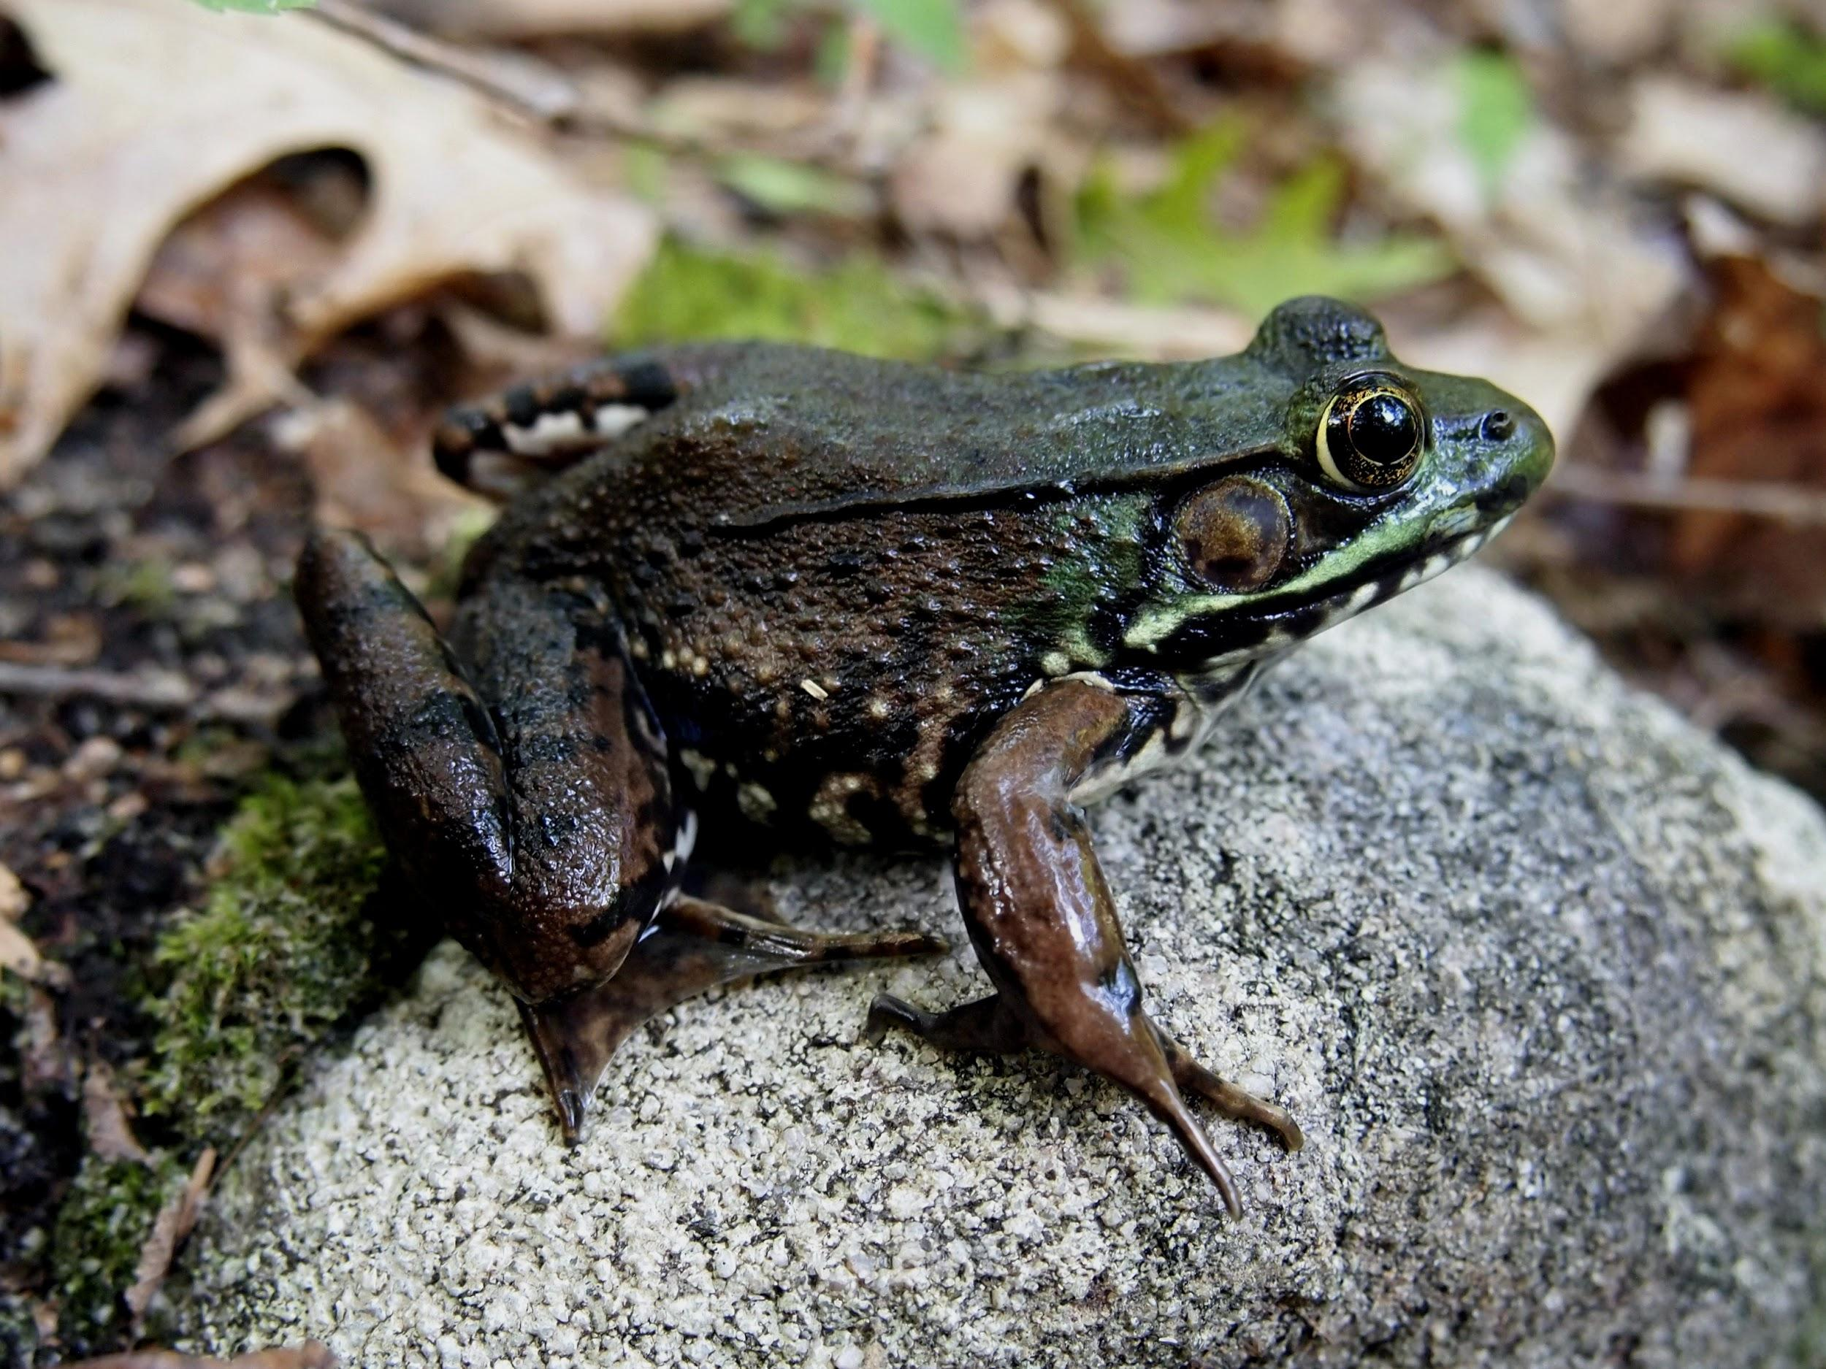
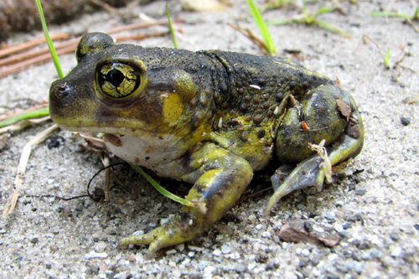
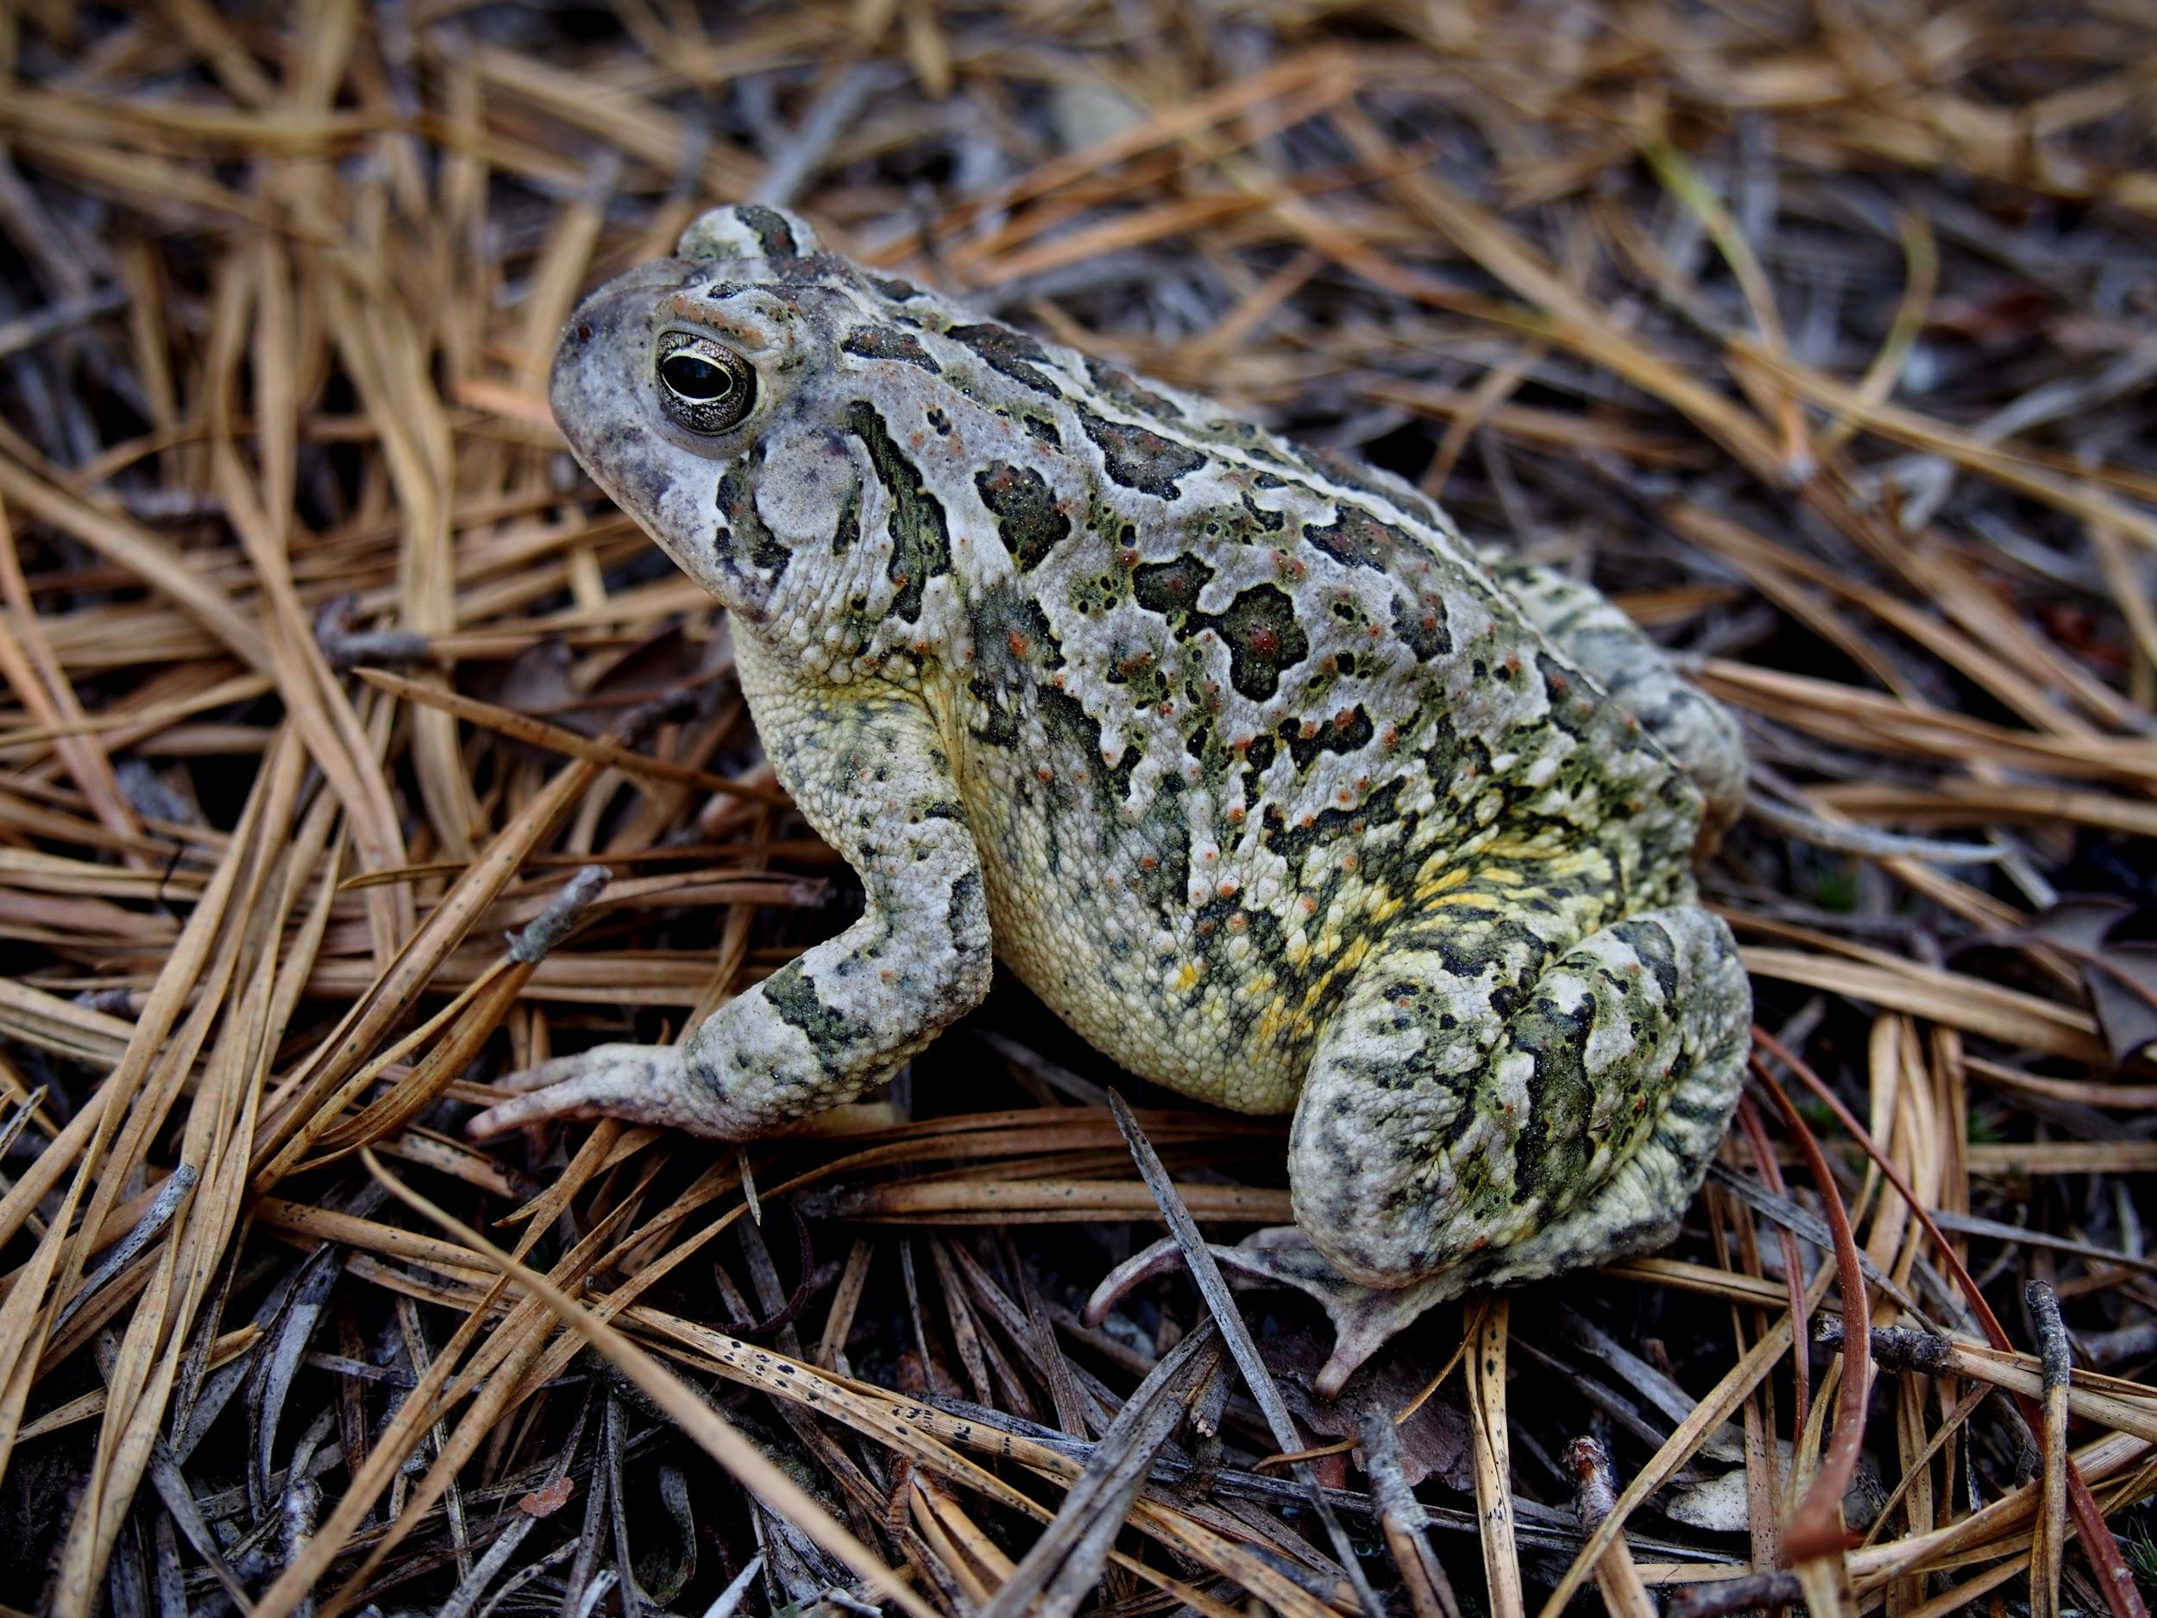
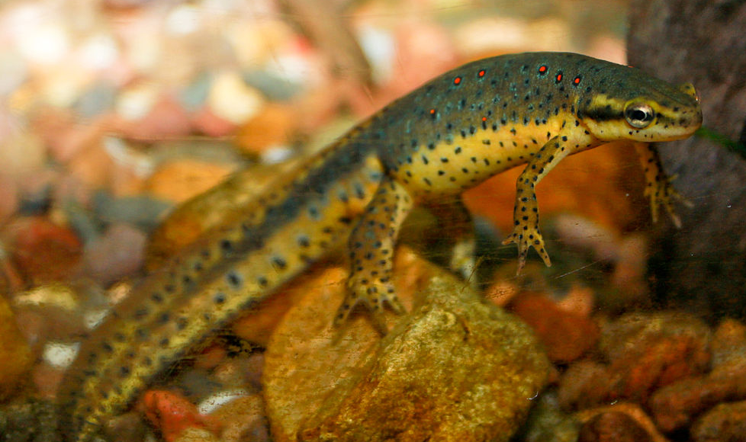
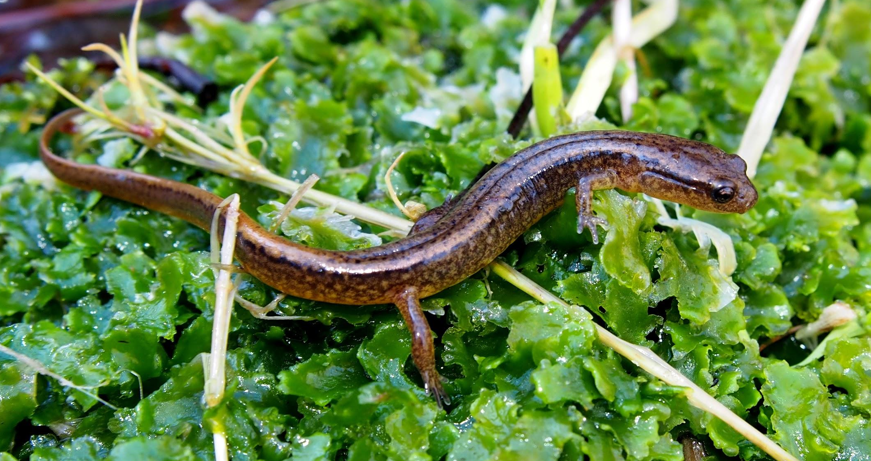
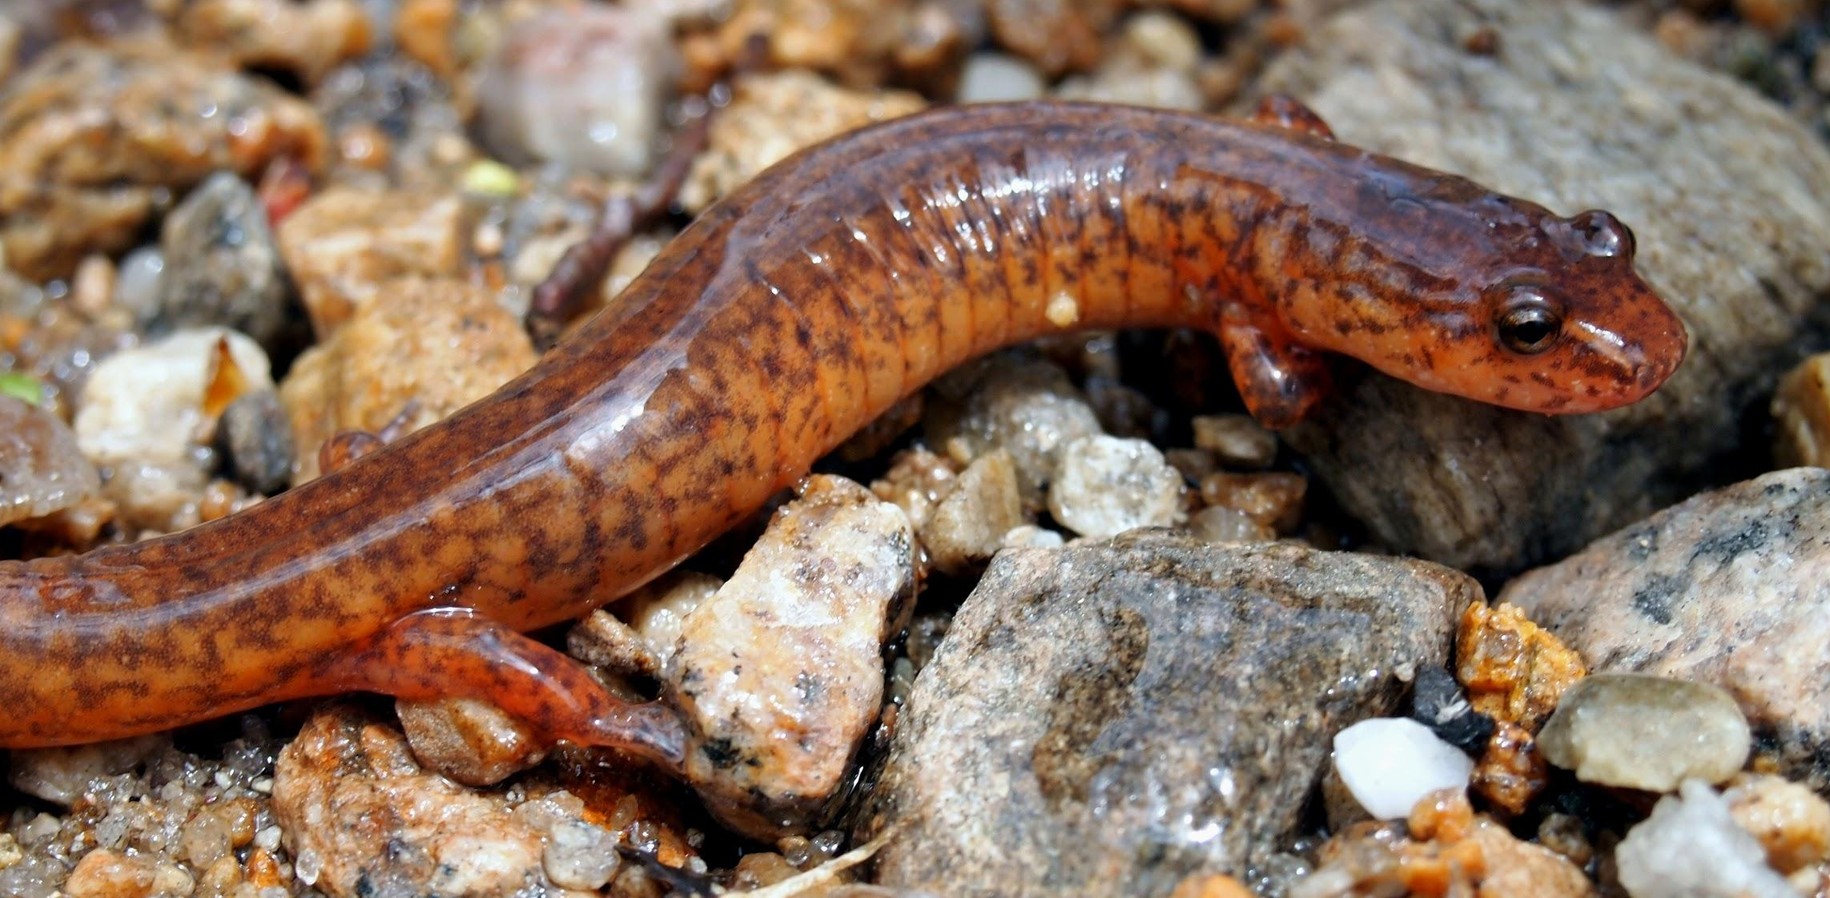
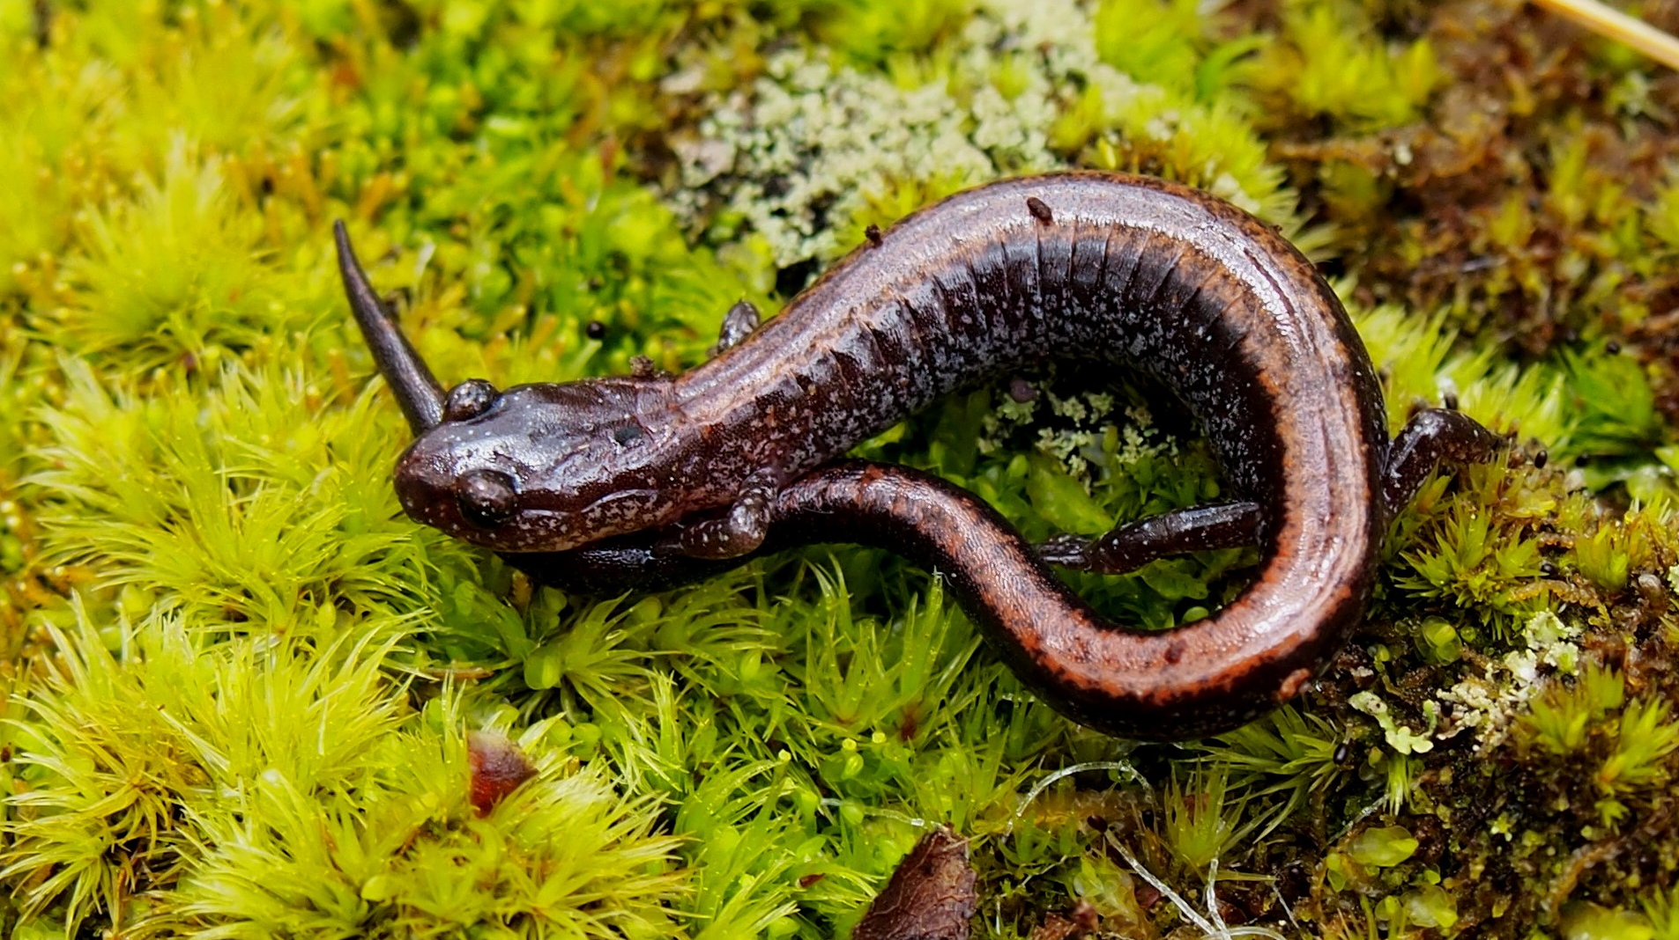
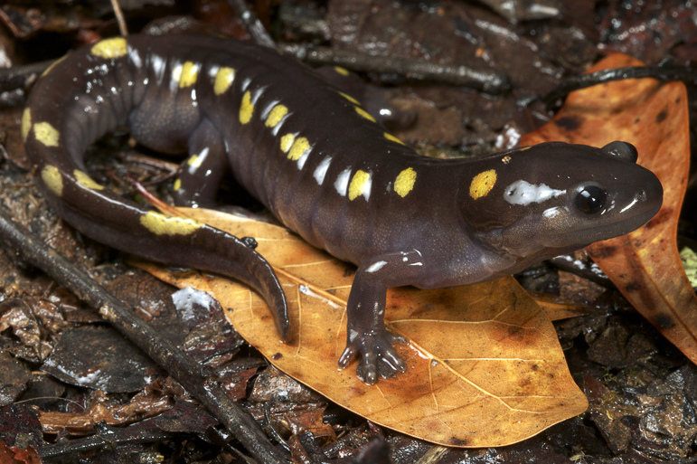
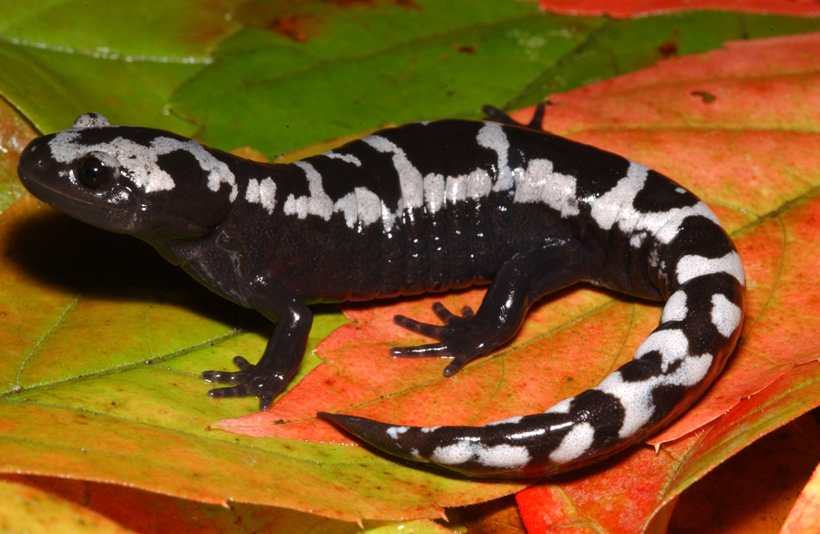
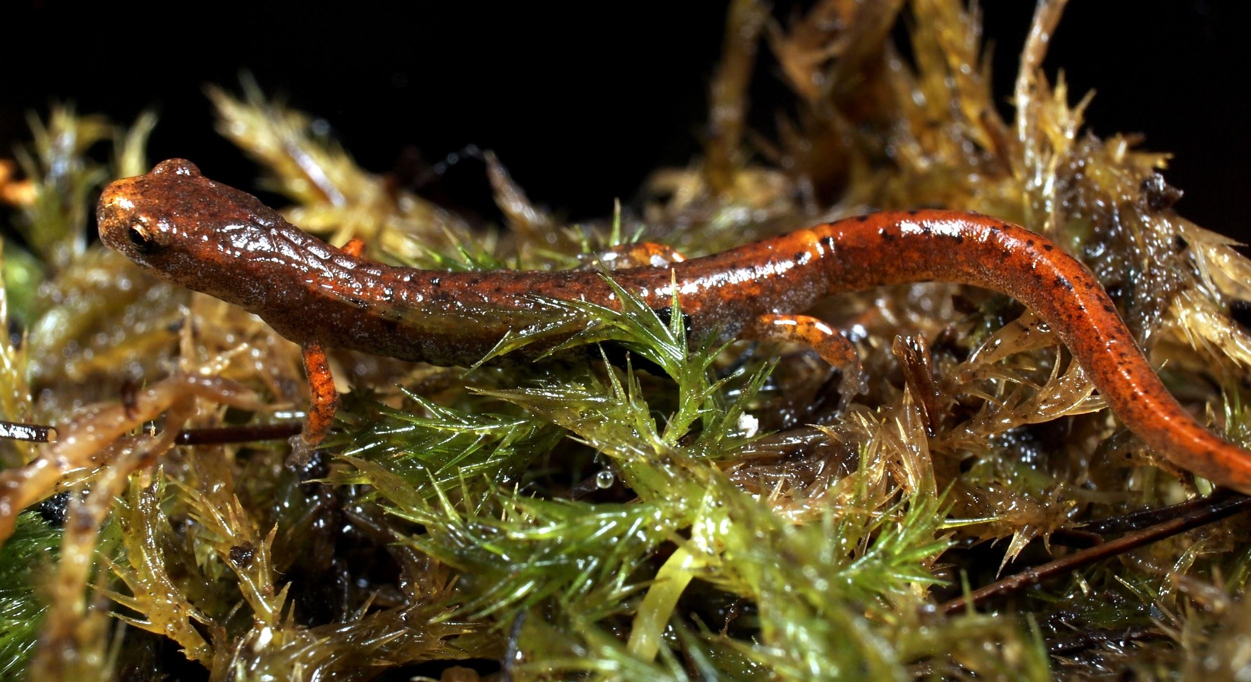
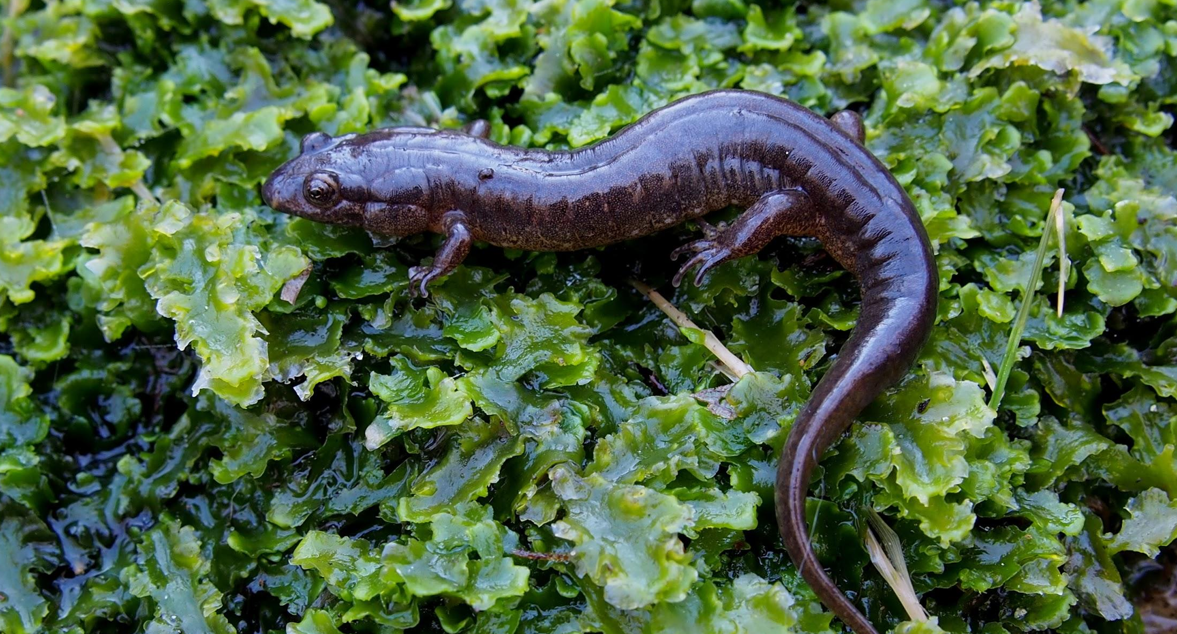
Have you seen an amphibian?
FROGS
TOADS
NEWTS
SALAMANDERS
Notes:
We have 18 different species of amphibians, 7 species of frogs, 3 species of toads, and 8 species of salamanders (including 1 newt).
Amphibians are all vertebrates, meaning they all have backbones.
Has anyone seen an amphibian?
From left to right:
Frogs: Wood frog, bullfrog, spring peeper, gray tree frog, northern leopard frog, green frog, pickerel frog
Toads: Eastern Spadefoot toad, Fowler’s toad, American toad
Newt: Red-spotted newt (technically still a salamander)
Salamanders: Spotted salamander, marbled salamander, northern two-lined salamander, four-toed salamander, eastern red-backed salamander, northern spring salamander, northern dusky salamander.

Slide 3
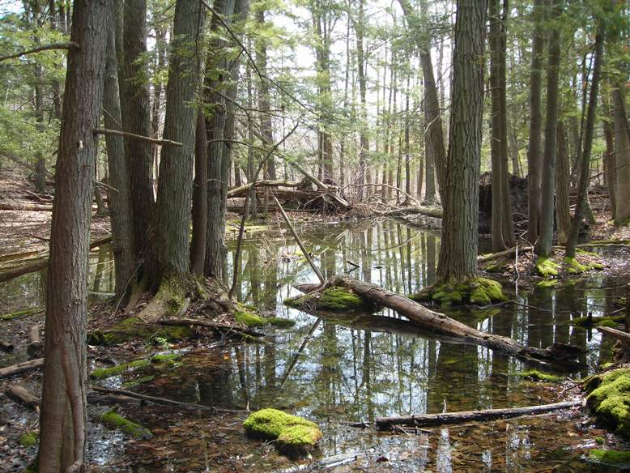
Amphibian Anecdotes
Where did you find it?
What did it feel like?
How big was it?
Was it cold, warm?
Notes:
Give students the opportunity to share their experiences with amphibians. Prompt discussion with the following questions and fill in with “why”:
Where did they find them?
Frogs, toads and salamanders spend part of their lives on land and part in the water. This is one of the characteristics that separates amphibians from other kinds of animals.
What did they feel like?
Amphibians have permeable skin. They absorb water, oxygen and nutrients this way. Since frogs and salamanders need to stay moist, they have a mucus coating on their skin to stop them from drying out, this is what makes them feel slimy. Toads lack this covering and can tolerate drier conditions, they feel rough and bumpy.
How big were they?
Amphibians go through metamorphosis, they change from egg, to larva (tadpole) to adult. Juveniles of most amphibians look like miniature versions of adults. (can talk about red-spotted newt)
Was it cold? Warm?
Amphibians are ectothermic, or cold-blooded. Discuss “Amphibians through the Seasons”.

Slide 4
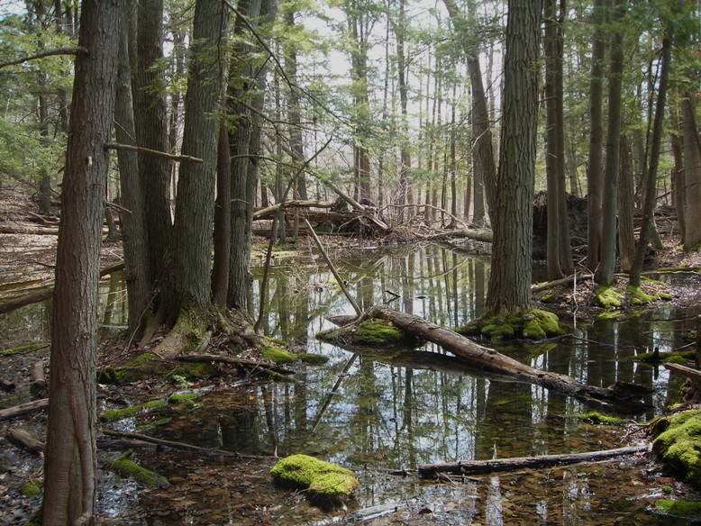
Amphibian Adaptations
Amphibians spend part of their lives on land, and part in the water!
Amphibians have permeable skin covered in a mucus coating for protection.
Amphibians go through metamorphosis and change from egg to larva to adult!
Amphibians are ectothermic, or cold-blooded. Their body temperature is the same as the temperature in their environment.
Notes:
Give students the opportunity to share their experiences with amphibians. Prompt discussion with the following questions and fill in with “why”:
Where did they find them?
Frogs, toads and salamanders spend part of their lives on land and part in the water. This is one of the characteristics that separates amphibians from other kinds of animals.
What did they feel like?
Amphibians have permeable skin. They absorb water, oxygen and nutrients this way. Since frogs and salamanders need to stay moist, they have a mucus coating on their skin to stop them from drying out, this is what makes them feel slimy. Toads lack this covering and can tolerate drier conditions, they feel rough and bumpy.
How big were they?
Amphibians go through metamorphosis, they change from egg, to larva (tadpole) to adult. Juveniles of most amphibians look like miniature versions of adults. (can talk about red-spotted newt)
Was it cold? Warm?
Amphibians are ectothermic, or cold-blooded. Discuss “Amphibians through the Seasons”.

Slide 5
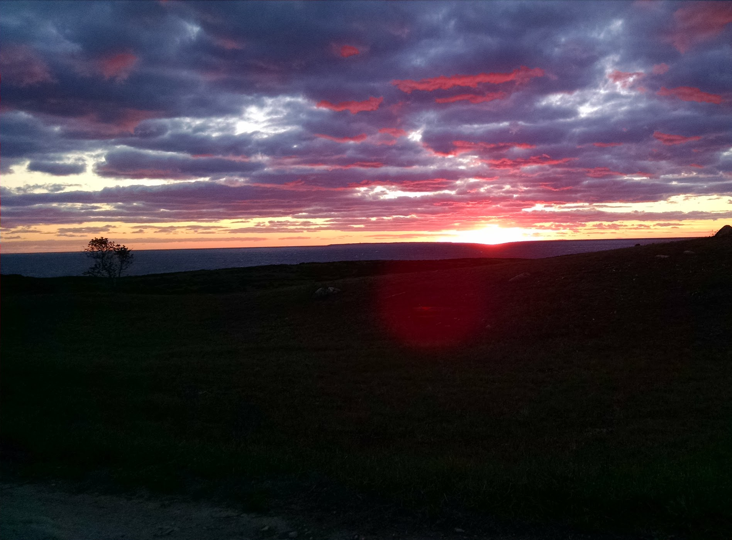
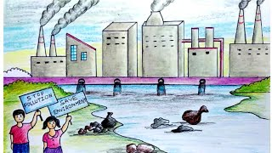
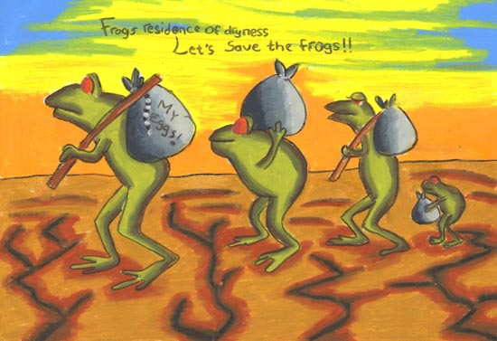
What have you heard about CLIMATE CHANGE?
Weather vs. Climate
Weather changes from day to day
Climate is the long term pattern over 30+ years
Notes:
Think of climate as your whole wardrobe for the year, but weather is your outfit for the day.
Have students write down or share words they have heard related to climate change:
ozone, CO2, ocean acidification, melting ice caps, sea level rise, pollution etc.
Explain that things like driving cars, producing electricity and creating new materials, produces a chemical called Carbon Dioxide. While this chemical does occur naturally on the earth, humans have started producing too much of it, Just like how if you have a little bit of sugar it’s okay but if you have too much it can make you really sick. This overproduction of CO2 is making the earth sick and it’s changing the earth’s climate, or long term weather pattern. Weather is getting more extreme, with hotter hot days and stormier storms. This is causing many different problems, for humans and the environment.

Slide 6
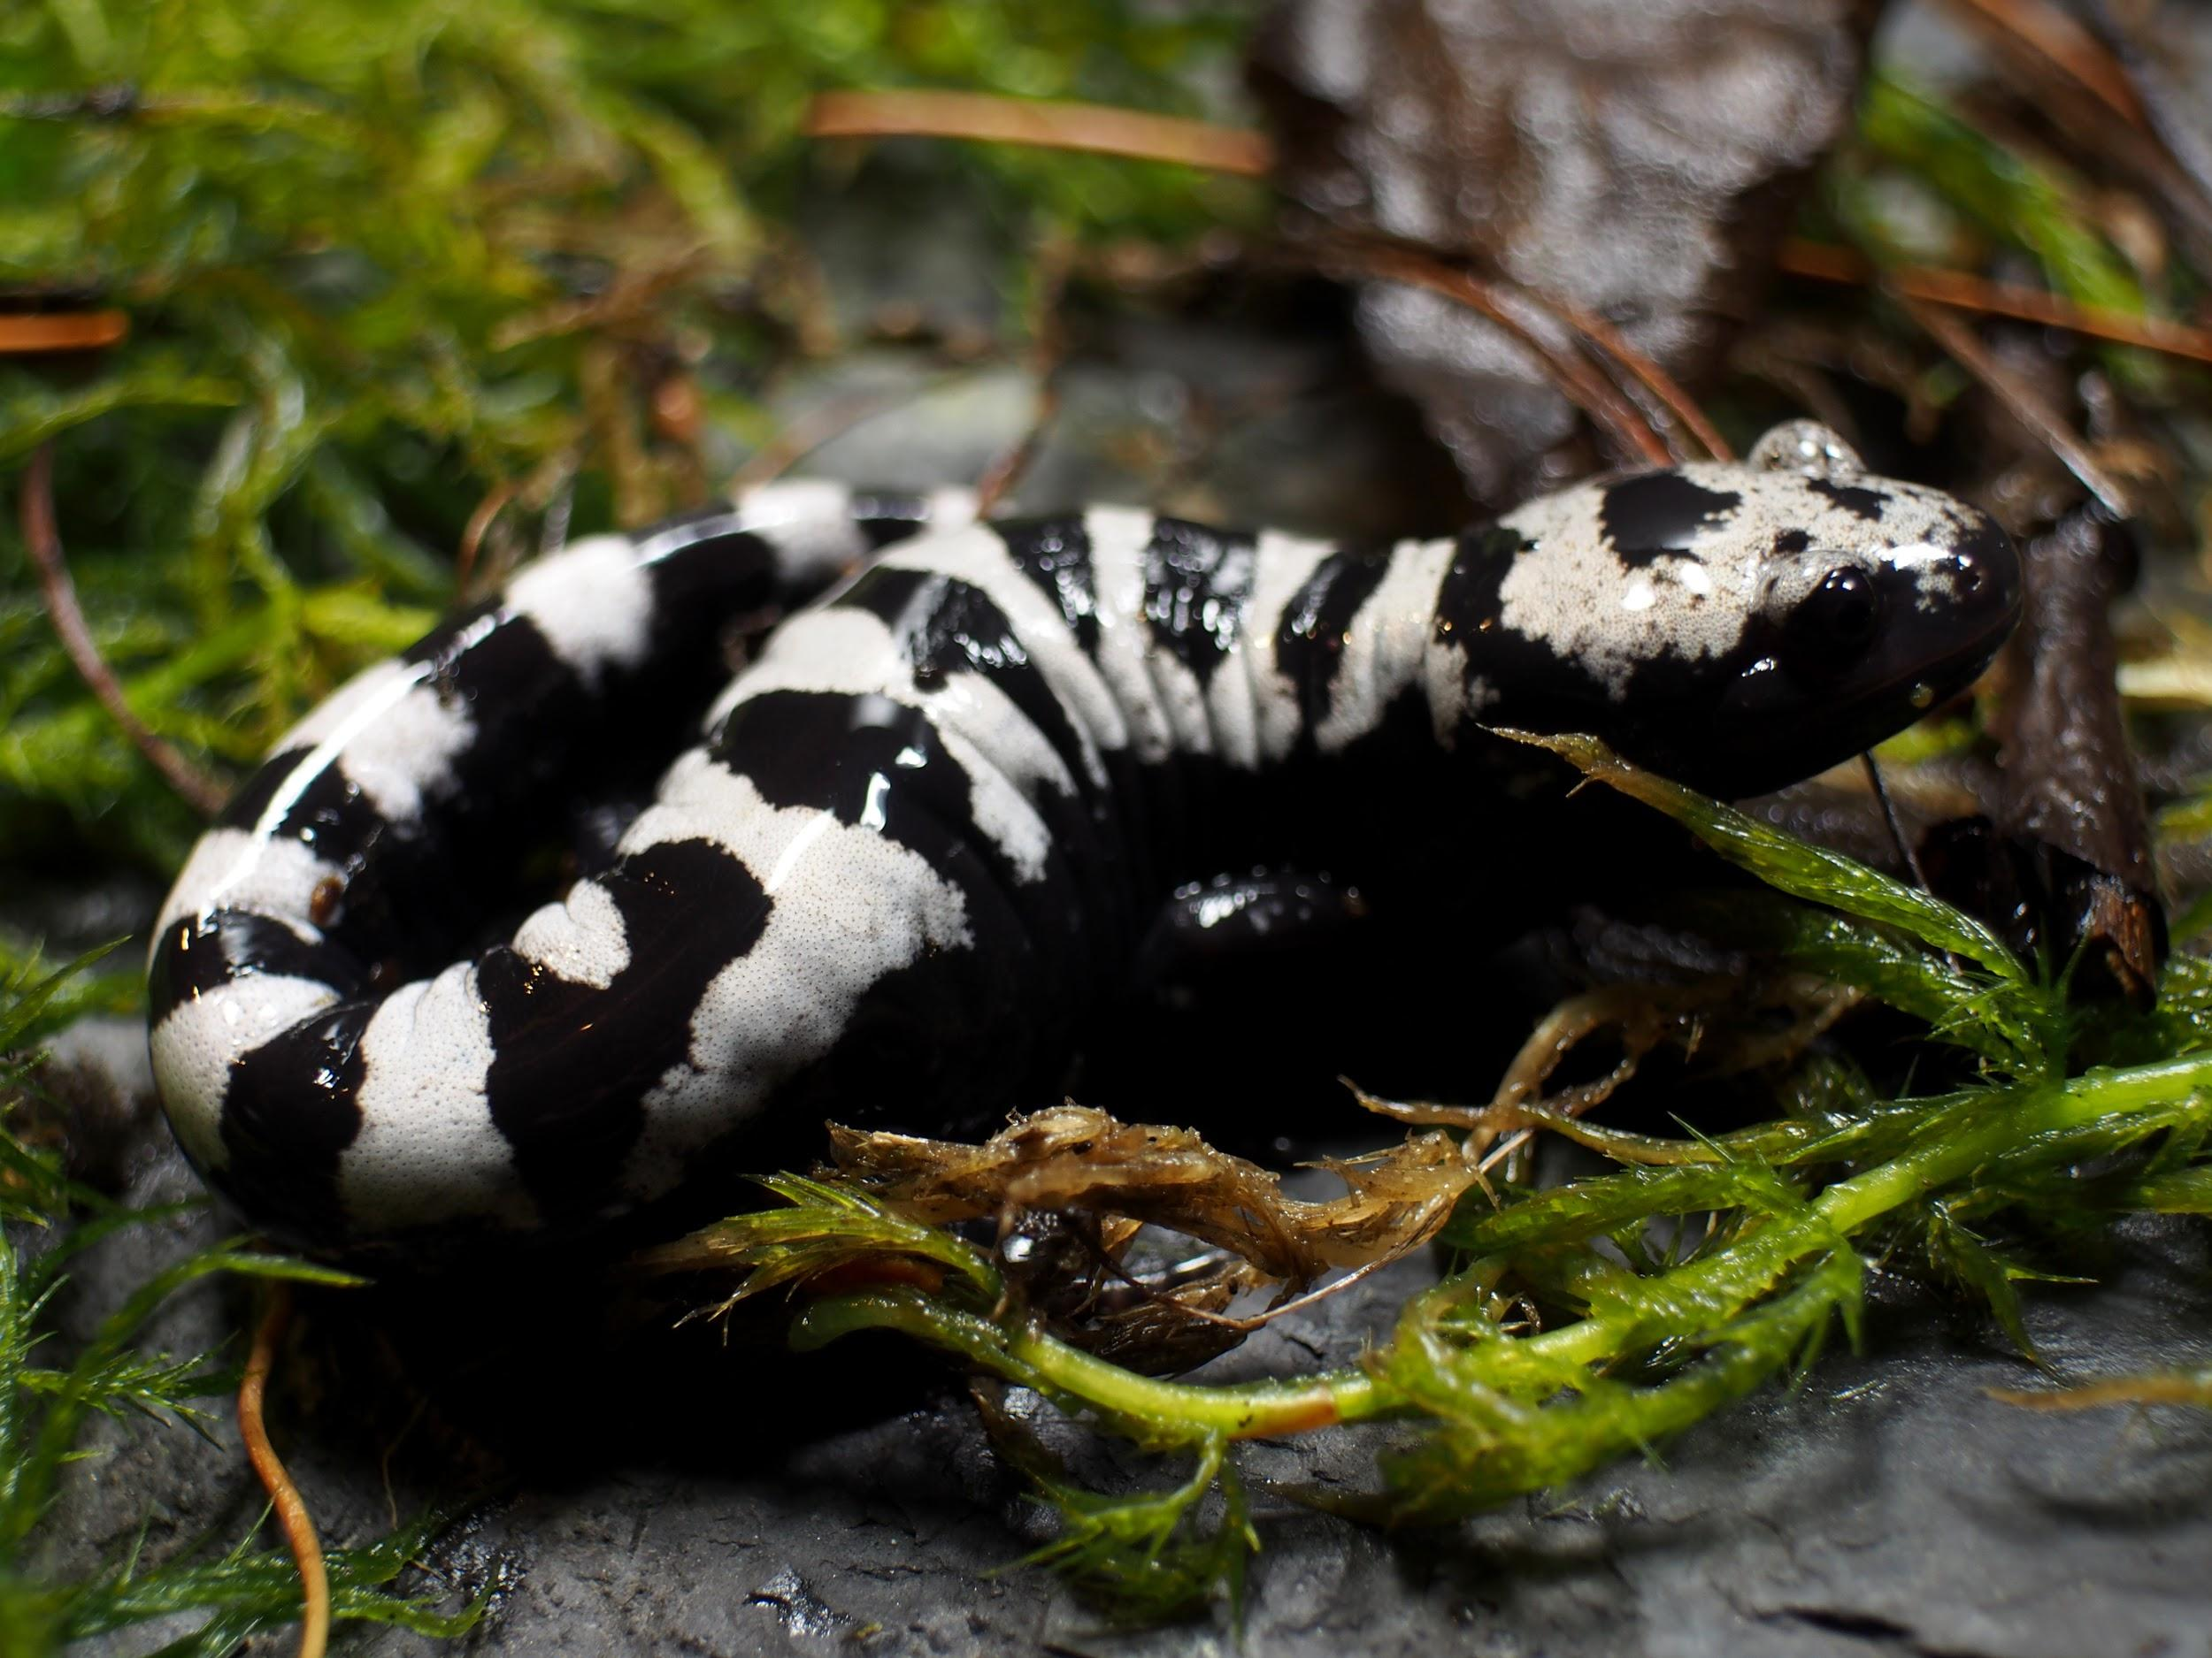
How does climate change impact amphibians?
Amphibians are INDICATOR SPECIES
They can tell us about the health of the environment
Notes:
Since amphibians have permeable skin with tiny holes that absorb water, when anything bad is in the water (like chemicals and toxins) they absorb that, too. This can cause them to become ill.
Because of this special adaptation, scientists can look at the health of an amphibian population and determine the health of the environment. If there are alot of sick amphibians, it could mean there is something wrong with the habitat. If there are a lot of healthy amphibians, that means the habitat is in great condition!
Since amphibians are ECTOTHERMIC their body temperatures depend on the air temperature. If there are fluctuations (changes) in the weather it will make it difficult for amphibians to keep their bodies at the appropriate temperature. If there are too many hot days, populations of amphibians could decline, or go down.
Freshwater wetlands near the coastline could also become flooded with saltwater due to sea level rise, most amphibians can not tolerate living in salt water, so this would shrink the resources available to them.

Slide 7
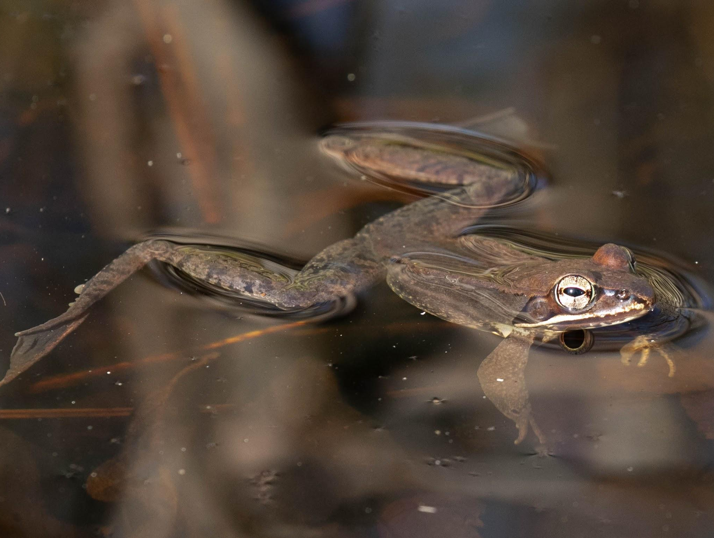
How can the Division of Fish & Wildlife help amphibians?

Slide 8
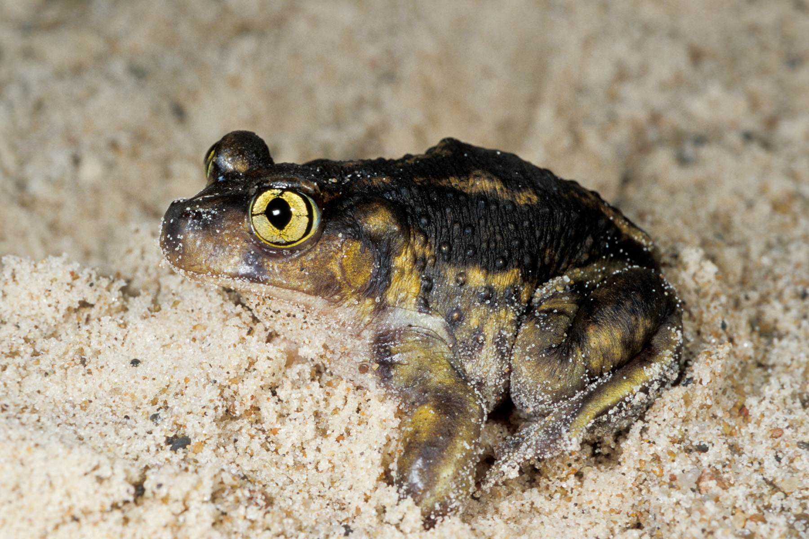
Species Highlight: Eastern Spadefoot Toad
I bury myself in sandy soils for months or years at a time!
I come out after storms with heavy rain.
Notes:
Spadefoot toads are one of the strangest and most difficult to find amphibians in Rhode Island. These unique amphibians have a mucus covering on their skin, vertical pupils, like a cat, and spend the majority of their time living underground. They are so picky that they will only breed during ideal weather conditions (warm weather and LOTS of rain), otherwise, they will wait several years to reproduce until these perfect conditions occur. With these peculiar and particular characteristics piled on top of all of the other threats to amphibians like habitat loss and fragmentation, spadefoot toads are having a hard time surviving in Rhode Island.

Slide 9
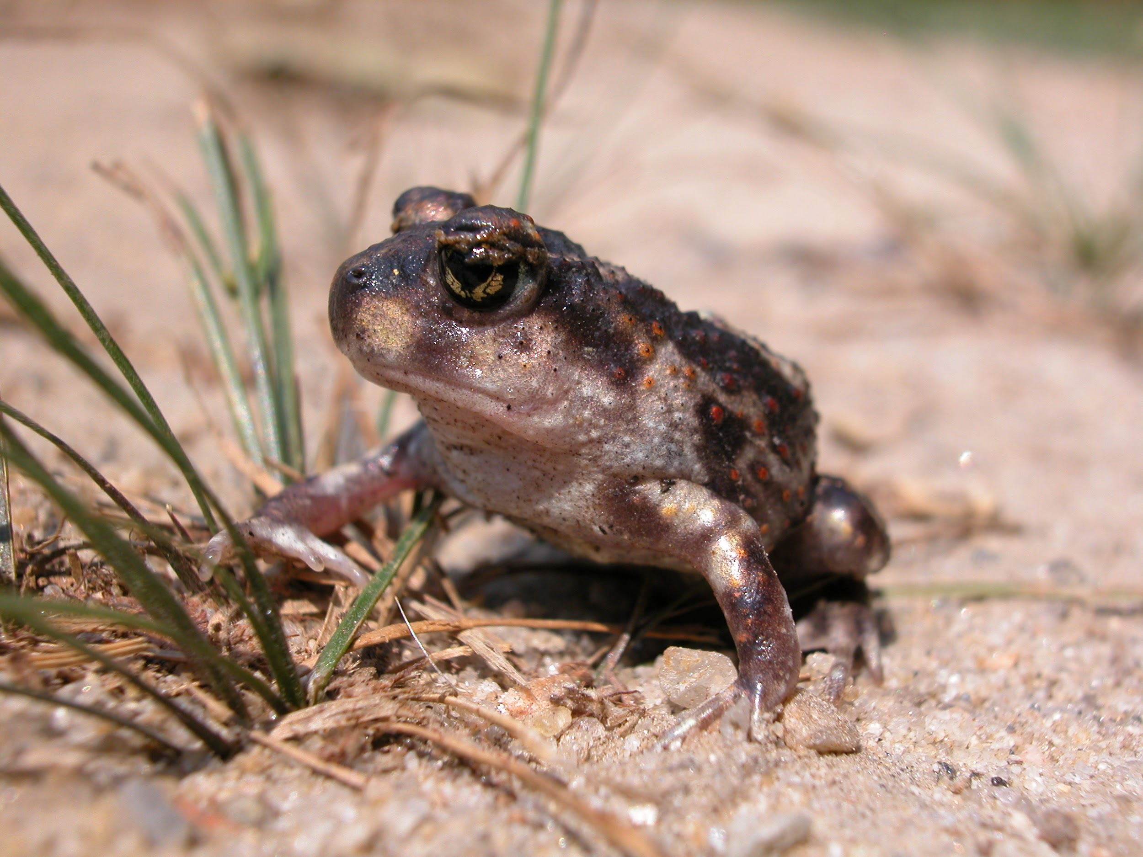
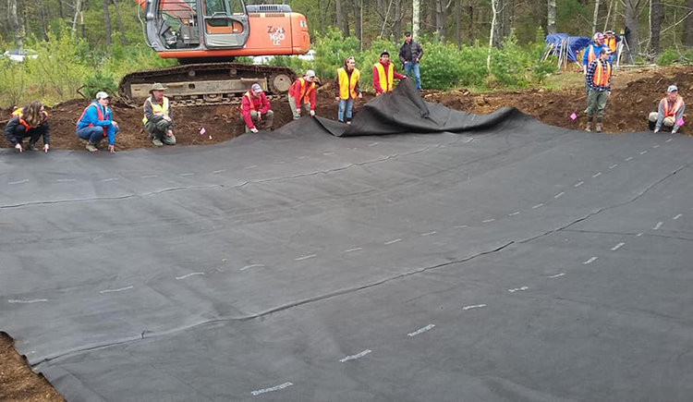
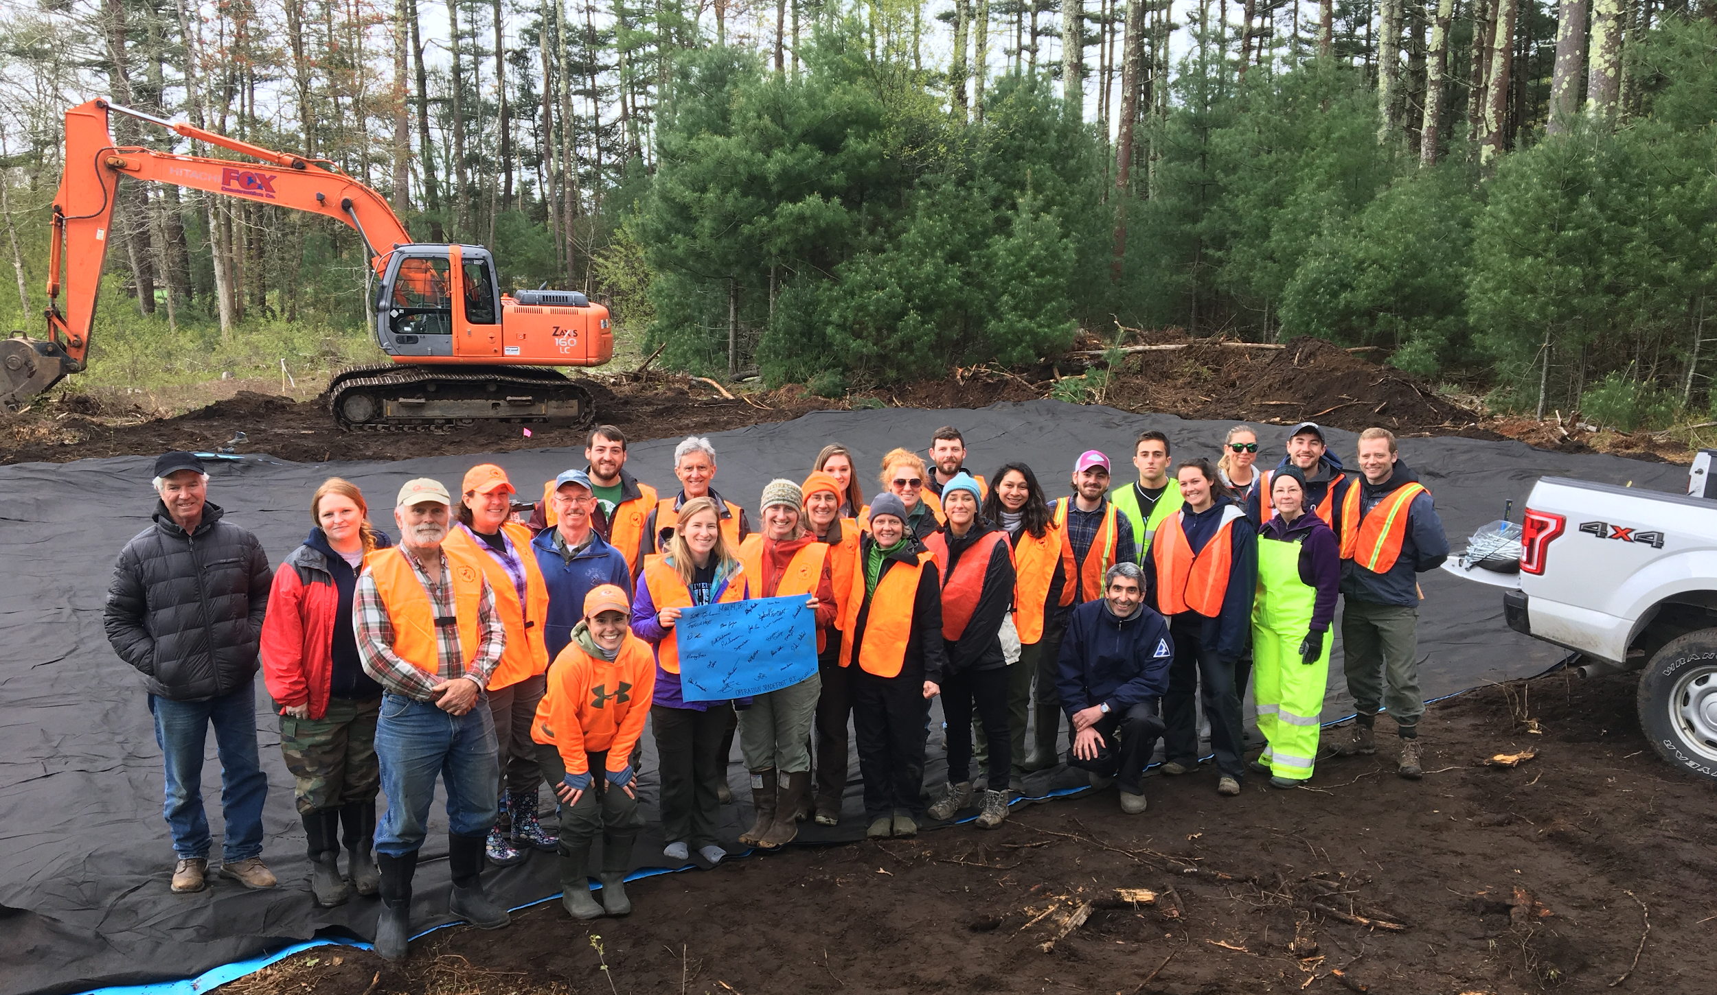
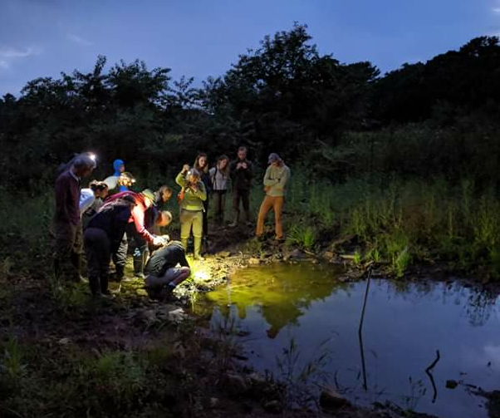
Operation: Spadefoot
Notes:
RI DEM Division of Fish & Wildlife Herpetologist, Scott Buchanan, teamed up with the University of Rhode Island, Roger Williams Park Zoo and the Rhode Island Natural History Survey to create more habitat for these little oddballs. With the help of a crew of volunteers, they dug out a large hole in nice sandy soil with shovels and a backhoe, lined it with a giant tarp and waited for the rainwater to fill it up, creating an artificial vernal pool. To make it a little more inviting, they planted native species around the edges. By chance, our friends at the US Fish and Wildlife Service found spadefoot tadpoles struggling to stay alive in a tiny puddle that was nearly dried up. We scooped up the little guys and released them into the new home we had just completed. This new generation of spadefoots will help boost Rhode Island’s population, giving spadefoots a fighting chance! Plans for creating even more spadefoot pools are underway!

Slide 10
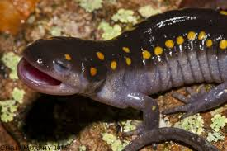
What can YOU do to help?
LET’S MAKE A MURAL!
Notes:
Have students work in groups to create a mural of small ways they can help.
Have each group share their mural and explain why it is important to them to protect amphibians and other wildlife.
Have each student pick one thing that was discussed today that they would like to share with someone in the future (friends, family, neighbors).
Don’t pollute
Don’t use pesticides
Clean up and protect amphibian habitats
Turn out the lights
Ride a bike instead of driving
Conserve water
Reduce, reuse, recycle

