Slide 1
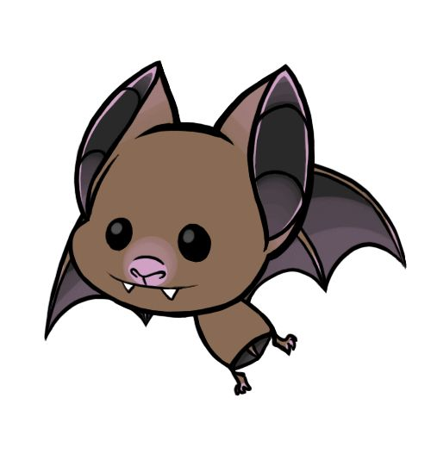
Bats
Template by Eric Curts

Slide 2
JEOPARDY BOARD
FINAL JEOPARDY
Rhody Bats | Bats Across the Globe | Bat Basics | Bat Threats | Bat Conservation
$100 | $100 | $100 | $100 | $100
$200 | $200 | $200 | $200 | $200
$300 | $300 | $300 | $300 | $300
$400 | $400 | $400 | $400 | $400
$500 | $500 | $500 | $500 | $500
Notes:
Click on the selected price block and it will bring you directly to the associated question.
Once you are on the question slide, you can press the arrow to see the answer.
Every answer slide has a home link back to the jeopardy board.

Slide 3
Rhody Bats - $100 Question
How many bats are found in Rhode Island?
Click to see answer

Slide 4
Rhody Bats - $100 Answer
8, ah ah ah!
Click to return to Jeopardy Board

Slide 5
Rhody Bats - $200 Question
Name one species of bat that can be found in RI
Click to see answer

Slide 6
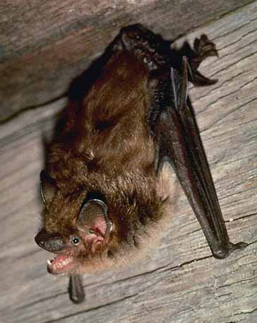
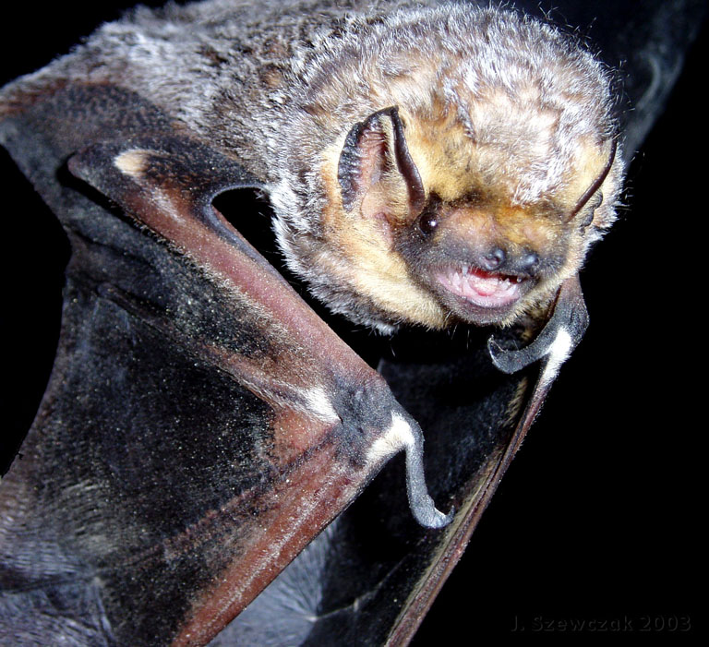
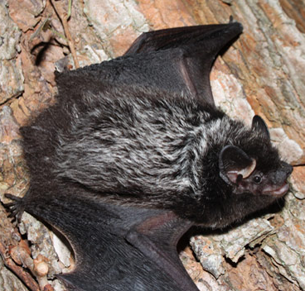
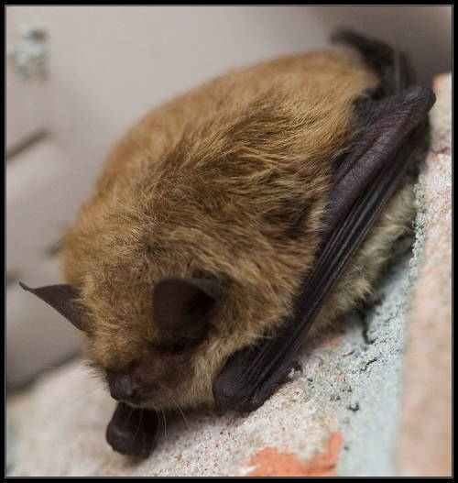
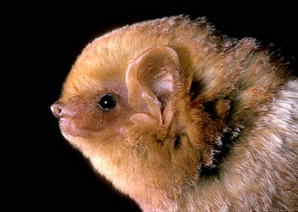
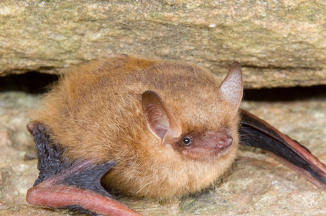
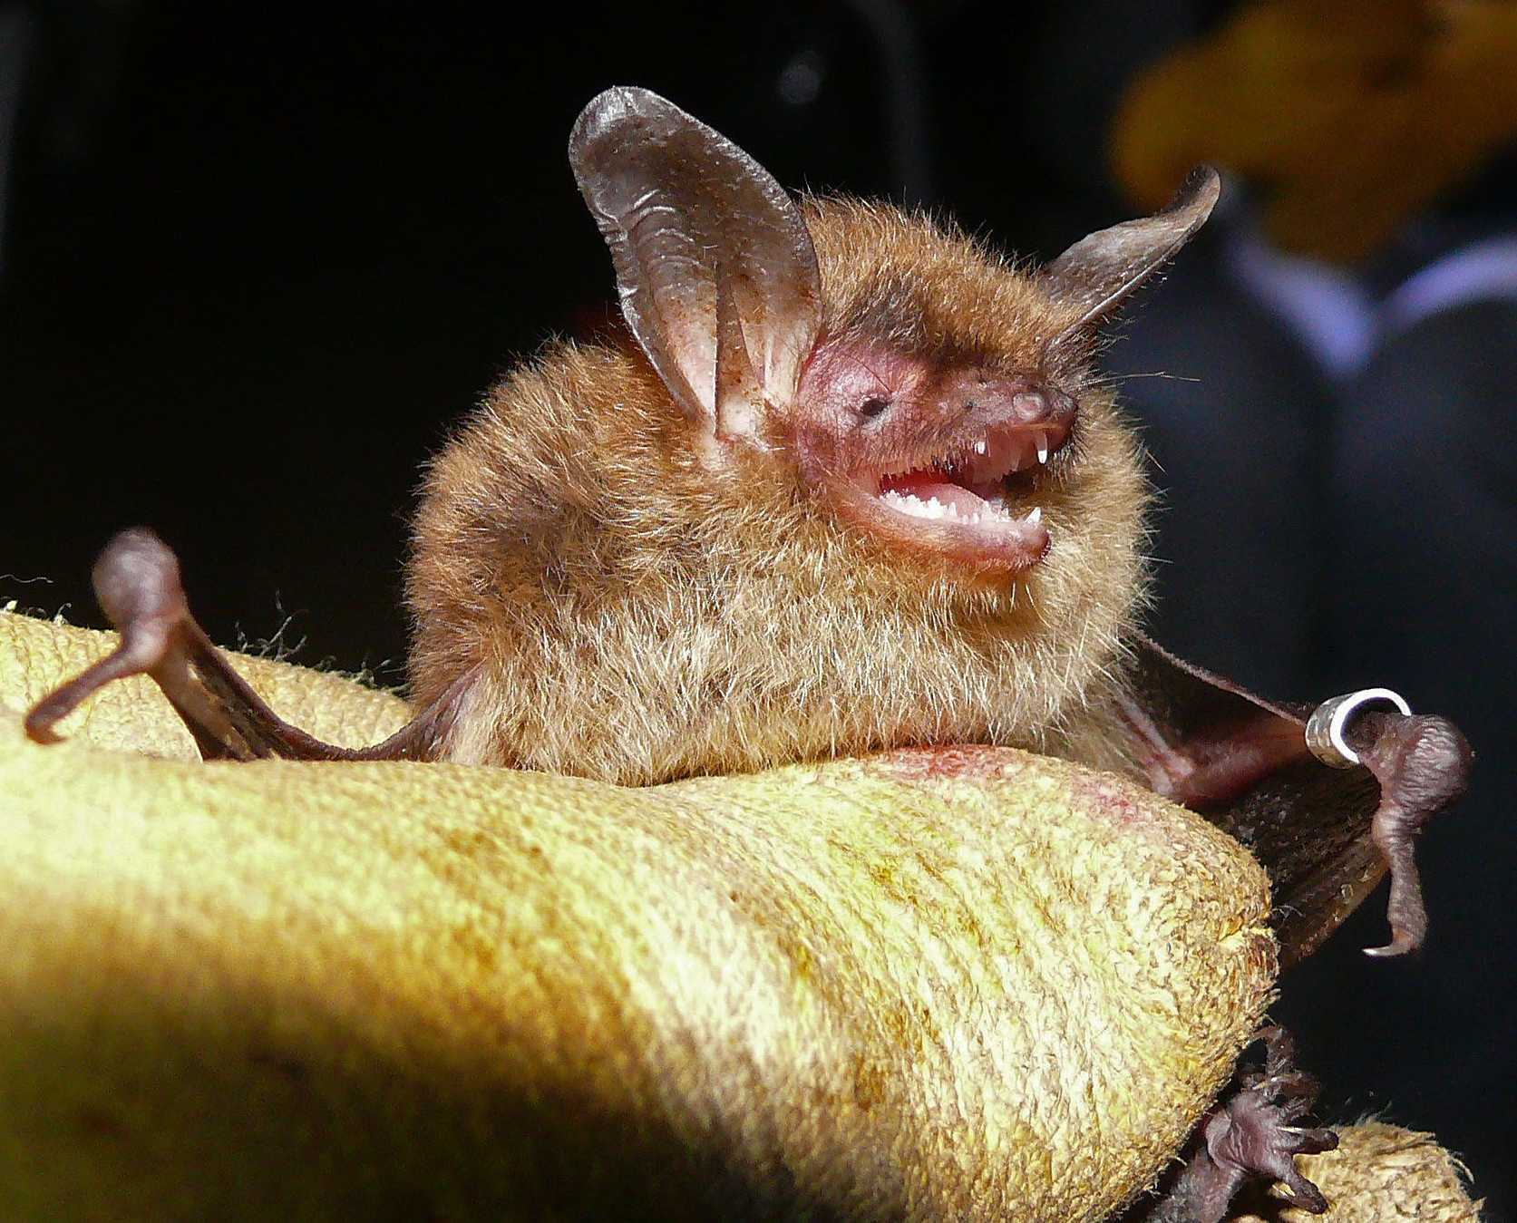
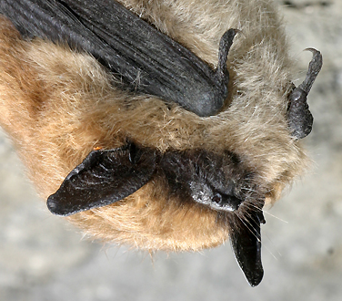
Rhody Bats - $200 Answer
Big Brown
Hoary
Silver-haired
Little Brown
Eastern Red
Tri-colored
Northern Long-eared
Eastern Small-footed ??
Click to return to Jeopardy Board
Notes:
All of these bats are believed to visit Rhode Island for a least a small part of the year, however some we haven’t actually seen or heard in many years, like the Eastern small-footed bat, because they are very hard to detect. Because scientists have found them in other areas around us and we have a similar habitat, we can make a good guess that they probably fly around RI.

Slide 7
Rhody Bats - $300 Question
Where do Rhody bats go in the winter?
Click to see answer

Slide 8
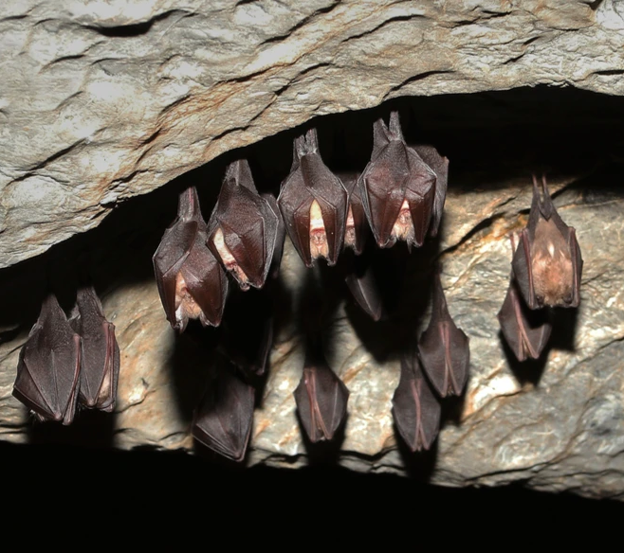
Rhody Bats - $300 Answer
Some bats go north to hibernate in caves in Vermont.
Some go south and stay awake all winter long.
Just a handful hibernate here in RI!
Click to return to Jeopardy Board
Notes:
Migrate North: Big-brown, little brown, tri-colored, Eastern small-footed, Northern long-eared
Migrate South: Eastern red, Hoary, Silver-haired
The most common bat found overwintering in Rhode Island is the big brown bat. Sometimes these guys will overwinter in attics and can find their way into homes.
If you do find a bat in your house, don’t panic. It is probably just a little lost and you can always call the RIDOH rabies hotline for help!

Slide 9
Rhody Bats - $400 Question
What do you call the place where female bats gather together to have their young?
Click to see answer

Slide 10
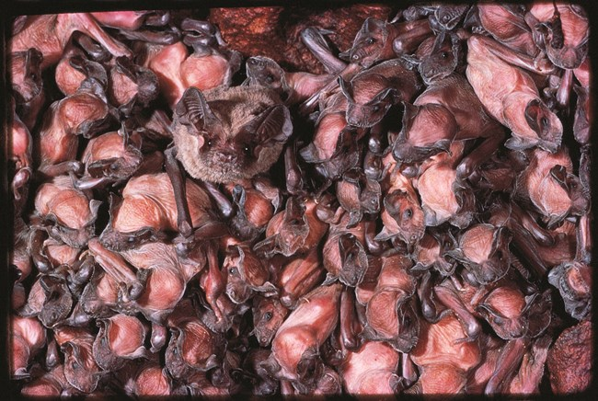
Rhody Bats - $400 Answer
A Maternity Roost/Colony
Click to return to Jeopardy Board
Notes:
Big brown bats and little brown bats form maternity roosts in Rhode Island. This provides safety in numbers and also keeps it nice and warm! The RI Division of Fish and Wildlife monitors these colonies by counting how many bats leave the roost before and after the young are born. Then they can figure out the difference to determine how many new bats were born that year!

Slide 11
Rhody Bats - $500 Question
How do Rhody bats locate their food?
Click to see answer

Slide 12
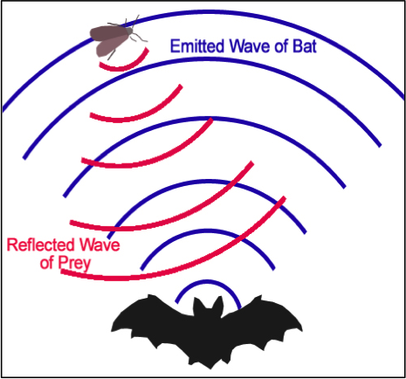
Rhody Bats- $500 Answer
Through echolocation!
Click to return to Jeopardy Board
Notes:
All of Rhode Island’s bats are insectivores and they use echolocation to find their food. Bats emit a high-pitched frequency which bounces off the insect and comes back to the bats ears, so they can tell exactly where that insect is! The Division of Fish and Wildlife has special equipment that can detect these calls and even tell them apart between species. This helps them learn what kinds of bats we have here in Rhode Island and by setting them up all around the state, they can learn where they like to spend their time!

Slide 13
Bats Across the Globe - $100 Question
How many different species of bats are there in the world?
Click to see answer

Slide 14
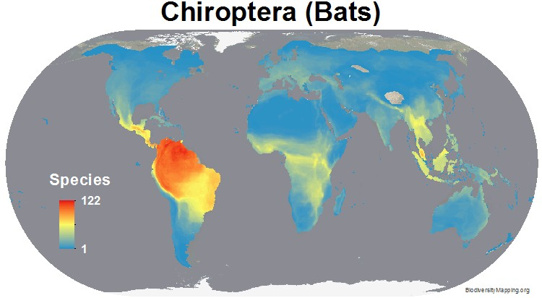
Amphibians - $100 Answer
Over 1,300 different species!!!
Click to return to Jeopardy Board
Notes:
The greatest diversity of species are located around the equator since it is nice and warm and there is plenty of food.

Slide 15
Bats Across the Globe- $200 Question
What is the largest species of bat in the world?
Click to see answer

Slide 16
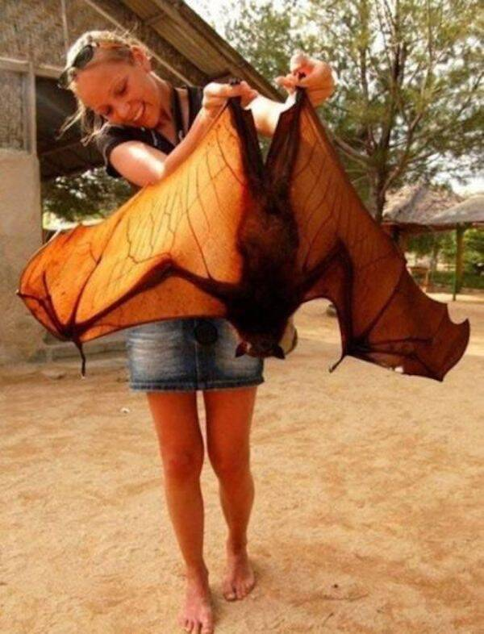
Bats Across the Globe- $200 Answer
The Flying Fox!
(specifically the golden-crowned flying fox)
Click to return to Jeopardy Board
Notes:
Bats come in all different shapes and sizes. The giant golden-crowned flying fox has a six-foot wingspan, while the bumblebee bat’s wingspan is only about 6 inches!

Slide 17
Bats Across the Globe - $300 Question
What do bats eat around the world?
Click to see answer

Slide 18
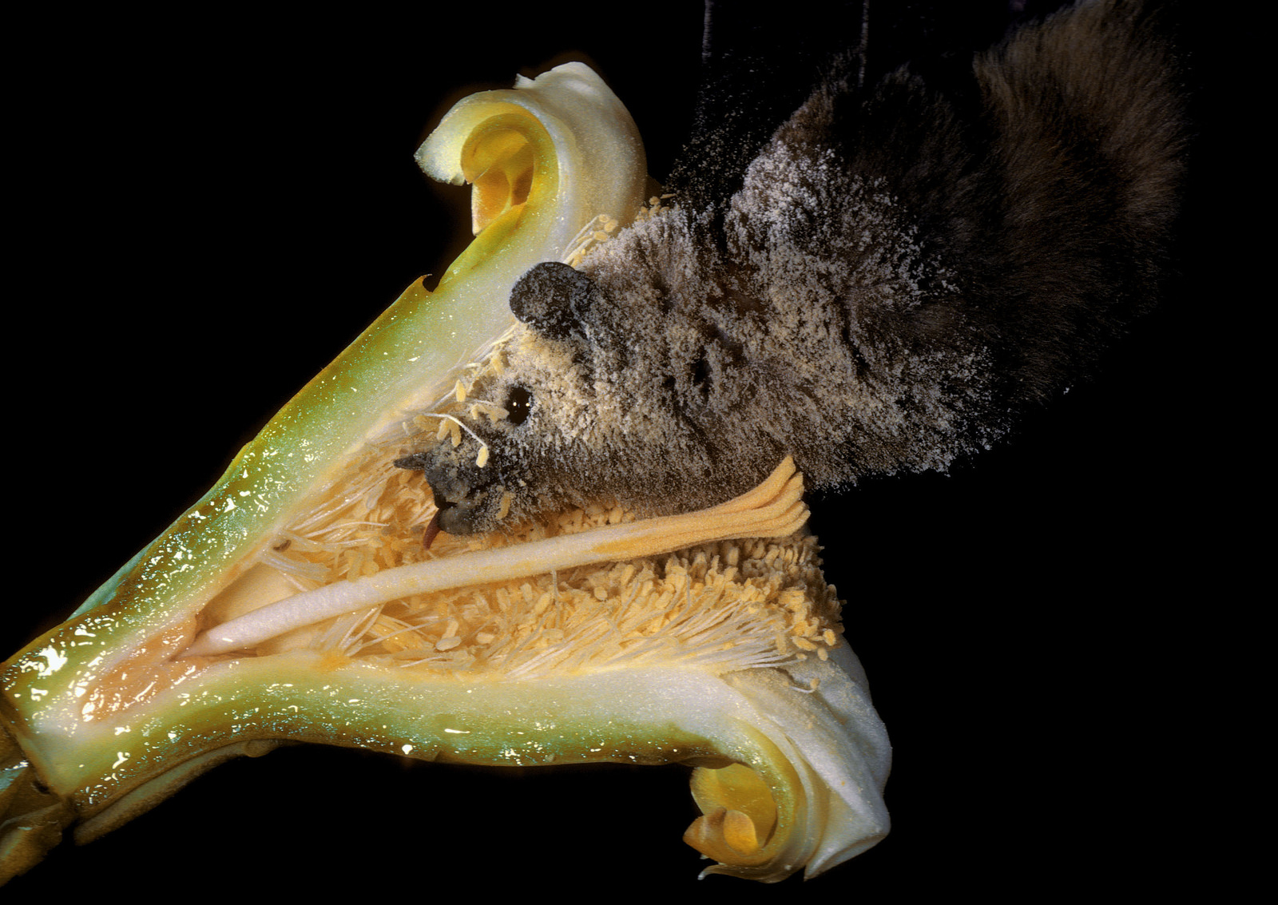
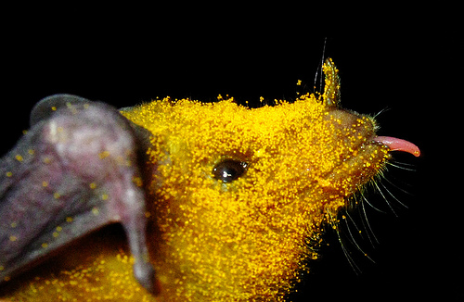
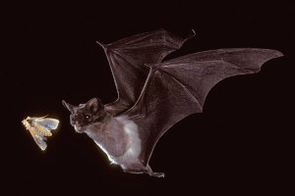
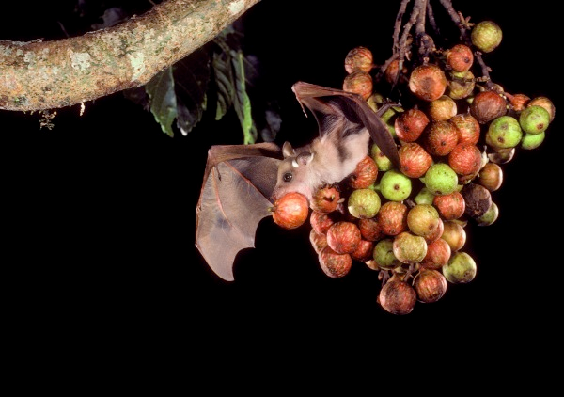
Bats Across the Globe - $300 Answer
Insects
Nectar
Blood
Fruit
Click to return to Jeopardy Board
Notes:
Different species of bats have different diets. There are only three species of bats in the world that drink blood and none of them live even close to New England. All New England bat species are insectivores.

Slide 19
Bats Across the Globe- $400 Question
Bats make up ____ percent of mammal species in the world.
Click to see answer

Slide 20
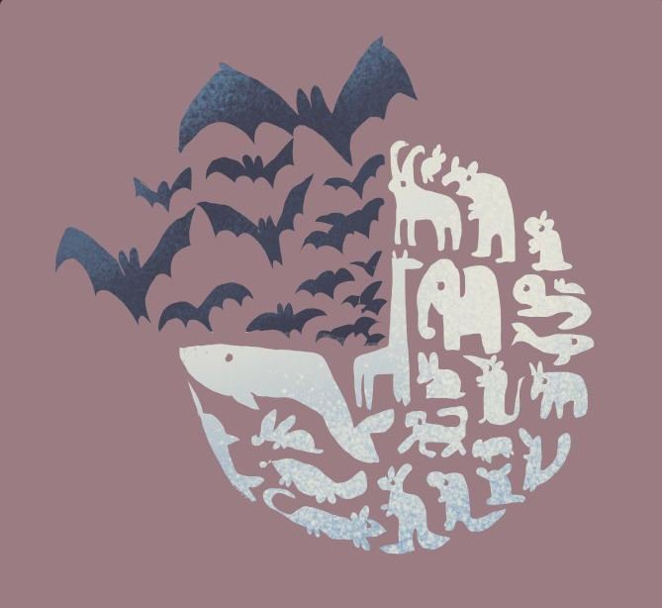
Bats Across the Globe - $400 Answer
≈20%
Click to return to Jeopardy Board
Notes:
That’s one-fifth of the total number of mammals!

Slide 21
Bats Across the Globe - $500 Question
Name how fruit-eating bats are beneficial to the planet
Click to see answer

Slide 22
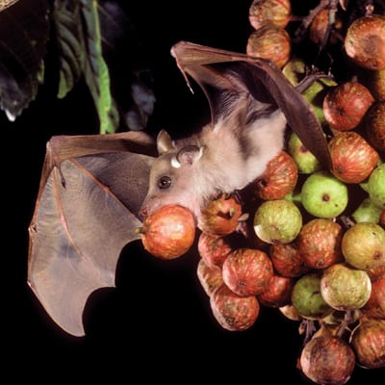
Bats Across the Globe - $500 Answer
They disperse seeds and plant new forests!
Click to return to Jeopardy Board

Slide 23
Bat Basics- $100 Question
What kind of animal is a bat?
Click to see answer

Slide 24
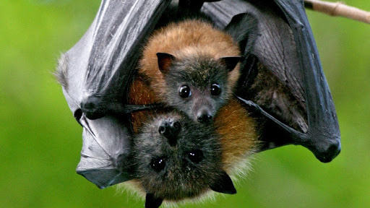
Bat Basics - $100 Answer
A mammal
Click to return to Jeopardy Board
Notes:
Bats have fur, have live young, nurse their young and are warm-blooded

Slide 25
Bat Basics - $200 Question
What do insectivores like to eat?
Click to see answer

Slide 26
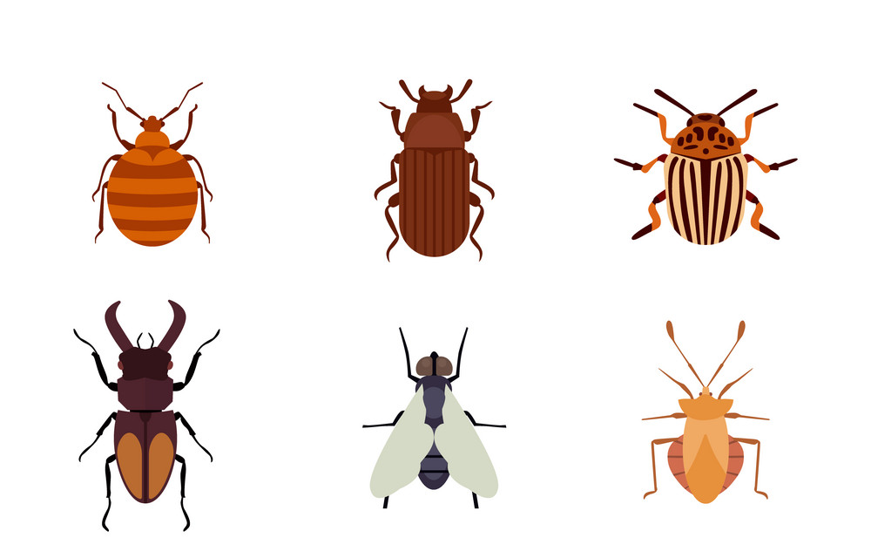
Bat Basics - $200 Answer
Insects:
Mosquitos, beetles, moths...
Click to return to Jeopardy Board
Notes:
All of the bats in New England are insectivores! Insectivores, like bats, help manage agricultural pests, that means they protect our food from being eaten by bugs. In the U.S. bats save farmers millions of dollars each year by acting as natural pest control! They even help small backyard gardens from pests, so we definitely want to keep them around!

Slide 27
Bat Basics - $300 Question
How do bats help humans?
Click to see answer

Slide 28
Bat Basics - $300 Answer
Pollinate plants
Pest control
Seed dispersal
Click to return to Jeopardy Board
Notes:
“Many people are unaware that over 500 plant species rely on bats to pollinate their flowers, including species of mango, banana, durian, guava and agave (used to make tequila). So, next time you […] eat a mango, say thanks to the bats! The pollination of plants by bats is called chiropterophily.”-bats.org.uk
If you want your garden safe from bad bugs, welcome bats! Bats not only help protect backyard gardens from pests but also save farmers in the United States millions of dollars each year by protecting their crops from insects.
Fruit eating bats help plant new forests through their droppings! They “go” on the go, and as they fly they spread seeds to new areas! The seed drops in it’s own little package of fertilizer and begins to grow.

Slide 29
Bat Basics - $400 Question
What is a baby bat called?
Click to see answer

Slide 30
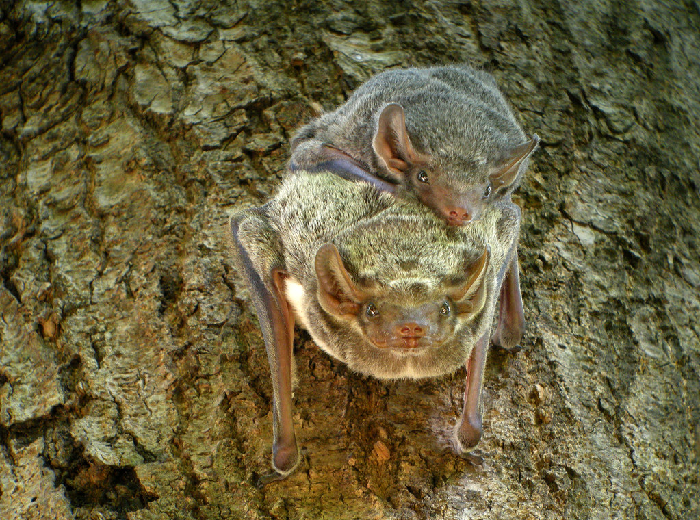
Bat Basics - $400 Answer
A pup!
Click to return to Jeopardy Board
Notes:
Hoary bats can have up to 4 pups, but having that many young is uncommon among bats. Most species of bats only have one pup...because the pup is born ⅓ the body weight of the mother!
10 quick facts about bat motherhood: https://www.batcon.org/motherhood-in-bats/

Slide 31
Bat Basics - $500 Question
What phrase does the word Chiroptera come from?
Click to see answer
Notes:
Pronounced: kai·raap·tr·uh

Slide 32
Bat Basics - $500 Answer
Hand-wing
Click to return to Jeopardy Board
Notes:
Chiroptera (Pronounced: kai·raap·tr·uh) comes from the Greek meaning “hand-wing”. This is because the bones in a bat’s wing are the same as the bones in a human’s hand! They just have very, very long fingers… except for their little thumb! When they fly they can move each digit individually, so they don’t “flap” like birds, they row and, they can use their wings to scoop bugs right up to their mouths!

Slide 33
Bat Threats- $100 Question
What is the name of the disease that is threatening bats in the United States?
Click to see answer

Slide 34
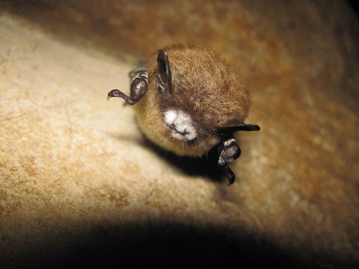
Bat Threats - $100 Answer
White-nose Syndrome
Click to return to Jeopardy Board
Notes:
White-nose syndrome is a fungus, Pseudogymnoascus destructans, that was discovered in the united states around 2006 and since has devastated our native bat populations.

Slide 35
Bat Threats - $200 Question
How do scientists believe White-nose Syndrome is spread?
Click to see answer
Notes:
Scientists believe that white-nose syndrome fir

Slide 36
Bat Threats - $200 Answer
On boots and equipment brought from one cave to another by humans.
From one bat to another while in their hibernacula.
Click to return to Jeopardy Board
Notes:
This disease was first discovered in New York state and since has moved across the united states an incredible fast rate.
View the interactive map of the spread of WNS: https://www.whitenosesyndrome.org/spreadmap

Slide 37
Bat Threats- $300 Question
Name one threat to bats besides WNS.
Click to see answer

Slide 38
Bat Threats - $300 Answer
Wind turbines
Pesticides
Click to return to Jeopardy Board
Notes:
While wind turbines are a great source of alternative energy, they can be dangerous for bats. During migration, bats can fly into turbines and it has become one of the leading causes of mortality in bats. Scientists are working to compromise on when the turbines can be shut down to decrease the harm they cause to our native bat populations.
Pesticides are chemicals used to kill insects that are harmful to plants. However, pesticides don’t just target the bad bugs, they can harm the beneficial ones, too. If there are no bugs, that means no pollinators and no food for bats! Bats can act as a natural pest control, keeping your garden safe by just having their dinner!

Slide 39
Bat Threats- $400 Question
What are some natural predators of bats?
Click to see answer

Slide 40
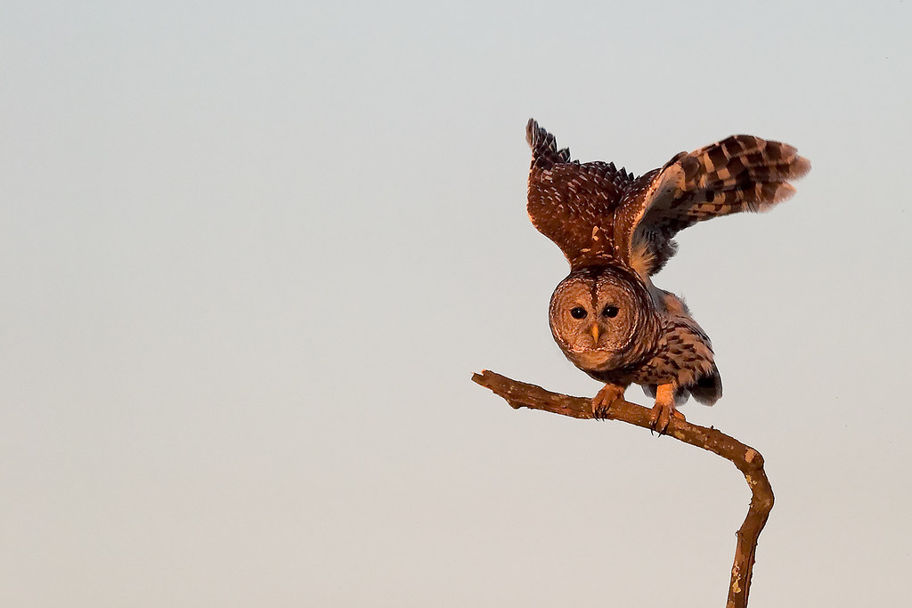
Bat Threats - $400 Answer
Owls, Hawks and Snakes
Click to return to Jeopardy Board
Notes:
These natural predators of bats don’t cause any large declines, they can help keep bat populations in check. It’s always important to have a balance in the ecosystem and natural predators are key to keeping that balance.

Slide 41
Bat Threats- $500 Question
How does White-nose syndrome harm bats?
Click to see answer

Slide 42
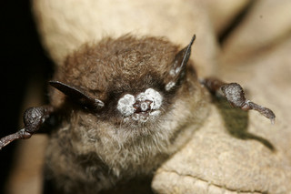
Bat Threats - $500 Answer
It grow on their noses and wings and wakes them up during the winter.
Click to return to Jeopardy Board
Notes:
This fungus grows on the nose and wings of bats and wakes them up during the winter hibernation when they should be sleeping. It’s too cold for them in the winter and there are no bugs in the winter so there is nothing for them too eat. Over 5 million bats have died from white-nose syndrome and it has caused declines in Rhode Island’s little brown bat population. WNS is not always fatal and biologists at the RI Division of Fish and Wildlife have captured bats that have scarring on their wings from surviving the disease and healing!
Some tests have been done to find a way to solve this problem, but scientists are still hard are work to find the answer. One study found that spraying a chemical used to preserve bananas and prevent fungus actually helped bats with WNS! More tests and research need to be done to find the best solution for this problem.

Slide 43
Bat Conservation - $100 Question
Name one way that YOU can help bats
Click to see answer

Slide 44
Bat Conservation - $100 Answer
Create good bug habitat
Put up a bat house
Don’t use pesticides
Tell your family, friends and neighbors that bats are awesome!
Click to return to Jeopardy Board
Notes:
There are lots of ways we can all help bats.
Create healthy habitat - Plant a bat-friendly garden with lots of different plants. This will attract insects, and provide natural food for the bats.
Don’t use pesticides - Chemical pesticides are often used to kill certain insect pests, but can end up unintentionally killing other insects too. This can impact bats because killing off insects greatly reduces their food source. Also, if an insect is sprayed, but does not die immediately, it could be eaten by a bat. The bat will have ingested the chemical pesticides via the insect. The poison can make its way up the food chain, eventually harming bats and other wildlife. This is a common occurrence with birds of prey eating rats that have consumed rat poison before becoming a hungry bird’s lunch.
Provide shelter - Building a bat house can help give bats a place to rest. Bats are very site faithful, meaning they return to the same roosts and hibernacula each year. They may not find your bat house right away, but it’s always good to offer them the option! Wisconsin Department of Natural Resources has a great guide on building bat houses. You can find it in the Resources & Lesson Plans folder.
Share what you know about bats with your friends and family! - The more people know about bats, the better. Bats are often misunderstood, and need your help to spread the word that bats are super cool!

Slide 45
Bat Conservation - $200 Question
How does the RIDEM Division of Fish and Wildlife study bats?
Click to see answer

Slide 46
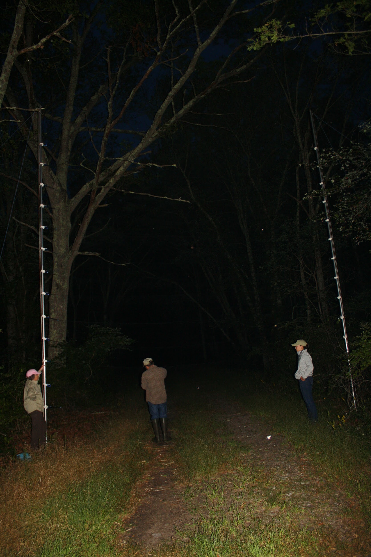
Bat Conservation - $200 Answer
Count bats at maternity roosts
Band bats during mist net surveys
Click to return to Jeopardy Board
Notes:
The Division of Fish and Wildlife collects all sorts of data from studying bats and monitors how our bat populations are doing.
During maternity roost surveys, biologists count how many new bats are born each year by counting them as they leave the roost at night to feed on insects. .
During mist-net surveys, biologist set up tall, fine netting between two tall posts at night. Bats fly into the net and biologists carefully take them out, collect information on age, sex, and measurements and then put a uniquely coded band on the wing of the bat.

Slide 47
Bat Conservation - $300 Question
Why do biologists band bats?
Click to see answer

Slide 48
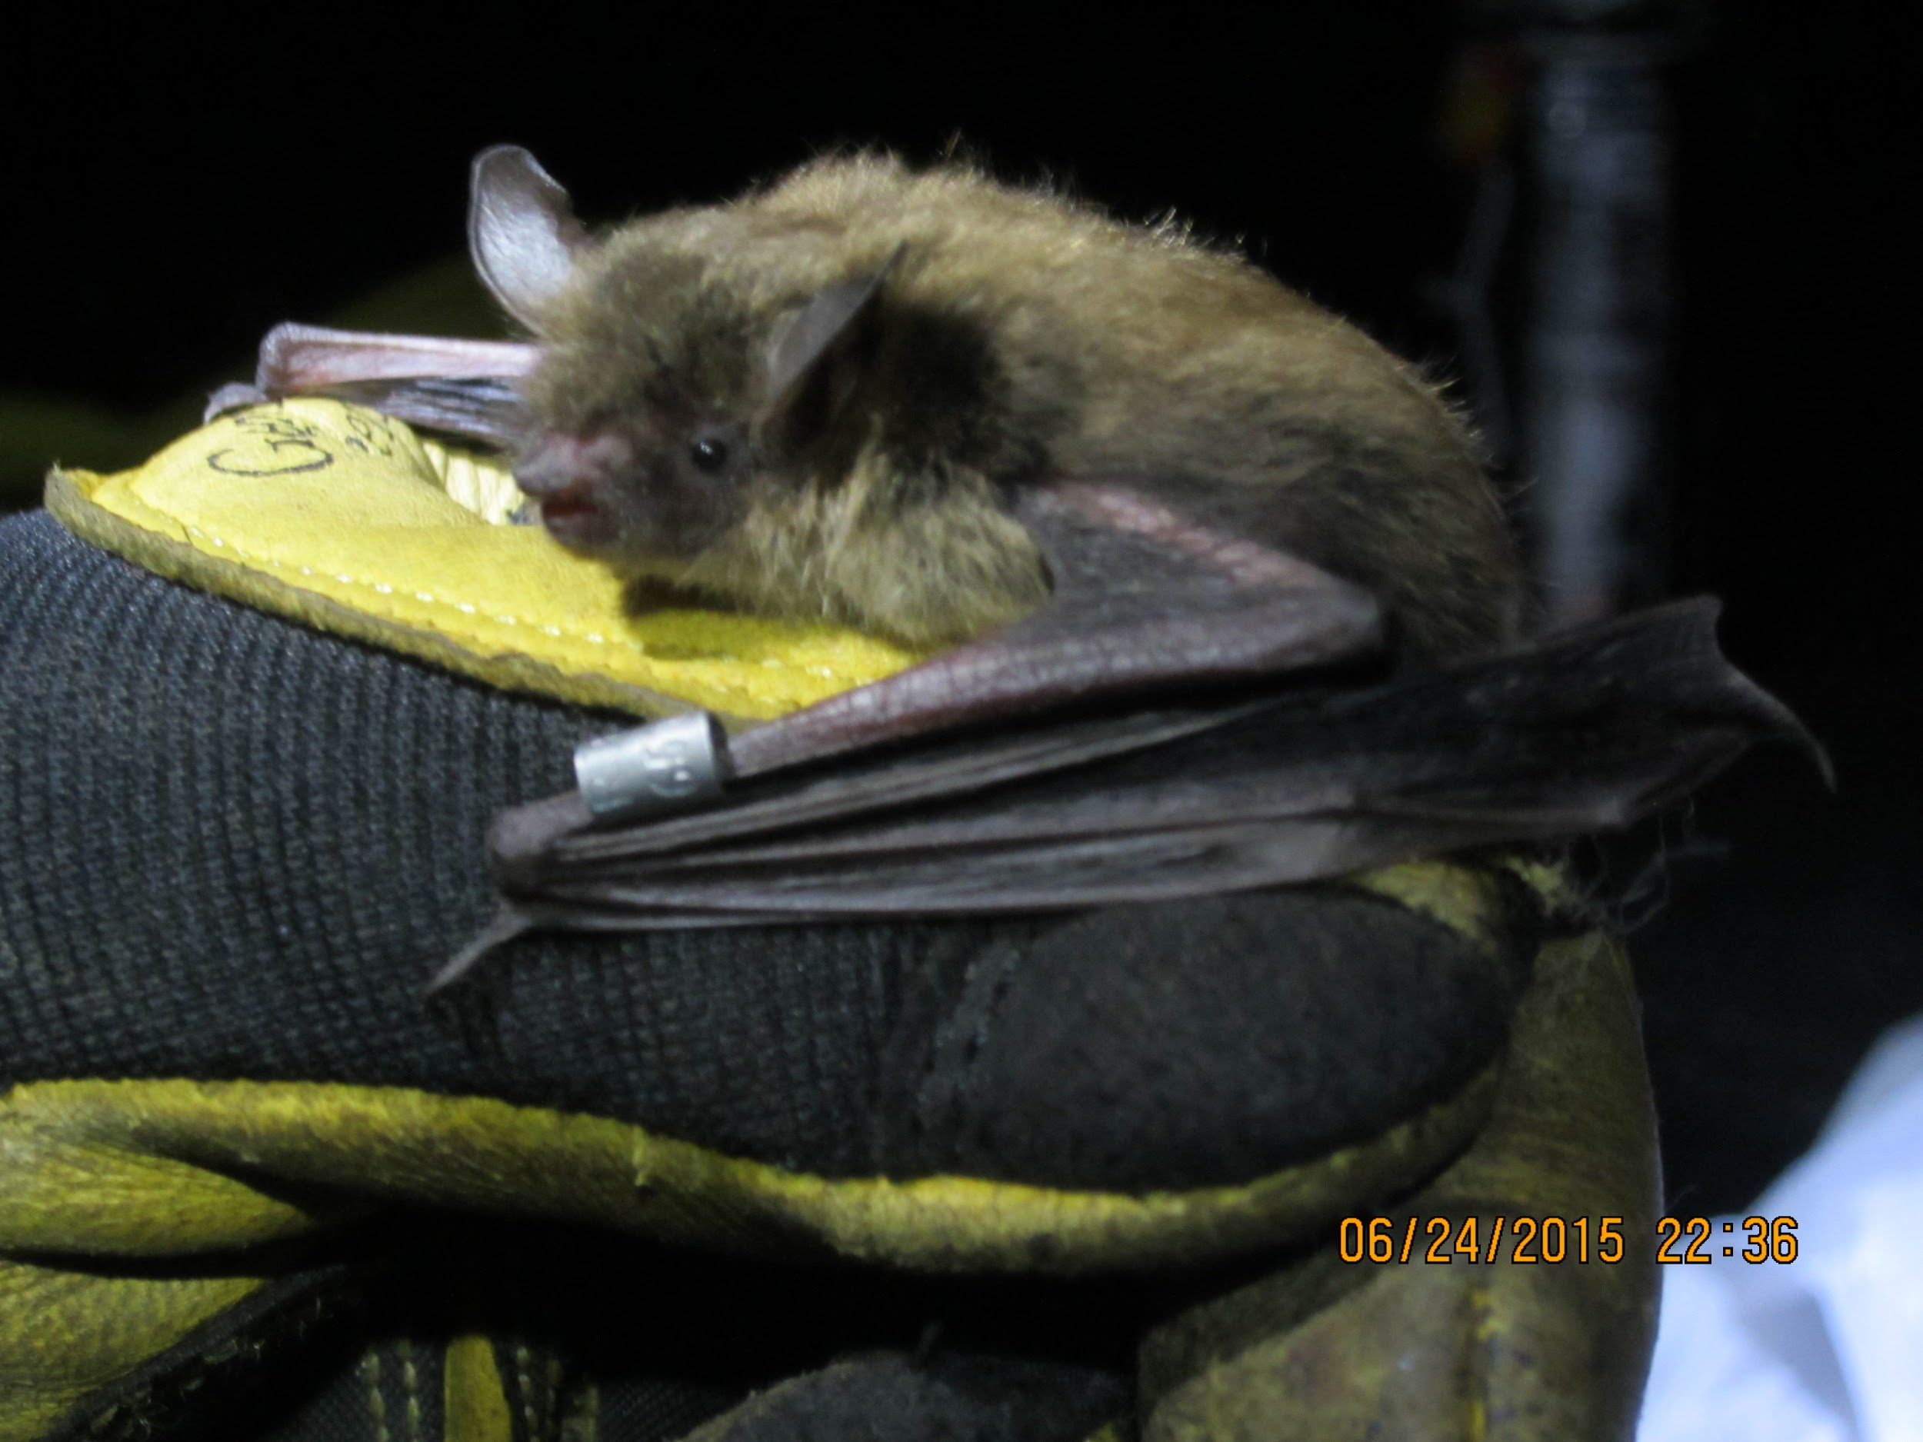
Bat Conservation- $300 Answer
To gather more information on their populations.
Click to return to Jeopardy Board
Notes:
Bands each have a unique code to identify individual bats.
While they band they collect data on sex, age and weight.
When banded bats are recaptured, it provides information on the age of the bat, where it came from, and if it has gained or lost weight.

Slide 49
Bat Conservation- $400 Question
Why are pesticides bad for bats?
Click to see answer

Slide 50
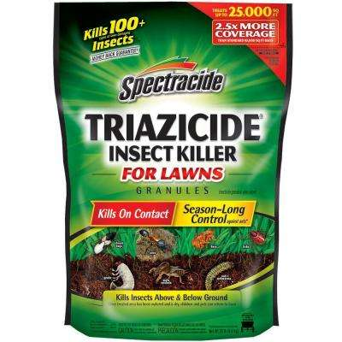
Bat Conservation - $400 Answer
Pesticides kill bugs which bats need to eat!
Click to return to Jeopardy Board
Notes:
When we take an action we have to think about not only who or what it directly impacts but what else is going to be affected by that action. You might be aiming to just protect your plants by using pesticides, but you might inadvertently, or accidentally, be harming the many other animals that depend on insects. Not to mention, if you want your plants to be fruitful, you need pollinators! Pesticides can be harmful to more than just the “bad” bugs.

Slide 51
Bat Conservation- $500 Question
Why is it important to conserve bats?
Click to see answer

Slide 52
Bat Conservation- $500 Answer
Bats help plant forests
Bats pollinate our food
Bats protect our crops
Bats are AWESOME!
Click to return to Jeopardy Board
Notes:
Teach your family, friends and neighbors about how important bats are to help in conserving their populations!

Slide 53
FINAL
Topic: Mammals
Click to see question

Slide 54
Final Jeopardy Question
What is the only native land mammal to Hawaii?
Click to see answer

Slide 55
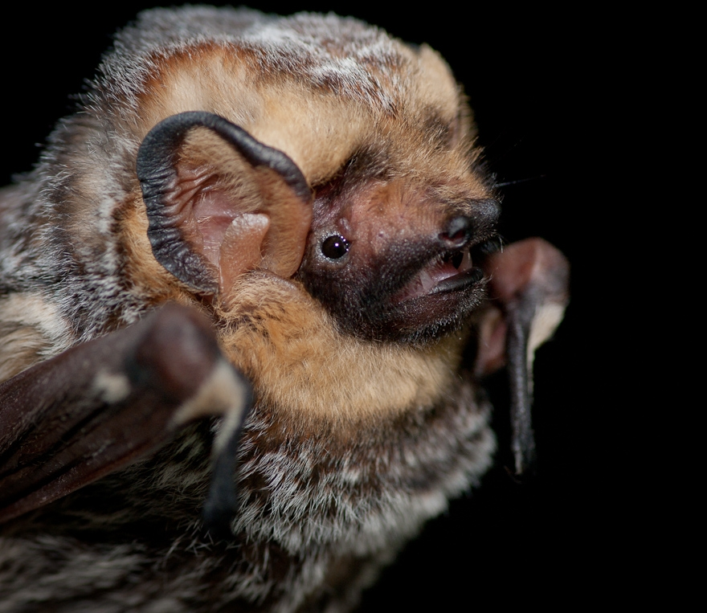
Final Jeopardy Answer
The Hawaiian Hoary Bat!
Click to return to Jeopardy Board
Notes:
There are many other terrestrial (land) mammals on Hawaii, but they have all been introduced by humans!

