Slide 1
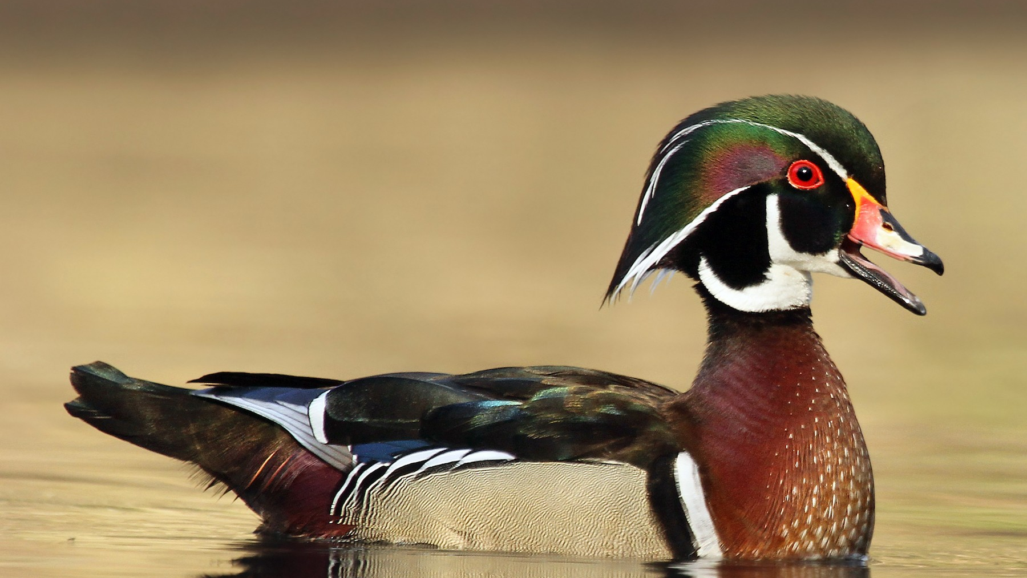
Wetland Wildlife:
The Wood Duck
RI DEM Division of Fish and Wildlife
Rhody Critter Kits Program

Slide 2
What are freshwater wetlands?
Places where the ground is covered with water
(Permanently or temporarily)
Marked by specialized water-loving plants
One of the four crucial parts of a habitat

Slide 3
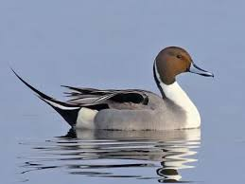
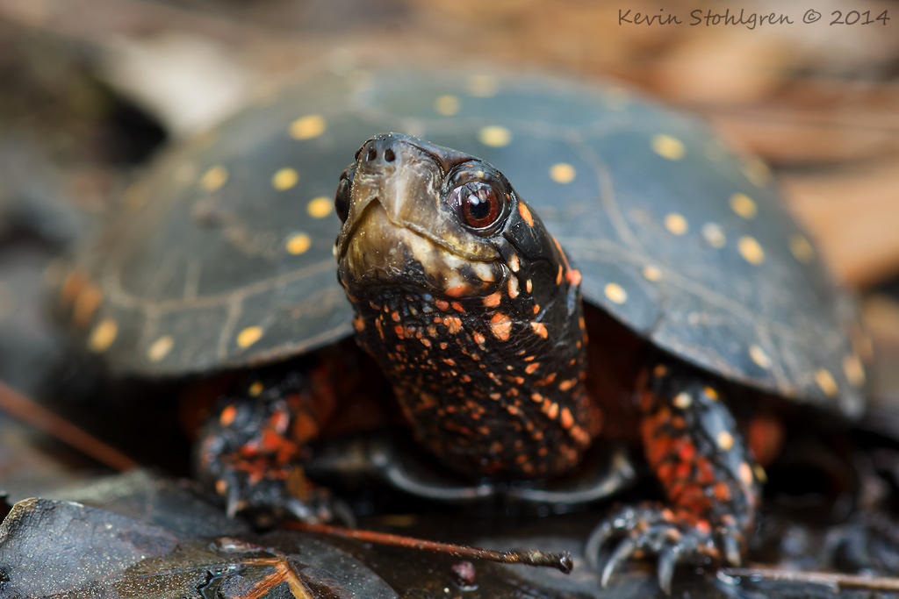
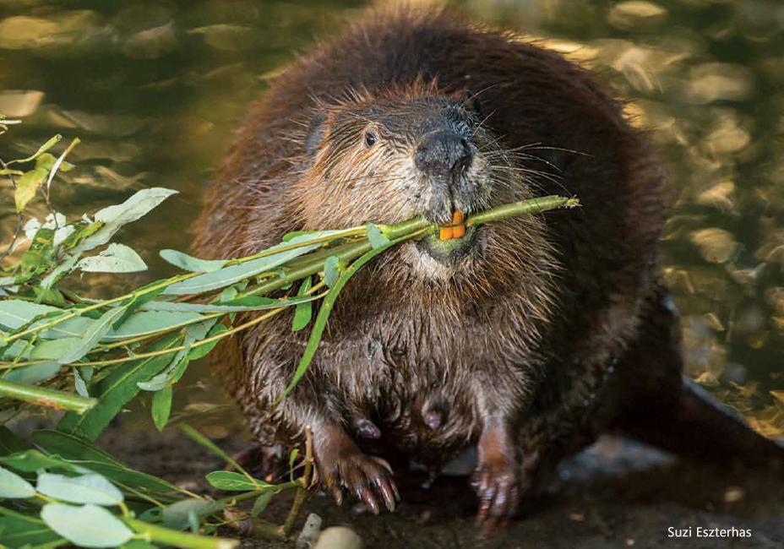
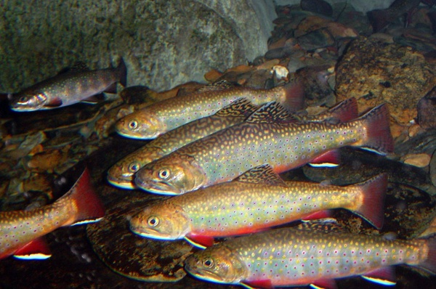
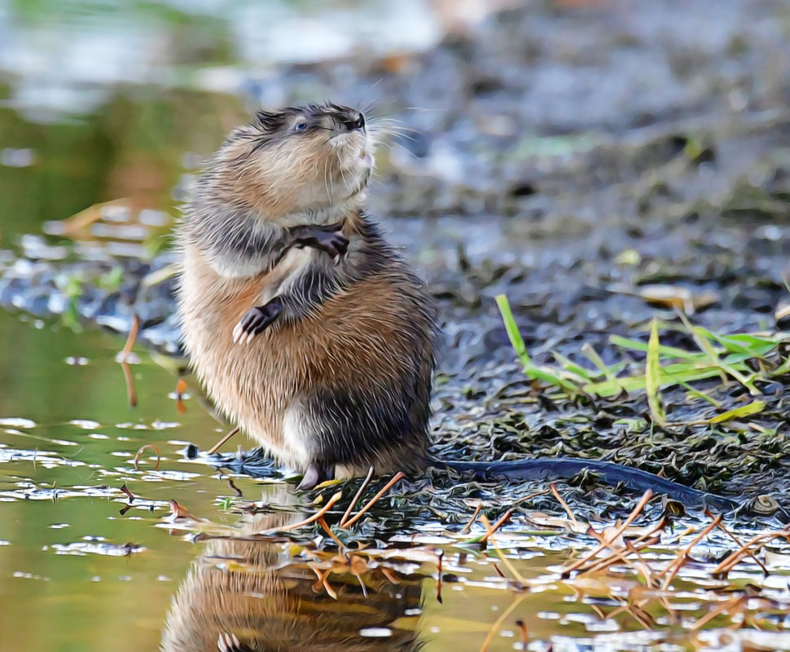
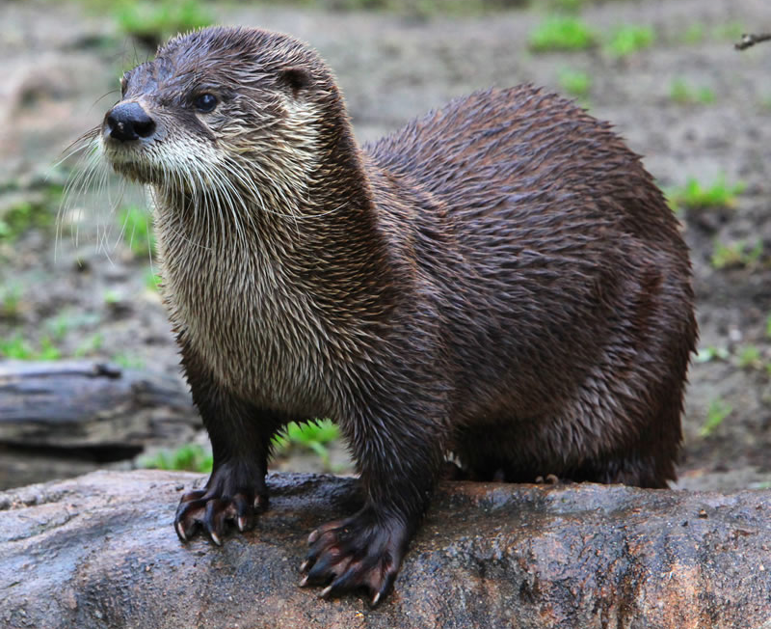
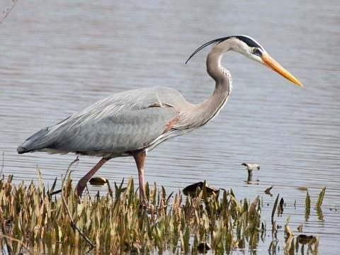
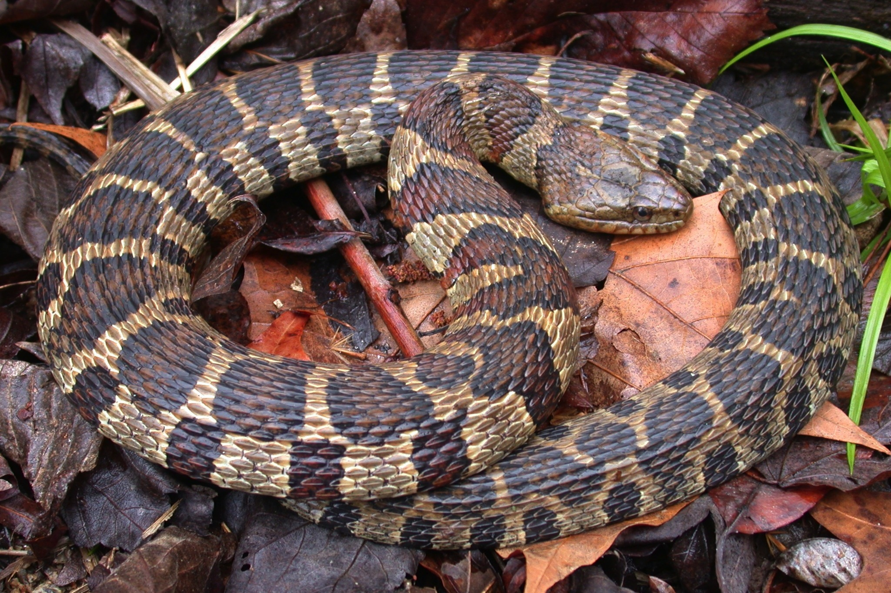
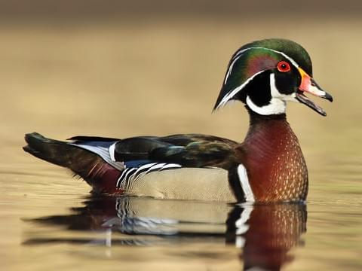
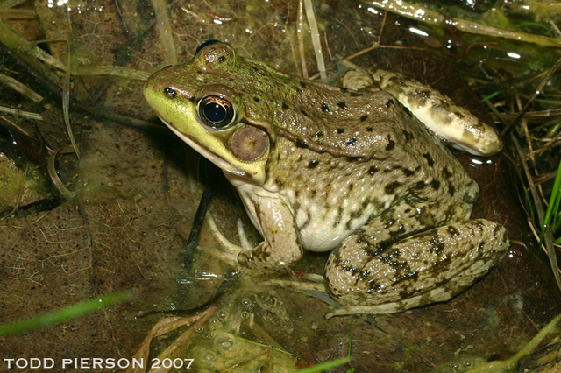
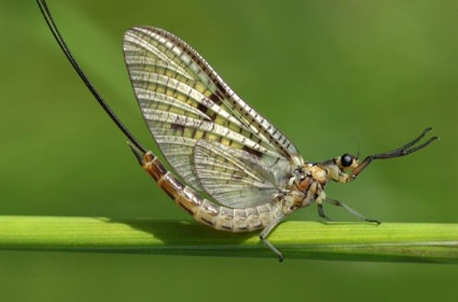
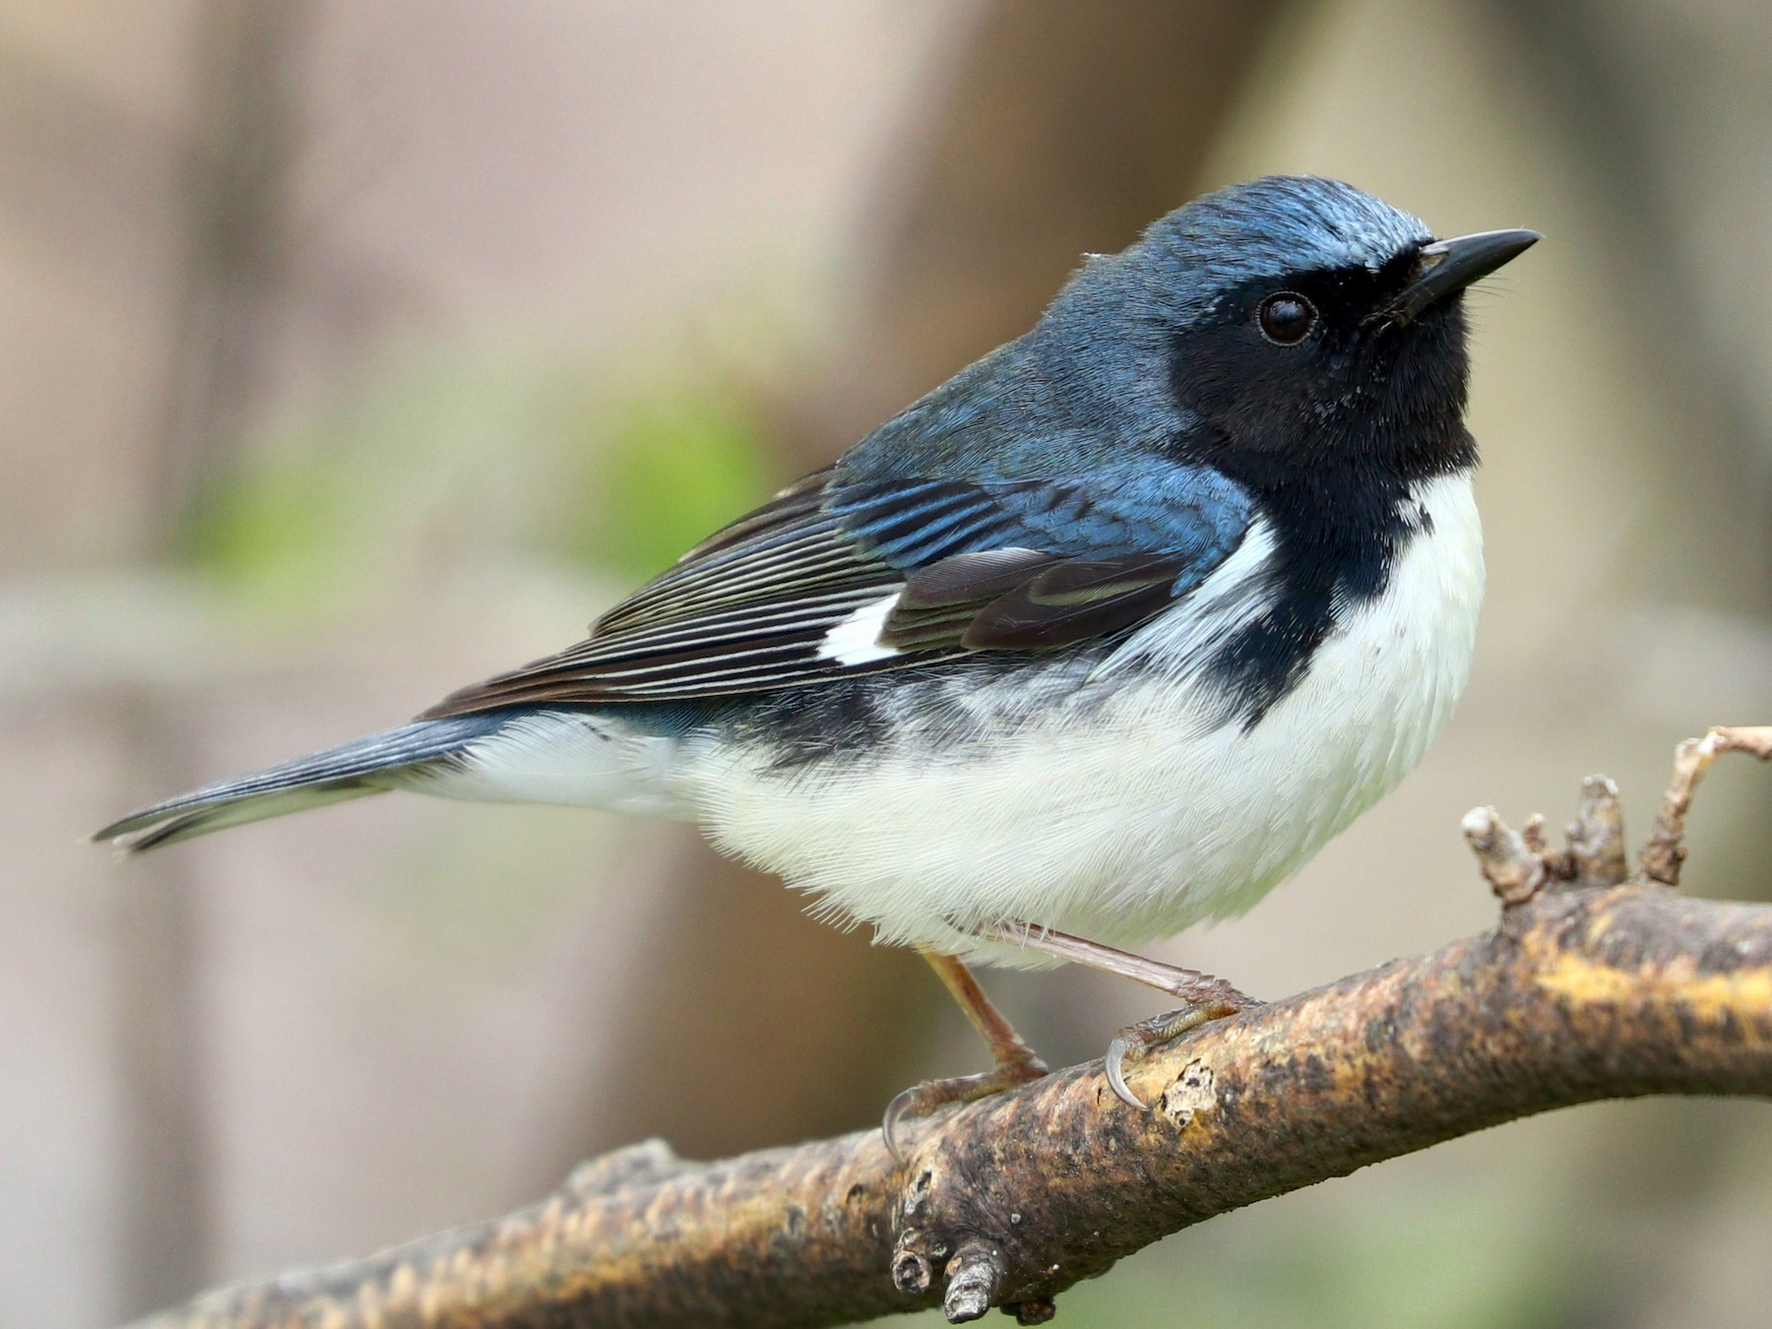
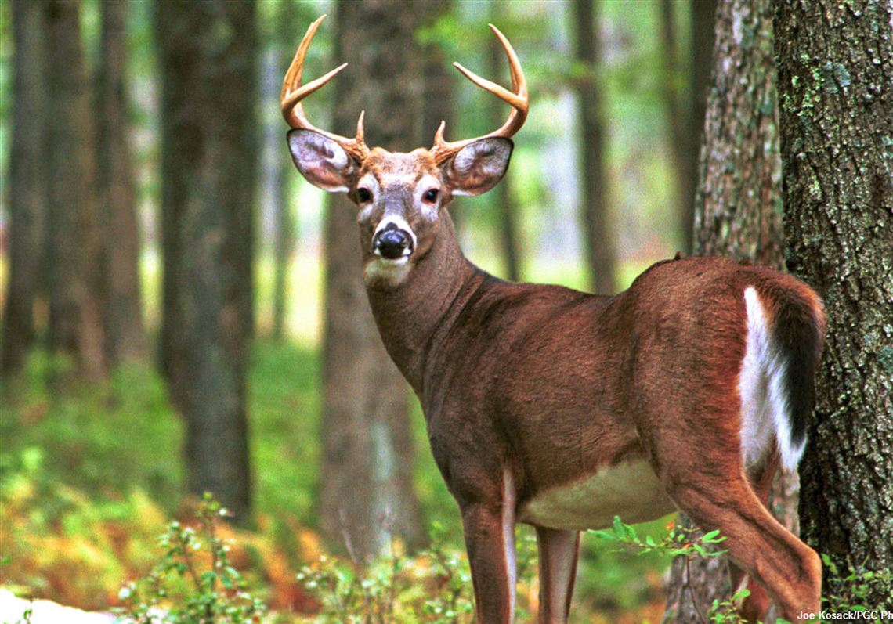
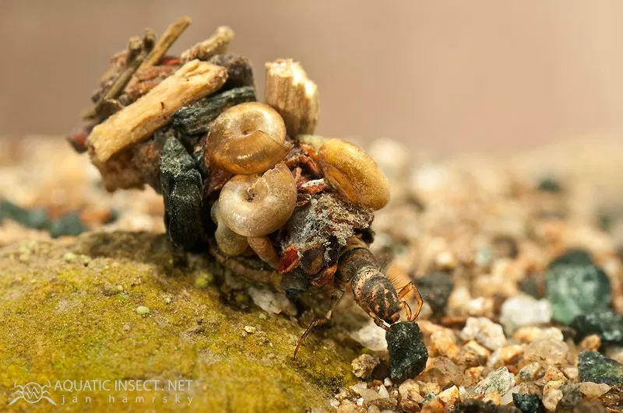
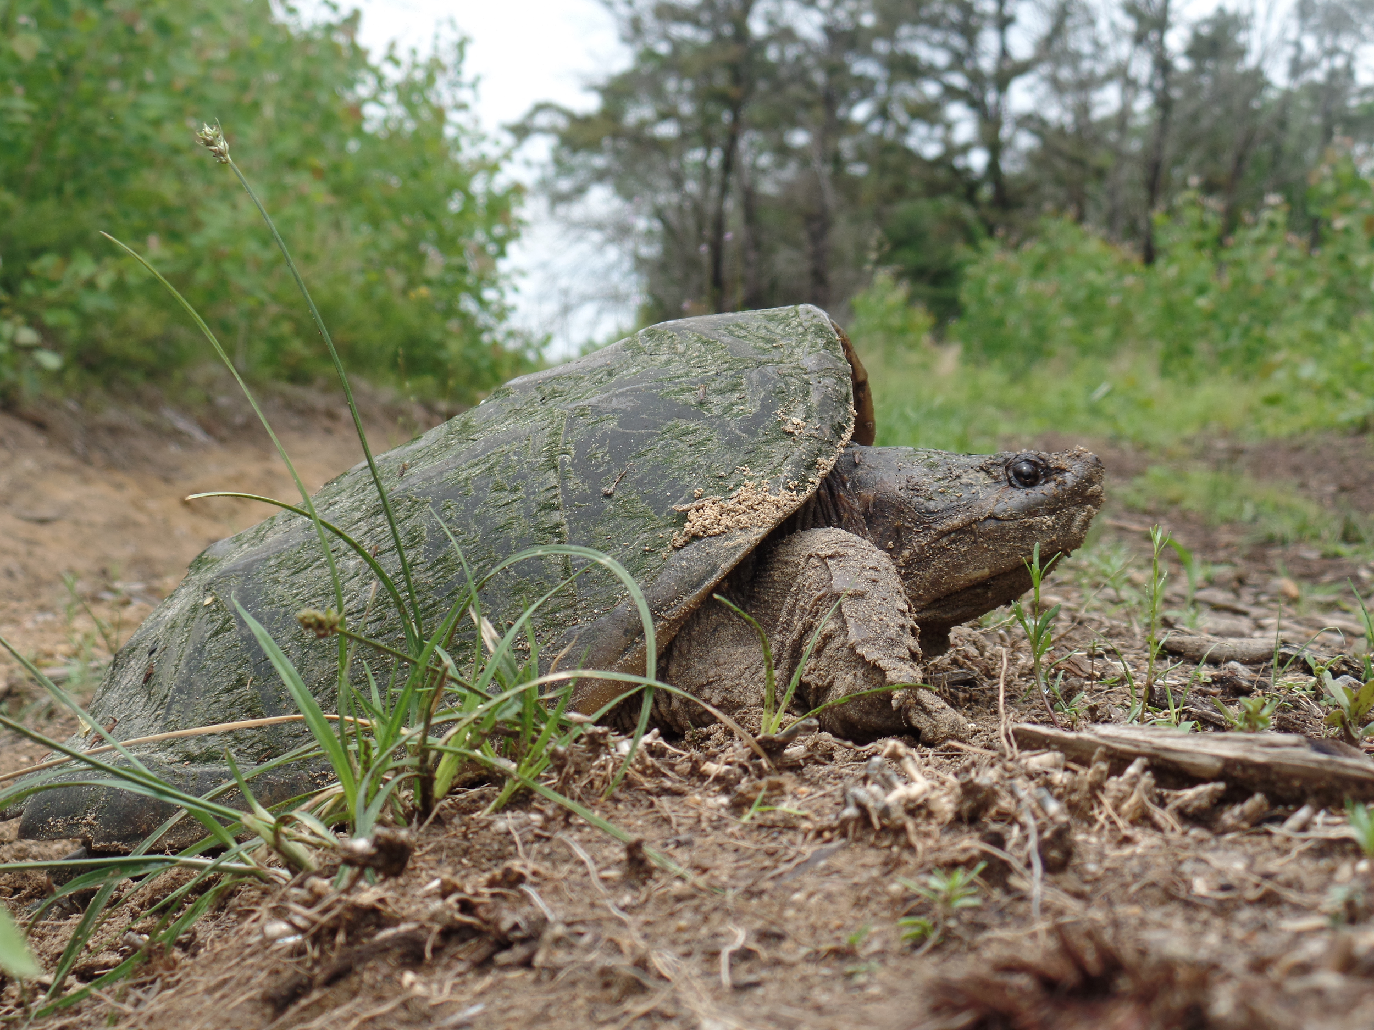
Who uses a wetland?
Notes:
Water is one of the four crucial parts of a habitat so all animals use wetlands.
All of these animals depend on wetlands to survive but today we will be focusing on one species that lives in wetlands, wood ducks (circled on click).
From left to right:
Northern pintail, spotted turtle, beaver, herring, muskrat
Otter, great blue heron, northern watersnake (non-venomous), wood duck, green frog
Mayfly, black-throated blue warbler, white-tailed deer, caddisfly larva, common snapping turtle

Slide 4
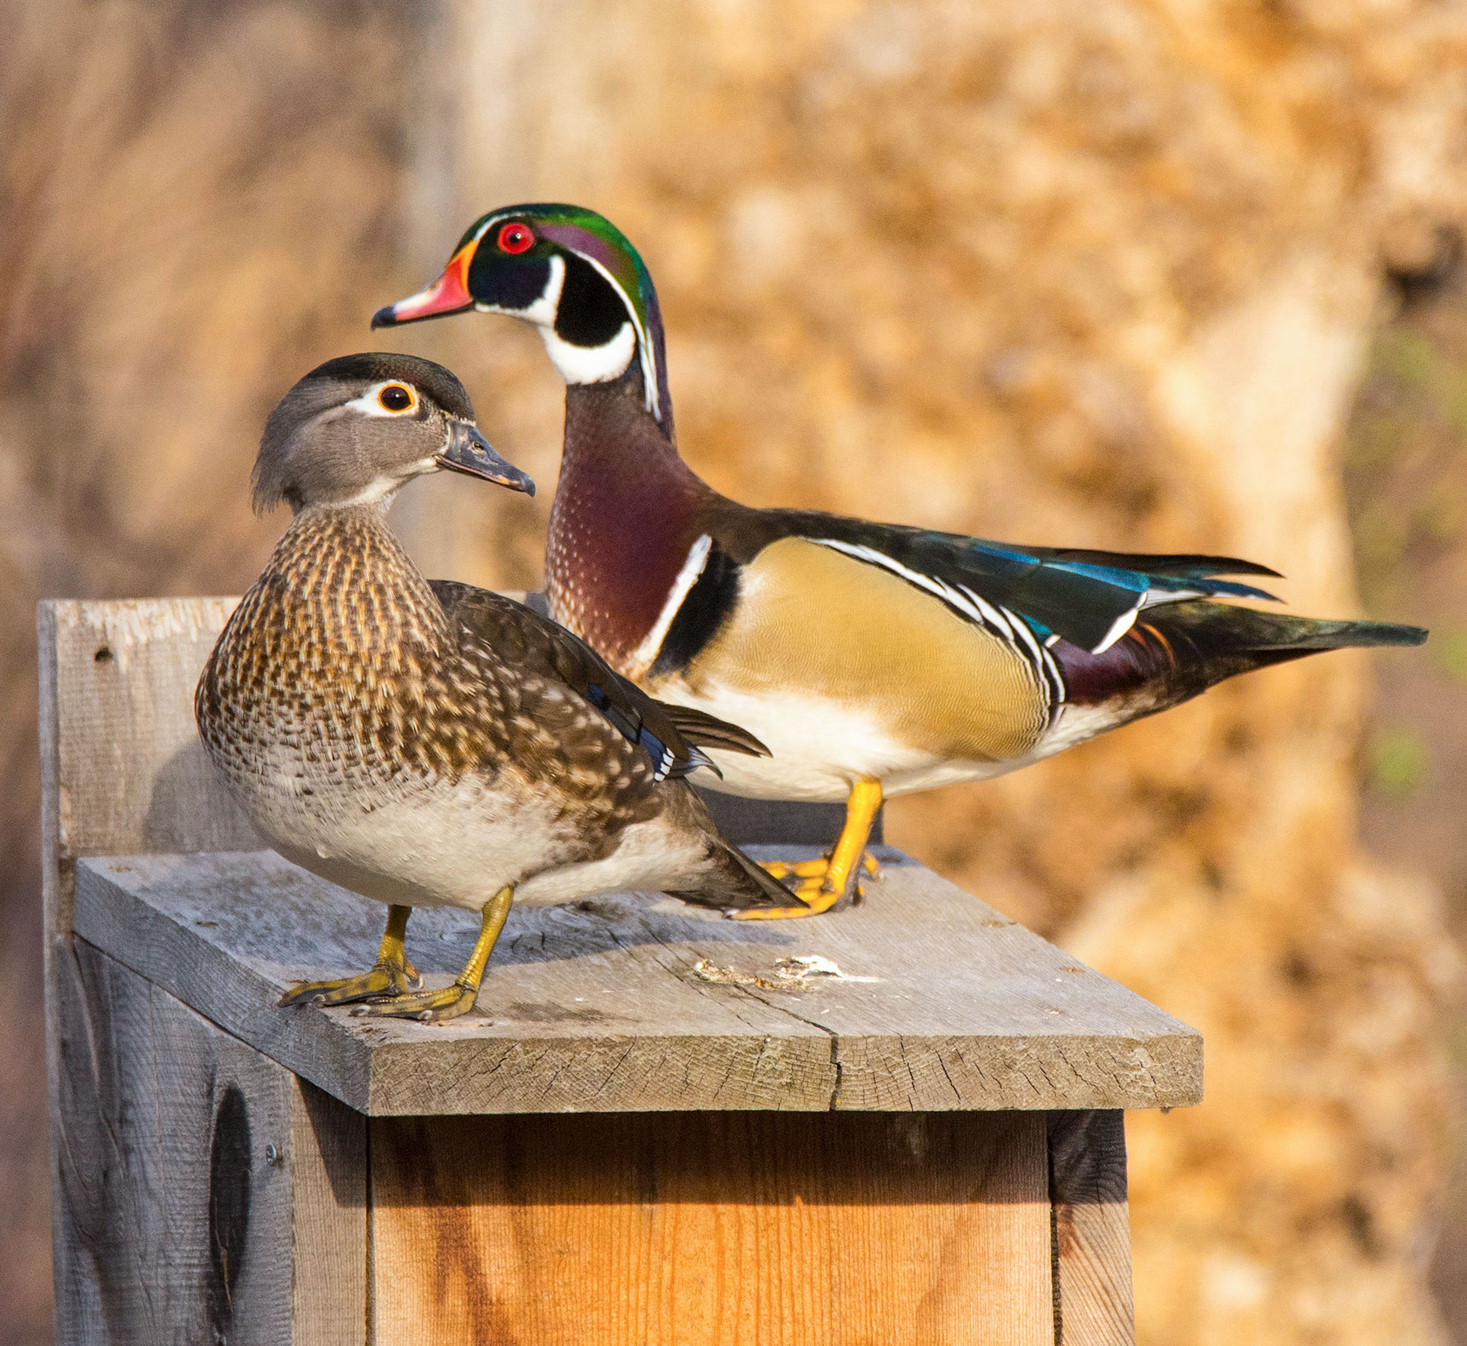
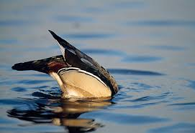
What’s a Wood Duck?
Males:
Red eye
Brightly colored
White “chin strap”
Iridescent head crest
Females:
White around eye
Brownish color
Iridescent color on wing
Grey head
That’s a wood duck!
Notes:
Male ducks are called drakes and females are called hens.
The males are brightly colored to attract females and the females are drab to hide (camouflage) from predators while they are nesting.
Wood ducks are called “dabbling ducks” because of their feeding behaviour. They tip their tails into the air and their heads down into the water to get their food.

Slide 5
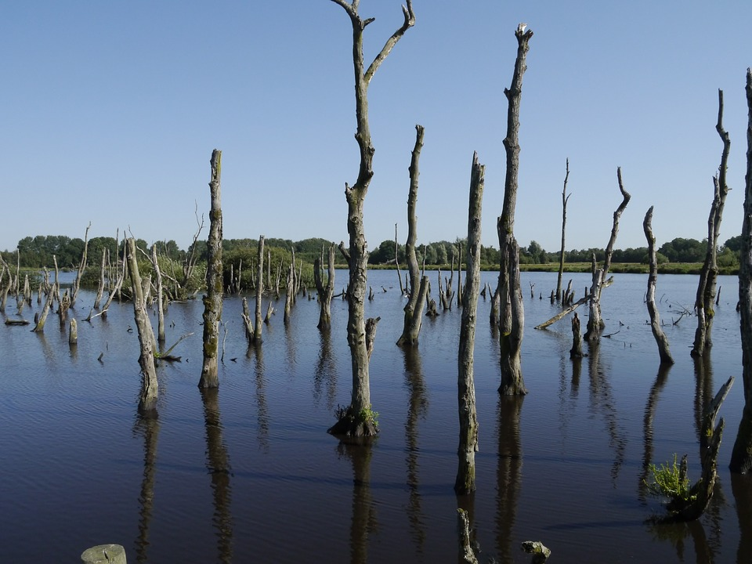
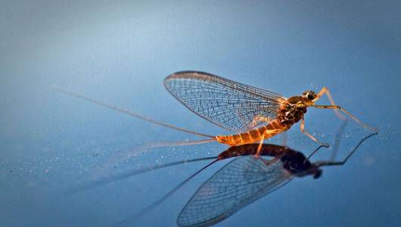
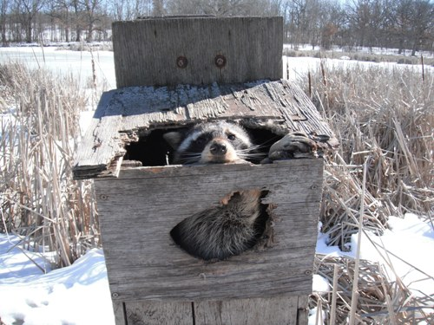
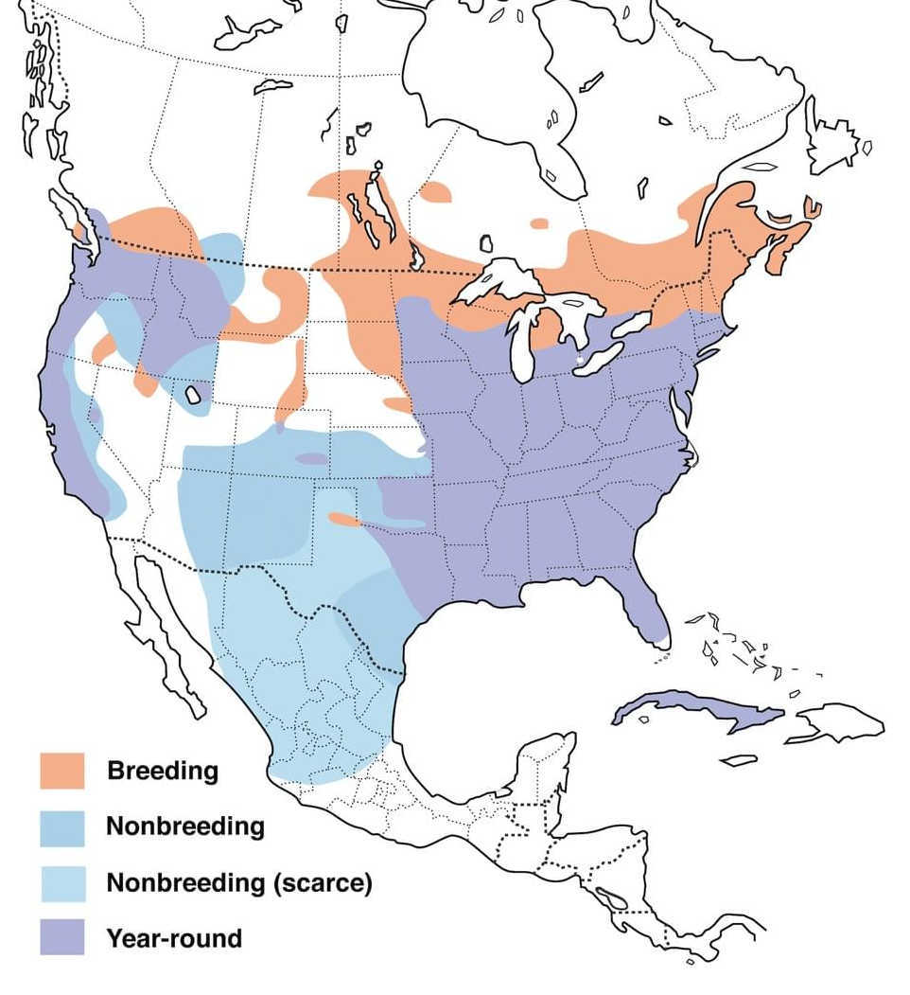
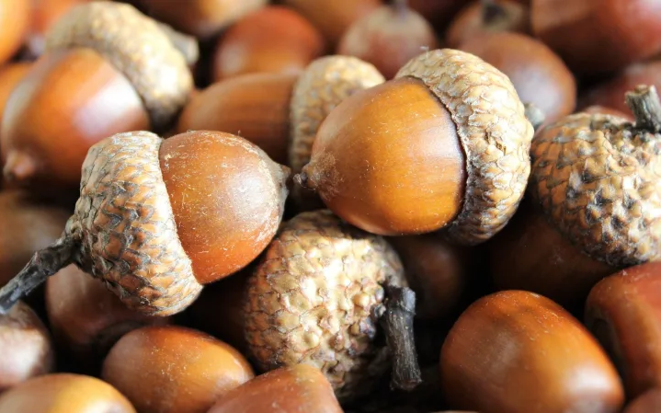
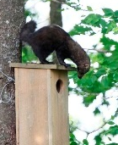
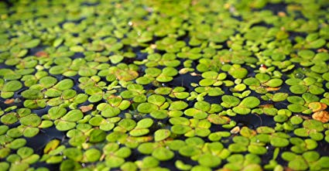
Wood Duck Life History
What does a wood duck eat?
Where does a wood duck live?
What eats a wood duck?
Notes:
Diet:
Wood ducks eat seeds, fruit, aquatic insects and acorns and nuts on land.
Habitat:
Wood ducks live in swamps, freshwater marshes and beaver ponds.
Wood ducks stay in the south during the wintertime and migrate north to nest in Rhode Island. Some wood ducks stay in the same place all year round.
Predators:
Birds of prey, black rat snakes, red foxes, and raccoons are all nest predators

Slide 6
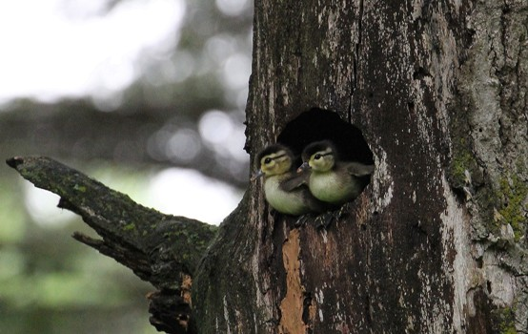
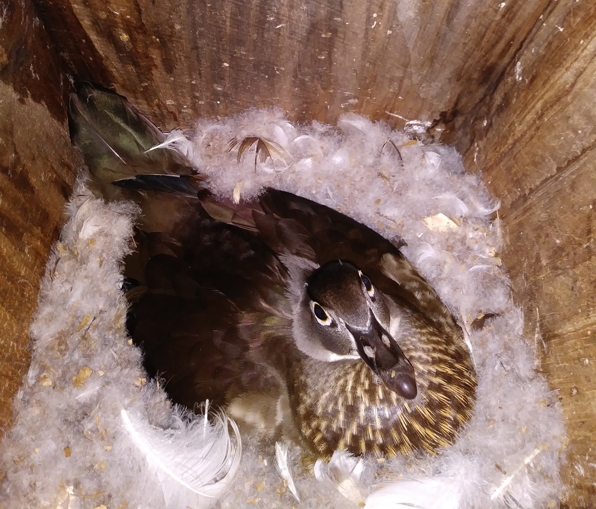
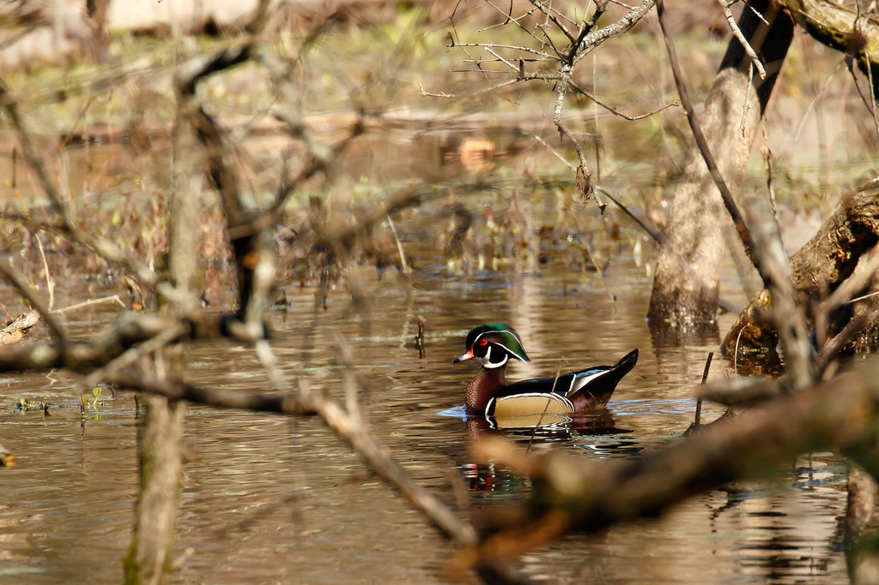
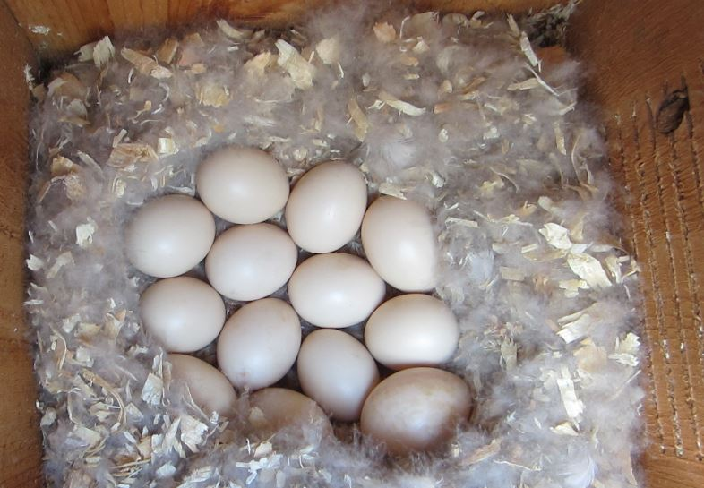
Nesting!
Notes:
Wood ducks pair up in January before moving to their nesting grounds in Rhode Island in early spring.
Females nest in tree cavities. They line the nest with down which they pull from their own bodies to keep the nest warm.
Wood ducks will lay between 8 and 15 eggs which hatch about a month later.
Females will return to the same location they were born to lay their own eggs!
Beavers provide perfect nesting habitat for wood ducks, they love to nest in holes of dead trees in standing water where they are safe from predators!

Slide 7
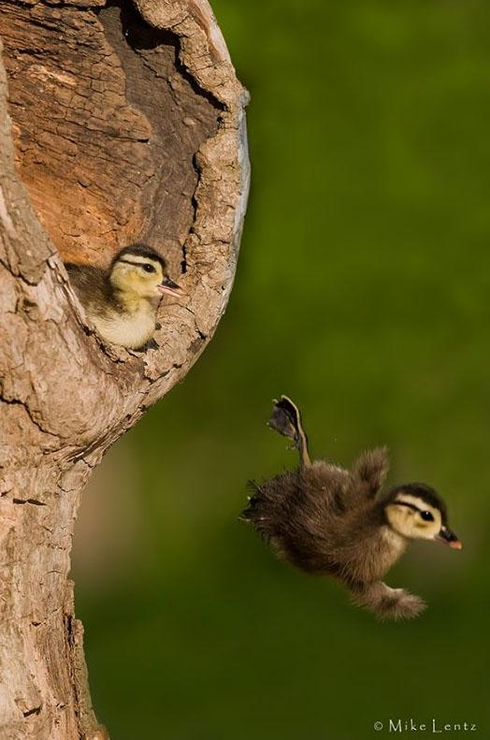
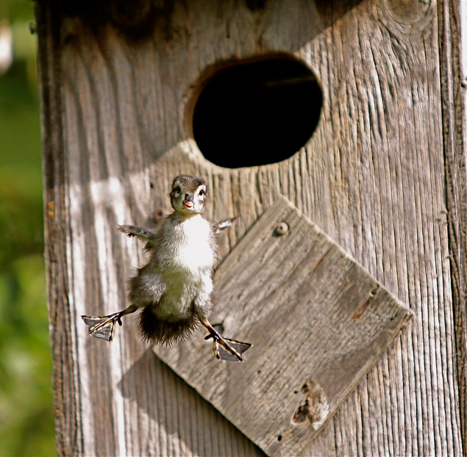
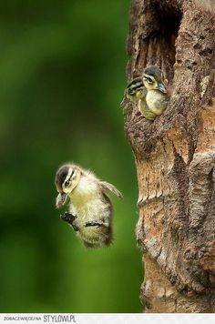
Leaping into the world!
Notes:
After spending just a couple of days in the nest, wood ducks chicks leap from their nests one by one, out into the wide world.
This is another reason why mother ducks nest over water or soft ground!
They will not return to their nest, but will stay with their mother, feeding on aquatic insects and plants until they are big enough to survive on their own.

Slide 8
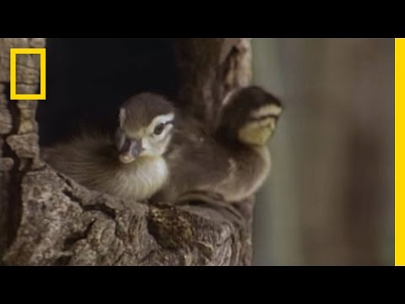
Leaping into the world!
Notes:
After spending a couple of days in the nest, wood ducks chicks leap from their nests one by one, out into the wide world.
This is another reason why mother ducks nest over water or soft ground!
They will not return to their nest, but will stay with their mother, feeding on aquatic insects and plants until they are big enough to survive on their own.

Slide 9
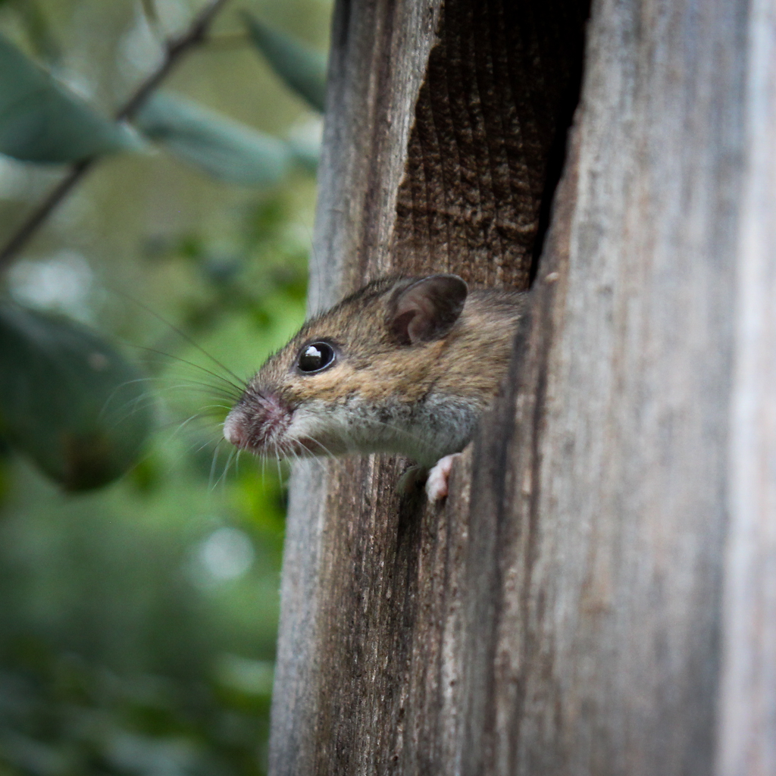
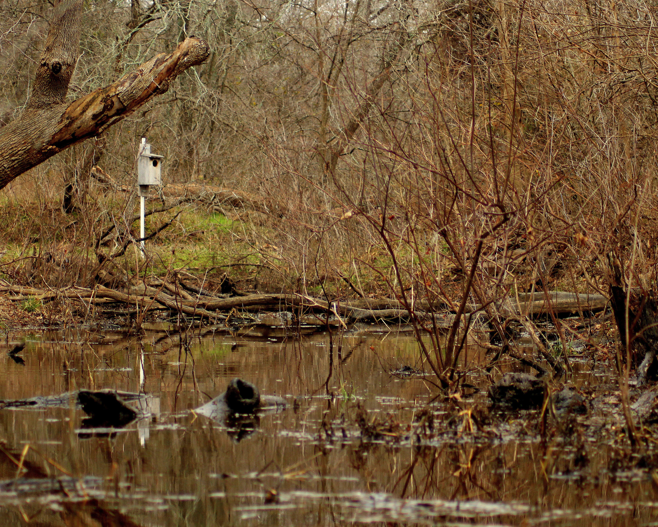
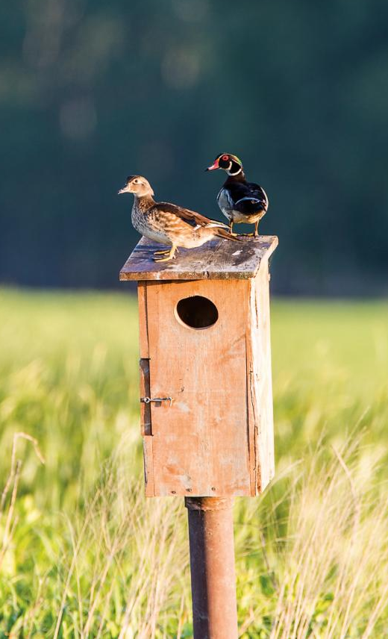
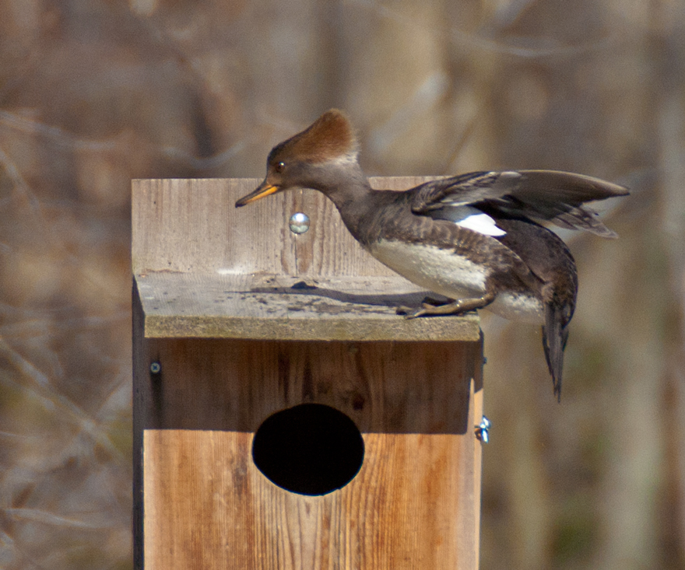
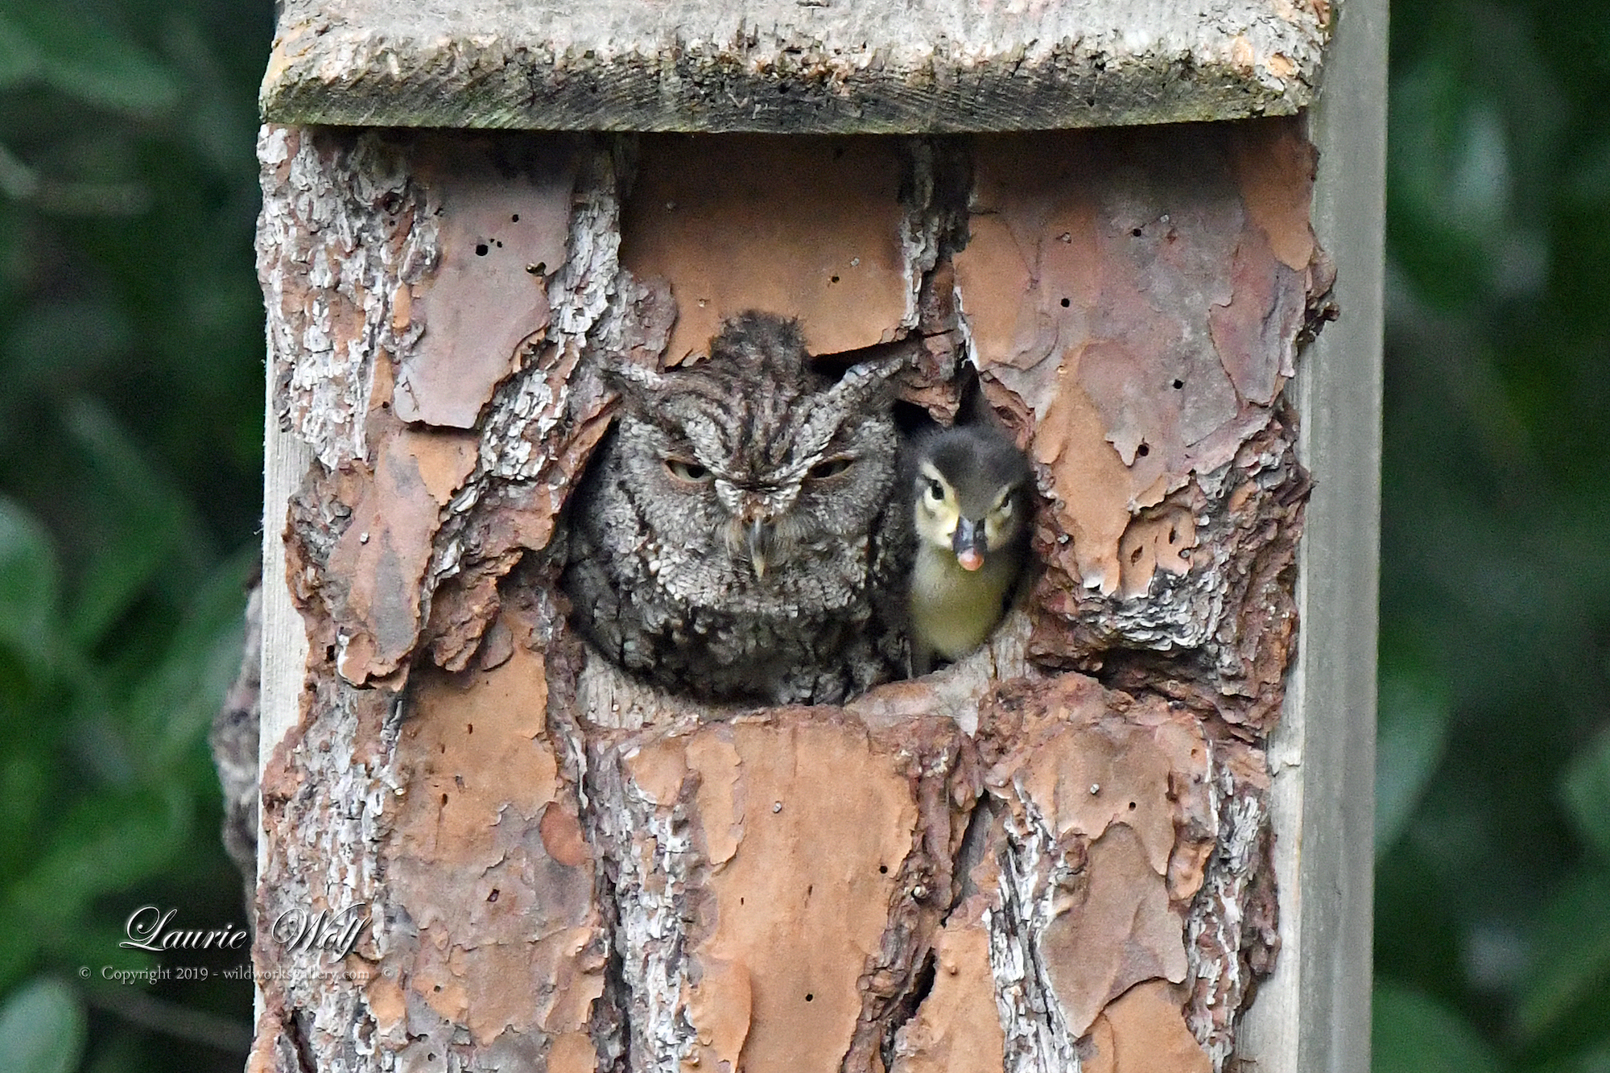
Wood duck nest boxes
Notes:
Wood ducks were historically one of the most abundant waterfowl in North America but due to habitat destruction and unregulated hunting in the late 1800’s they were pushed to the brink of extinction.
Today their numbers have risen again thanks to protection from the Migratory Bird Treaty Act of 1918 as well as the introduction of artificial nesting sites known as wood duck boxes.
These boxes were first introduced in 1937 by the US Fish & Wildlife Service to replicate the holes in trees where wood ducks would normally nest. Fifty percent of the boxes were used during the initial trial and today it is estimated that 100,000 – 150,000 wood ducks are produced from the boxes each year!
DEM builds these boxes and puts them up in suitable wetland habitats around Rhode Island. They are checked each year to see how many boxes were used and how many eggs hatched by looking at the remnants of shells in the nest.
Other animals benefit from wood duck nest boxes too!
Mice, hooded mergansers and screech owls all nest in wood duck boxes!

