Slide 1
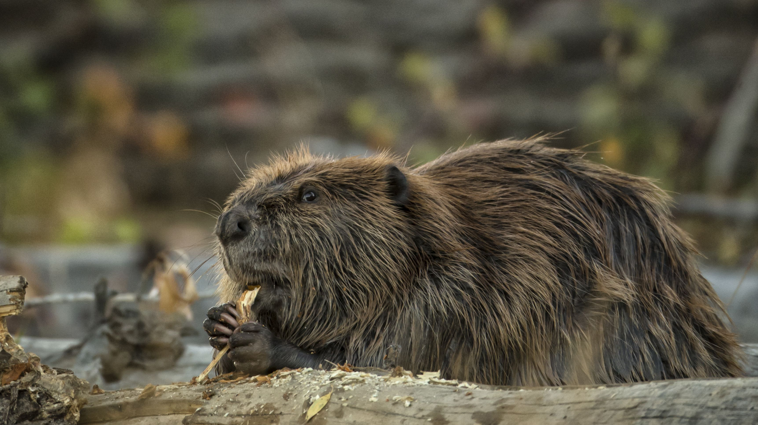
Wetland Wildlife:
The American Beaver
RI DEM Division of Fish and Wildlife
Rhody Critter Kits Program

Slide 2
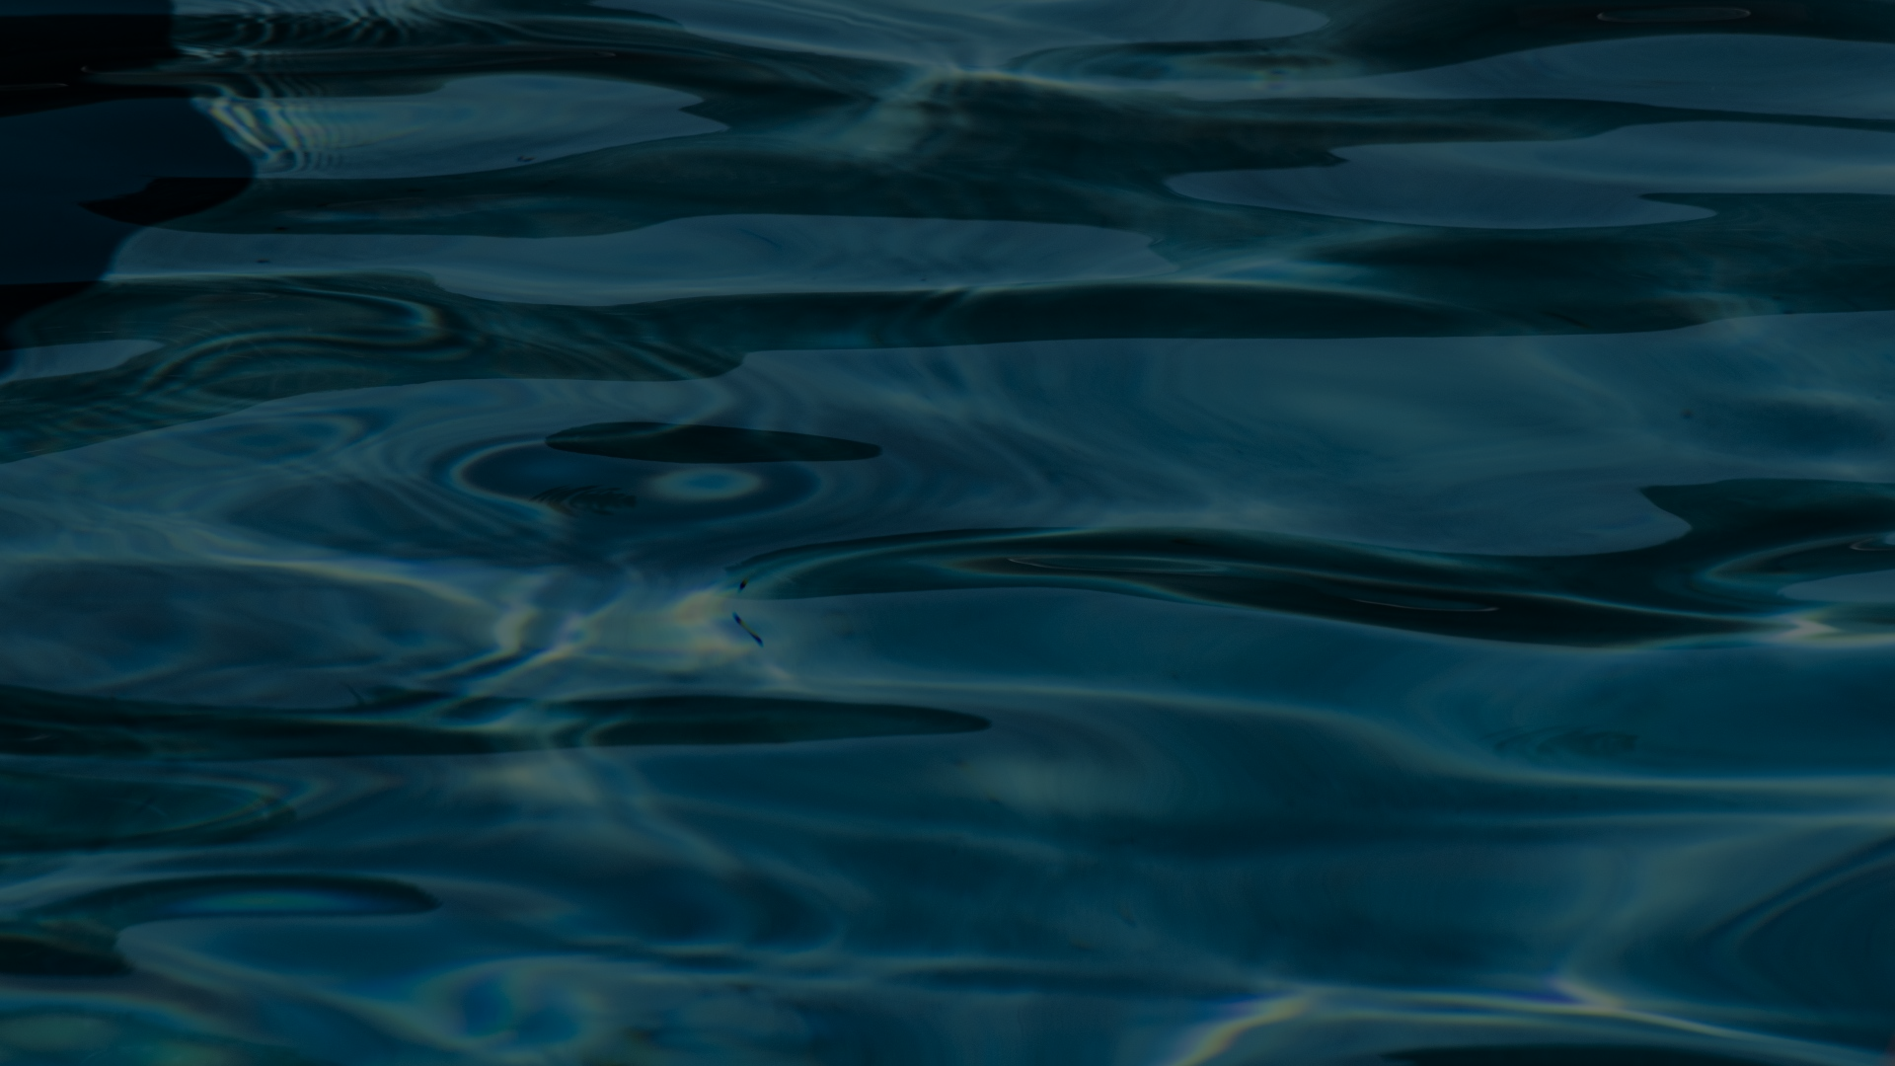
What are freshwater wetlands?
Places where the ground is covered with water
(Permanently or temporarily)
Marked by specialized water-loving plants
One of the four crucial parts of a habitat

Slide 3
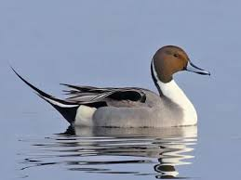
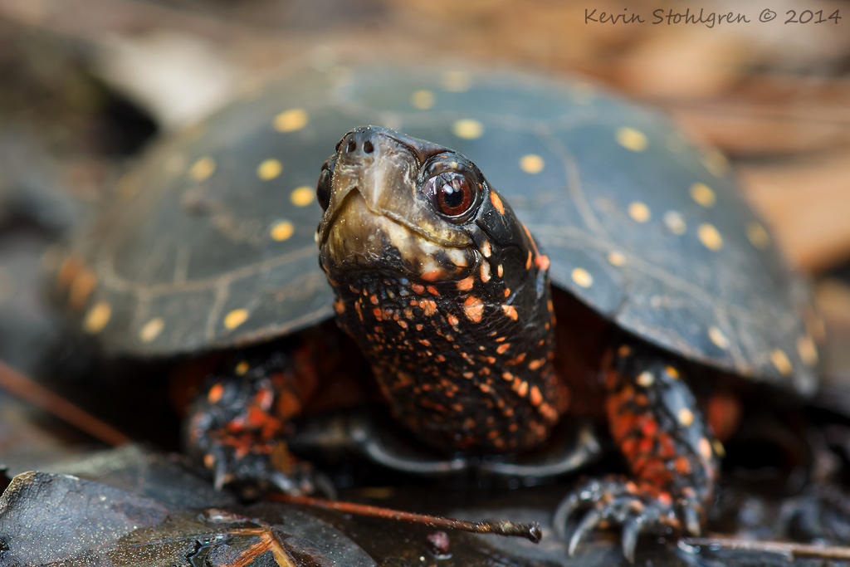
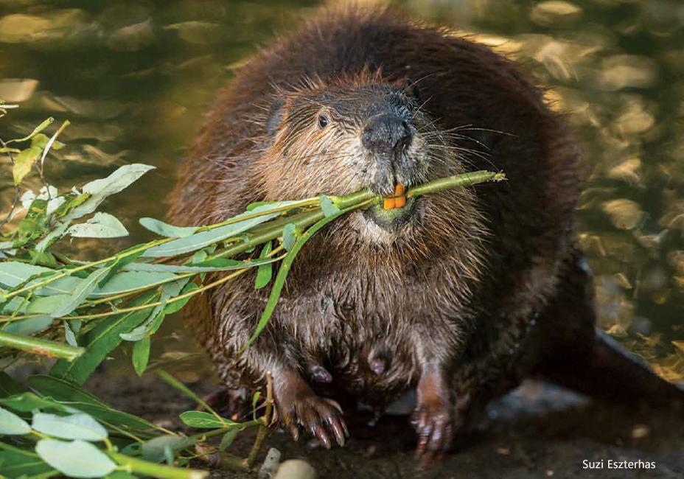
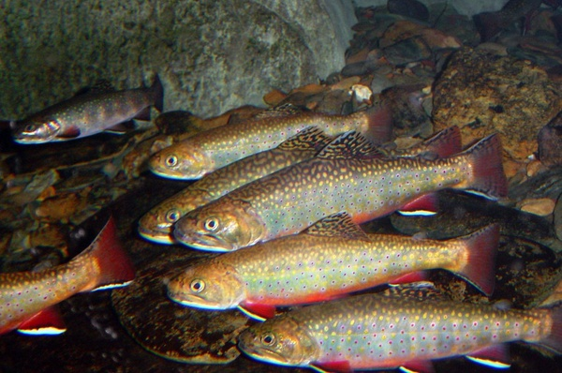
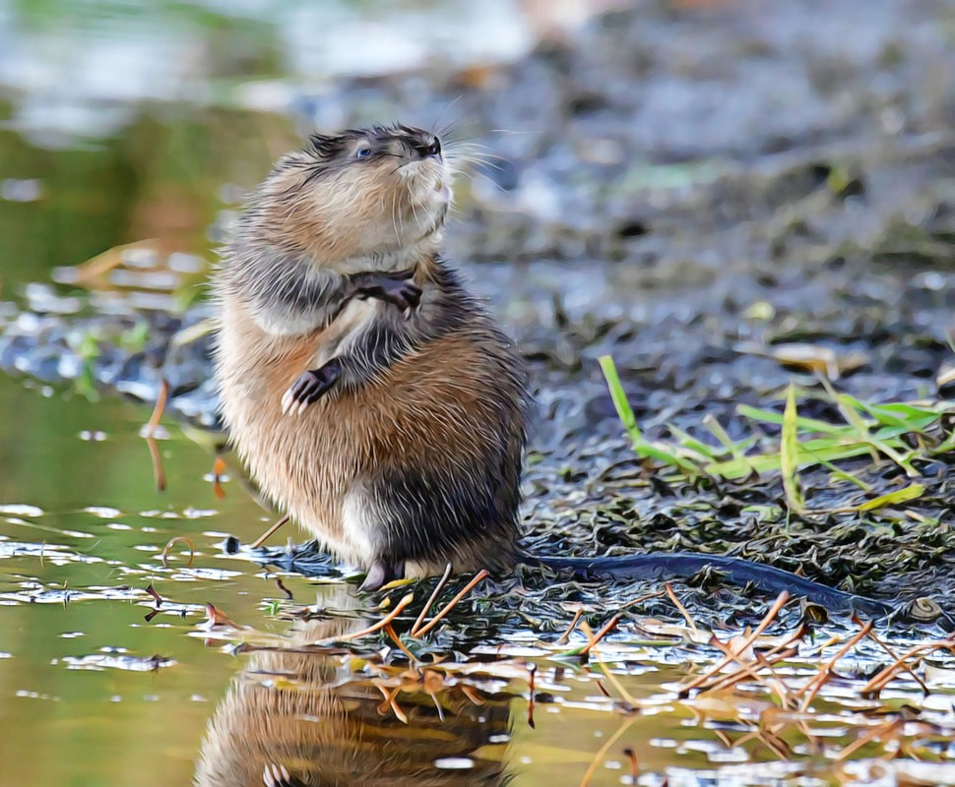
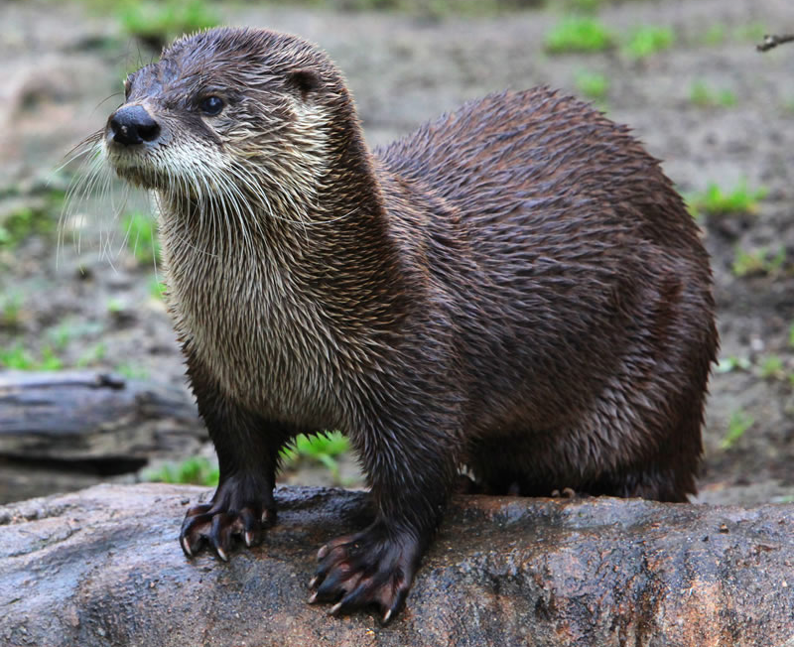
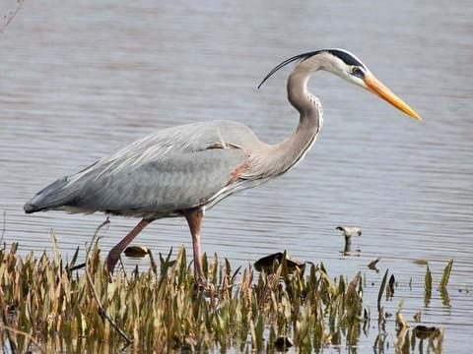
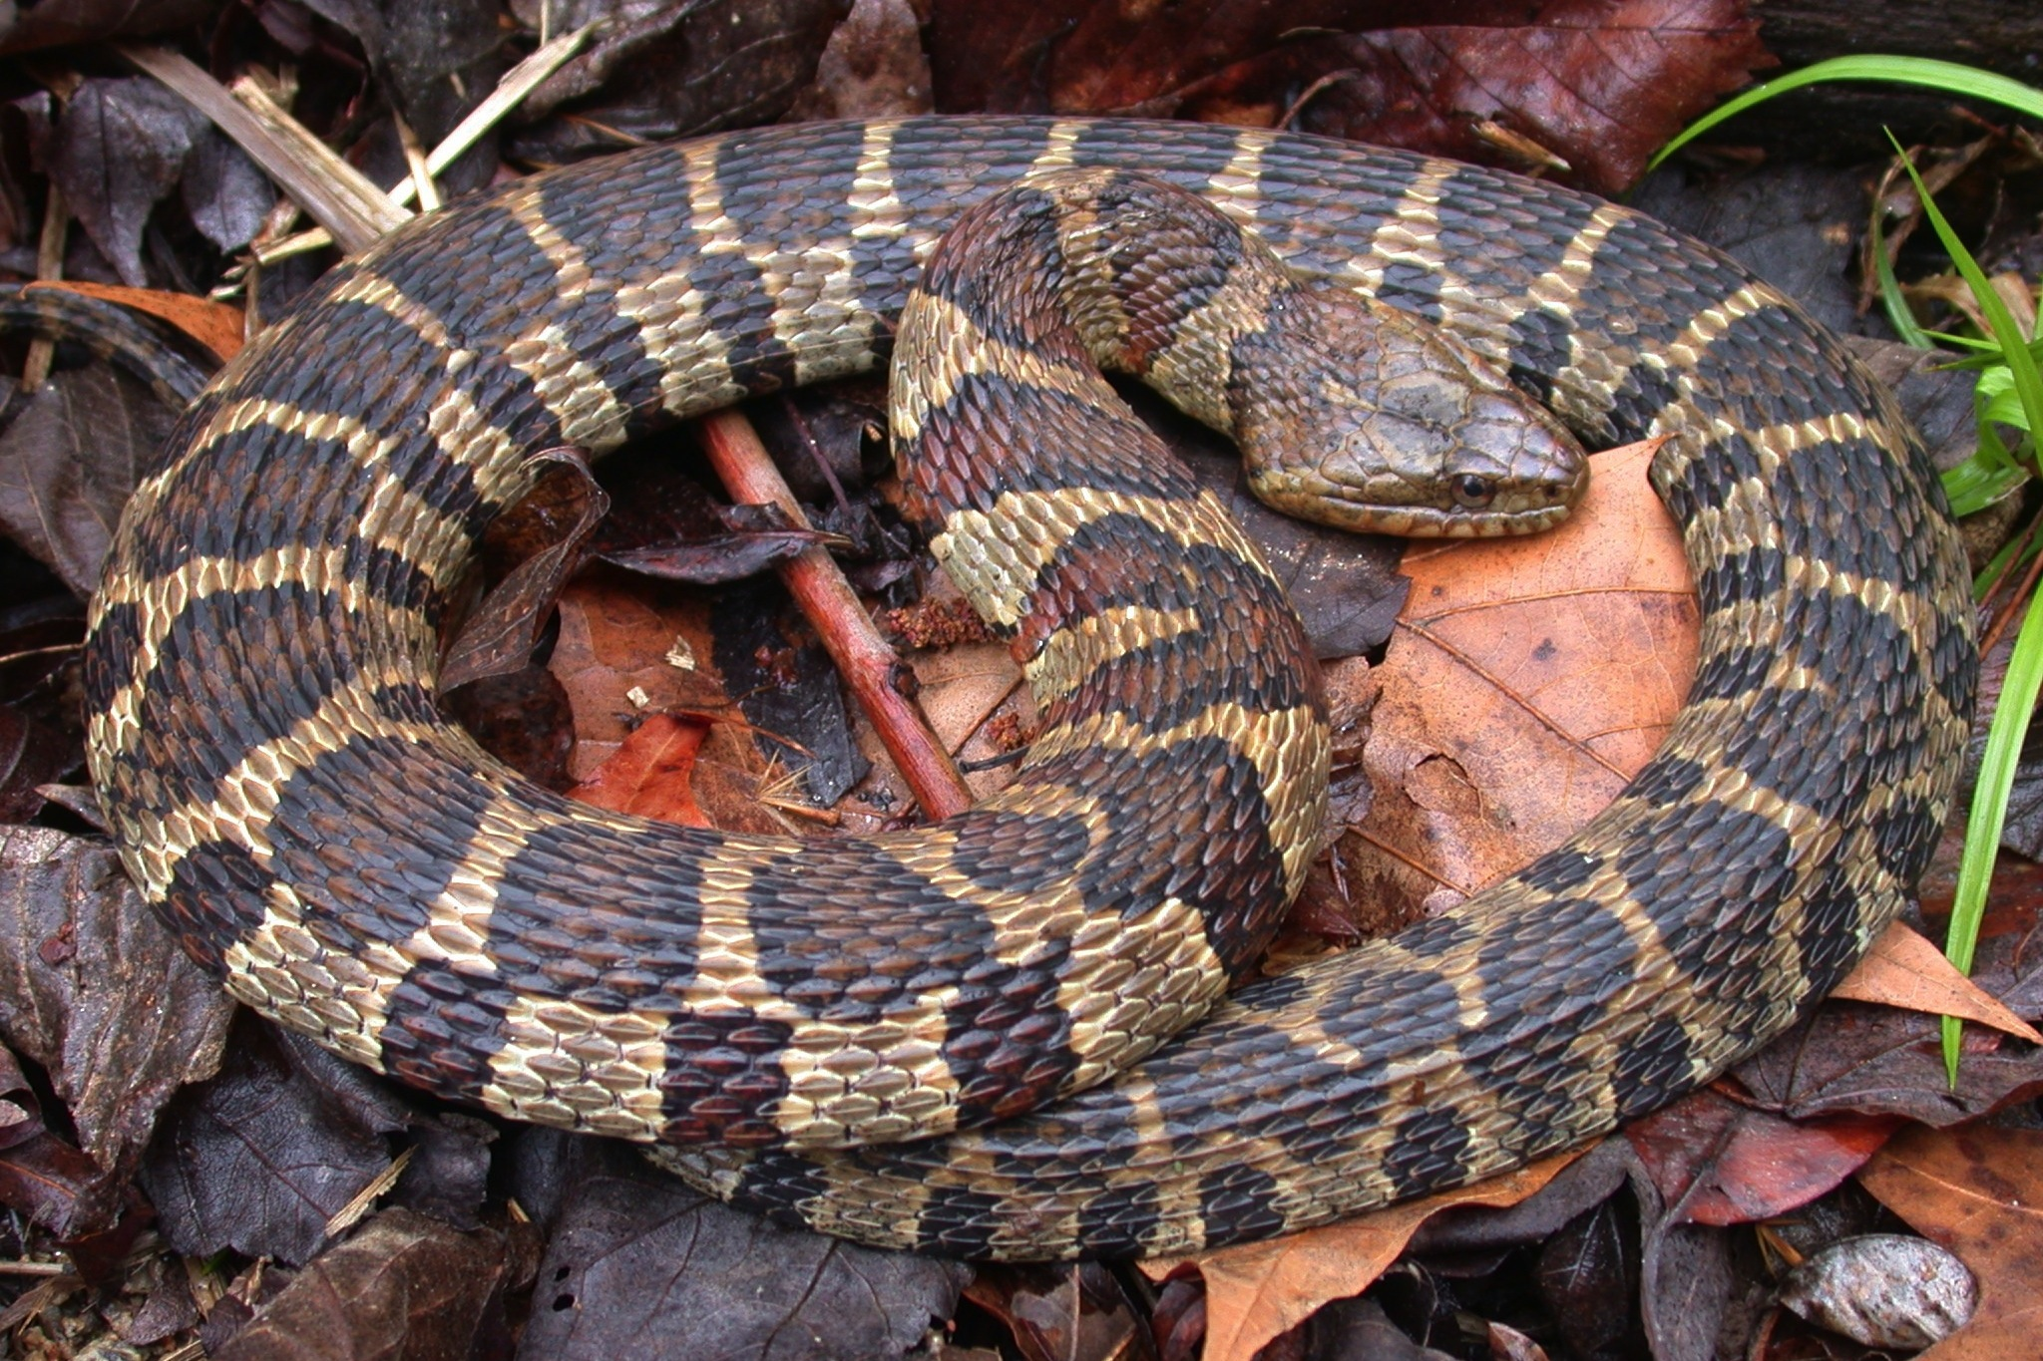
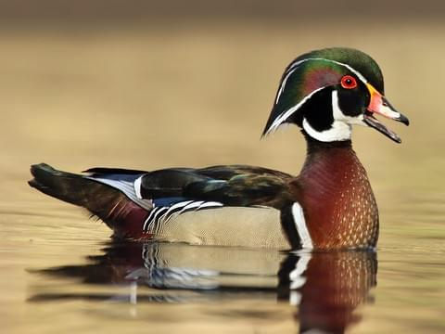
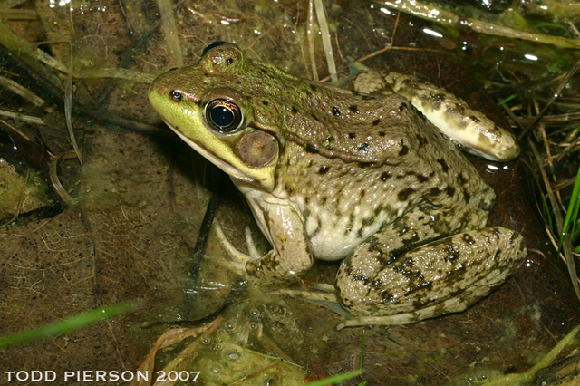
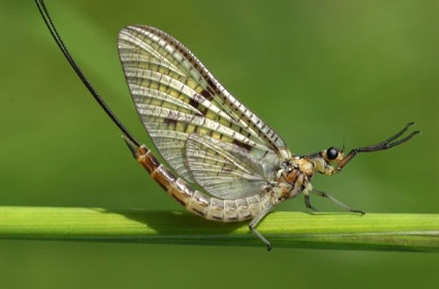
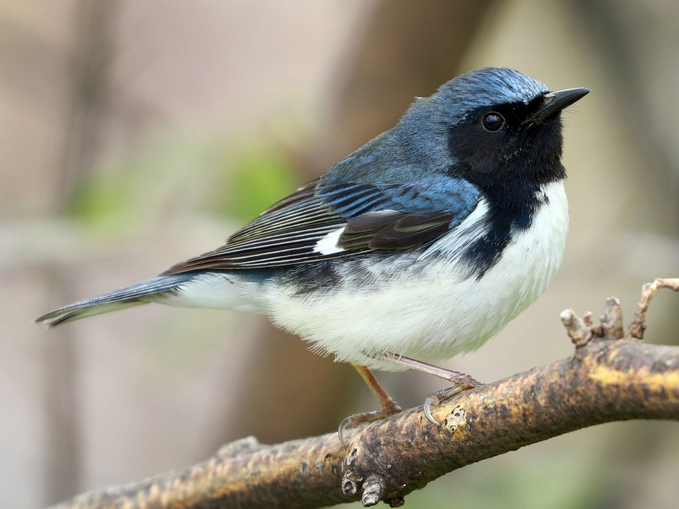
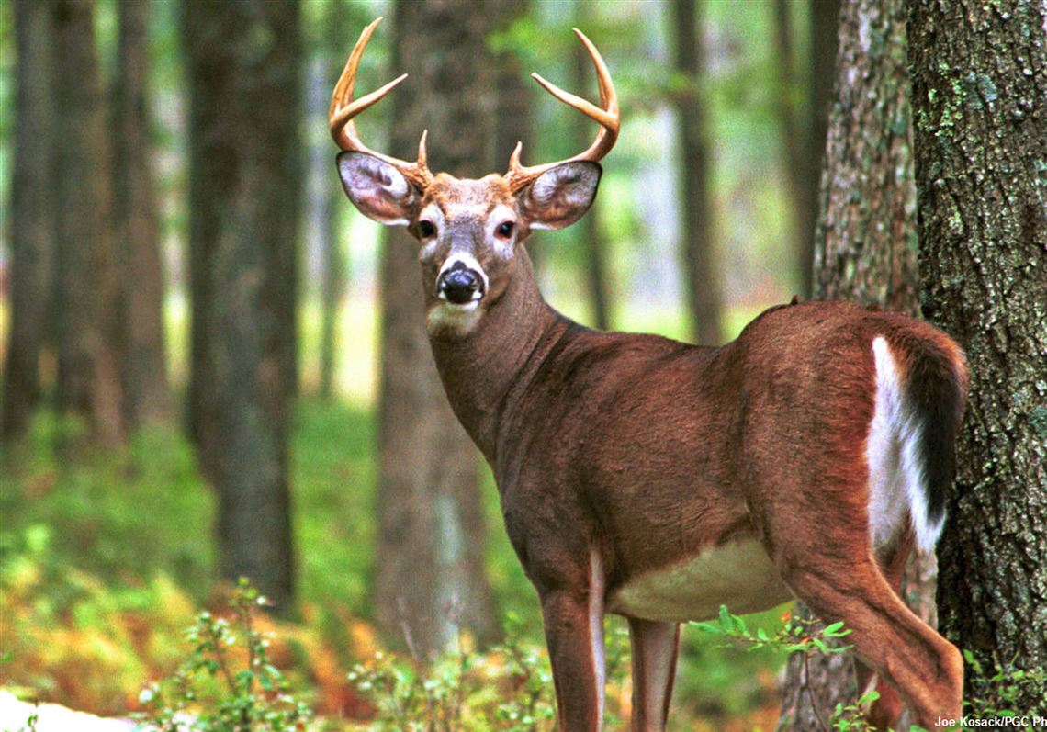
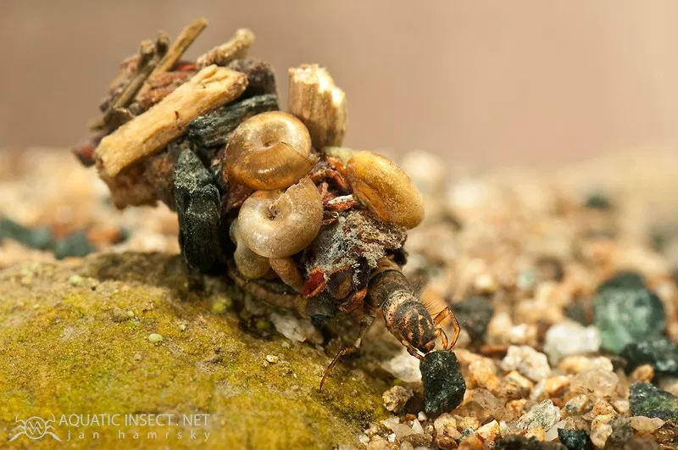
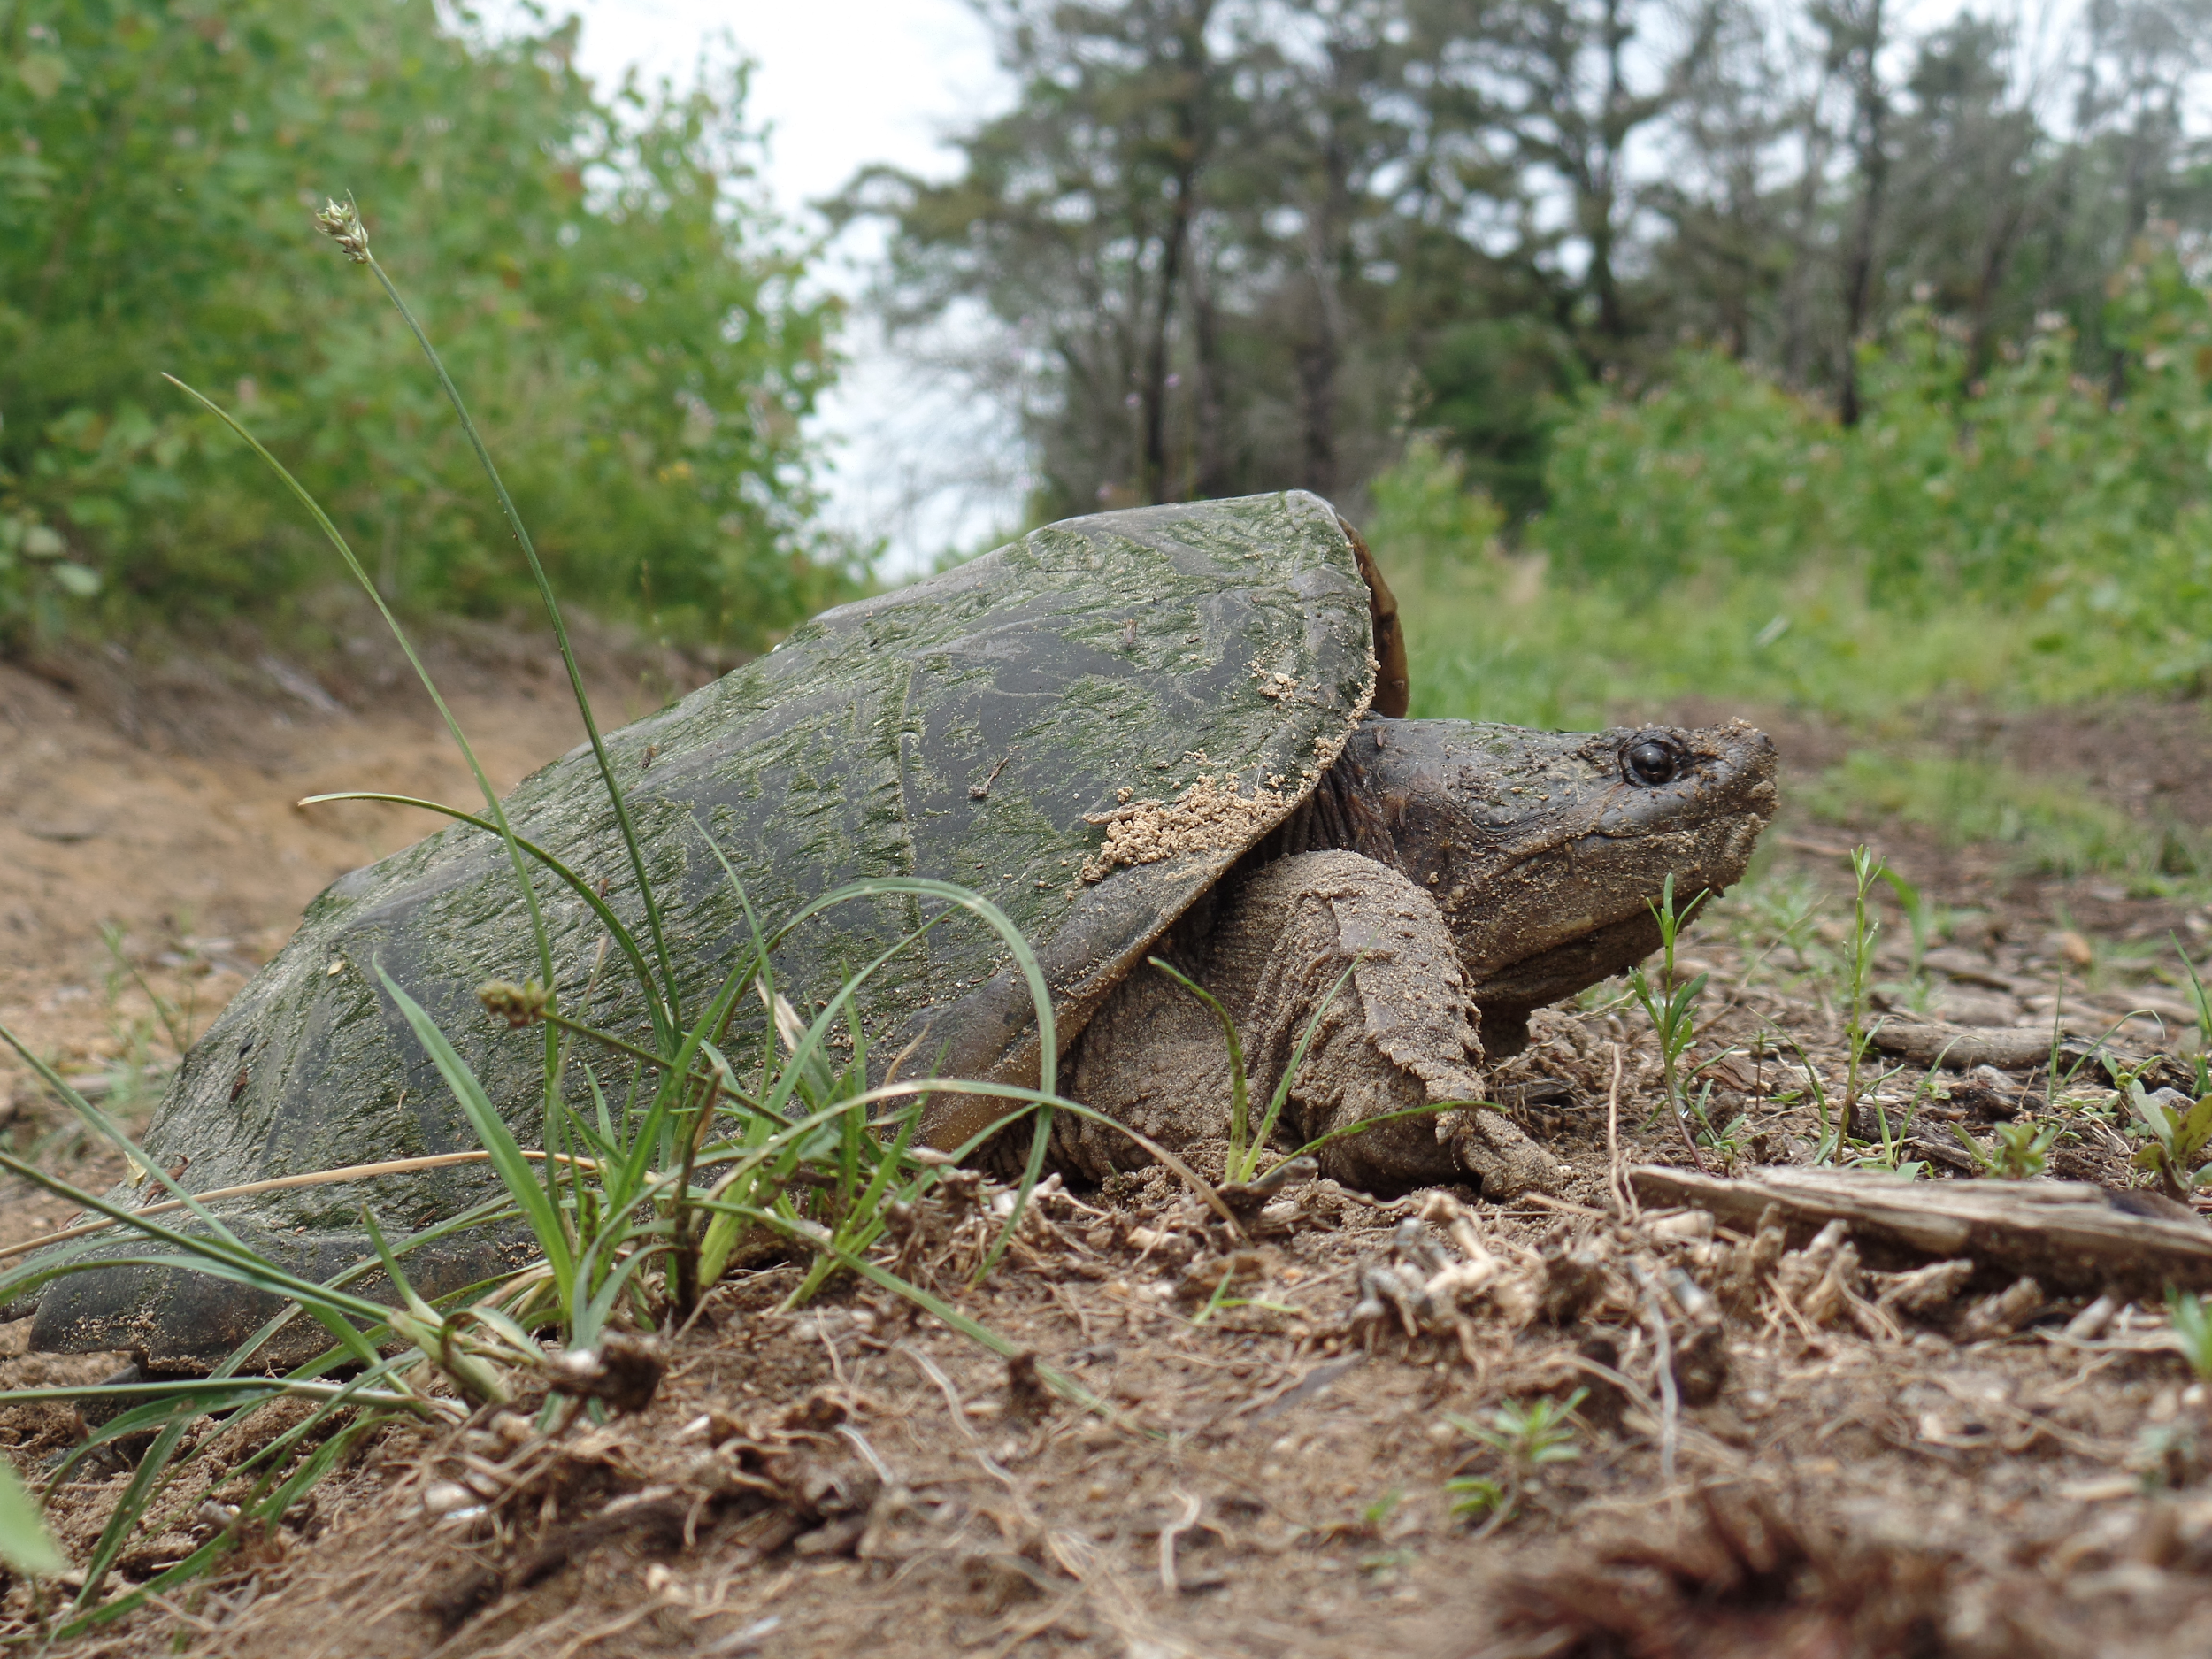
Who uses a wetland?
Notes:
Water is one of the four crucial parts of a habitat so all animals use wetlands.
All of these animals depend on wetlands to survive but today we will be focusing one species that live in wetlands, Beavers (circled on click)
From left to right:
Northern pintail, spotted turtle, beaver, herring, muskrat
Otter, great blue heron, northern watersnake (non-venomous), wood duck, green frog
Mayfly, black-throated blue warbler, white-tailed deer, caddisfly larva, common snapping turtle

Slide 4
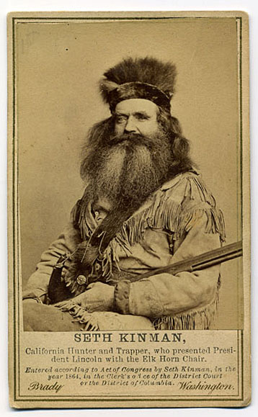
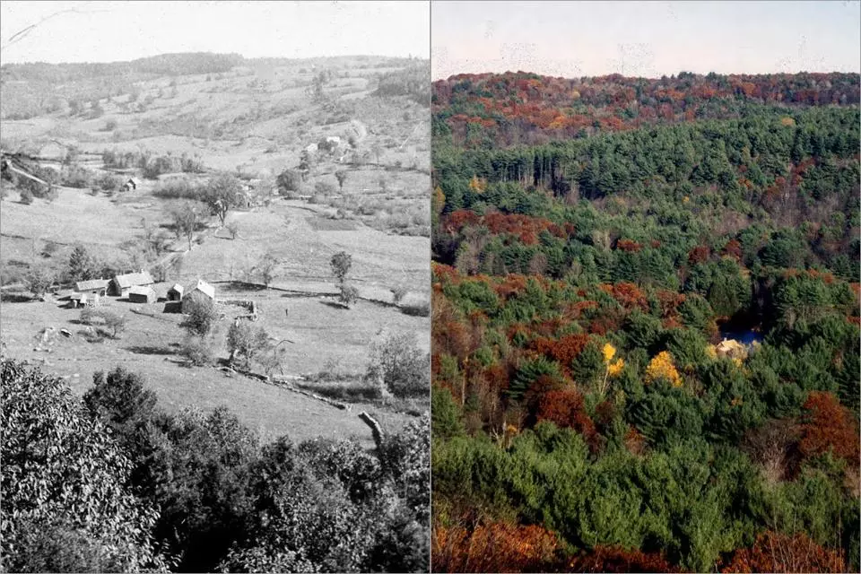
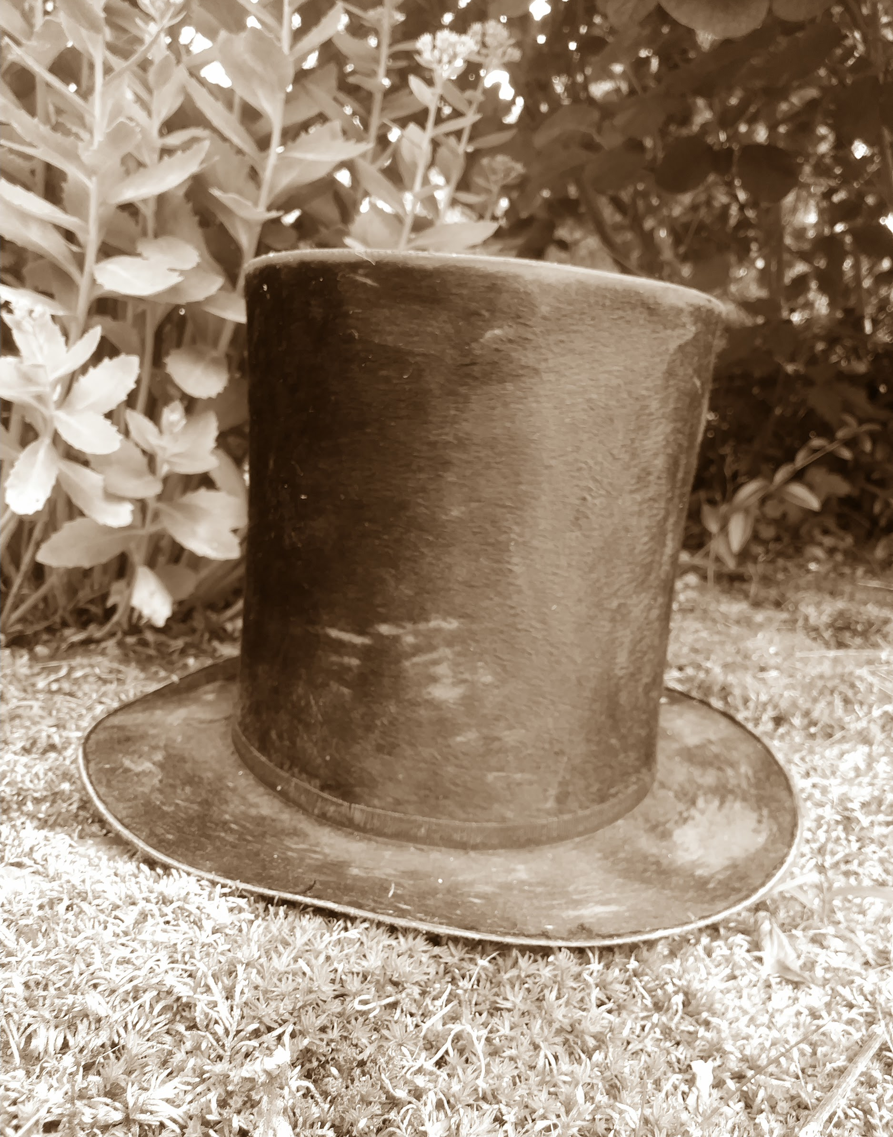
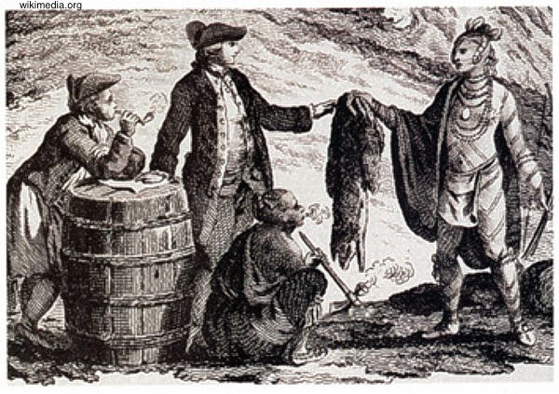
Back in time with beavers...
Notes:
Settlers first arrived and found an abundance of animals
Settlers used the pelts as currency (money)
The cost of a rifle was a pile of beaver skins the same height as the gun
Settlers took more than they needed and sent it back overseas to make things like hats and jackets
Beavers disappeared from RI in early 1800’s and didn’t return until 1976
Due to Over-harvesting and habitat loss... developments and farmlands took over the landscape (2 right images)

Slide 5
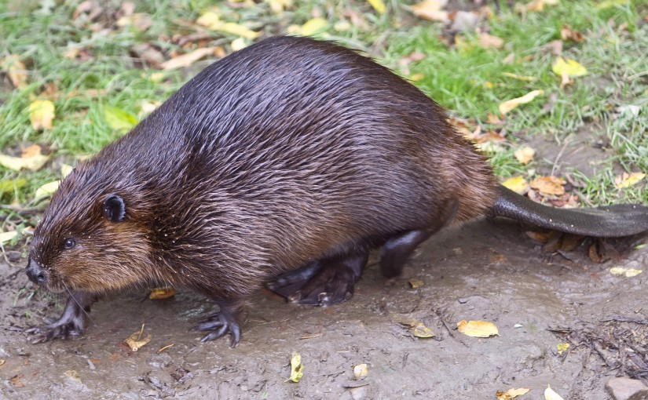
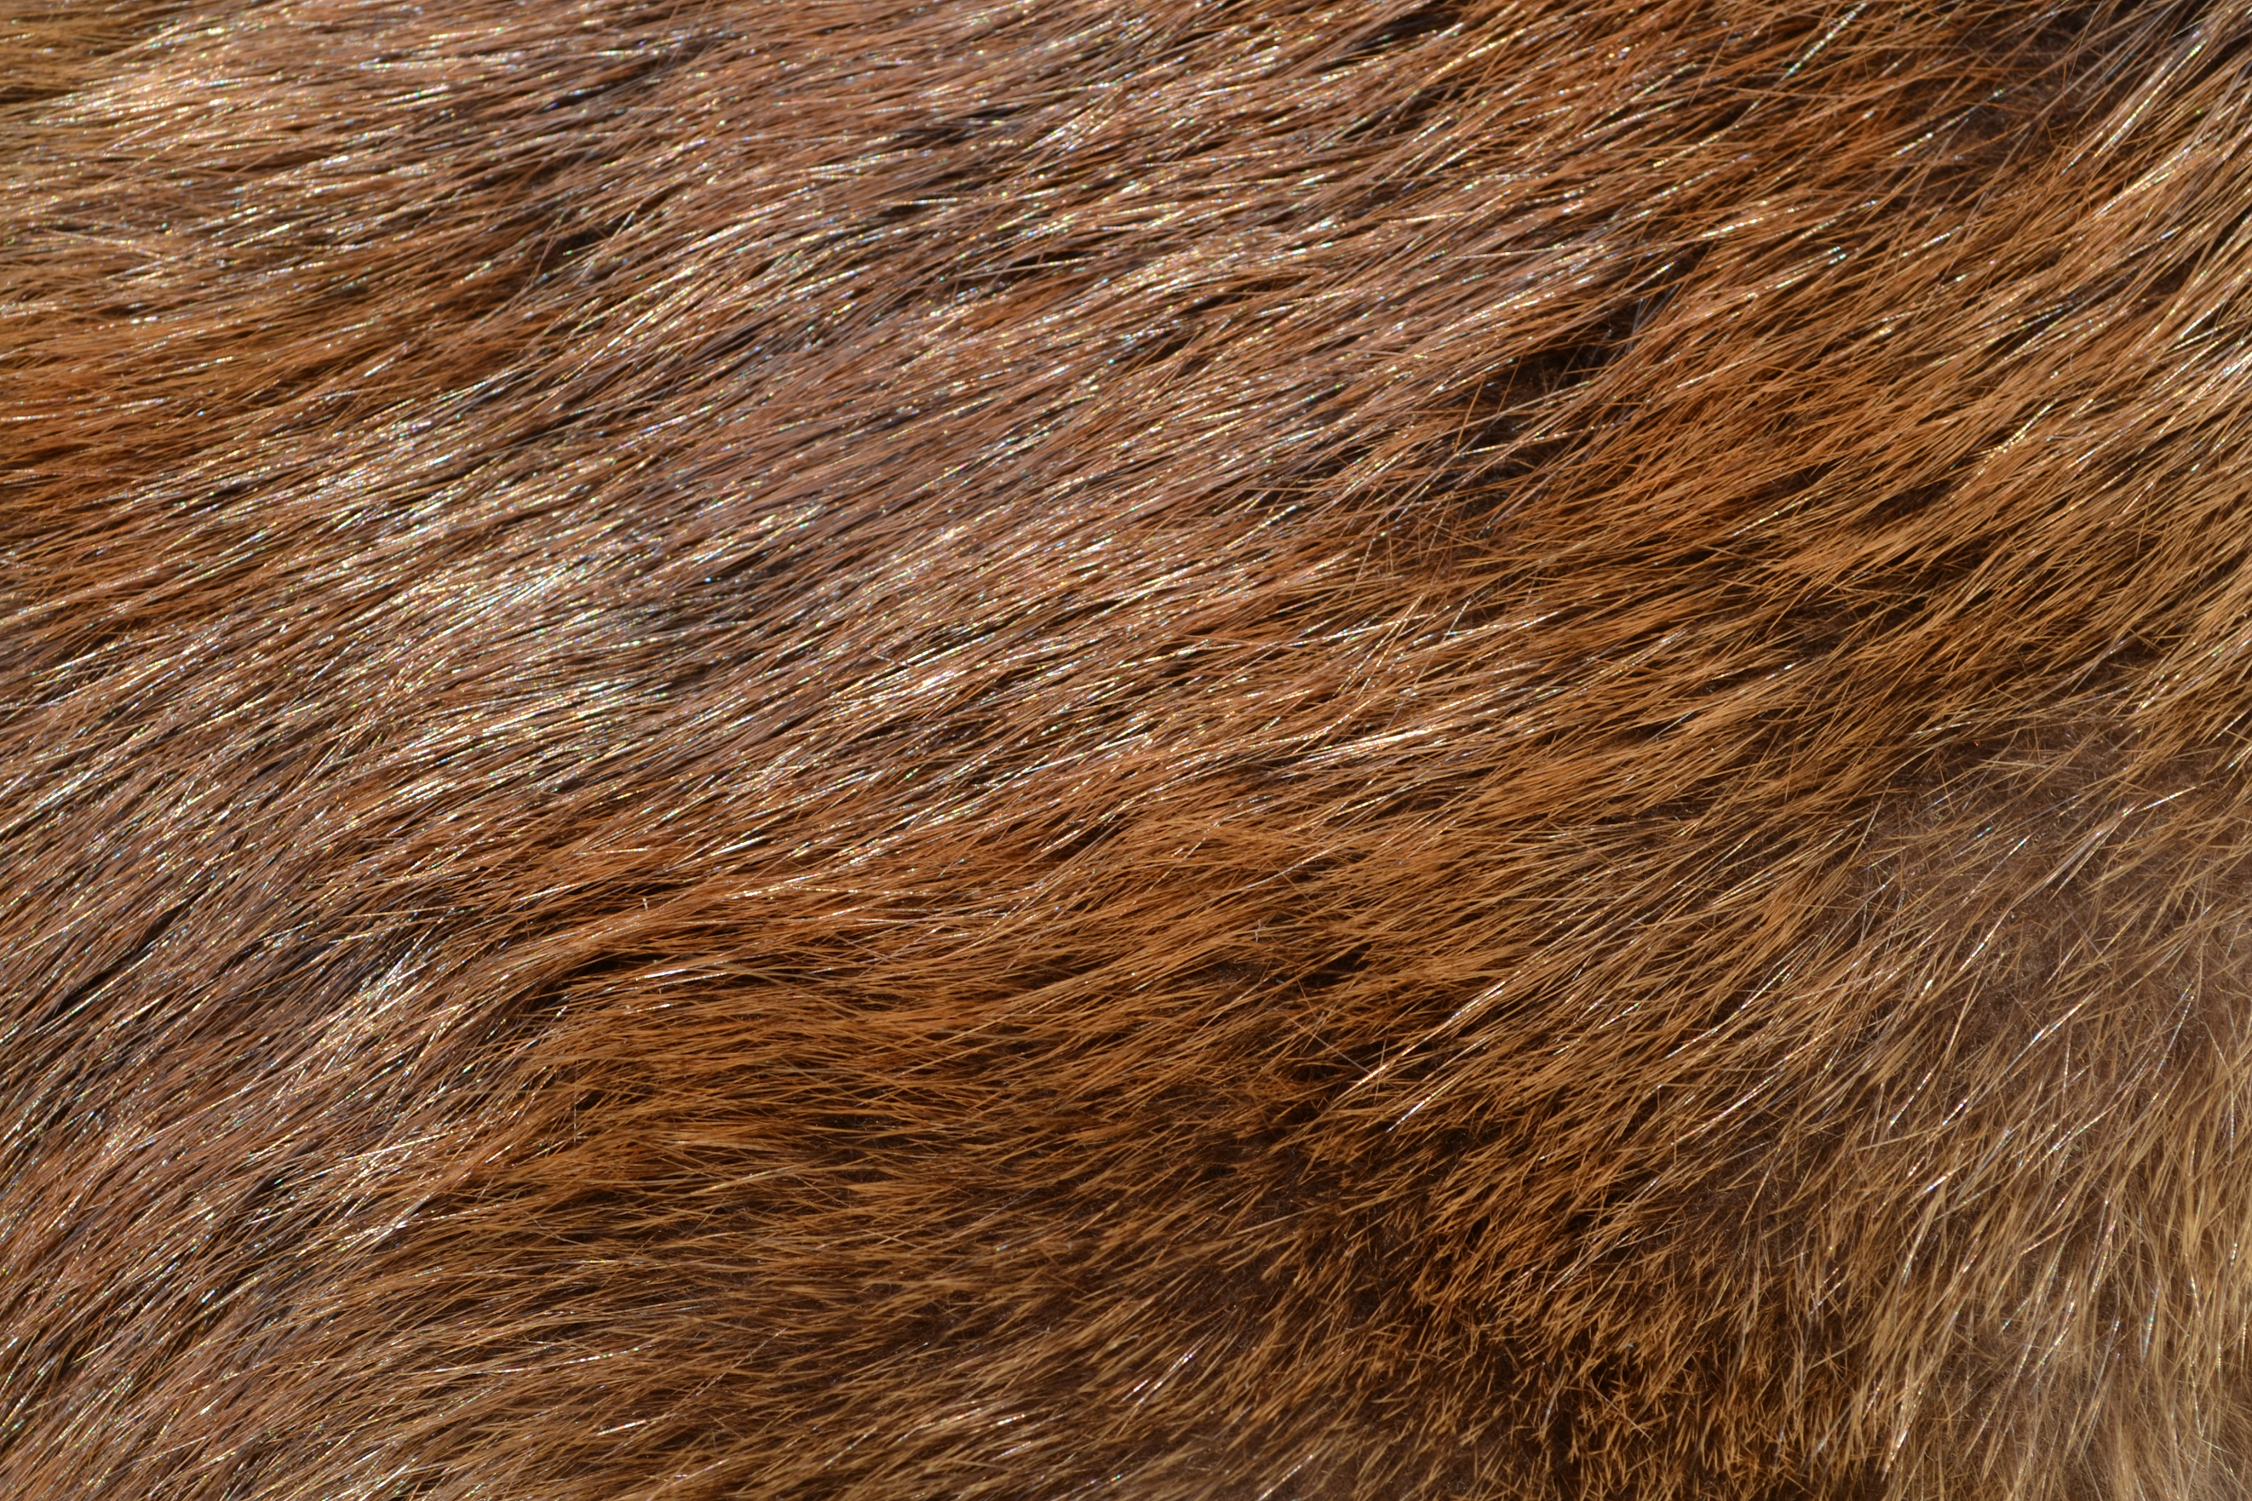
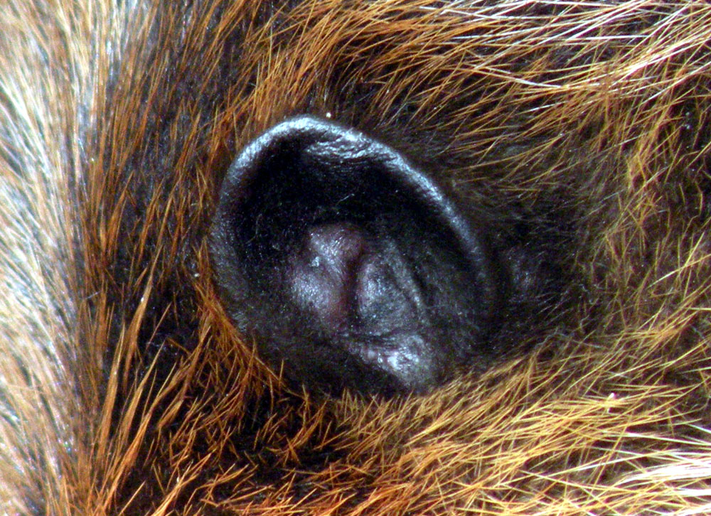
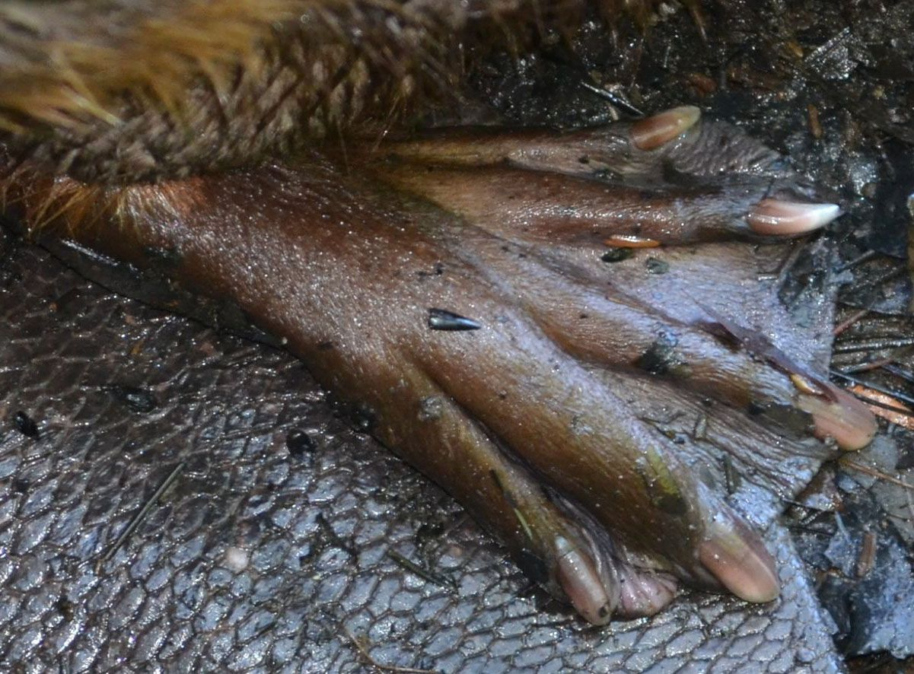
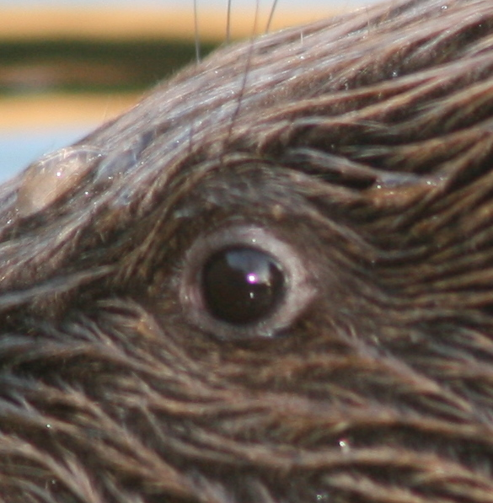
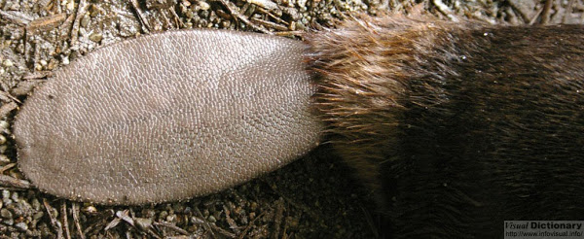
How are beavers built for living in water?
Notes:
Physical adaptations of beavers
Fur - thick, warm, waterproof
Eyes - eyelid that acts like goggles
Nose - nostrils can close while underwater
Ears - shut out water
Feet - webbed back feet for swimming
Tail - acts like a propeller and used for pressing down mud while building, fat storage

Slide 6
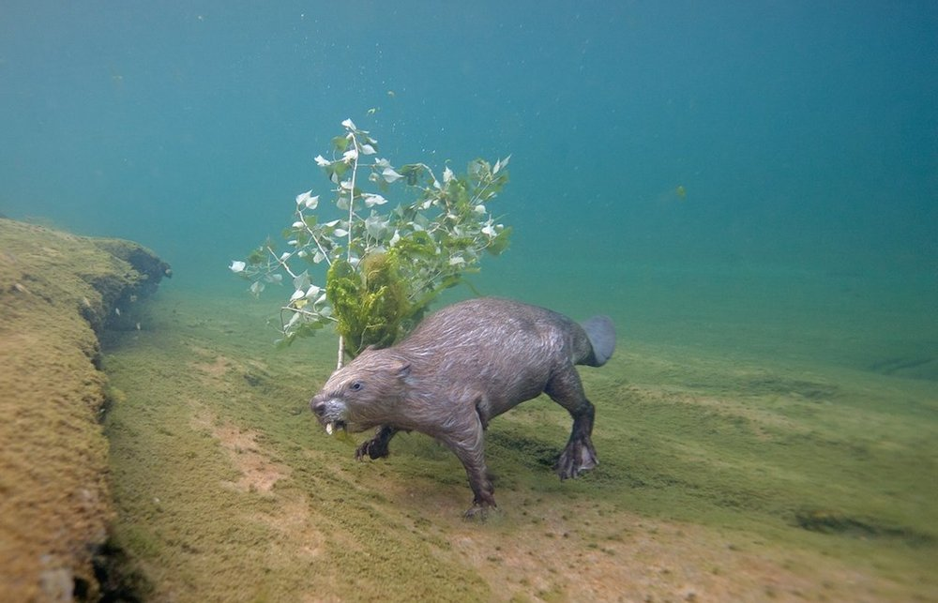
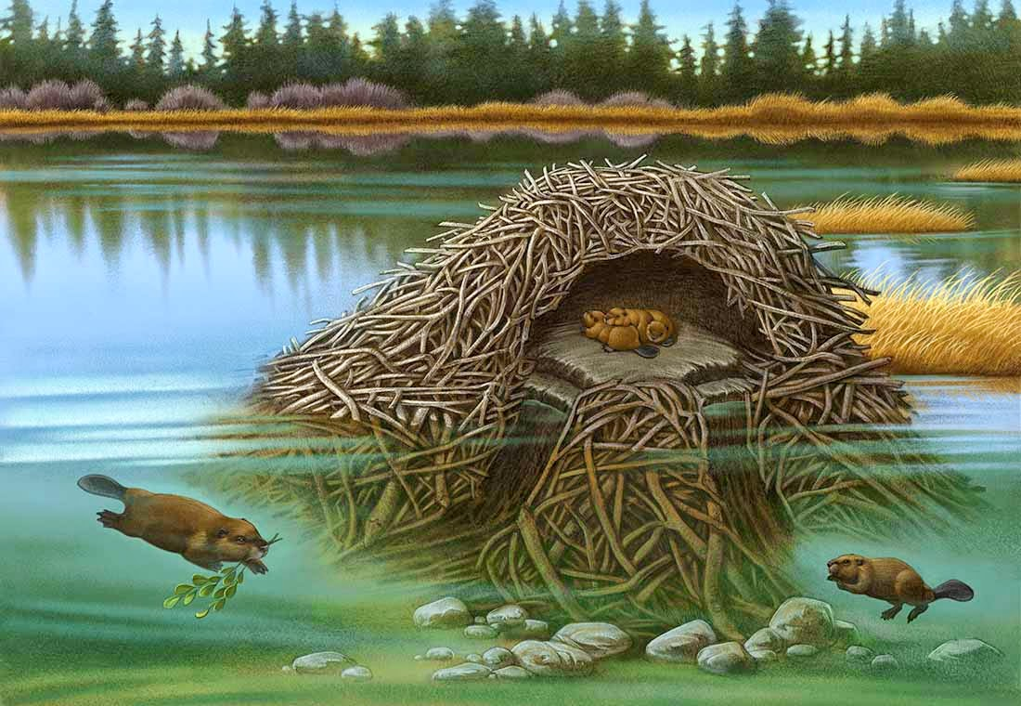
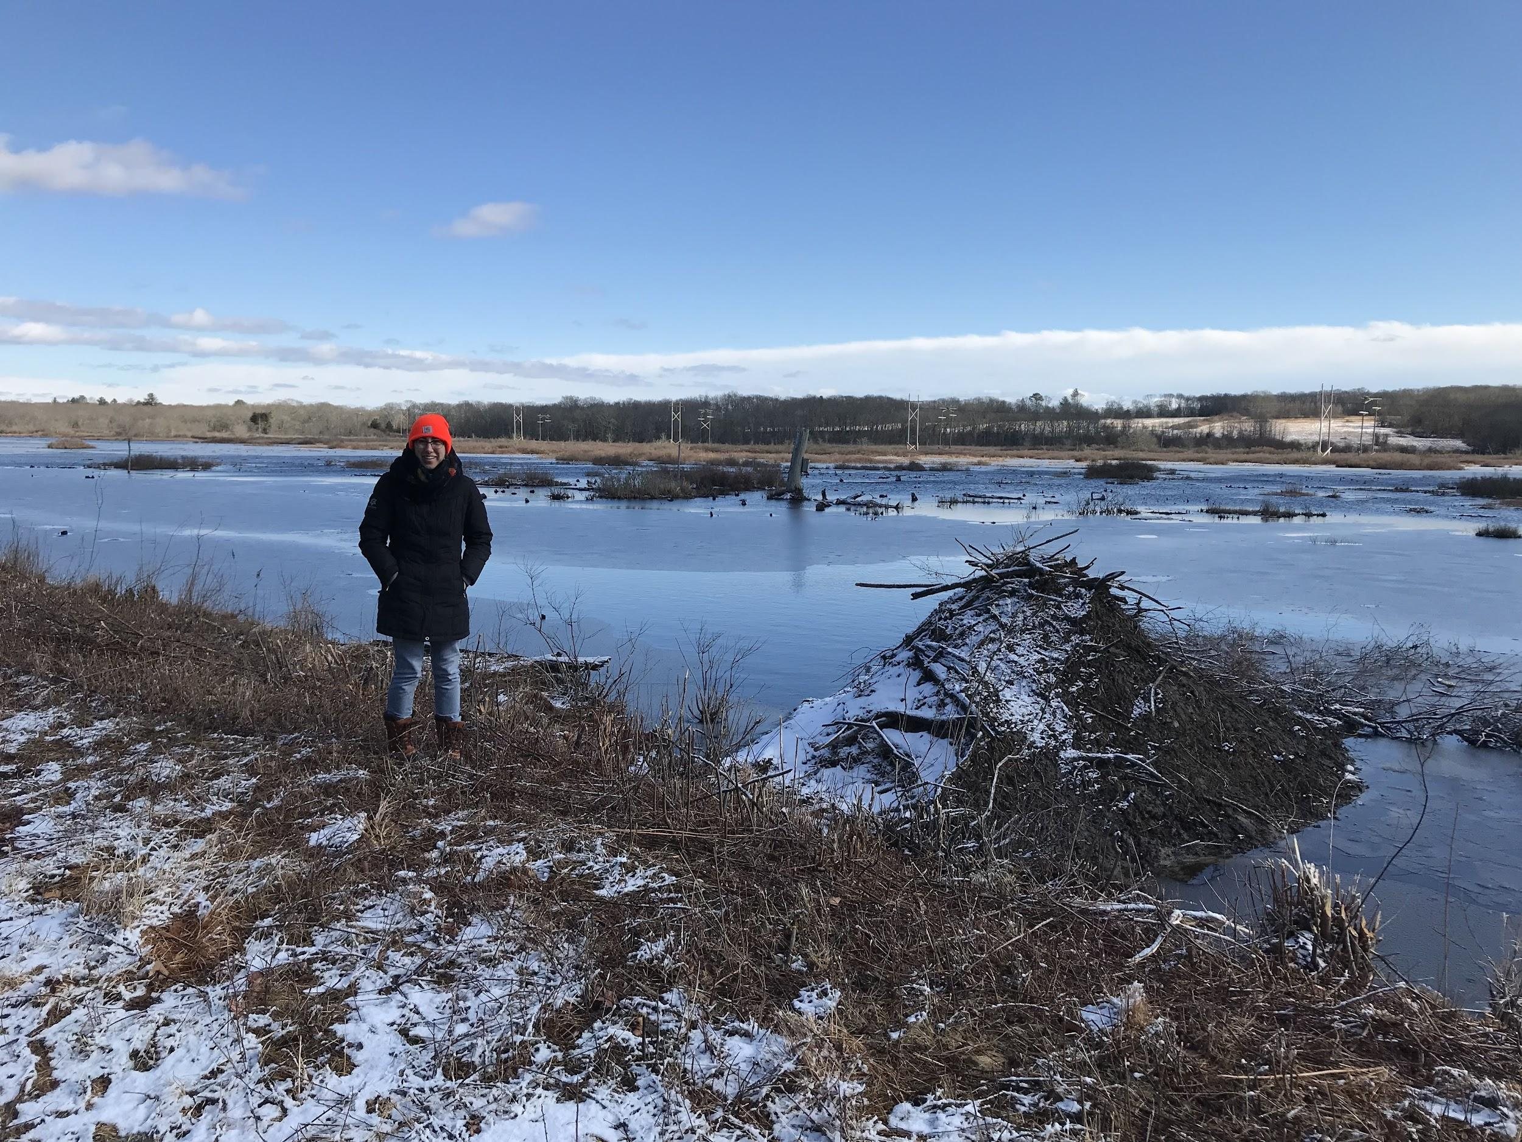
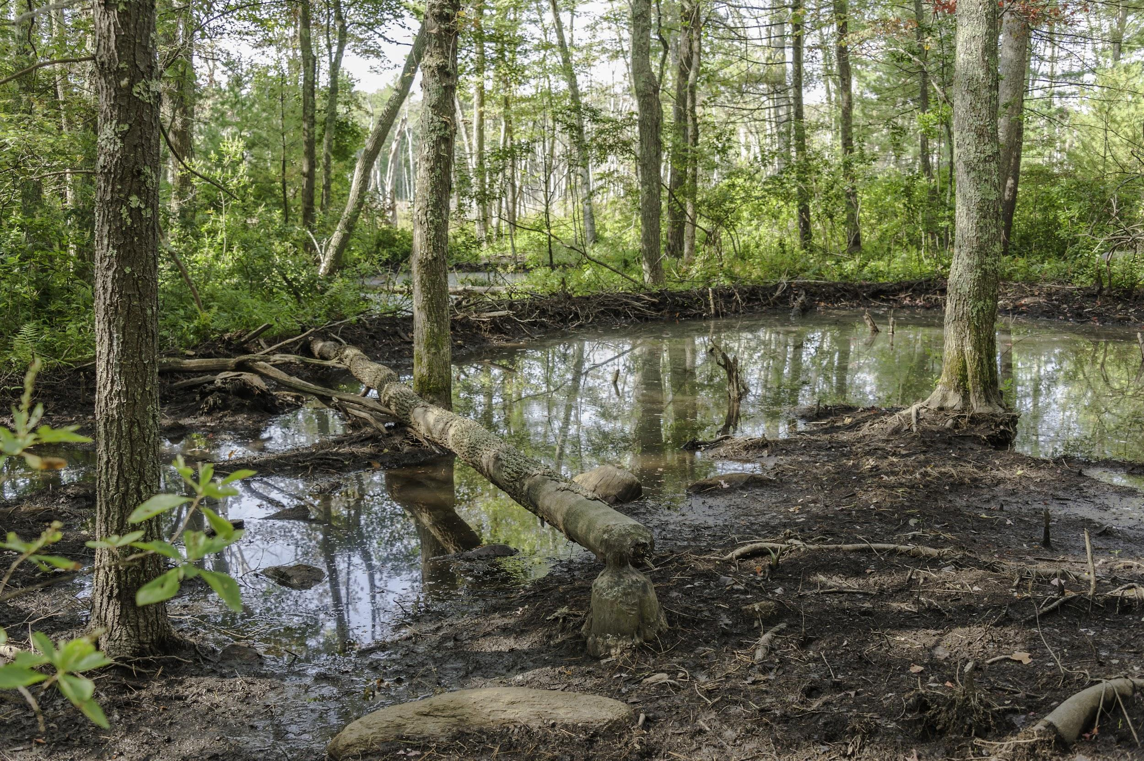
Busy Beavers
Beavers store food around the lodge in a food cache for the winter.
Beaver families work together to build dams.
Beaver families build a lodge out of logs, sticks and mud.
Notes:
Behavioral adaptations

Slide 7
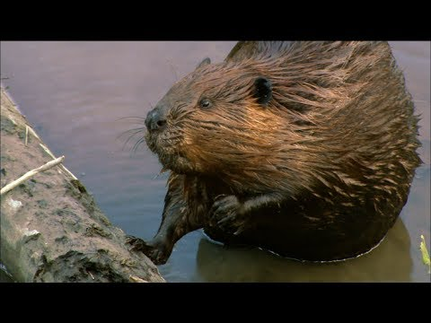
Notes:
Beaver dam building video!
Why are beavers important?
Dams act as filters keeping wetlands clean
Soil built up on dams stores nutrients
They help prevent floods and draughts

Slide 8
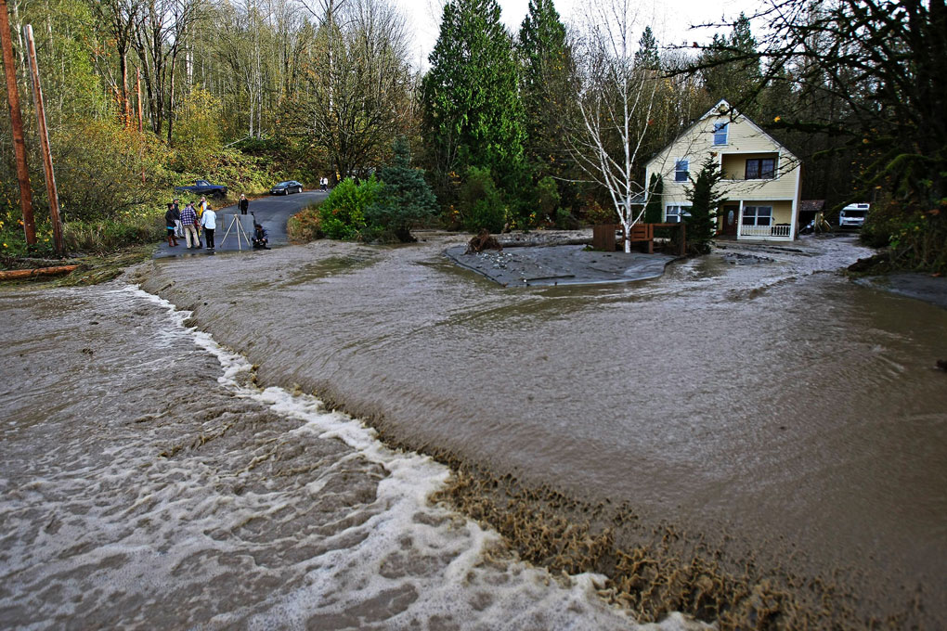
Humans and Beavers
Notes:
Trapping is allowed for beavers because they can sometimes cause damage and people use their pelts.
Trapping is permitted from December - February on state land and November - March on private land.
Trappers can only take 20 beavers in a season.
Trappers are careful not to deplete their supply of beavers in an area, they want to be able to trap in the future so they leave enough beavers around so that their population can persist.

Slide 9
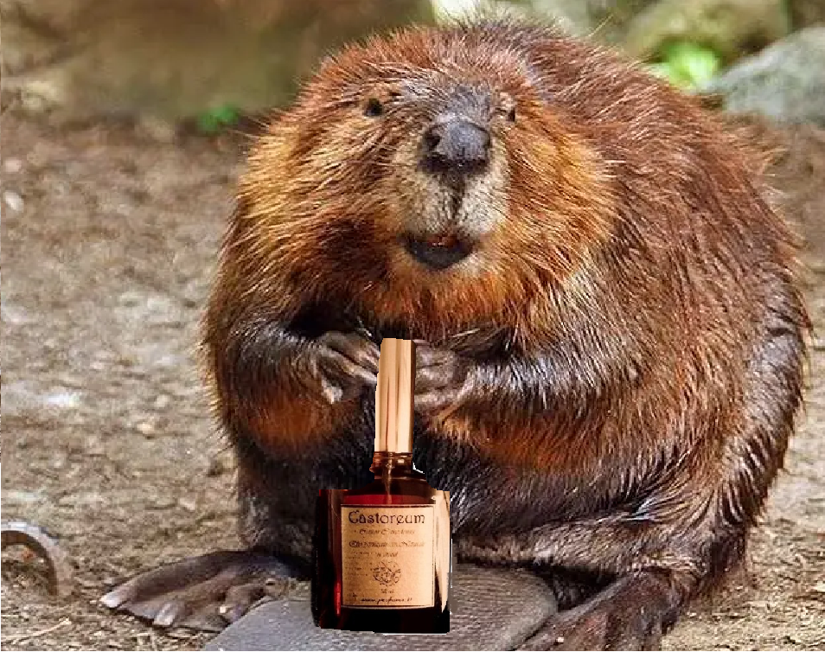
How does the DEM manage beavers?
Notes:
While beavers are excellent at creating wetlands just the way they like them, sometimes they change a habitat so much that it is no longer helpful for certain kinds of wildlife… or humans.
When beavers dam up the flow of water to an area too much, it makes the water too deep for dabbling ducks and doesn’t allow aquatic vegetation, which is their food source, to grow very well.
When beaver dams break they can flood roads and homes.
The DEM puts water control structures in wetlands to allow biologists to raise and lower the level of the water as needed.
The DEM also manages the beaver population by regulating trapping. Permitted trappers are allowed to harvest beavers in certain areas, they use the meat for food, their pelts are used for clothing and they even use their scent glands, called castor sacs, to make perfume and flavor foods!
Trappers must be licensed and can only take a limited number of beavers during a specific trapping season.
20 beavers/seasons. Season runs from Nov. 1 to March 14 on private land and Dec 1 to Feb 29 on state land.
This helps keep the balance and ensure beavers don’t disrupt other animal’s habitats or damage property. Just like humans, when beavers alter habitat to suit their own needs, we must make sure it doesn’t harm other wildlife in the process.
Photos:
Beaver with perfume made using castoreum, from the castor sacs.
Home and road flooded from breached beaver dam.
Beaver fur vest

Slide 10
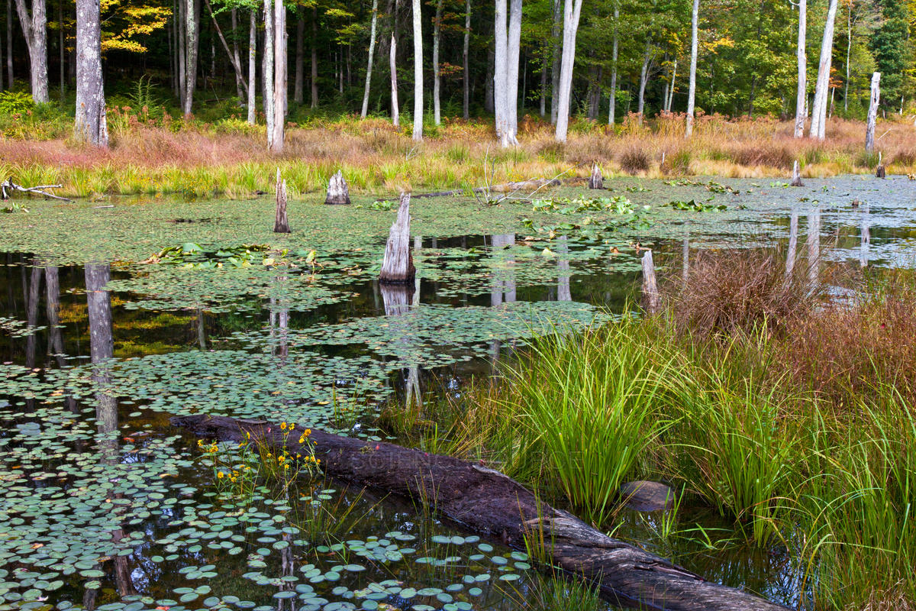
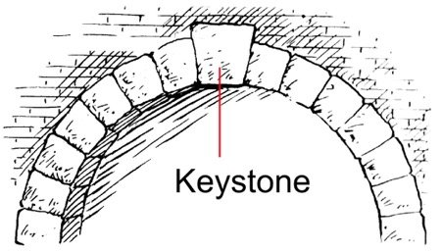
What is a keystone species?
Beavers are a KEYSTONE species
Notes:
Beavers are keystone species:
The habitat that they create also supports many other animals (on click).
A keystone is the piece that holds everything together and if removed could me everything fall apart.
Many other animals, including wood ducks, depend on the wetlands that beavers create, and if they were to go extinct, many other animals would be affected by the loss.
Beavers are the only animal, aside from humans, that change their habitat to fit their needs. They are important to have in the ecosystem but it is also important to keep their populations in check in order to maintain balance.

