Slide 1
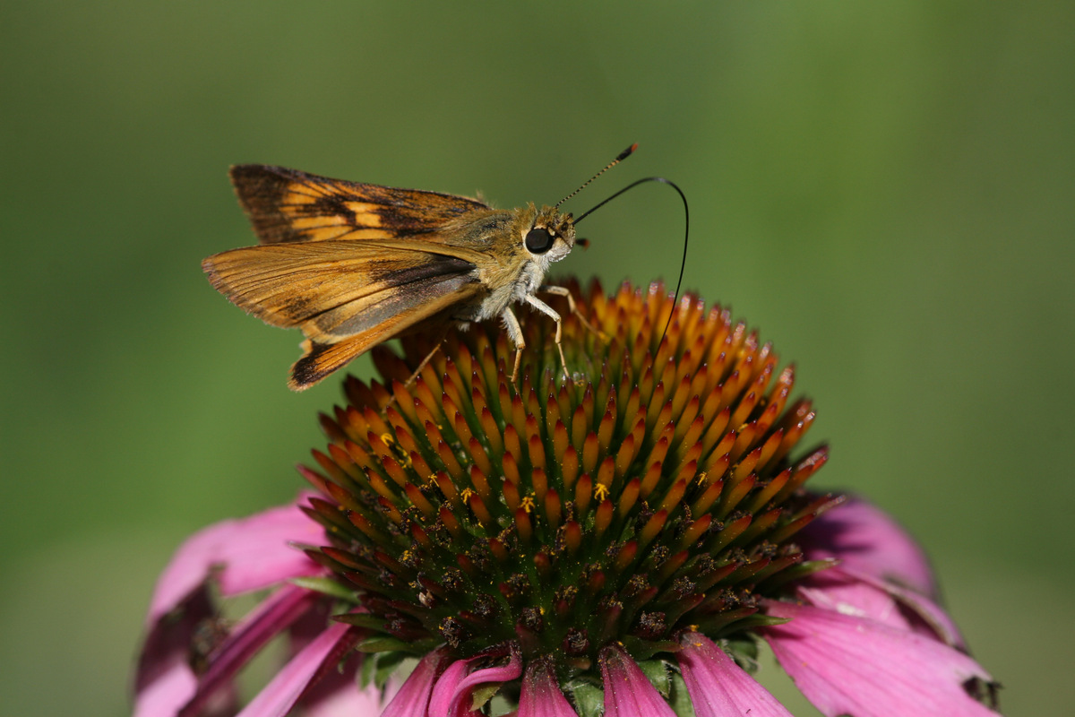
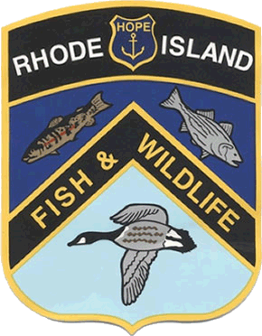
The Power of Pollination
RIDEM Division of Fish and Wildlife
Rhody Critter Kits Program
Notes:
Photo: USFWS

Slide 2
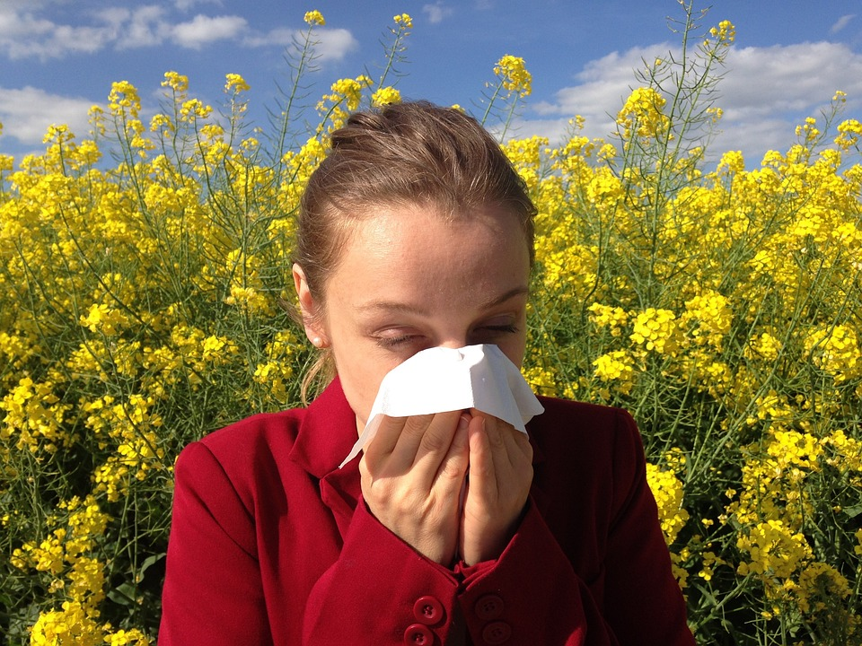
What is pollen?
It makes me sneeze!
Notes:
Ask students if anyone gets especially sneezy in the spring or fall? This is due to pollen, a yellow powder that helps a plant make new seeds (which grow into new plants) and sometimes gets into our noses and causes allergies.

Slide 3
Pollen helps plants make new seeds!

Slide 4
How does pollen travel?
?
Notes:
Ask students how the pollen moves from one flower to another. Explain there there are some plants that use wind and water, but most plants need an animal to help spread the pollen, also known as a pollinator!
Ask students to names some pollinators: bees, butterflies, moths, bats, birds, beetles, ants and even mice

Slide 5
It’s carried by pollinators!
Notes:
Around the world, butterflies, moths, bees, wasps, beetles, flies, bats, and birds all help pollinate! In Rhode Island, we don’t have any pollinating bats (our bat species only eat insects), but we can see all of these other types of pollinators!

Slide 6
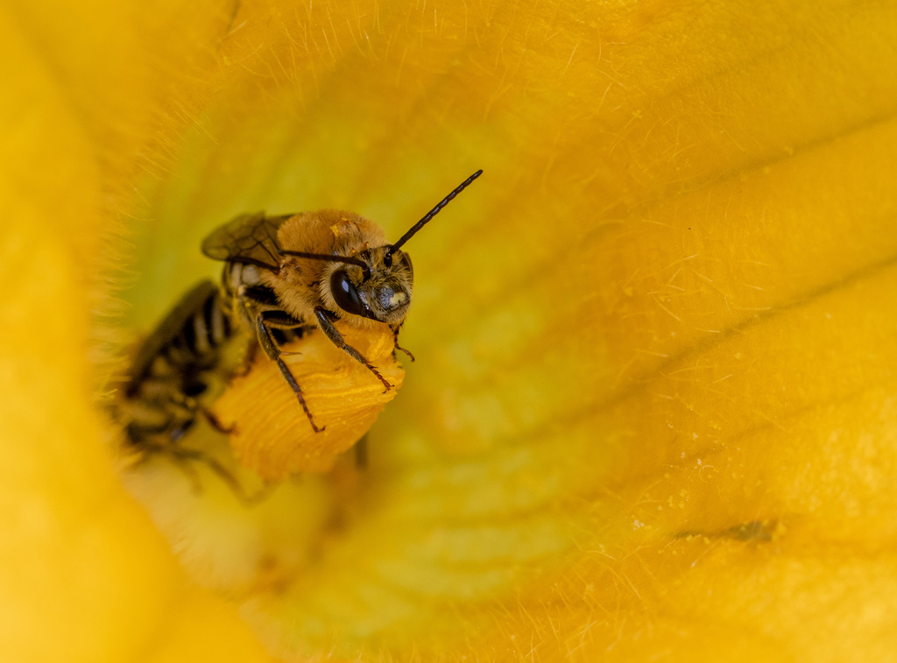
Why do pollinators want to visit flowers?
Yummy!
Bright colors mean there’s tasty nectar to drink and pollen to eat!
Notes:
Photo: Spencer Hardy

Slide 7
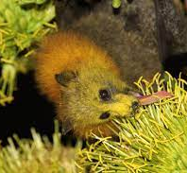
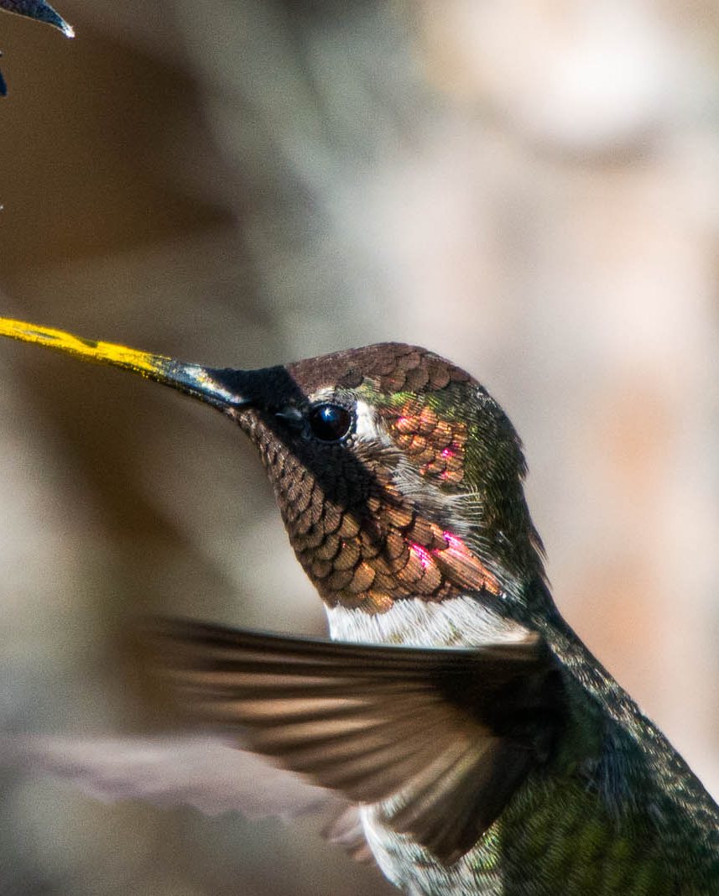
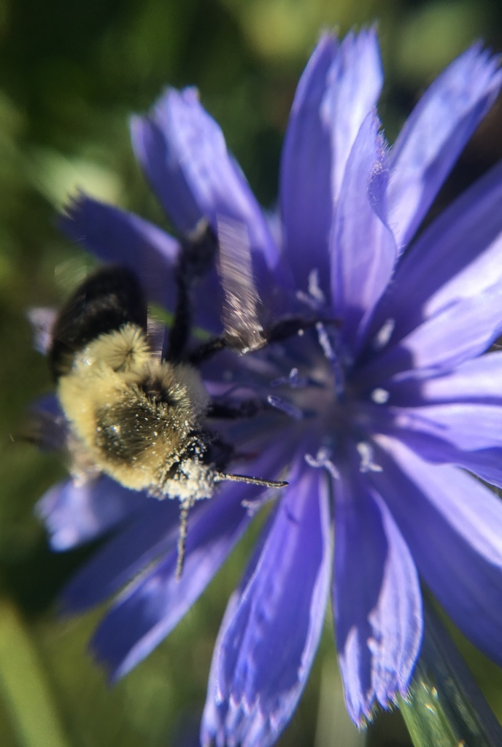
Pollen is sticky!
Notes:
Describe how when pollinators move from flower to flower, they accidentally knock against the stamen and pollen gets stuck on their fur or feathers.
^{Bumblebee photo: Spencer Hardy}

Slide 8
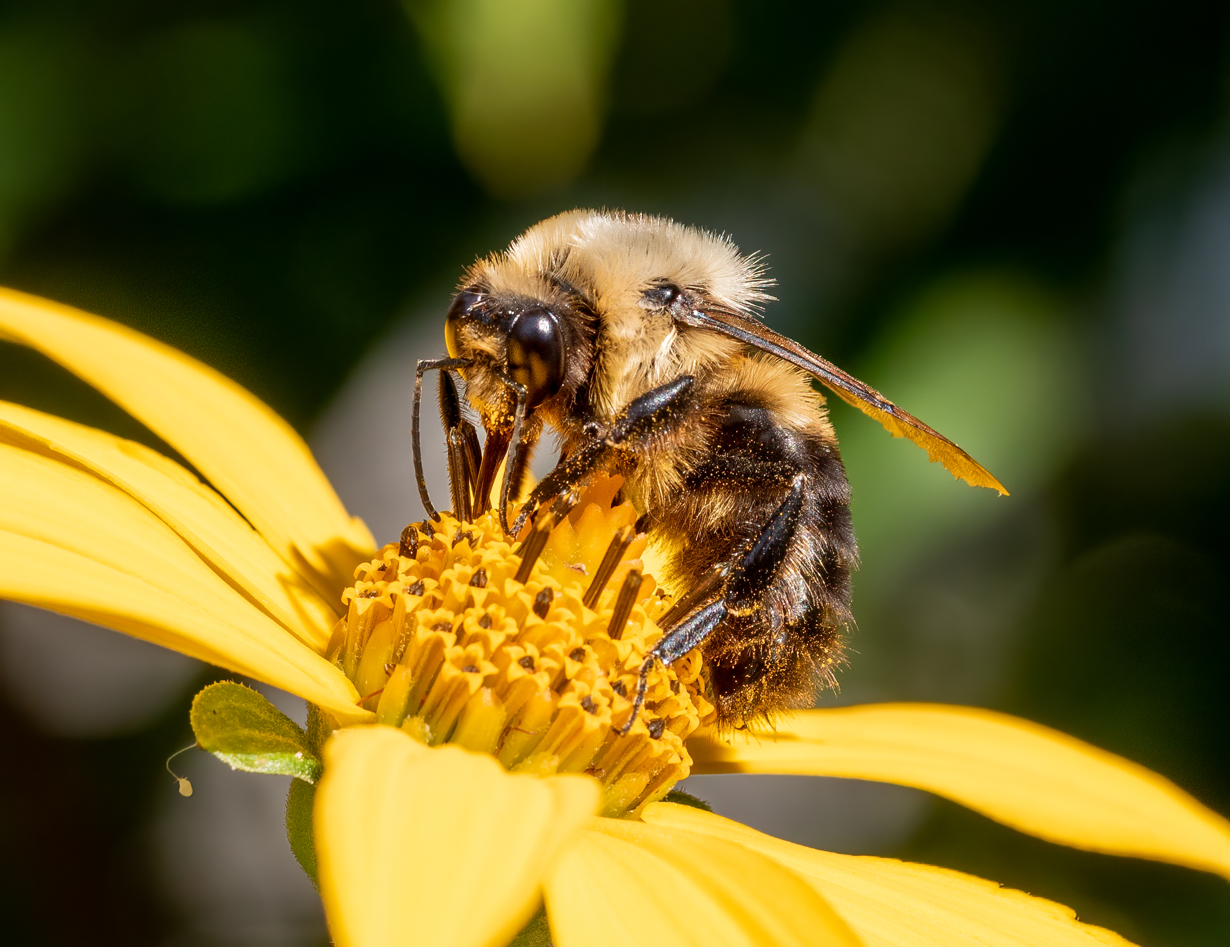
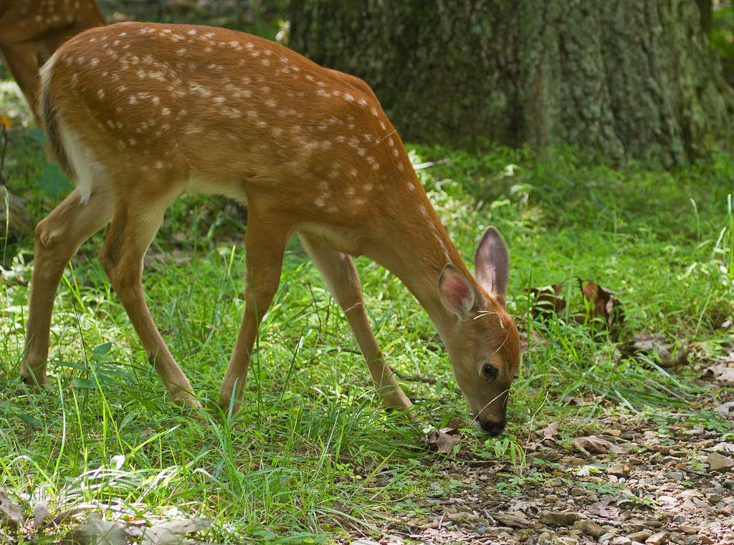
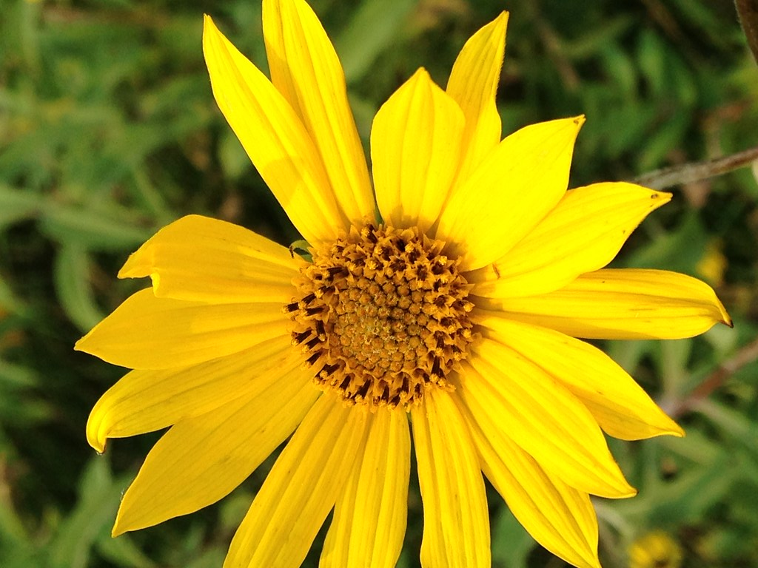
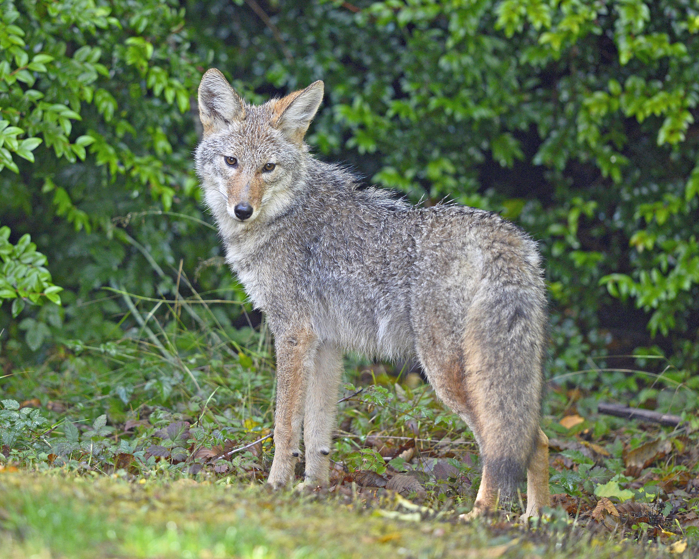
Pollination connects everyone!
Notes:
When we think about plants and animals, we can’t think about just one at a time, we have to think of how they all fit together, like pieces of a puzzle. If one piece is missing, the puzzle will never be complete. Pollinators are especially important because they help create new plants, and plants are able to make their own energy, unlike other living things. Herbivores have to eat plants to get energy. Then, when carnivores eat herbivores, the energy goes into their bodies! Plants also create oxygen, which we all need to breathe, so we want lots of pollinators to help create lots of energy and oxygen for our planet!
In this simple food chain example, a bumblebee pollinates a wild sunflower, which then produces other sunflowers. Deer love to snack on sunflowers and other plants, and some deer are eaten by coyotes. We could make lots of other connections like this and trace them back to the hard work of pollinators!

