Slide 1
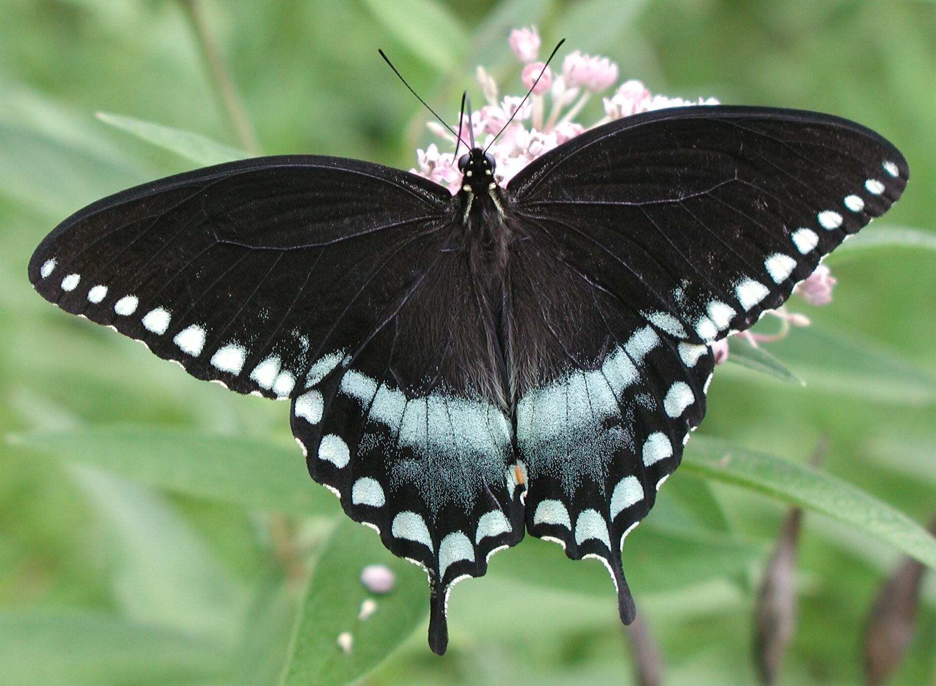
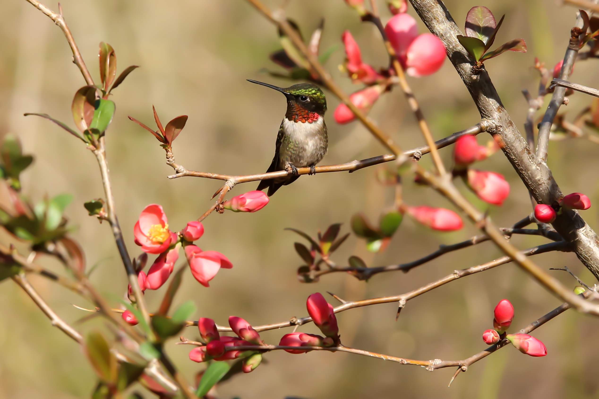
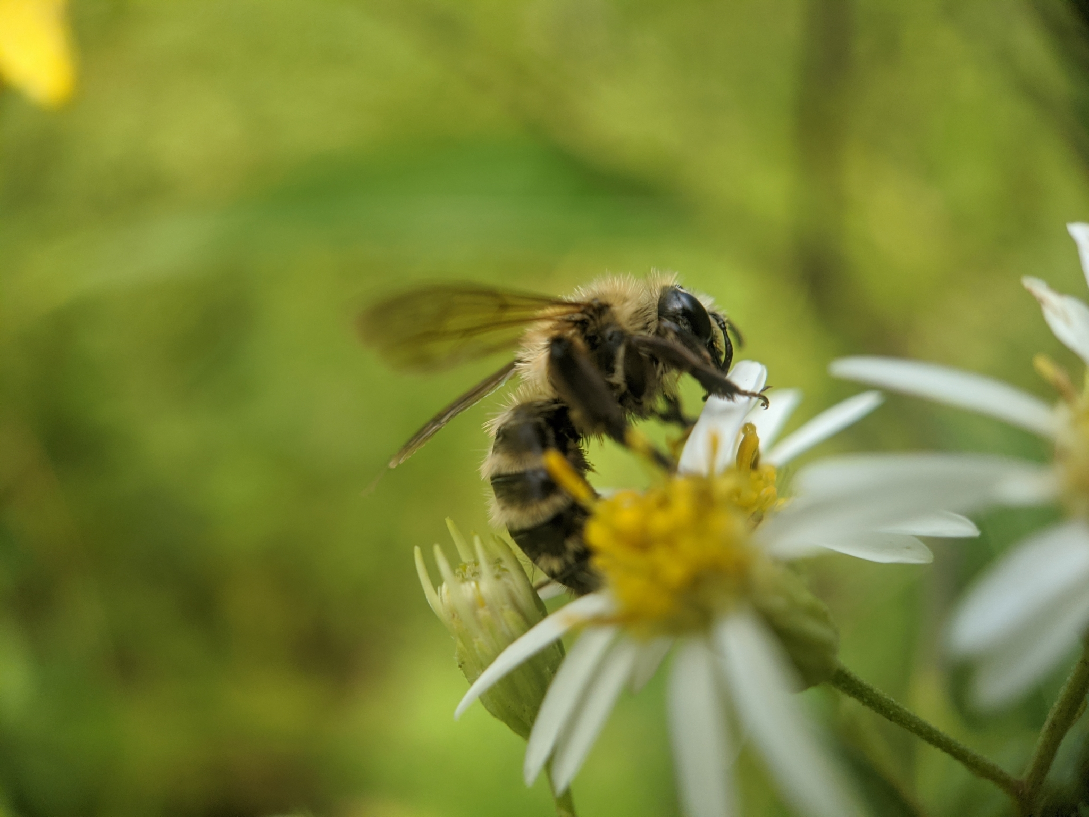
Pollinator Pals
Template by Eric Curts
Notes:
Photos by Anita Gould, Dean Birch, Spencer Hardy

Slide 2
JEOPARDY BOARD
FINAL JEOPARDY
Pollinator Habitats | Pollinator Groups | Pollinator Adaptations | Ecosystem Services | Helping Pollinators
$100 | $100 | $100 | $100 | $100
$200 | $200 | $200 | $200 | $200
$300 | $300 | $300 | $300 | $300
$400 | $400 | $400 | $400 | $400
$500 | $500 | $500 | $500 | $500

Slide 3
Pollinator Habitats - $100 Question
What is a native plant?
Click to see answer

Slide 4
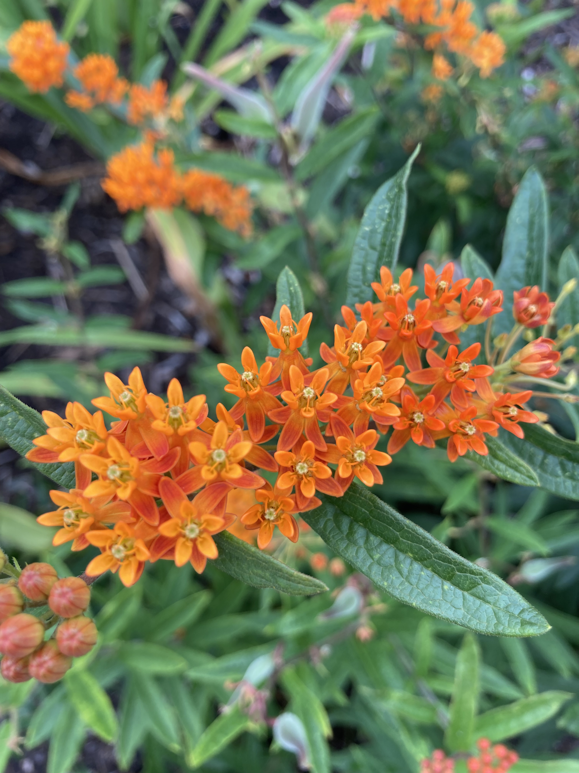
Pollinator Habitats - $100 Answer
A native plant is one that is naturally found in an area. It has adapted to live in that place and is important for wildlife.
Click to return to Jeopardy Board
Notes:
Some native plants in RI include milkweed, blueberry, oak, and New England aster!

Slide 5
Pollinator Habitats - $200 Question
True or false?
All bees live in a hive.
Click to see answer

Slide 6
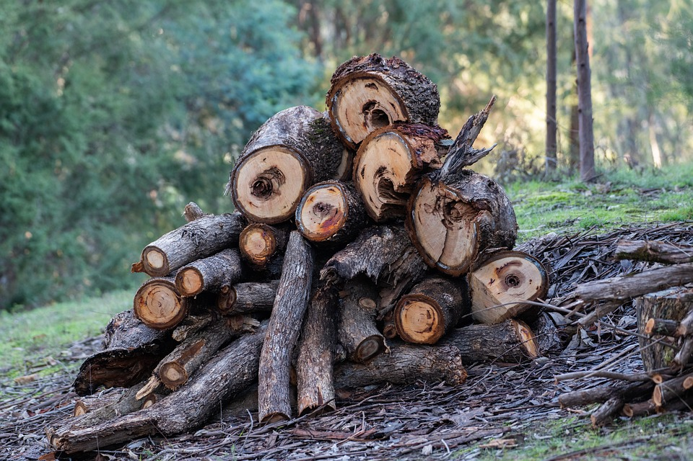
Pollinator Habitats - $200 Answer
False! Some bees and wasps live in hives, but many bees make nests under leaf piles, in bunch grasses, or in fallen logs.
Click to return to Jeopardy Board
Notes:
Bumblebees like to make their nests in piles of grass or wildflower stems, leaves, and sticks. Mason bees burrow into rotting logs (or sometimes the side of your house!), and solitary bees live in tiny holes in the soil.

Slide 7
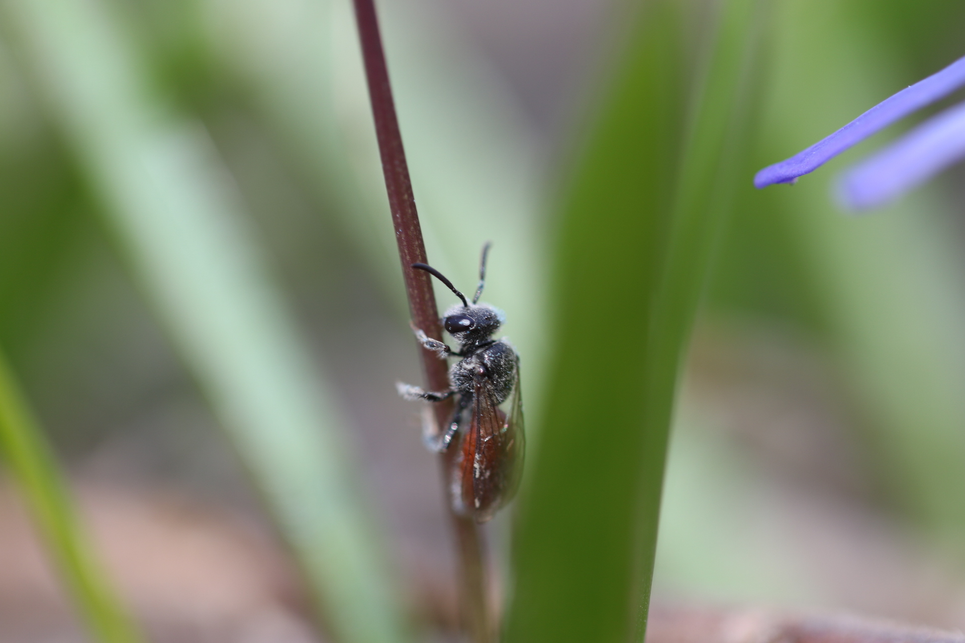
Pollinator Habitats - $300 Question
Plants with _____ stems are very important for some types of bees.
Click to see answer
Notes:
Photo: Spencer Hardy

Slide 8
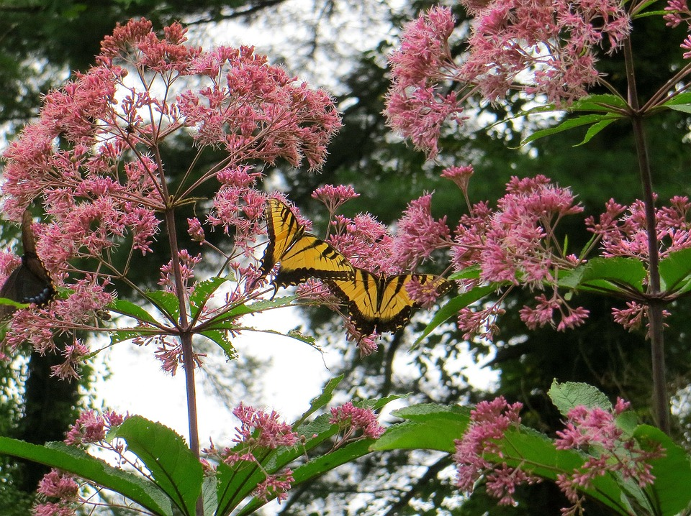
Pollinator Habitats - $300 Answer
HOLLOW stems
Click to return to Jeopardy Board
Notes:
Many native plants have hollow stems. When the plants dry out in the fall and winter, they create a perfect little tube for solitary bees to lay their eggs in when spring comes. The plant in this photo is called Joe Pye weed. It grows very tall and has thick, hollow stalks, perfect for the bees! It also has beautiful pink flowers that all pollinators enjoy!

Slide 9
Pollinator Habitats - $400 Question
____ plants are not from Rhode Island, but have been introduced and have started to grow here.
These plants can cause problems in the ecosystem because they take up space where native plants could be growing.
Click to see answer

Slide 10
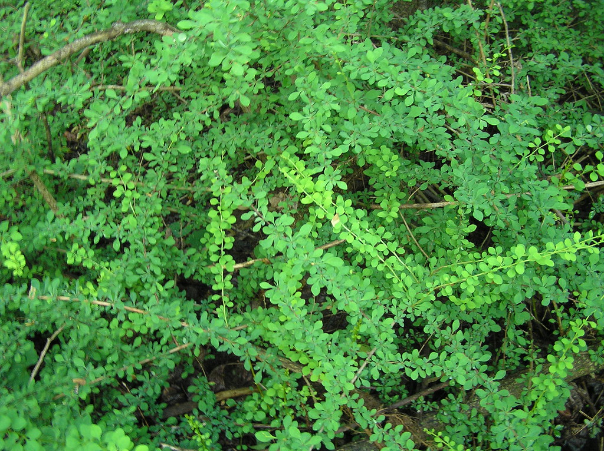
Pollinator Habitats - $400 Answer
Invasive plants!
“Grrrr! No space for native plants here. I’m taking over!”
-Barberry
Click to return to Jeopardy Board
Notes:
These pesky plants grow fast and compete with native plants for space. Less native plants means it’s harder for pollinators to find the food they need. This is especially an issue for insects that require a host plant, especially host plants that grow in very specialized habitats, like wild lupine or wild indigo.
There are a lot of invasive plants in RI, like autumn olive, Oriental bittersweet, multiflora rose, Japanese barberry, purple loosestrife, glossy buckthorn, and black swallowwort. It’s important to get rid of these invasive plants so that native plants have room to grow. Our local wildlife rely on native plants for food and shelter!
Photo: Frederick County Forestry Board

Slide 11
Pollinator Habitats - $500 Question
What are the 4 parts of a healthy pollinator habitat?
Click to see answer

Slide 12
Pollinator Habitats - $500 Answer
Food
Water
Shelter
Open space
Click to return to Jeopardy Board
Notes:
All creatures, including pollinators, need all four of these things fairly close together in a healthy habitat in order to survive and thrive!

Slide 13
Pollinator Groups - $100 Question
Name a bird that pollinates!
Click to see answer

Slide 14
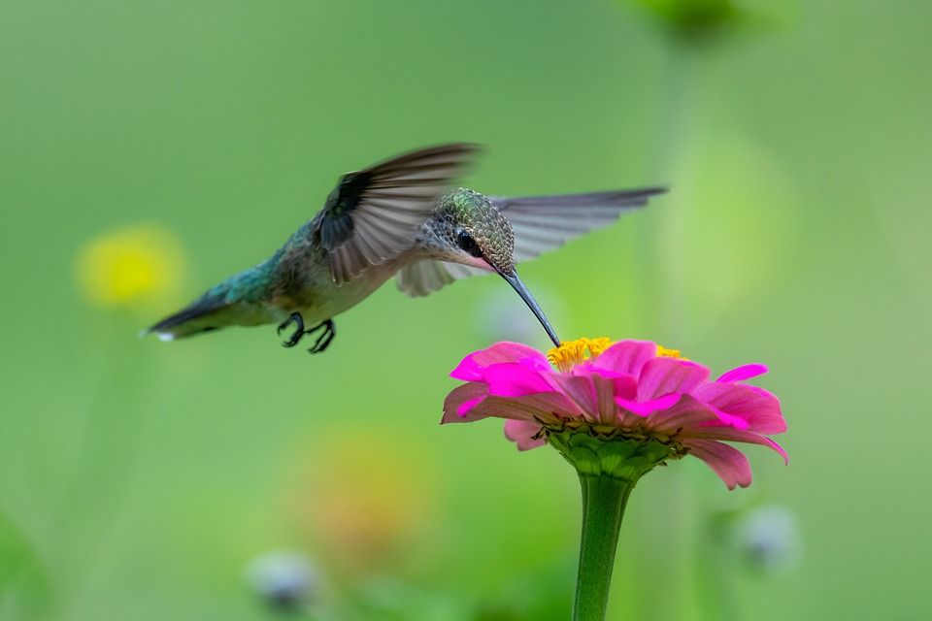
Pollinator Groups- $100 Answer
Hummingbird!
Click to return to Jeopardy Board

Slide 15
Pollinator Groups - $200 Question
Which flying mammal is a pollinator?
Click to see answer

Slide 16
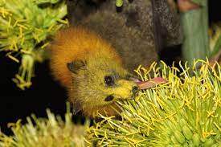
Pollinator Groups - $200 Answer
Bats!
Click to return to Jeopardy Board
Notes:
Pollinating bats can be found in the desert and in tropical rainforests. As they drink nectar from flowers, their fur is covered with pollen and spread from flower to flower. Bats are important pollinators of many tropical foods we enjoy, like cocoa, bananas, mangoes, and agave. The bats in RI solely eat insects, which is still very important!

Slide 17
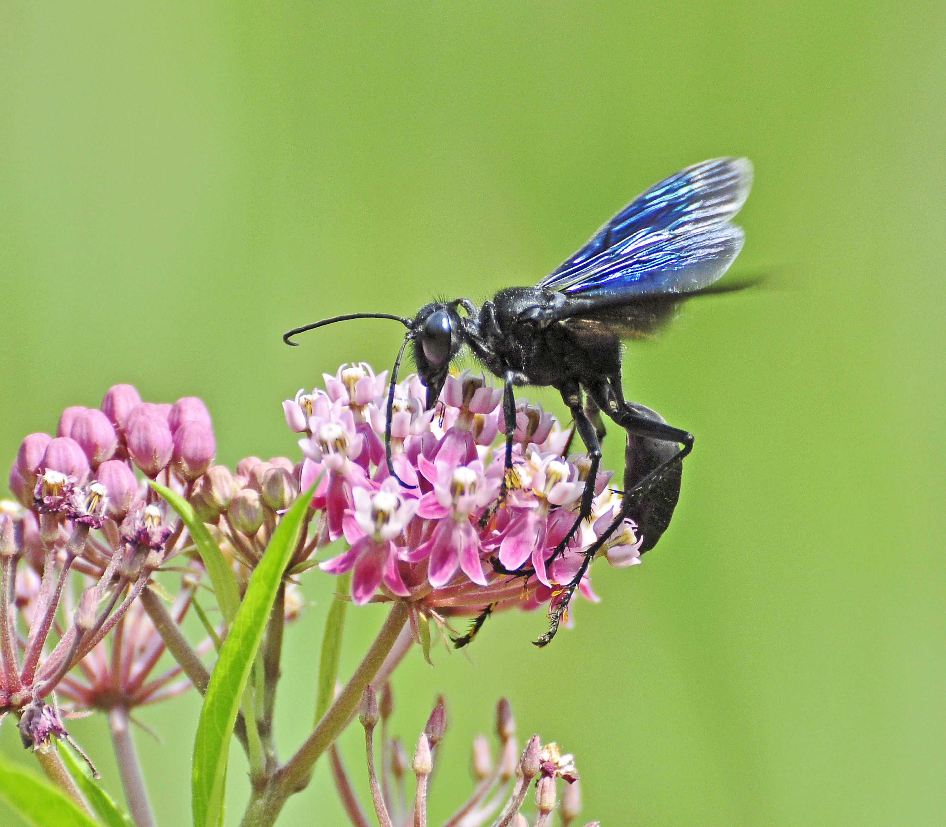
Pollinator Groups- $300 Question
Are wasps bees?
Click to see answer

Slide 18
Pollinator Groups - $300 Answer
No! Wasps are in their own group!
Click to return to Jeopardy Board
Notes:
Wasps and bees both belong to a group called “Hymenoptera,” which are insects that have two pairs of wings and the females have stingers. But wasps are not bees! Wasps are mostly hairless and they are omnivores, while bees are fuzzy and are herbivores!

Slide 19
Pollinator Groups- $400 Question
Many moths and butterflies only lay eggs on one type of plant. This is called their ____ plant.
Click to see answer

Slide 20
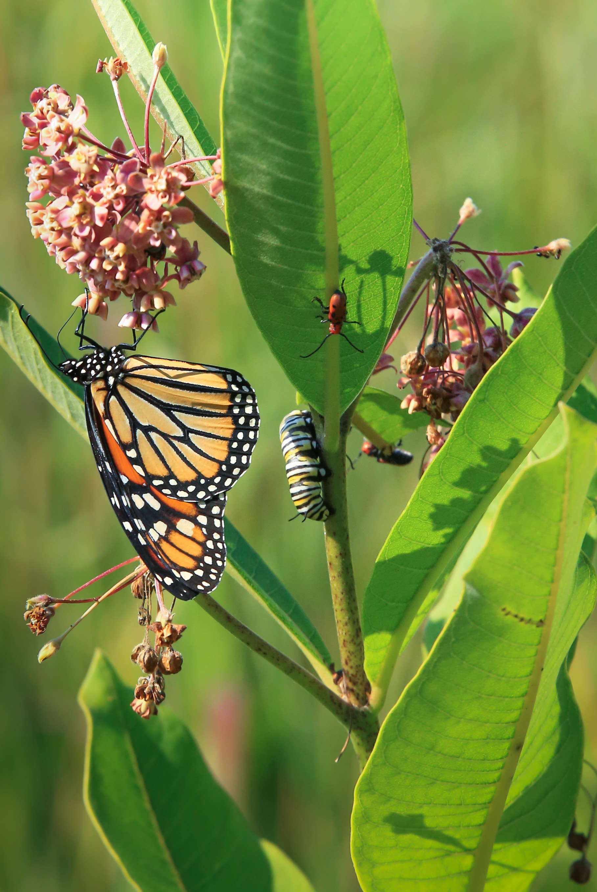
Pollinator Groups - $400 Answer
HOST plant!
One of the most famous host plants is milkweed for monarch butterflies.
Click to return to Jeopardy Board
Notes:
A host plant is where a female moth or butterfly will lay her eggs and is the first food the hatched caterpillars will eat. Therefore, host plants are super important for butterflies and moths to complete their lifecycles. One of the best-known examples of a butterfly-host plant association, is the relationship between Monarch Butterflies and milkweeds. Milkweeds not only provide a place for female Monarchs to lay their eggs and feed Monarch caterpillars, but they also imbibe the caterpillars with a toxin that makes them poisonous to bird and mammal predators. Other examples of important host plants include grasses like little bluestem and Indiangrass, which are used by skipper butterflies, and oaks, which support hairstreak butterflies and silk moths. In Rhode Island, the Frosted Elfin is one of our rarest butterflies and relies on yellow wild indigo and wild lupine as host plants.
Photo: Dean Birch

Slide 21
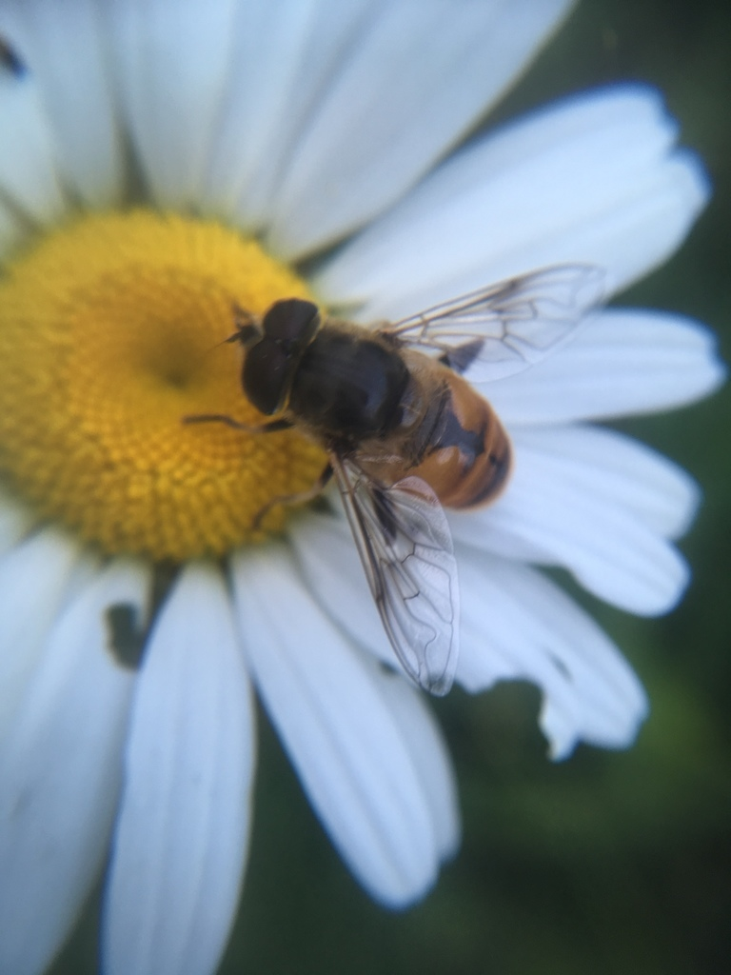
Pollinator Groups- $500 Question
A bee, or not a bee?
Click to see answer
Notes:
Photo: Spencer Hardy

Slide 22
Pollinator Groups- $500 Answer
NOT a bee! This is a flower fly disguised as a bee!
Only 2 wings
Short antennae
GIANT eyes
Click to return to Jeopardy Board
Notes:
In Northeastern North America, there are about 400 species of flower fly that come in a wide range of sizes and colors. Many are quite beautiful, with brightly colored spots and stripes that often mimic the patterns found on bees and wasps. This type of mimicry is called Batesian Mimicry, in which the flies mimic protective coloration in order to trick potential predators into thinking that they have a stinger (even though they do not and are harmless).
As larvae, flower flies feed on either decaying plant and animal material or feed on other insects, like aphids and thrips. As adults, the flies feed on nectar and pollen from a wide variety of flowers, though they seem to prefer white and yellow flowers. When they visit these flowers, pollen gets stuck to their hairs which allows them to carry out pollination. Next to bees, syrphid flies are considered one of the most important pollinator groups and contribute to the pollination of many wild and cultivated plants.

Slide 23
Pollinator Adaptations - $100 Question
Many pollinators have a long _____ to help them sip flower nectar.
Click to see answer

Slide 24
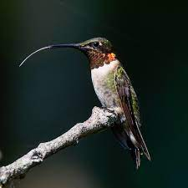
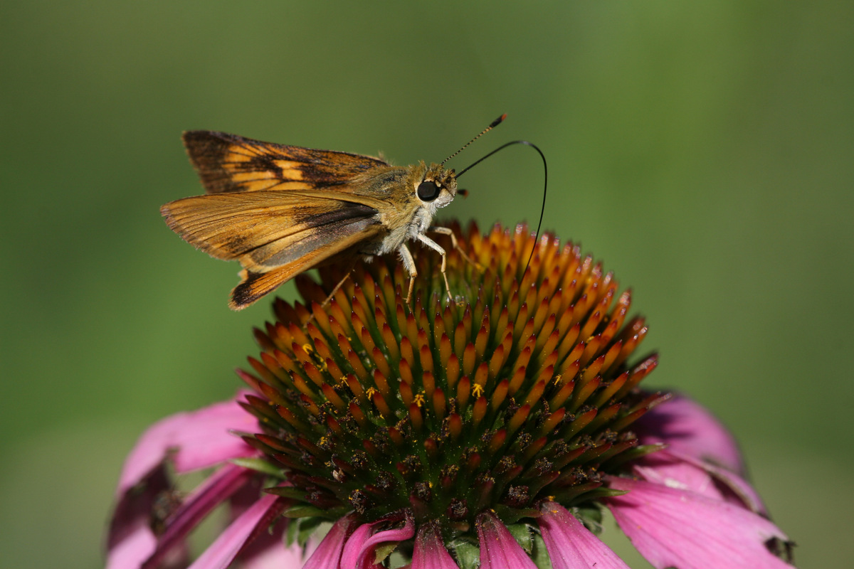
Pollinator Adaptations - $100 Answer
TONGUE!
Click to return to Jeopardy Board
Notes:
The fancy word for an insect’s tongue is a proboscis!

Slide 25
Pollinator Adaptations - $200 Question
Which one is fuzzy?
Bumblebee or wasp?
Click to see answer

Slide 26
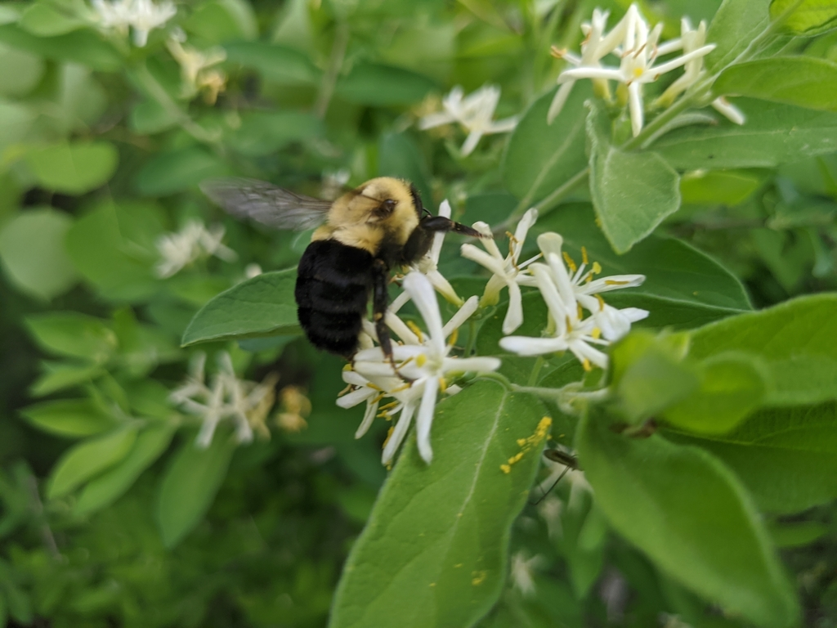
Pollinator Adaptations - $200 Answer
Bumblebee!
Click to return to Jeopardy Board
Notes:
All that fuzz is great for picking up pollen as bumblebees fly from flower to flower!

Slide 27
Pollinator Adaptations - $300 Question
The best pollinators are ones that can ____.
Click to see answer

Slide 28
Pollinator Adaptations - $300 Answer
Fly! This helps them spread pollen farther and faster!
Click to return to Jeopardy Board

Slide 29
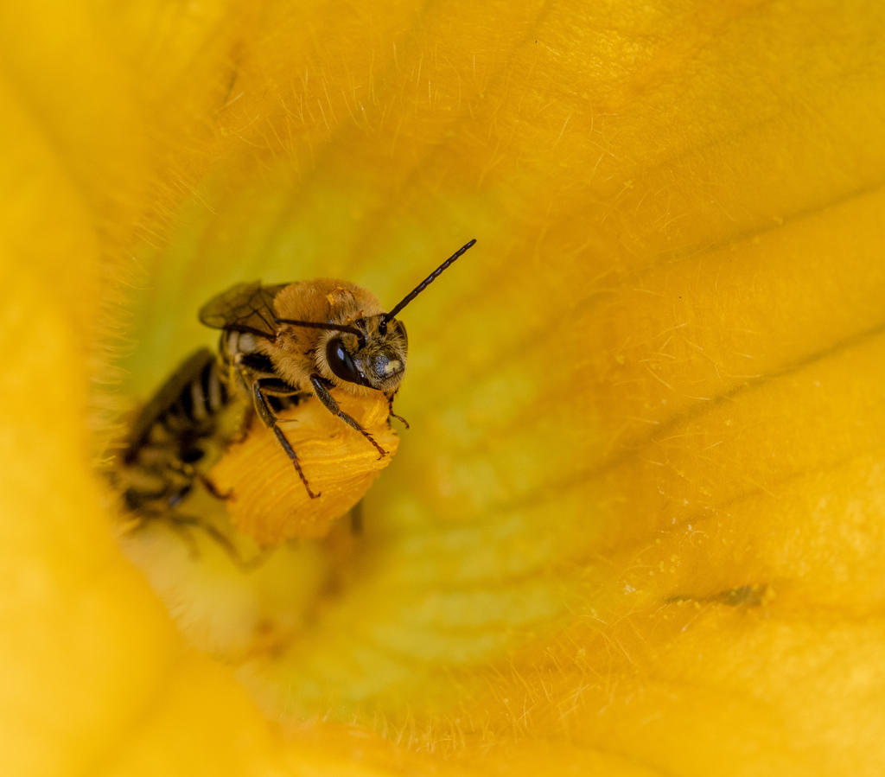
Pollinator Adaptations - $400 Question
These help pollinators sense the world around them…
Click to see answer

Slide 30
Pollinator Adapations - $400 Answer
Antennae!
Click to return to Jeopardy Board
Notes:
All insects have two antennae on top of their head. They can come in all shapes and sizes, but all antennae are excellent at sensing the world around the pollinators.

Slide 31
Pollinator Adaptations - $500 Question
True or false: Butterflies can taste with their feet.
Click to see answer

Slide 32
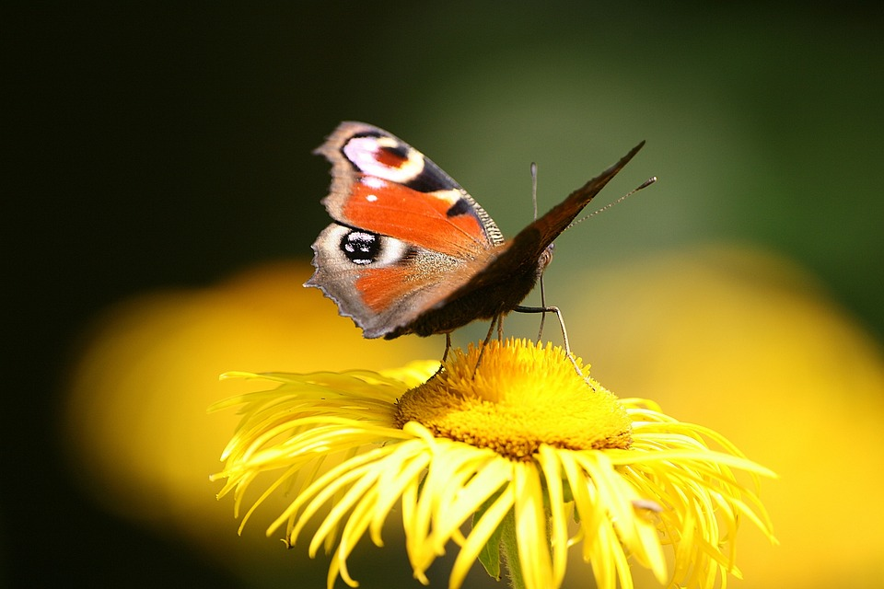
Pollinator Adaptations - $500 Answer
True!
Click to return to Jeopardy Board
Notes:
A butterfly’s tongue actually doesn’t have many taste buds. Most of their taste buds are on their feet!

Slide 33
Ecosystem Services-
$100 Question
What is an ecosystem service?
Click to see answer

Slide 34
Ecosystem Services -
$100 Answer
Ecosystem services are ways that humans are helped by nature and from healthy ecosystems.
Some examples are pollination, decomposition, and water filtration.
Click to return to Jeopardy Board

Slide 35
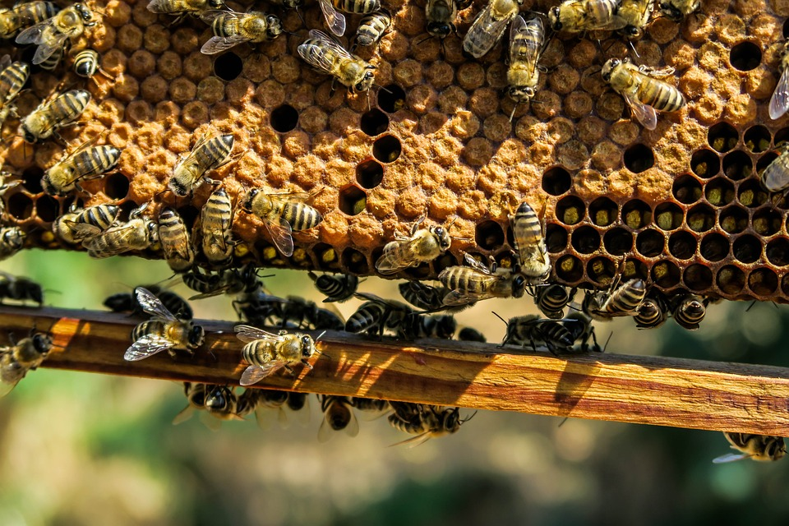
Ecosystem Services-
$200 Question
True or false: Honeybees are the best pollinators of all crops.
Click to see answer

Slide 36
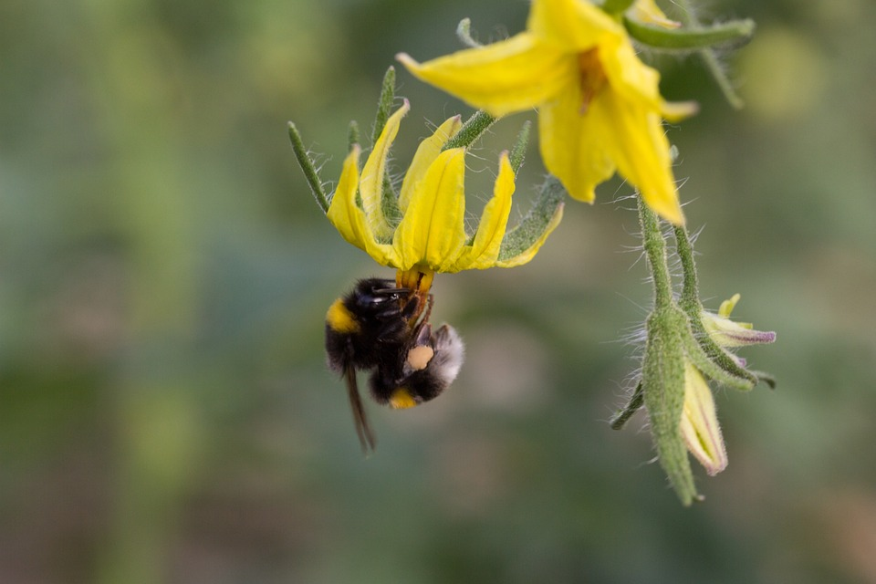
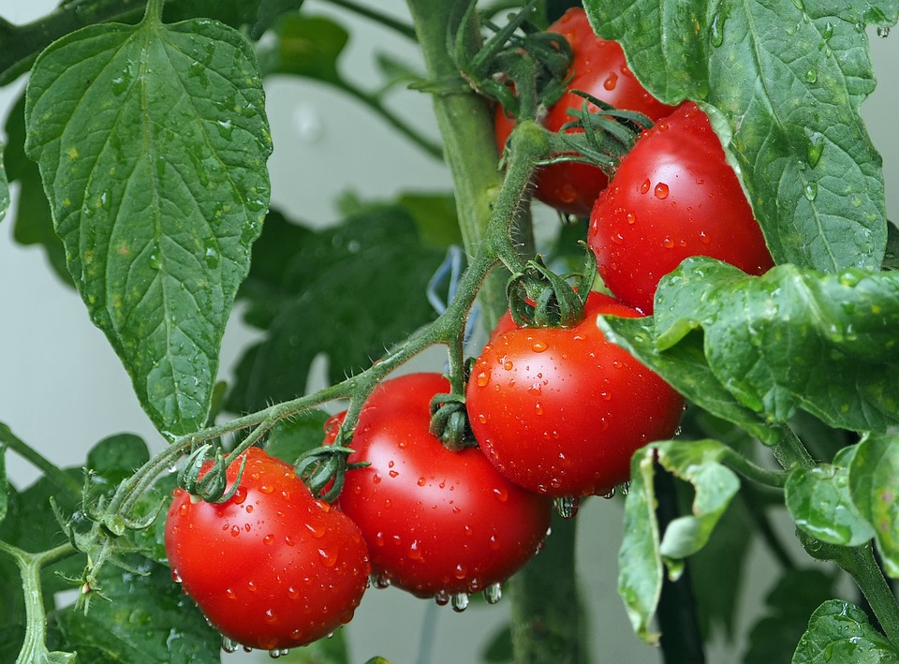
Ecosystem Services-
$200 Answer
False! Honeybees are pretty good pollinators, but native bumblebees are much better at pollinating crops like tomatoes, blueberries, and eggplants.
Click to return to Jeopardy Board
Notes:
Native bumblebees and solitary bees perform a specialized type of pollination, called buzz pollination. The bees buzz their wings while feeding from flowers, creating vibrations that loosen up more pollen to be transferred. Next time you watch see a bumblebee on a flower, see if you notice it buzz pollinating!

Slide 37
Ecosystem Services -
$300 Question
True or false? Human beings would not be able to grow as many crops without pollinators.
Click to see answer

Slide 38
Ecosystem Services -
$300 Answer
True! Without pollinators, it would be very difficult to grow crops, and we wouldn’t be able to grow as many different types of fruits and veggies.
Click to return to Jeopardy Board

Slide 39
Ecosystem Services -
$400 Question
True or False: Other wildlife species are not connected to pollinators at all, and could survive without them.
Click to see answer

Slide 40
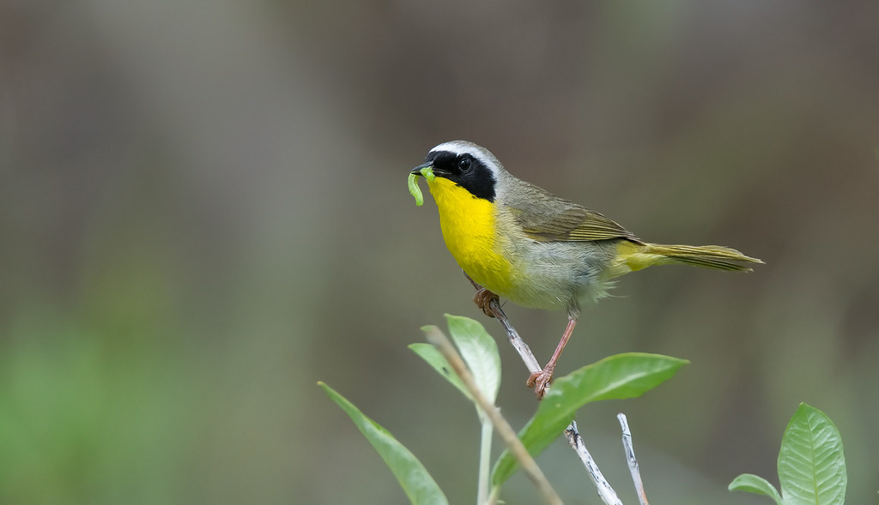
Ecosystem Services-
$400 Answer
False! Other critters need pollinators too!
Click to return to Jeopardy Board
Notes:
Pollinators help plants grow, produce fruits, and produce seeds, all of which are food for a wide variety of animals. Pollinators themselves are a valuable food source for many animals, particularly moths and butterflies (and their caterpillars) for birds. Without pollinators, our food webs and ecosystems would collapse!
Photo: Keith Williams

Slide 41
Ecosystem Services-
$500 Question
People also benefit from pollinators by making money from their ecosystem services, like selling food. How much money do pollinators contribute to the world’s economy each year?
100 million dollars
500,000 dollars
100 billion dollars
Up to 515 billion dollars
Click to see answer

Slide 42
Ecosystem Services -
$500 Answer
D. Up to 515 billion dollars!
Click to return to Jeopardy Board
Notes:
Approximately 75% of crops benefit in some way from animal pollination and about 10% depend fully on pollinators to produce the food that we eat. These foods include chocolate, coffee, avocados, almonds, bananas, mangos, strawberries, and many more. The food crops amount to about 30% of global food production and the majority of human Vitamin C, Vitamin A, and calcium intake. The crop services that animal pollinators provide contribute between $157 and 515 billion to the global economy per year - and pollinators do it for free!

Slide 43
Helping Pollinators - $100 Question
A _____ is a type of chemical that kills insects.
Click to see answer

Slide 44
Helping Pollinators - $100 Answer
Pesticide
Click to return to Jeopardy Board
Notes:
Pesticides are used to kill insects that are causing a problem, like crop pests, but can also kill other non-target insects in the process, like bees, butterflies, and moths.

Slide 45
Helping Pollinators - $200 Question
What is one way you can help pollinators in your own backyard or community?
Click to see answer

Slide 46
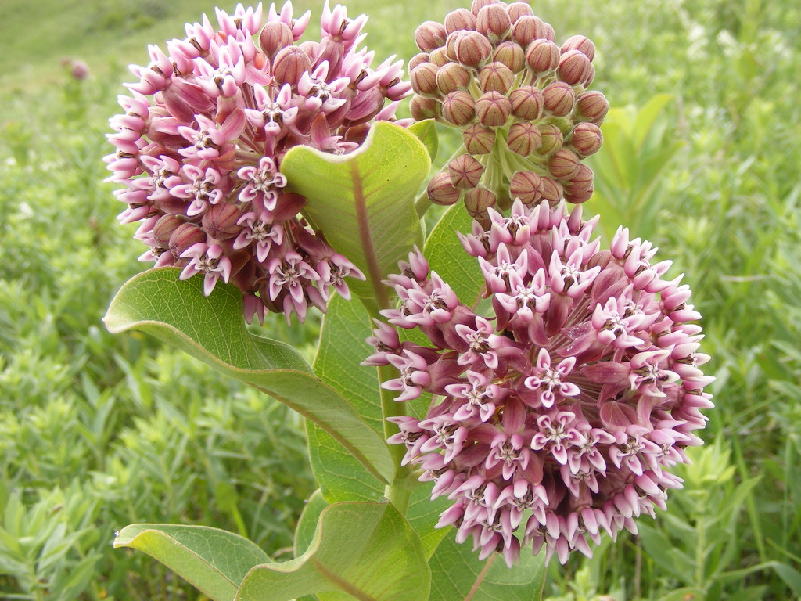
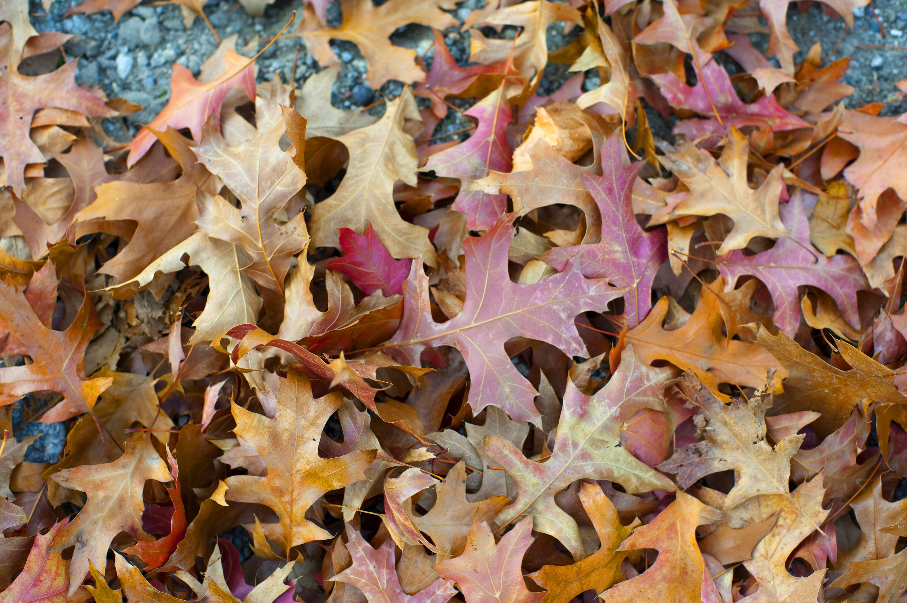
Helping Pollinators - $200 Answer
Plant native plants
Don’t spray chemicals
Leave the leaves!
Sugar water for hummingbirds (no red dye!)
Help out with community science projects, like the RI Wild Bee Observer project!
Click to return to Jeopardy Board
Notes:
Tips for hummingbird feeders: Hummingbird feeders should contain a 1:4 sugar:water ratio, and the liquid should NOT contain any dyes or coloring. Hummingbird feeders should be hung up in a shady area, and should only be filled halfway. The water should be changed every 2-3 days to avoid mold growth, which can be toxic to hummingbirds. Feeders should be thoroughly rinsed and scrubbed with hot water when refilled to keep clean. If all of this seems like too much work, you can always plant flowers for hummingbirds, or shrubs that produce fruits for other birds!
Photos: USFWS

Slide 47
Helping Pollinators - $300 Question
What are some ways you could create shelter for pollinators?
Click to see answer

Slide 48
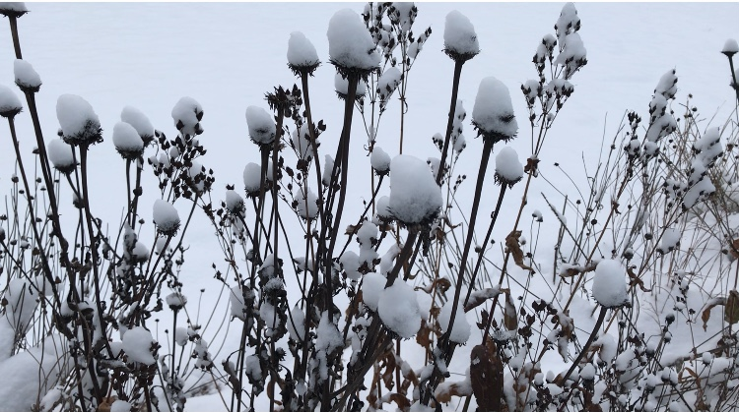
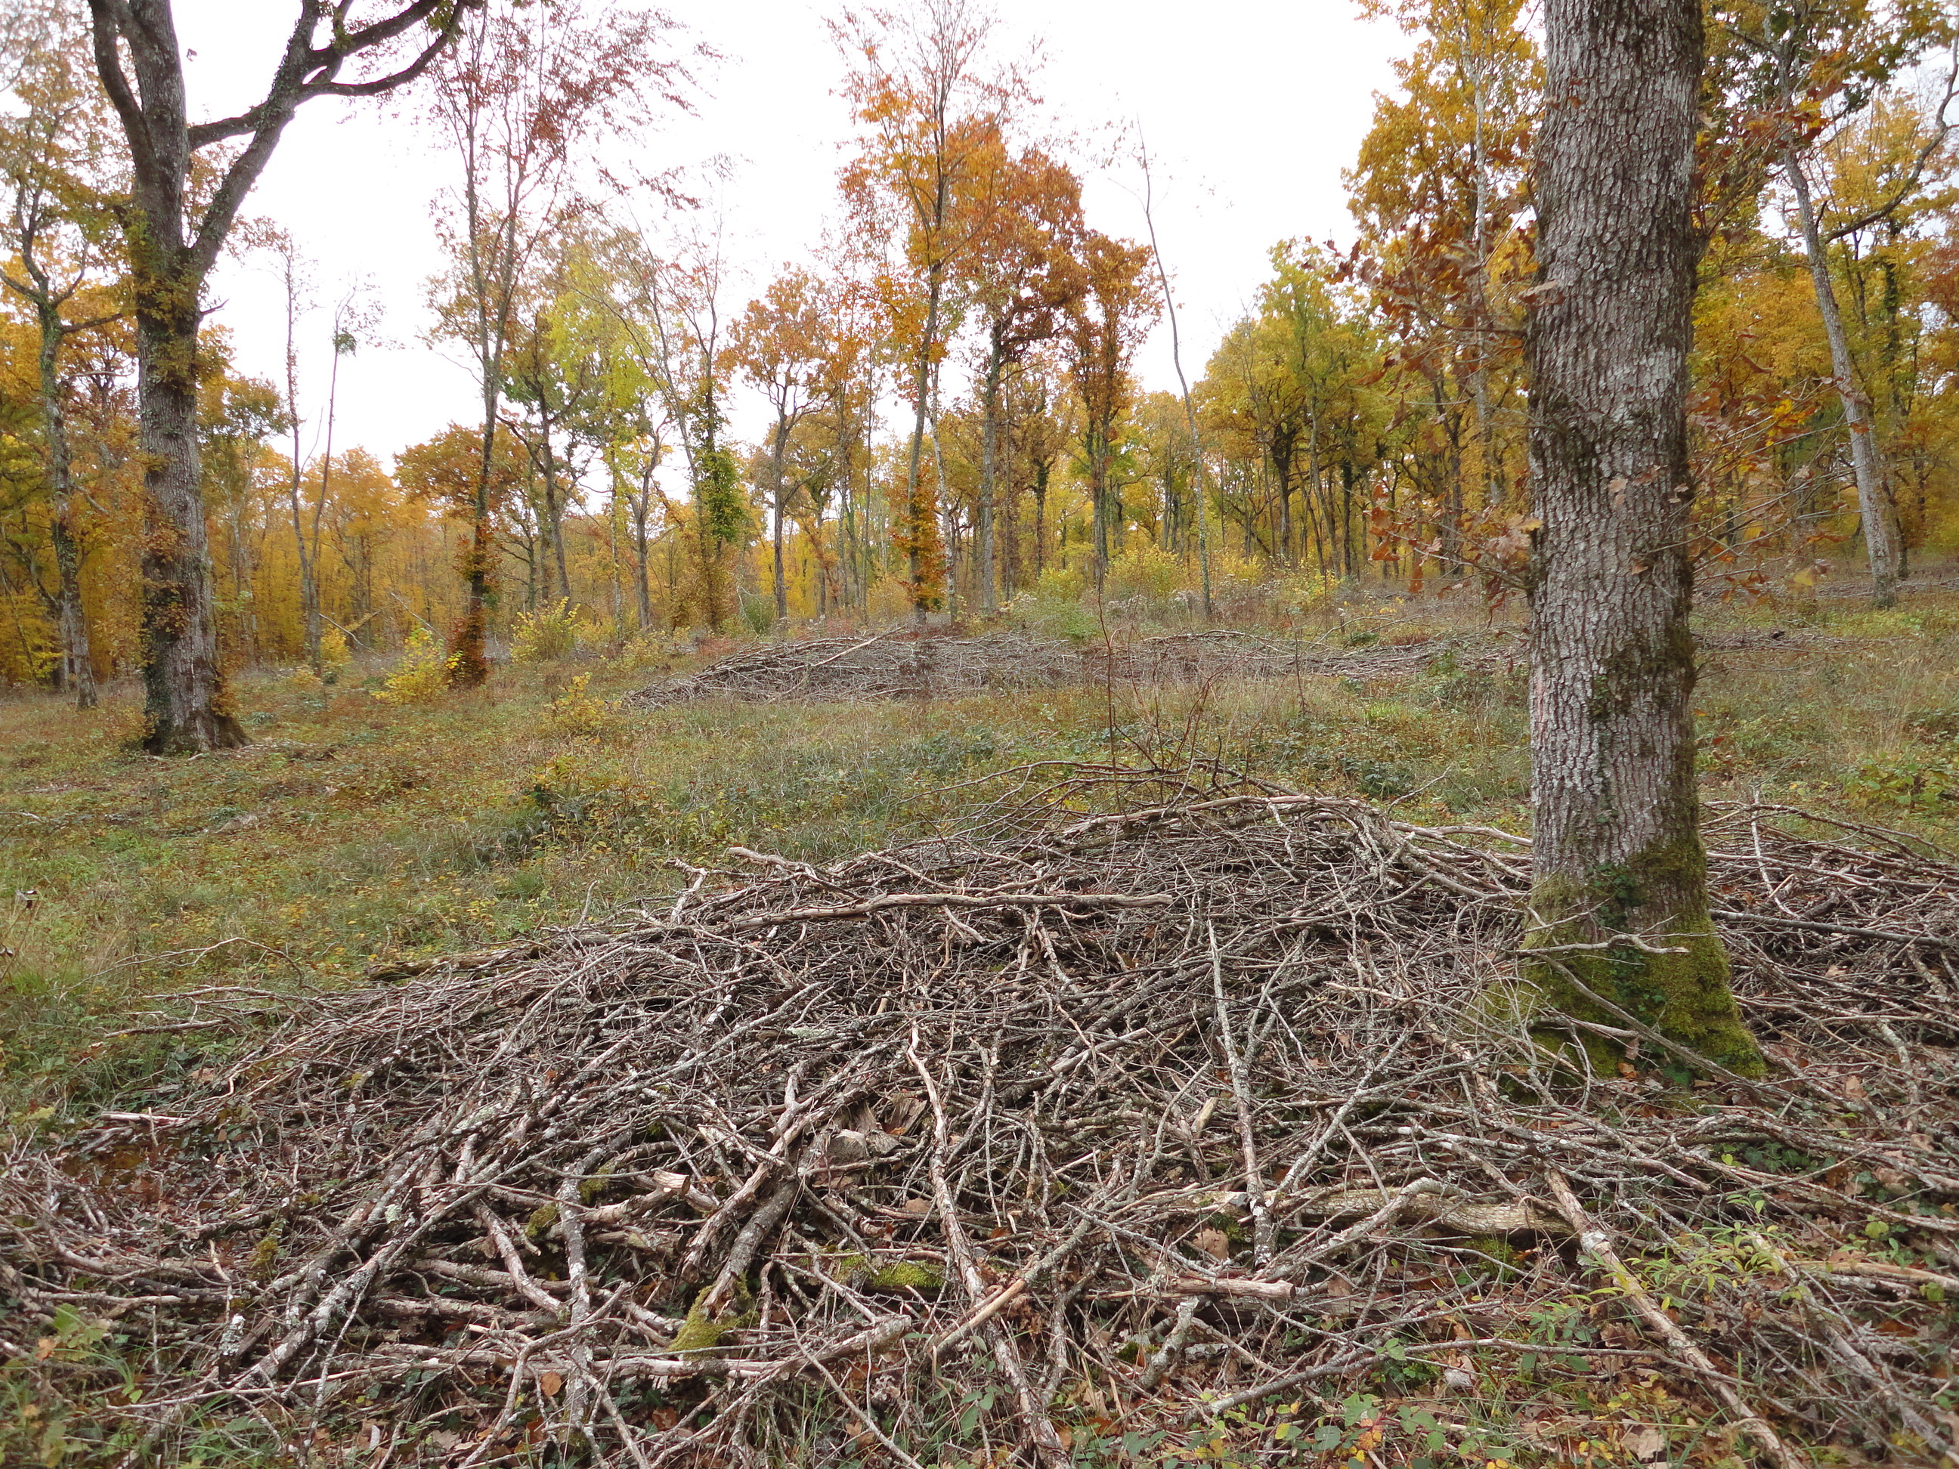
Helping Pollinators - $300 Answer
Leave dead plant stalks up over the winter and into spring
Make a brush pile of leaves and sticks
Leave large tree branches or logs on the ground
Click to return to Jeopardy Board
Notes:
Solitary bees like to lay their eggs inside of hollow plant stalks. Leaving them up over the winter allows birds to eat the flower seeds, and then sets up “bee hotels” in the spring. If you need to cut back the stems in the spring, leave them about 8-12 inches high. This will still provide habitat for bees and the new plant growth will cover up the old stalks. You can lay the cuttings on the ground as mulch and cover for other insects. Brush piles are great places for bumblebees to find shelter and build their nests. Old logs are open habitat for mason bees to burrow in!
Photos: Mary Gannon, Benoît Gabrielle

Slide 49
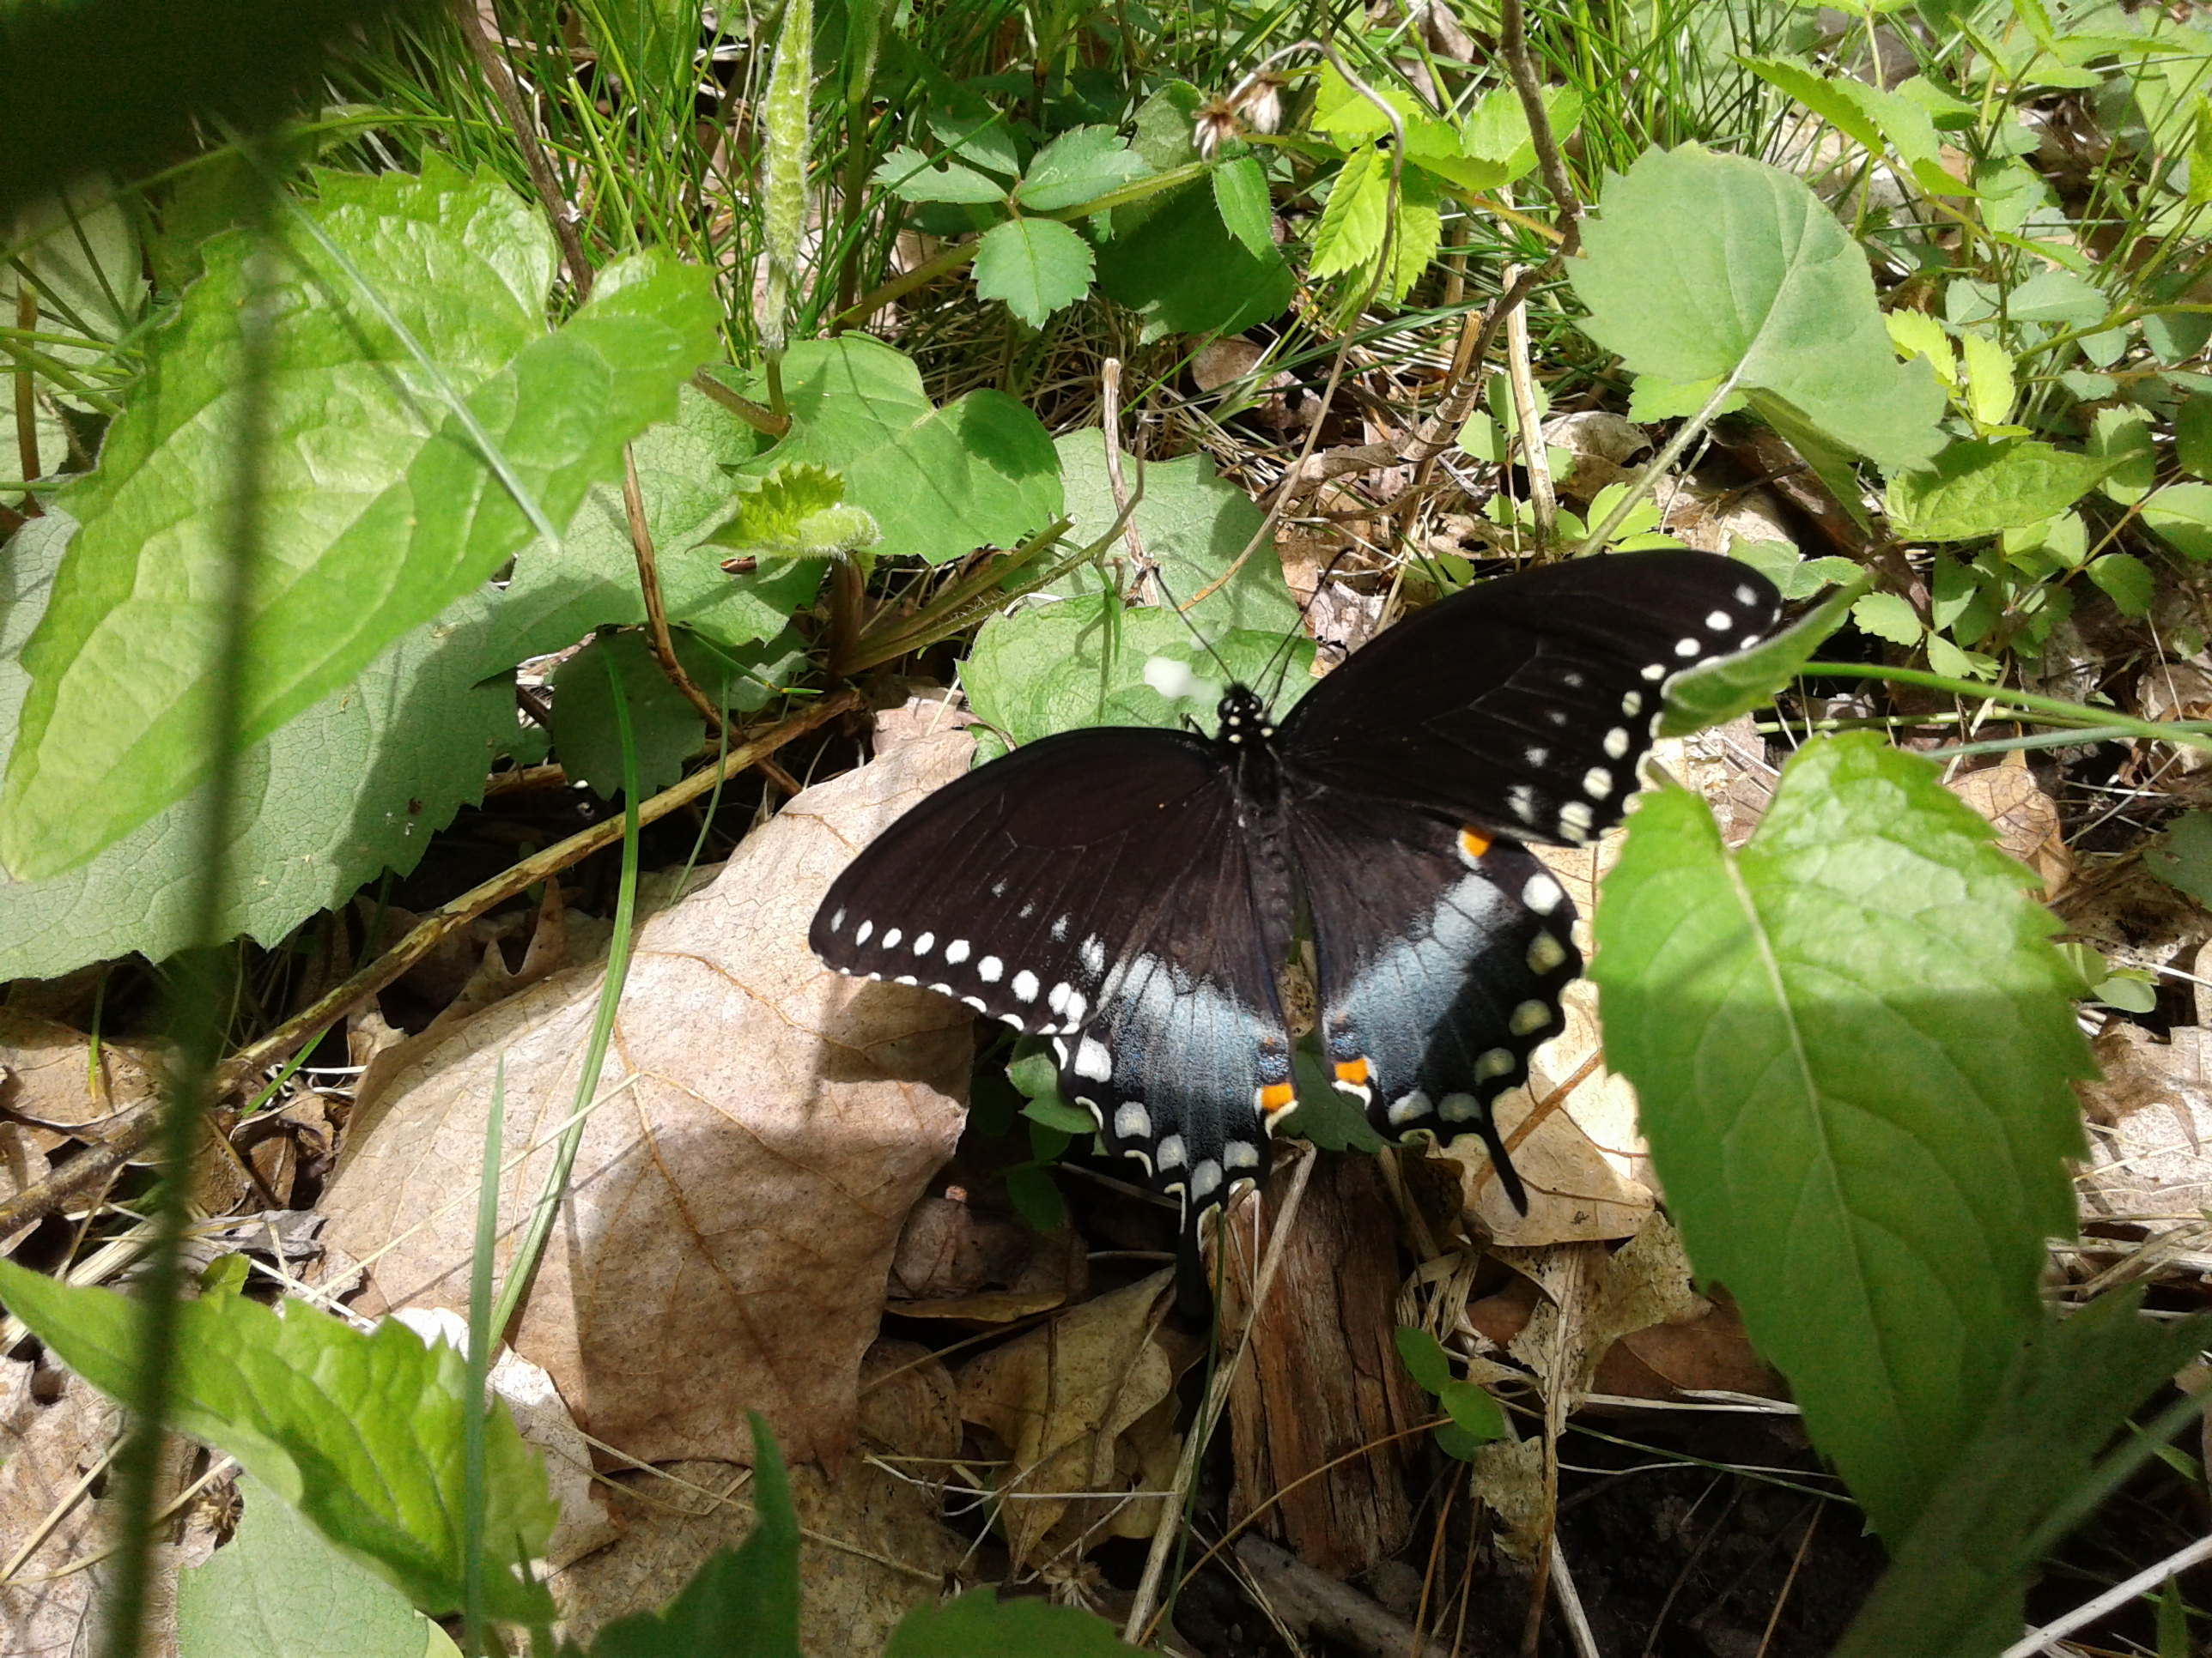
Helping Pollinators - $400 Question
True or false: You need a big yard or lots of land to help pollinators.
Click to see answer
Notes:
Photo: Mary Gannon

Slide 50
Helping Pollinators - $400 Answer
False! You can help pollinators by creating habitats of any size, even if it’s just in a flowerpot on the front steps!
Click to return to Jeopardy Board
Notes:
Native plants and host plants can be grown and overwintered in pots or containers. It’s very important that we create habitat in places where there’s limited open space, like in cities and very developed neighborhoods. Habitat is everywhere, and everyone can help!

Slide 51
Helping Pollinators - $500 Question
True or false? Honeybees are native to Rhode Island.
Click to see answer

Slide 52
Helping Pollinators - $500 Answer
False!
Click to return to Jeopardy Board
Notes:
Honeybees are not native. They were brought here from Europe to make honey and help on farms, and are kept in captive hives by a beekeeper. Think of them like livestock, but the only livestock that’s allowed to run free in the wild! Honeybees get a lot of attention because they are used in large scale agriculture, but few people know about the plight of our native bees. Taking actions to help honeybees (fewer pesticides, quality habitat) will also help our native bee species, many of which are facing conservation threats. Help spread the word about our native bees by sharing what you’ve learned in this kit!

Slide 53
FINAL
Topic: Habitat Fragmentation
Click to see question

Slide 54
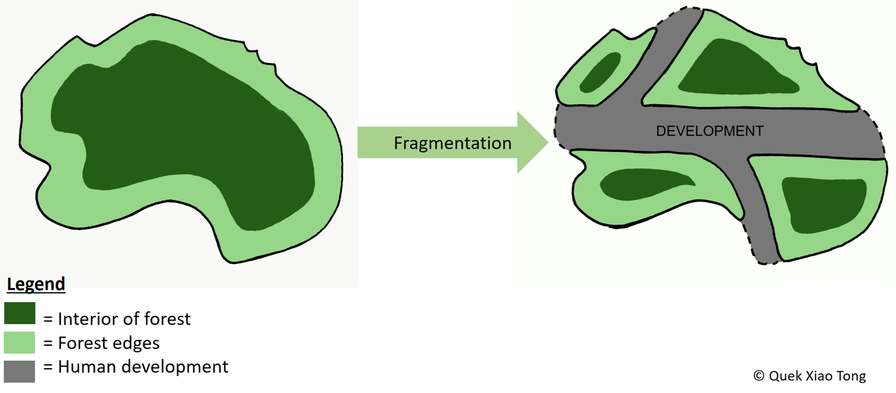
Final Jeopardy Question
How does habitat fragmentation impact pollinators?
Click to see answer

Slide 55
Final Jeopardy Answer
Harder to find places to find food/rest
Less habitat
Special habitat types get split up and shrink
Habitat patches too small to support population
Click to return to Jeopardy Board
Notes:
One of our biggest missions at RIDEM Division of Fish and Wildlife is to protect and manage habitat for all wildlife. RIDEM often buys pieces of land that are up for sale, adding to our Wildlife Management Areas and protecting that habitat forever. We have over 60,000 acres protected so far! It’s important to protect as much habitat as we can to combat the impacts of fragmentation, but we need a lot of help! Most of the land in Rhode Island is owned in much smaller chunks by lots of different people. If we all work together to make our home gardens and yards into wildlife and pollinator friendly habitats, it will make a huge difference!

