Slide 1

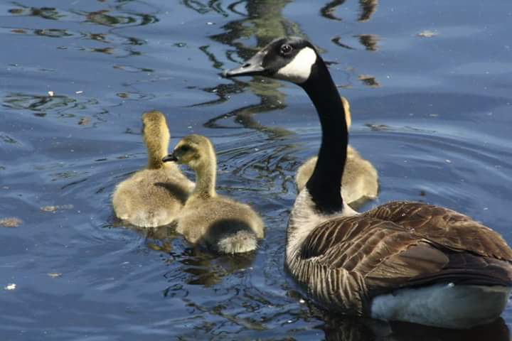
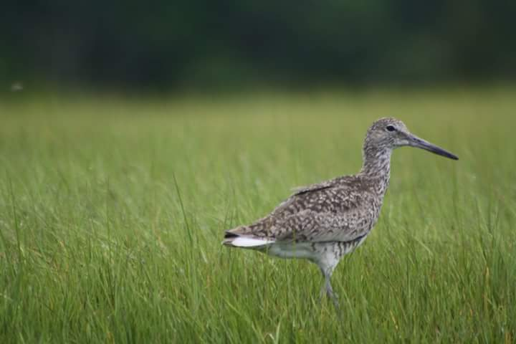
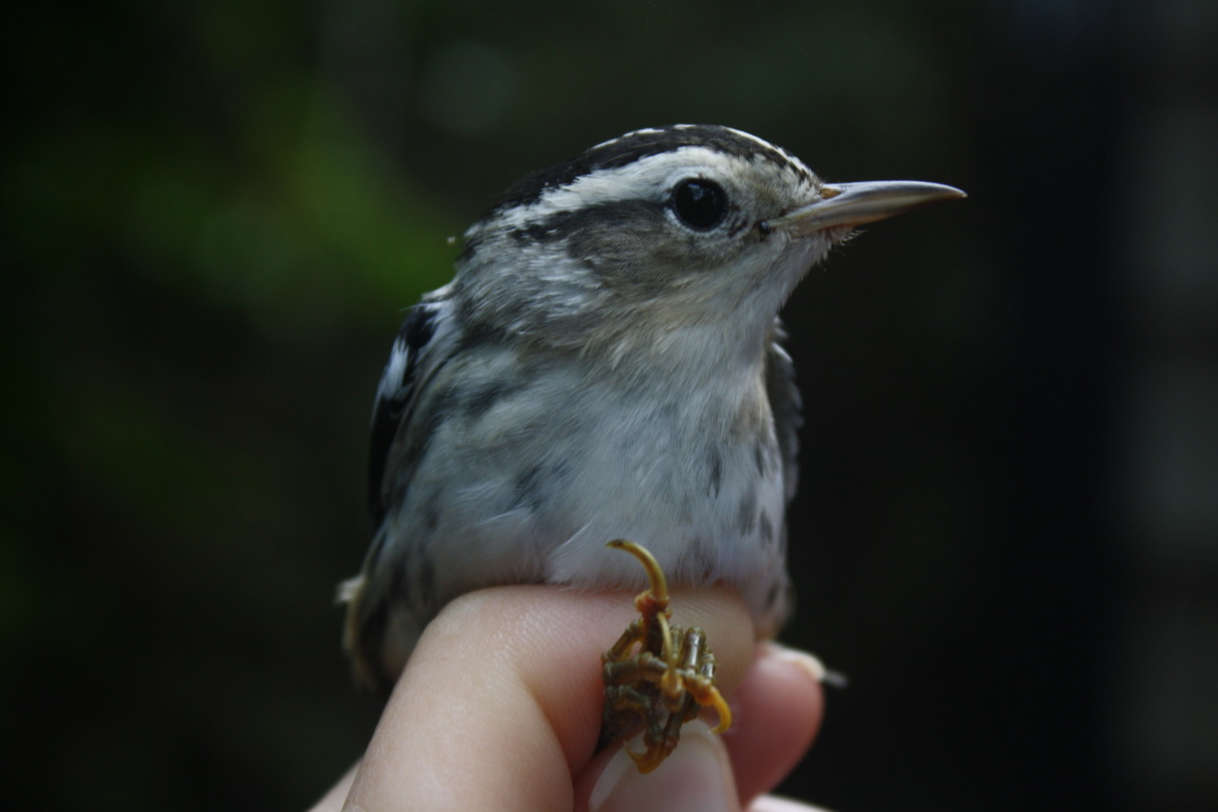
RI Birds
Template by Eric Curts

Slide 2
JEOPARDY BOARD
FINAL JEOPARDY
Bird Habitats | Bird Groups | Bird Adaptations | RI Bird Conservation | Helping Birds
$100 | $100 | $100 | $100 | $100
$200 | $200 | $200 | $200 | $200
$300 | $300 | $300 | $300 | $300
$400 | $400 | $400 | $400 | $400
$500 | $500 | $500 | $500 | $500

Slide 3

Bird Habitats - $100 Question
What is a young forest?
Click to see answer

Slide 4
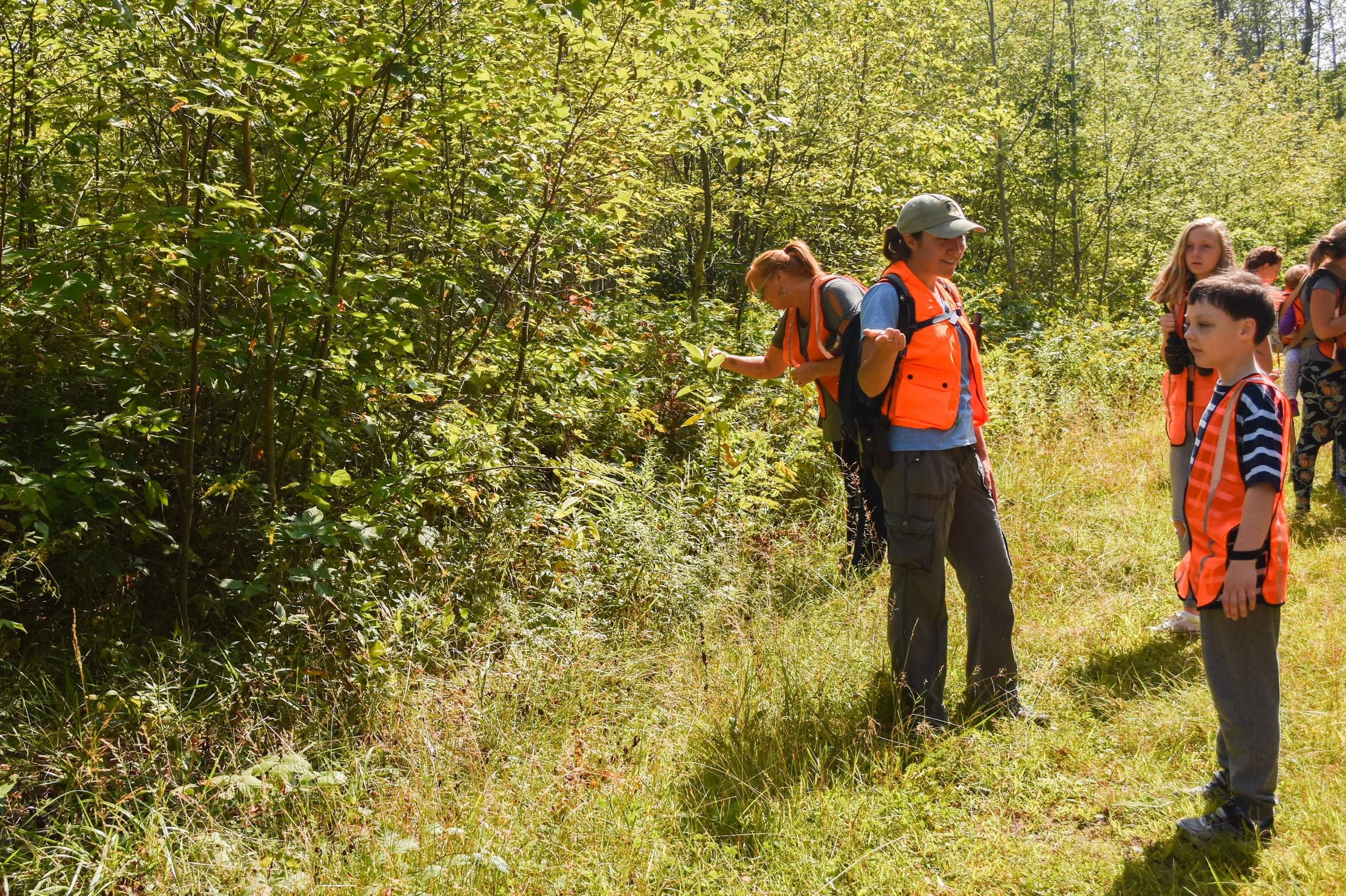

Bird Habitats - $100 Answer
A young forest has small, young trees that grow close together. This creates a lot of cover/shelter for many birds!
Click to return to Jeopardy Board
Notes:
Young forests are characteristically made up of sun-loving species like aspens, birches, maples, and oaks. There’s usually lots of briars and shrubs in the understory. Young forests also provide lots of food for birds in the form of insects and fruits.

Slide 5
Bird Habitats - $200 Question
Name a bird that might use a dead tree as habitat?
Click to see answer

Slide 6
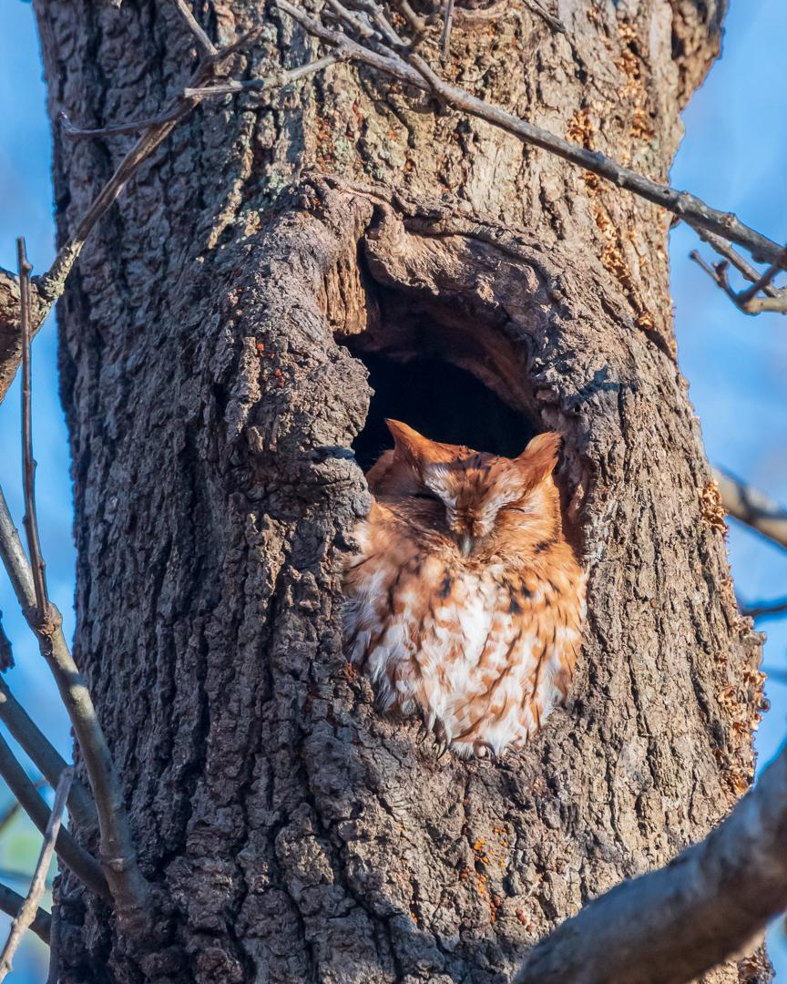
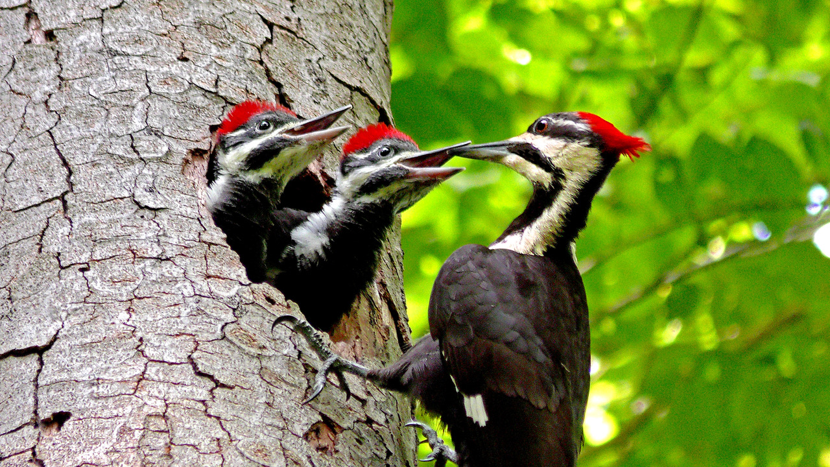
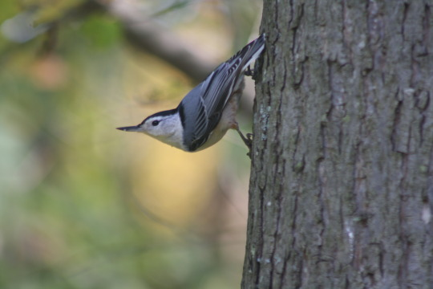
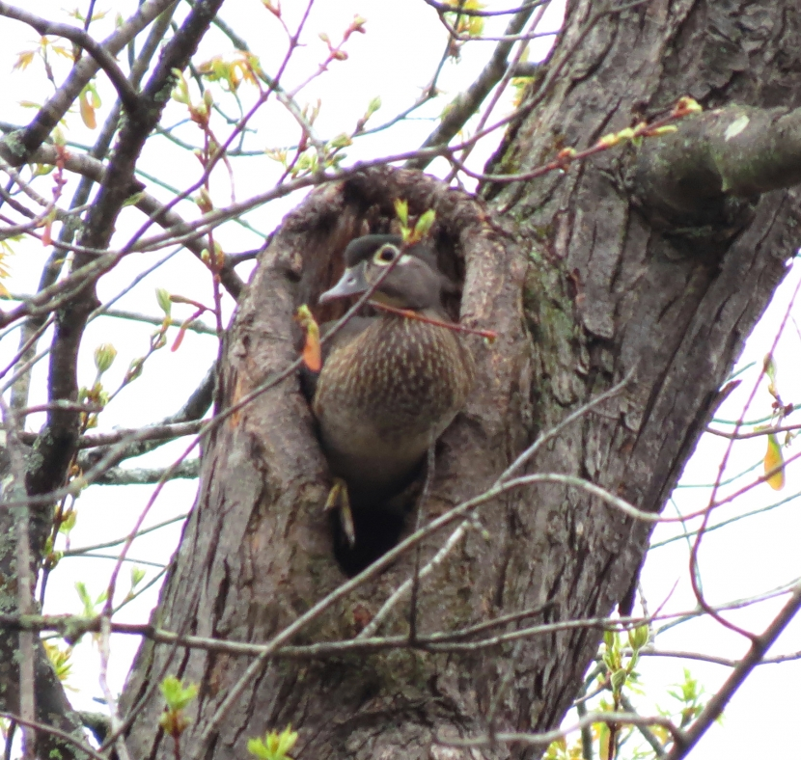
Bird Habitats - $200 Answer
Owl
Woodpecker
Chickadee
Nuthatch
Wood duck
Many more!
Click to return to Jeopardy Board
Notes:
Some birds, like wood ducks and owls, will use existing tree cavities as places to build their nests. Most woodpeckers use existing tree cavities with the exception of the pileated woodpecker (at the top right). Pileated woodpeckers actually excavate their own cavity in a tree trunk using their strong beaks! Nuthatches and woodpeckers use their beaks to pry underneath loose bark to look for insects to eat. There are lots of ways dead trees (AKA “snags”) can be beneficial to birds!

Slide 7
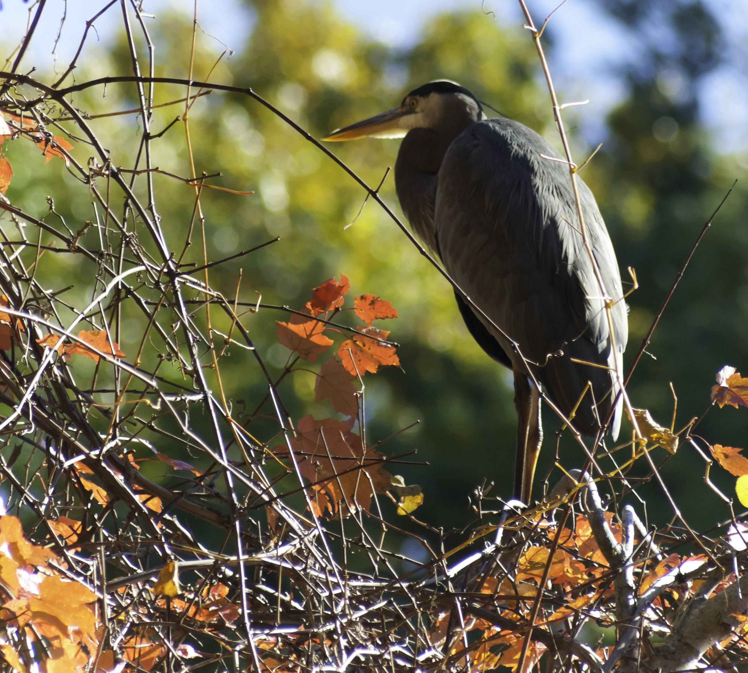
Bird Habitats - $300 Question
In which habitat would you find a great blue heron?
Click to see answer

Slide 8
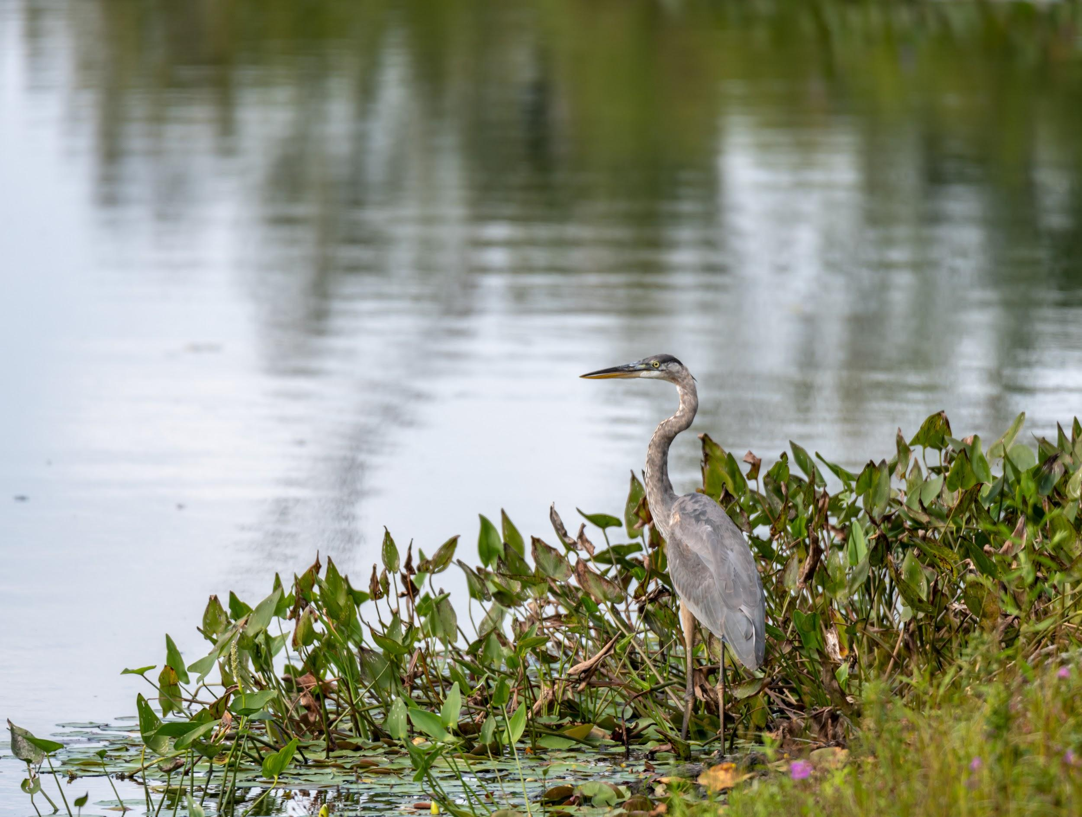
Bird Habitats - $300 Answer
A wetland!
Click to return to Jeopardy Board
Notes:
Wetlands could be swamps, marshes, salt marshes, ponds, bogs, etc. They are habitats where land and water interact.

Slide 9
Bird Habitats - $400 Question
What is an upland habitat?
Click to see answer

Slide 10
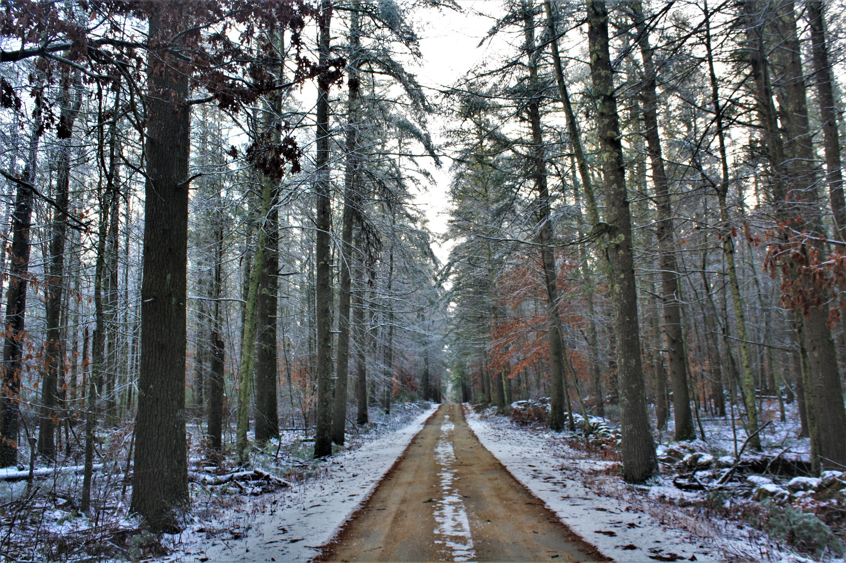
Bird Habitats - $400 Answer
Habitats like forests, shrublands, and meadows (typically dry habitats)
Click to return to Jeopardy Board
Notes:
Upland habitats have drier soils (unlike a wetland, which has soggy soil).

Slide 11
Bird Habitats - $500 Question
Name one threat to bird habitats in Rhode Island.
Click to see answer

Slide 12
Bird Habitats - $500 Answer
Habitat destruction, fragmentation, loss of young forest habitats, renewable energy land development
Click to return to Jeopardy Board
Notes:
Fragmentation is when a big patch of habitat is broken into lots of smaller chunks that are separated by human development (roads, neighborhoods, etc). Loss of habitat due to new human development and removal of forests for renewable energy sources (wind/solar farms) can have negative impacts on birds as well. Young forest habitats are not as common in RI, and many bird species rely on them.

Slide 13
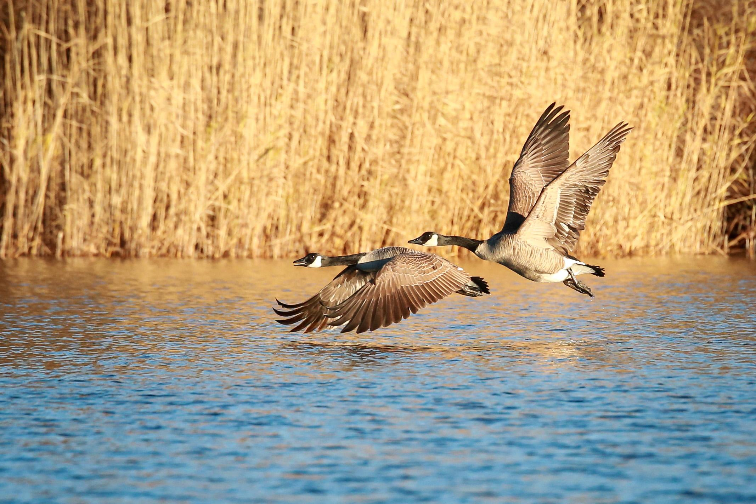
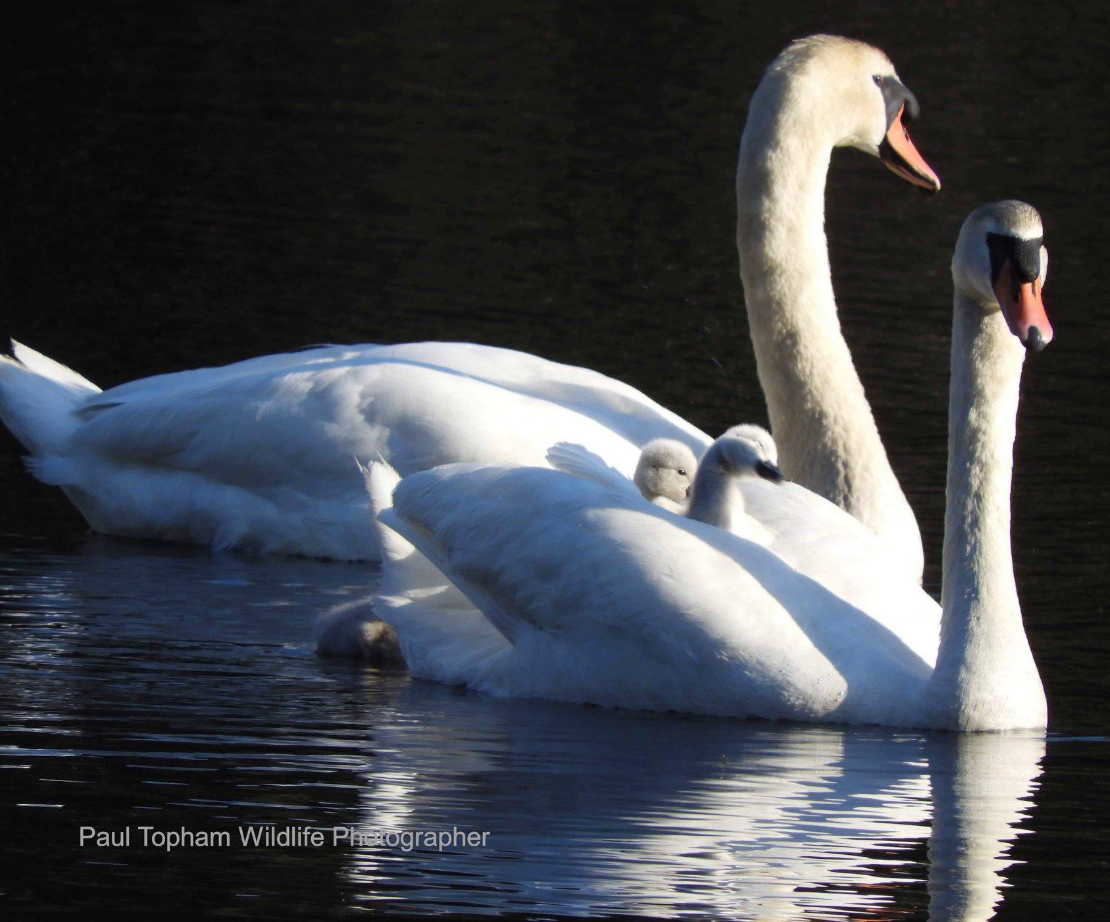
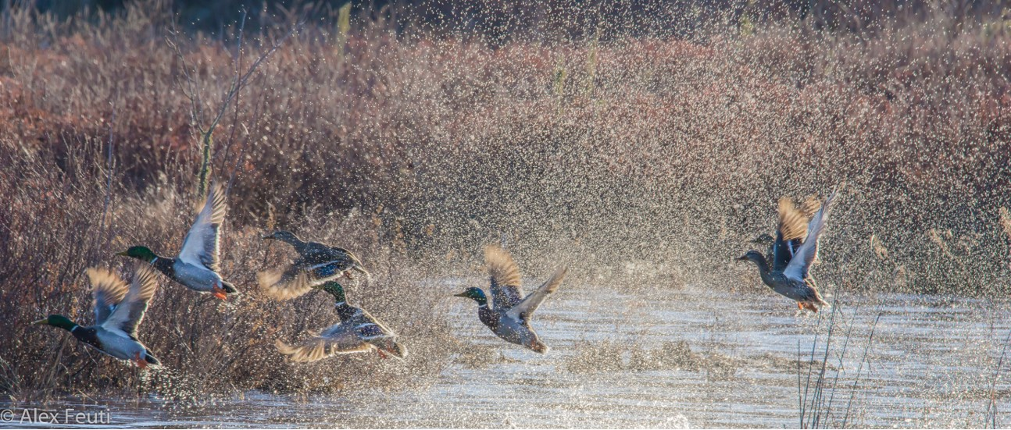
Bird Groups - $100 Question
Ducks, Geese, Swans - Which group?
Click to see answer

Slide 14
Bird Groups- $100 Answer
Waterfowl!
Click to return to Jeopardy Board
Notes:
Waterfowl are built for life in wetlands, with webbed feet and super waterproof feathers.

Slide 15
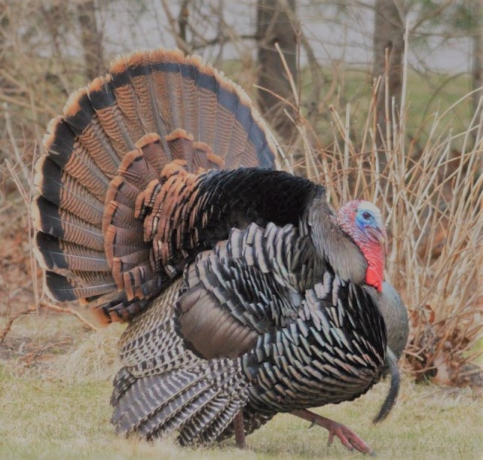
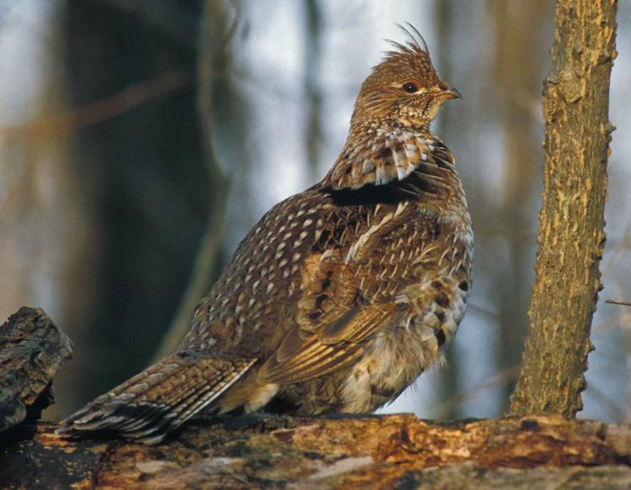
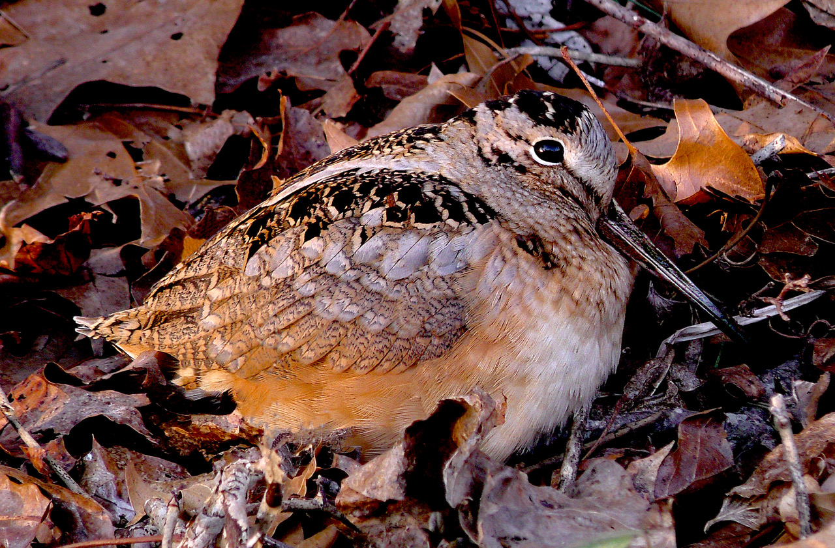
Bird Groups - $200 Question
Wild Turkey, Ruffed Grouse, American Woodcock - Which group?
Click to see answer

Slide 16
Bird Groups - $200 Answer
Upland Game Birds!
Click to return to Jeopardy Board
Notes:
Upland game birds typically nest on the ground, and are very good at camouflaging in their habitats (forests, fields, and shrublands).

Slide 17
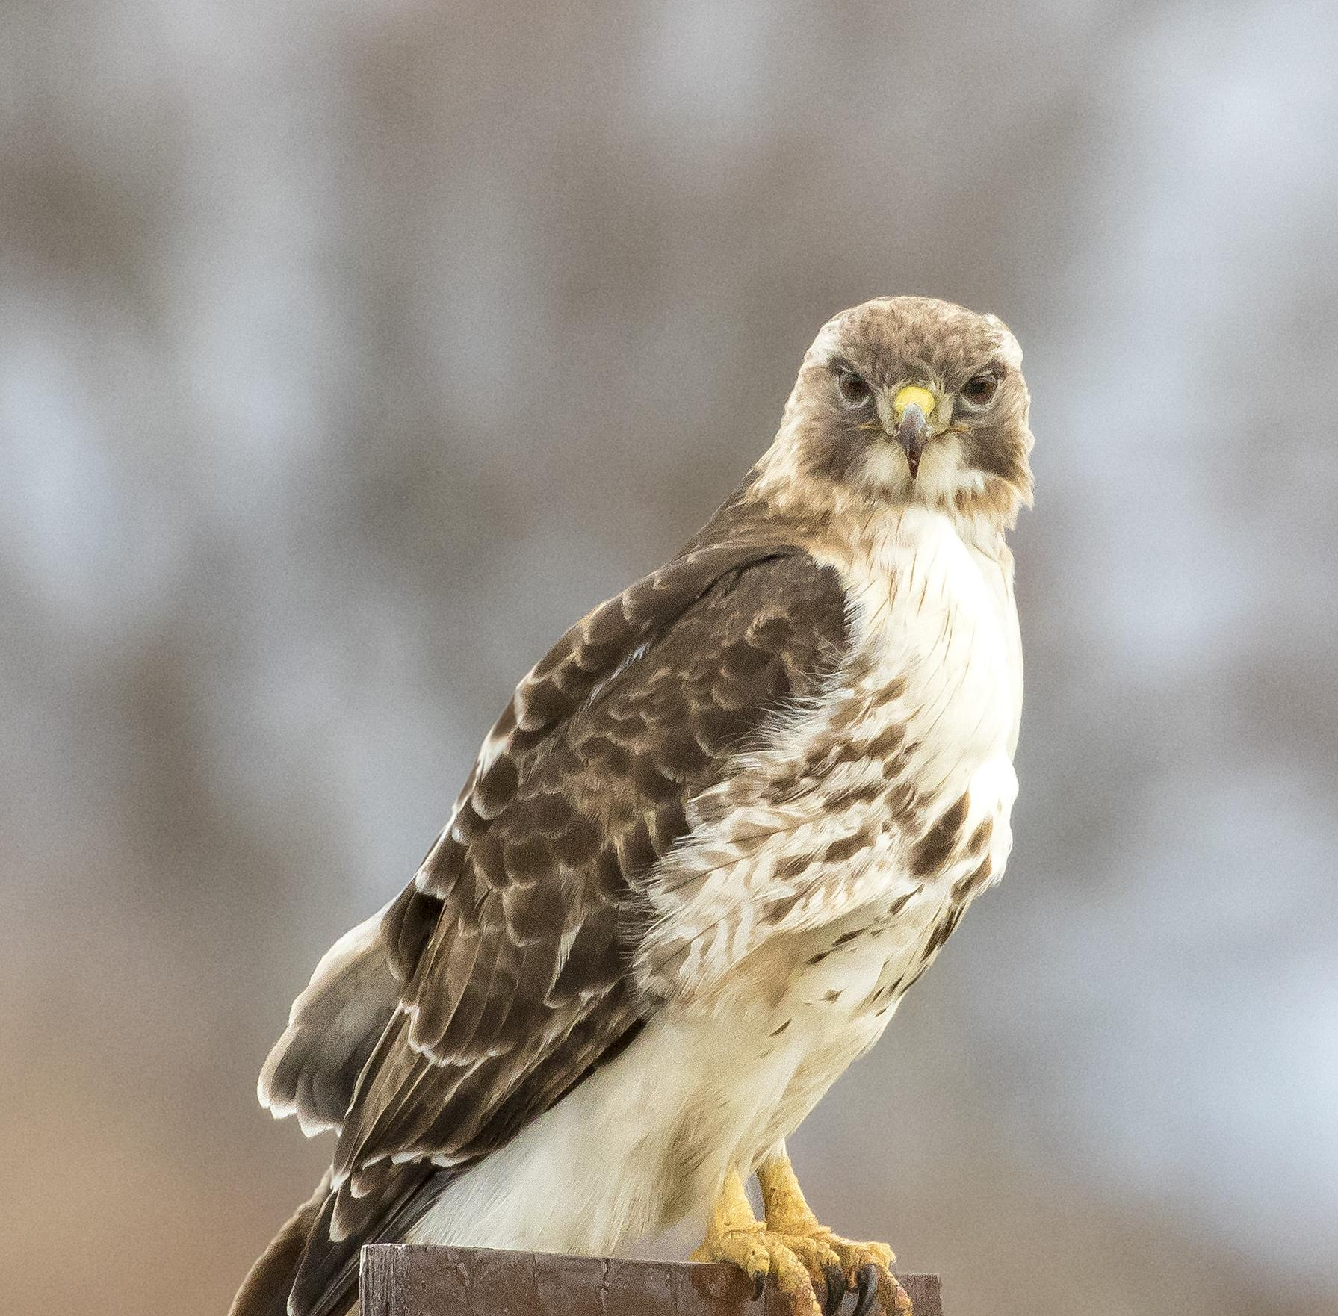
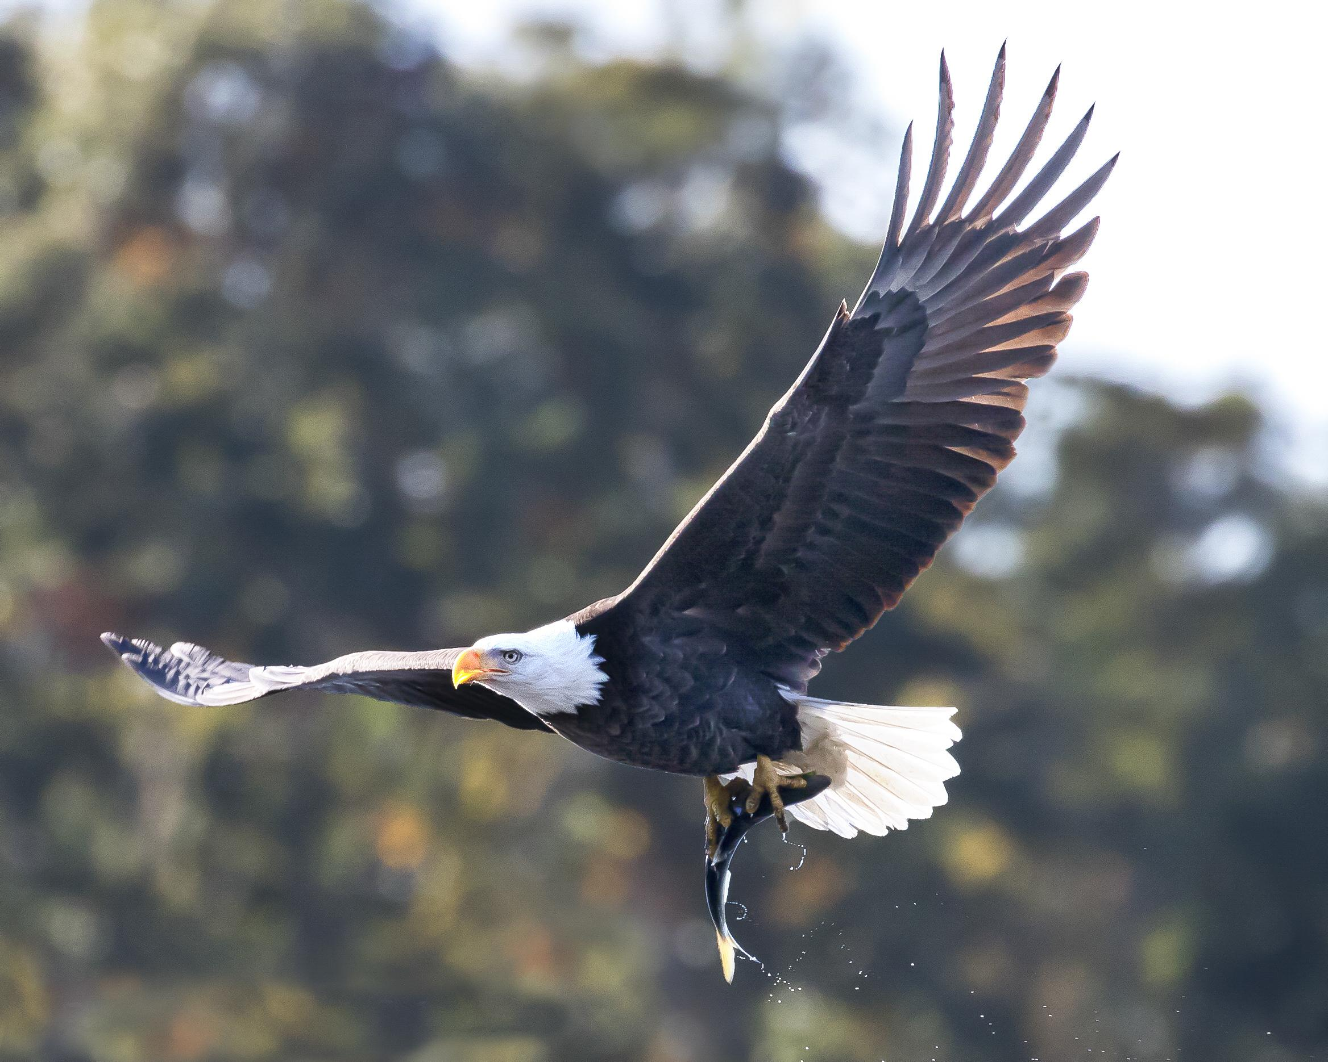
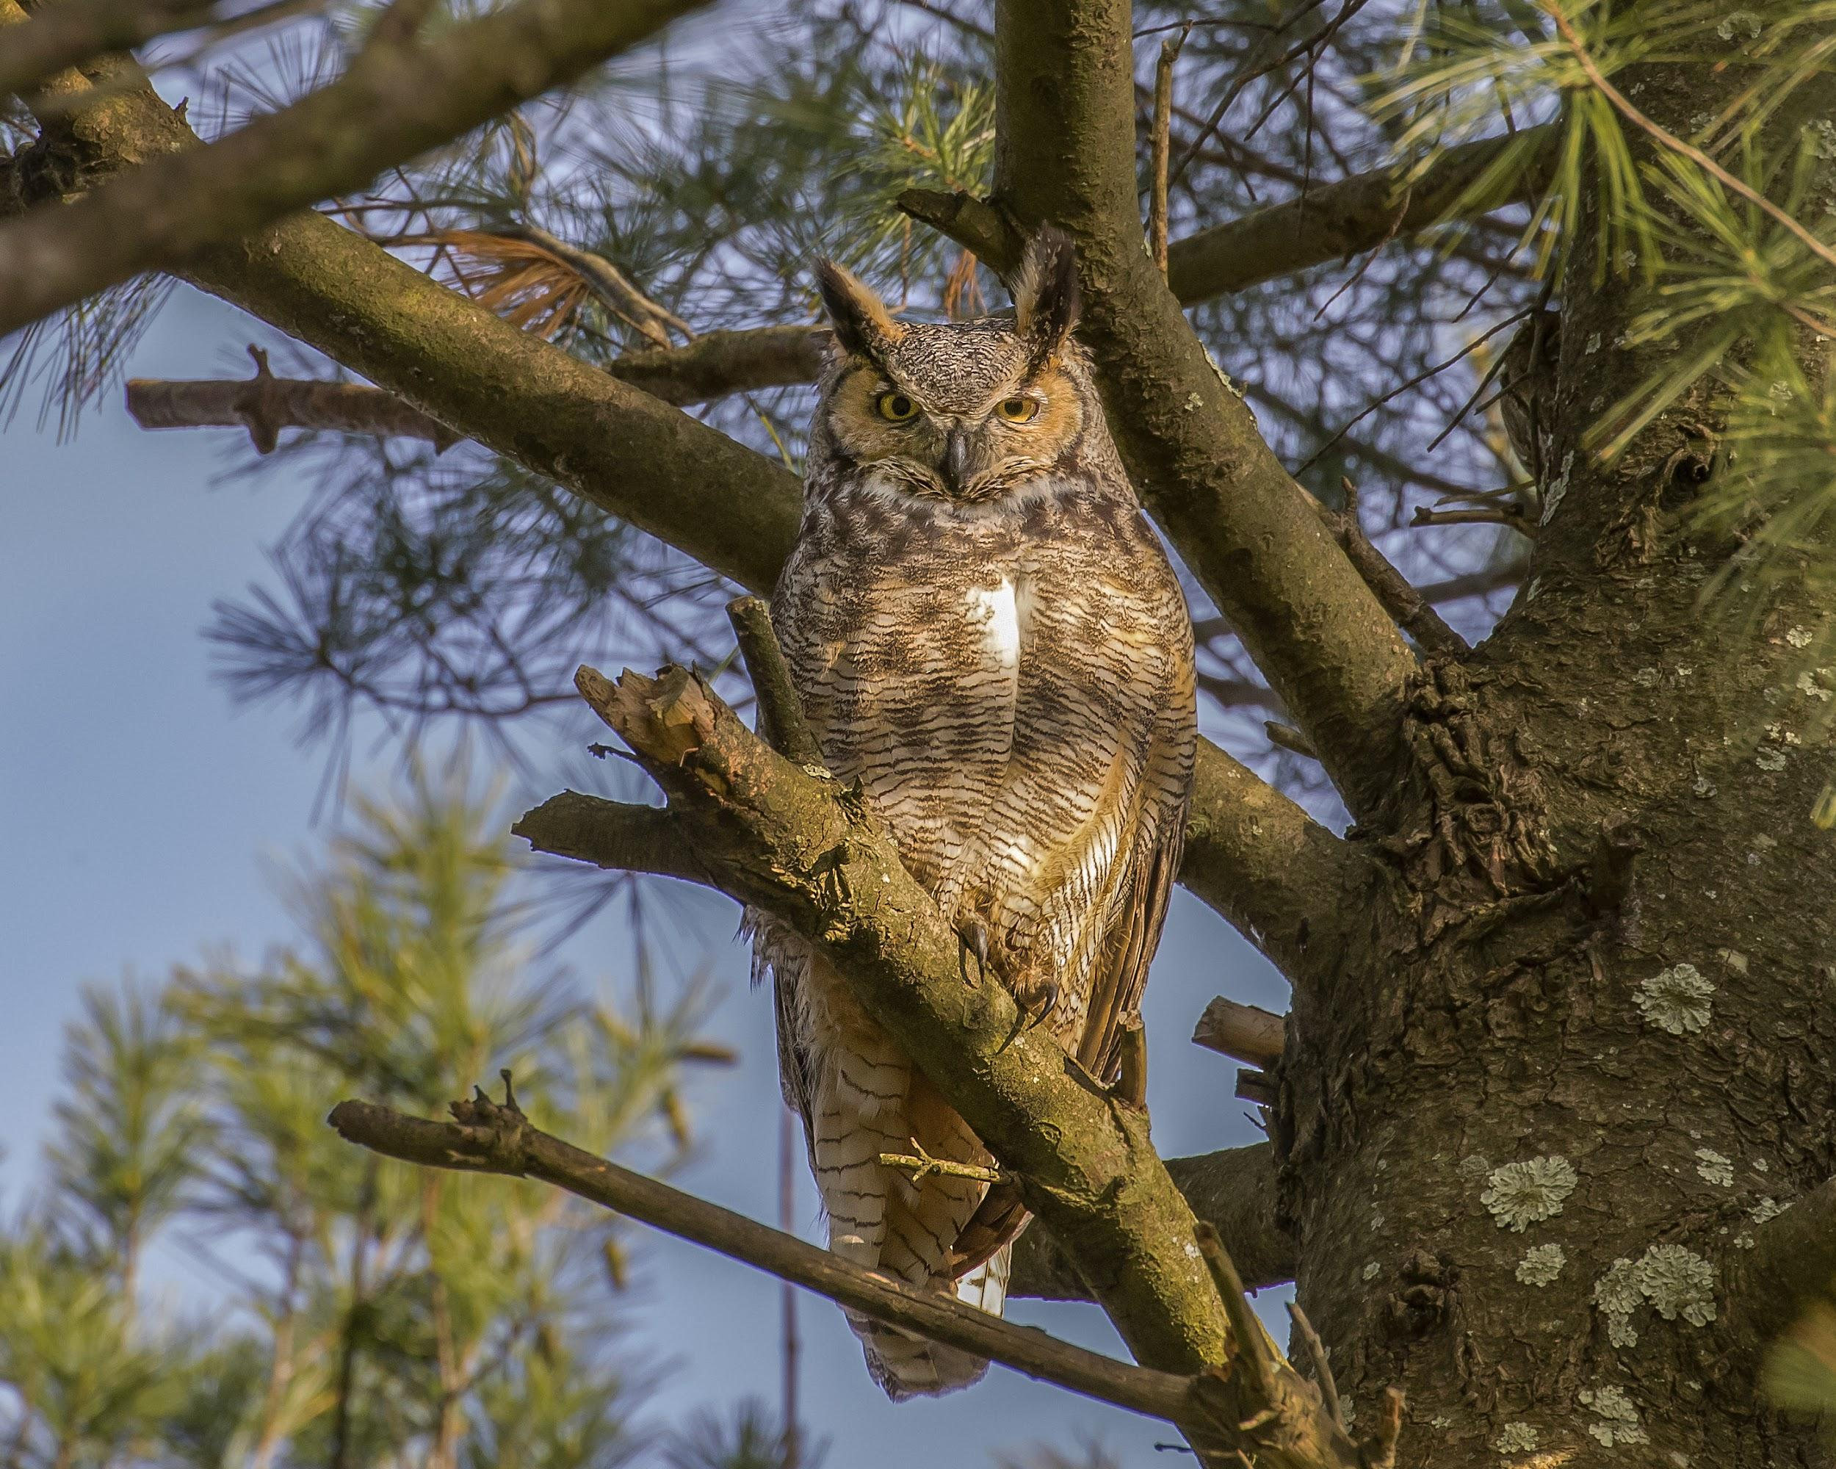
Bird Groups- $300 Question
Hawks, Eagles, Owls - Which group?
Click to see answer

Slide 18
Bird Groups - $300 Answer
Raptors!
Click to return to Jeopardy Board
Notes:
Raptors are birds of prey that live in diverse habitats, from forests to cities. They eat lots of different things: small mammals, other birds, reptiles, amphibians, and insects. They are particularly important for controlling rodent populations, and can be harmed by the use of rat poisons as pest control.

Slide 19
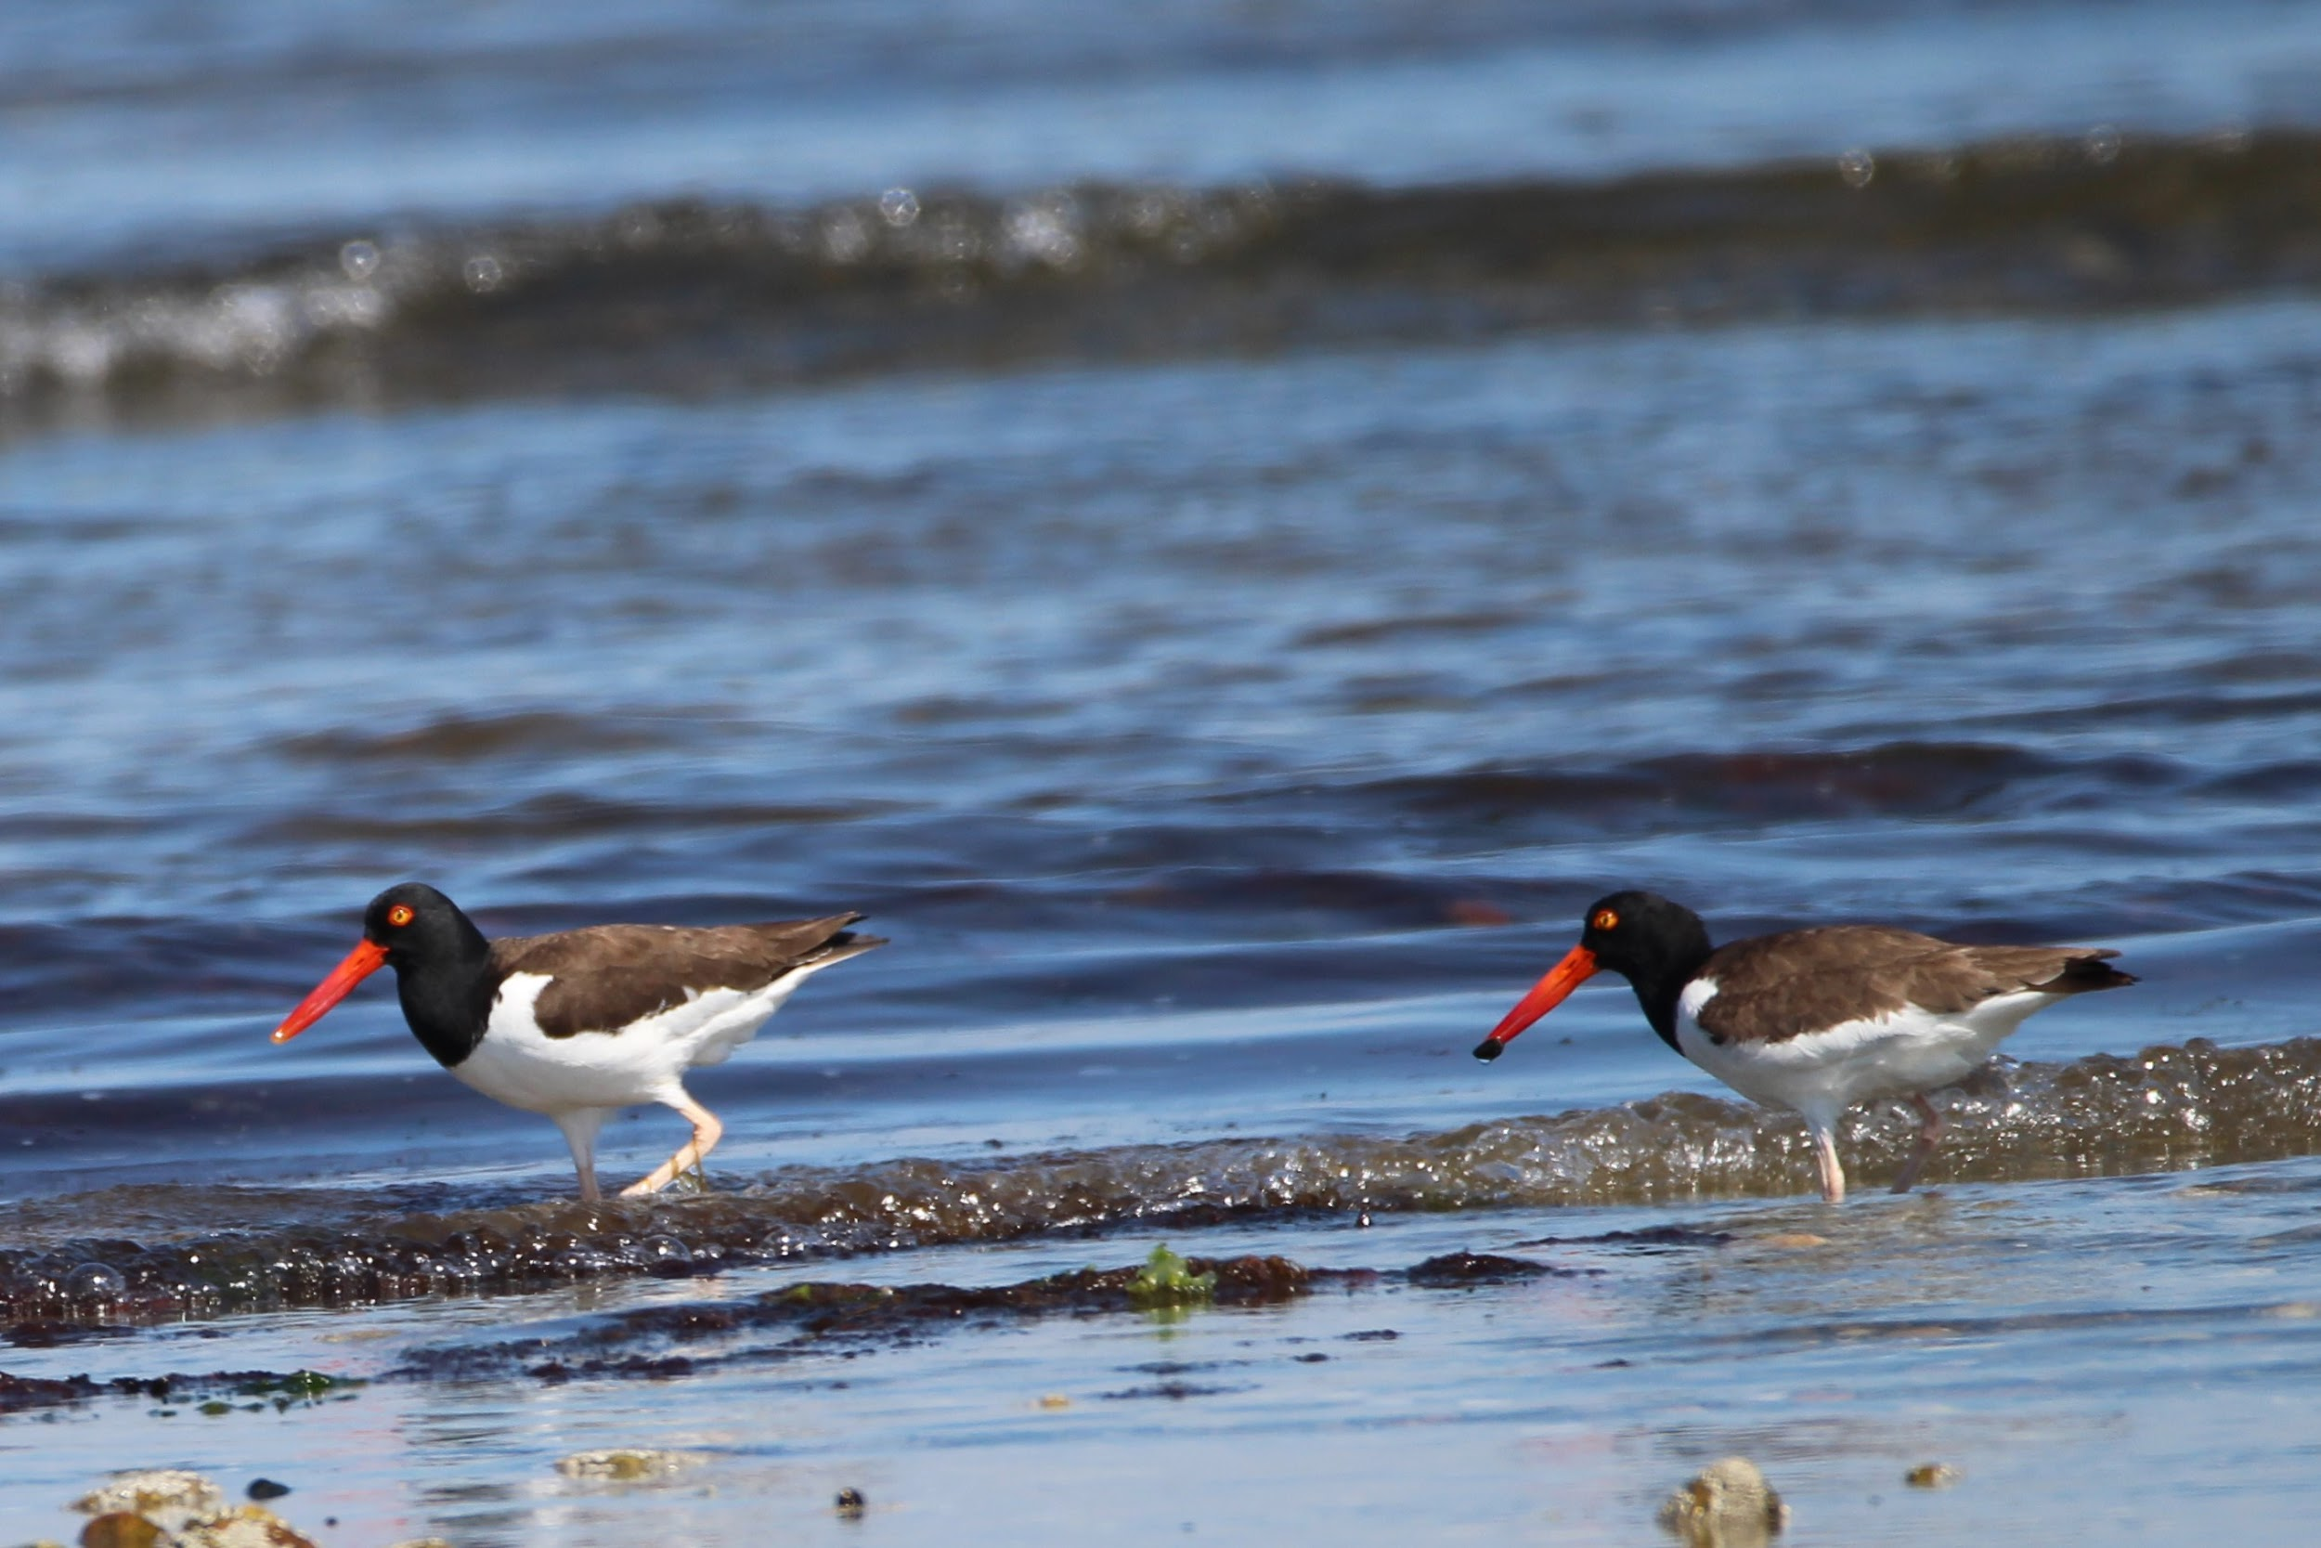
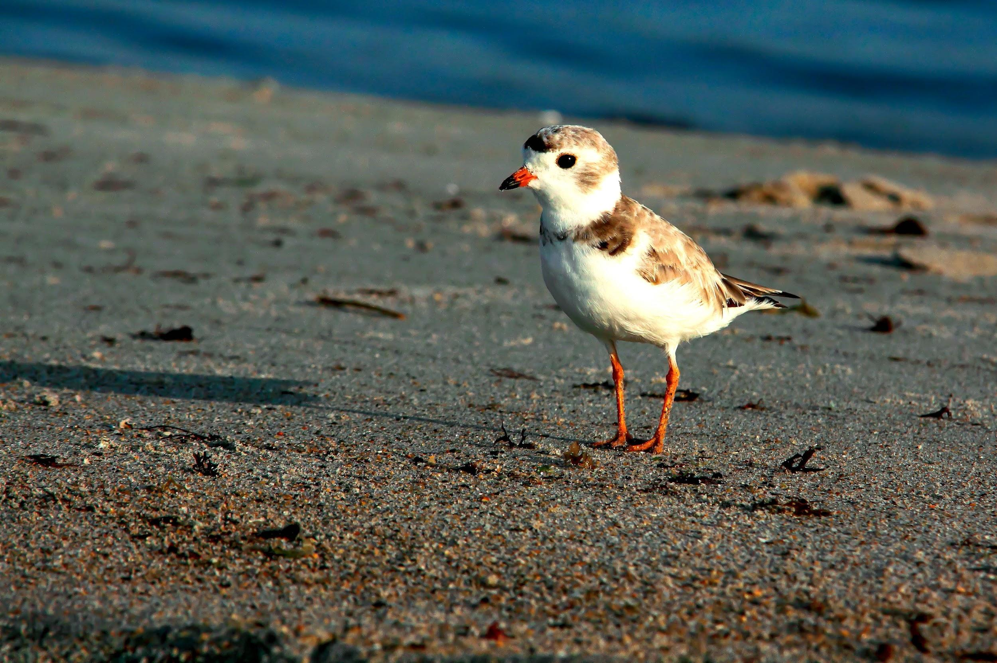
Bird Groups- $400 Question
Sandpipers, Plovers, Oystercatchers - Which group?
Click to see answer

Slide 20
Bird Groups - $400 Answer
Shorebirds!
Click to return to Jeopardy Board
Notes:
Shorebirds typically live on beaches and in salt marshes. They use their long, probe-like beaks to poke through the sand for invertebrates to eat.

Slide 21
Bird Groups- $500 Question
Songbirds - Which group?
Click to see answer

Slide 22
Bird Groups- $500 Answer
Passerines!
Click to return to Jeopardy Board
Notes:
Passerines refers to all perching birds (birds with 3 toes in the front and 1 toe in the back) AKA songbirds. This is a very diverse group and accounts for almost half of all the bird species in the world. Passerines typically eat fruits, insects, and seeds.

Slide 23
Bird Adaptations - $100 Question
True or False: Birds have teeth.
Click to see answer

Slide 24
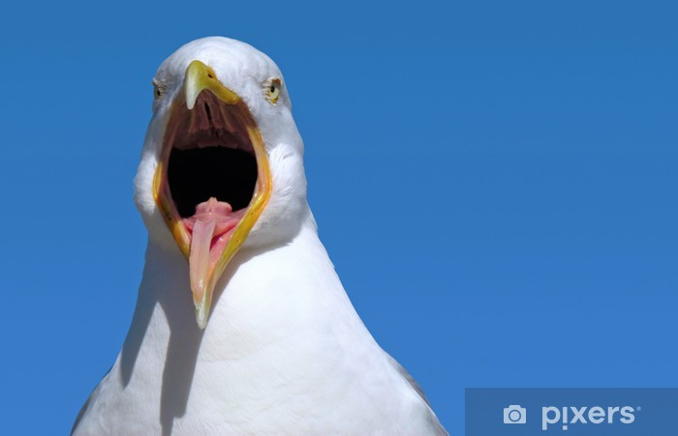
Bird Adaptations - $100 Answer
False!
Click to return to Jeopardy Board

Slide 25
Bird Adaptations - $200 Question
What about a bird’s bones helps it to fly?
Click to see answer

Slide 26
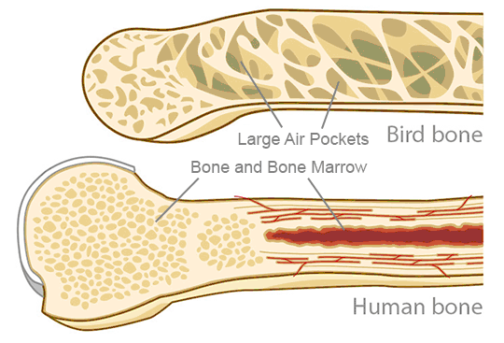
Bird Adaptations - $200 Answer
Many of a bird’s bones are hollow.
Click to return to Jeopardy Board

Slide 27
Bird Adaptations - $300 Question
Name ONE adaptation that makes raptors good predators?
Click to see answer

Slide 28
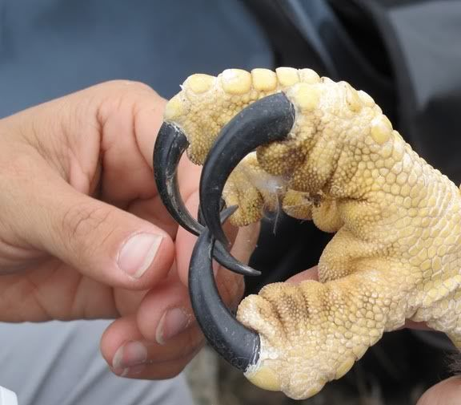
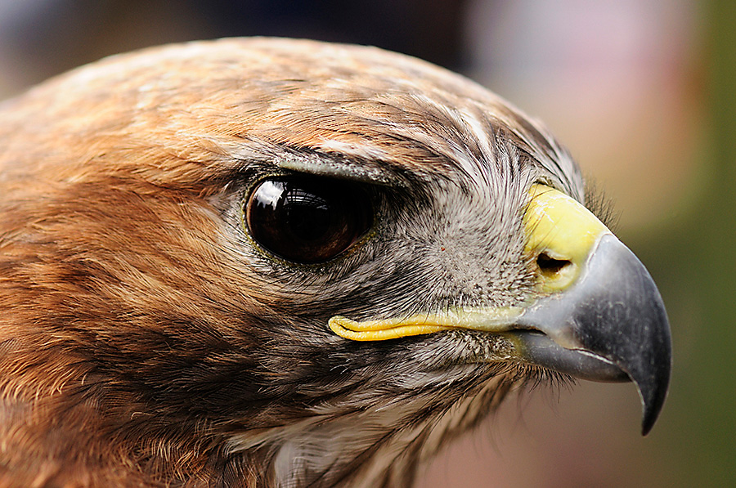
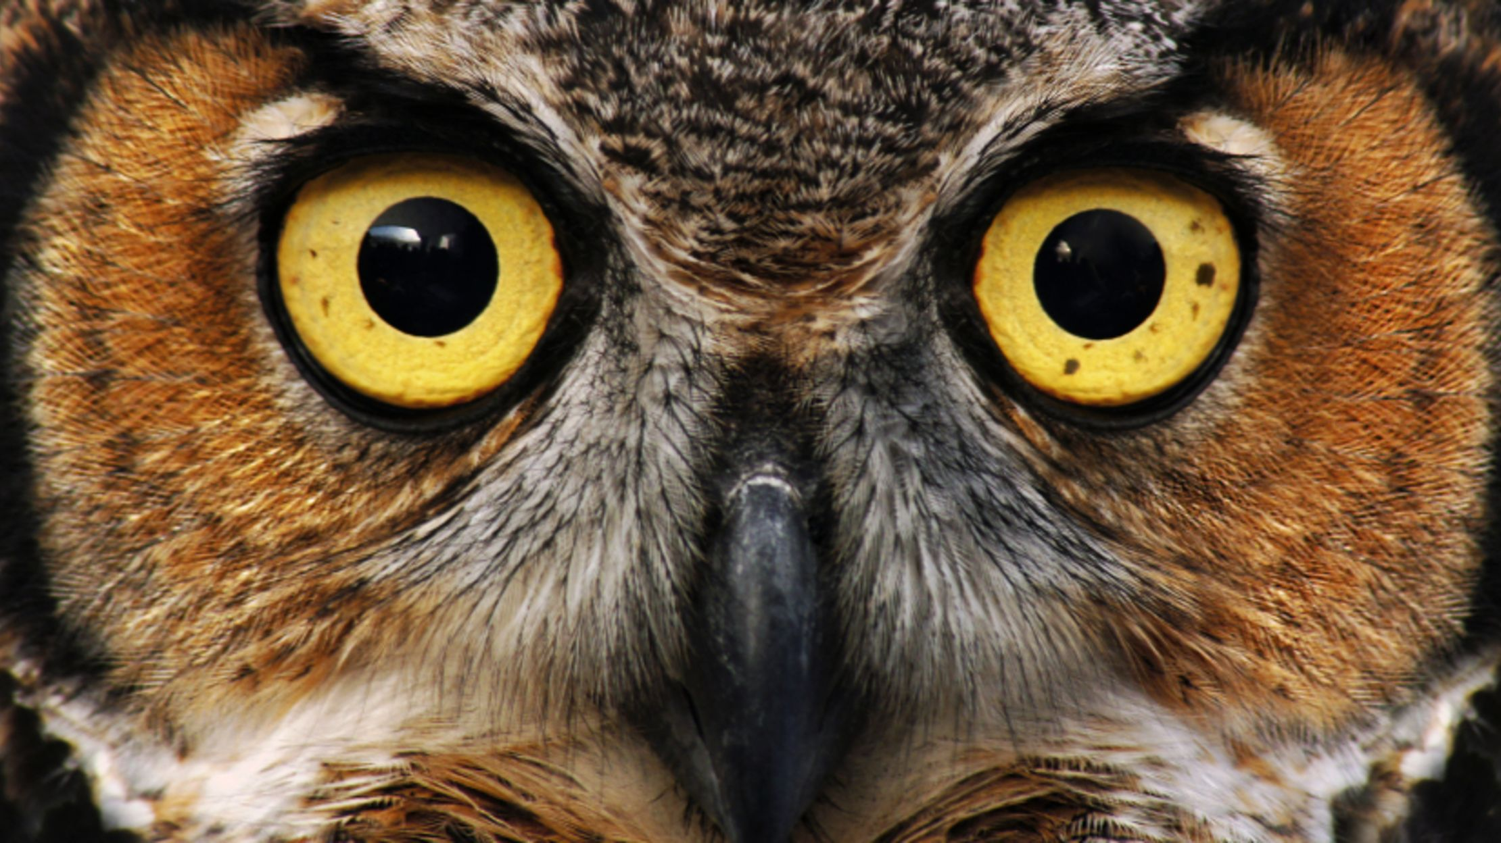
Bird Adaptations - $300 Answer
Sharp beaks, good eyesight, sharp talons
Click to return to Jeopardy Board

Slide 29
Bird Adaptations - $400 Question
What is the name of the structure in a bird’s digestive system that crushes food for digestion?
Click to see answer

Slide 30
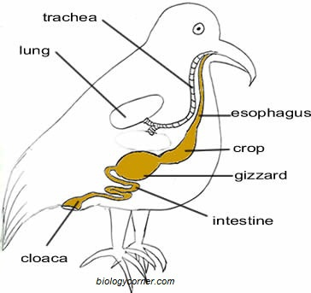
Bird Adapations - $400 Answer
Gizzard
Click to return to Jeopardy Board
Notes:
The gizzard grinds up a bird’s food, and has very strong muscles. Birds will often swallow tiny pebbles or sand, which is stored in their gizzard. These objects help to crush and grind food for digestion.

Slide 31
Bird Adaptations - $500 Question
What is the name of the structure that birds use to store food?
Click to see answer

Slide 32
Bird Adaptations - $500 Answer
Crop
Click to return to Jeopardy Board
Notes:
Why are there no frogs on Antarctica?-Too cold!

Slide 33
RI Bird Conservation -
$100 Question
If you see a goose wearing a metal leg band in RI, what does that mean?
Click to see answer

Slide 34
RI Bird Conservation -
$100 Answer
That goose has been captured, marked with a numbered band, and released by RI Fish and Wildlife biologists!
Click to return to Jeopardy Board
Notes:
Every year, we capture, mark, and release Canada geese to determine population size in RI, age/sex ratios within the population, and how many birds are harvested during the goose hunting season. Hunters are required to report the number written on the band if they harvest a banded bird. This helps our biologists make the most responsible decision when determining season lengths and the number of animals that can be harvested by each hunter per day (bag limit). The goal is to make sure we care for our game populations in such a way that allows them to thrive and recuperate after a hunting season. It’s all about keeping the balance!

Slide 35
RI Bird Conservation -
$200 Question
What is the name of the big project that recorded all of the bird species that live in RI?
Click to see answer

Slide 36
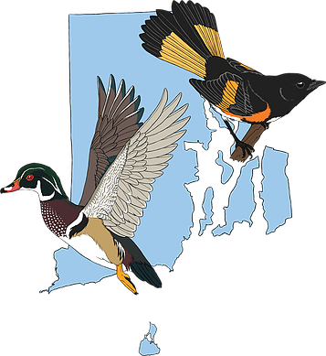
RI Bird Conservation -
$200 Answer
The Rhode Island Bird Atlas
Click to return to Jeopardy Board
Notes:
The original RI Bird Atlas was completed in the 1980s. Our state and its bird populations have changed a lot since then, so it was time to update our information. From 2015-2019, over 200 volunteers and 20 biological technicians gathered data on birds across the entire state during the breeding season, fall/spring migration, and even during the winter. The results have given us an amazing snapshot of which bird species we have in the state and the spread of habitats each species is using. All of this information will be very valuable in the future as we make habitat conservation and management decisions to benefit our birds and other wildlife.

Slide 37
RI Bird Conservation-
$300 Question
Which very secretive bird uses young forest habitat? (Hint: It makes a very silly call, and does a fancy “sky dance” in the spring…)
Click to see answer

Slide 38
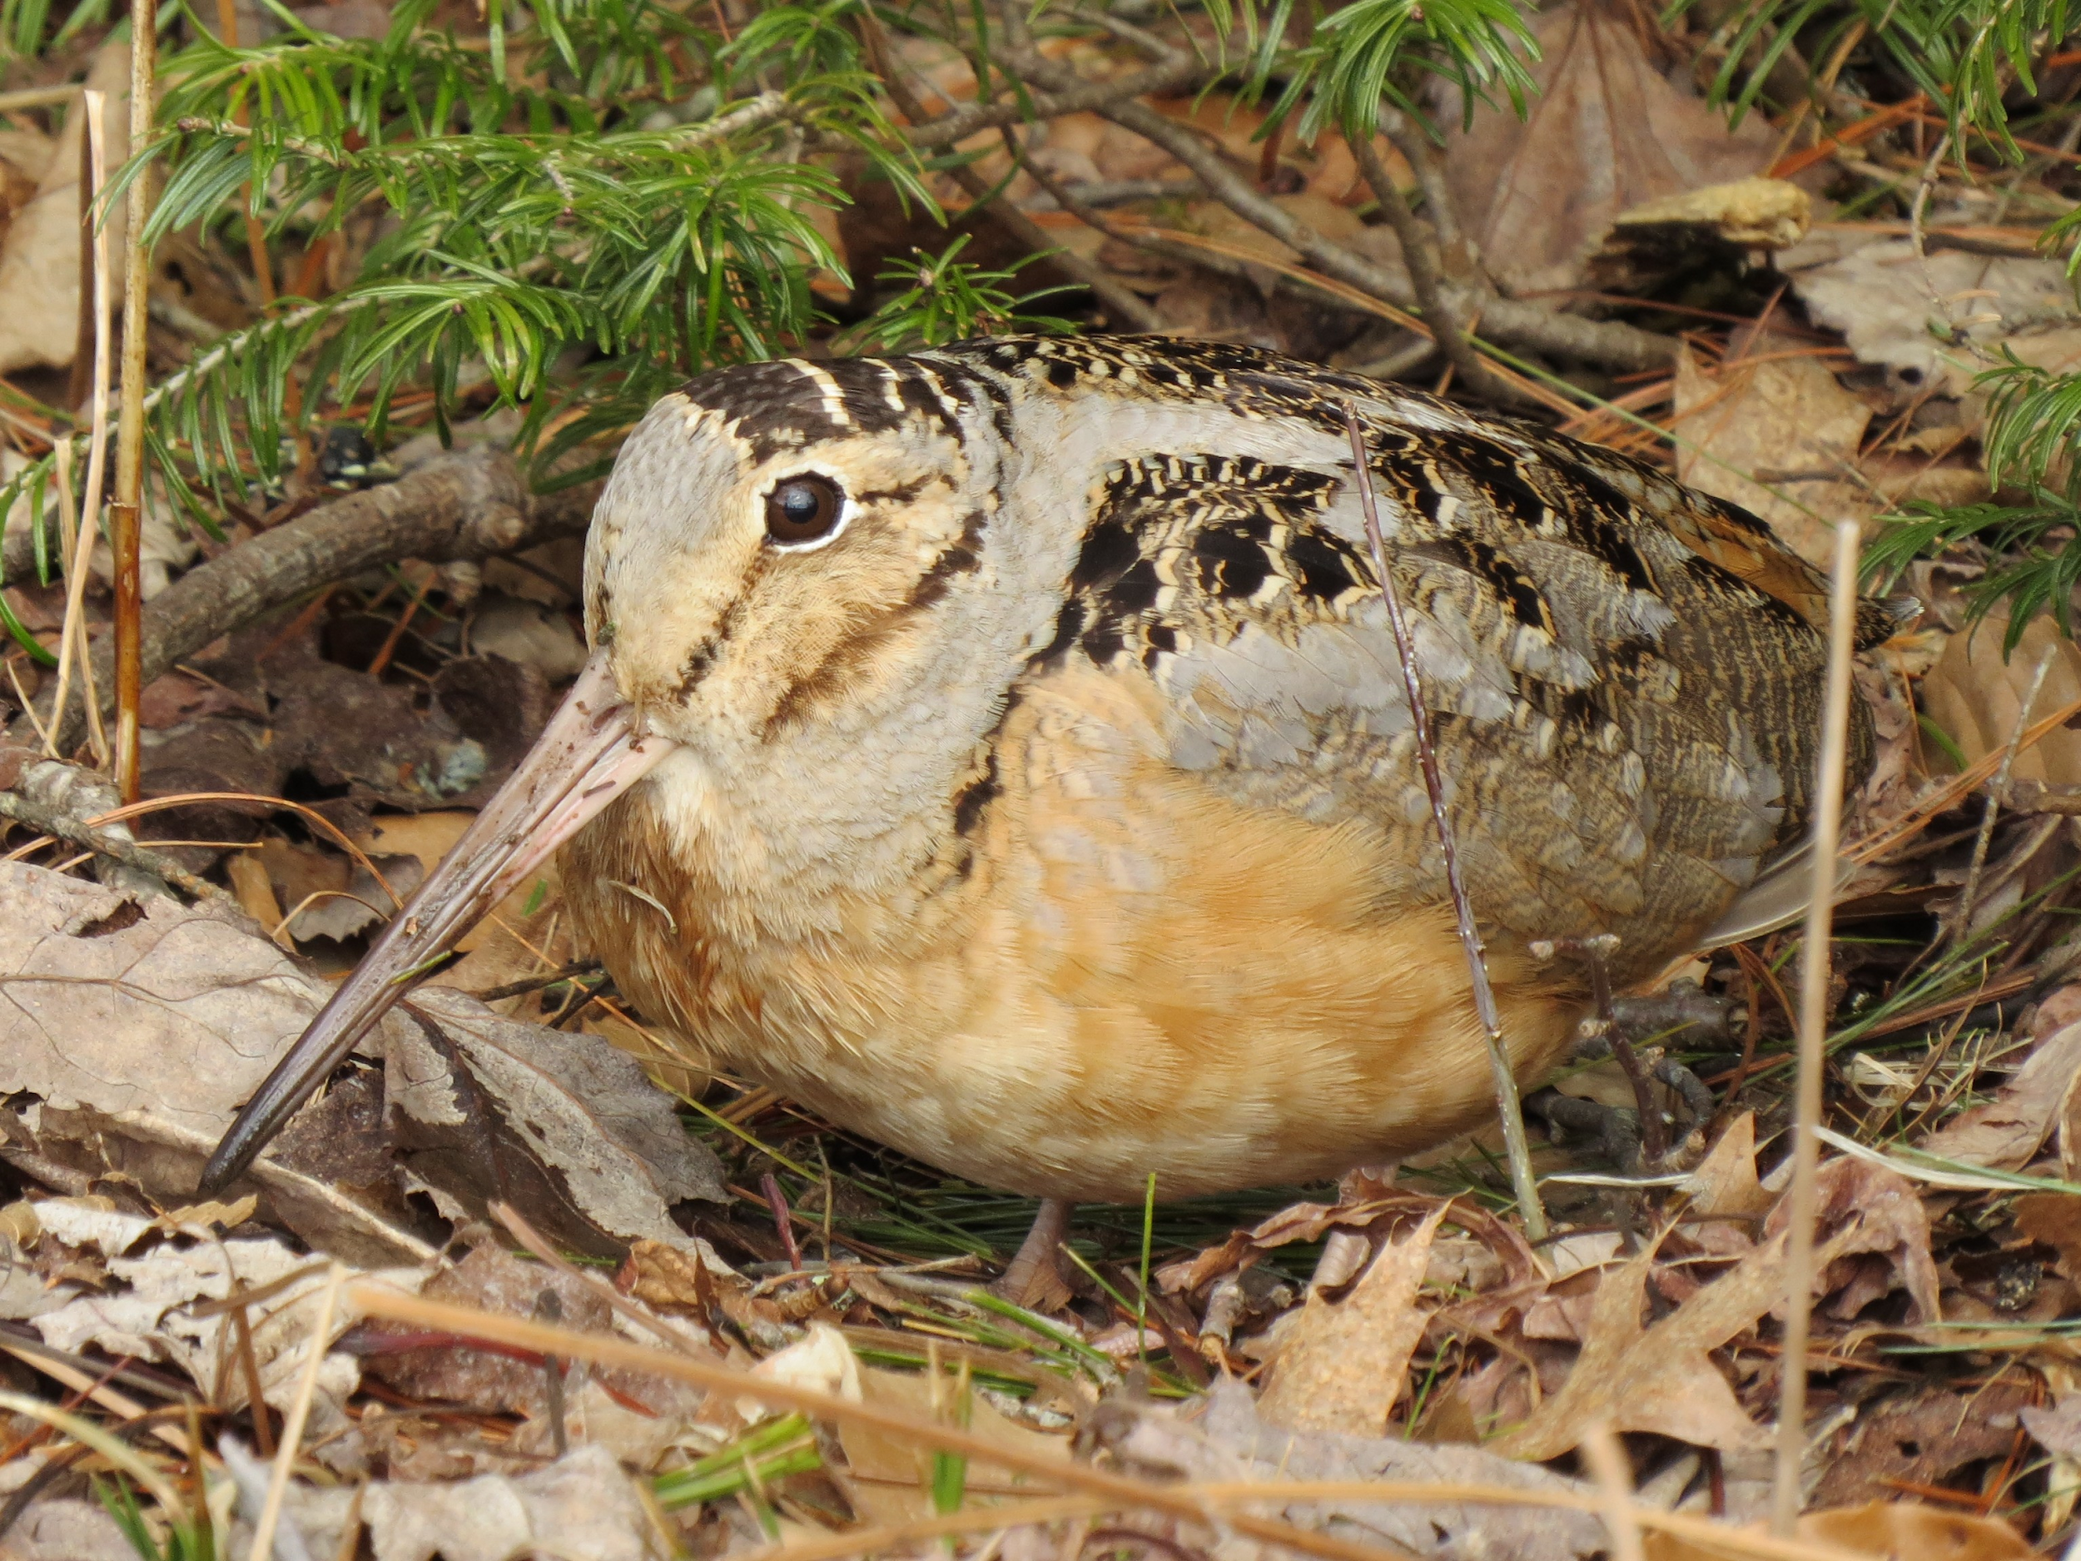
RI Bird Conservation -
$300 Answer
The American Woodcock
(Timberdoodle)
Click to return to Jeopardy Board
Notes:
The American woodcock requires a bunch of different habitats: fields for its spring mating display, called the “sky dance,” wetlands to find worms to eat, and young forest for nesting. This shy little bird nests on the ground and is very good at camouflaging. In Rhode Island, we are working to create and maintain young forest habitat for this species, which positively affects many other bird species too! We’ve also worked with graduate students at URI to track woodcock fitted with tiny backpack radiotransmitters to learn more about their habitat preferences and movements.

Slide 39
RI Bird Conservation-
$400 Question
True or False: Birds only migrate to RI for the summer.
Click to see answer

Slide 40
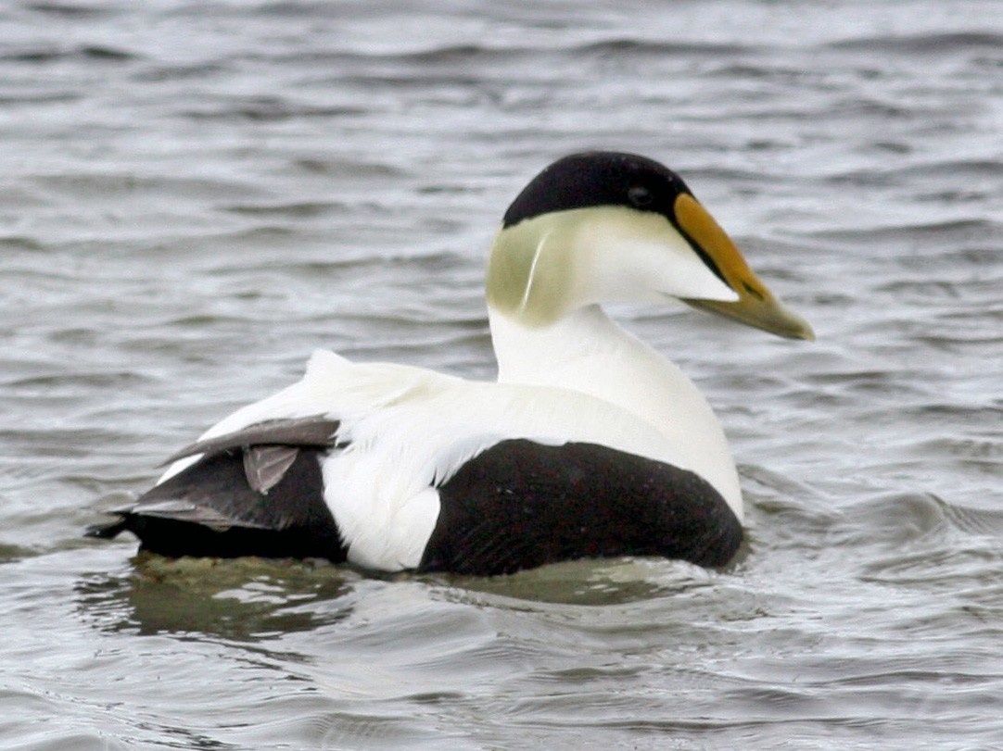
RI Bird Conservation -
$400 Answer
False!
Click to return to Jeopardy Board
Notes:
We have quite a few birds that stay in RI all year long, and some that migrate to RI only for the winter, like our sea ducks! The Narragansett Bay is an important winter habitat for sea ducks and other coastal water birds like loons and grebes, and rarer visitors like razorbills and gannets.

Slide 41
Bird Conservation -
$500 Question
What is the RI Wildlife Action Plan?
Click to see answer

Slide 42
RI Wildlife Conservation -
$500 Answer
It’s our plan to help RI’s Species of Greatest Conservation Need! In it, you can find a list of all the species in RI that need our help.
Click to return to Jeopardy Board
Notes:
To view the list of SGCN birds, click here: http://www.dem.ri.gov/programs/bnatres/fishwild/swap/sgcncomm.pdf

Slide 43
Helping Birds- $100 Question
True or False: Bread is a good food to feed birds.
Click to see answer

Slide 44
Helping Birds - $100 Answer
False! Bread is actually very unhealthy for birds.
Click to return to Jeopardy Board
Notes:
Bread can get trapped in a bird’s throat/digestive system, and moldy bread can even be toxic to birds. Bread has no nutritional value for birds, so eating a lot of it can actually cause growth deformities, especially in waterfowl.

Slide 45
Helping Birds - $200 Question
What are some good foods you can feed your backyard birds?
Click to see answer

Slide 46
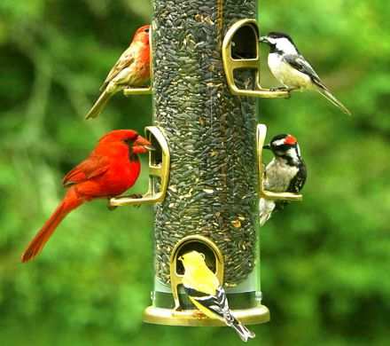
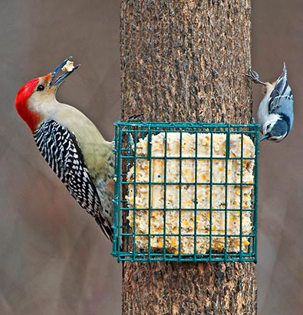
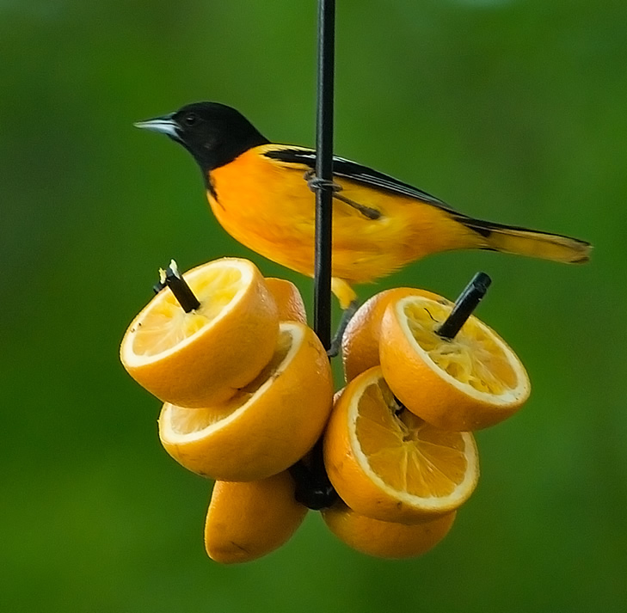
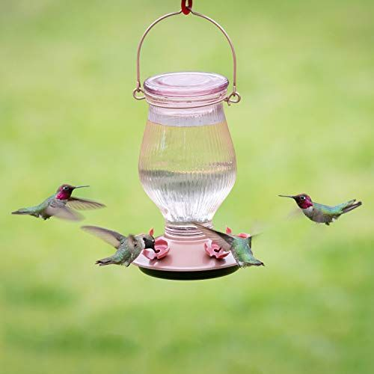
Helping Birds - $200 Answer
Seeds
Fruit
Suet
Sugar water
Click to return to Jeopardy Board
Notes:
There are a lot of things you need to do to properly feed birds. Bird feeders should be cleaned properly with hot water and a diluted vinegar/water or bleach/water solution. Birds can get sick if bird feeders are not cleaned properly. Old seeds and wet food should be removed to avoid mold growth, which can be toxic to birds. Hummingbird feeders should contain a 1:4 sugar:water ratio, and the liquid should NOT contain any dyes or coloring. Hummingbird feeders should be hung up in a shady area, and should only be filled halfway. The water should be changed every 2-3 days to avoid mold growth, which can be toxic to hummingbirds. Feeders should be thoroughly rinsed and scrubbed with hot water when refilled to keep clean. If all of this seems like too much work, you can always plant flowers for hummingbirds, or shrubs that produce fruits for other birds!

Slide 47
Helping Birds - $300 Question
What are some ways you could create shelter for birds in your neighborhood?
Click to see answer

Slide 48
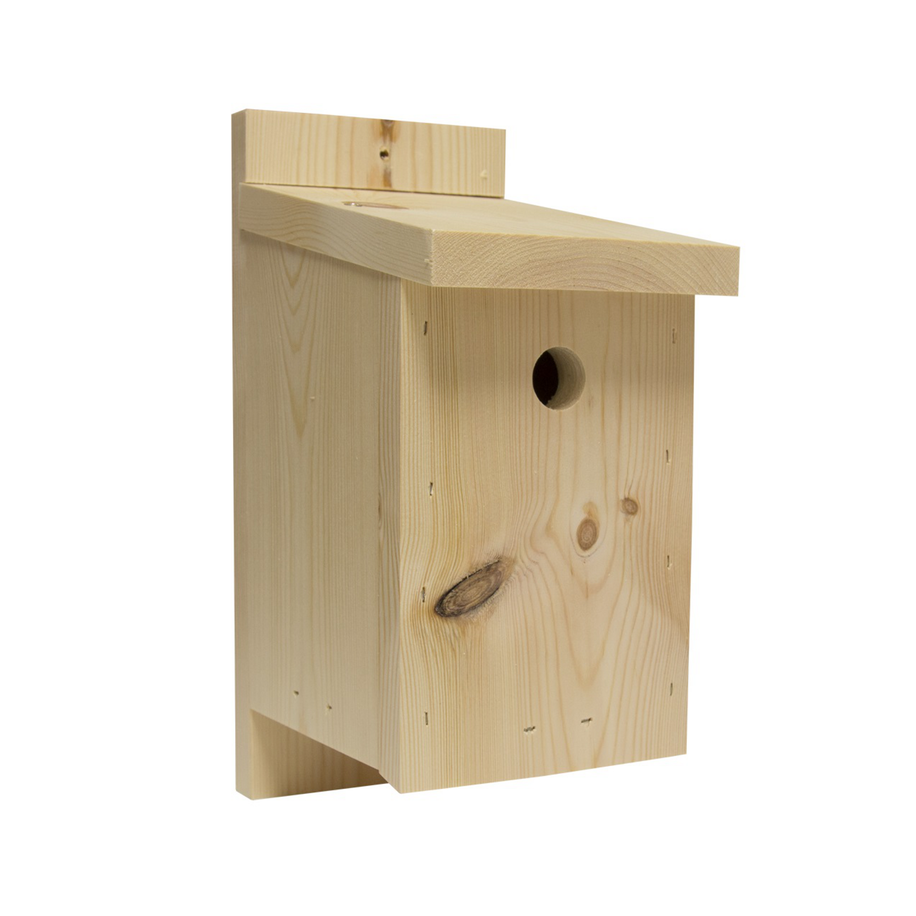
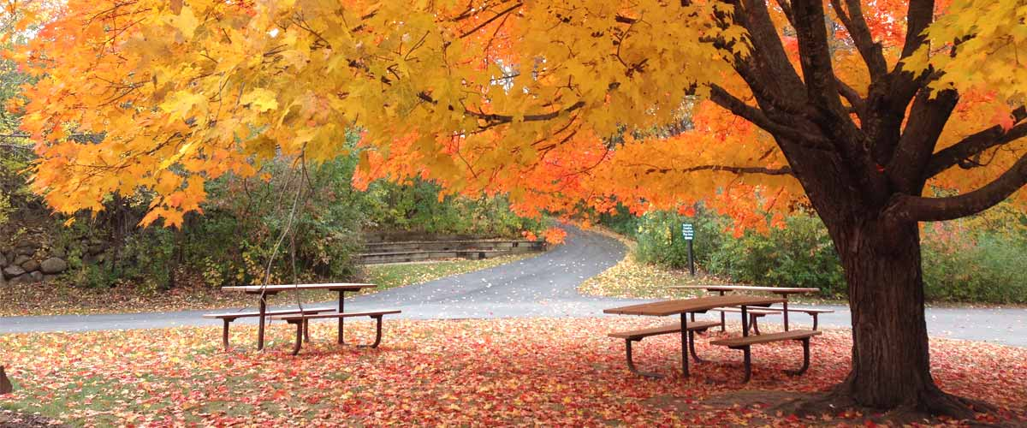
Helping Birds- $300 Answer
Build nest boxes
Plant a native tree/shrub
Click to return to Jeopardy Board
Notes:
Cornell Lab of Ornithology has instructions on how to build a wide variety of nest boxes:
https://www.birds.cornell.edu/k12/educators-guide-to-nest-boxes/
https://nestwatch.org/learn/all-about-birdhouses/

Slide 49
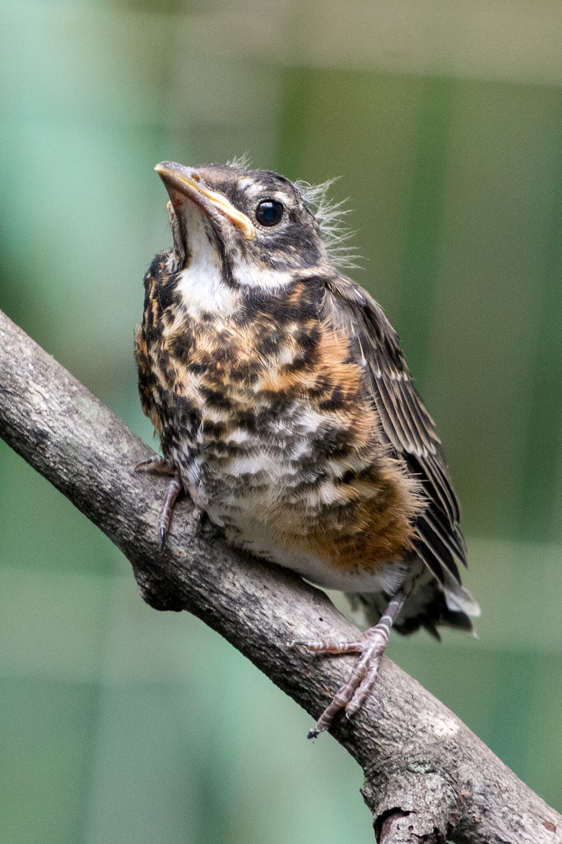
Helping Birds - $400 Question
You found a baby bird on the ground. It can hop, and has feathers. What should you do?
Click to see answer

Slide 50
Helping Birds - $400 Answer
Leave it be! This is a fledgling. It is learning how to fly. They often hop around on the ground, and their parents will take care of them.
Click to return to Jeopardy Board
Notes:
If the fledgling is in danger (i.e. in the road or a driveway) move it to a safe place nearby. If the fledgling is injured, contact the RI Wildlife Rehabilitators Association at 401-294-6363.

Slide 51
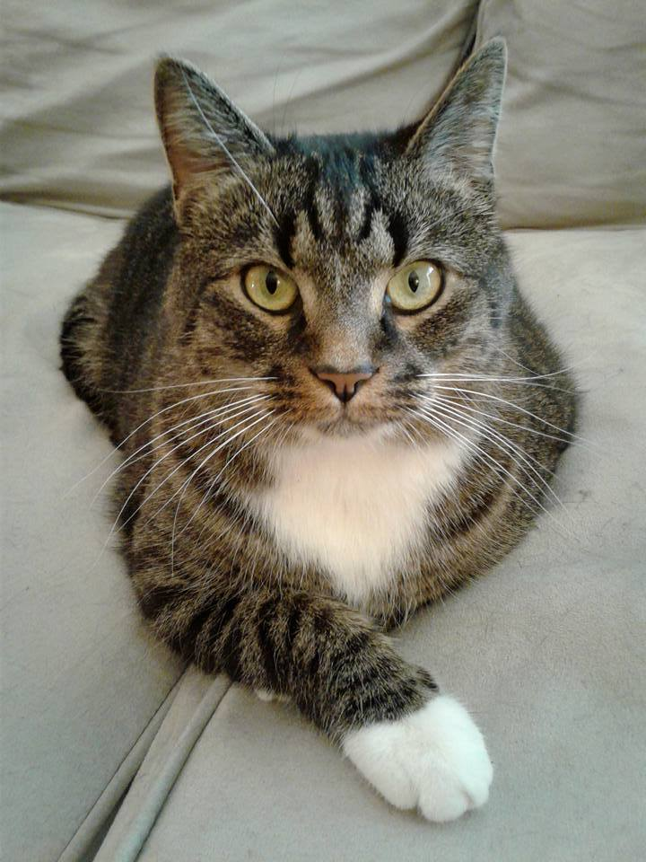
Helping Birds- $500 Question
True or False: Outdoor cats are very dangerous for birds.
Click to see answer

Slide 52
Helping Birds - $500 Answer
True! Cats kill a lot of wild birds each year. Keeping your kitty inside is a good way to help prevent this from happening.
Click to return to Jeopardy Board

Slide 53
FINAL
Topic: Habitat Fragmentation
Click to see question

Slide 54
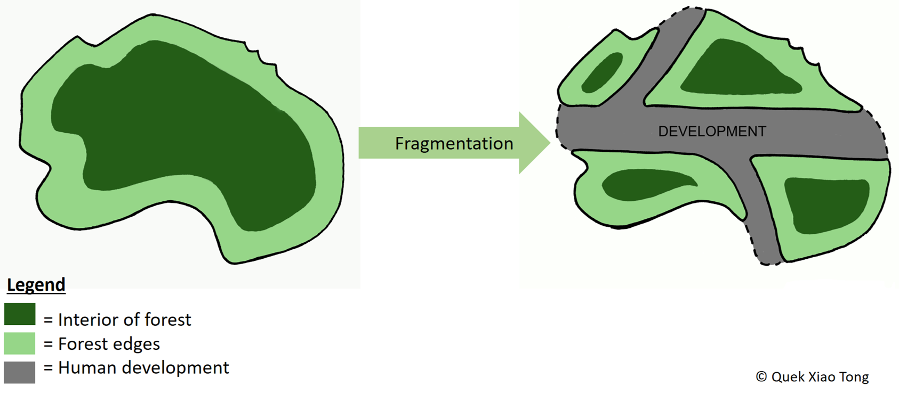
Final Jeopardy Question
How does habitat fragmentation impact birds?
Click to see answer

Slide 55
Final Jeopardy Answer
Harder to find places to find food/rest
Less habitat
Special habitat types get split up and shrink
Habitat patches too small to support nesting population
Click to return to Jeopardy Board

