Slide 1
The Balancing Act
RIDEM Division of Fish and Wildlife
Rhody Critter Kits Program

Slide 2
Keeping the balance can be tricky!
What do all animals (including people) need to survive?
What are some things that animals might do that bother or scare people? What problems might wildlife cause for people?
What are some things that people might do that make it harder for wildlife to survive? What problems can people cause for wildlife?

Slide 3
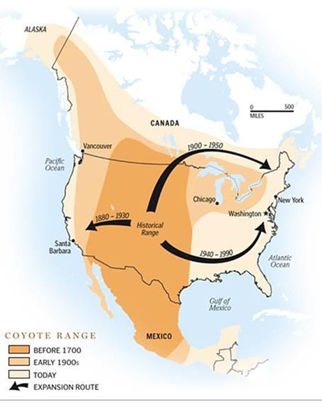
The Coyote’s Story
Canis latrans
Scientific name = “Barking Dog”
Coyote came from the Aztec word “coyotl”
Part of many Native American folktales
First seen in Rhode Island in 1960
Notes:
Once upon a time, there were no coyotes in Rhode Island.
The predators were wolves, cougars and bears until humans pushed them all out and hunted many until they were almost gone.
Coyotes moved from the west to the east, following wagon trains moving people and livestock. Coyotes picked on the trash piles left behind by humans, and took advantage of the easy feeding opportunity.
Once the larger predators were gone, there was more food and space, allowing coyotes to spread all over North America. Coyotes are very comfortable living nearby humans.

Slide 4
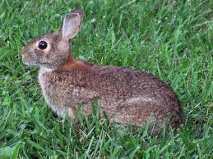
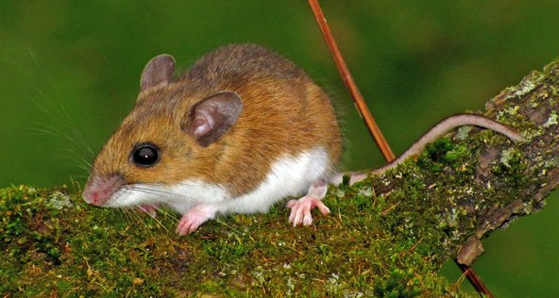
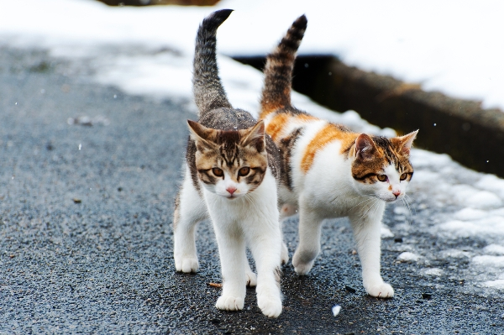
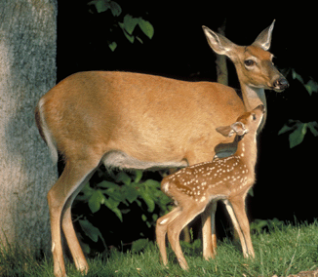
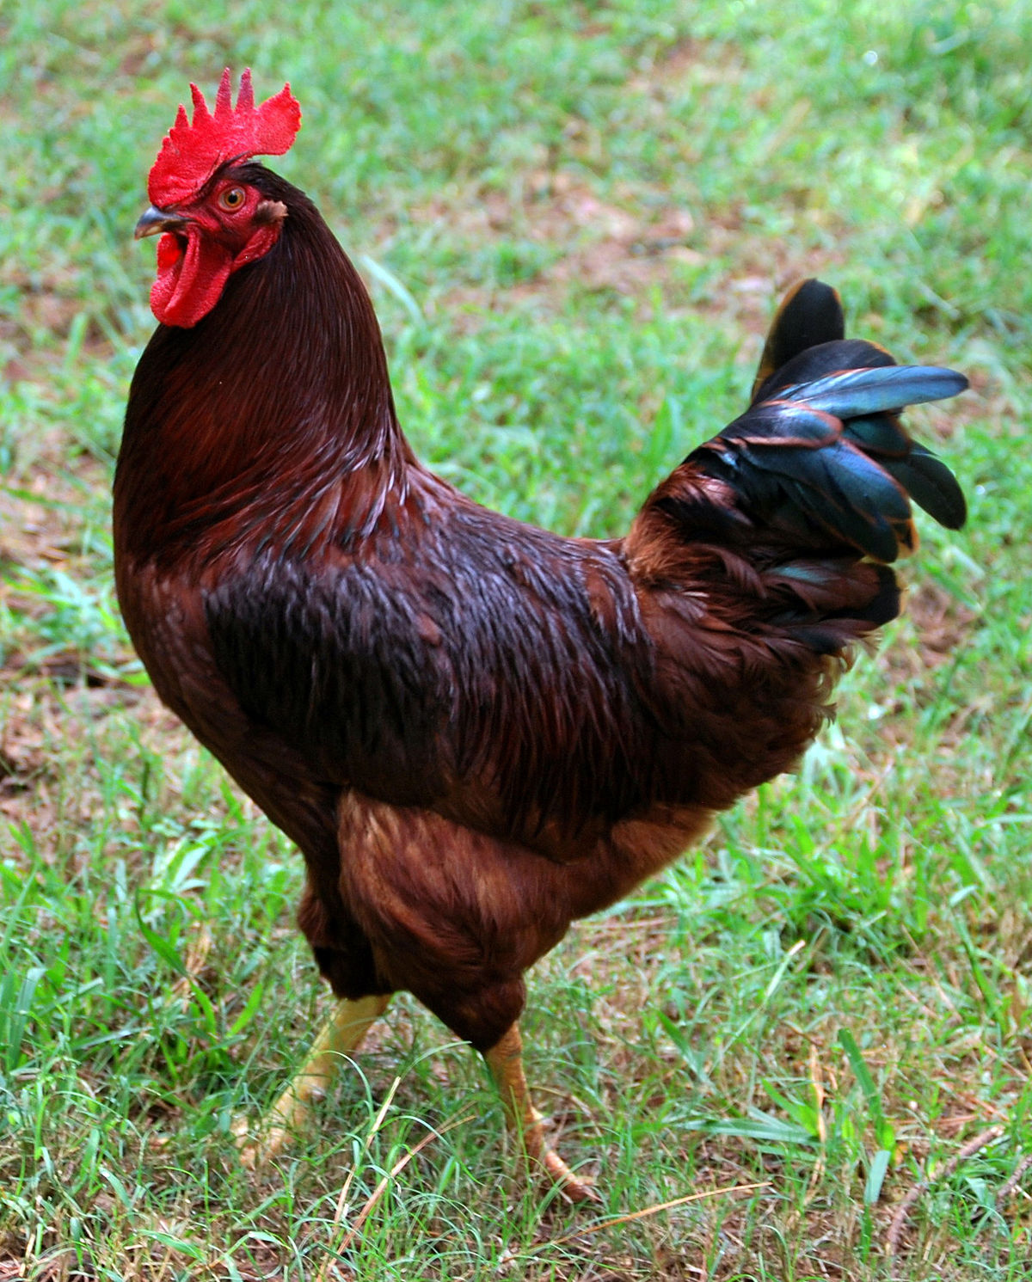
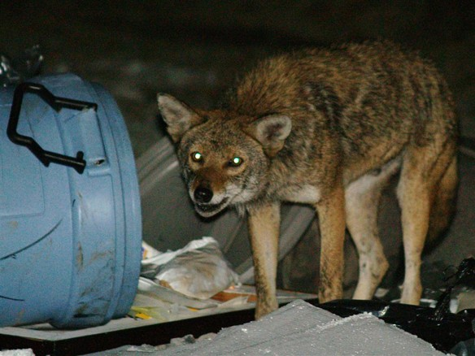
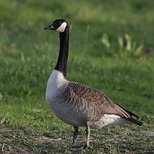
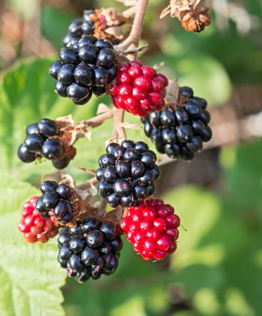
What do coyotes eat?
Notes:
Coyotes are omnivores and eat a wide variety of foods...including garbage, pet food, compost, and garden fruits/veggies. Naturally, coyotes consume small rodents (making them excellent control agents for rodent populations), wild fruits, deer, and occasionally birds. Small pets can be at risk of becoming a coyote meal if left unattended. Coyotes do not know the difference between a squirrel and a stray cat.

Slide 5
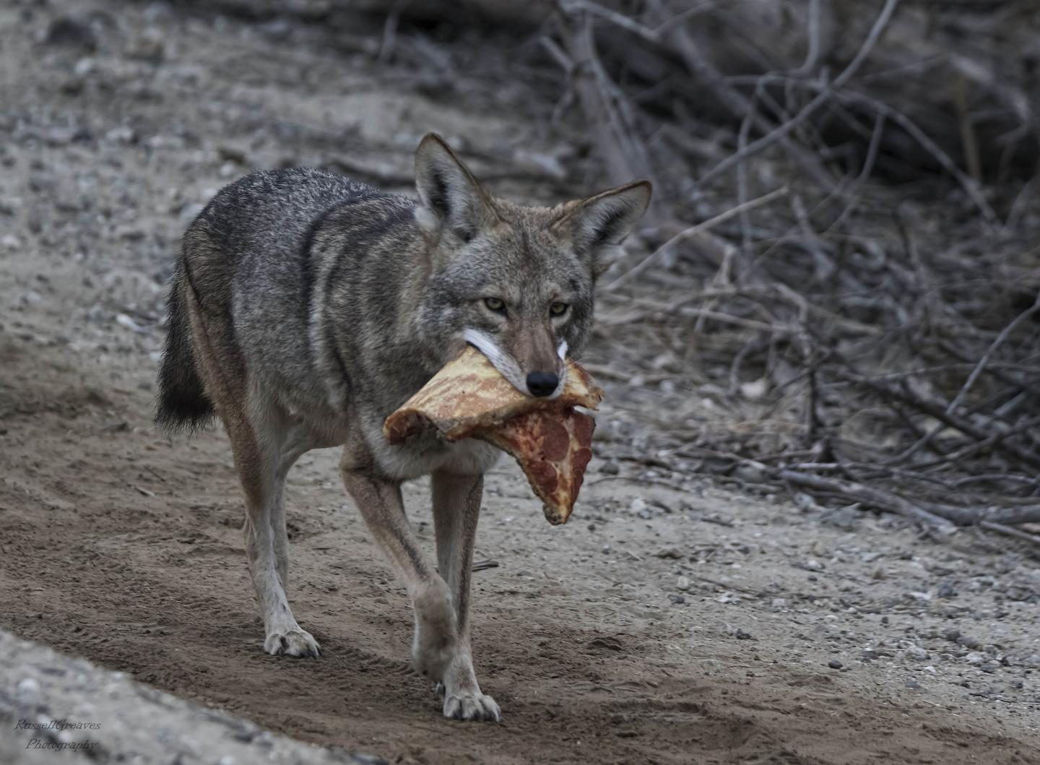
They will hunt...but they also like leftovers!
Notes:
They are generalists, they will eat just about anything they can find or catch. This easy adaptability can cause potential problems when it comes to human-coyote coexistence.

Slide 6
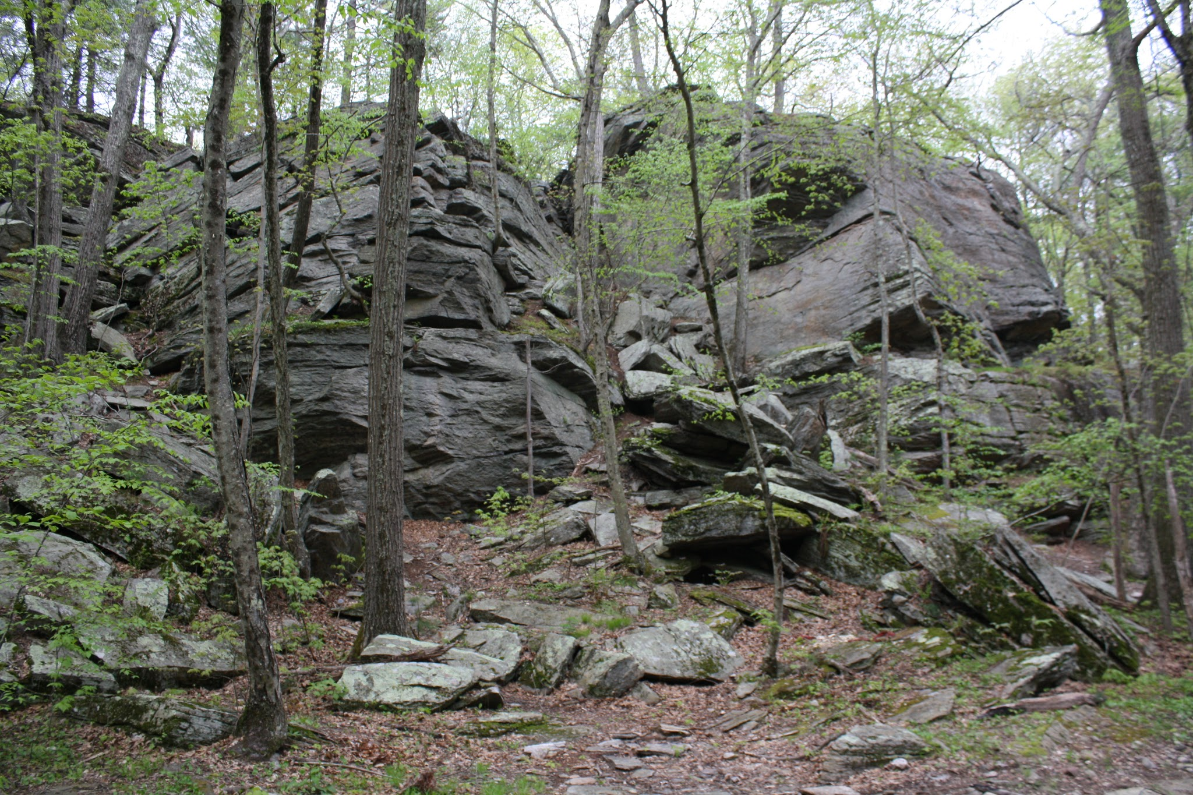
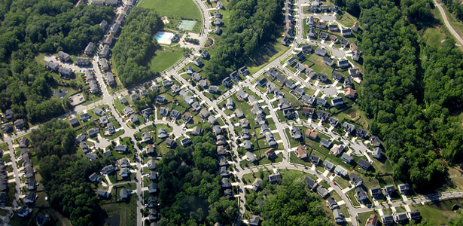
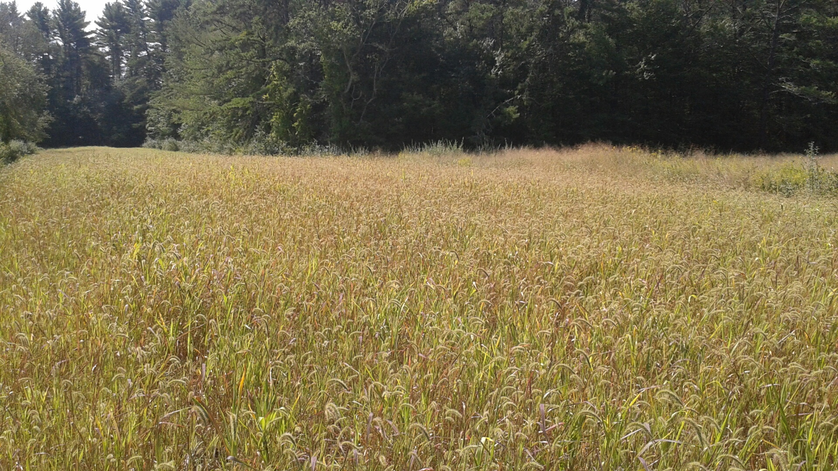
What kind of habitats do coyotes like?
Notes:
Coyotes naturally live in a variety of natural habitats like forests and field edges, but because they are so easily adaptable and opportunistic feeders, they are perfectly happy setting up their homes in suburban neighborhoods, or even in cities (like on the East Side of Providence!).

Slide 7
Can you think of some solutions to solve problems people might have with wildlife?

Slide 8
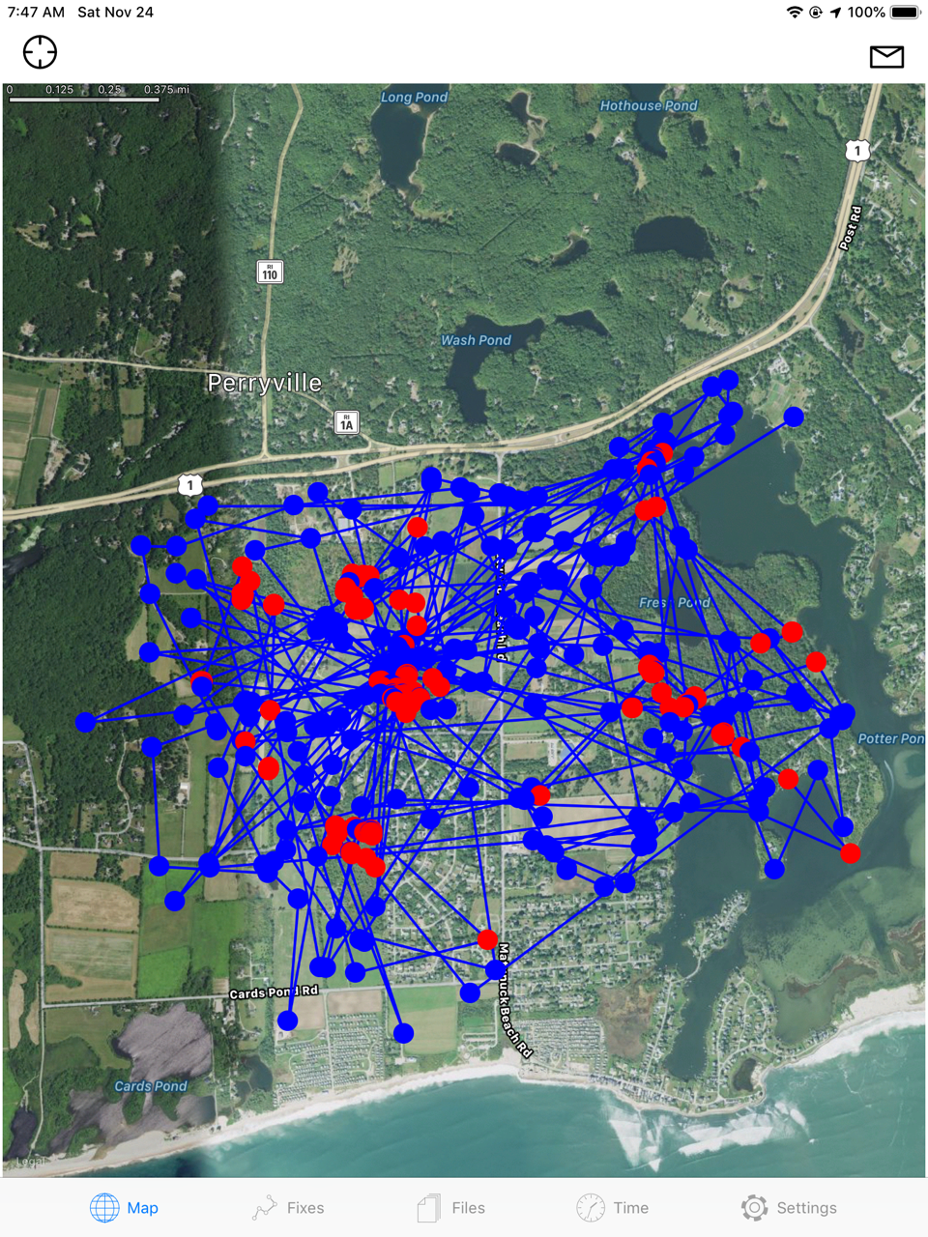
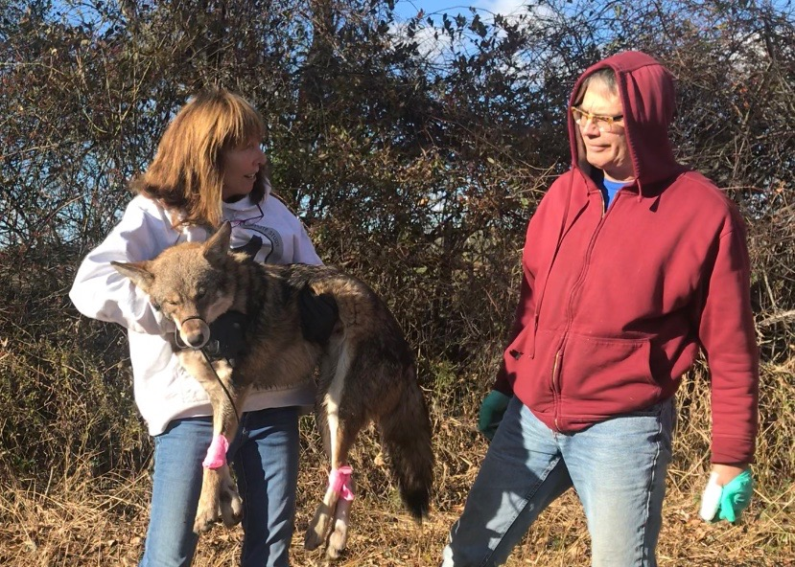
Studying wildlife behavior can help!
Notes:
DEM is working with volunteers and the Narragansett Bay Coyote Study to learn more about coyote behaviors.
Numi Mitchell (on left) is trapping coyotes and attaching radio-collars around their necks to see where they go, and where they spend the most time.
This information will tell biologists where coyotes are getting their food from, because this is where a coyote spends most of its time.
By identifying these food sources it will help biologists decrease human-coyote conflicts by removing any unnatural food sources that are allowing populations to grow too large.

Slide 9
Other ways to live peacefully with wildlife:
DON’T FEED THEM!! It’s against the law.
Things wildlife might see as a free buffet:
Food from your trash can
Rotting fruits or veggies in your garden
Pet food that is left outside
Stray cats/small pets!
Keep an eye on your pets outdoors.
Give wild animals their space.
Use scare tactics to keep wild animals WILD and uneasy around humans.
Notes:
If we eliminate any human sources of food, such as trash, compost piles and pet food, it removes these extra resources that are allowing coyote populations (or other nuisance wildlife) to grow larger and become bolder. More coyotes means more human wildlife conflicts. Rhode Island residents need to help keep a balance where everyone can be happy. It is against the law to intentionally feed wildlife in Rhode Island, with the exception of raised backyard bird seed/suet feeders.
Supervising pets outside is important because when left unattended, pets can become a potential meal for wildlife (small pets), or been seen as a territorial threat (large dogs). Making sure outdoor enclosures for chickens, rabbits, and other small livestock will help deter hungry predators.
Many people have good intentions, and just want to connect with nature, but trying to get close to wildlife, or tame wildlife (training squirrels or birds to eat out of your hand, handling baby wild animals, etc.) is truly detrimental to wildlife. Wild animals need space, and should be observed at a distance. Trying to get too close or training wildlife can cause issues regarding potential rabies exposure, loss of natural behaviors, and increased road crossing, all of which could lead to human health risks and/or the unnecessary death of an animal.
“Hazing” nuisance species can help deter unwanted behavior. With the example of coyotes, making loud noises (like with a coyote shaker) whenever a coyote comes on your property reinforces to the coyote that humans are scary and that they should be skittish around us. When animals forget that humans are a threat, they sometimes can get too comfy with our presence, which can cause issues later on. It may seem mean to want to scare wild animals, but it can make a big difference in keeping animals safe and people free from conflicts with wildlife. You certainly can just quietly observe wildlife too; you don’t need to scare every single critter you see!

Slide 10
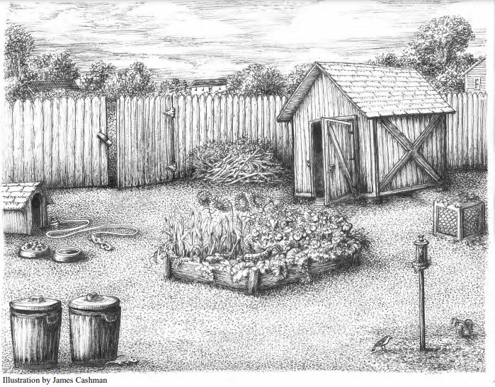
What might attract a critter to this backyard?
Notes:
Open gate
Open shed (shelter, potentially something to eat in the shed)
Brush pile (pile of sticks and leaves in the back, good spot for a den)
Dog house and dog food (small pet left unattended is a potential prey item, food bowl is an open invitation to have a snack)
Unsecure trash cans (great food for nosy critters)
Unfenced garden (fruits and veggies)
Bird feeder (lots of animals other than birds like to eat birdseed)
Open compost bucket (rotting food scraps are a smelly attractant)
Place underneath shed (perfect for a burrow or den)

