Slide 1
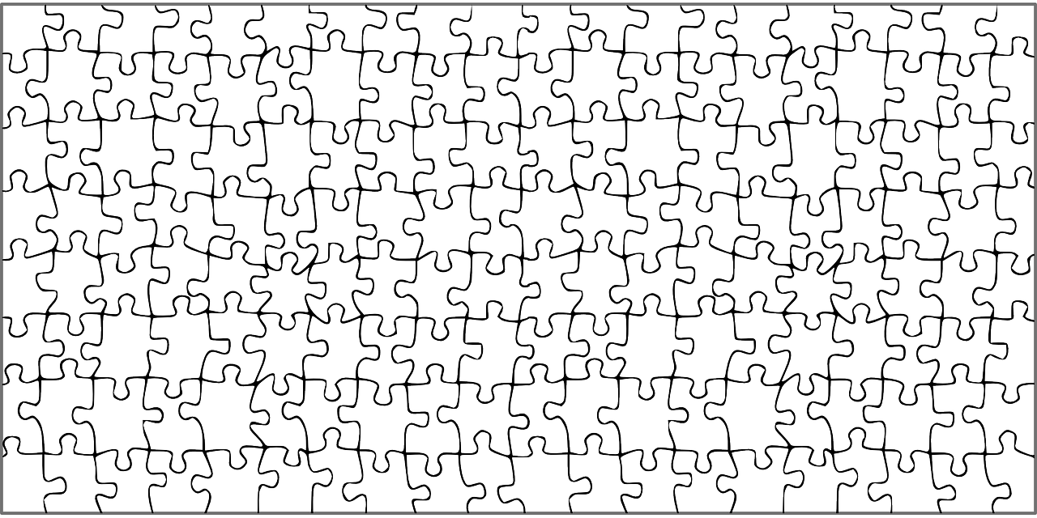
The Population Puzzle
RIDEM Division of Fish and Wildlife
Rhody Critter Kits Program

Slide 3
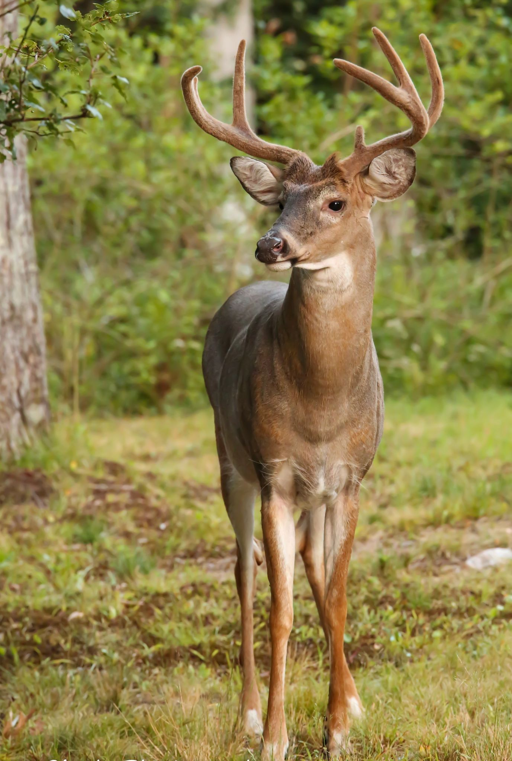
White-tailed Deer
Found all over Rhode Island
Likes forest and field habitat → also found in swamps, neighborhoods, and on the islands in Narragansett Bay

Slide 4
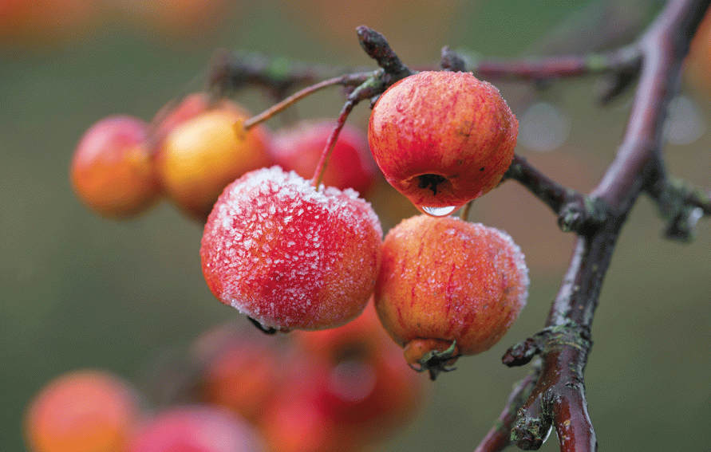
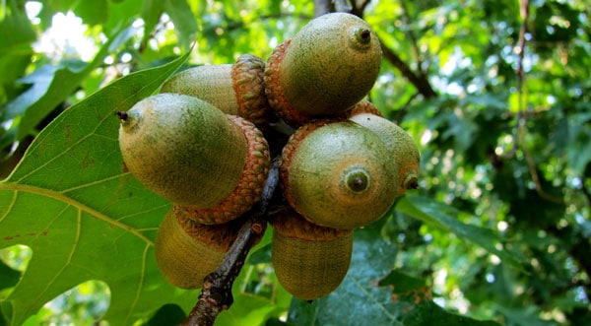
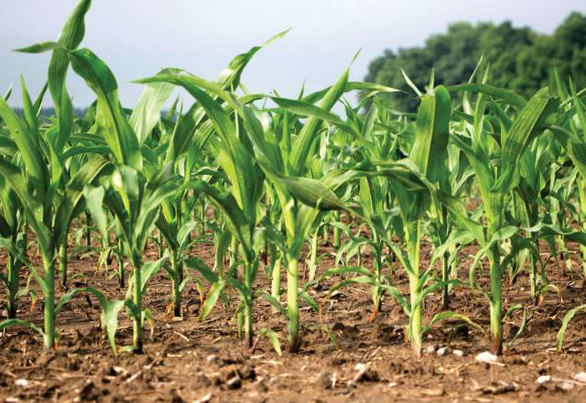
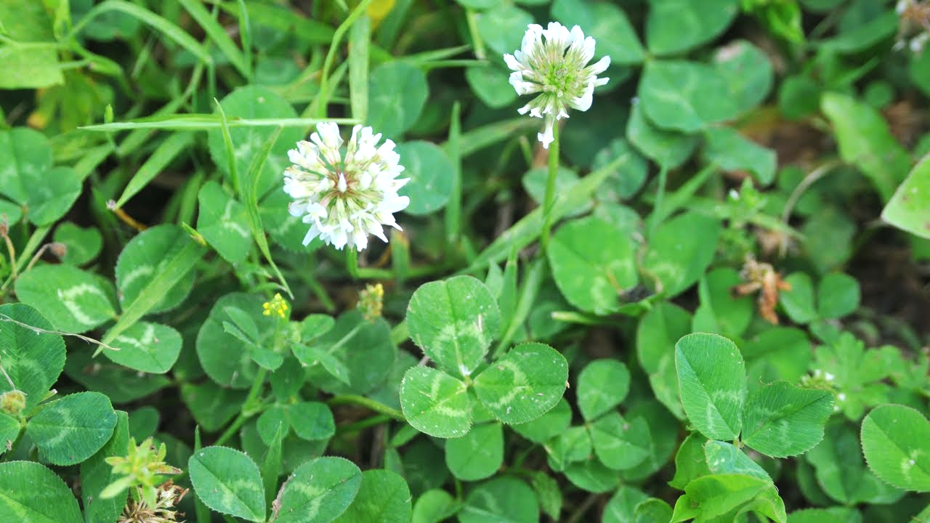
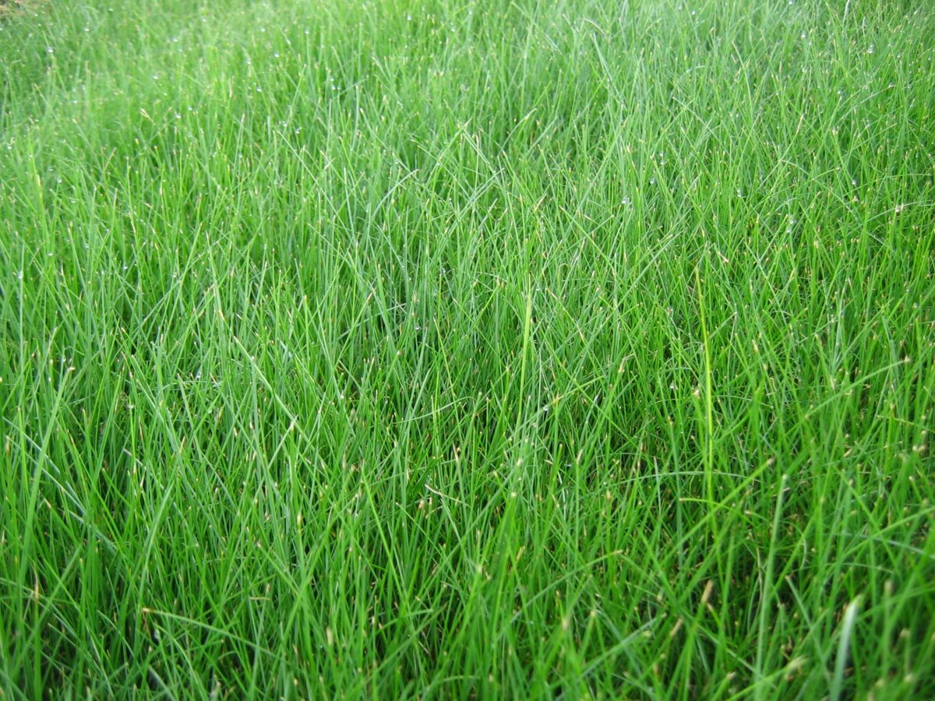
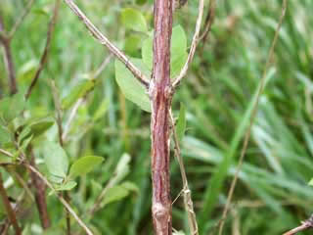
What do deer eat?
crops
fruits
acorns
woody plants
grasses
small plants
How much can a deer eat in one day?
Notes:
Deer eat between 5-9 pounds of food a day. Deer will eat nearly 500 species of plants, included prized garden flowers!

Slide 5
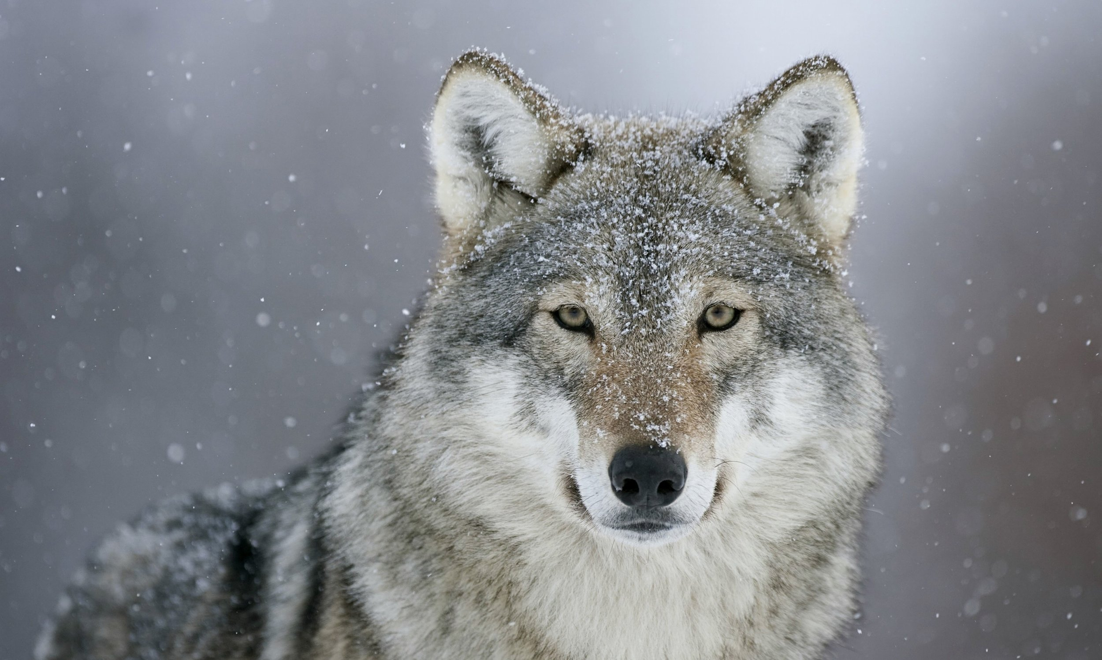
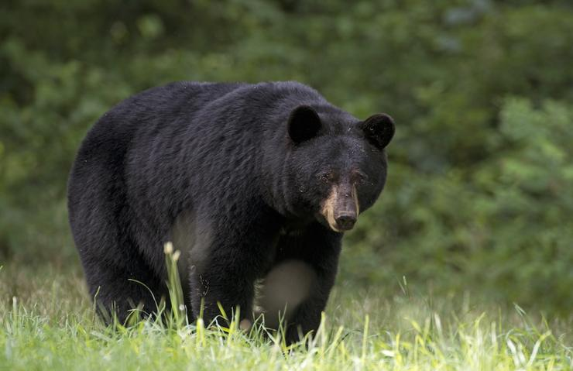
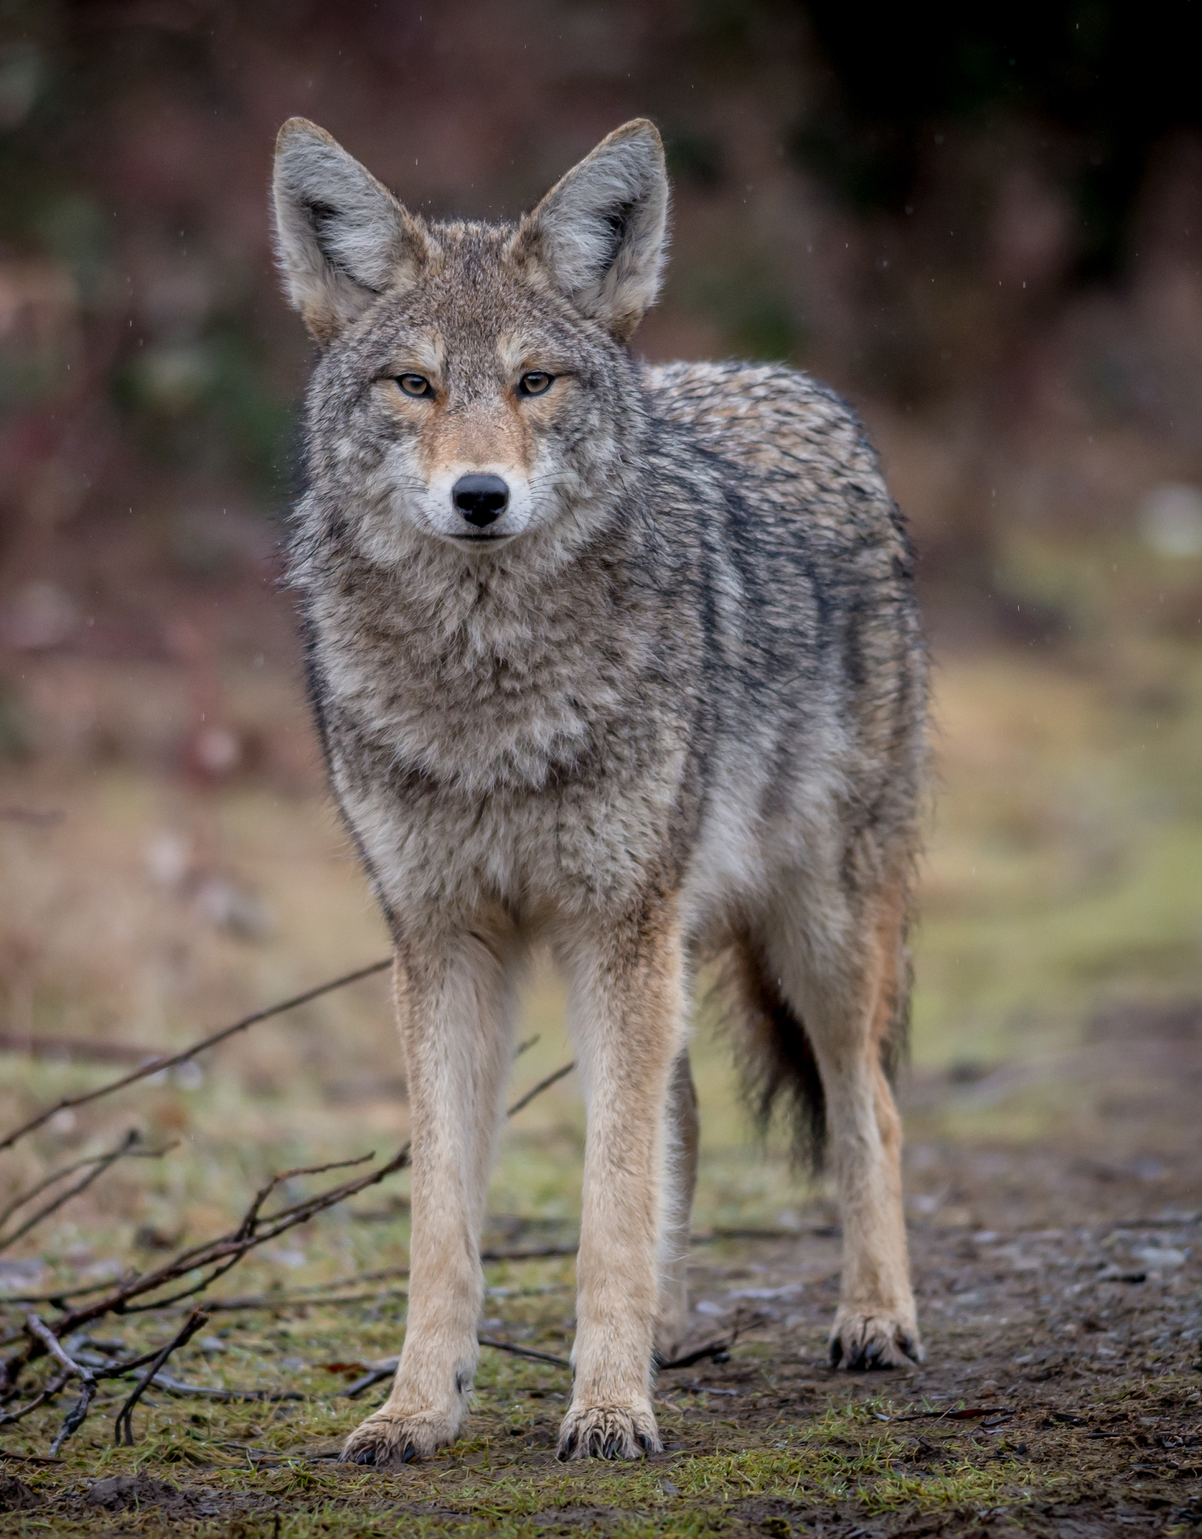
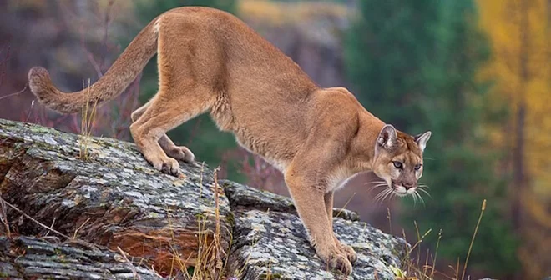
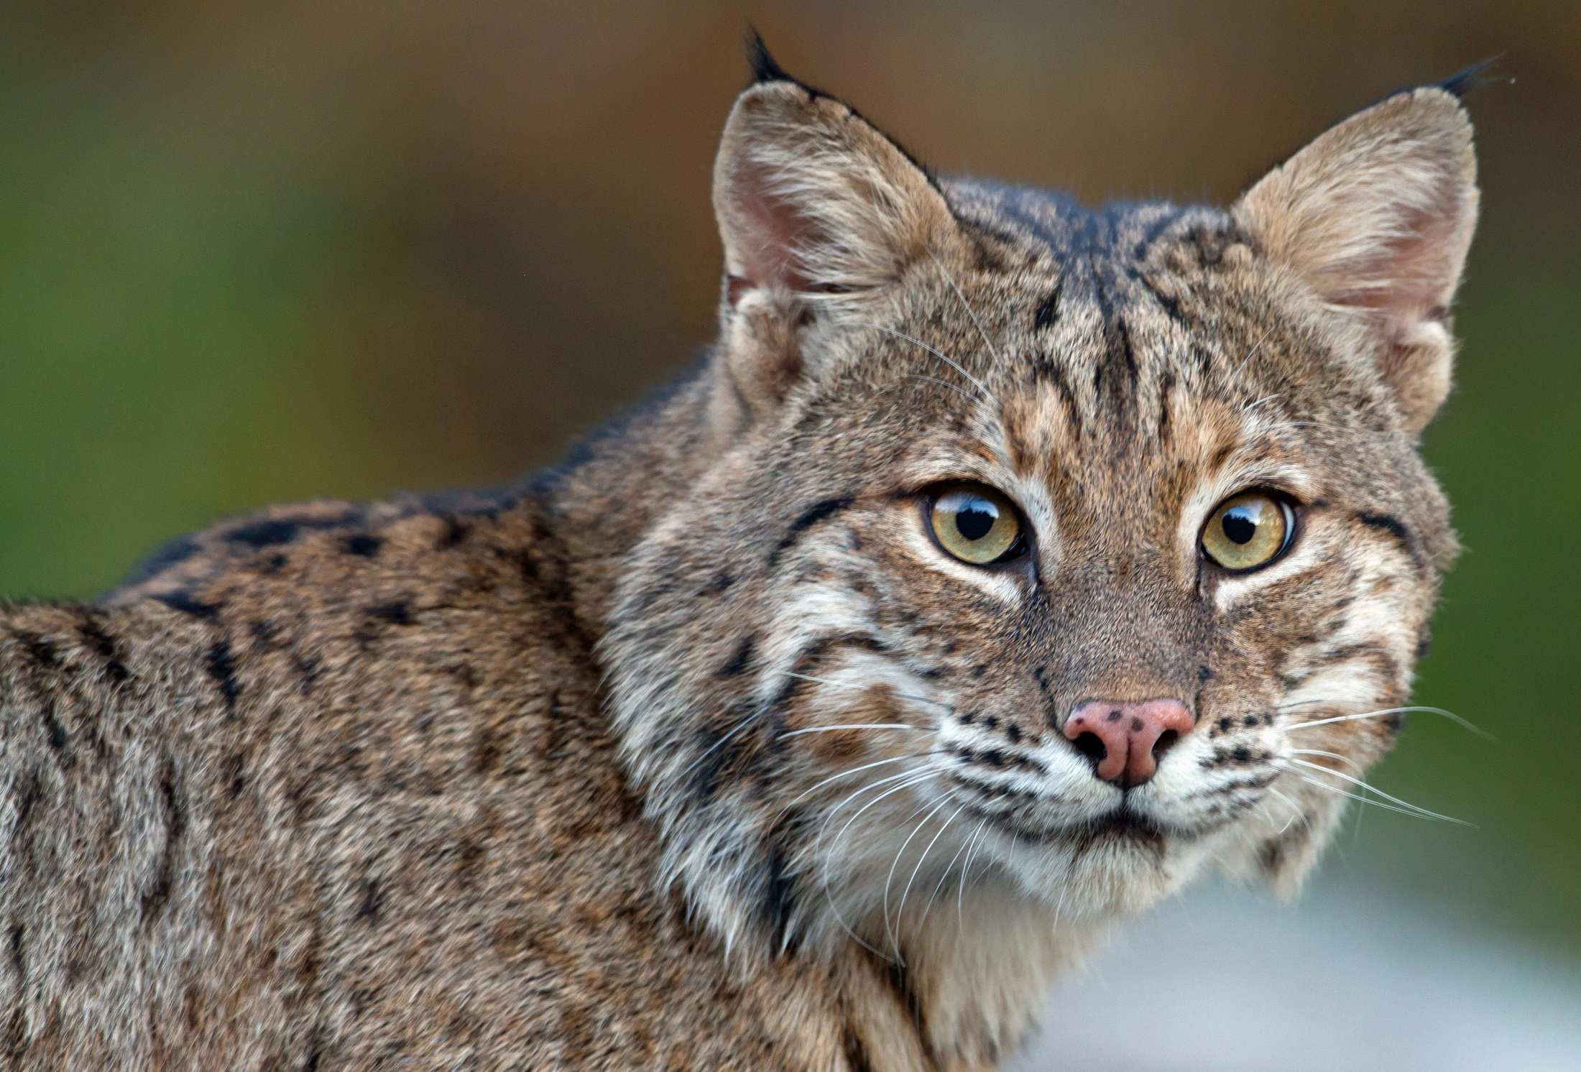
Which RI animals eat deer?
Back in Time
Today
Gray wolf
Coyote
Black bear
Mountain lion
Bobcat
Notes:
Present day predators like coyotes and bobcats usually take fawns or sick deer. Bears may predate fawns, but are more likely to scavenge off already dead deer.
Wolves and mountain lions could take deer of all sizes. Wolves were extirpated by European settlers, and the last mountain lion in Rhode Island was killed in the 1800s. .

Slide 6
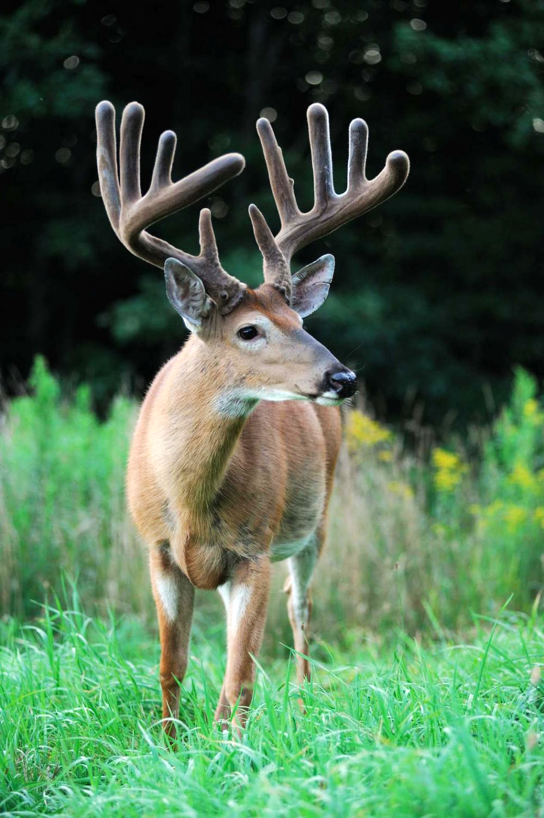
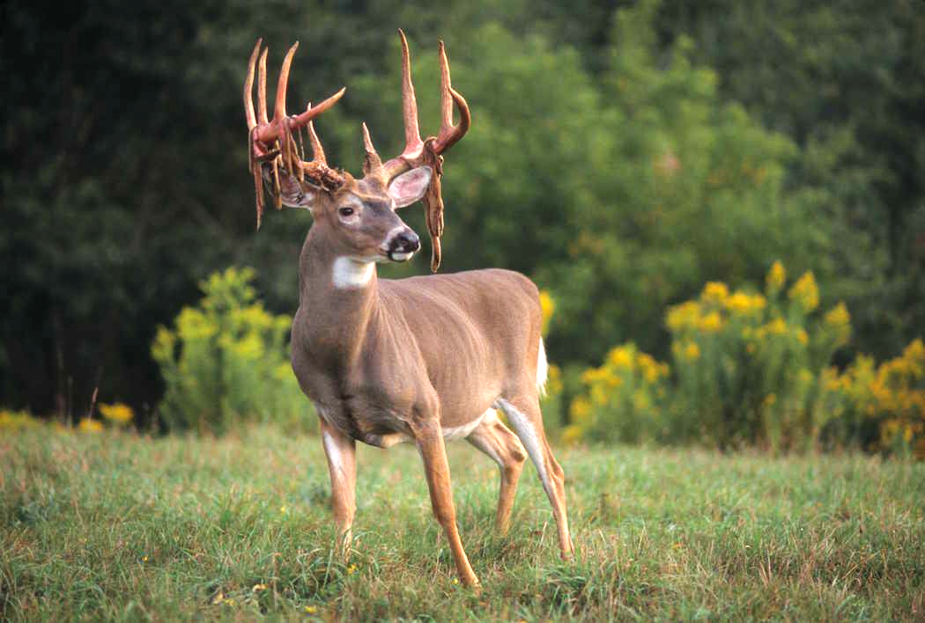
Summer: Feeding & Growing Season
New antlers covered in velvet
Shed velvet in late summer
Notes:
During growth, antlers are soft and are comprised of a complex matrix of cartilage, nerves, arteries and blood vessels. The antlers appear fuzzy during this period, giving them their colloquial name, “velvet”. If an antler were to be injured during this time, it would appear deformed or twisted, when fully formed. When the daylight hours decrease, testosterone production increases, triggering the hardening, or mineralization, of the antlers. Minerals are deposited into the cartilage matrix by capillaries, turning the soft tissue into bone. Antlers harden from the base to the tip and after about a month, around late August, the mineralization is complete. Once hardened, an injury to an antler would appear broken, not bent. These hardened antlers and testosterone boost coincide with the deer breeding season, called the “rut”. Deer will rub their antlers on trees to leave scent, simultaneously removing the remaining outer velvet layer and revealing the new solid bone beneath. Bucks display their striking new set of antlers, called a rack, likely in hopes to impress females and use them as a weapon to fight off, or box, other males.
Read more about antlers in our Wild Rhode Island newsletter: http://www.dem.ri.gov/programs/bnatres/fishwild/pdf/wriwi21.pdf

Slide 7
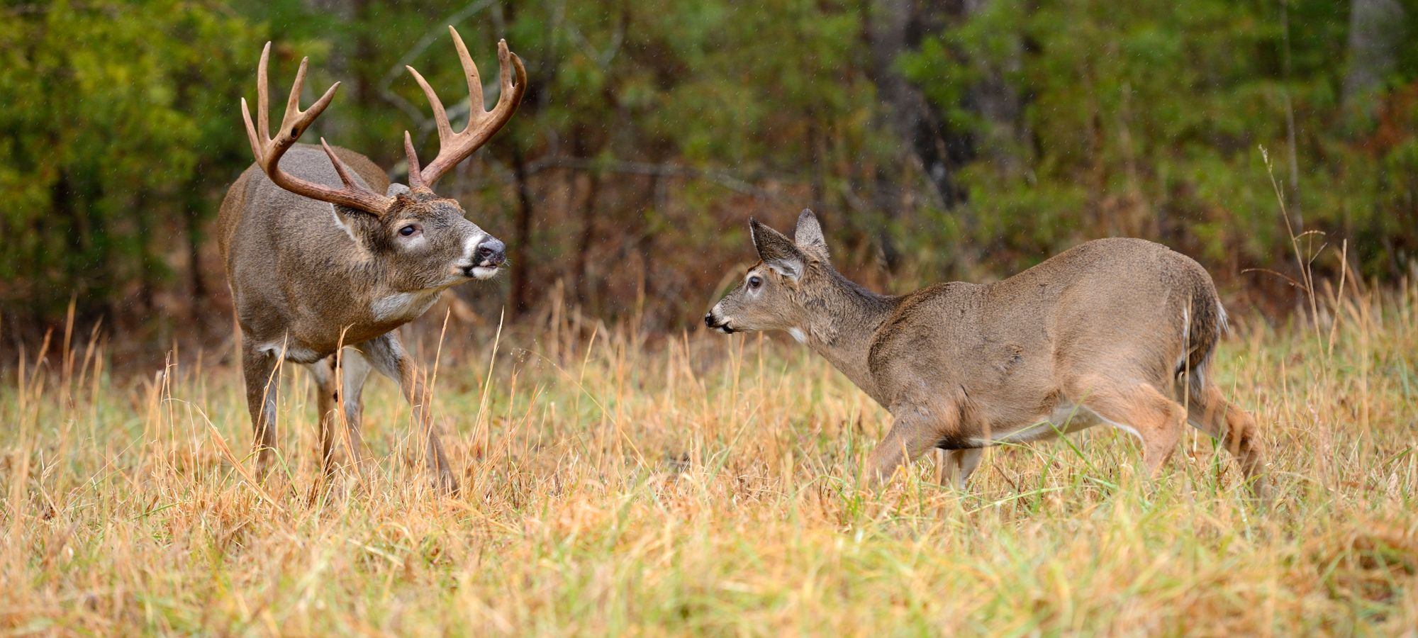
Autumn: Breeding Season
“The Rut”
Notes:
The breeding season, also called the “rut,” can begin as early as September, but peaks during the first two weeks of November when bucks travel far and wide in search of receptive does. During the rut, bucks will rub their antlers on saplings, removing the bark and leaving scent, and create scrapes by thrashing overhanging vegetation with their antlers and scraping the adjacent ground with their front hooves. Early in the rut, bucks establish dominance by sparring with their antlers. Estrus, or breeding receptivity in does, lasts approximately 24 hours, reoccuring after about 28 days if breeding has not taken place.

Slide 8
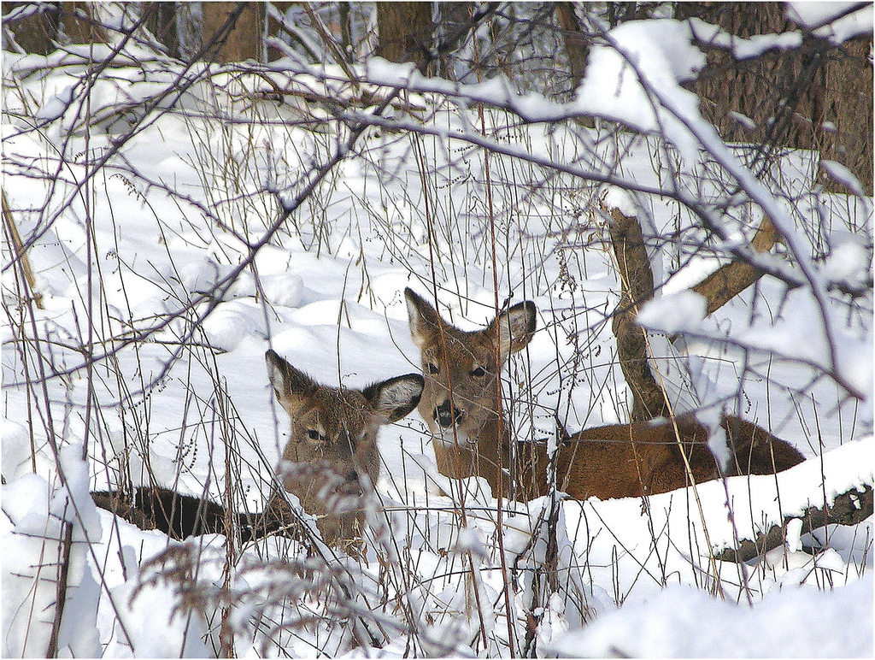
Winter: Survival Season
Shelter in dense thickets and evergreen forests
Grow a thick, double coat of hair
Take it slow!
Bucks shed antlers
Notes:
Antlers are cast, or shed, earlier in the north and later in the south, between late winter or early spring, when hormone levels drop after the rut. The time of shed depends on natural variance and nutrition. Though most bucks in an area will shed within a month of each other, individual bucks have their own unique antler cycle, most likely based on when they were born. Just before the antler is ready to fall, the skin around the pedicle becomes shiny and swollen as the bone is reabsorbed by osteoclasts. The base of the antler becomes severely weakened and the antler breaks off almost immediately. Both antlers are typically cast within a day of each other.

Slide 9
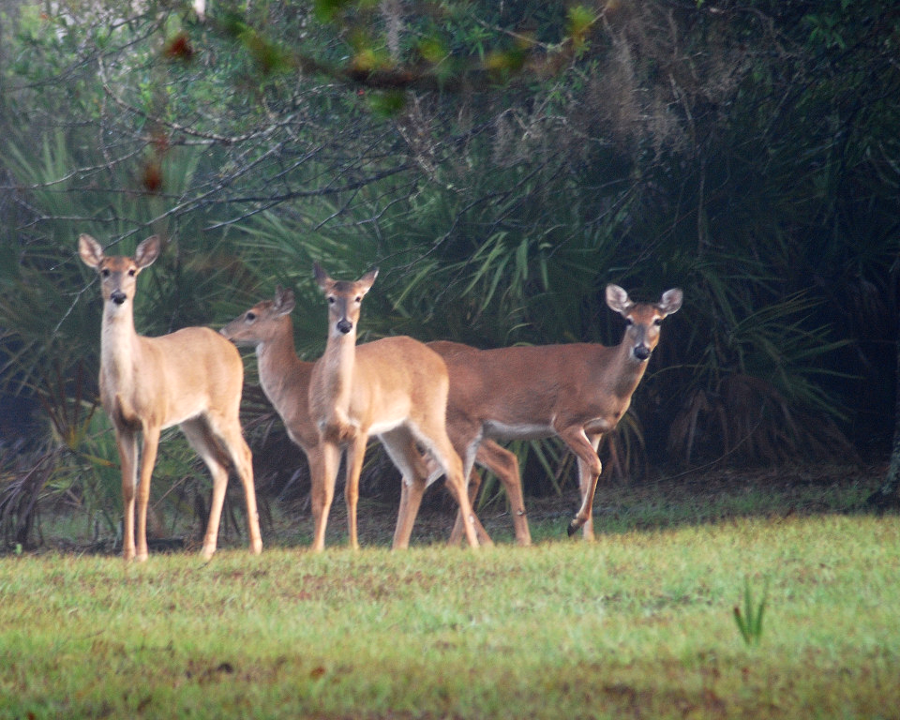
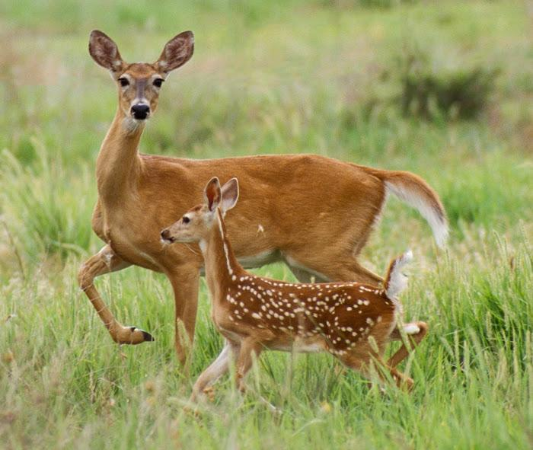
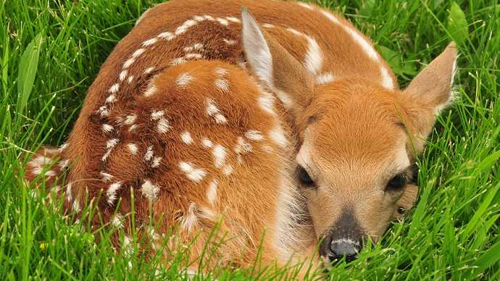
Spring: Fawns are born
Born in May & June
Female fawns can remain with mom for up to two years
Male fawns are driven off during fall or following spring
Notes:
Does separate from their groups in late May or early June, when they give birth to their fawns. Young does typically have one fawn, while older, more experienced females may have twins or even triplets under excellent conditions. The fawn is born covered in fur and stands up within an hour of being born. Fawns are born with natural spotted camouflage to help avoid predators.

Slide 10
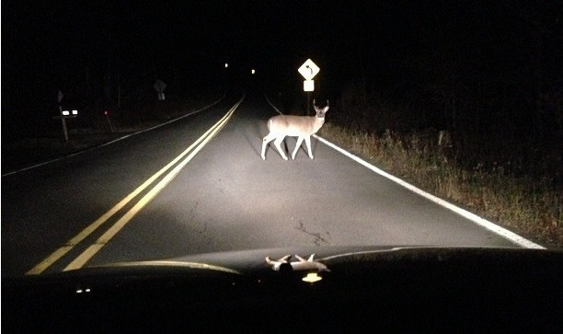
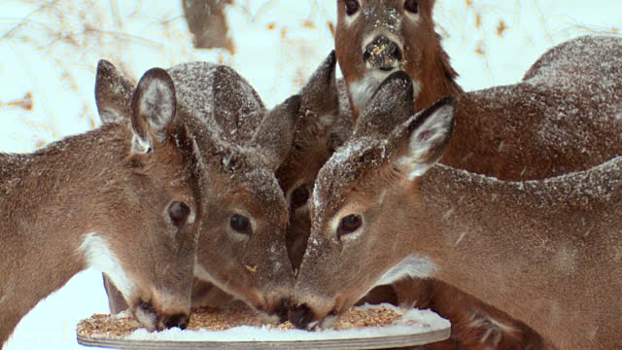
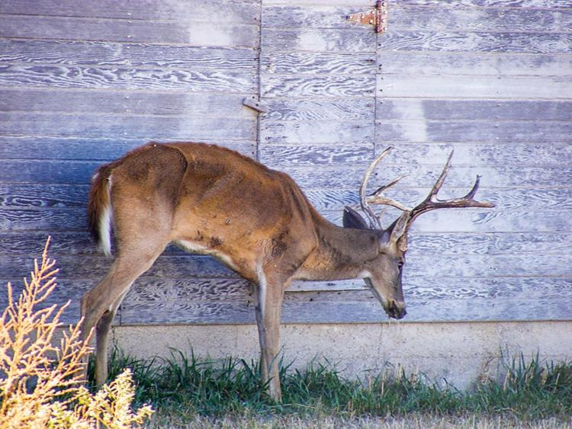
Dangers to Deer
Crossing roads
Humans feeding them
Chronic Wasting Disease
Notes:
Feeding food high in carbs (rather than the high fiber food deer are naturally eating over the winter), messes the up their stomach chemistry, making it hard for them to digest. This shocks their system, which has gradually adjusted to deal with the harsh winter conditions. For more information about the dangers of supplemental feeding, click here: https://extension.unh.edu/resource/more-harm-good-why-you-shouldnt-feed-deer#:~:text=Supplemental%20Feeding%20Can%20Harm%20Deer&text=spread%20disease%20among%20deer.,leading%20to%20injury%20or%20death.&text=increase%20deer%2Dvehicle%20collisions.,naturally%20succumb%20to%20winter%20mortality.
Chronic Wasting Disease (CWD) is a devastating neurological disease that affects deer, moose, and elk across North America. It is passed through urine, feces, and saliva, and can persist in the soil for years, subsequently contaminating habitat and further spreading to the population. Monitoring and preventing the spread of CWD has become a major priority of deer biologists across the nation. Though CWD has not yet occurred in Rhode Island, we have taken monitoring measures in order to protect the health of our state’s deer population. Biological samples (lymph nodes) are tested from road killed and hunter-harvested deer each year. A collaboration with the Division of Law Enforcement (DLE), meat processors, taxidermists, and hunters has enabled us to receive and process a large number of samples. A CWD prevention and response plan is being created in order to safeguard our deer population, hunting culture, and future of wildlife management in Rhode Island.
As deer populations grow, individuals have to cross roads more frequently to find food, water, shelter, and space. In the fall, males are particularly active as they search for a mate. This all leads to increased vehicle collisions with deer.

Slide 11
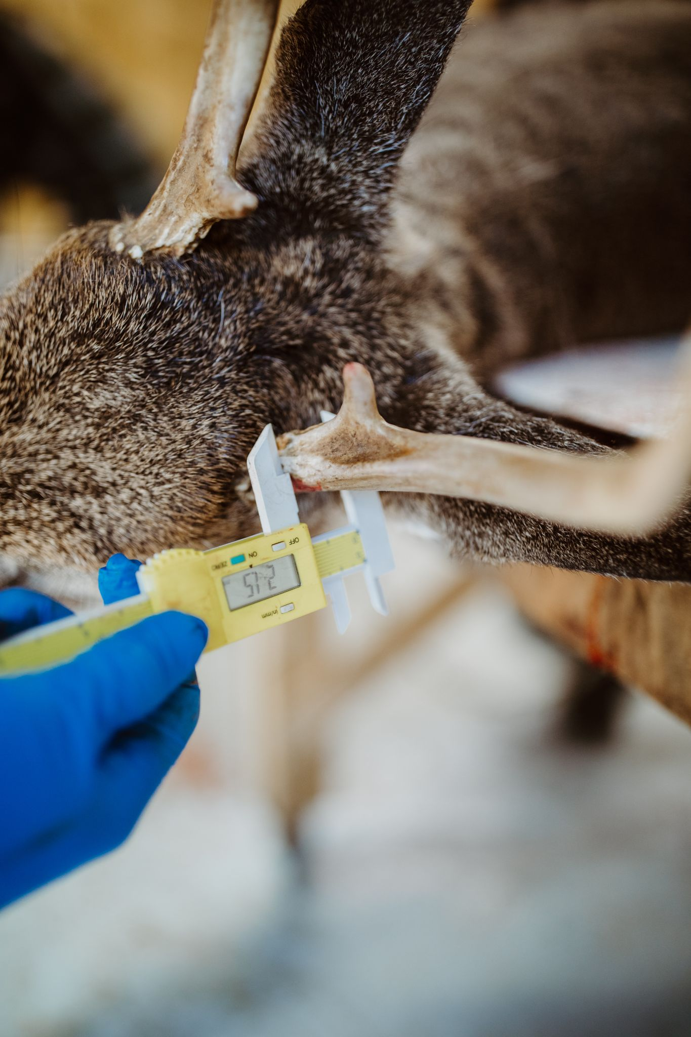
Keeping an Eye On Chronic Wasting Disease
Biologists collect data from hunter-harvested deer to check deer health:
Lymph nodes
Blood samples
Tooth sample (for age)
Antler width
Weight
Notes:
Chronic Wasting Disease (CWD) is a devastating neurological disease that affects deer, moose, and elk across North America. It is passed through urine, feces, and saliva, and can persist in the soil for years, subsequently contaminating habitat and further spreading to the population. Monitoring and preventing the spread of CWD has become a major priority of deer biologists across the nation. Though CWD has not yet occurred in Rhode Island, we have taken monitoring measures in order to protect the health of our state’s deer population. Biological samples (lymph nodes) are tested from road killed and hunter-harvested deer each year. A collaboration with the Division of Law Enforcement (DLE), meat processors, taxidermists, and hunters has enabled us to receive and process a large number of samples. A CWD prevention and response plan is being created in order to safeguard our deer population, hunting culture, and future of wildlife management in Rhode Island.
How can you get involved?
Each year, we take volunteers to help at our deer check stations. Volunteers help collect data, learn how to age deer by tooth wear, and if they would like to participate, extract lymph nodes for CWD sampling from harvested deer. We understand that not everyone may be comfortable with this experience, so there is another way to get involved with deer conservation at a distance! RIDFW annually seeks citizen science volunteers to submit incidental observations of deer in order to gather an estimate of fawn recruitment to the population. It’s as simple as downloading the Survey123 app and filling out a quick survey when you see a deer of any age, anywhere in the state. Visit dem.ri.gov/reportwildlife to learn more about how to become a citizen scientist for our deer program and other projects!

Slide 12
Can you survive the
year as a deer?

Slide 13
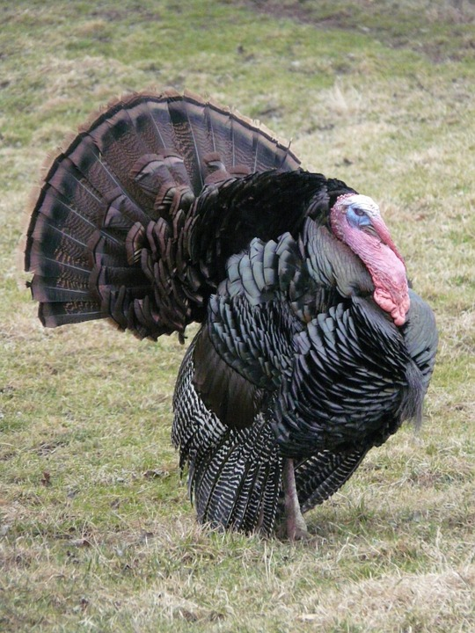
Wild Turkey
Found all over Rhode Island
Likes forest and field habitat → also found in cities, parks, neighborhoods, and farms
Need trees to roost in at night

Slide 14
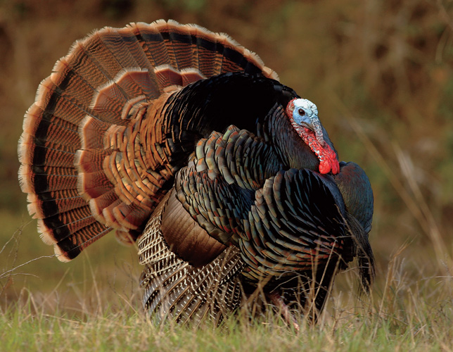
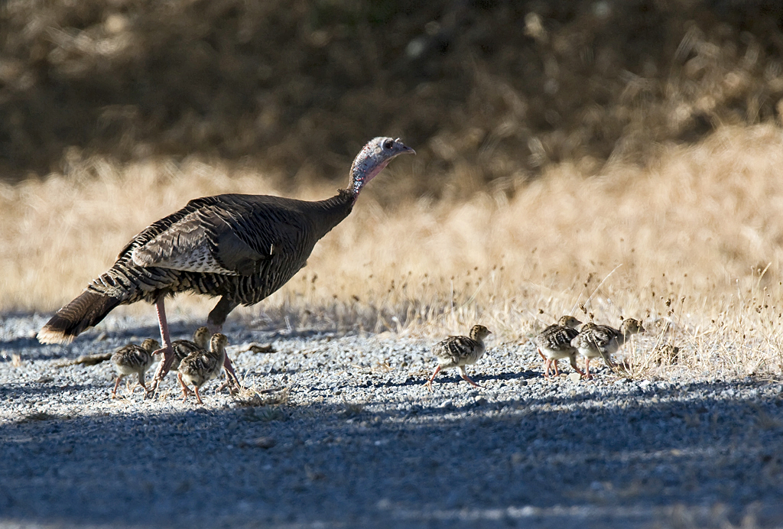
Turkey Terms
A female turkey is a...
snood
Hen
caruncles
Poults
beard
Baby turkeys are...
A male turkey is a...
Tom
Notes:
Snood: bump over beak of tom, use for display
Caruncles: fleshy bumps that change color from excitement
Beard: stiff modified feathers on toms (and some females)
Poults: babies
Jakes & Jennies: young male & female turkeys
Toms & Hens: adult male and female turkeys

Slide 15
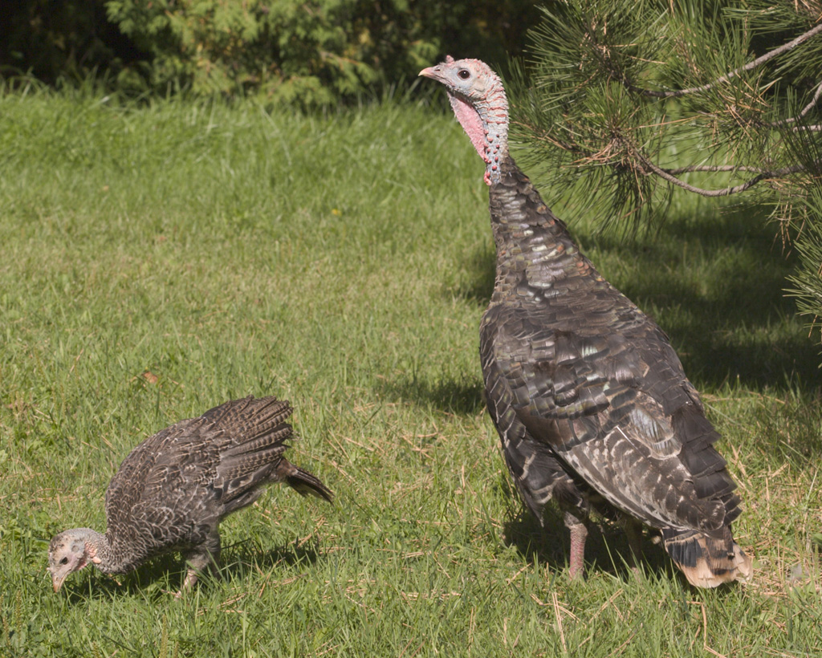
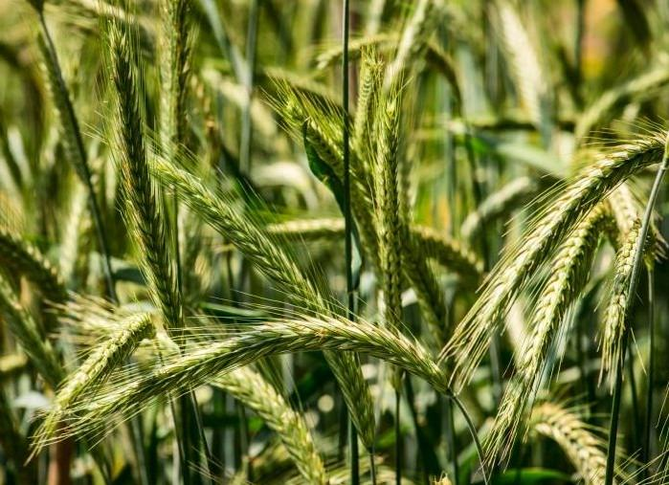
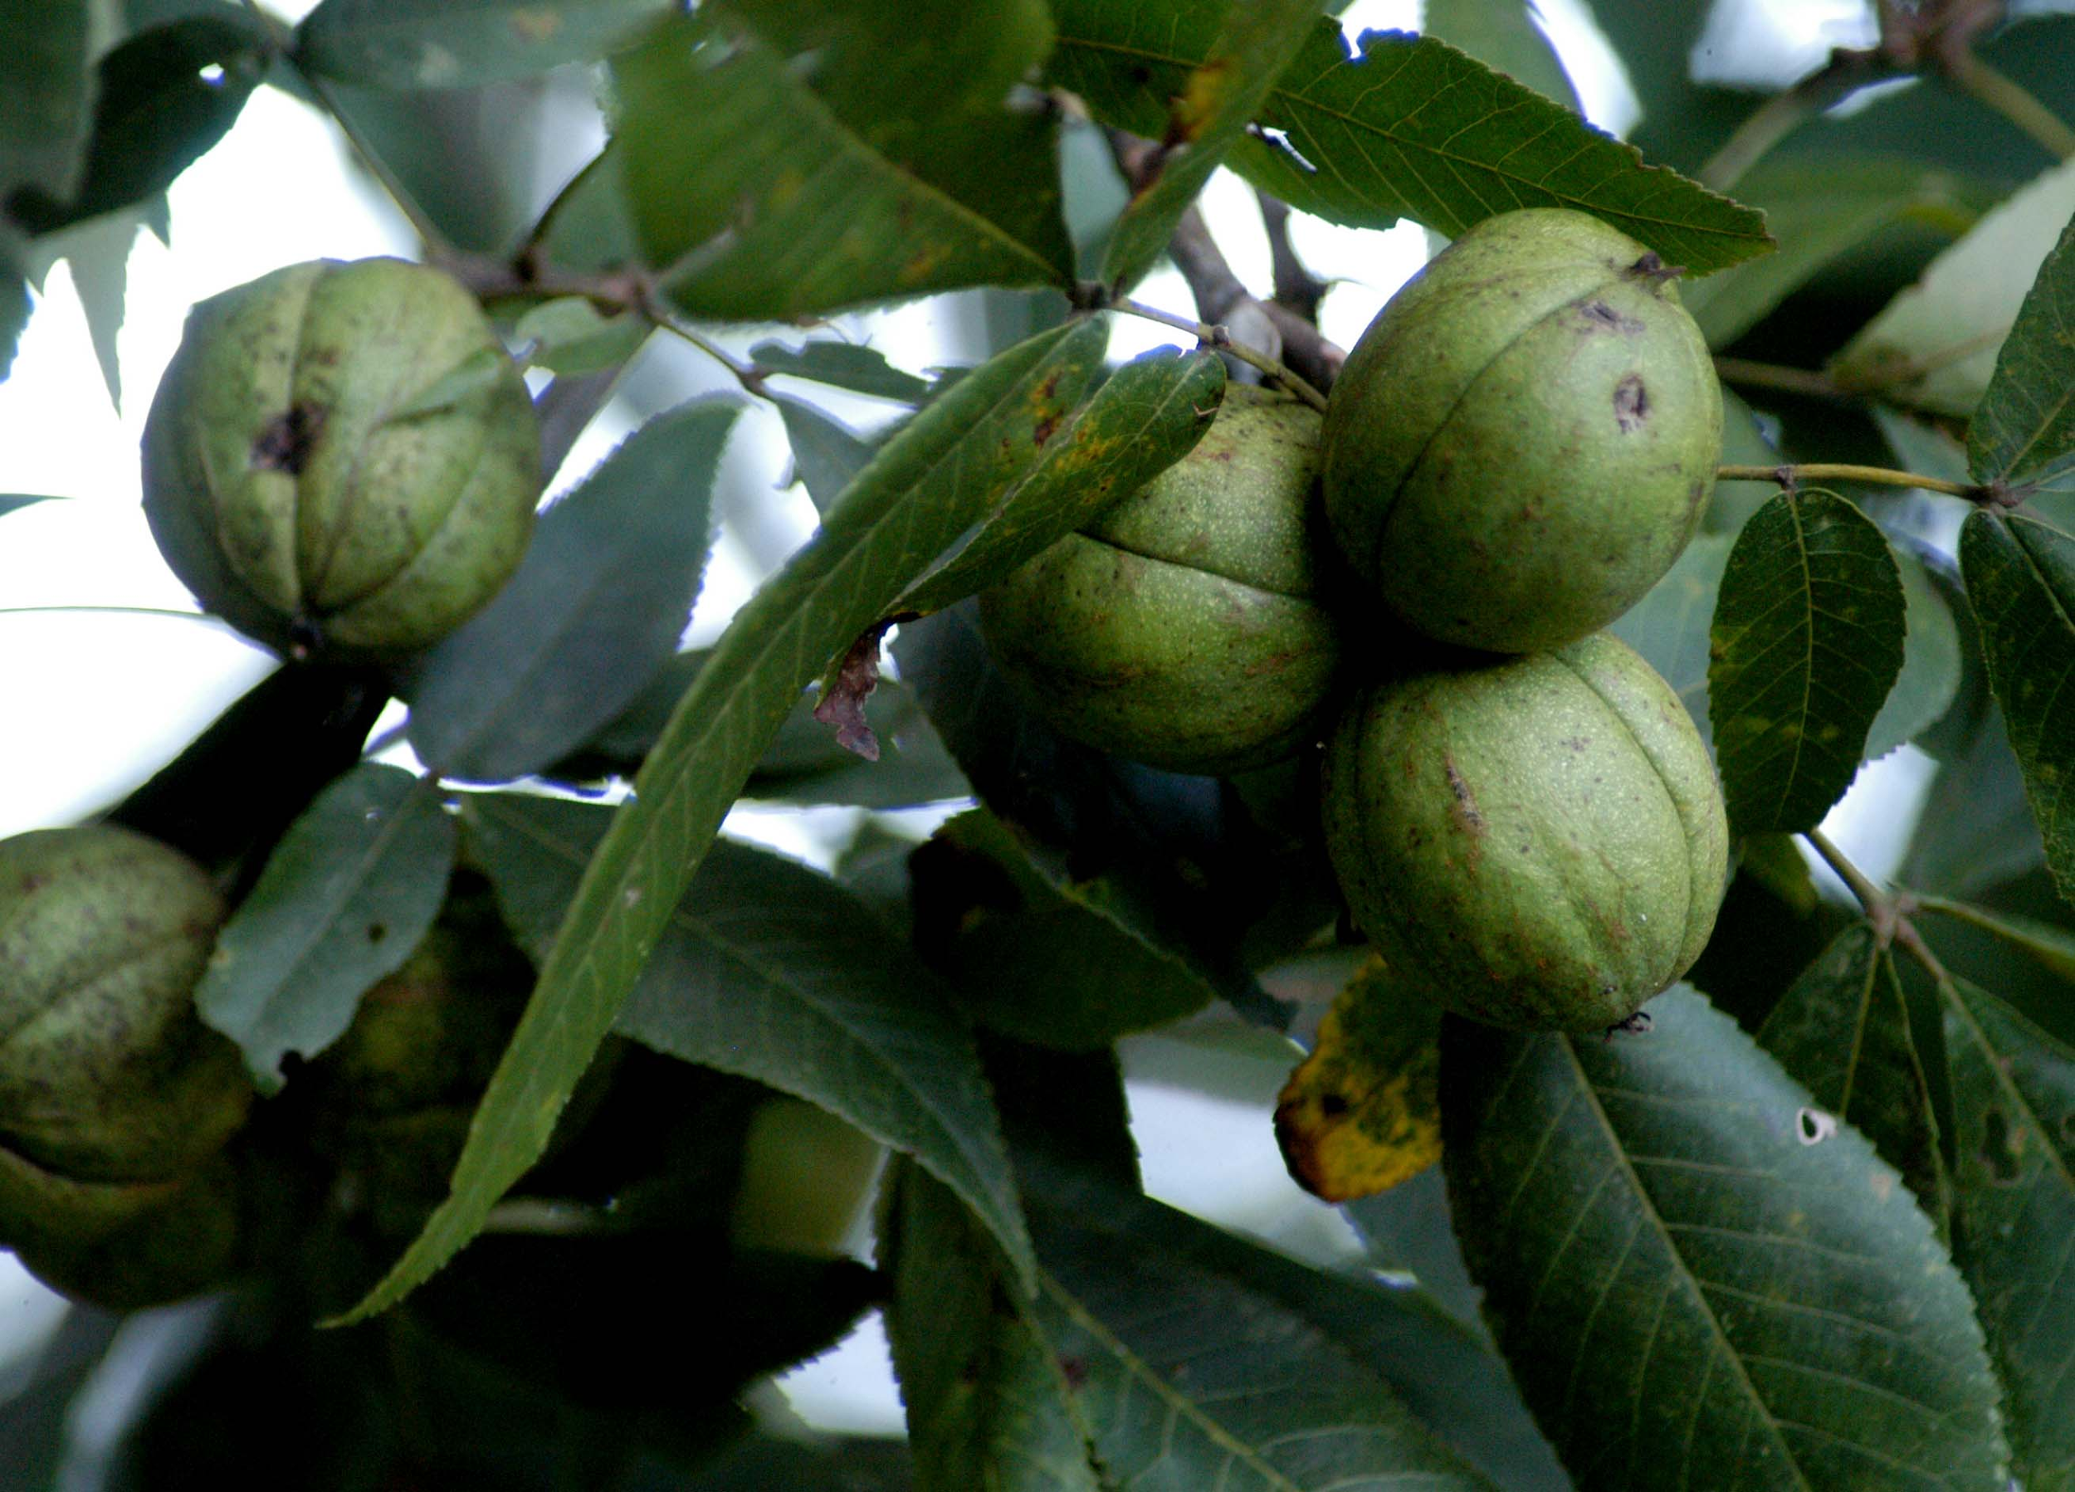
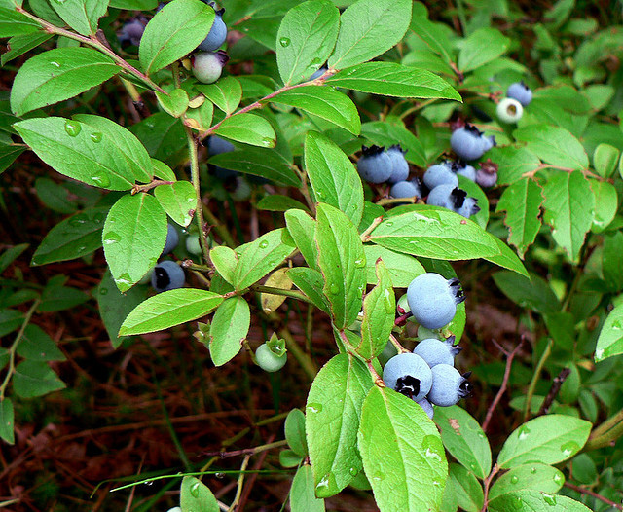
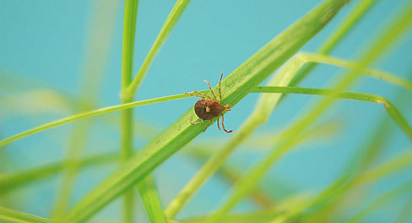
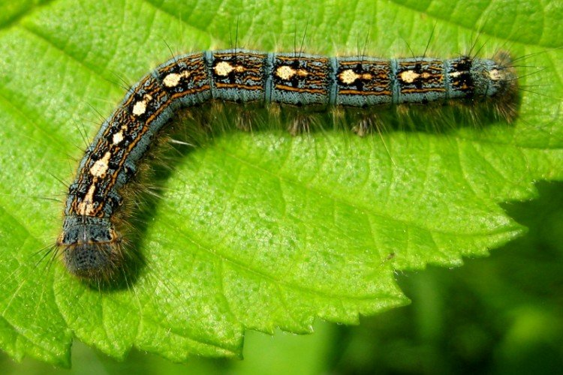
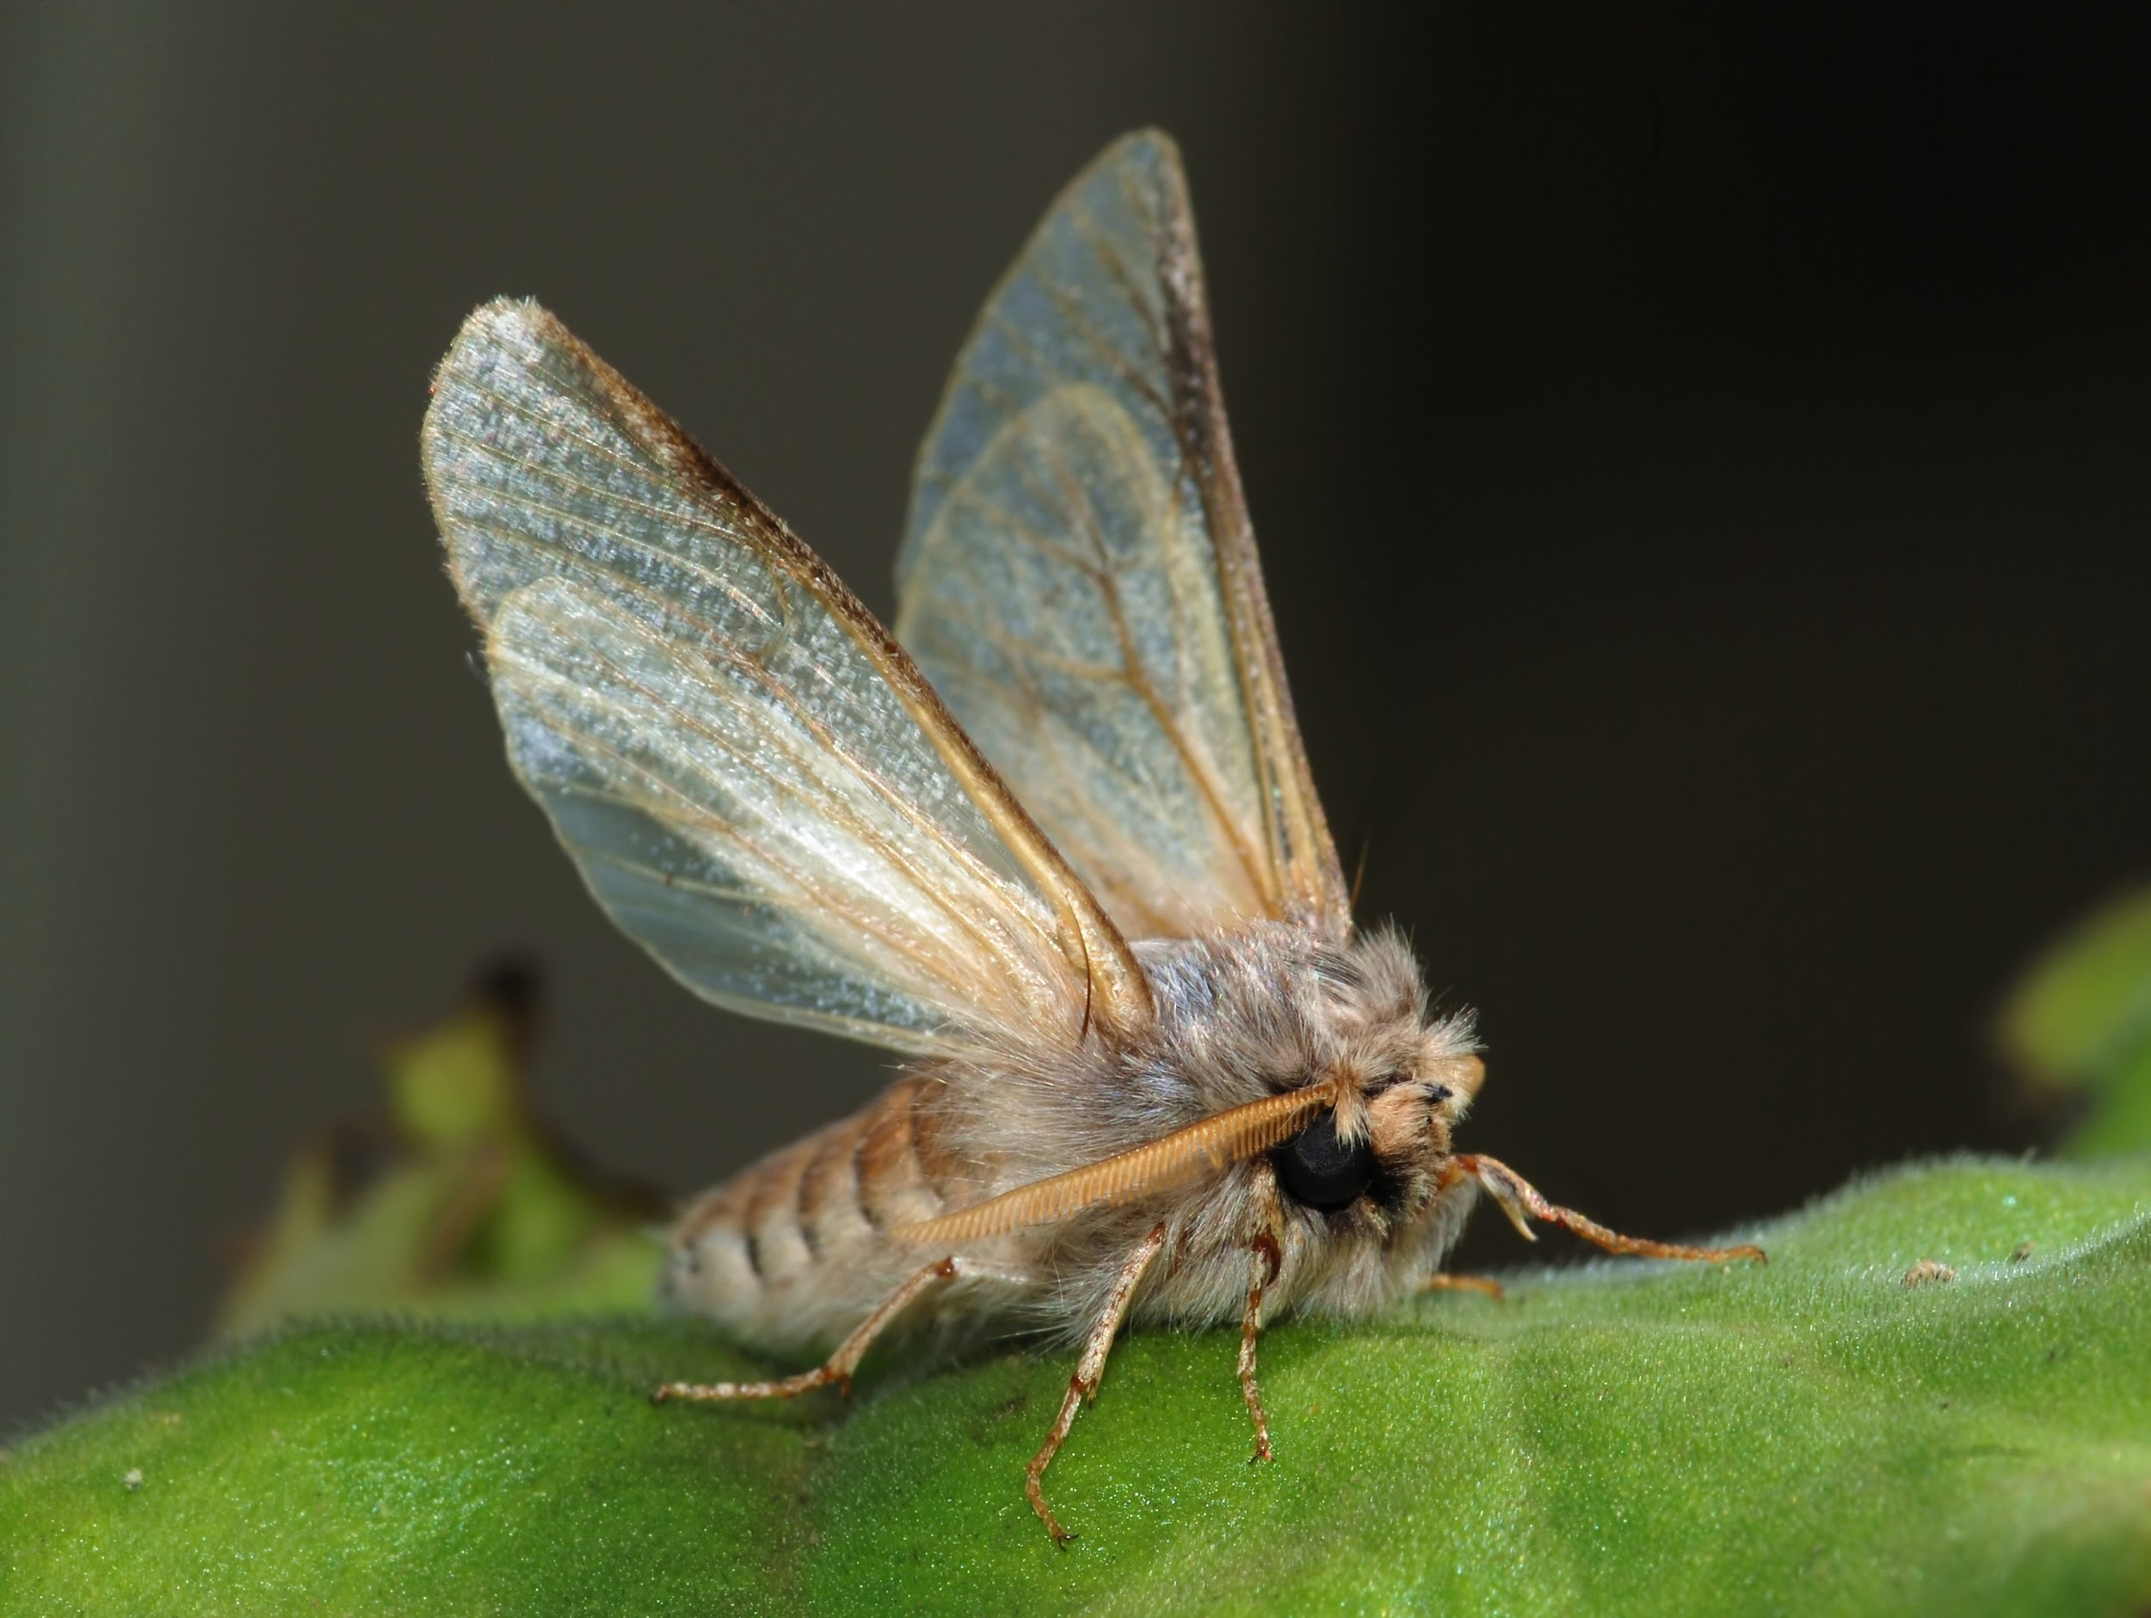
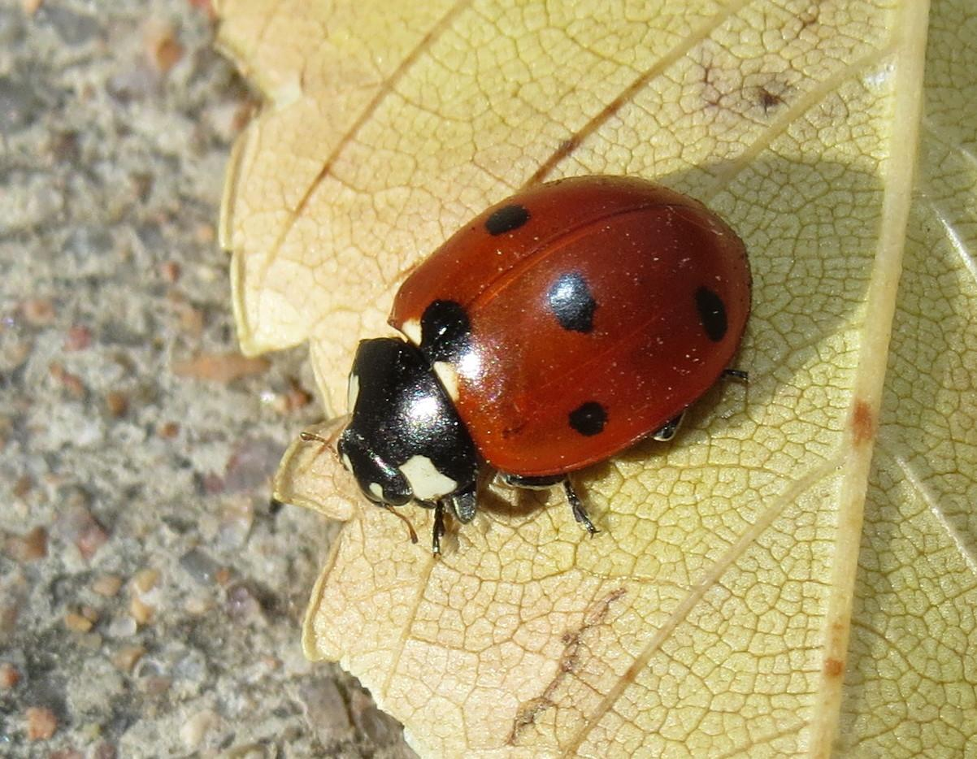
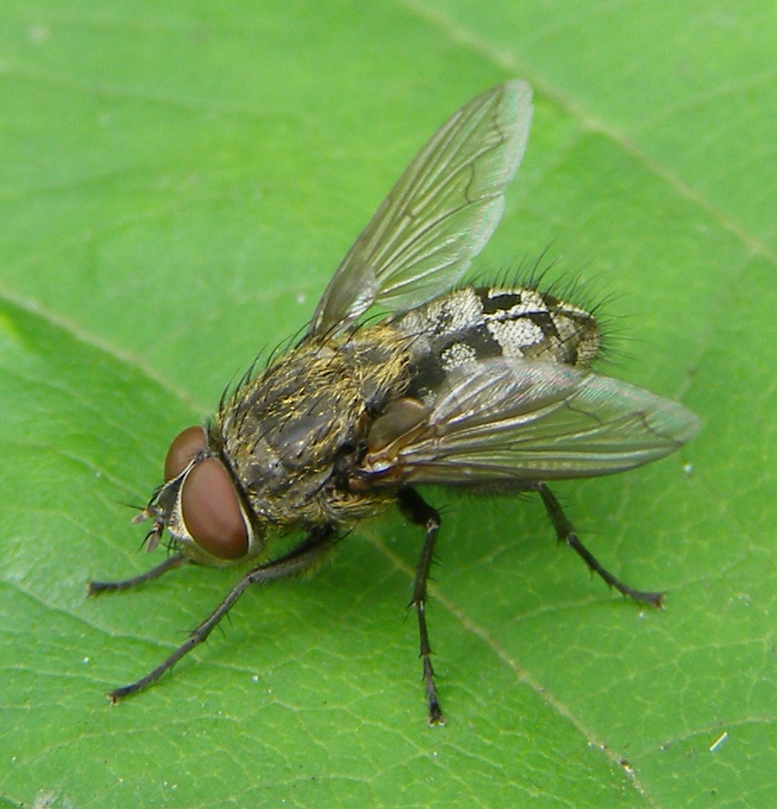
What do turkeys eat?
Poults just eat insects!
Notes:
Wild turkeys eat a wide variety of foods, including grasses, seeds, acorns, beech nuts, hickory nuts, berries, insects, snails, and even ticks! Turkeys have also been known to eat salamanders and hatchling turtles. Poults mostly eat insects, and then branch out to other foods.

Slide 16
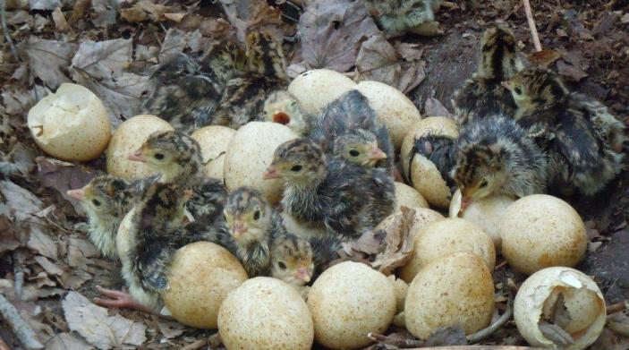
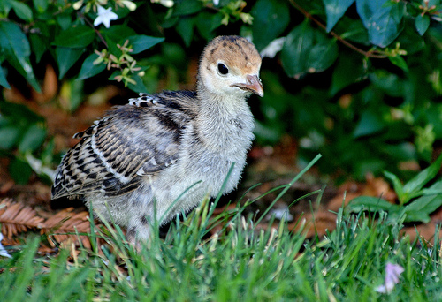
Baby turkeys are
called poults
How many eggs are in a nest?
How long does the mother sit on the eggs?
How long do the babies stay with the mother?
Notes:
Wild turkey hens will lay between 12 - 15 eggs in a shallow depression on the ground. After a 28 day incubation, the eggs hatch. Poults are born with fuzzy down feathers, and their eyes are open. They are able to walk around and follow their mother shortly after hatching, unlike most birds, which hatch featherless, helpless, and with eyes closed. As mainly ground-dwelling birds, poults have to be able to leave the nest quickly to avoid becoming a snack for a hungry predator. After 4-5 months, the poults are able to venture on their own.

Slide 17
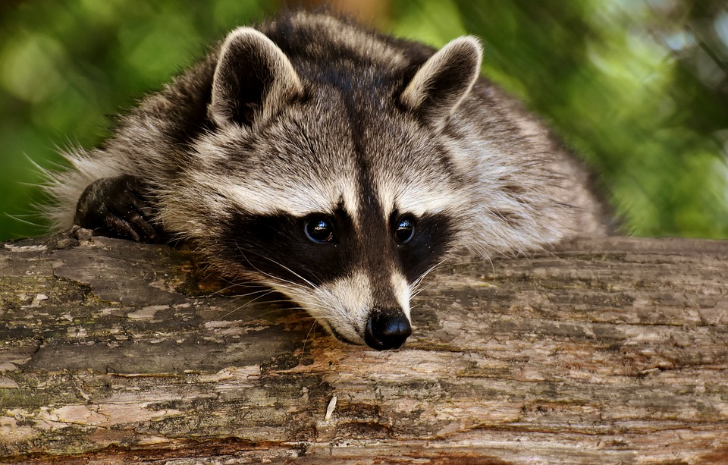
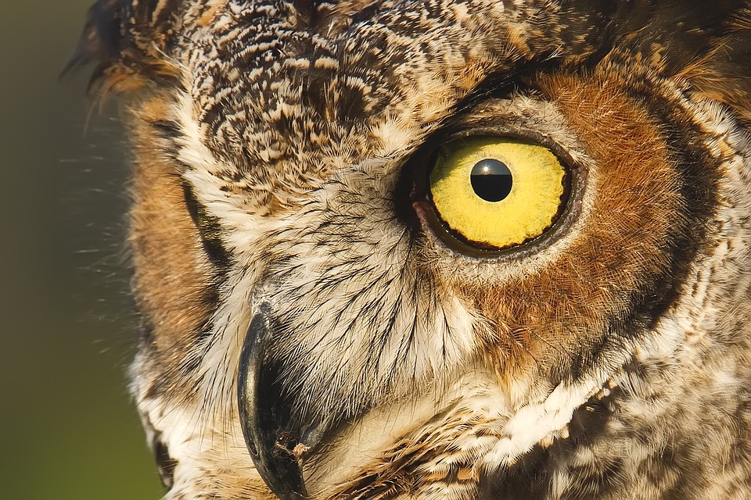
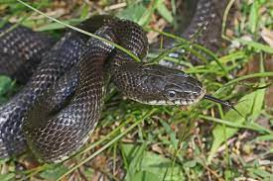
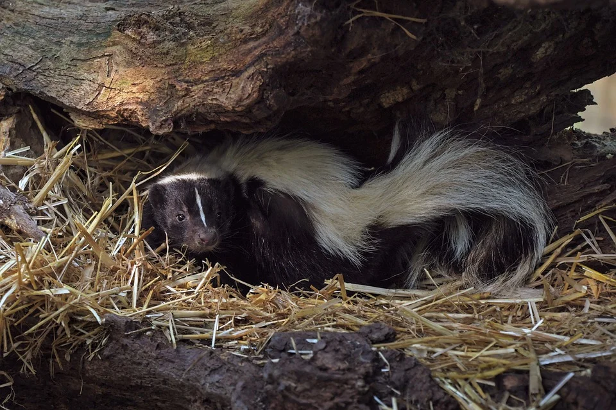
Which RI animals eat turkeys?
Great horned owl
Raccoon
Coyote
Black rat snake
Striped skunk
Bobcat
Notes:
Lots of animals eat turkeys! Raccoons, skunks, and snakes are examples of nest predators that make a meal out of turkey eggs. Owls are most likely hunting for poults, while coyotes and bobcats will eat both poults and adults. .

Slide 18
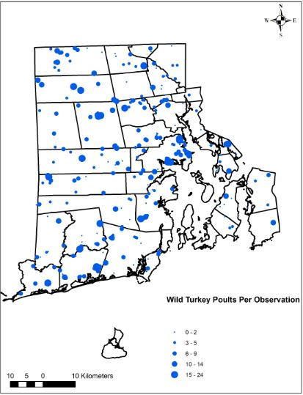
Counting Turkeys
Each July and August, biologists ask Rhode Islanders to send in sightings of hens and poults
This helps give biologists an idea of how many poults are hatching and surviving
Notes:
Visit www.dem.ri.gov/reportwildlife to participate in the annual community science turkey monitoring project!

Slide 19
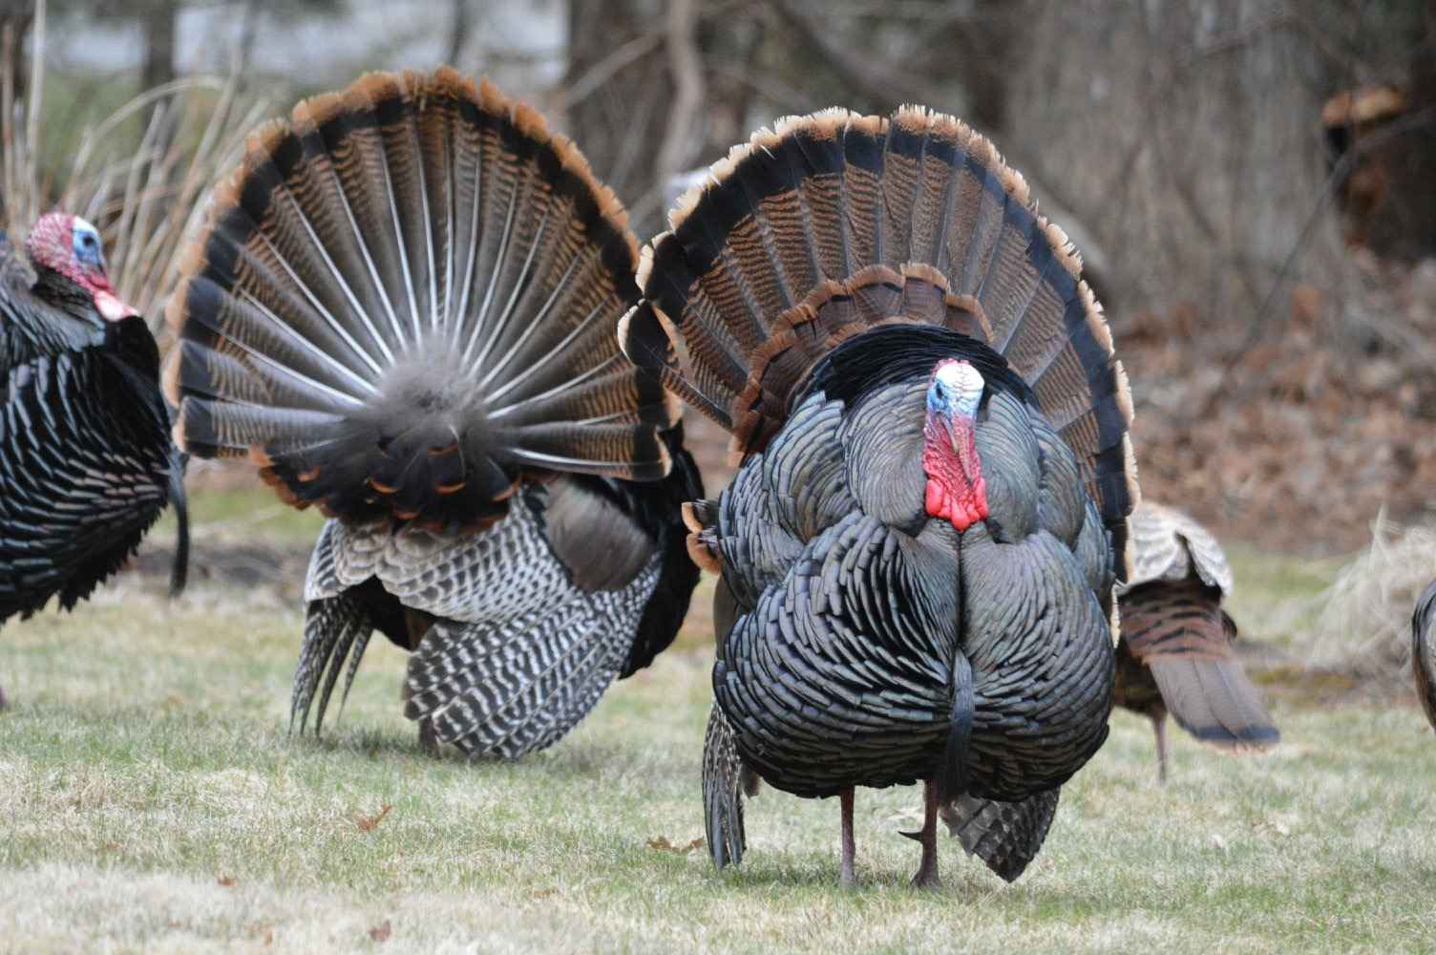
Can you survive in the wild as a turkey?

