Slide 1
Learning from the Past
RIDEM Division of Fish and Wildlife
Rhody Critter Kits Program

Slide 2
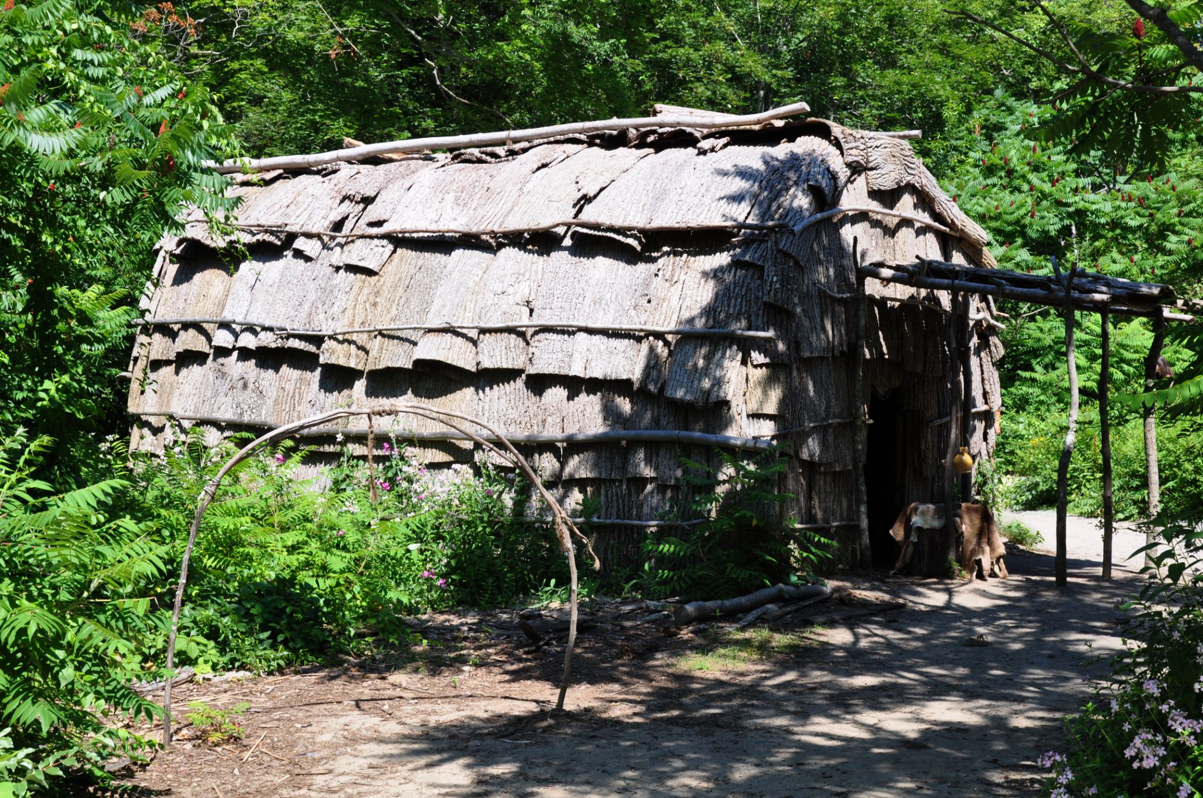
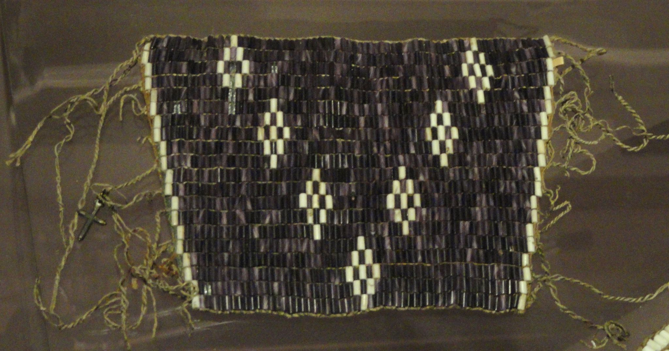
Before 1600
Amaury Laporte
Notes:
Before 1600: Indigenous people live, farm, hunt, trap, and fish for survival. The Narragansett, Wampanoag, Niantic, Nipmuck, Manissean, and Pequot tribes all relied on natural resources in Rhode Island. Members of these tribes are still here today, continuing their cultural practices and relationship to wildlife resources.

Slide 3
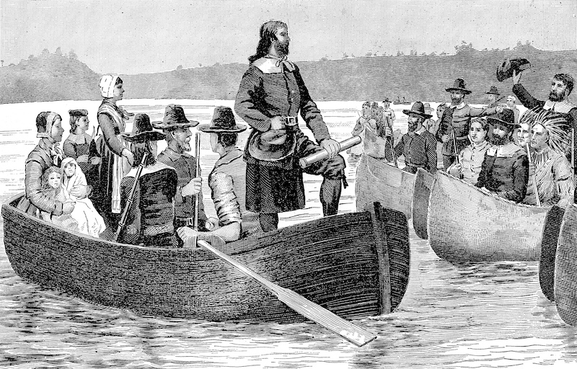
1636
Notes:
1636: First European settlement in Rhode Island is founded by Roger Williams.

Slide 4
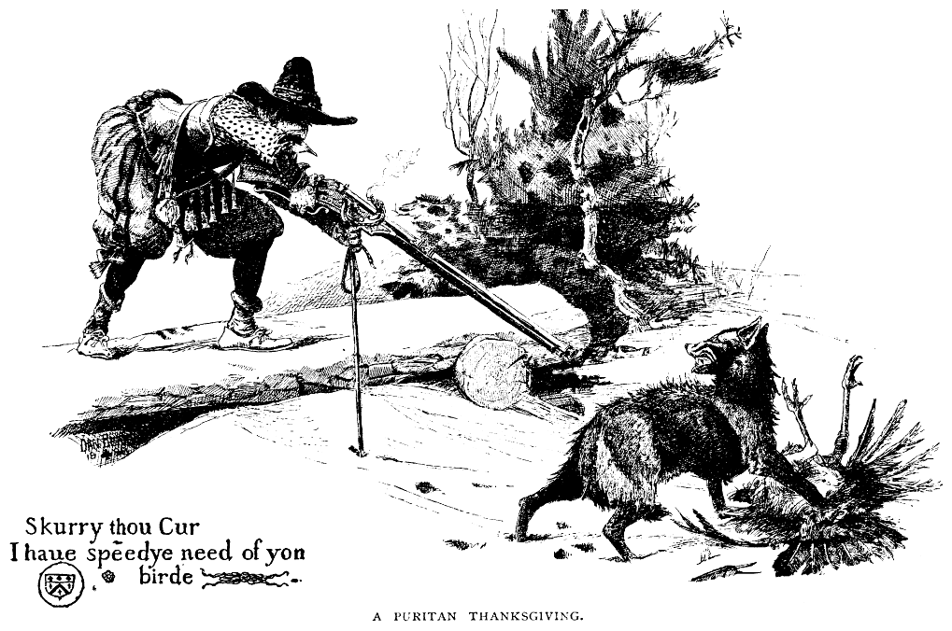
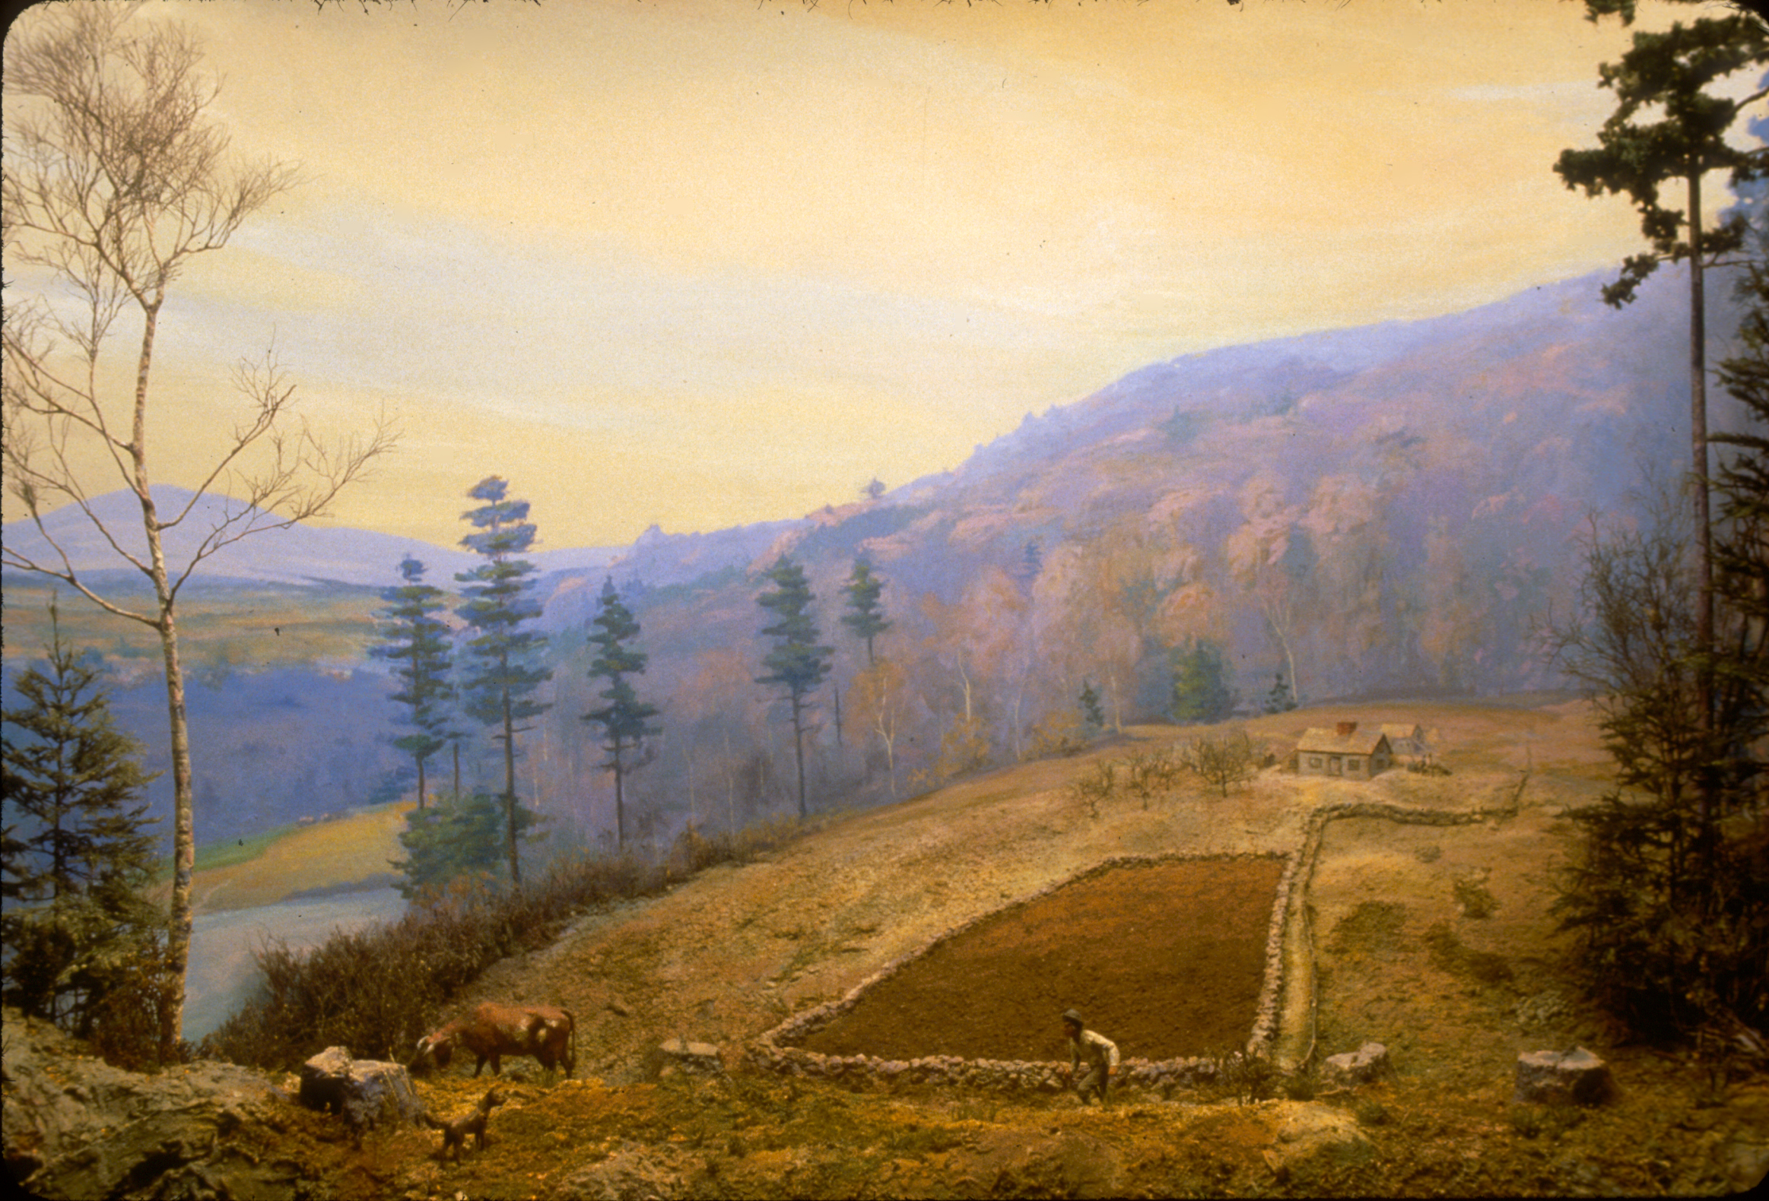
1740
Notes:
1740: Extensive European settlement leads to forest habitat removal for agriculture, overhunting/trapping of game, and removal of predators (wolves, mountain lions).
Photo: Harvard Forest

Slide 5
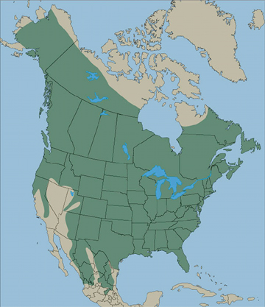
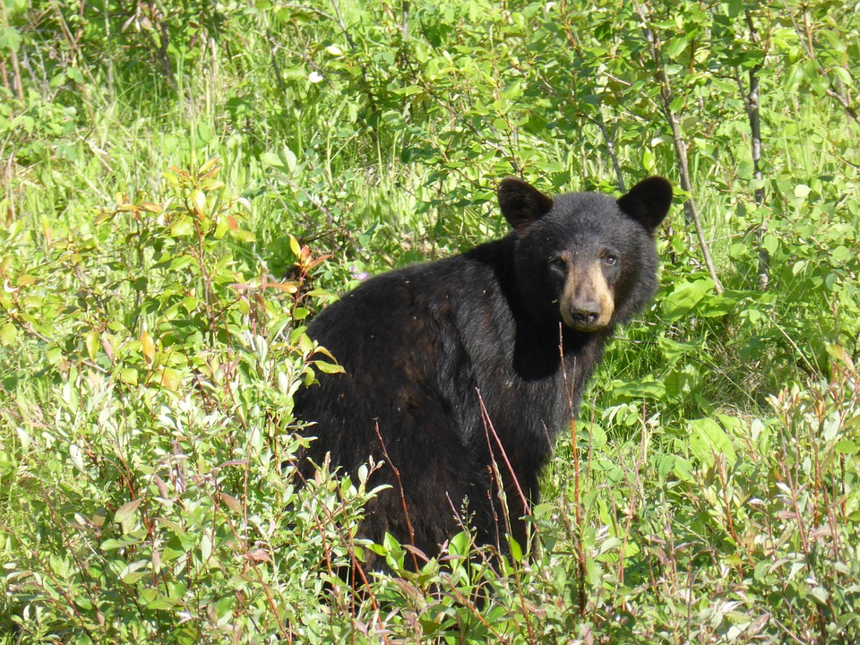
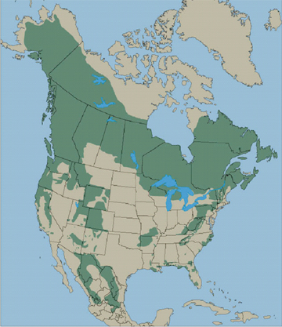
1800
Notes:
1800: The American black bear disappears from Rhode Island. The top map shows the distribution of black bears prior to European settlement. The bottom map shows the modern distribution of black bears, though some areas are starting to see black bear populations again (like we are in Rhode Island!).

Slide 6
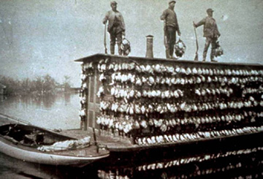
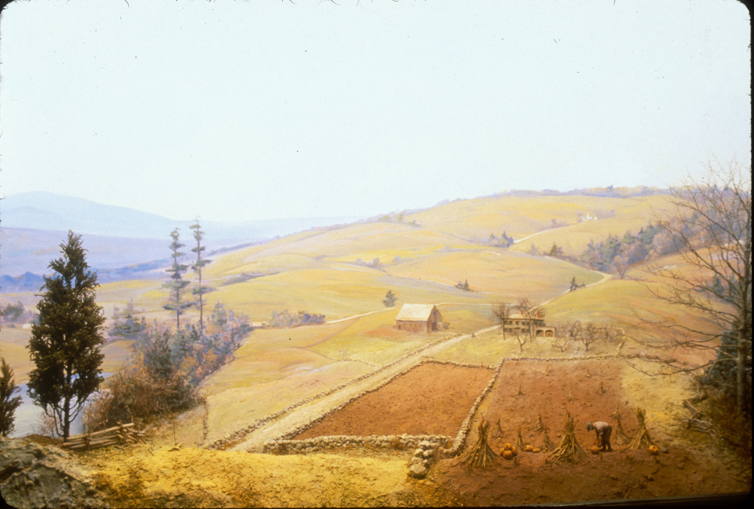
1830
Notes:
1830: Peak levels of deforestation. Market hunting of waterfowl and other birds begins to become popular, resulting in the overharvest of many bird species and subsequent population declines.

Slide 7
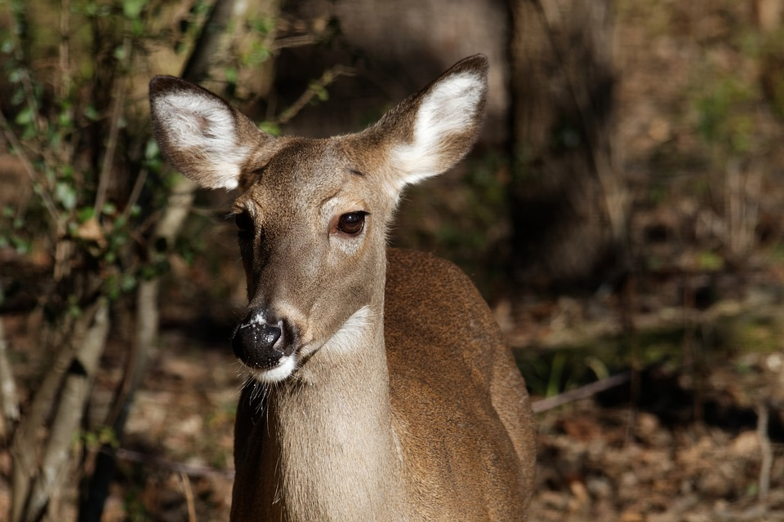
1900
Notes:
1900: The Lacey Act, the first federal legislation for wildlife, is signed. This Act made it “unlawful to import, export, sell, acquire, or purchase fish, wildlife or plants that are taken, possessed, transported, or sold.”

Slide 8
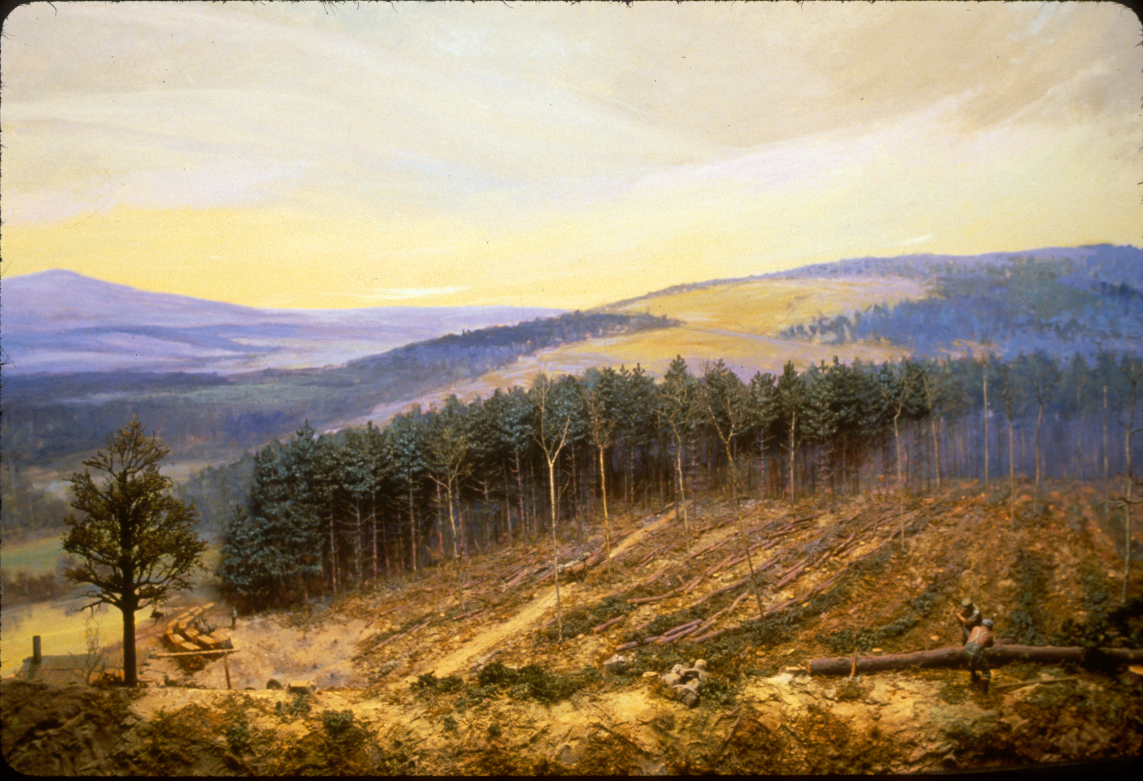
1910
Notes:
1910: Farms have increasingly been abandoned as people move to cities for work, or moved westward for better farming opportunities. Forests begin to regenerate, and are logged for timber.

Slide 9
1918
Notes:
1918: The Migratory Bird Treaty Act is passed. This Act states that “it is unlawful to pursue, hunt, take, capture, kill, possess, sell, purchase, barter, import, export, or transport any migratory bird, or any part, nest, or egg of any such bird, unless authorized under a permit issued by the Secretary of the Interior.” A few exceptions include scientific research (with a permit), species that are hunted under strict regulations during set seasons, and artifacts for Native American cultural and religious ceremonies.

Slide 10
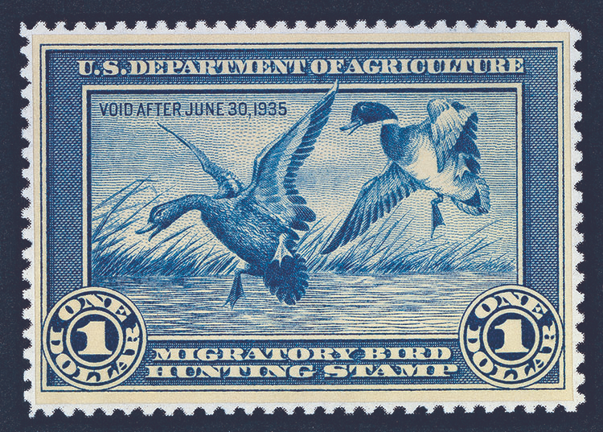
1934
Notes:
1934: President Franklin D. Roosevelt signs the Duck Stamp Act. This act makes it a requirement of all waterfowl hunters ages 16 and up to purchase a Federal Duck Stamp each year. The proceeds of Duck Stamp sales (98 cents out of every dollar), goes towards purchasing or leasing wetland habitat for the National Wildlife Refuge system.

Slide 11
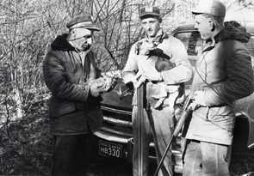
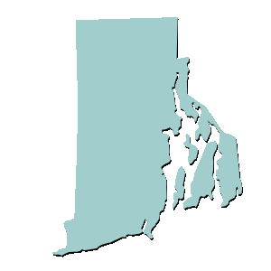
1935
Notes:
1935: The “Rhode Island Division of Fish and Game” is established, including law enforcement officers. In 1978, the Division of Fish and Wildlife and the Division of Law Enforcement would become distinct divisions at RIDEM.

Slide 12
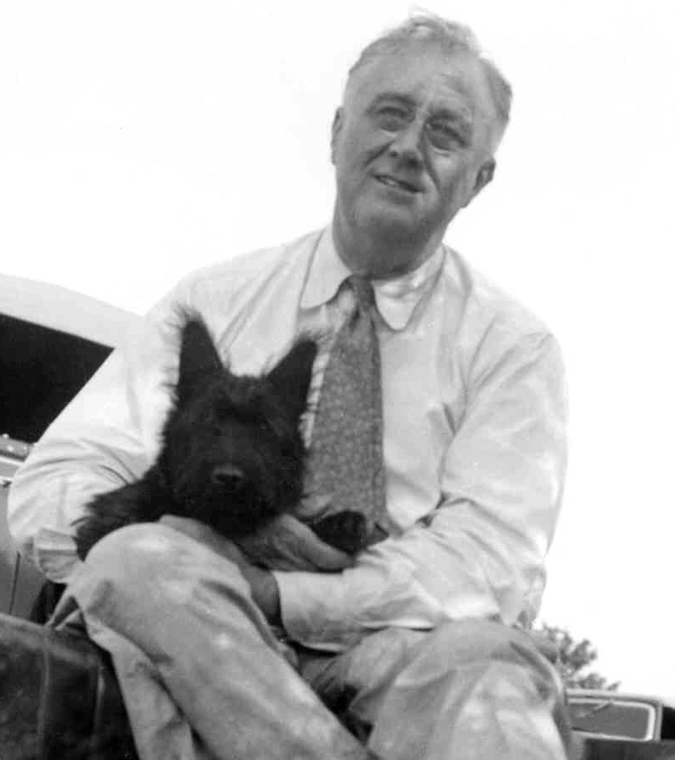
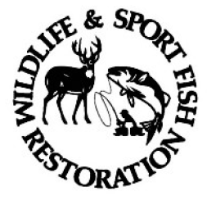
1937
Notes:
1937: President Franklin D. Roosevelt signs the Pittman-Robertson Act. This act places an excise tax on firearms and ammunition, with a later extension to archery equipment. The proceeds of this excise tax, paid by the manufacturers, are allocated to each state by the United States Fish and Wildlife Service. The funds acquired must be used for habitat acquisition, management, and restoration, research and monitoring of bird and mammal species, and hunter education.
EM.

Slide 13
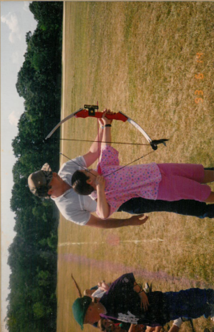
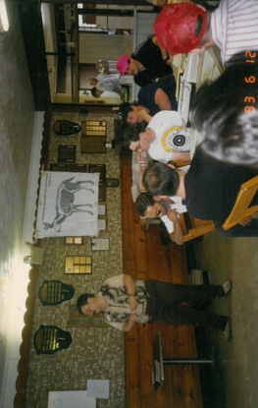
1956
Notes:
1956: Hunter education program is established in Rhode Island to ensure safe and ethical hunting in the state.

Slide 14
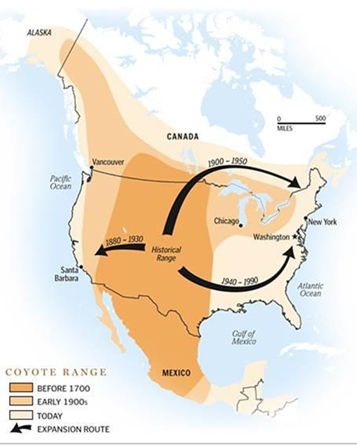
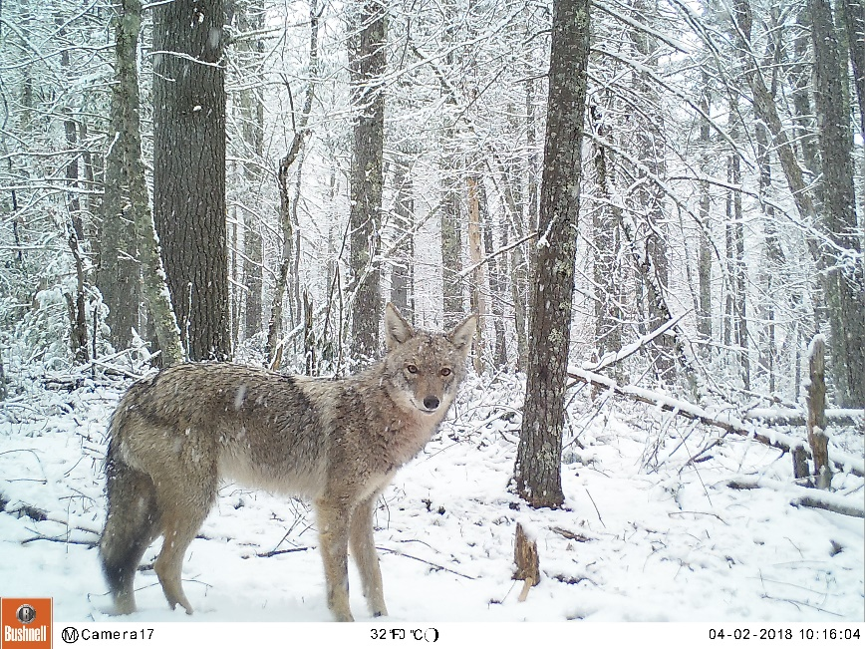
1960
Notes:
1960: Coyotes expand their range from the central United States to Rhode Island to fill the ecological niche that was left open when wolves were eradicated by colonists.

Slide 15
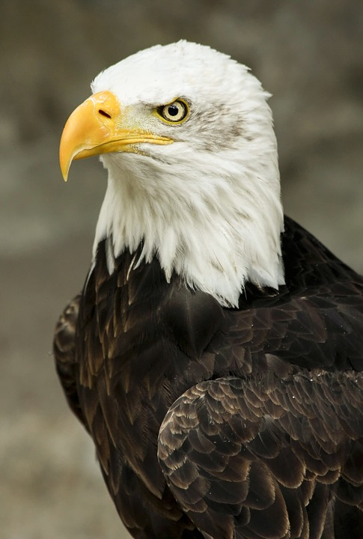
1973
Notes:
1973: The Endangered Species Act is signed, further protecting America’s endangered and threatened wildlife and their habitats.

Slide 16
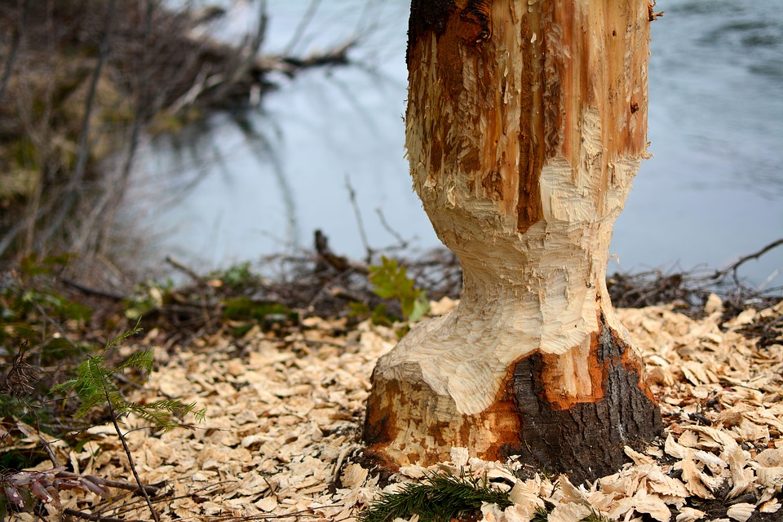
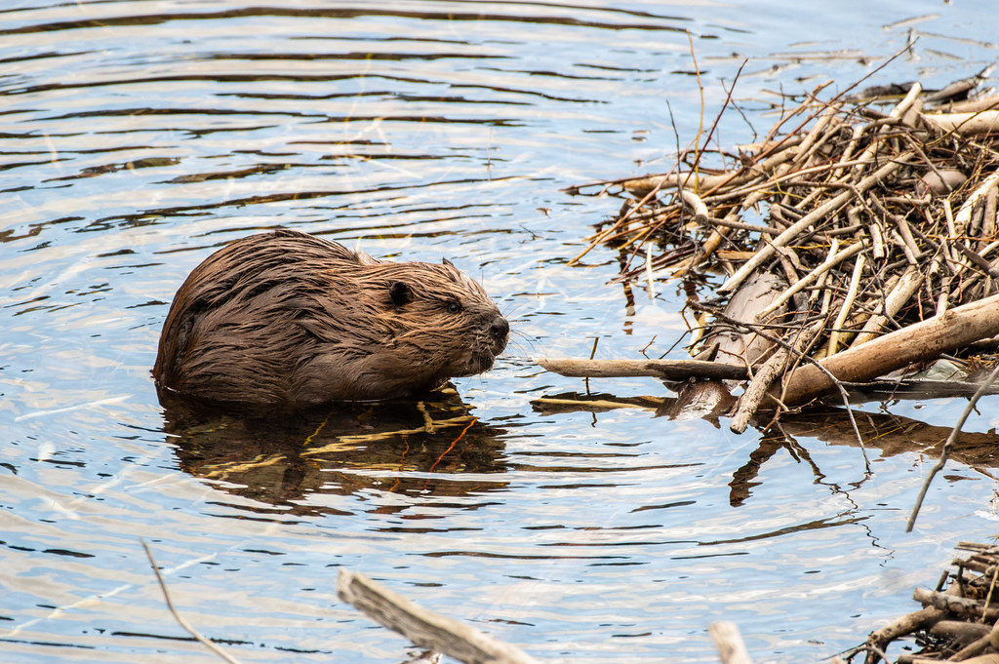
1976
Notes:
1976: Beavers return to Rhode Island’s watersheds!

Slide 17
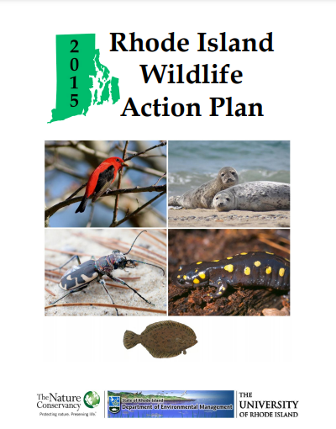
2000
Notes:
2000: State Wildlife Grants are established to support conservation of Species of Greatest Conservation Need, as determined by the Rhode Island Wildlife Action Plan. This plan includes birds, mammals, invertebrates (terrestrial and aquatic), fish, reptiles, and amphibians.

Slide 18
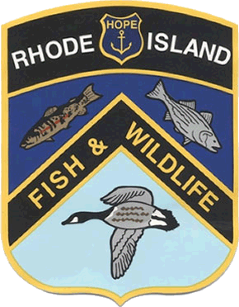
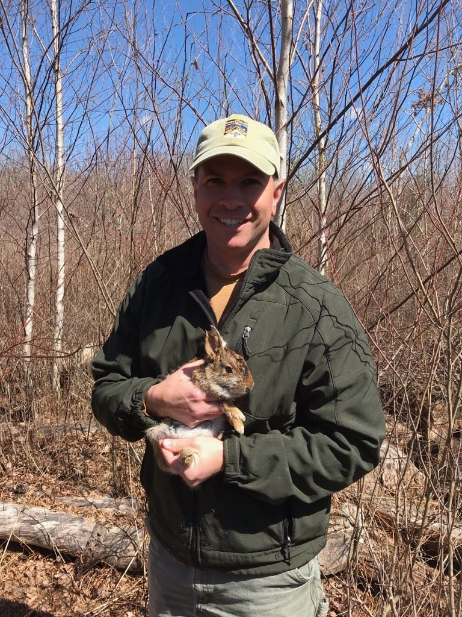
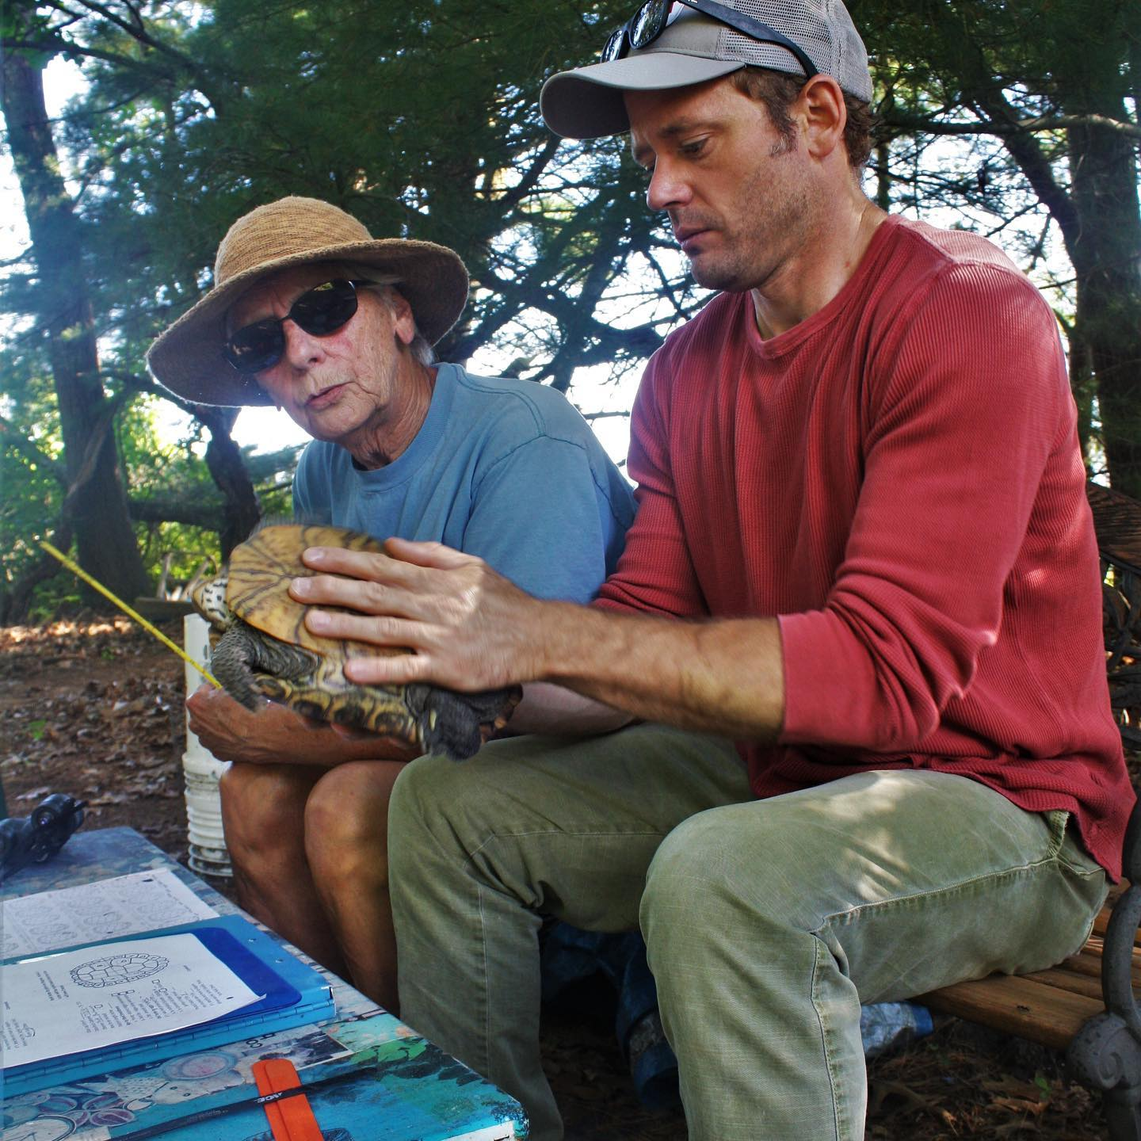
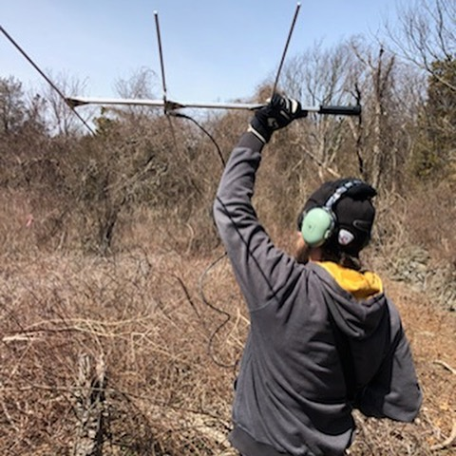
Present Day
Notes:
Present Day: The Rhode Island Division of Fish and Wildlife continues to protect, restore, and manage wildlife populations and their habitats.

