Slide 1

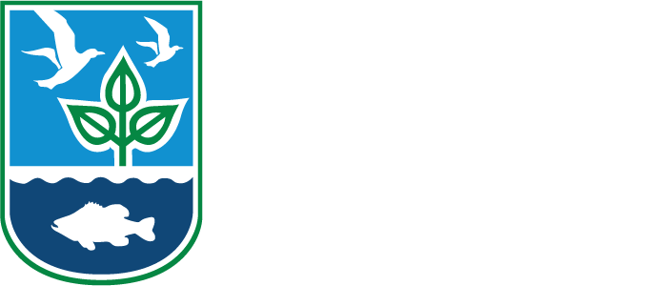
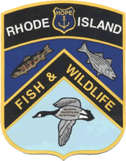
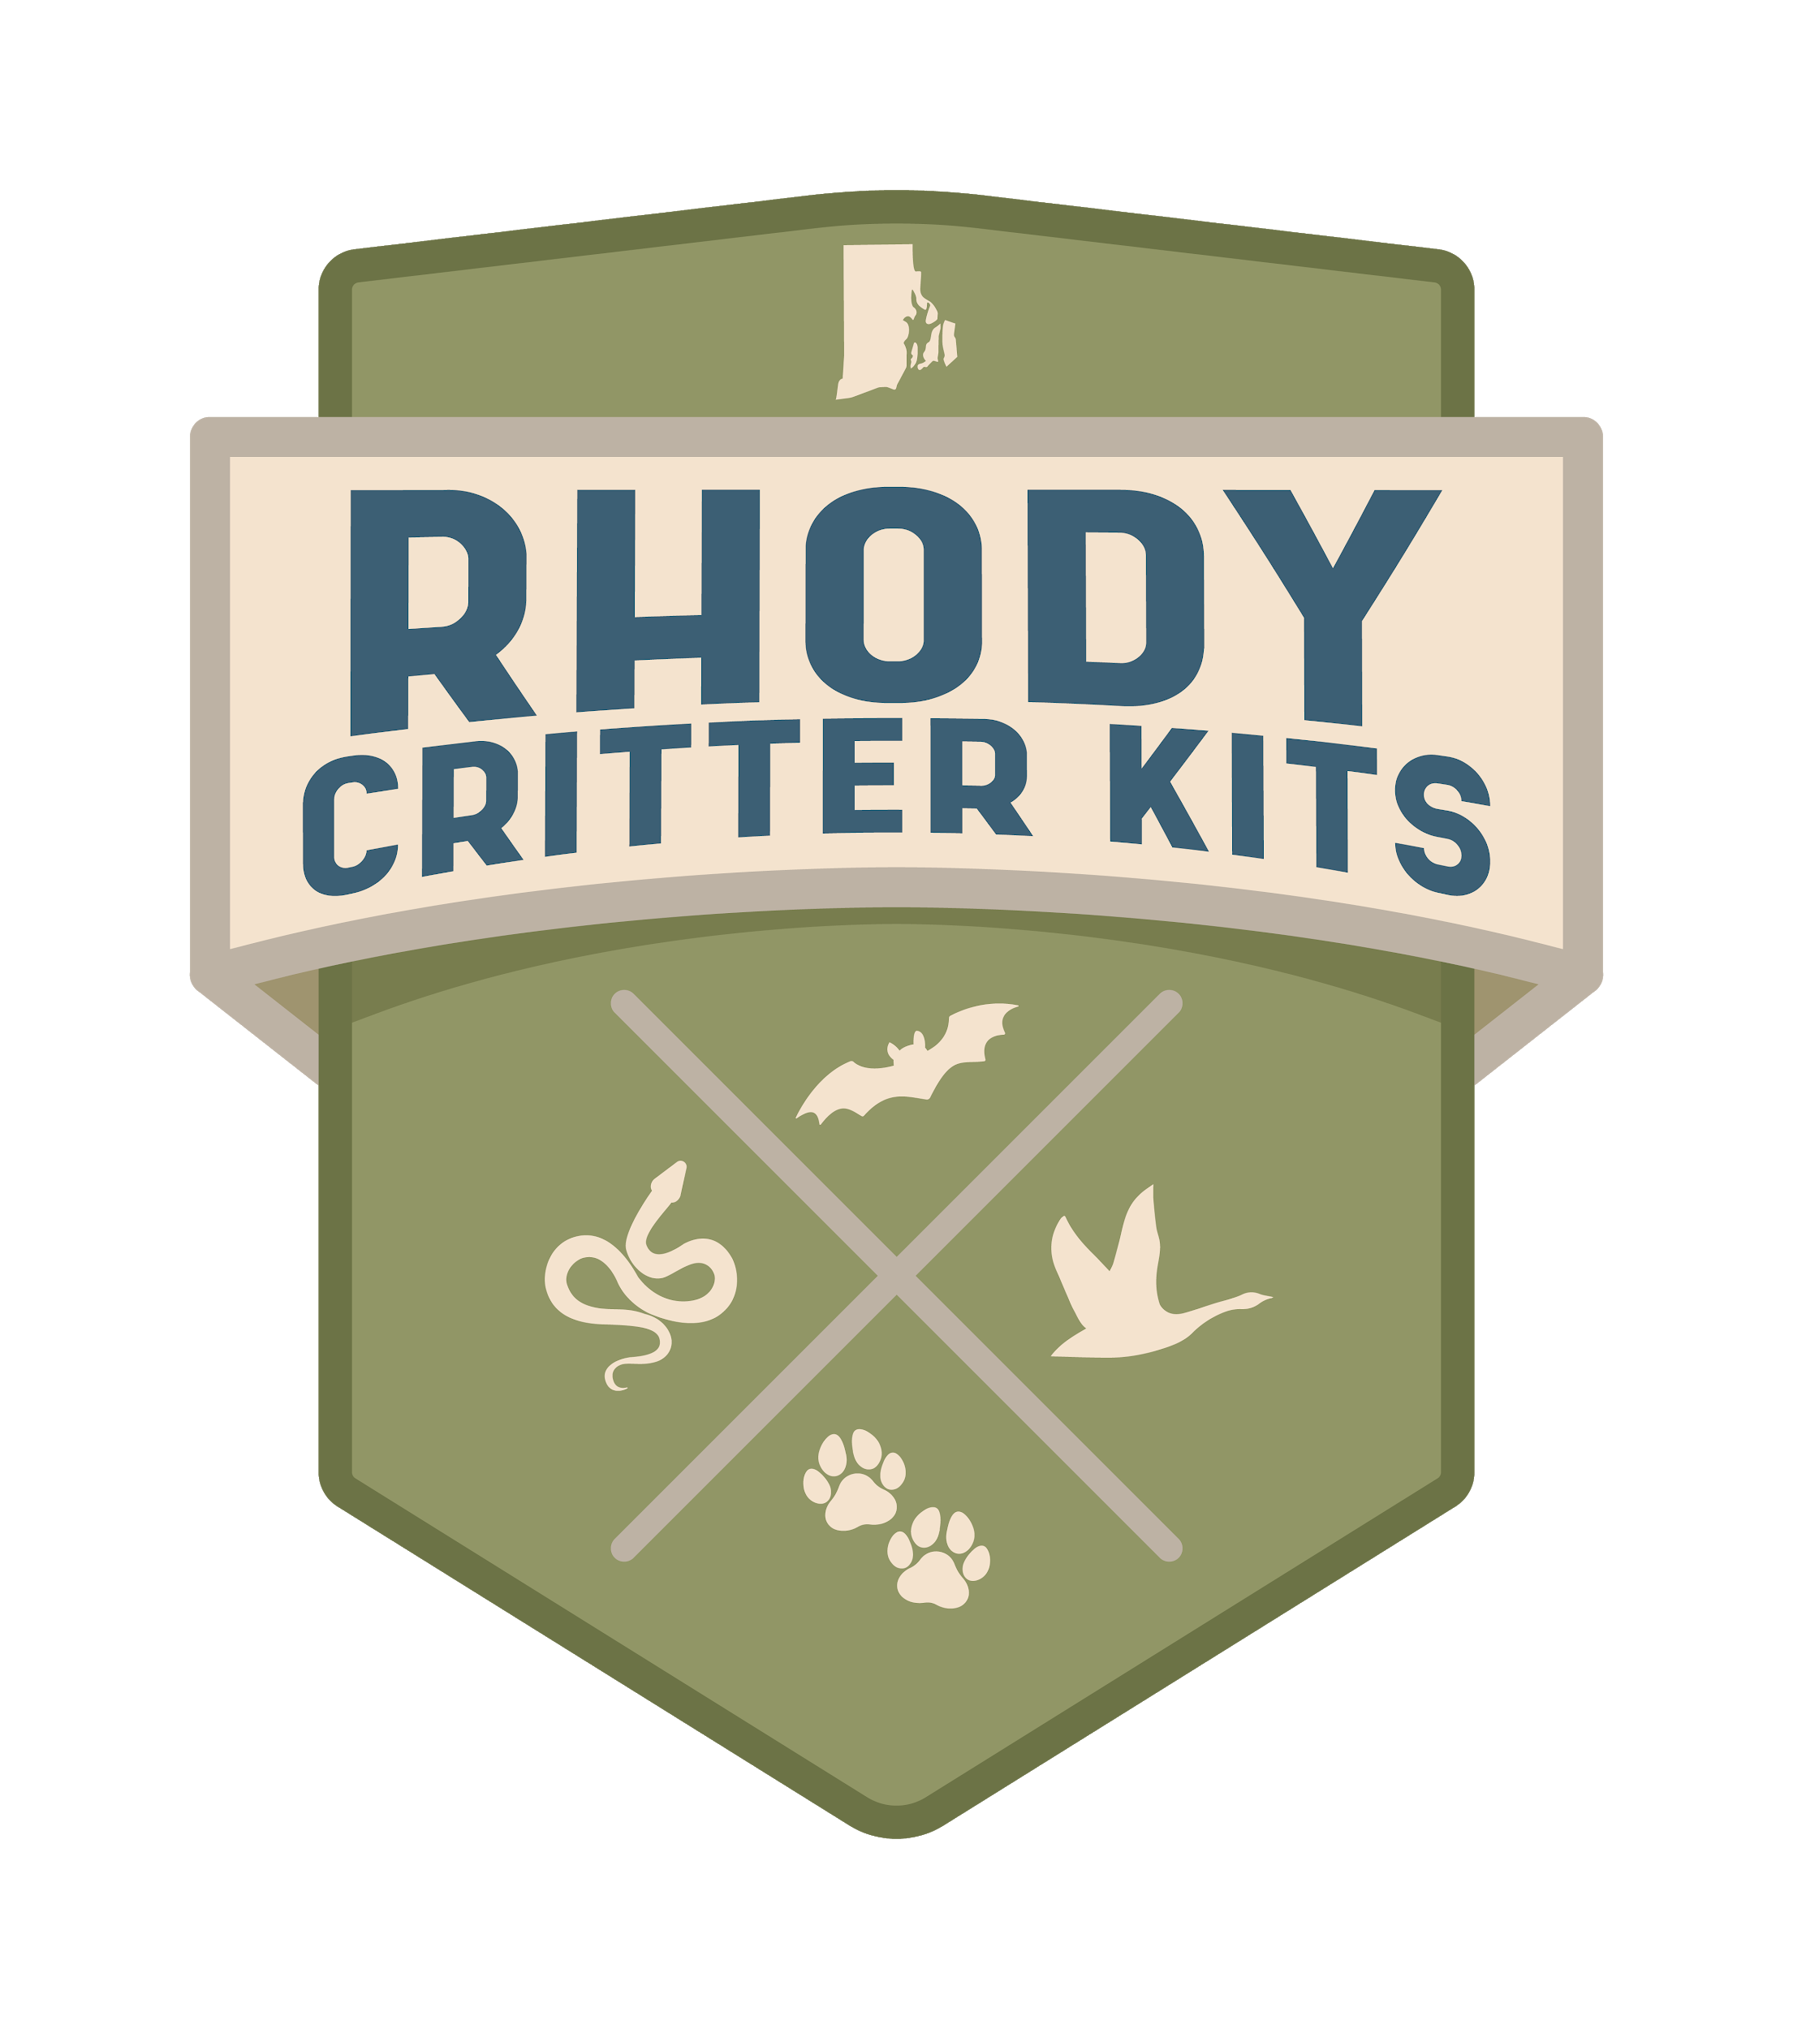
Bat Conservation
Rhode Island DEM Division of Fish and Wildlife
Rhody Critter Kits Program

Slide 2
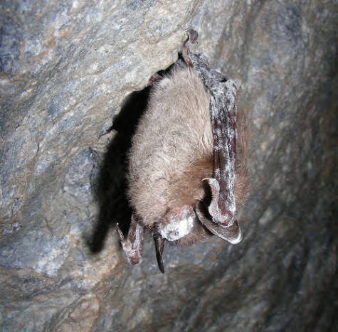
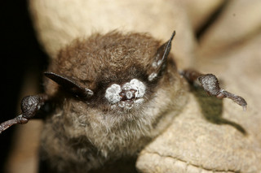
White Nose Syndrome
Notes:
White-nose Syndrome (WNS) is a disease that has caused rapid, dramatic declines in bat populations of some once-common species in the Eastern United States and Canada. It is caused by a fungus, Pseudogymnoascus destructans (“Pd”) that occurs in the cold, humid environments of caves and mines where bats tend to hibernate.
How does WNS affect bats?
The fungus grows on the noses and other parts of bats and can cause the wing membrane to deteriorate. The disease affects the bats during hibernation by disrupting their metabolism, causing dehydration and loss of fat reserves. Bats arouse from hibernation apparently to search for food and water only to encounter sub-freezing temperatures, predators, and no available resources. At least 6 million bats have died in North America from this disease, but scientists believe that this is a serious underestimate. Scientists across the United States are doing lots of research to learn how to treat bats with WNS. Currently, there is no precise cure. There is hope though! Evidence of bats surviving WNS has been documented. Researchers have found genetic differences between bats that survived and bats that succumbed to the disease.
Where did WNS come from?
WNS was first documented in upstate New York in 2007; as of 2022 it has been confirmed in 38 states and 8 Canadian provinces. It is believed that the fungus may have been transported by humans, possibly on equipment or clothing, from caves or mines in Europe, where the fungus is now known to have originated. Scientists across the United States are doing research to learn how to treat and cure bats with WNS. Currently, there is no precise cure.
To see a time lapse of the spread of WNS across the United States, click here: https://www.whitenosesyndrome.org/spreadmap
Are there any human impacts?
The disease does not affect humans and the fungus does not occur in hot, dry environments such as attics. However, the loss of bats causes negative impacts on our ecosystem, which will also impact humans because of all the ecosystem services bats provide.
What are we doing to help in Rhode Island?
In 2016, the RI Division of Fish and Wildlife conducted sampling in the few known places where small numbers of bats hibernate in Rhode Island. The presence of the fungus was confirmed at all sites, and present on a single tri-colored bat. It was not unexpected, as WNS had been previously confirmed in all other New England states. Although large die-offs of bats have not been documented here, the finding does not bode well for the long-term viability of bat populations in the region.We continue annual monitoring of bat populations and local hibernacula.

Slide 3
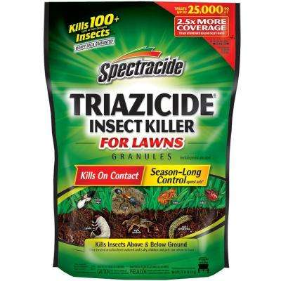
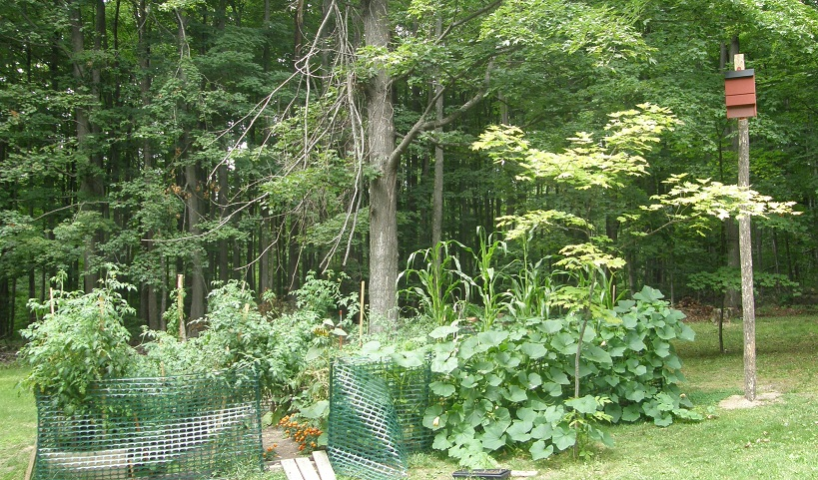
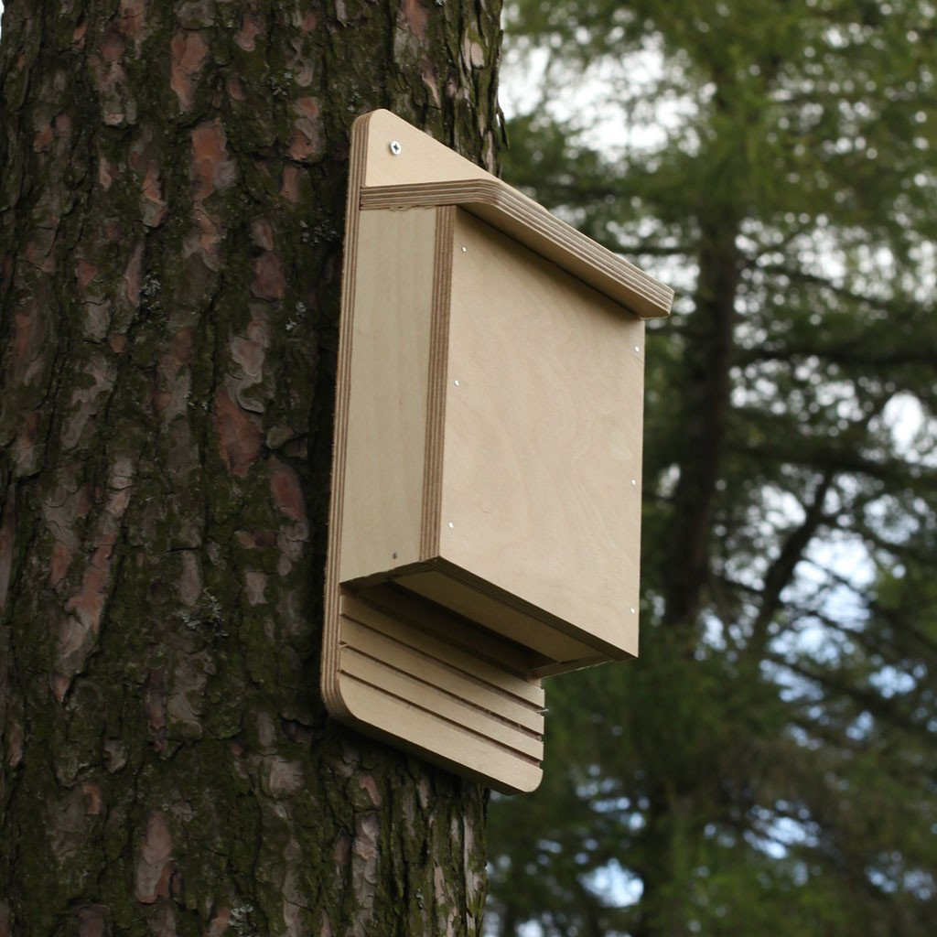
How can YOU help bats?
Notes:
There are lots of ways we can all help bats.
Create healthy habitat - Plant a bat-friendly garden with lots of different plants. This will attract insects, and provide natural food for the bats.
Don’t use pesticides - Chemical pesticides are often used to kill certain insect pests, but can end up unintentionally killing other insects too. This can impact bats because killing off insects greatly reduces their food source. Also, if an insect is sprayed, but does not die immediately, it could be eaten by a bat. The bat will have ingested the chemical pesticides via the insect. The poison can make its way up the food chain, eventually harming bats and other wildlife. This is a common occurrence with birds of prey eating rats that have consumed rat poison before becoming a hungry bird’s lunch.
Provide shelter - Building a bat house can help give bats a place to rest. Bats are very site faithful, meaning they return to the same roosts and hibernacula each year. They may not find your bat house right away, but it’s always good to offer them the option! Wisconsin Department of Natural Resources has a great guide on building bat houses. You can find it in the Resources & Lesson Plans folder.
Share what you know about bats with your friends and family! - The more people know about bats, the better. Bats are often misunderstood, and need your help to spread the word that bats are super cool!

