Slide 1
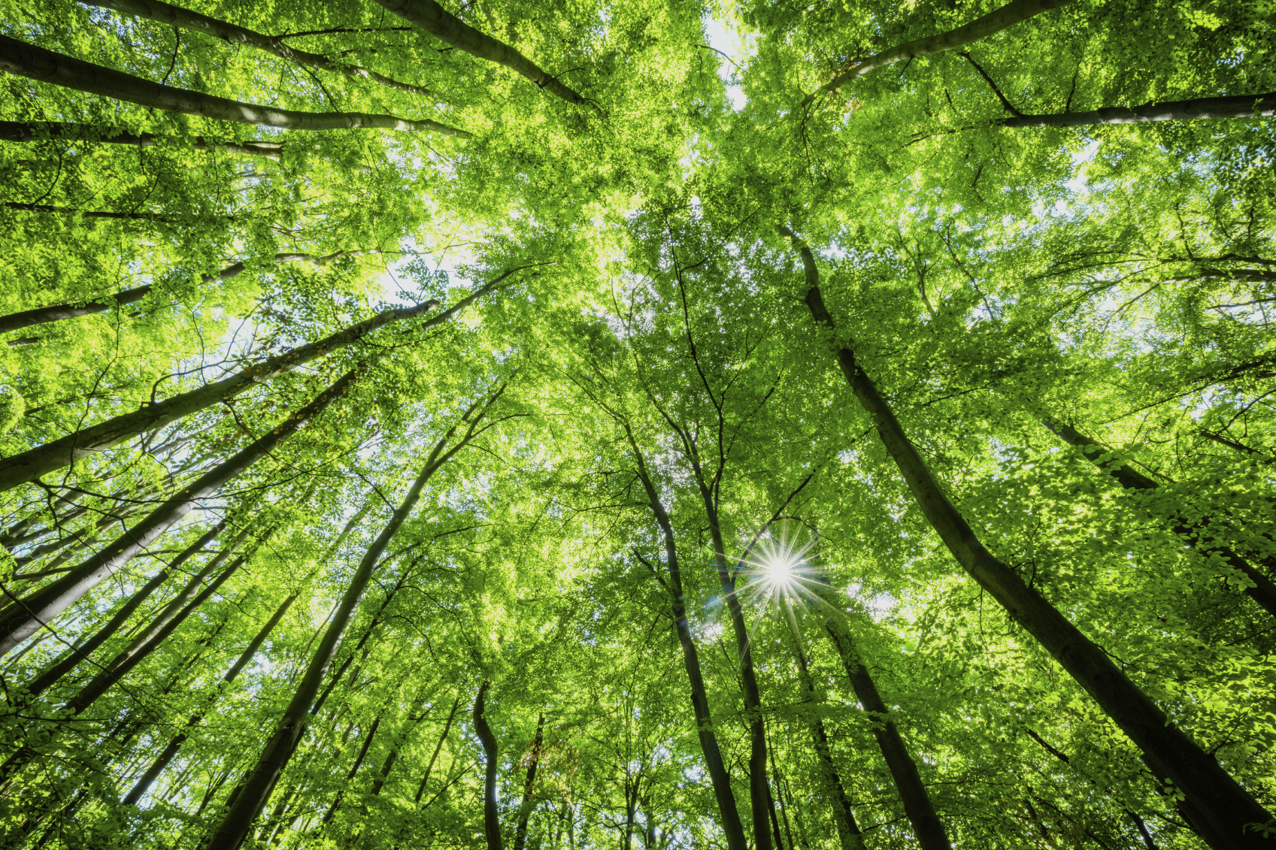
Rhode Island’s Forest Story
RI DEM Division of Fish and Wildlife
Rhody Critter Kits Program
Notes:
What is a habitat?- An animal’s home, made up of food, water, shelter and space.
What habitats can you find around Rhode Island?
Fields/Meadows
Hardwood forests
Pitch pine forests
Ponds/freshwater habitats
What is different about these landscapes?
What animals might you find in each one?

Slide 2
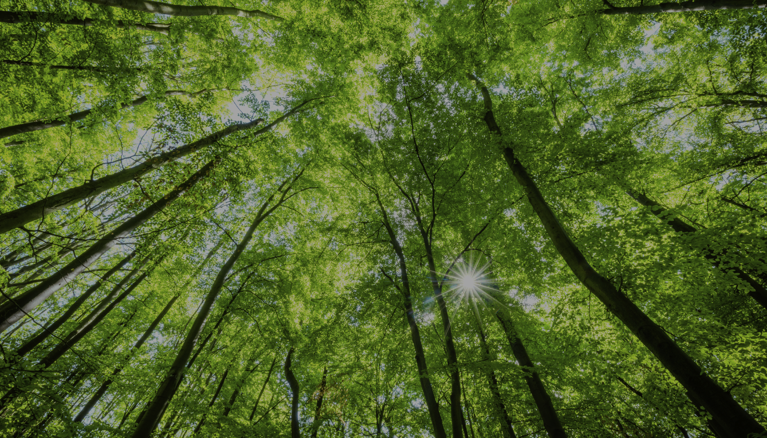
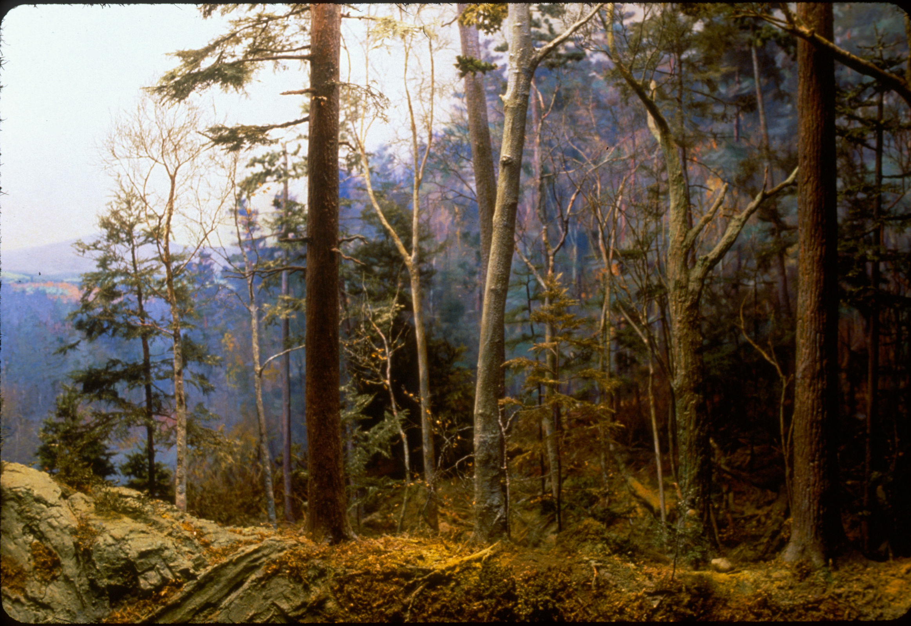
Notes:
Before the settlers arrived in America, Rhode Island’s landscape was covered in vast forests. There was an abundance of habitat for wildlife to live in and resources were plenty. The forests ranged in age, size and density due to natural occurrences such as fires from lightning strikes, floods from beavers and hurricanes knocking down trees. The indigenous people would sometimes manage small areas of habitat for crops or burn areas of the woods to chase out game. This created a diverse landscape and a variety of habitat for different animals.

Slide 3
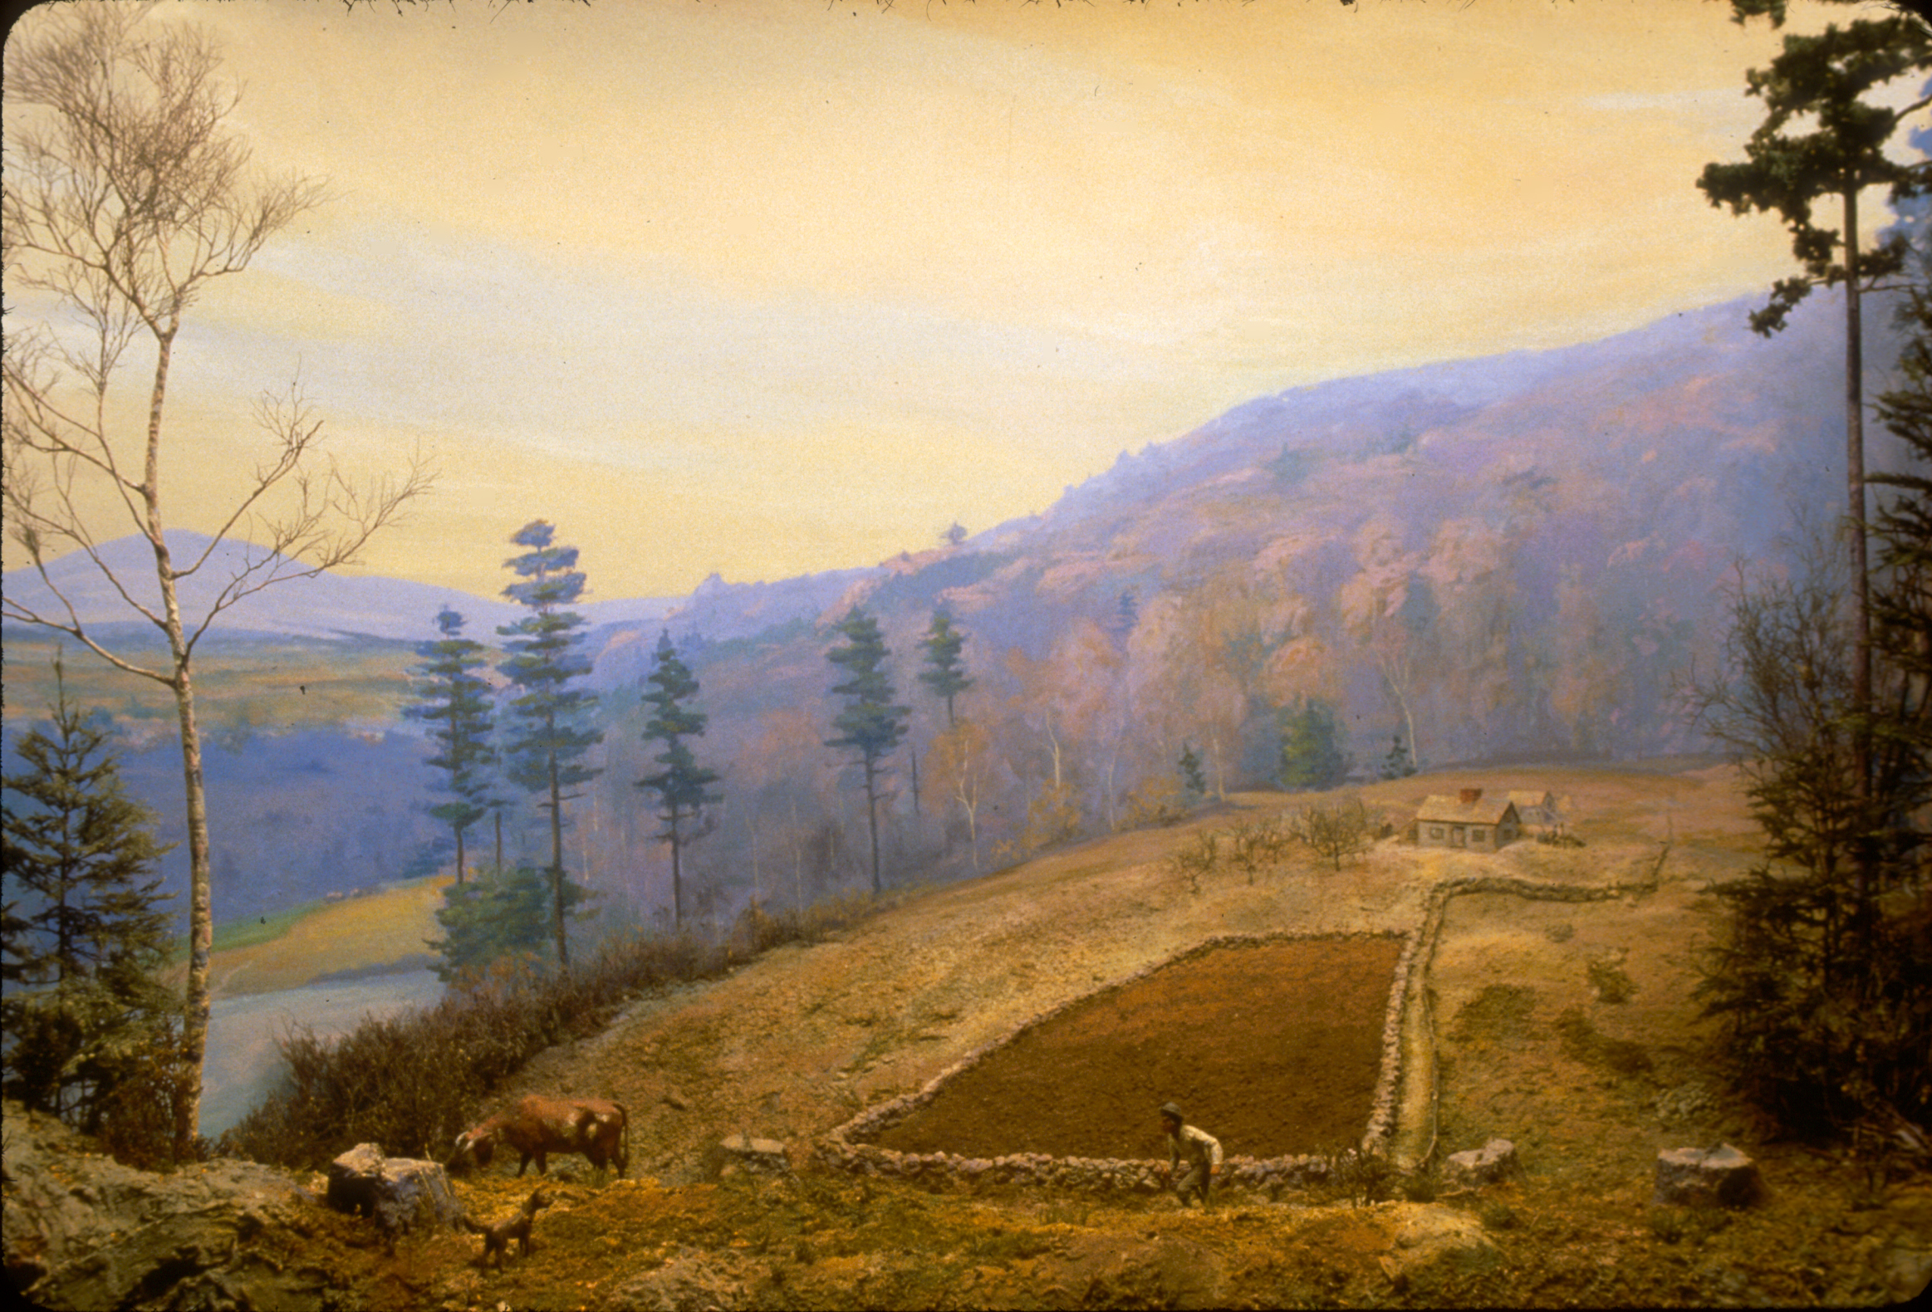
Notes:
The settlers thought that the forests were endless so they began to cut them down to build fields for crops and livestock. They built houses for themselves and hunted the animals for food and fur.

Slide 4
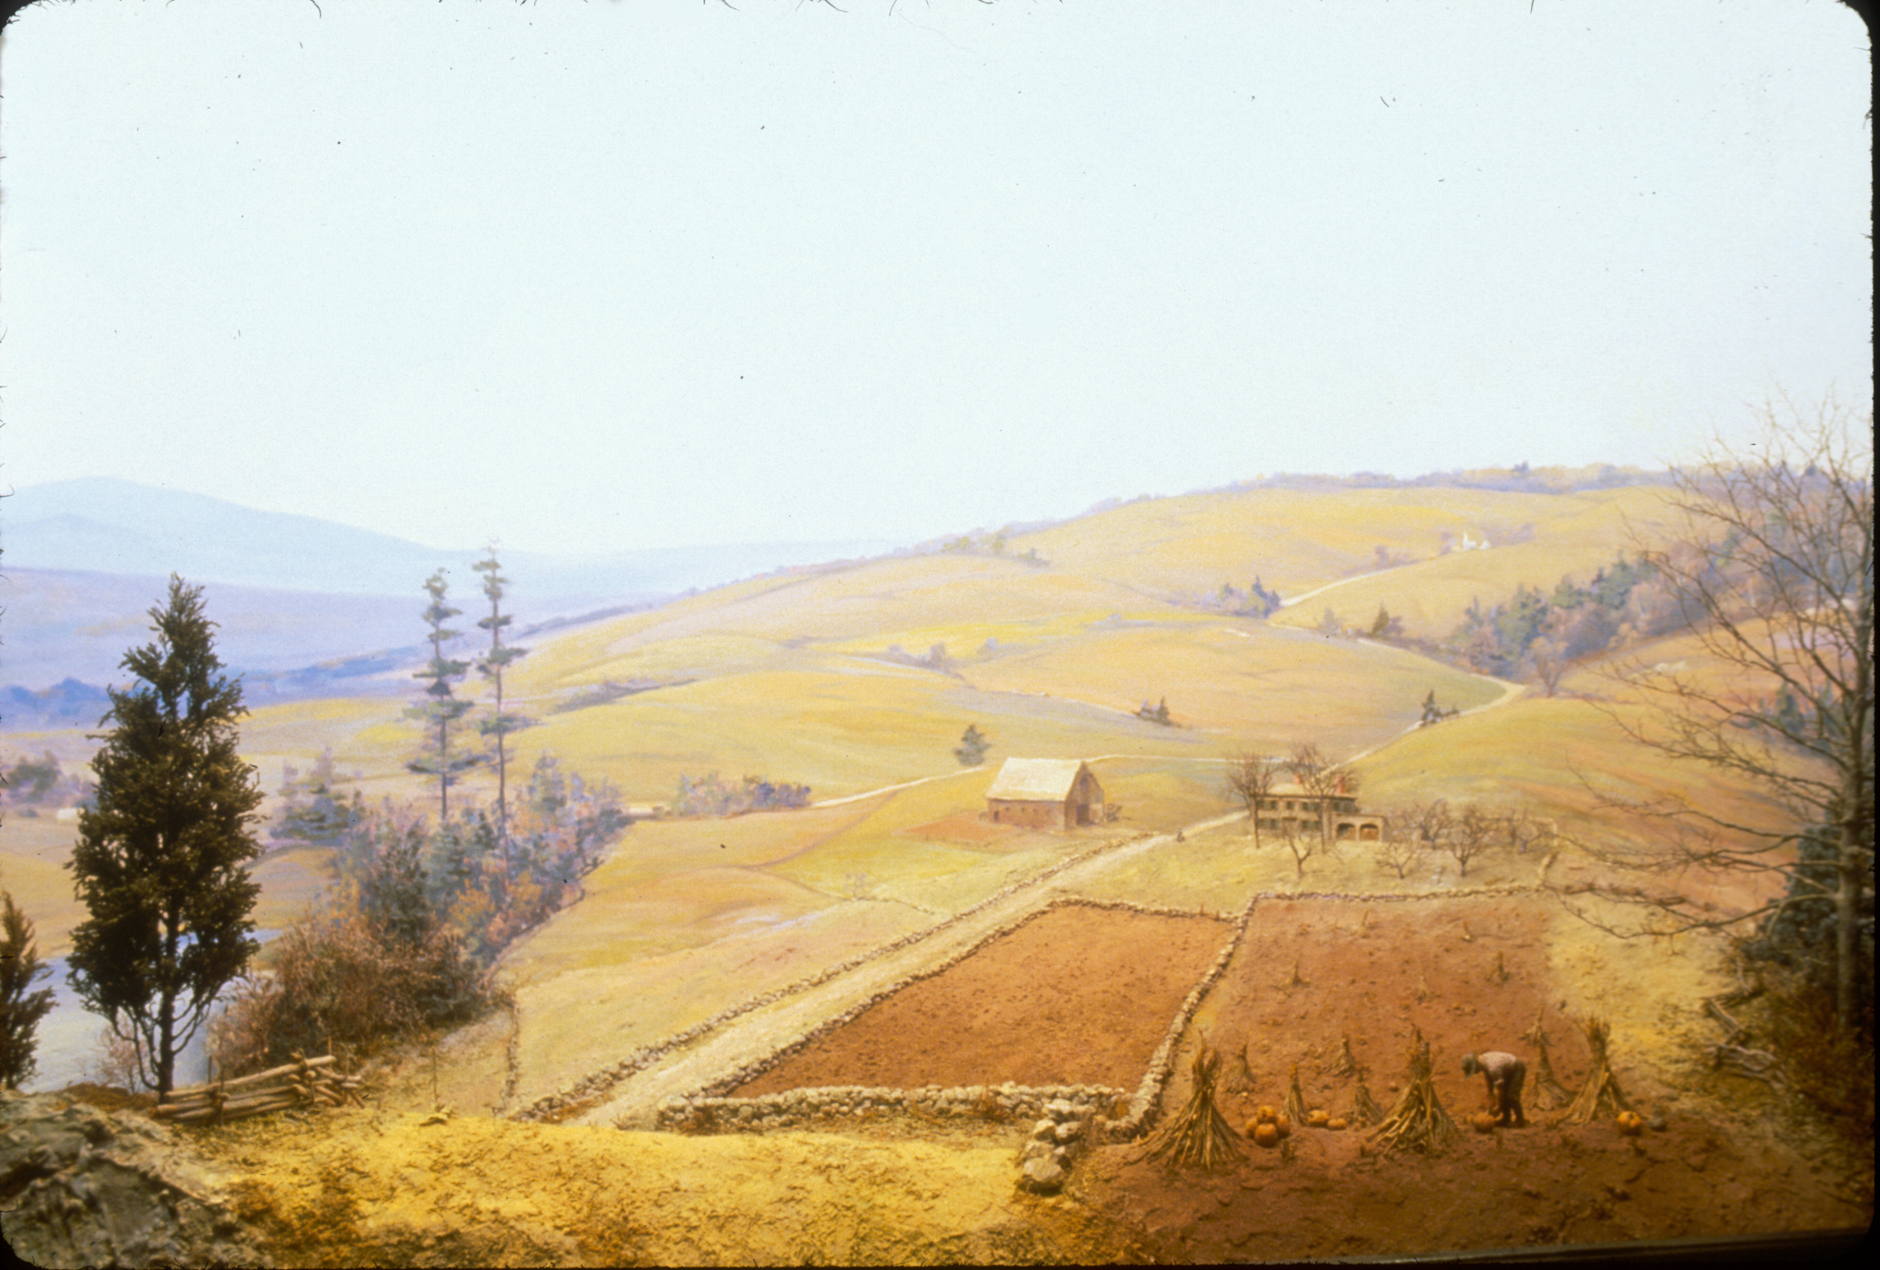
Notes:
As more settlers arrived, more and more forest was cut down to create farmland. The landscape changed and there was very little habitat left for wildlife. Stone walls marked where one property ended and another began. 60-80% of the forest was cut down between 1830-1880. The remaining forest was frequently cut for lumber and fuel.

Slide 5
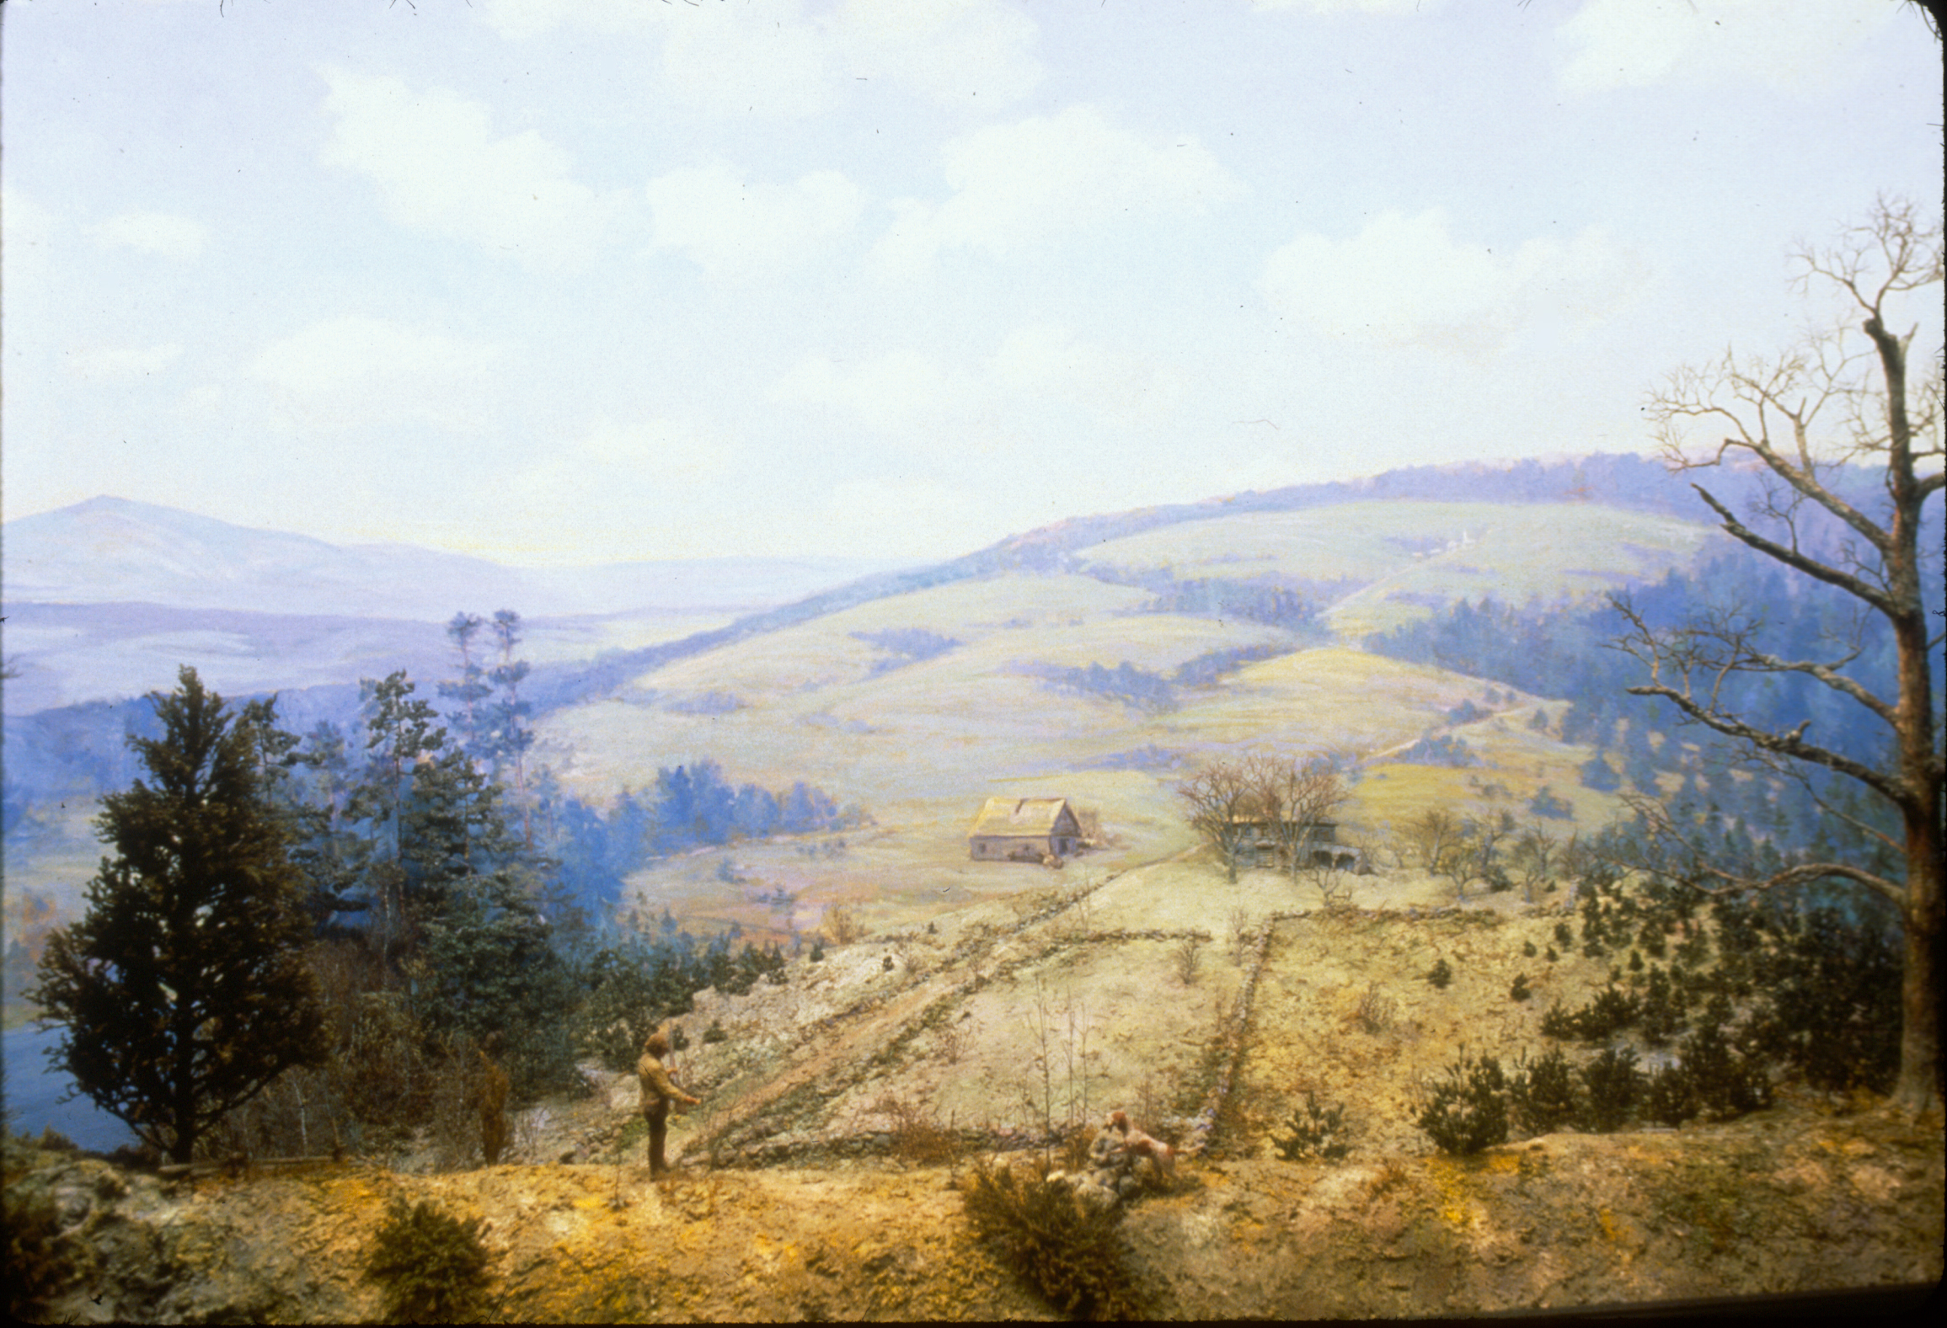
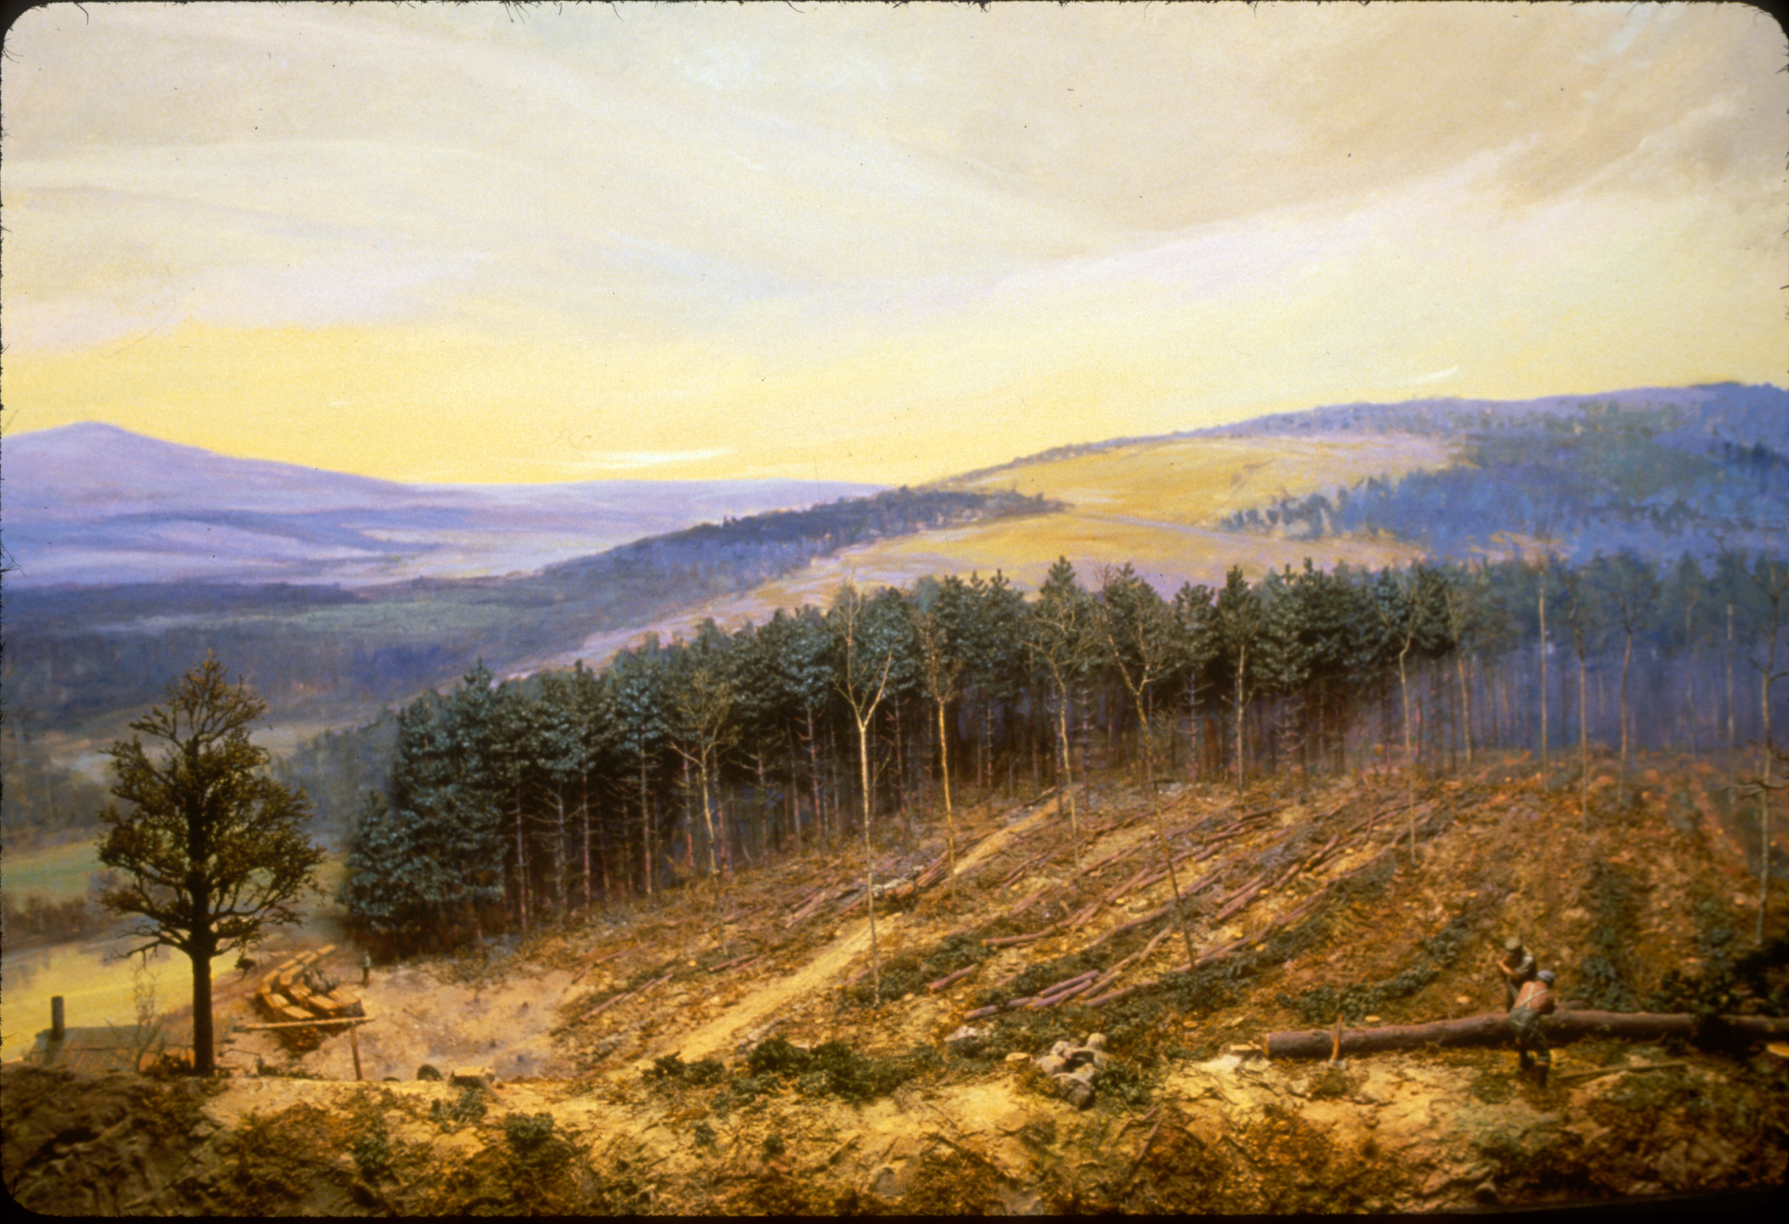
Notes:
Image 1: Around the 1850’s, many fields were abandoned as people moved to new areas and found new jobs. The fields began to quickly grow into young white pine forests.
Image 2: As the white pines grew into middle aged forests, people realized that the pine wood was valuable as lumber for creating shipping crates and so they were cut down and harvested for timber.

Slide 6
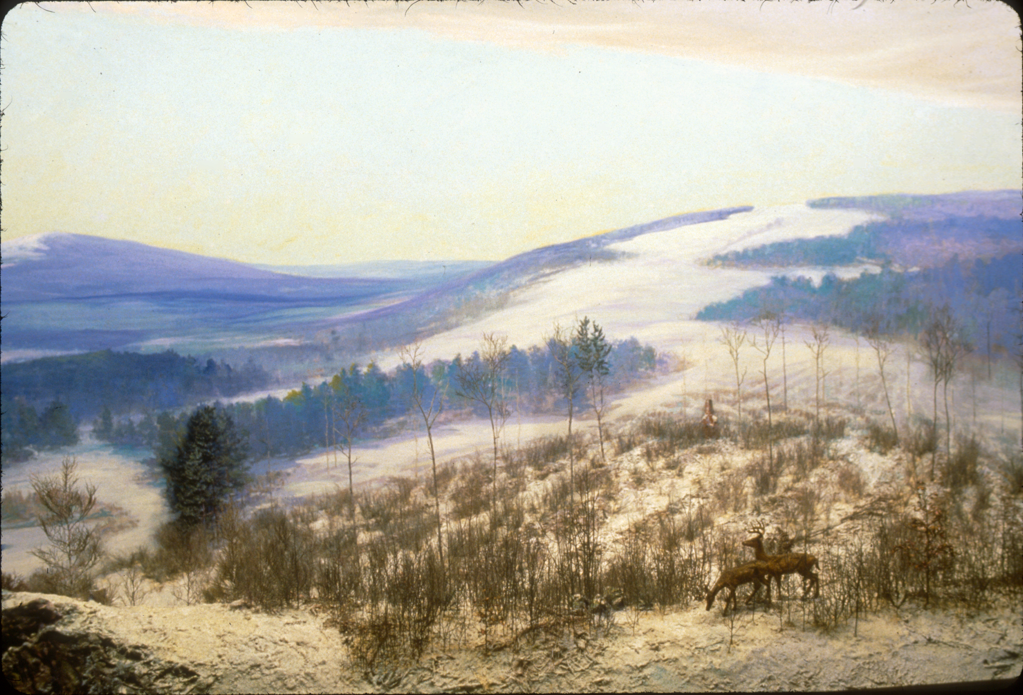
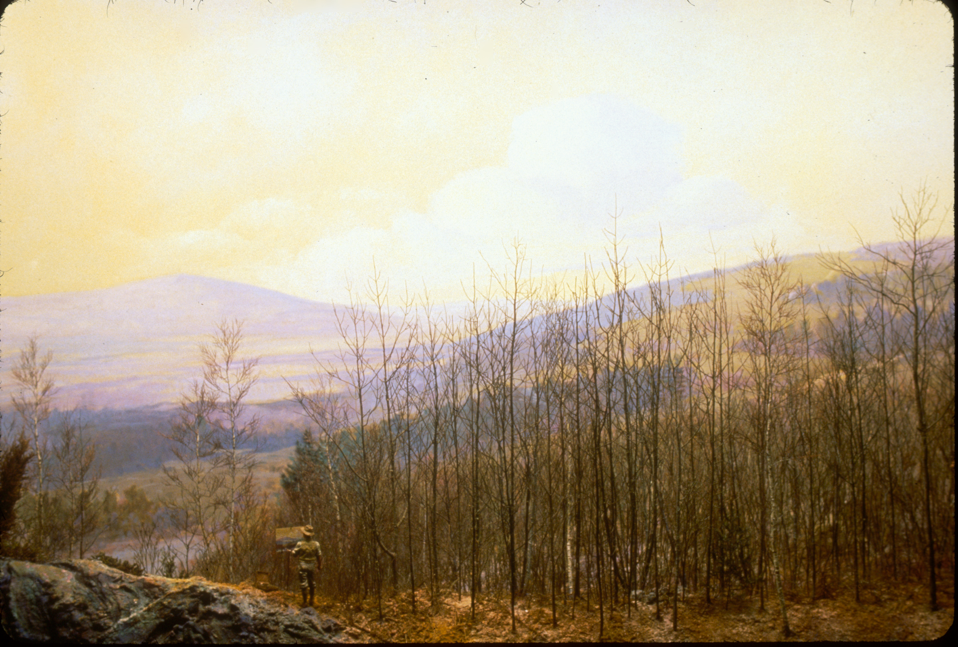
Notes:
Image 1: Clear-cutting (removing all of the trees) the white pines made way for the hardier “Hardwood” trees to take over, such as oaks, cherries and maples. These fast growing trees grew in tight clumps, creating dense thickets. Areas that had been cut earlier grew tall trees that shaded out undergrowth and became mature forests. The landscape started to look like a quilt with different aged patches of forests covering Rhode Island. This created beautiful, varied landscapes for wildlife again.
Image 2: Forests have now matured but the history of the early settlers still shows in the stone walls that once divided farmland but now reside among mature forests. As humans we suppress fires and stop floods because we want to protect our homes, however, these occurrences are a natural part of the ecosystem and are necessary to create the diverse forests that existed before settlers arrived.

Slide 7
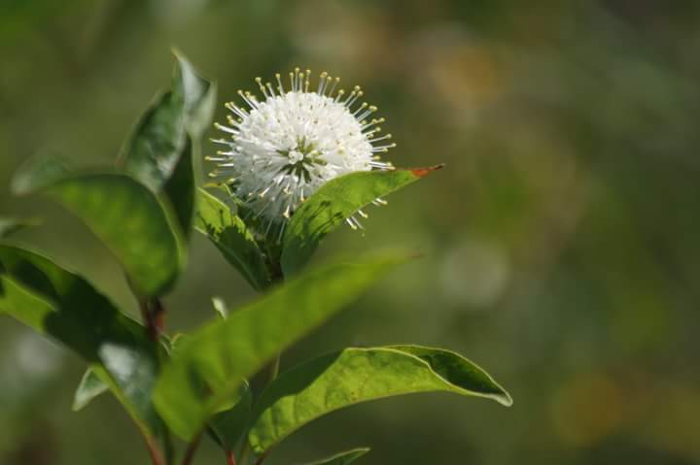
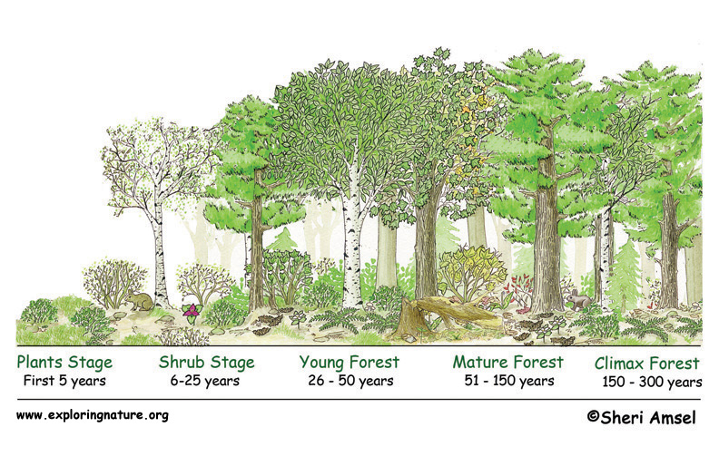
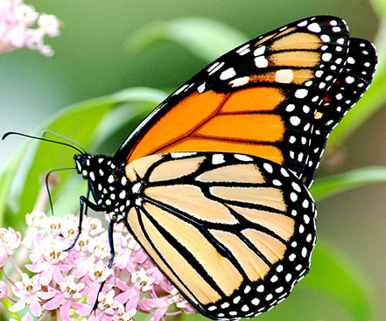
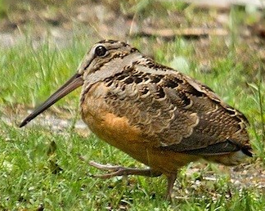
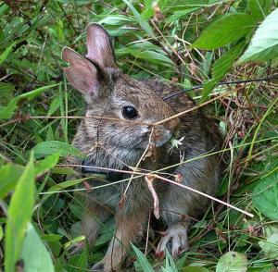
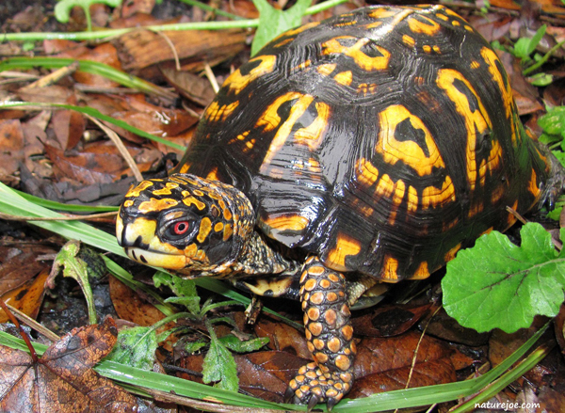
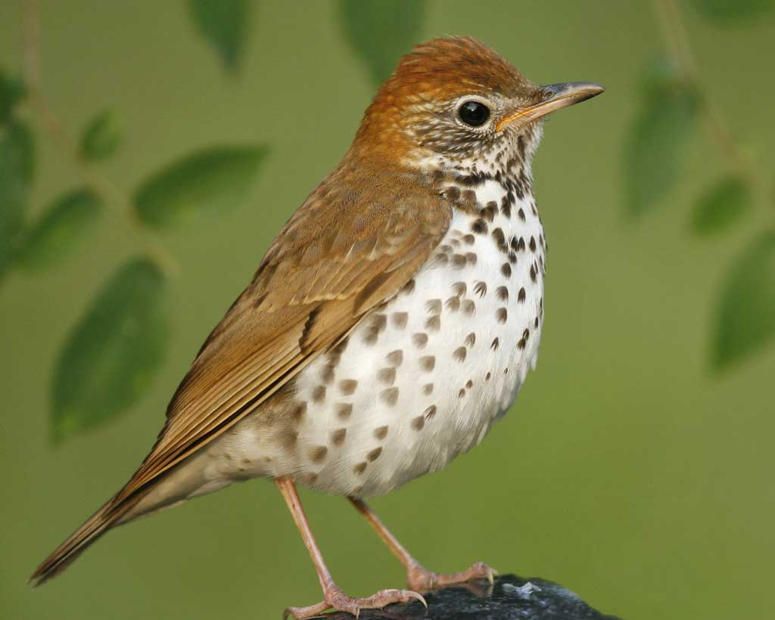
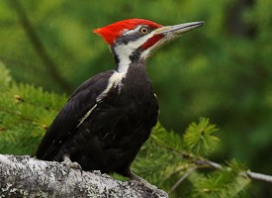
The Story of a Forest
Notes:
This diagram shows forest succession. As forests grow, they support different types of animals because they provide different types of food and shelter.
Plant stage: 0-5 years-support insects, pollinators, mice, hawks and bluebirds.
Shrub stage: 6-25 years supports american woodcocks, many different songbirds, bobcats, new england cottontail rabbits
Young forest: 26-50 years supports deer, skunks, foxes, whip-poor-wills
Mature forest: 51-150 years deer, turkey, racoon, owls, black bear
Climax forest 150-300 years pileated woodpeckers, fishers, squirrels
Forest landscapes require disturbance in order to have each of these stages present to support all of the different species of wildlife in Rhode Island.
Do “Story of a Forest” Activity.

Slide 8
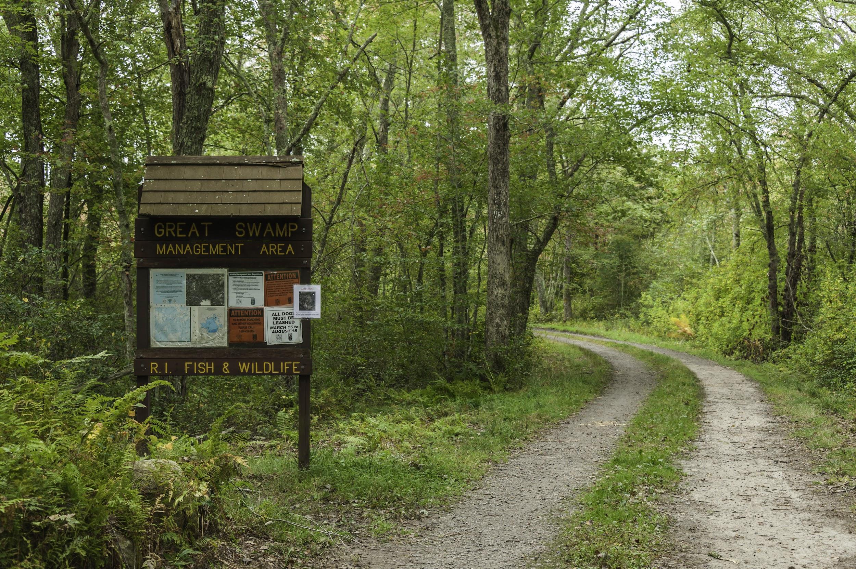
How is the DEM helping forest habitat in Rhode Island?
By protecting it!
Notes:
The DEM protects habitat all throughout Rhode Island in Wildlife Management Areas. These are places where no one is allowed to build houses, malls or roads. They are places where animals can live without facing the danger of crossing roads or wandering onto people’s property. The green areas on the map show where the DEM Wildlife Management areas are located in the state.

Slide 9
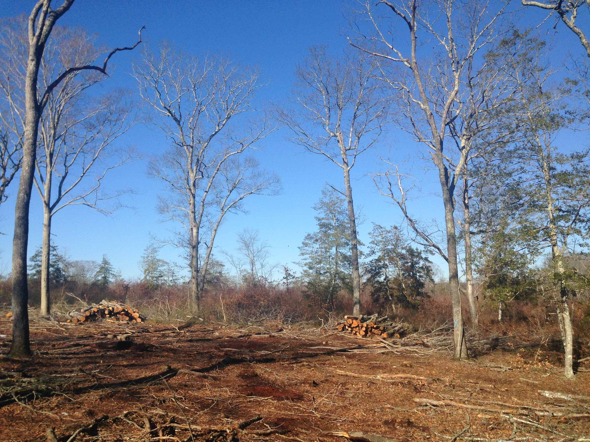
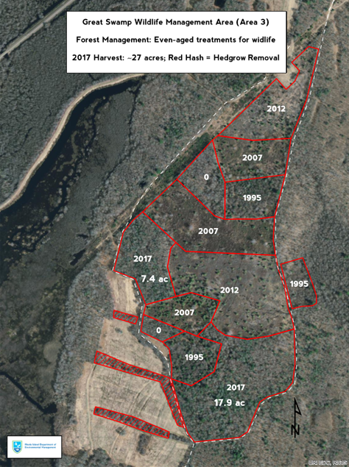
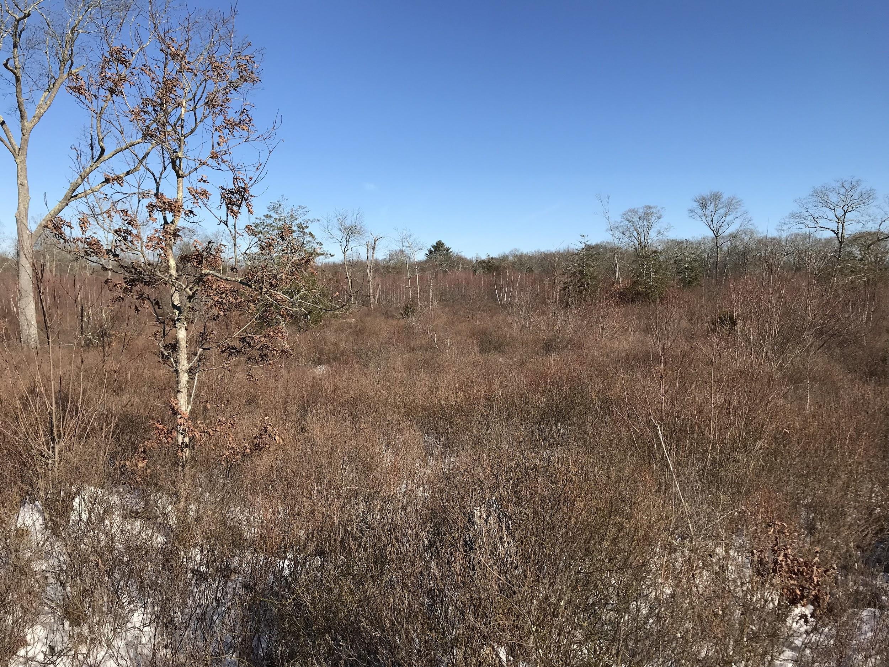
How is the DEM helping forest habitat in Rhode Island?
By creating it!
Notes:
The DEM clear-cuts areas periodically to replicate the natural clearing that would occur as a result of hurricanes or flooding.
The image on the left is before and after (on click) a clear-cut. You can see that within 5 years the cleared area has already grown into a shrubland.
The aerial map on the right shows the Great Swamp Management Area. The sections are dated by year of the last clear-cut. You can see each patch is at a different stage of forest succession. The DEM will continue to rotate cutting through these sections to ensure that there are always various stages of forest present in this area.

Slide 10
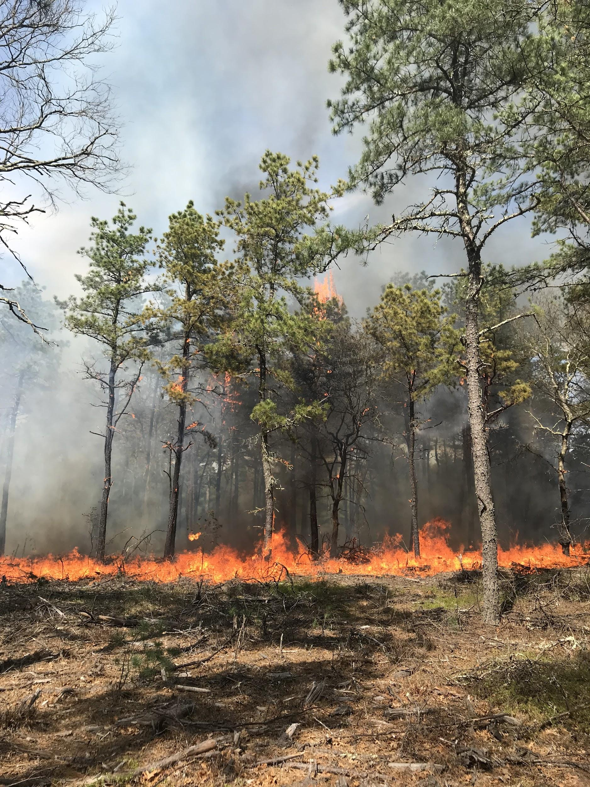
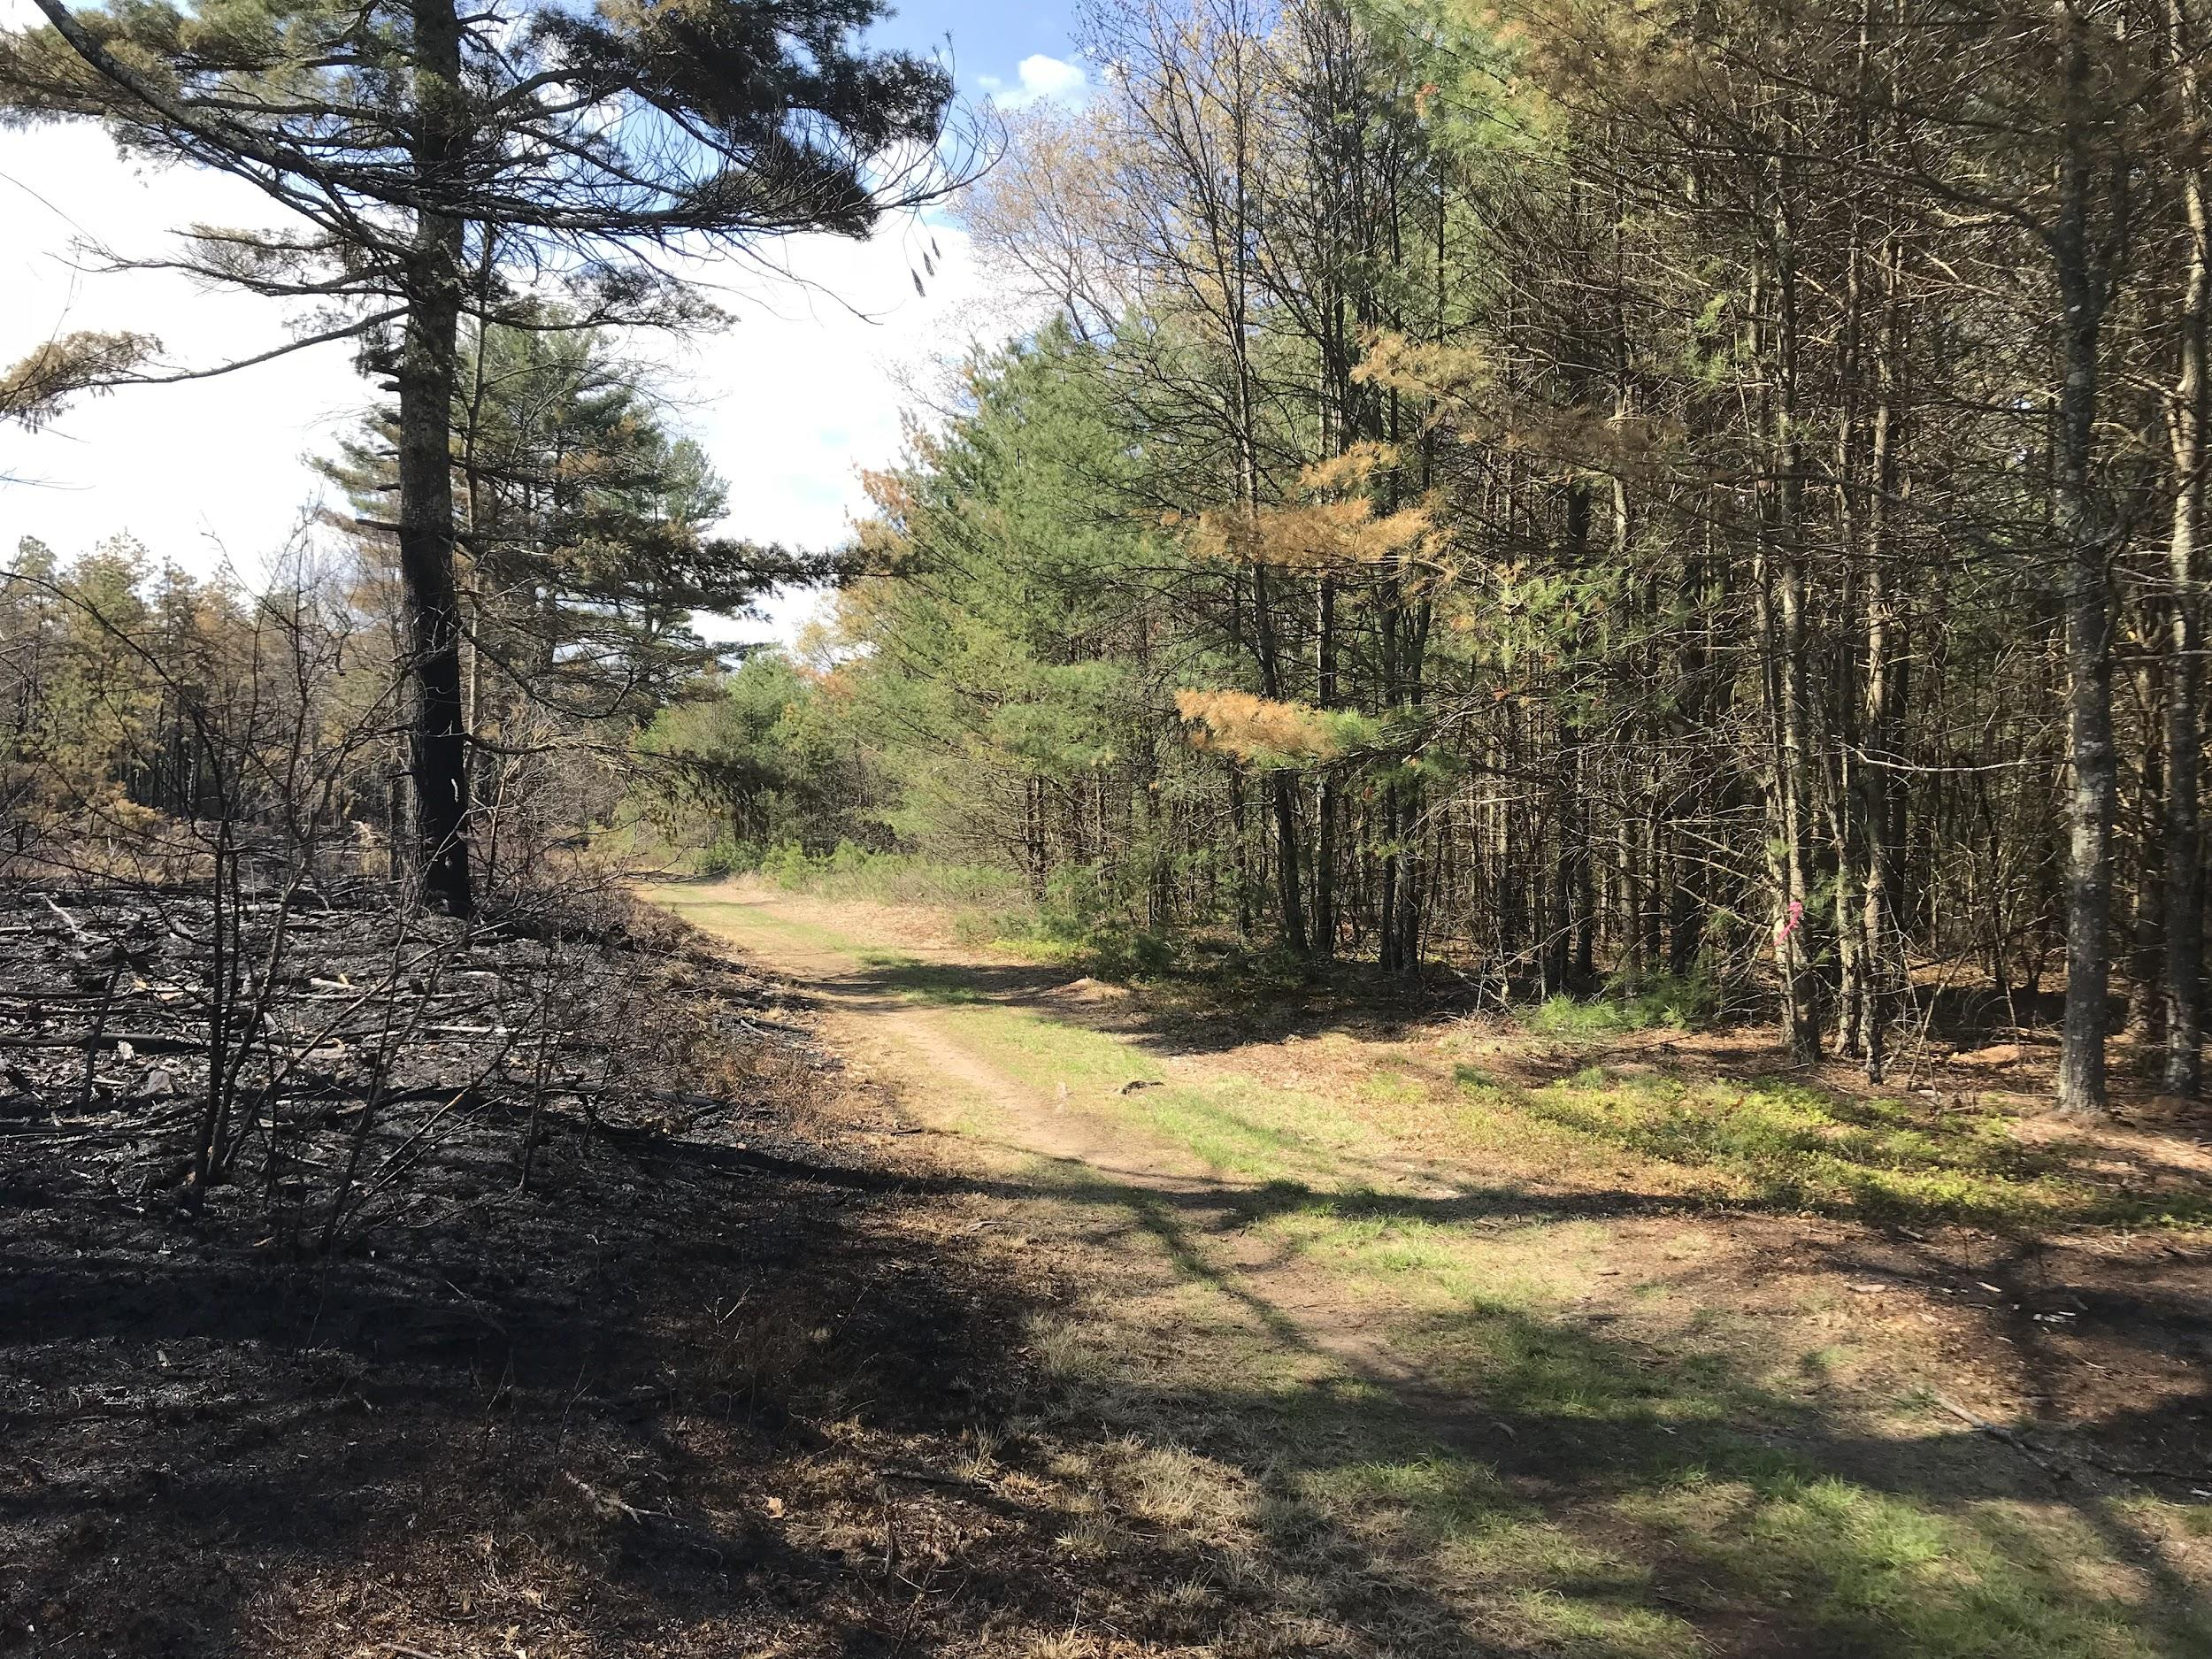
How is the DEM helping forest habitat in Rhode Island?
By restoring it!
Notes:
The two images are of Nicholas Farm Management Area during and after a prescribed burn. Nicholas Farm is unique because it contains a pitch pine forest. Pitch pines have evolved to benefit from forest fires. They have thick, fire-resistant bark and their pine cones will only release seeds when they are subjected to heat. Humans have suppressed fires since settlers first arrived, preventing the pitch pine seeds from releasing and spreading and allowing white pines to take over the area. To help restore this unique habitat, the DEM carefully burns sections of the forest, eliminating the white pines which can’t tolerate the heat, and making way for new pitch pines to grow. (Burned section can be seen left of the road. The unburned section is on the right of the road, you can see it is much thicker with white pines)

Slide 11
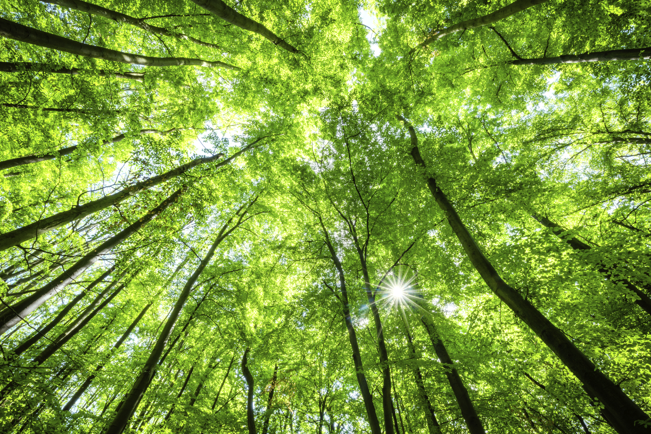
How can you help forests?
Notes:
Don’t litter
Pick up trash
Plant native plants in your yard
Reduce, Re-use, Recycle!

