Slide 1
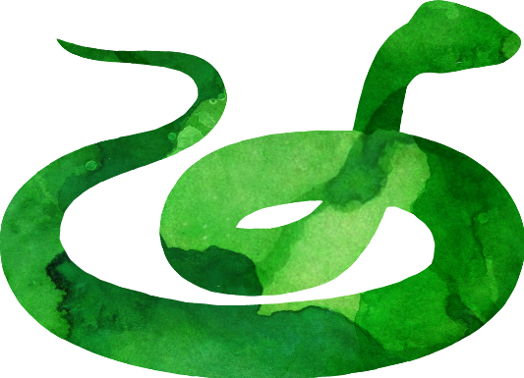

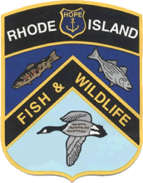
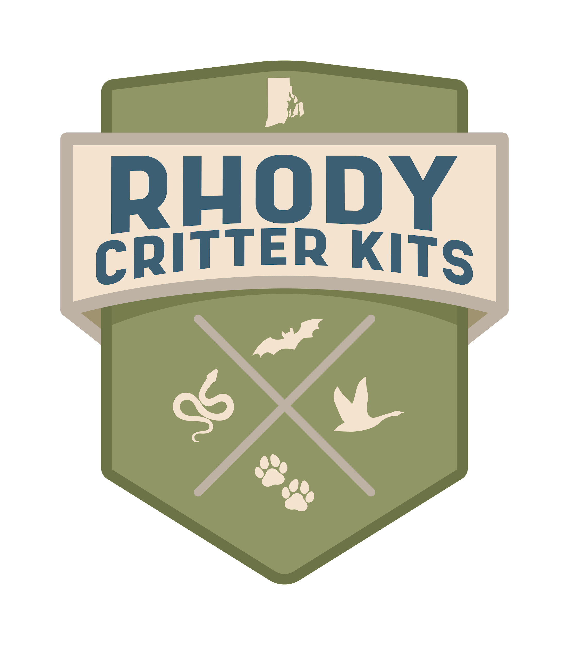
Rhody Reptiles
Rhode Island DEM Division of Fish & Wildlife
Rhody Critter Kits Program

Slide 2

What do you know about reptiles?
Scales made of keratin
Shed scales as they grow
In the order Testudines
Have four limbs
Brumate in winter
Lay eggs/Live birth
REPTILES
Hard protective shell
In the order Squamata
SNAKES
TURTLES
Sleek, muscular body
Vertebrates
Ectothermic
Lay eggs on land
No limbs
In the class Reptilia
Notes:
Organize these characteristics or have the class come up with their own.
Pass out ID sheets to encourage discussion
Reptiles are Vertebrates, they have backbones (yes even snakes!).
In the Class Reptilia, consisting of snakes, turtles, crocodilians, lizards and tuatara (we only have snakes and turtles in Rhode Island)
Snakes are in the Order Squamata while turtles are in the Order Testudines. What sets them apart?
Reptiles brumate-(similar to hibernation) in winter, snakes hide under rocks, in stone walls or under logs and turtles hide beneath the mud on the bottom of ponds or streams.
More information is included in packet.

Slide 3
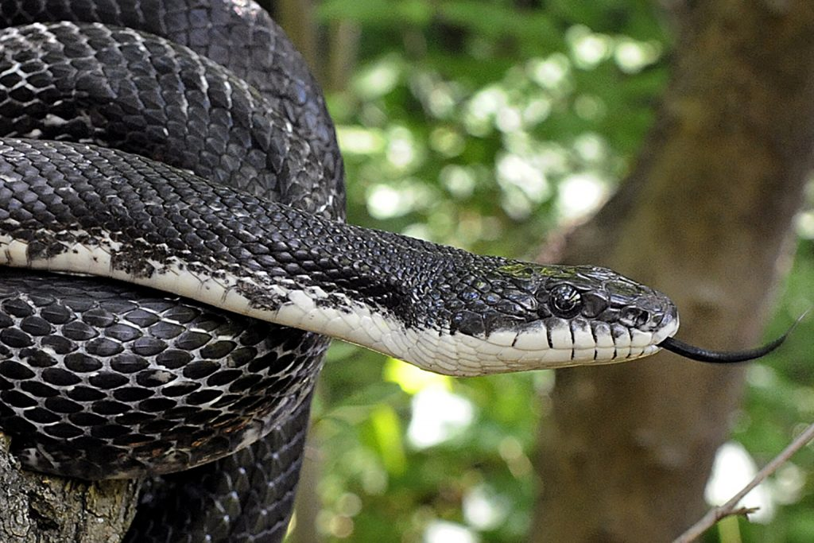
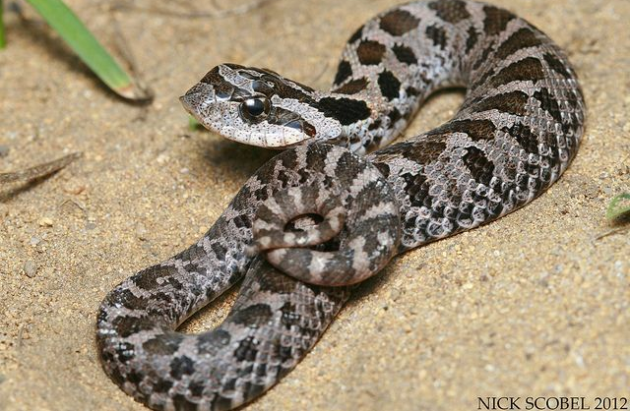
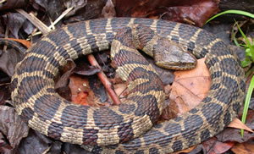
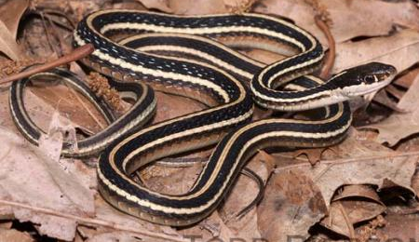
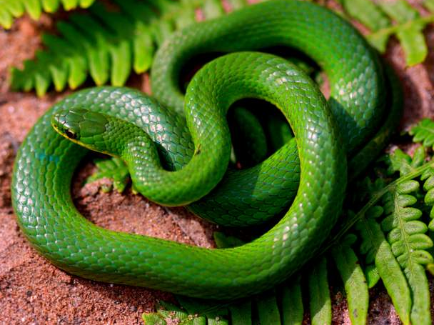
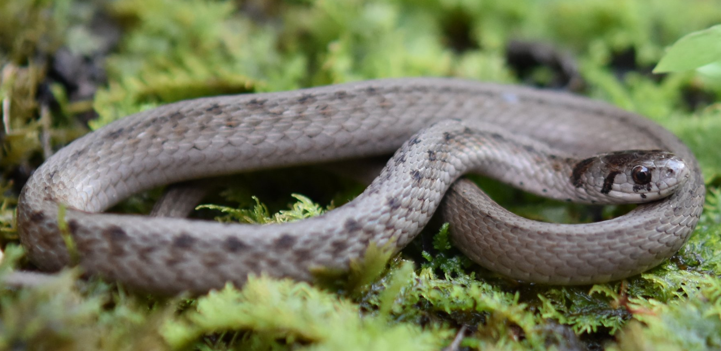
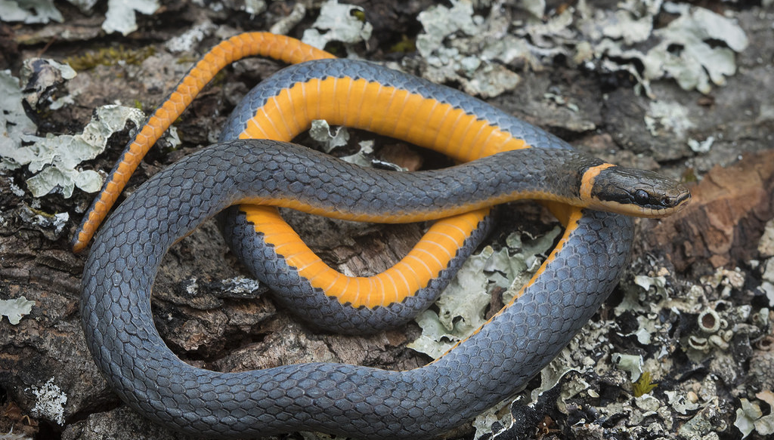
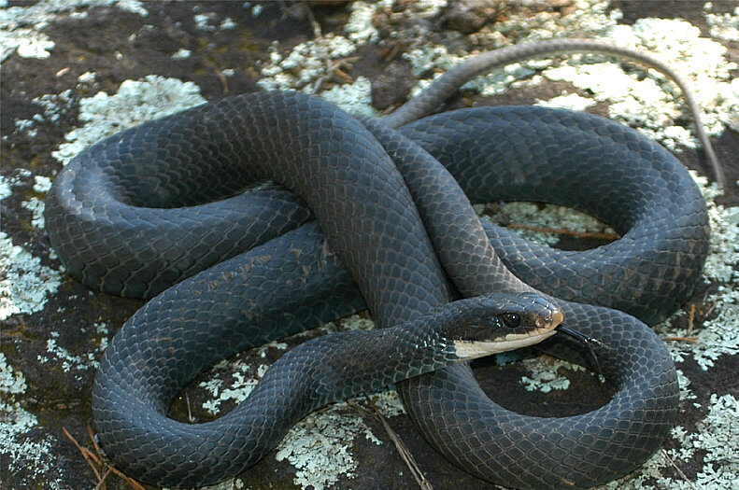
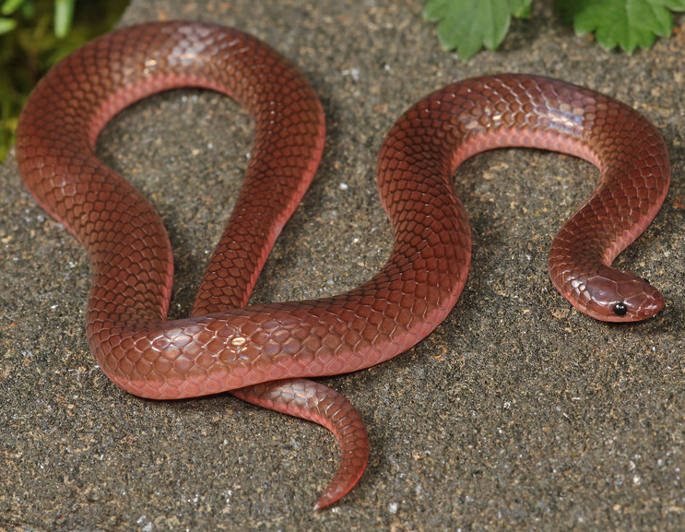
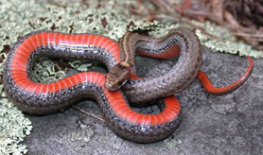
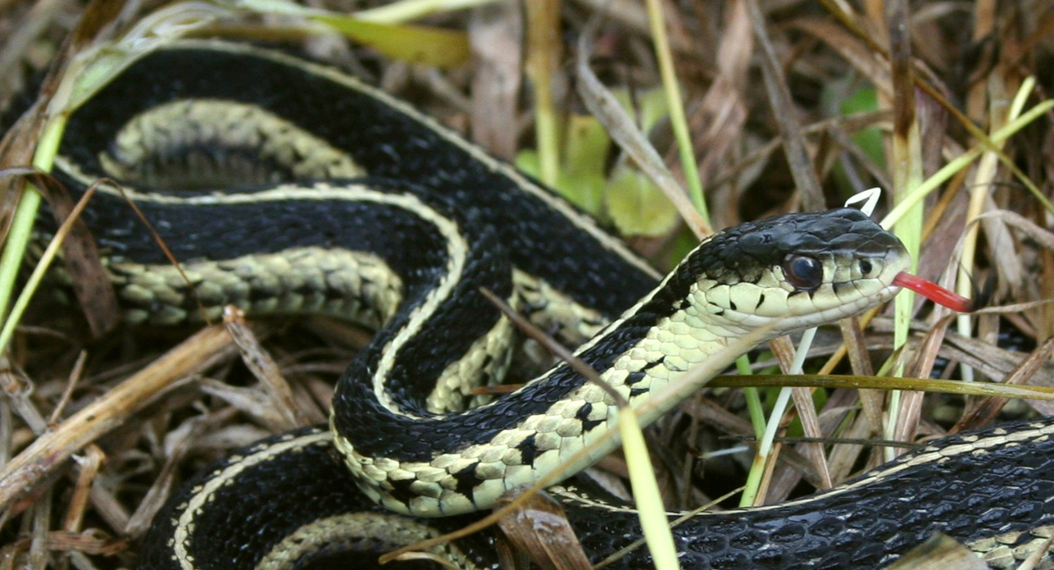
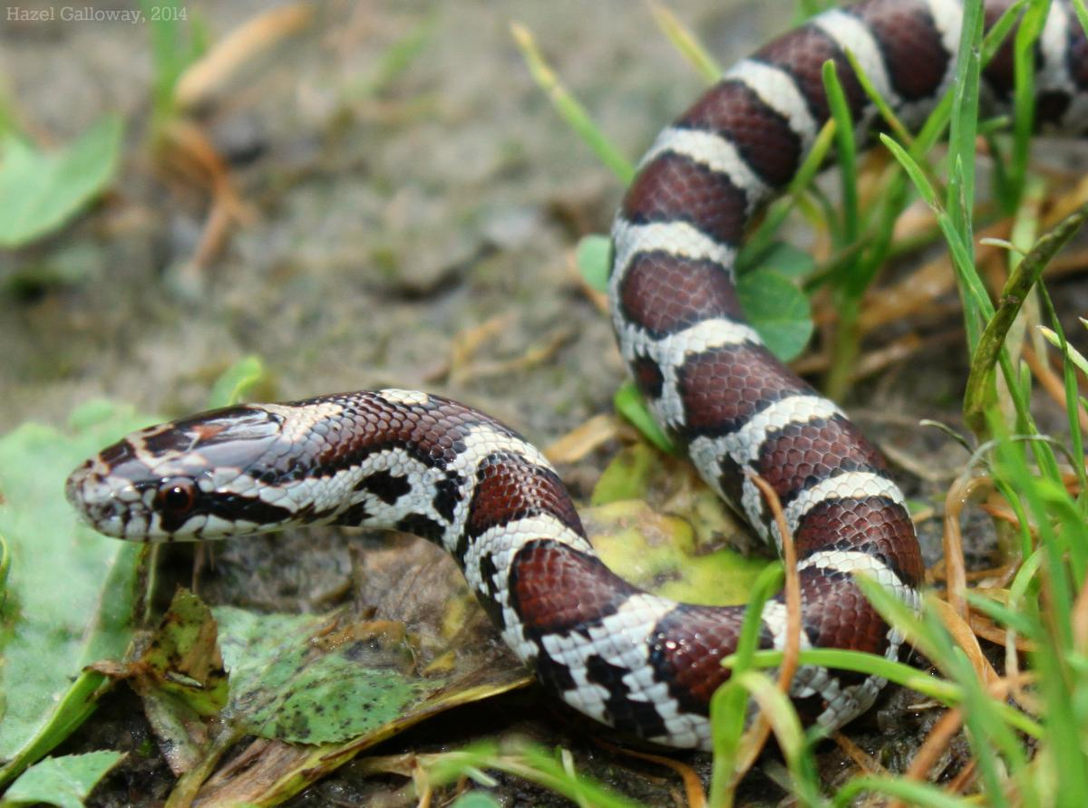
Native Snakes of Rhode Island
Eastern Hognose Snake
Northern Watersnake
Eastern Ribbon Snake
Eastern Ratsnake
Northern Ringneck Snake
Smooth Greensnake
Northern Black Racer
Dekay’s Brownsnake
Northern Red-bellied snake
Eastern Gartersnake
Eastern Milksnake
Eastern Wormsnake
Notes:
12 species of snakes live in Rhode Island.
1 species is extirpated- Timber rattlesnakes.
Has anyone seen any of these snakes before?
Each of these snakes requires a different type of habitat.
Some species like the northern watersnake and eastern ribbon snake like to live close to water. Other snakes like the eastern gartersnake and Dekay’s brownsnake are happy to live anywhere, even in your backyard.
Gartersnakes are often called “garden snakes” because people see them in their yards but their name actually comes from “garters” that men used to wear to hold up their socks, making it look like they had a stripe on their legs just like on a gartersnake!

Slide 4
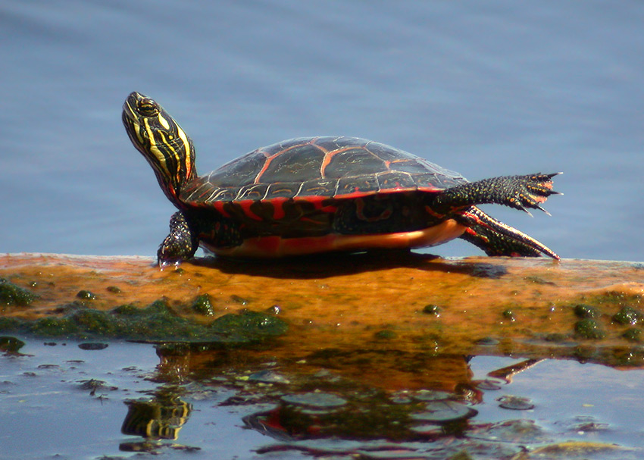
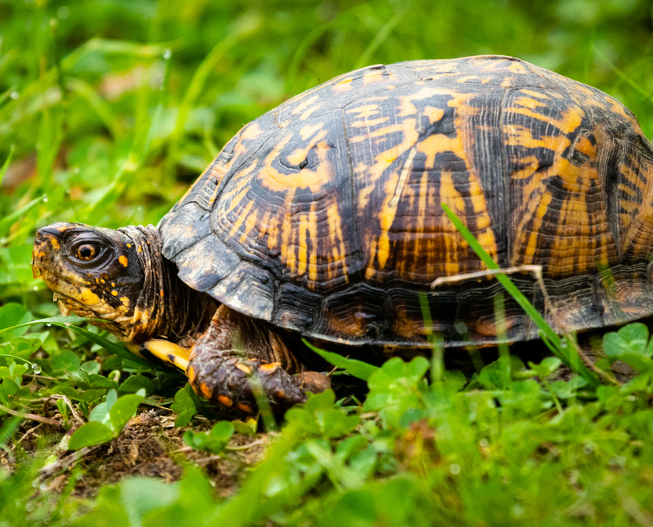
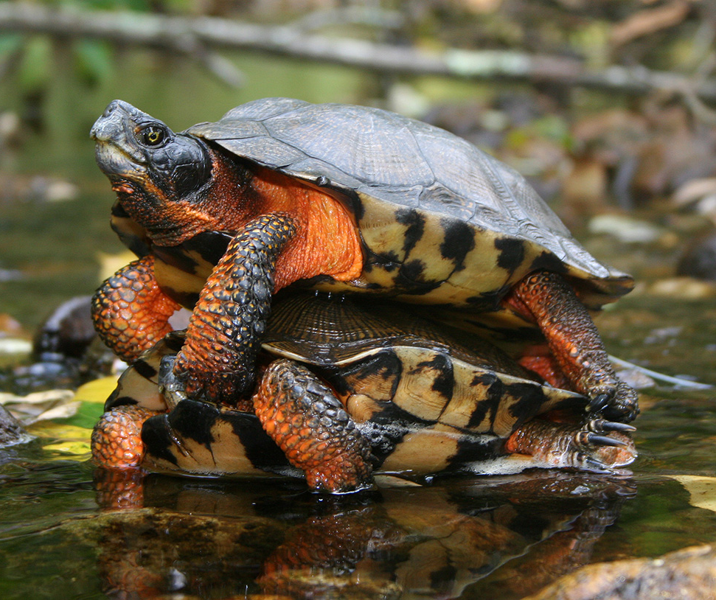
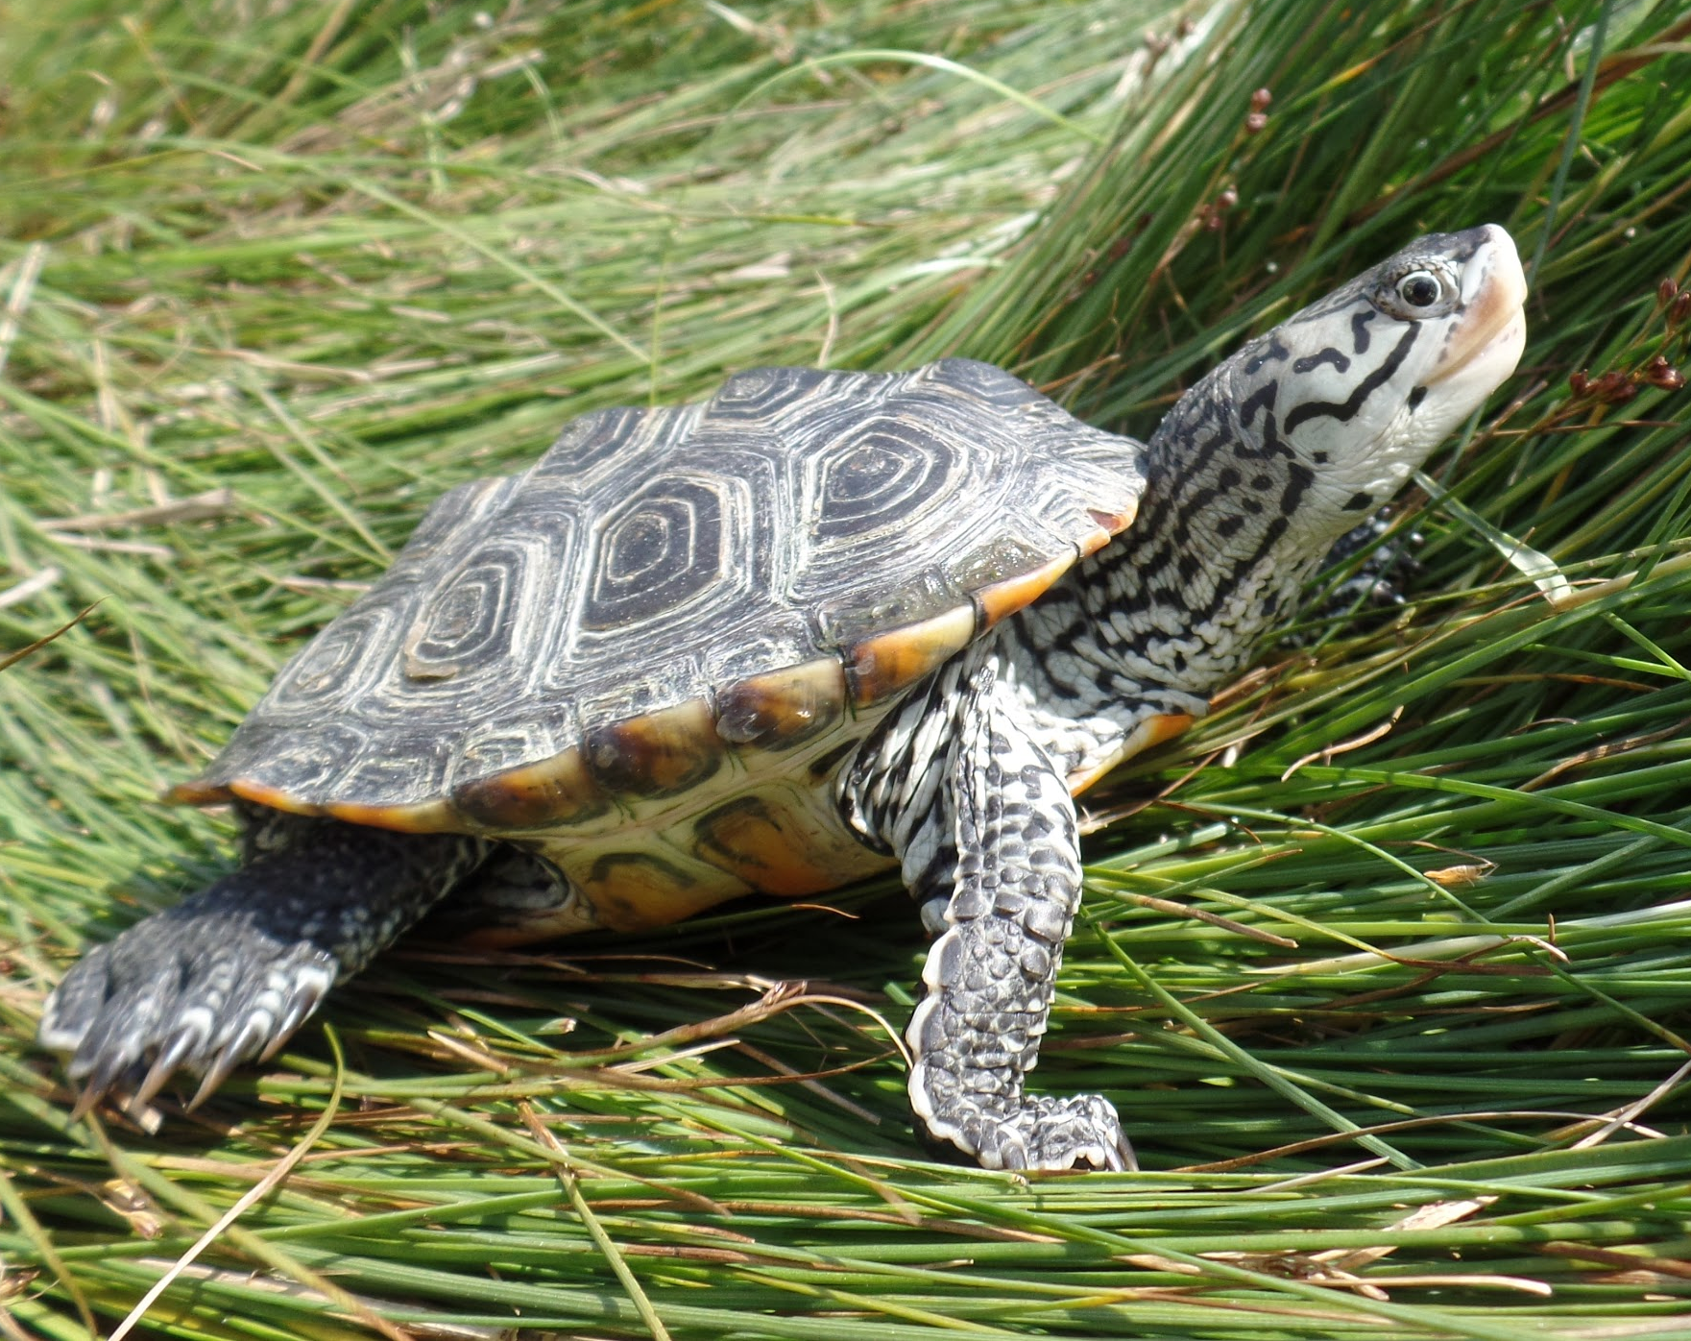
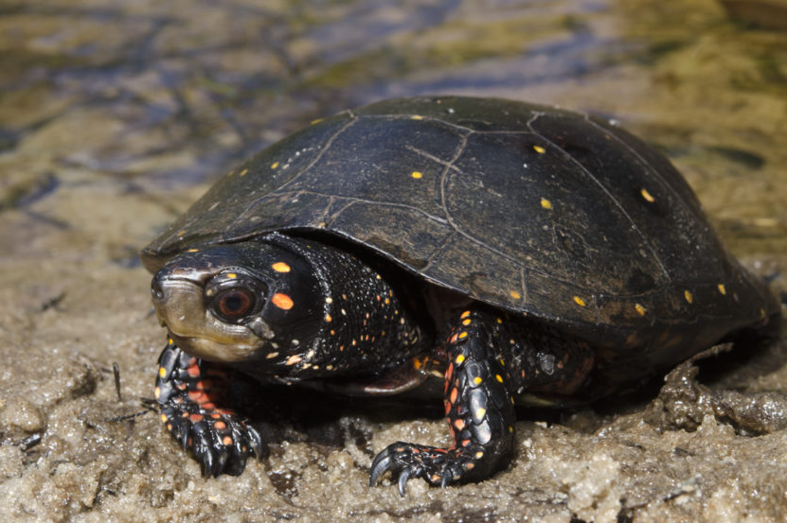
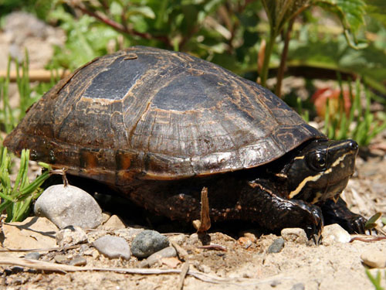
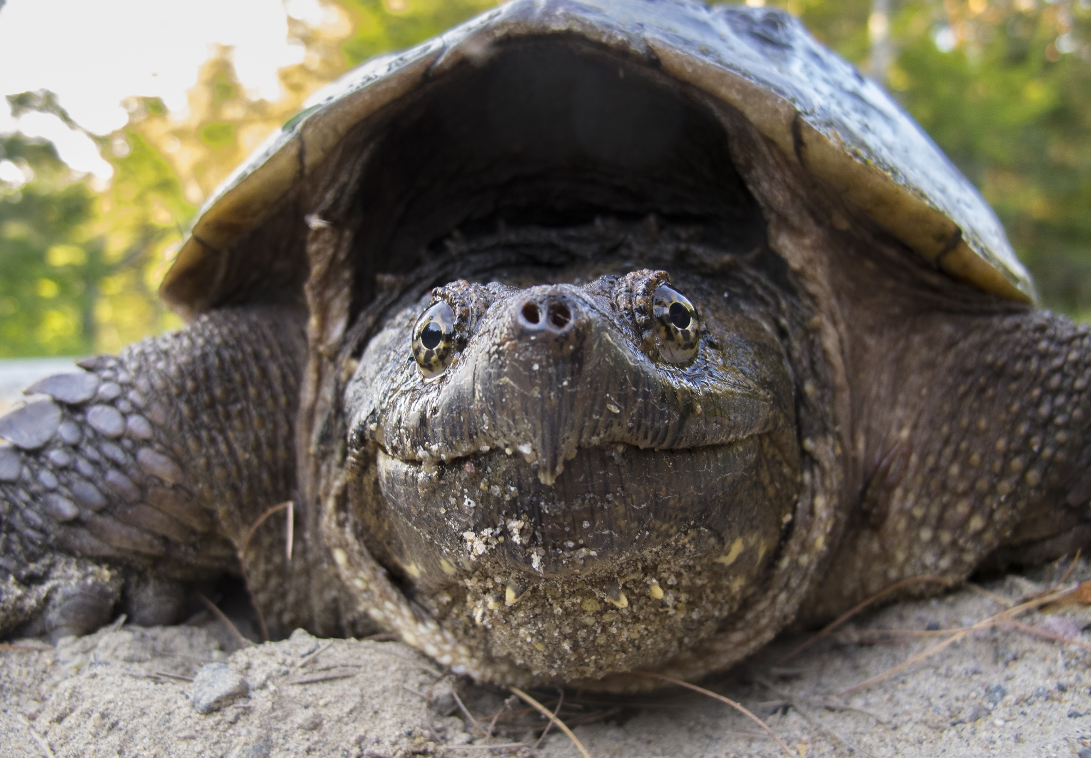
Native Turtles of Rhode Island
Eastern Painted Turtle
Northern Diamondback Terrapin
Eastern Box Turtle
Wood Turtle
Spotted Turtle
Eastern Musk Turtle
Common Snapping Turtle
Notes:
6 species of native freshwater turtles live in Rhode Island.
1 species of brackish water turtle: The diamondback terrapin.
1 exotic turtle: The red-eared slider.
4 species of marine turtles visit Rhode Island: Kemp’s Ridley, loggerhead, leatherback and green sea turtle
Has anyone seen any of these turtles before?
Fast Facts:
Painted turtles are very common and live in most ponds in Rhode Island. They live very well alongside humans.
Eastern box turtles live in fields and woodland edges. They burrow into the ground in winter and can close up their shells to protect themselves from predators.
Common snapping turtles can grow very large. They have a powerful bite and a long neck. They are afraid of people and will swim away if they see you in the water.
Spotted turtles are very rare. They are sensitive to changes in their habitat. The DEM is studying their populations to see where they are and how they are doing.
Eastern musk turtles like running streams and are fairly common. They are sometimes called stinkpot turtles because they have a stinky smell. They also have a hinged plastron like the box turtle.
Wood turtles are also rare. They live partly in running fresh water and partly on land where they love to eat mushrooms and worms.

Slide 5
REPTILES
SNAKES
TURTLES
Vertebrates
In the class Reptilia
Scales made of keratin
Shed scales as they grow
Brumate in winter
Ectothermic
In the order Squamata
No limbs
Lay eggs/Live birth
Sleek, muscular body
In the order Testudines
Have four limbs
Lay eggs on land
Hard protective shell
Notes:
Reptiles are Vertebrates, they have backbones (yes even snakes!).
In the Class Reptilia, consisting of snakes, turtles, crocodilians, lizards and tuatara (we only have snakes and turtles in Rhode Island)
Snakes are in the Order Squamata while turtles are in the Order Testudines. What sets them apart?
Reptiles brumate-(similar to hibernation) in winter, snakes hide under rocks, in stone walls or under logs and turtles hide beneath the mud on the bottom of ponds or streams.

Slide 6
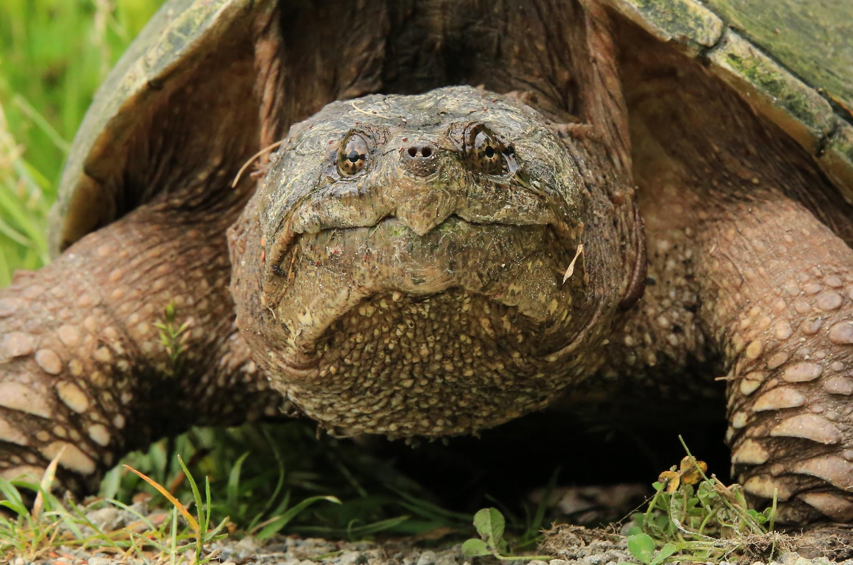
WHAT IS AN ADAPTATION?
SOMETHING THAT HELPS AN ANIMAL TO SURVIVE
physical or behavioral
Notes:
All of the characteristics that we just put into the venn-diagram help reptiles to survive and set them apart from other animals.
Adaptations can be physical, such as having a shell for protection or behavioral, such as brumating during the winter.
Ask the class for a few examples of physical adaptations in animals and behavioral adaptations in animals.
We will look at the anatomy, or physical adaptations of a box turtle and discuss how these characteristics help it to survive.

Slide 7
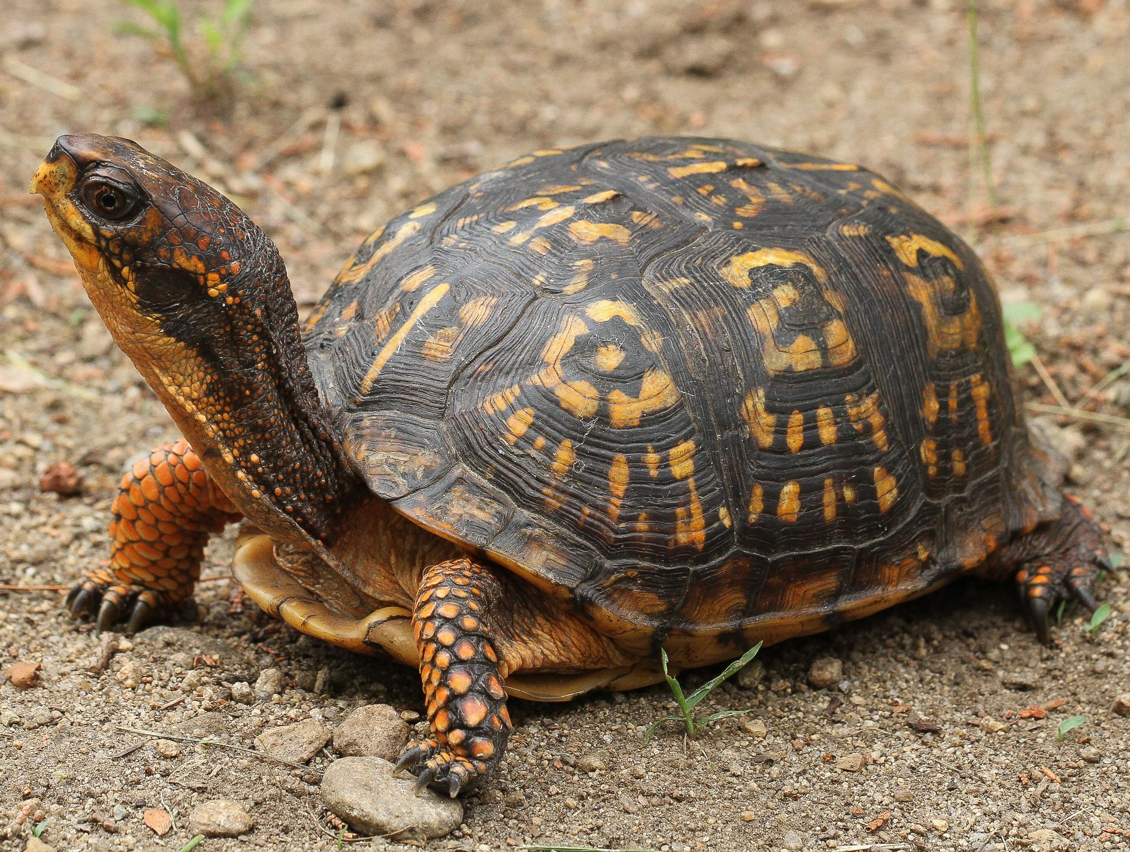
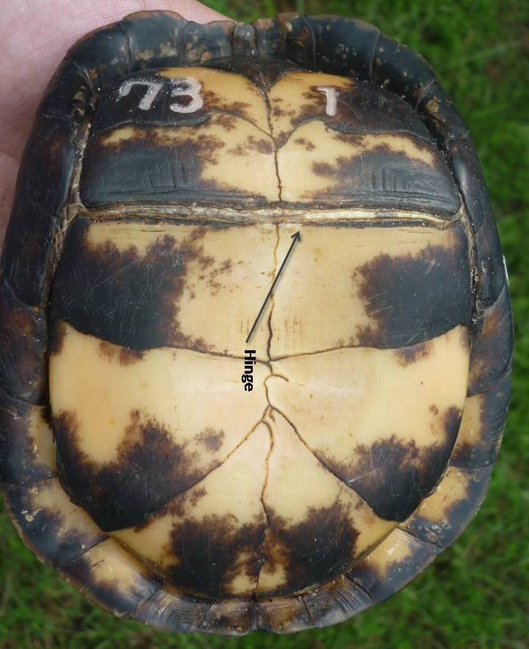
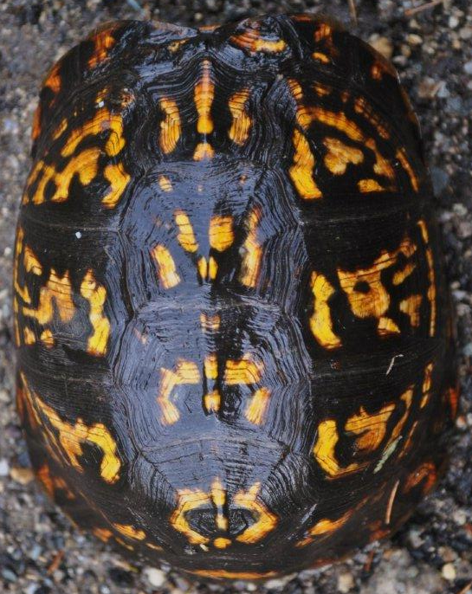
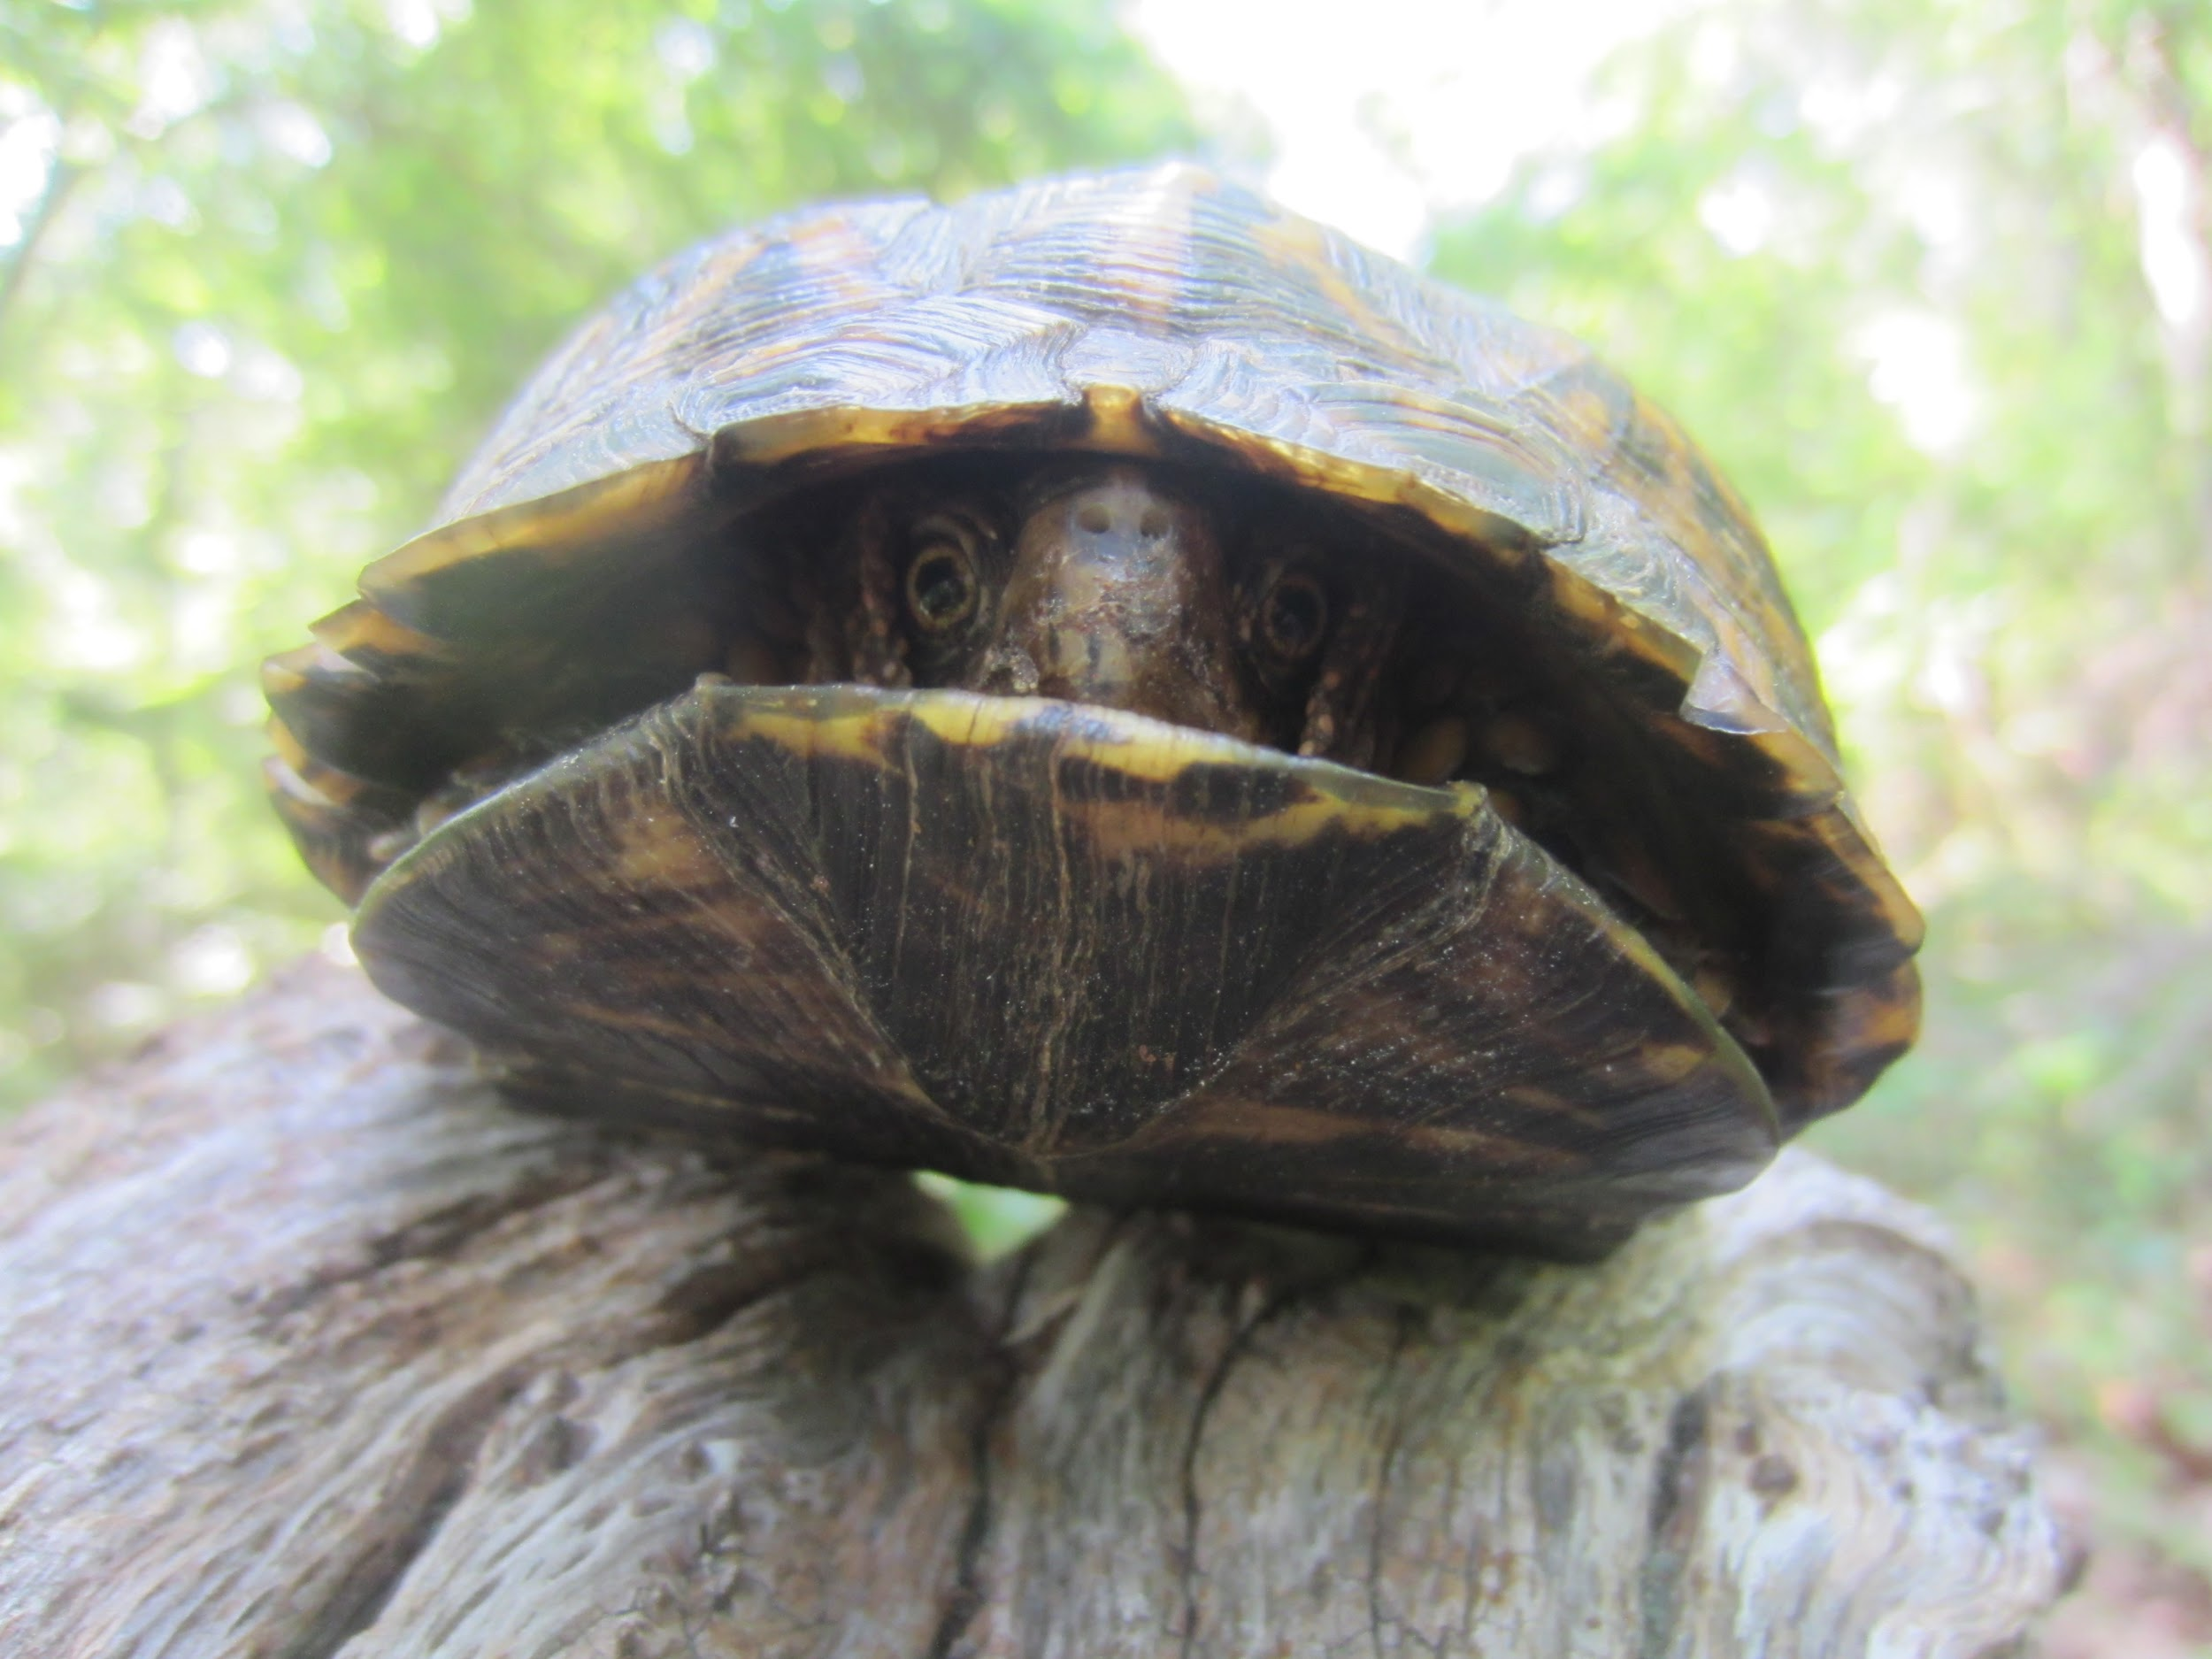
Box Turtle Adaptations
PLASTRON
CARAPACE
Notes:
Bottom-plastron, on some turtles you can determine age by looking at annuli (lines on plastron)
Top-carapace has nerve endings
Spine and ribs are fused (attached) to carapace in turtles, they have nerves in their shell!
Some turtles, such as box turtles have a hinged plastron to hide from predators. They can pull their body totally inside their shell and seal up tight!
Turtles have scutes on their shell, made up of keratin (like our fingernails), which they shed when they grow. They have scales on their legs for protection.
By looking closely at their body structure/adaptations, you can tell what habitat they live in.
If they have webbed feet where might they live?.....In an aquatic environment

Slide 8
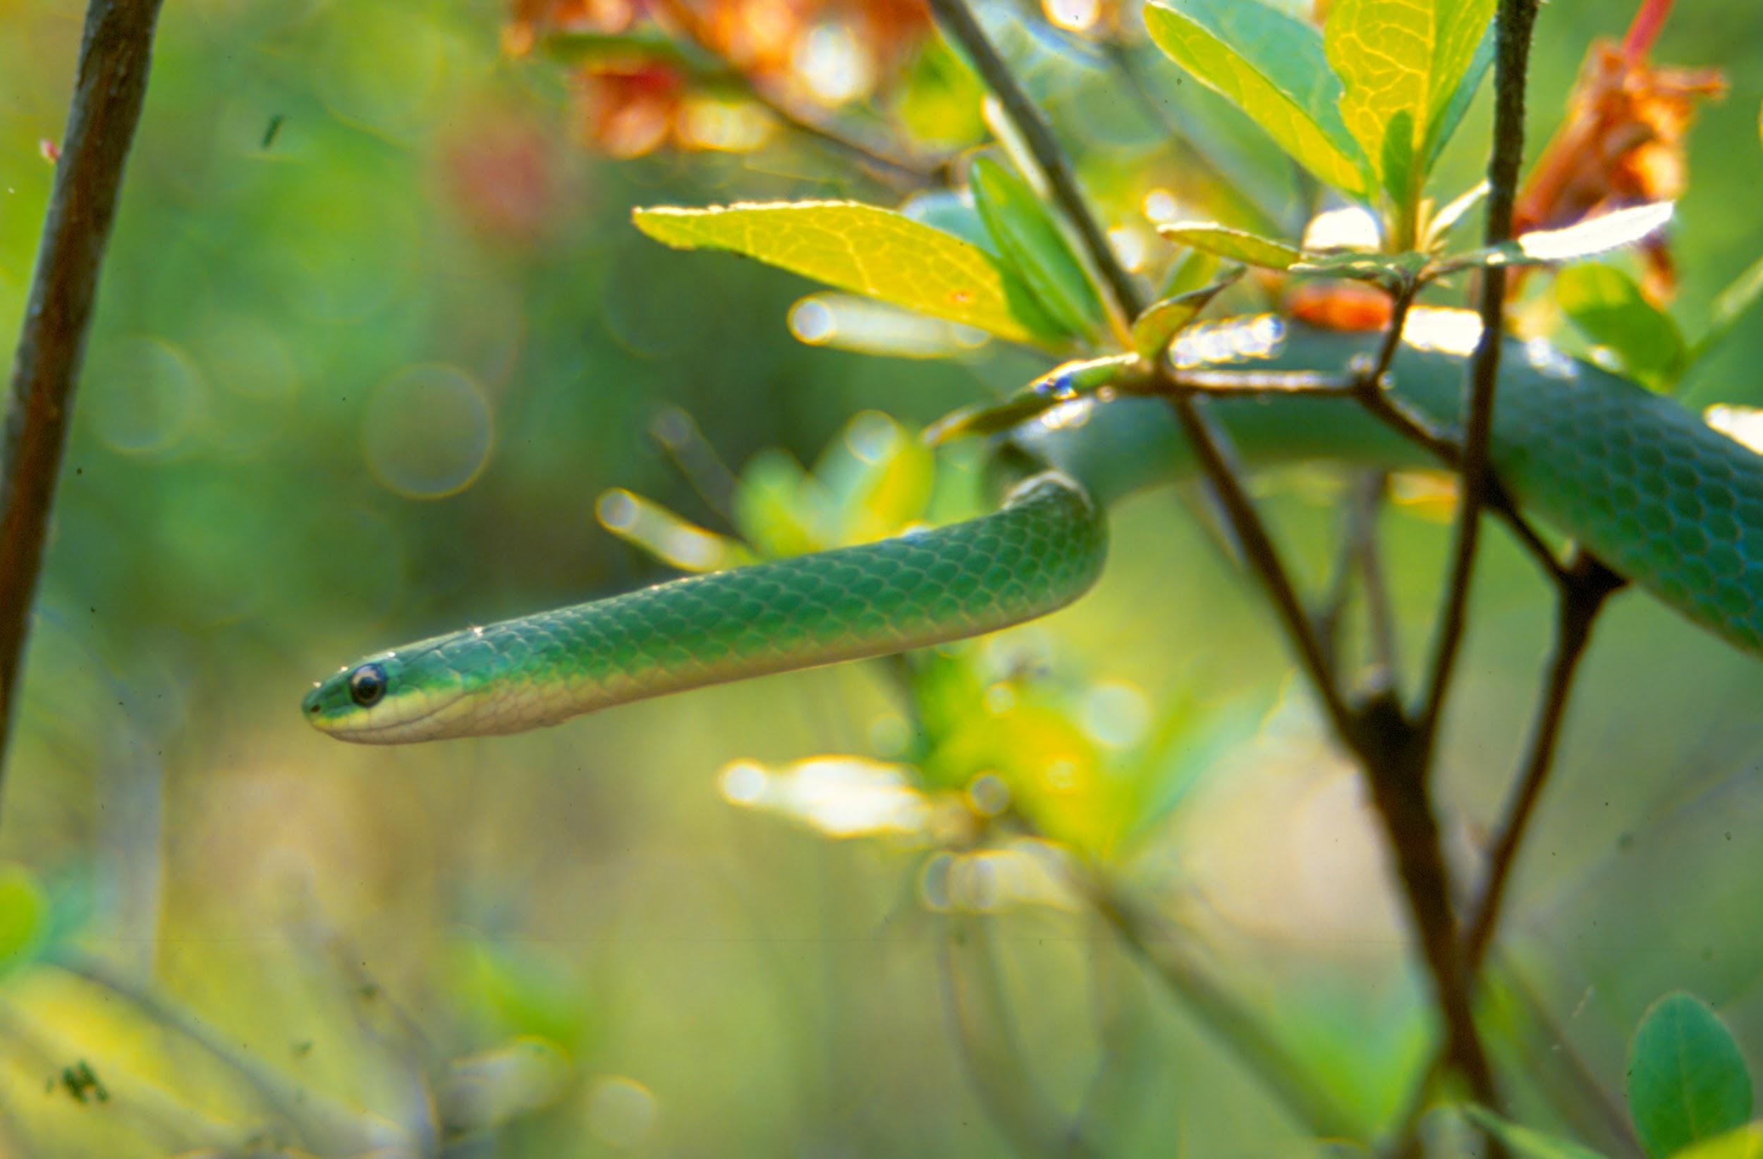
WHAT HAVE YOU HEARD ABOUT REPTILES?
REPTILE RUMORS
Notes:
There are a lot of rumors about reptiles because they are so different from other animals. Often, when people are afraid of something, it’s because they don’t understand it.
Reptiles have gotten a bad reputation, so we are going to review some reptile rumors and figure out where they might have come from.
Review “Reptile Rumors” activity.

Slide 9
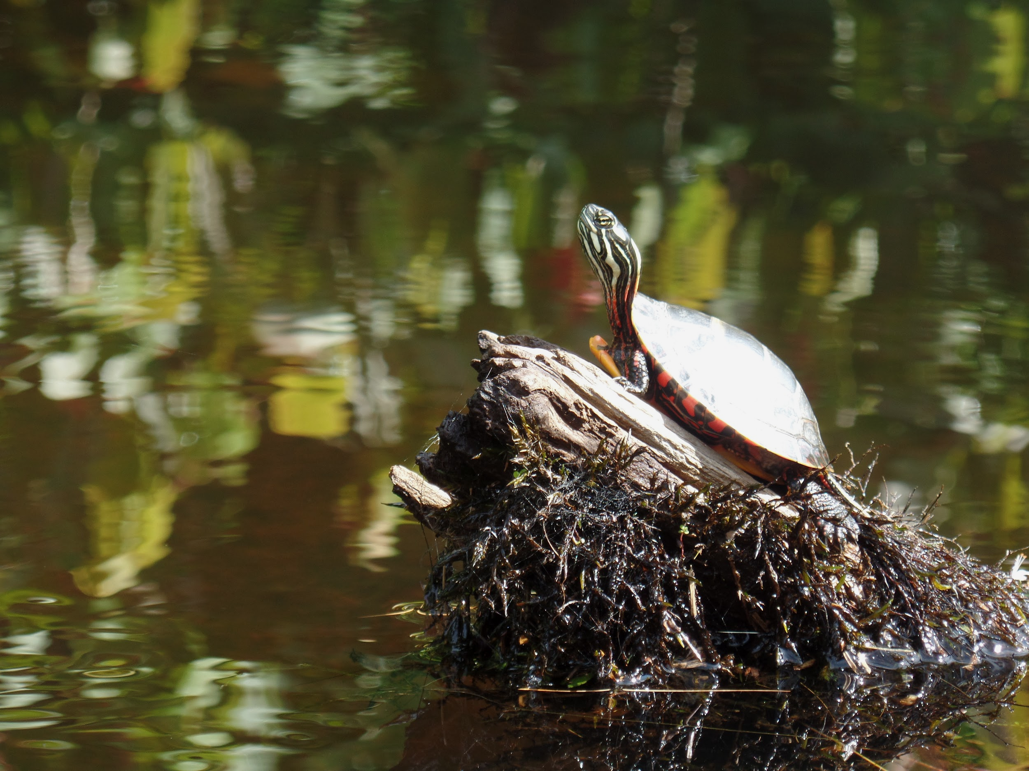
Reptiles through the Seasons
Winter: Brumate
Spring: Mate
Summer: Estivate/young born
Fall: Return to hibernacula
Notes:
Winter: Reptiles, like many other northern animals, don’t like to be out during the winter. Since they are ectothermic, the cold weather makes their bodies cold and slow, which makes them vulnerable to predators. So, during the winter, reptiles brumate. Similar to hibernation, brumation is when the reptile's body slows down during the winter while they hide in a safe place. Snakes hide in places called hibernacula, where the temperature stays above freezing, these are typically under rocks, houses or brush piles. During this time, many snakes, even a mix of different species, will all cuddle together to make it through the long winter months. Turtles spend the entire winter under the water, buried in the mud at the bottom of streams and ponds. They breathe through pores in their mouth and around their cloaca. They only require a small amount of oxygen since their metabolism has slowed and they are using very little energy.
Spring: Once the spring arrives, snakes emerge from their hibernacula to seek mates, and turtles come to the surface of the water to heat up. We see reptiles more during this time as they need to bask in the sun to keep warm and snakes are traveling more frequently in search of mates. Larger reptiles need to spend more time basking to heat up their bigger bodies, but they maintain that heat longer. Smaller reptiles bask for shorter amounts of time, but must do so more frequently since they also lose heat more quickly.
Summer: As spring turns to summer, reptiles start to spend less time in the hot sun. Young are born between June and September, depending on the species. Reptiles lay eggs, with a few exceptions in some species of snakes. If the temperature gets too hot, snakes can overheat, so during the summertime, snakes estivate. Estivation is like summer hibernation. Snakes will stay under rocks or brush piles in shaded areas where it is cooler. Turtles just hop in and out of the water to maintain the perfect body temperature.
Fall: When autumn peaks it’s head around the corner, the last of the young are born and reptiles prepare for the long winter ahead. As long as the weather is above about 50⁰F, reptiles can be seen soaking up the last rays of sun before returning to brumate, once more.

Slide 10
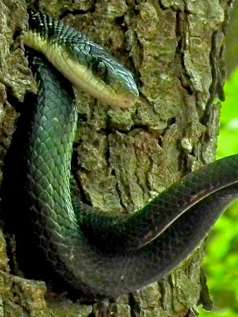
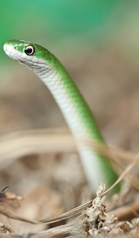
I SAW A SNAKE!
Ahhh!
I SEE A HOOMAN!
Snakes like to bask in sunny areas not too far from cover
Snakes love brush piles, stacks of wood or any old junk pile
Snakes can live:
  near water
  Up in trees
  Sometimes find their way into our homes
If you see a snake… AWESOME!
Take a look or a picture if you want
Make a note of where and when you saw it!
Never pick up a snake that you can’t 100% identify
Notes:
Snakes are like Goldilocks, they don’t like it too hot or too cold, it has to be just right!
Occasionally, snakes think a human’s home makes a great hibernacula.
If you don’t want snakes in your home, make sure to close up any holes in the house.
If you don’t want snakes in your yard, clear away brush piles, keep grass mowed, keep away rodents
If you DO want snakes in your yard, do the opposite!

Slide 11
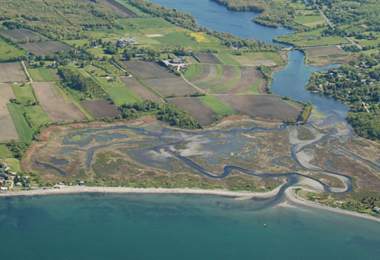
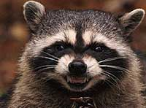
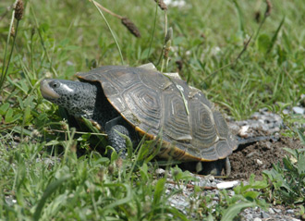
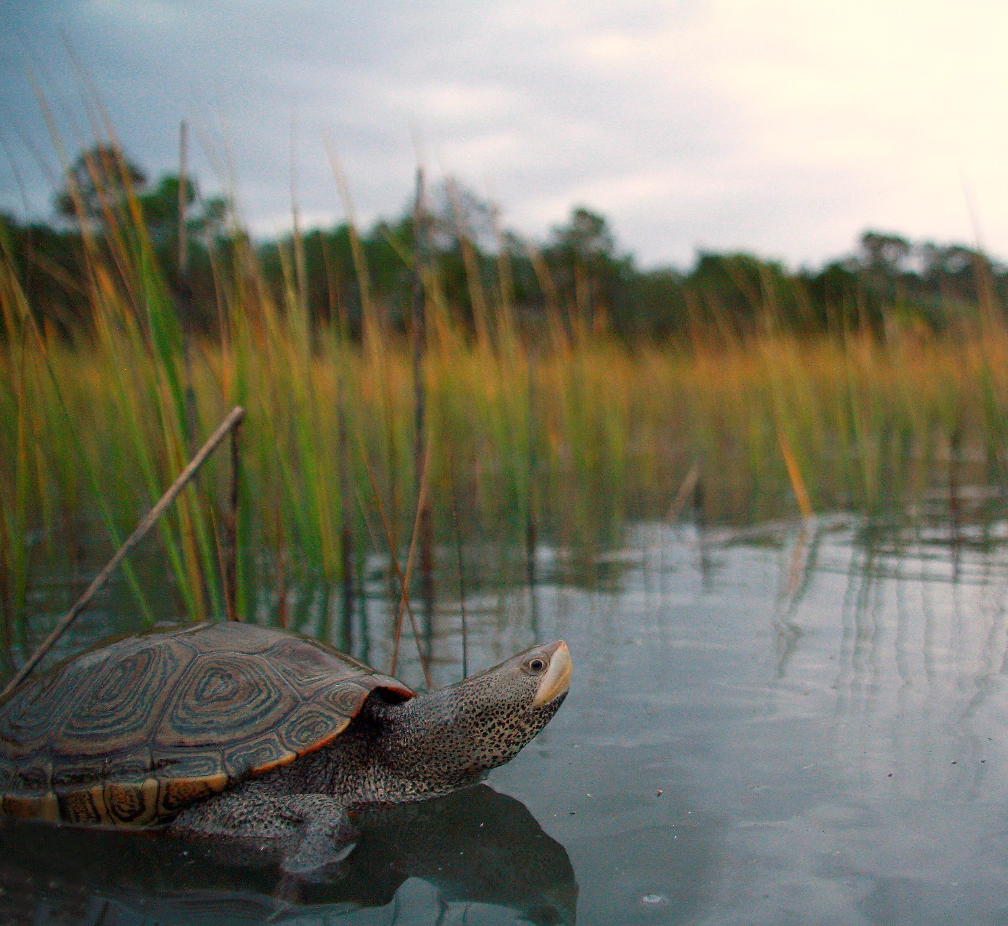
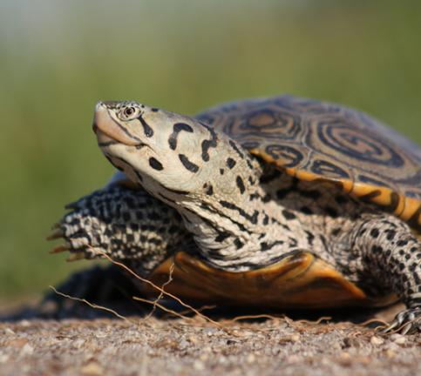
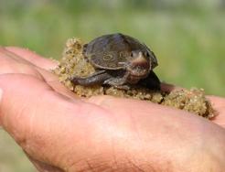
NORTHERN Diamondback Terrapin
Notes:
Why are diamondback terrapins so special?
Diamondback terrapins are beautiful turtles, quite unique in their appearance and choice of habitat. They live in estuaries, where saltwater meets freshwater. They bask up on saltmarshes and nest in sand and dirt in the surrounding uplands. In the early 1900s, these animals were highly valued as a food source. They were collected in large numbers and used to make turtle soup or poached and sold in the pet trade. Diamondback terrapins were harvested so heavily that they nearly disappeared, and at the same time, their habitat was slowly disappearing as houses were built close to the water, destroying their crucial nesting grounds. They are a Species of Greatest Conservation Need and are listed as endangered in Rhode Island, but the Division of Fish and Wildlife and many others are working hard to protect them.
Northern Diamondback Terrapins are state endangered, which means they need protection.
They live in saltmarshes, where salt water meets fresh and they nest on the surrounding land.
People used to harvest them as a food source, people built houses on their nesting grounds, and there were more predators (raccoons, foxes and coyotes) finding their nests.
All of these things led to the near total disappearance of diamondback terrapins.
Volunteers from the town of Barrington banded together to help monitor and protect nests in the last known nesting location in Rhode Island.

Slide 12
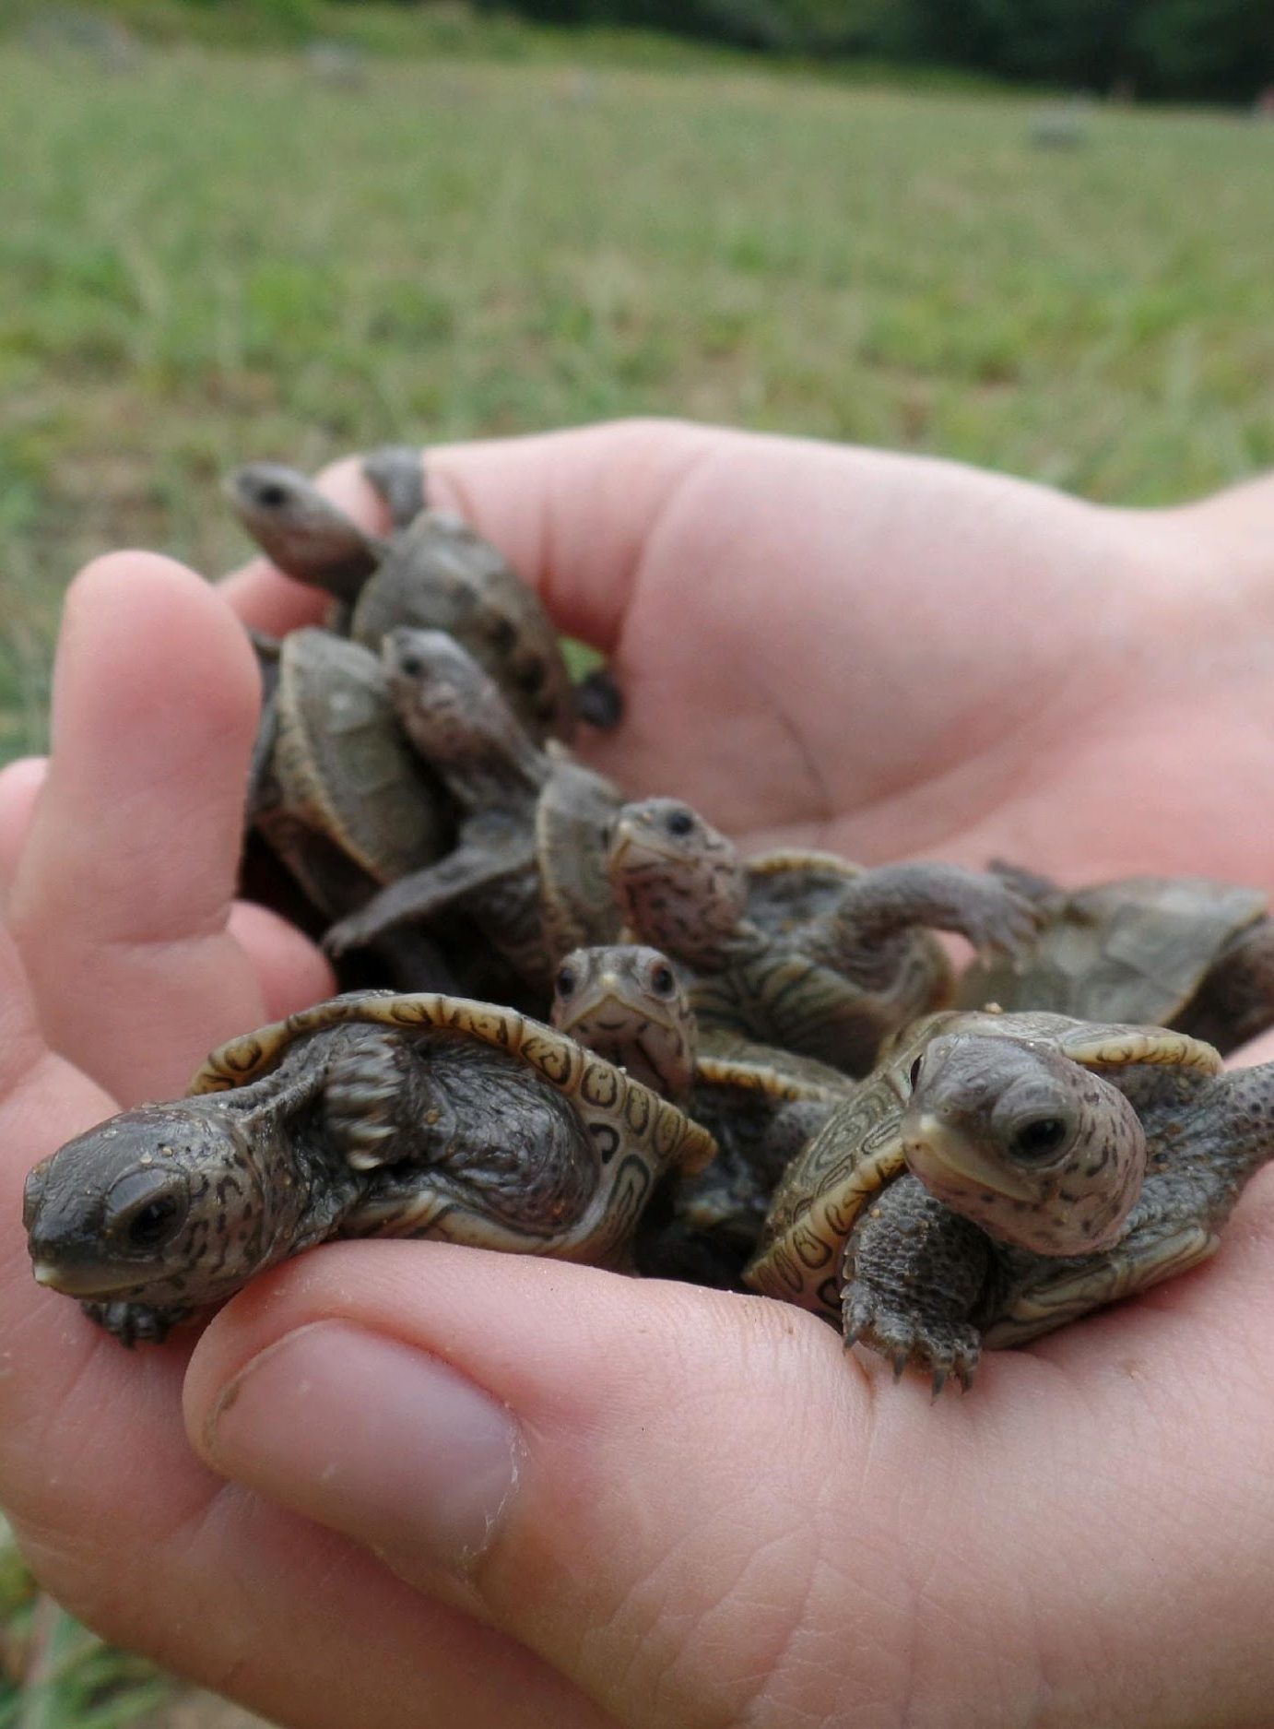
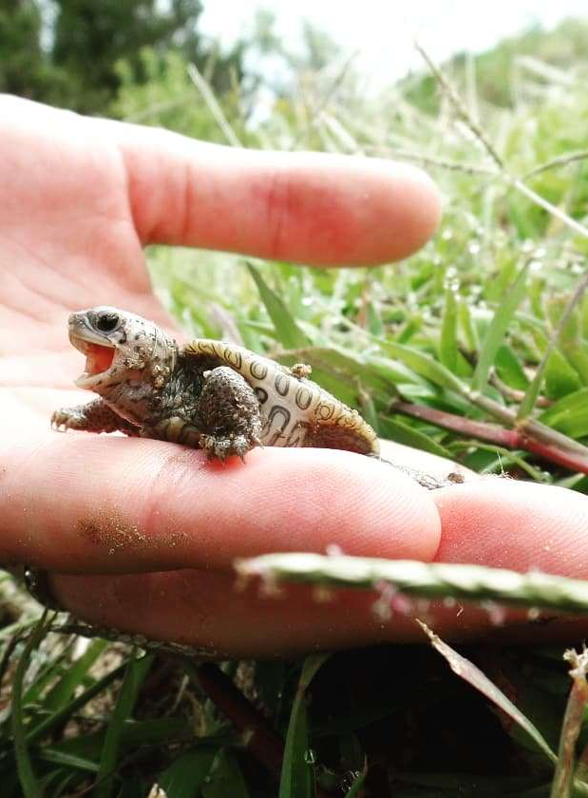
The RI Division of Fish and Wildlife Is Helping!
Can you spot the turtle?
Notes:
How are we helping these turtles in Rhode Island?
Barrington locals discovered the rare turtles nesting on a farm and together they decided to do everything in their power to help them. In 1990, they formed the Barrington Land Conservation Trust and they have been protecting terrapin nests and hatchlings ever since. The RI Division of Fish and Wildlife has joined this effort and, with the help of a “turtle drone”, has discovered new populations in other areas of the state. Our State herpetologist monitors these populations through visual observations, counting the number of turtles seen, and by trapping and marking them. Turtles are given a small file mark on their carapace, get a PIT tag and are released. A pit tag is similar to a microchip that many pet owners have placed under the skin of their dogs and cats. It has a unique code that can be read with a special device. So, if we catch the same turtle twice, we can tell just by waving the wand over the leg where the pit tag is located, and we don’t double count it. All of these measures allow us to monitor how diamondback terrapins are doing in our state and give us a better idea of how we can help them.
Today, the RIDEM Division of Fish and Wildlife has joined forces with the Barrington land Conservation Trust to help save diamondback terrapins.
Using the “turtle drone”, they have found new populations around the state and are monitoring populations by marking and tagging turtles.
By monitoring turtle populations in Rhode Island, we can make sure that diamondback terrapins never come close to disappearing again.
Play video of turtle drone: click link in circle “Can you spot the turtle?”

Slide 13
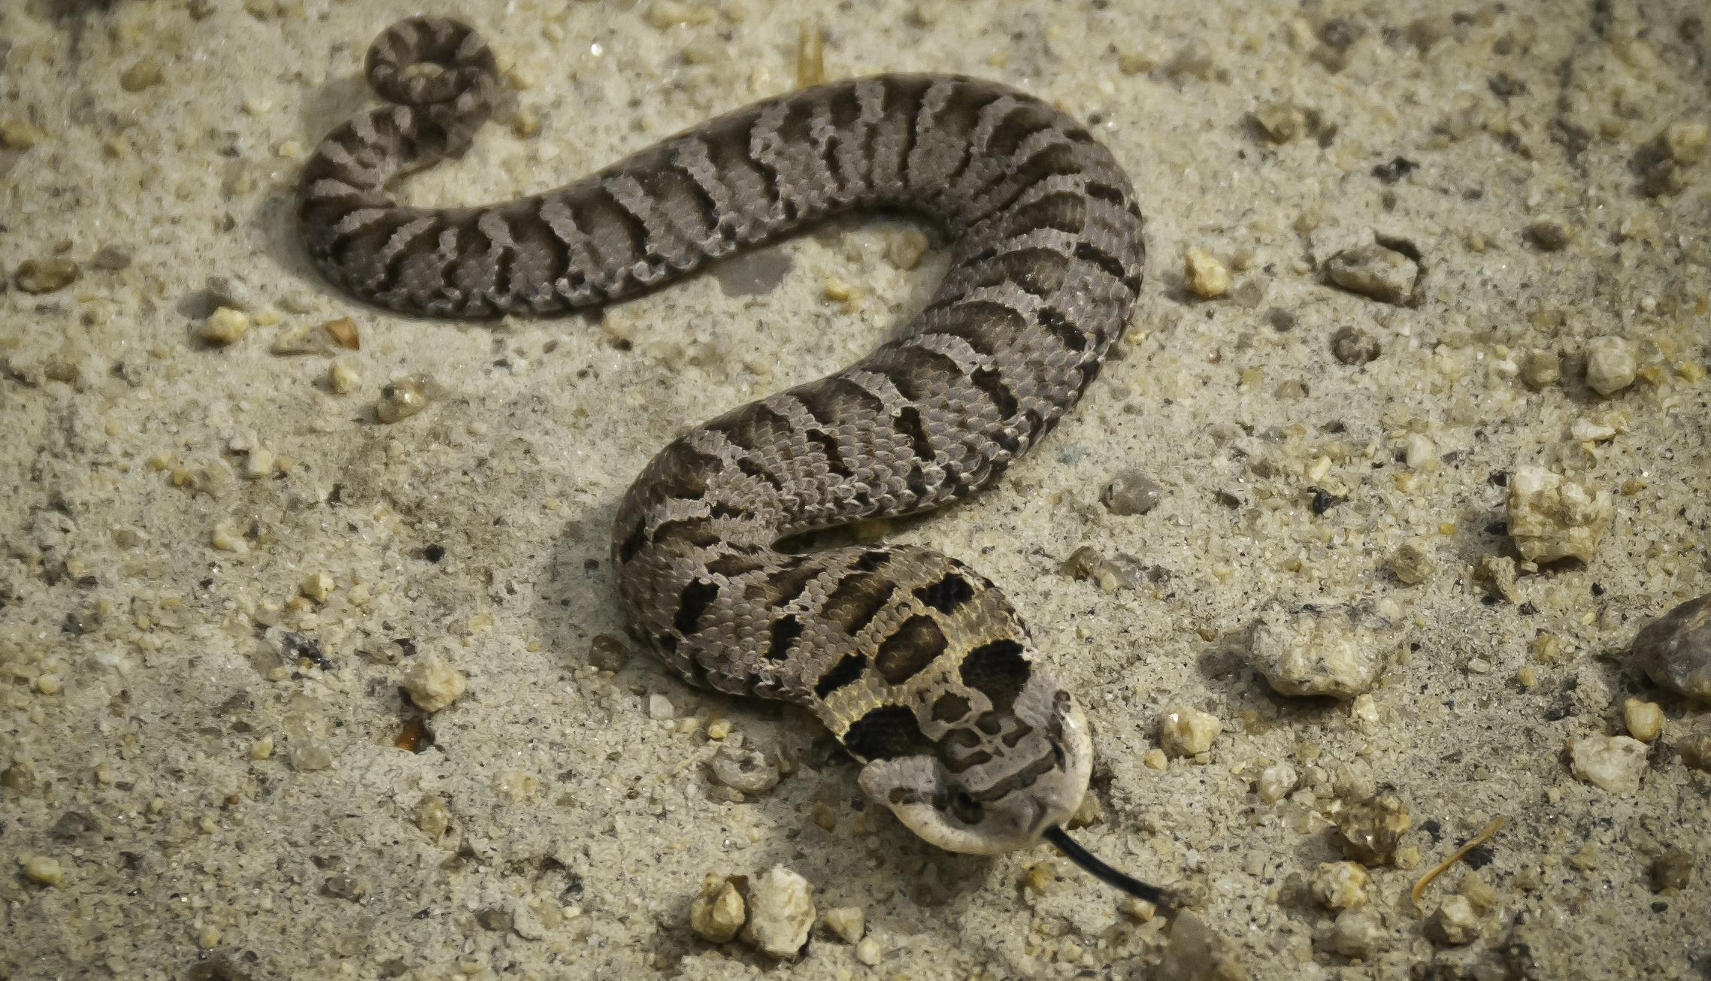
Any questionsss?

