Slide 1
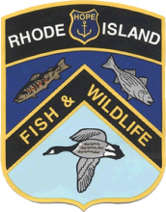
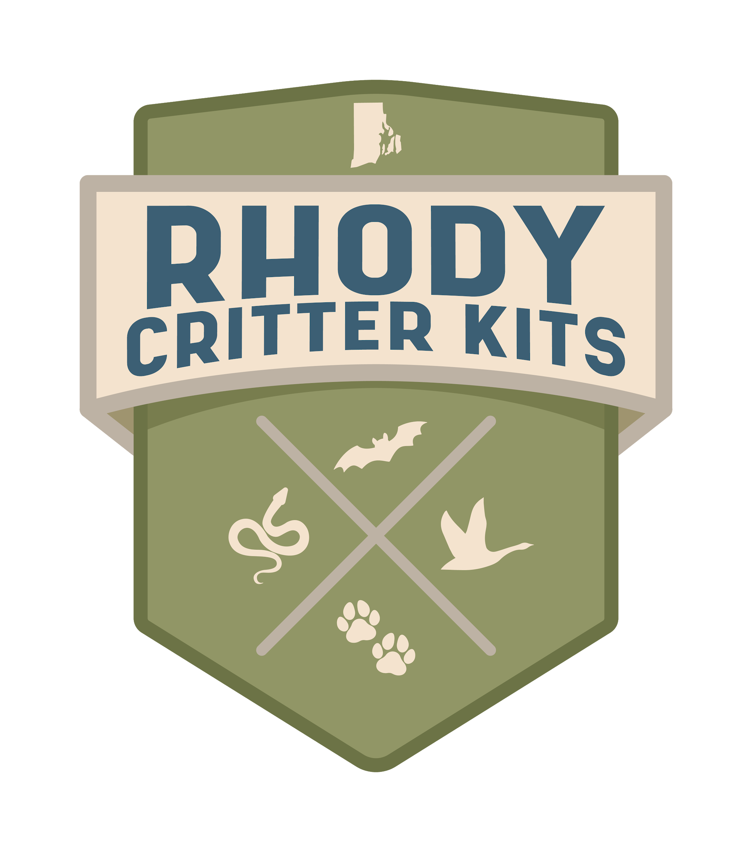

How Can I
Help Birds?

Slide 2
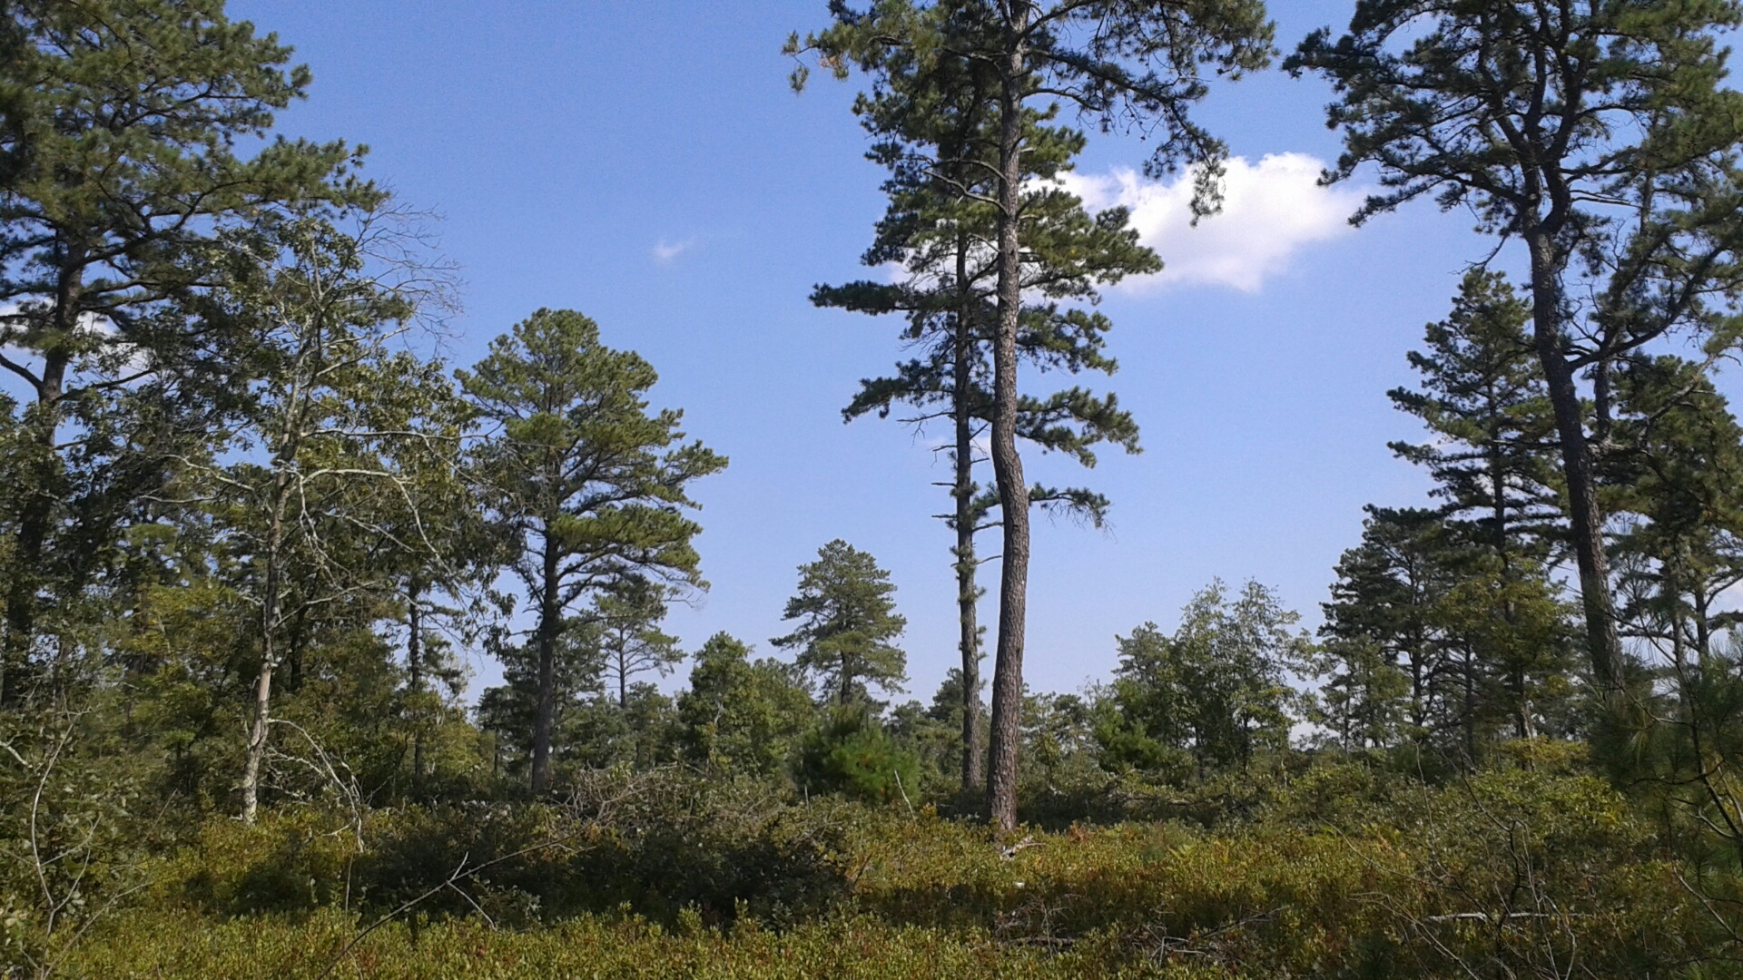
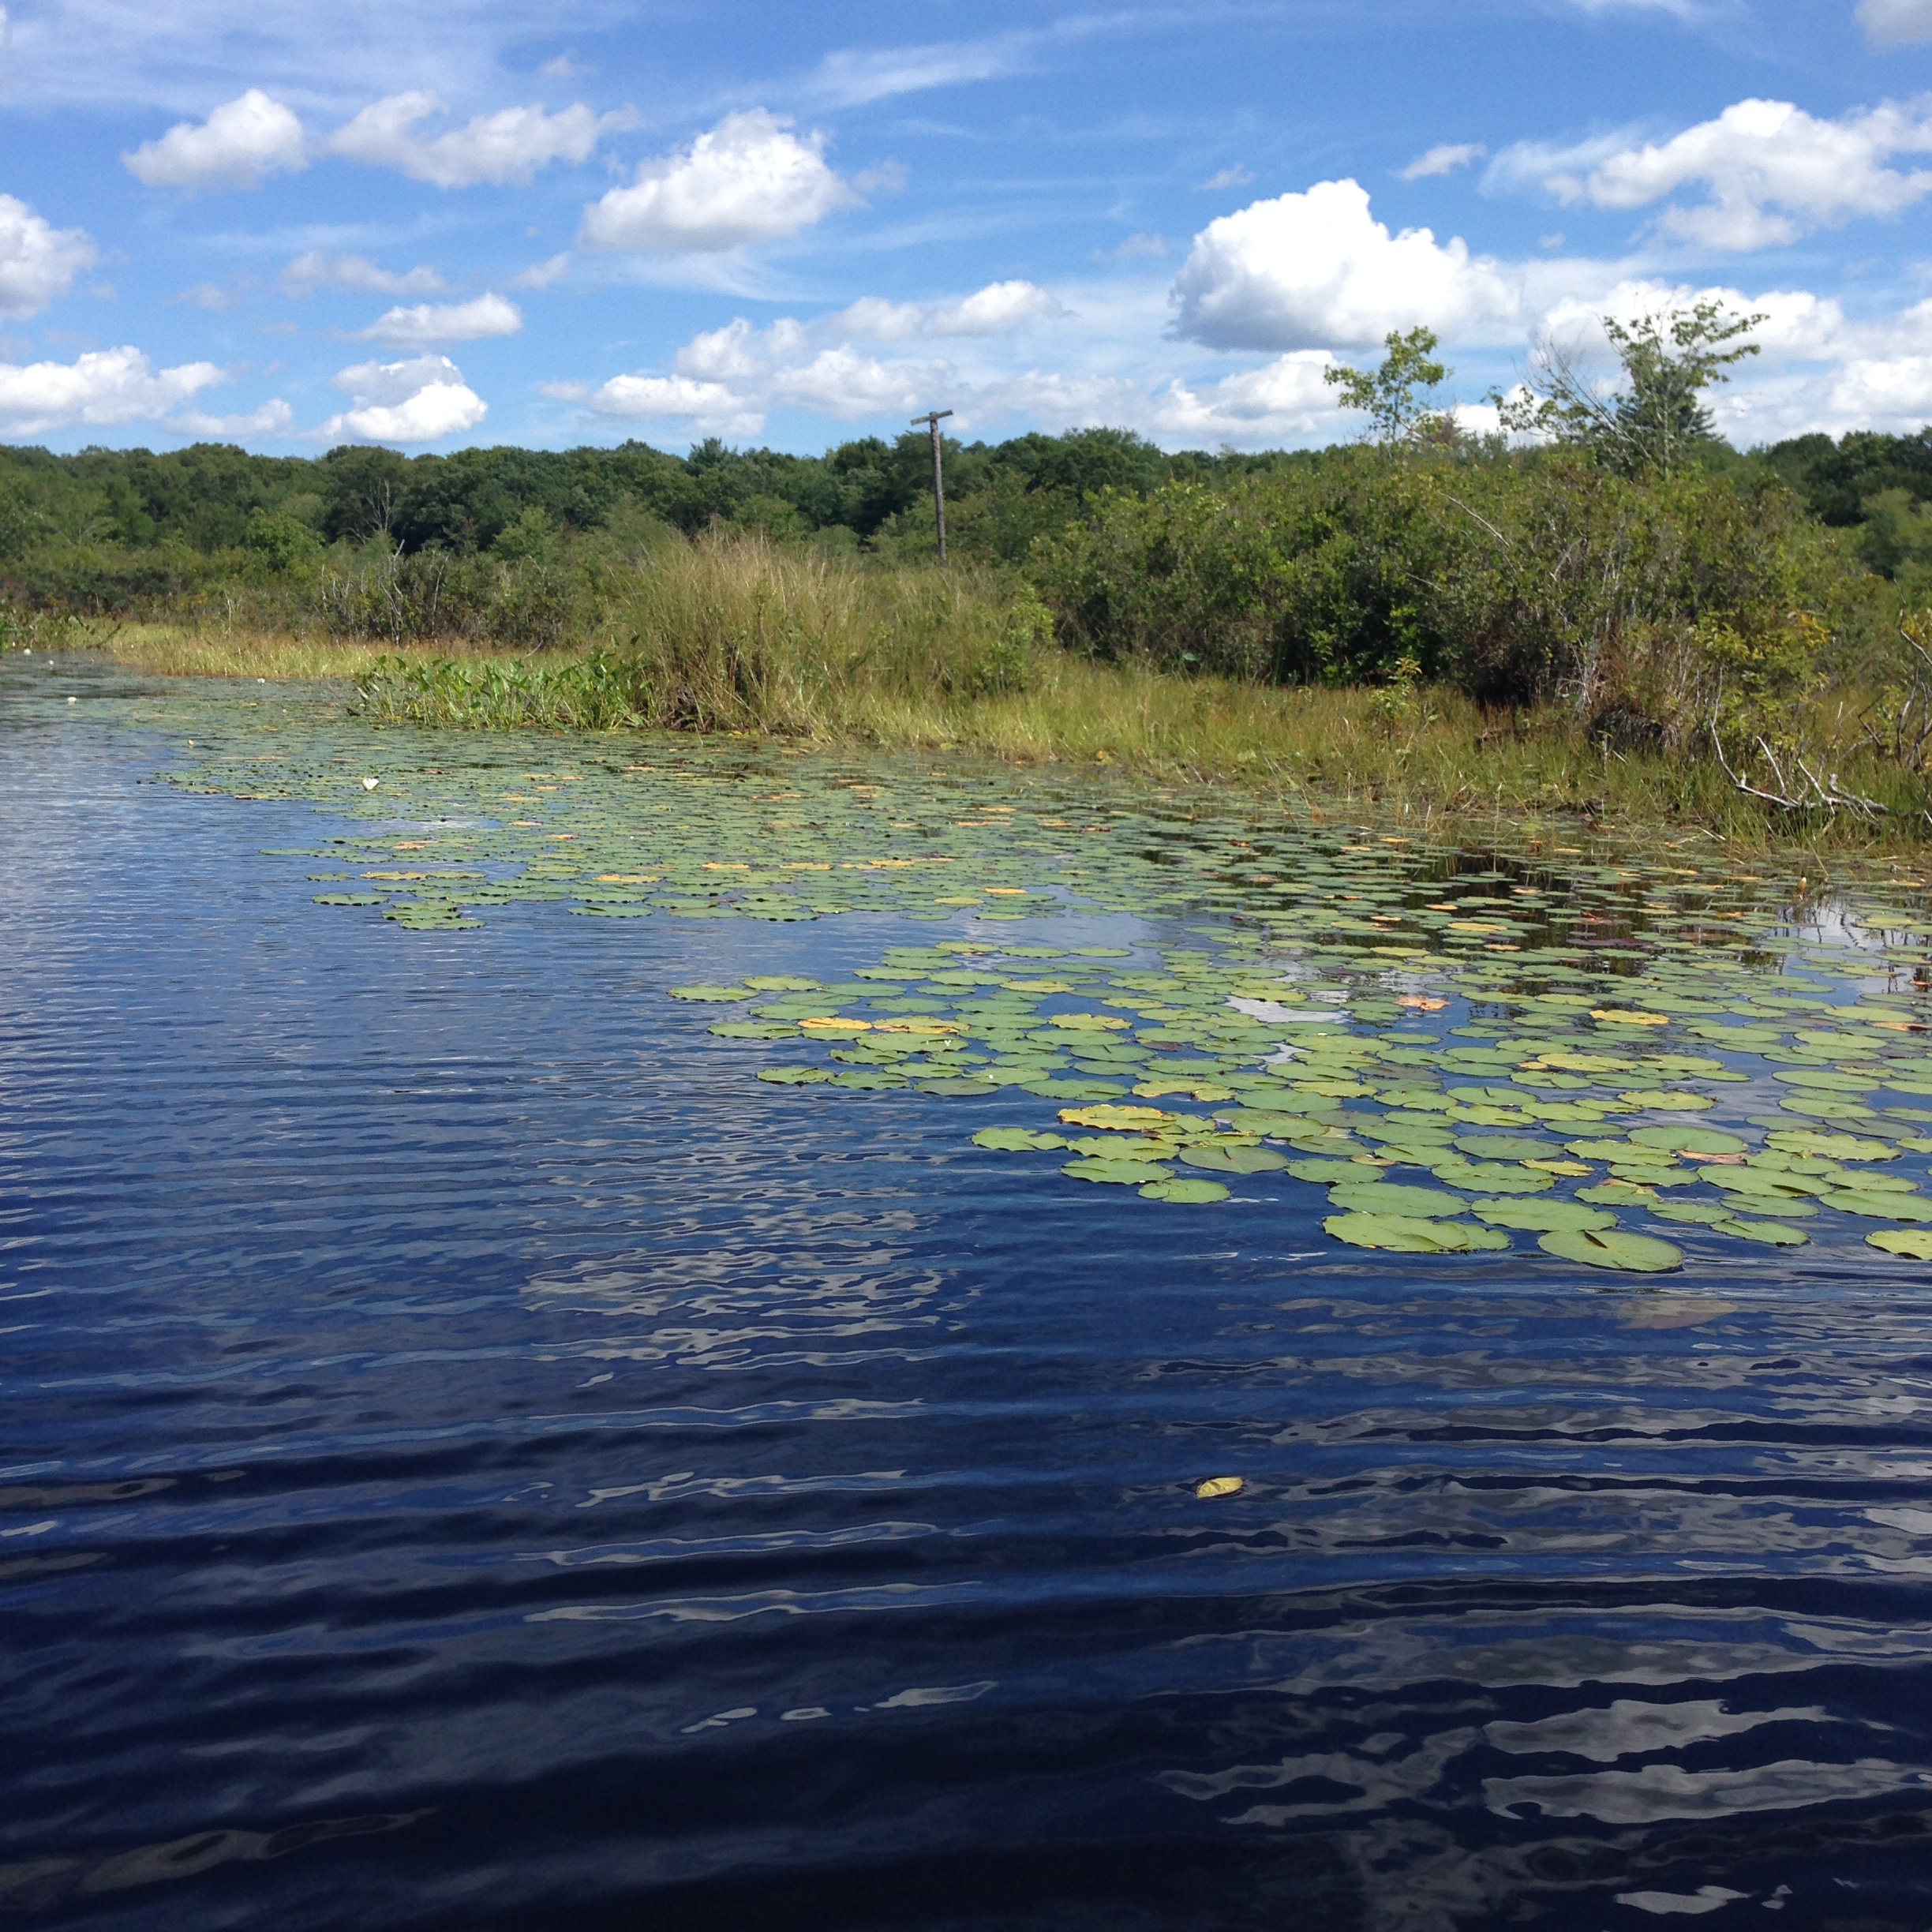
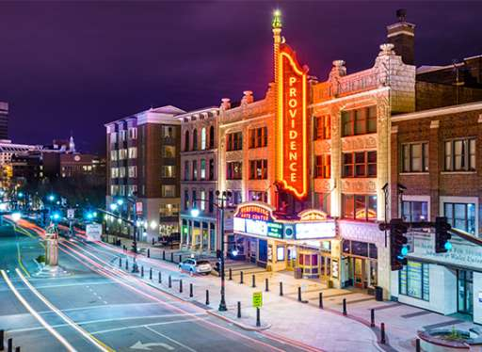
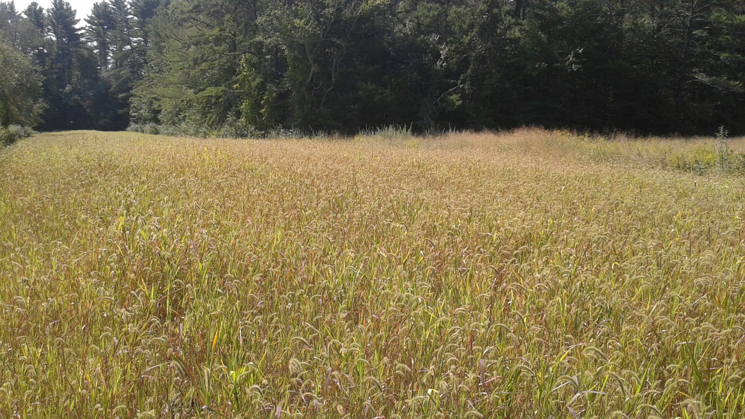
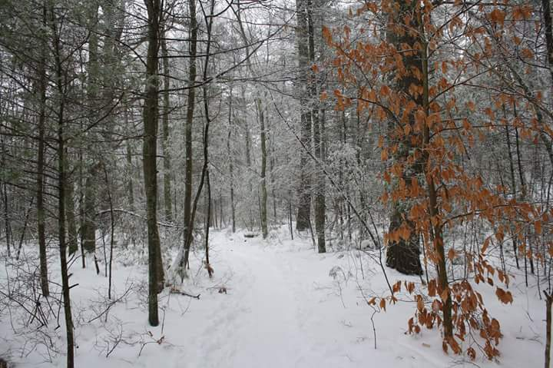
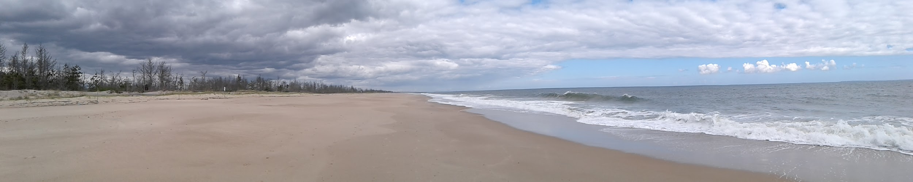
Birds fill many niches, in many different habitats
Young forest / Shrubland
Grasslands
Wetlands
Cities & Towns
Forests
Beaches / Coasts
Notes:
Birds live everywhere; you can find them in forests, fields, wetlands, beaches, even cities! As we learned in the last lesson, a bird’s adaptations determine the habitat in which it lives, and the niche that it fills. Some species have only adapted to live in one type of habitat, while others are less picky about where they live.

Slide 3
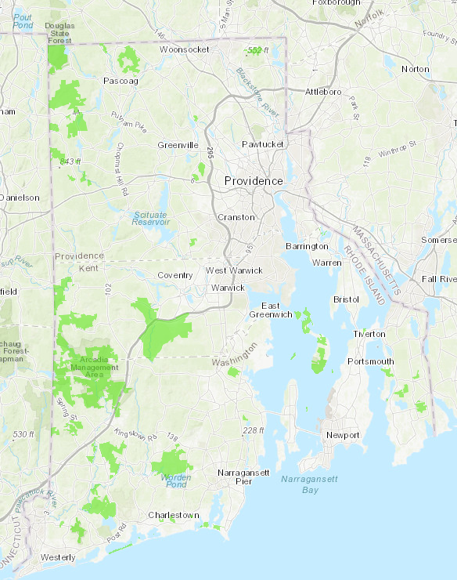
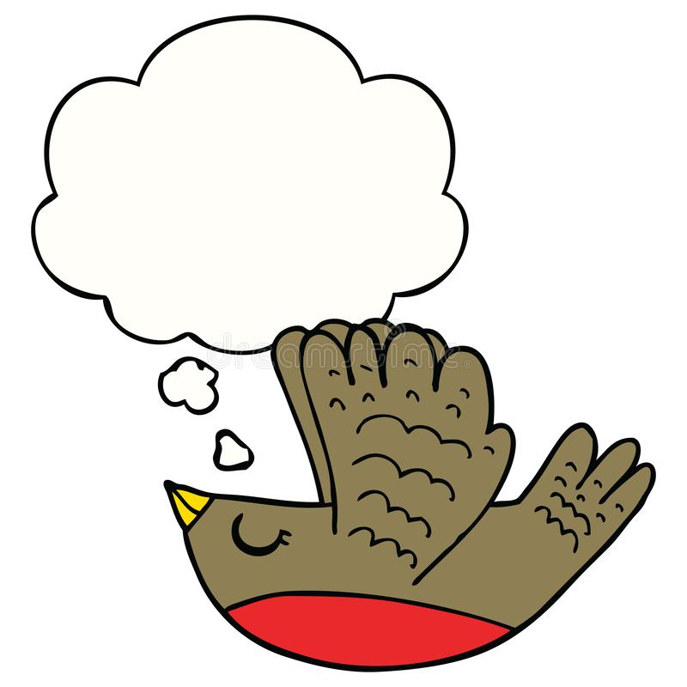
We want to conserve as much
habitat as we can !
Thank you!
Notes:
In Rhode Island, one of our big goals is to protect as much diverse habitat as possible. The more habitat we conserve/manage, and the more diverse habitats we protect (forest, coastline, wetlands, etc), the better for our birds. In Rhode Island, we have approximately 60,000 acres of land conserved in our State Management Areas (green shapes on the map). Rhode Island’s birds have most definitely benefited from State conservation land, as well as from State Parks and other conservation land throughout RI (Audubon, Nature Conservancy, town land trusts).

Slide 4
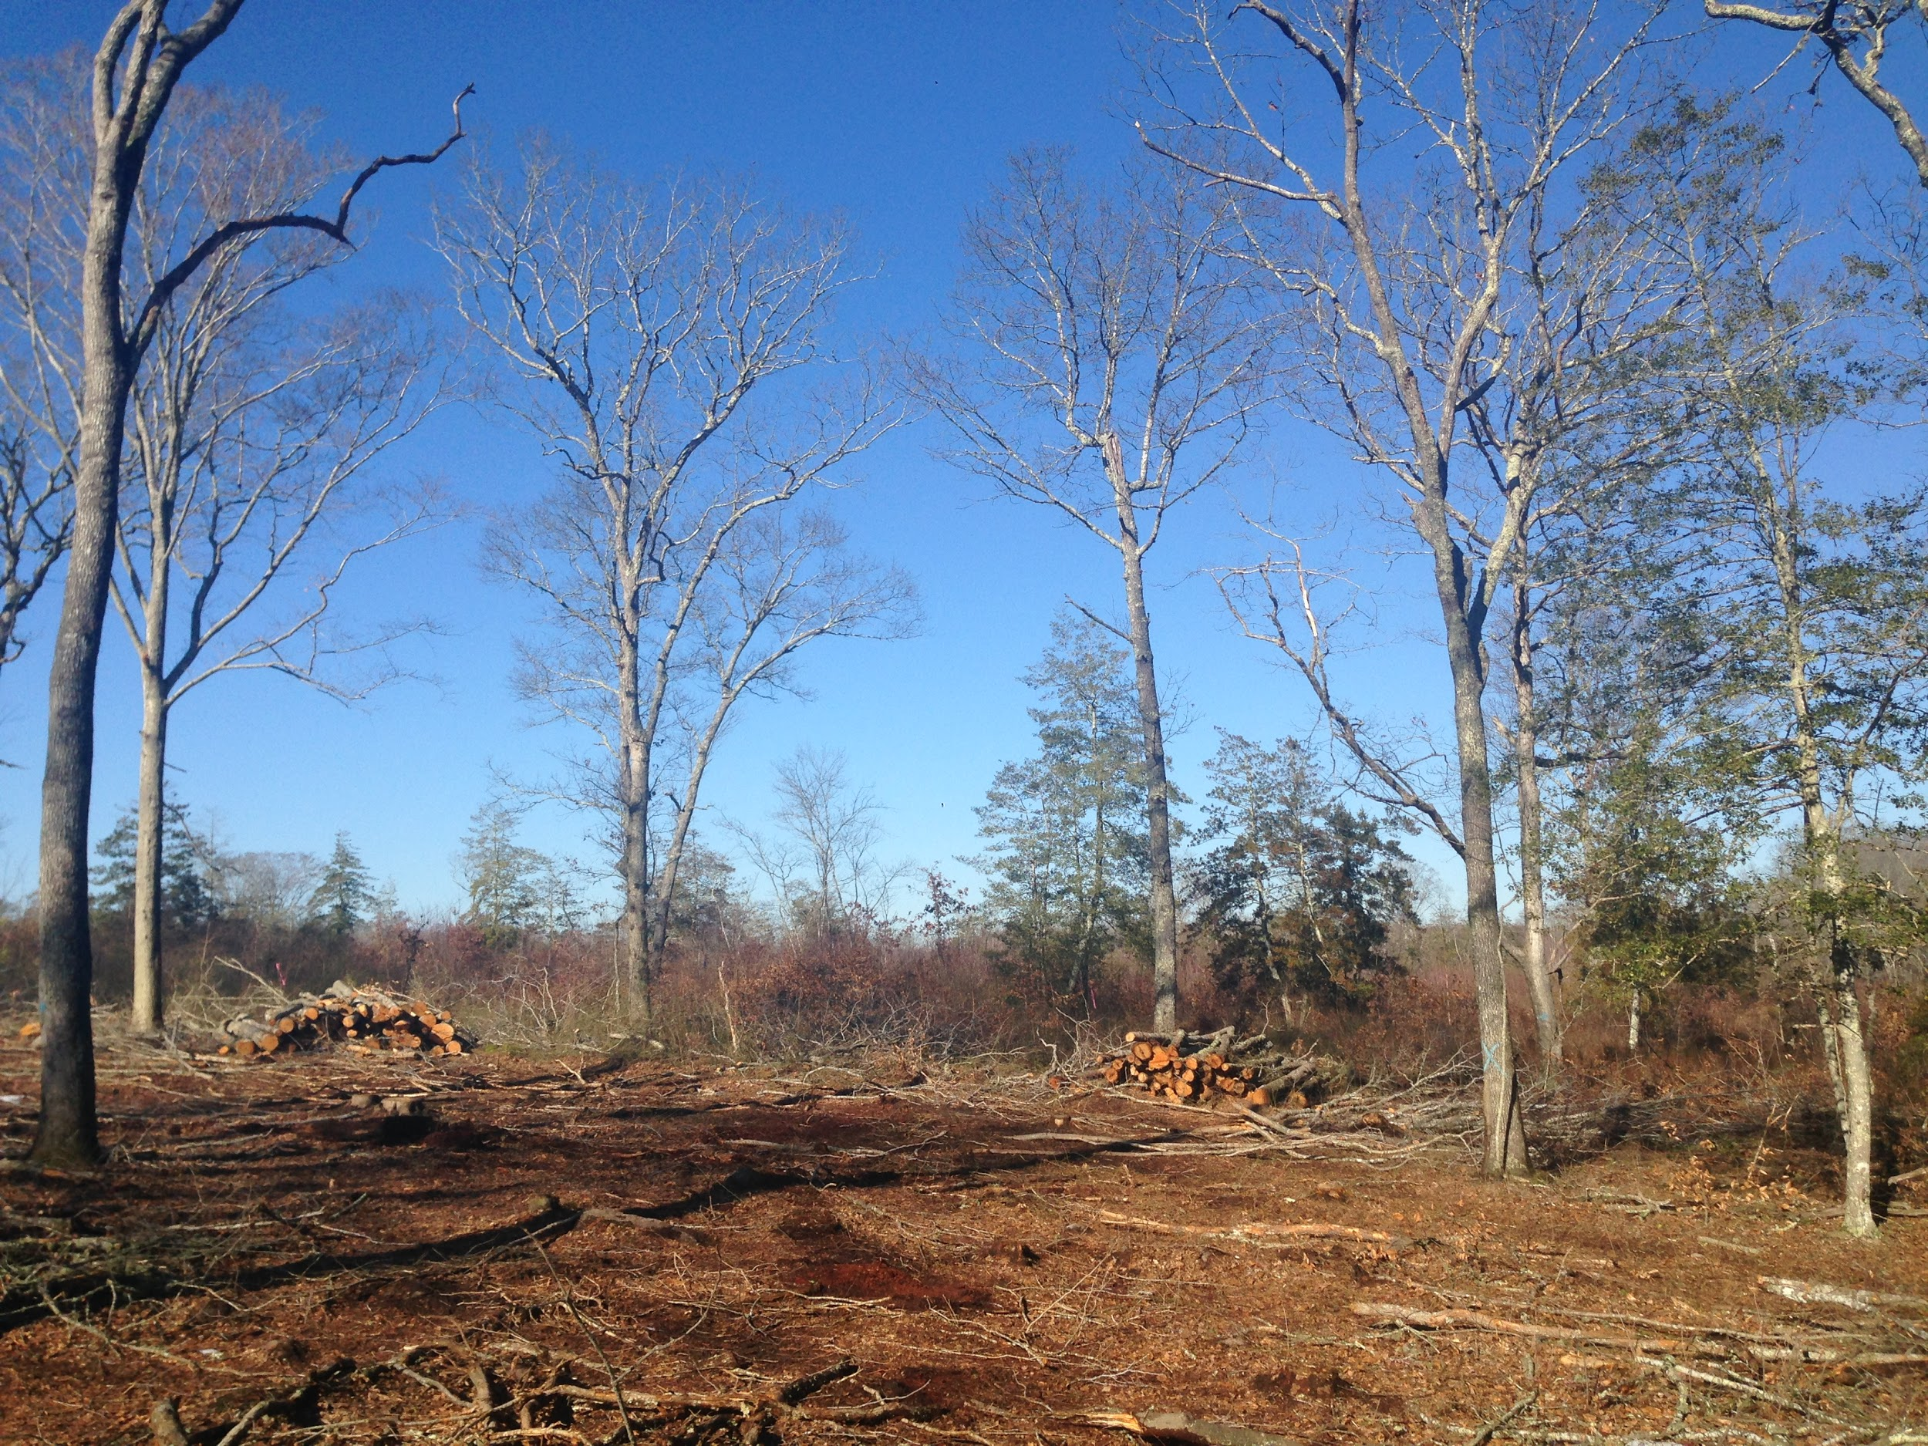
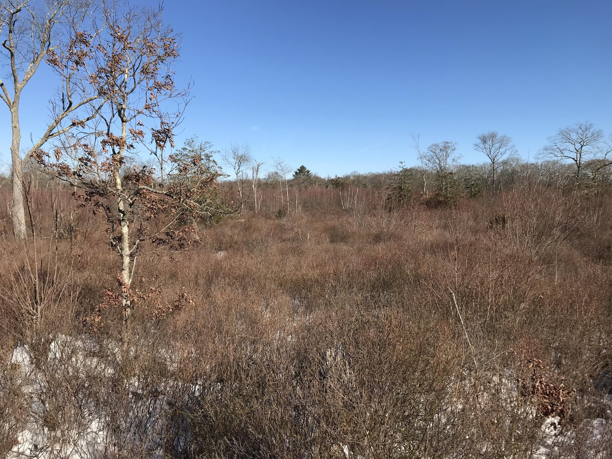
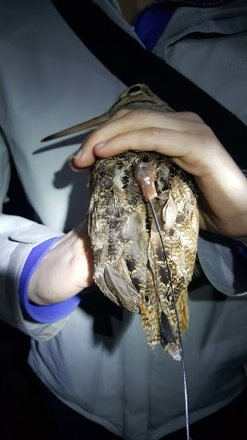
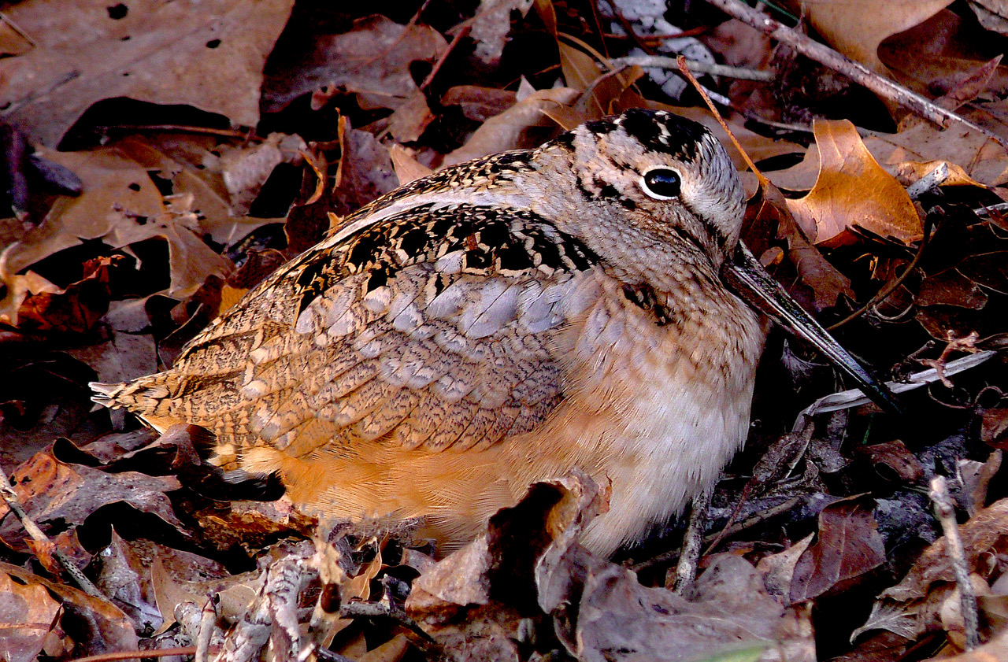
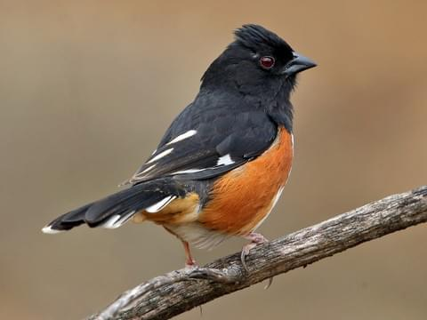
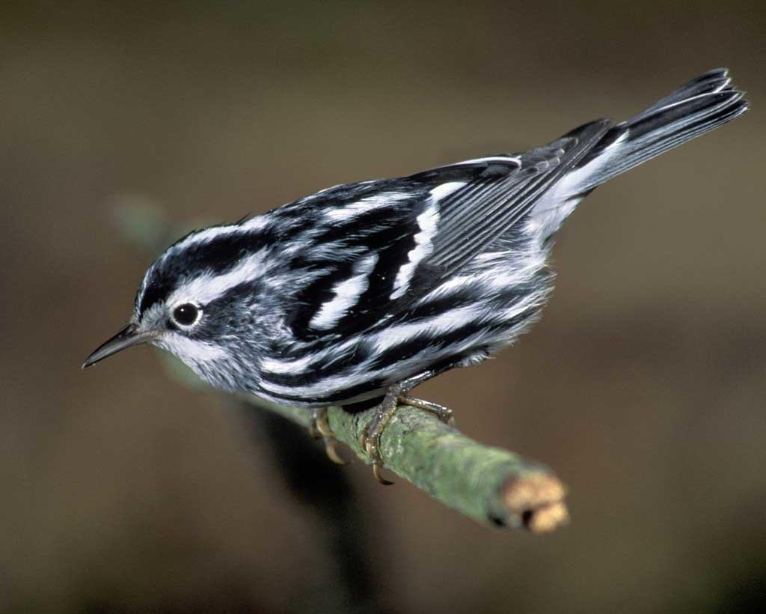
Young Forest Habitat
Notes:
What is a young forest?
A young forest is characterized by small, young trees that are about 10 to 20 years old. They grow very close together, and there are lots of shrubs and briar thickets growing in the understory of the forest. Trees like birches, apsens, oaks, and maples are the most common trees you’ll see in a young forest. These tree species prefer to grow in areas with lots of sun. You won’t see too many aspens or birches in an old forest that is shaded by big pine or beech trees. In a mature forest, the understory has very few plants, and the trees are spaced far apart. Young forests grow as the result of some type of disturbance on the landscape, like fire, intense storms, or logging. If left undisturbed, forests age into mature forest habitat. The tree species and the structure of a forest influences the bird species that you’ll find in that forest.
Which bird species live in young forest habitats?
In the Northeast, more than 40 bird species need young forest habitat, and are considered Species of Greatest Conservation Need. The dense thickets of young forest habitat provide lots of food for these birds, including insects and fruits, as well as cover and protection from predators. Warblers (like the black-and-white warbler and chestnut-sided warbler), sparrows (like the white-throated sparrow), ruffed grouse, whip-poor-will, Eastern towhee, black-billed cuckoo, and American woodcock all require young forest. And that’s just a few species! Even birds that live in the mature forest will spend time in young forest searching for food or getting ready for migration at the end of the summer.
What are we doing in Rhode Island to manage young forest habitat?
In Rhode Island, we are focusing on creating and managing young forest habitat across our State Management Areas. We have performed selective clear cuts at some sites, with plans to do more. Each cut is strategically placed on a set number of acres that is relatively small in comparison to the rest of the property. For example, a 2017 cut at the Great Swamp Wildlife Management Area only affected 37 of the 3,600 total acres that make up the management area. Our habitat biologist and foresters carefully select which trees will be cut, and which trees will remain to provide healthy seeds to naturally replant the area. We make brush piles with the branches of the cut trees to provide cover for rabbits, snakes, and other small animals. We also leave standing dead trees, or snags, for woodpeckers, owls, bats, and other wildlife. Cuts are strategically placed near previous cuts to create a network of forest patches that are all different ages. This connectivity and age diversity benefits the wildlife that use young forest habitat.
Photos:
Habitat photos → Left: A selective clear cut at the Great Swamp Wildlife Management Area. Note that some large, healthy trees have been left. These trees will drop their seeds to replant the area. There are piles of branches and small logs, called brush piles, placed throughout the cut. This will create shelter for small mammals, snakes, and salamanders. Right: A 5 year old young forest. The large trees are still there, but the bare soil has been covered with young trees (sprouted from old stumps or new individual trees) and shrubs. The young forest is thick and brushy, which provides a lot of shelter and food for many species of birds.
Bird photos (Left to right) → American woodcock, Eastern towhees, and black-and-white warblers all use young forest habitat. The RI Division of Fish and Wildlife has collaborated with a number of graduate students at URI to track woodcock habitat use on state management areas. In this picture, a woodcock has been fitted with a tiny backpack-style radiotransmitter, which allows biologists to track its movements. Data gathered from these collaborative studies can help us make habitat management decisions to benefit woodcock in the future.

Slide 5
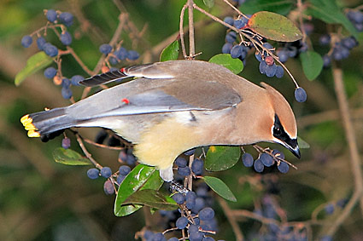
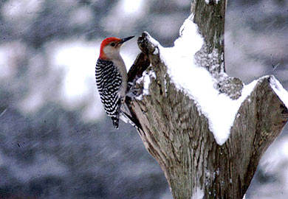
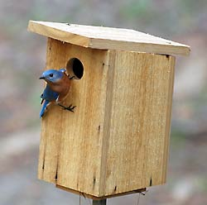
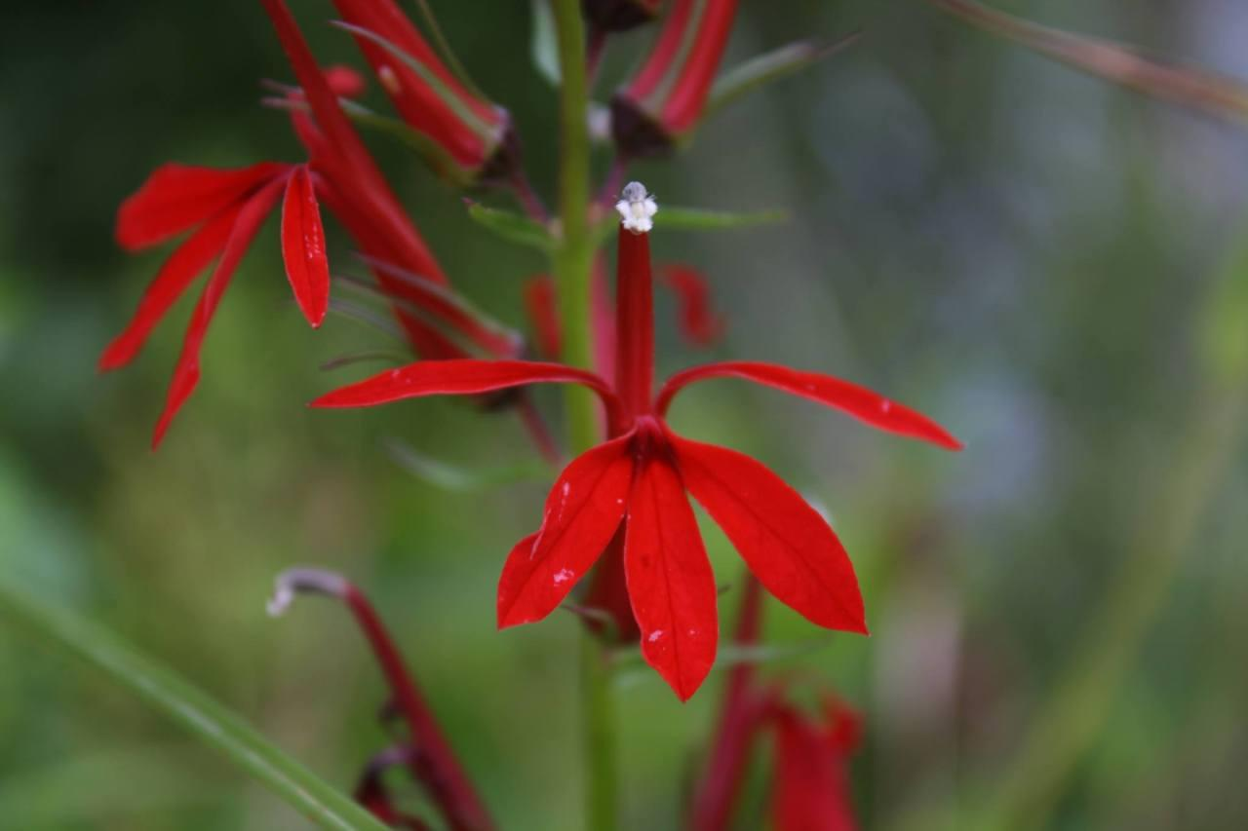
Make a bird habitat!
  Plant fruit bushes and wildflowers
  If you can, leave up a dead tree stump
  Build some bird houses
Notes:
You don’t have to have a lot of space to make your backyard bird-friendly. In fact, you don’t have to have a backyard at all! There are lots of little ways that we can help birds. Collectively, each small effort makes a big difference for our birds, and helps to create more connections to our bigger conservation lands around the state. Planting native varieties of shrubs, trees, and flowers provides food and shelter for birds and other wildlife. Native plants are the best because they are what birds recognize and prefer. Birds also benefit from non-native landscape plants as well, but mixing in some natives makes a big difference. Dead tree stumps and logs provide woodpeckers with places to forage for insects, and can provide cavities for various bird species to build their nests inside. Of course, you should only leave up a dead tree if it is not posing any danger to people, pets, or homes. If you don’t have any trees nearby, you can mimic a tree cavity by building a nest box! The Cornell Lab of Ornithology has a great resource on nest box building for different species: https://nestwatch.org/learn/all-about-birdhouses/
Photos (left):
Cedar waxwings are one of the many species of birds that will be attracted to fruit-bearing shrubs and trees in your yard.
Hummingbirds love cardinal flower (Lobelia cardinalis), which is a native wildflower species.
Photos (right):
A red-bellied woodpecker foraging on a dead tree, also called a snag.
Bluebirds are one species that will happily use nesting boxes.

Slide 6
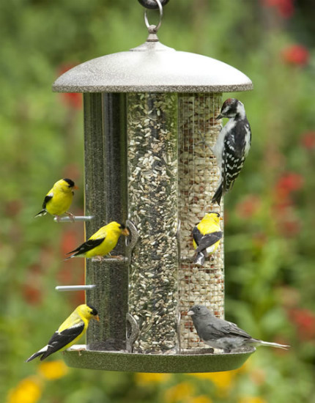
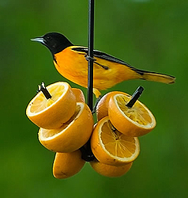
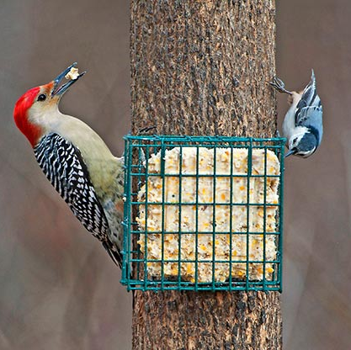
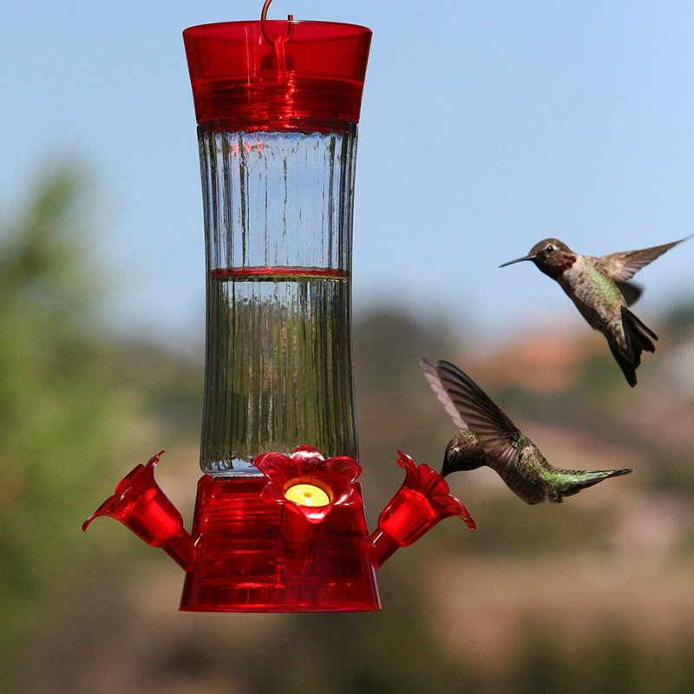
What can I feed the birds?
  Sugar water for hummingbirds
  Seeds
  Suet
  Fruit
Notes:
It is illegal to intentionally feed wildlife in Rhode Island, with the exception of backyard birds. There are definitely right and wrong ways to feed birds! Bird feeders should be kept clean, and you should only offer seeds, suet, sugar water for hummingbirds, and fruit. Maintaining a bird feeder the right way can be a lot of work. If it seems like too much of a responsibility, the best thing you can do for birds is to provide food naturally through your backyard habitat, by planting beneficial plants and by not using chemical pesticides. Targeting one pest ends up accidentally killing many other non-target species, and makes your yard look like an empty plate for insectivorous birds. For tips on how to clean bird feeders, click here: https://www.allaboutbirds.org/news/how-to-clean-your-bird-feeder/
For information on safely feeding hummingbirds, check out RI Division of Fish and Wildlife’s video: https://www.youtube.com/watch?v=PueYTKCTva0&t=5s
Photos (Left to right):
Goldfinches and downy woodpeckers are frequent visitors to backyard bird feeders.
Red-bellied woodpeckers and white-breasted nuthatches love suet!
Ruby-throated hummingbirds can be attracted to your backyard with a feeder. Be sure to change the nectar twice a week, don’t use red dye, and only fill the feeder halfway. You should also scrub the feeder with hot water each time you refill to prevent mold growth.
Orioles love to eat orange slices!

Slide 7
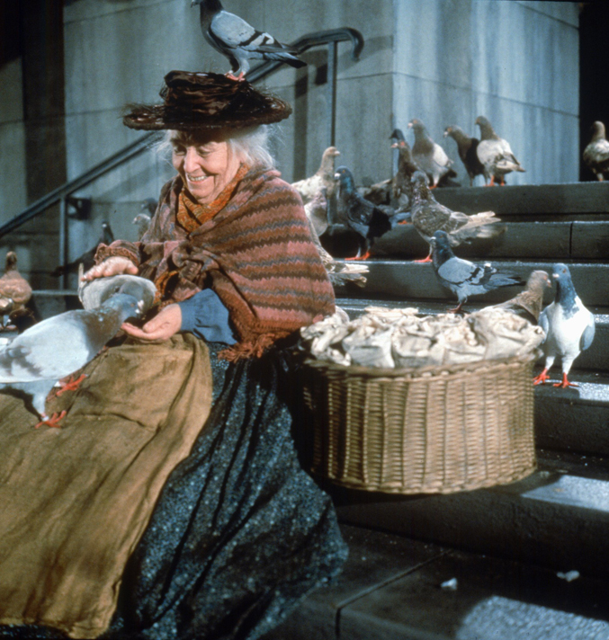
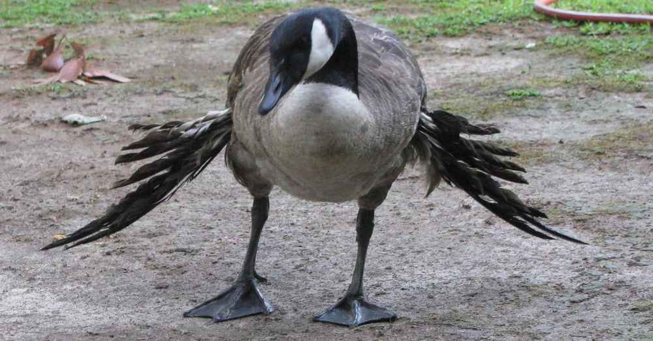

Bread is bad!
Bread is like junk food
Large pieces get stuck in throat
Birds can get sick
Birds will rely on humans
Notes:
Bread is notoriously unhealthy for birds, providing no nutritional value. Old bread can also contain toxic mold, and can impact within birds’ throats and digestive systems. Birds that are fed bread heavily (like ducks and geese at parks) often develop “angel wing,” a growth deformation caused by malnutrition that renders them unable to fly. Birds that are fed by hand often become reliant on humans, and can also become aggressive. They start to associate humans with food, and begin to approach people with no fear. This is not natural or healthy behavior. It’s best for the birds to keep them wild and self-sufficient.

Slide 8
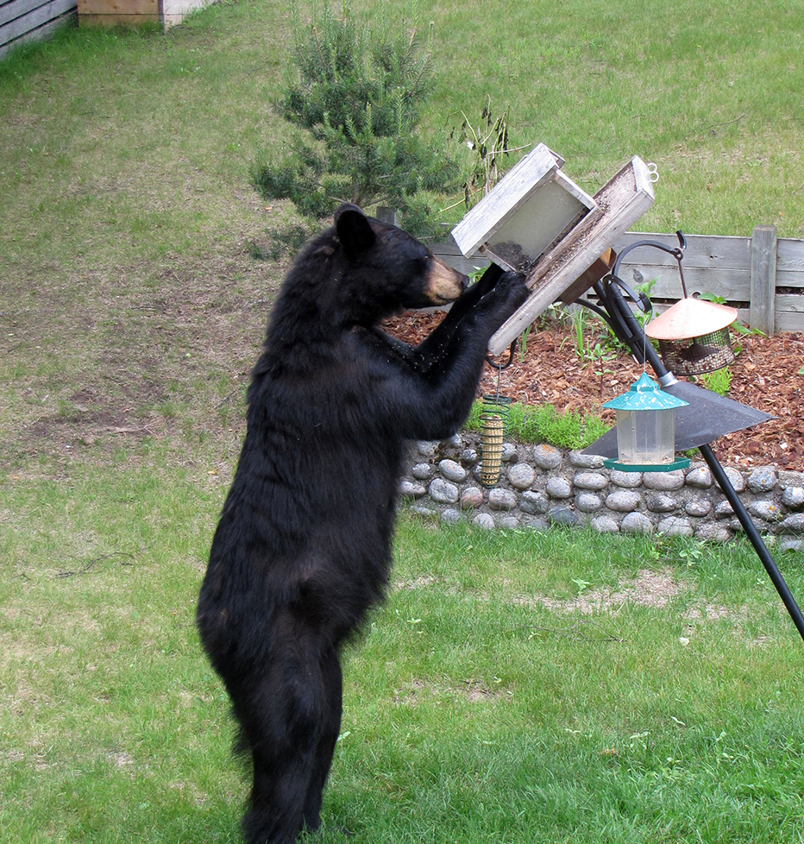
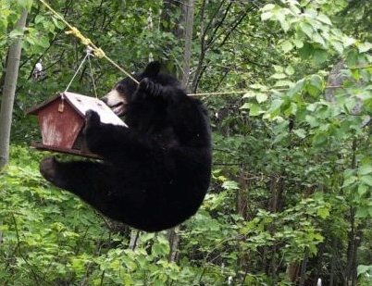
Why should I take my bird feeder down in the summer?
Notes:
RI Division of Fish and Wildlife recommends taking down your bird feeders from March through November. Rhode Island has had an increase in black bear observations, and bird feeders are a major attractant for bears. Birds are perfectly capable of finding their own food, as are bears. There’s no need to turn your bird feeder into a bear feeder! This can lead to bears becoming habituated with human sources of food, which is something we want to avoid for the safety of bears and people.

Slide 9
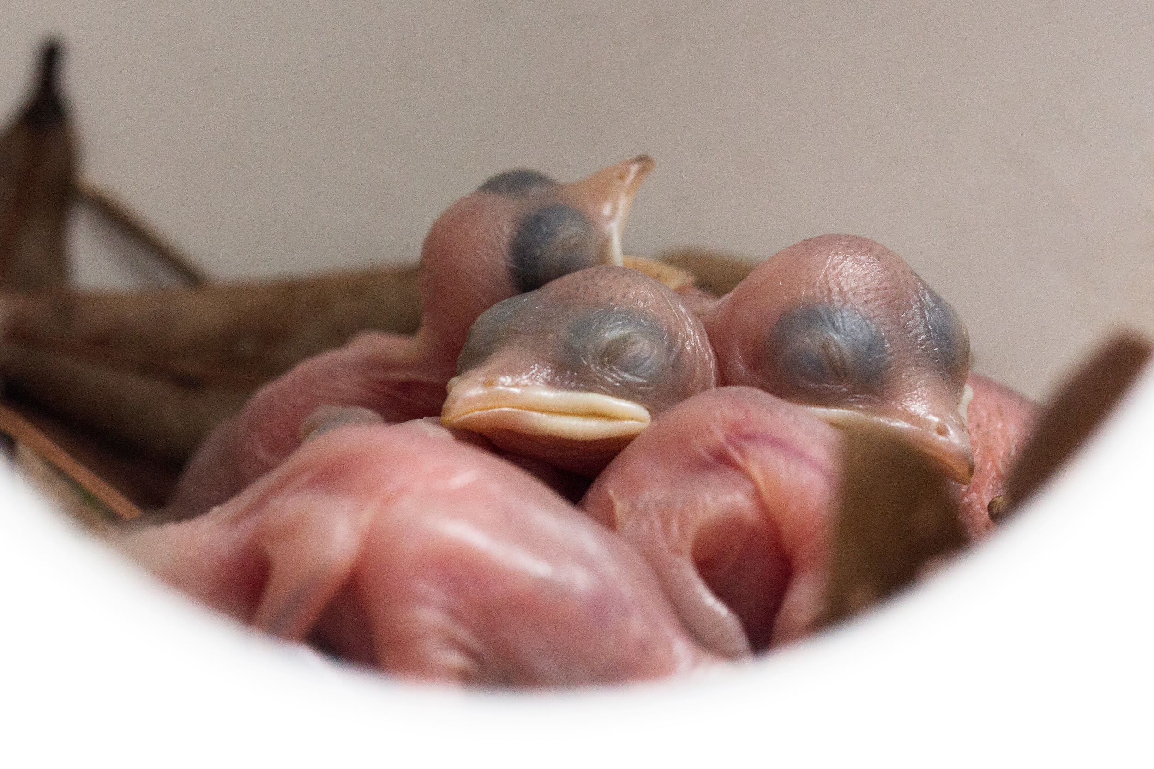
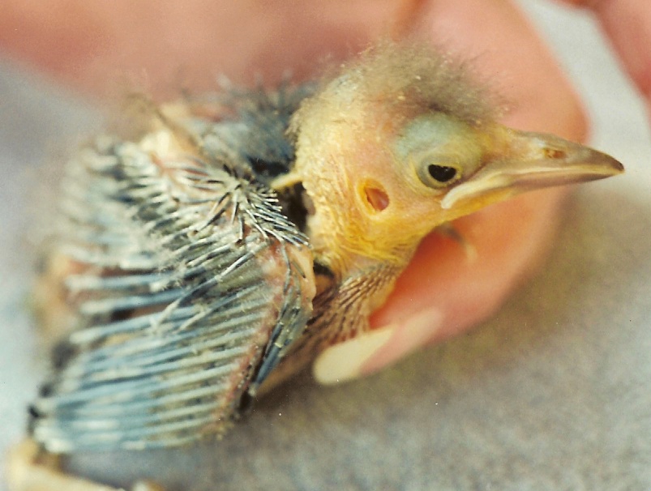
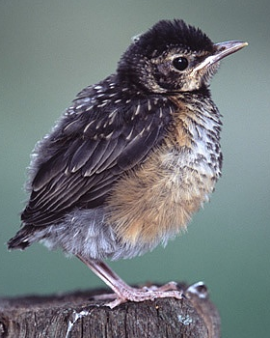
I found a baby bird…
What should I do?
Hatchling - Place back in nest
Nestling - Place back in nest
Fledgling - Leave it be!
Notes:
If you find a baby bird that is hopping on the ground and has feathers, leave it be! It is a fledgling learning to hop and fly, and its parents are nearby ready to care for it. If the baby bird is in a dangerous situation, like in a road or driveway, you can certainly move it out of harm’s way, but to a safe place nearby. Baby birds that have few feathers, or none at all (with eyes closed), are called nestlings and hatchlings. If found on the ground, they should be placed back in the nest, if it can be found. If you are concerned about a baby bird or find an injured baby bird, you can call the Wildlife Rehabilitators Association of Rhode Island for assistance at 401-294-6363.

Slide 10
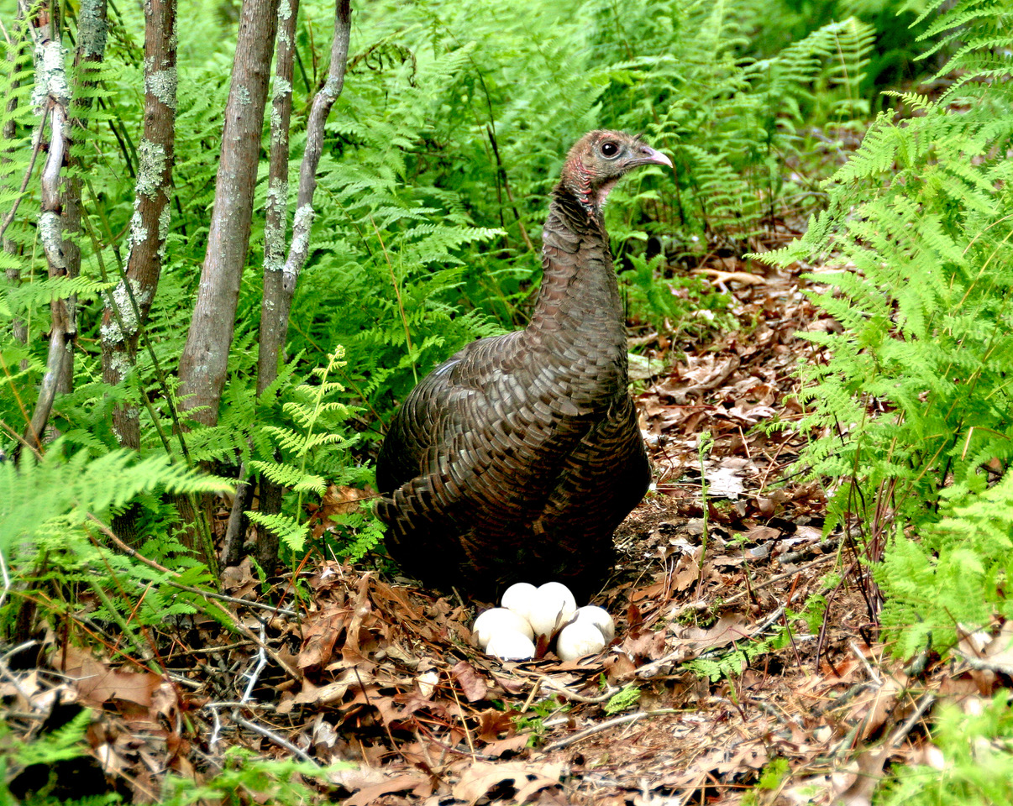
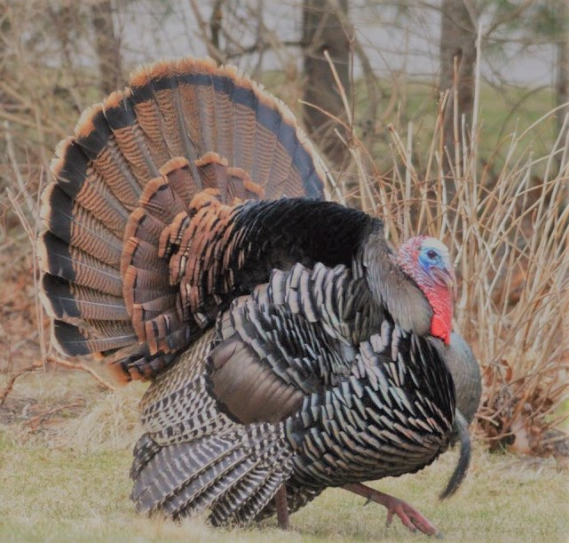
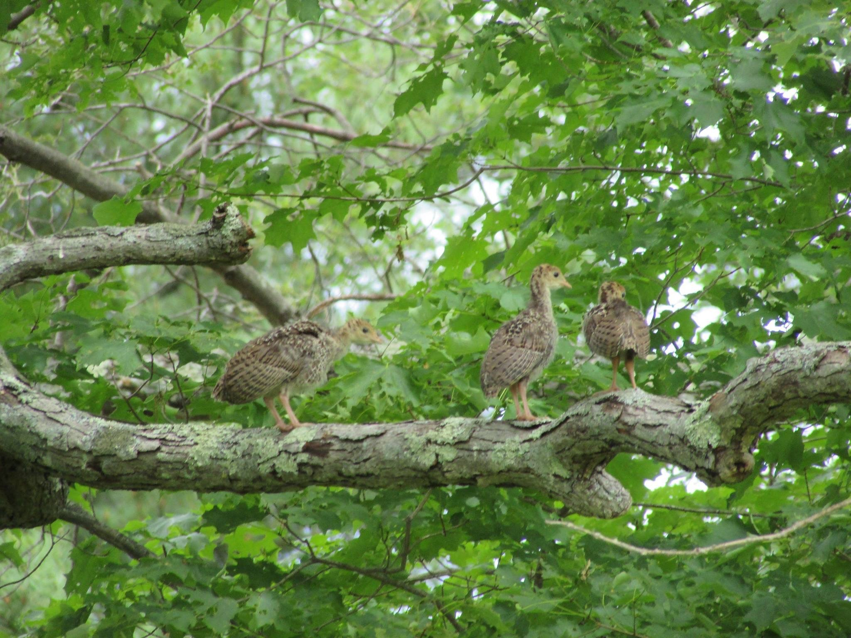
Be a community scientist!
Notes:
What is a community scientist?
A community scientist is a volunteer who helps collect biological data. You don’t have to have any background in science to participate. You just need to care about wildlife! There are community scientist projects all over the world, including right here in Rhode Island!
How can I help?
Every year, we ask Rhode Islanders to submit observations of wild turkeys in July and August. We ask for observations of males, females, baby turkeys (poults). You don’t have to go anywhere special to gather these observations. If you see a turkey in your yard, neighborhood, or while you’re out and about, you can submit your data. Information about this project is circulated via social media and a press release from the RIDEM.
Why are we gathering this information?
The data that is collected from these observations allows RI Fish & Wildlife biologists to estimate the number and distribution of turkeys in the state each year. Looking at the data from years past can give us an idea of how our turkey population is doing. Are there more turkeys than last year? Less? Can we see any trends? By asking these questions, biologists can determine if our population is healthy or if we need to take steps to manage turkeys, such as allowing a higher bag limit, lower bag limit or take other management actions, like protecting or restoring habitat. Turkeys disappeared from the state once before and we don’t want that to happen again. They are highly valued as a food source and play an important role the ecosystem. By monitoring their numbers through this community science project and our spring gobbling surveys, we can help maintain a healthy turkey population in Rhode Island.

