Slide 1
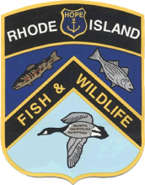
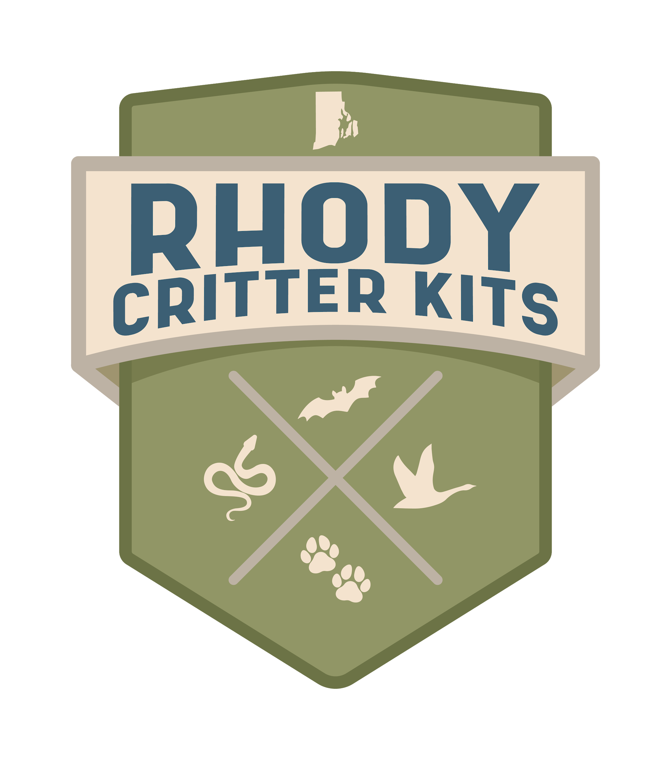

Bird
Adaptations

Slide 2
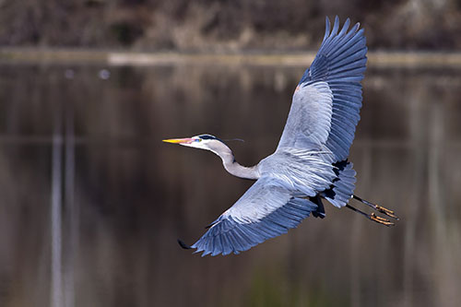
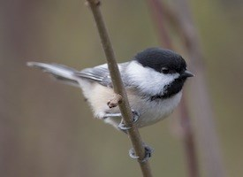
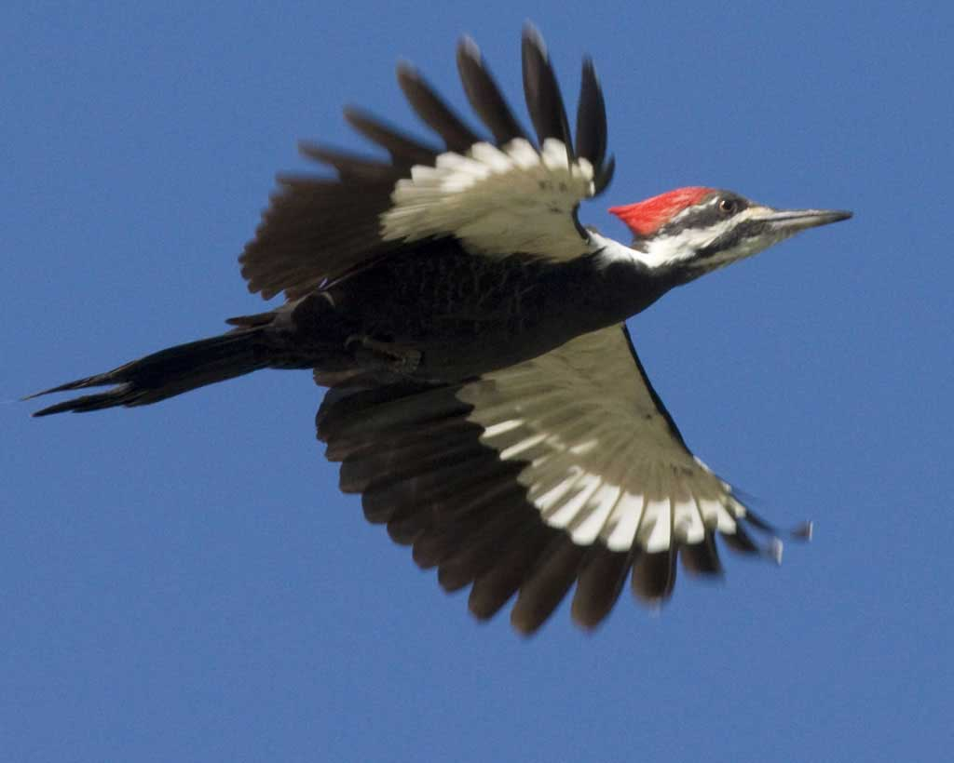
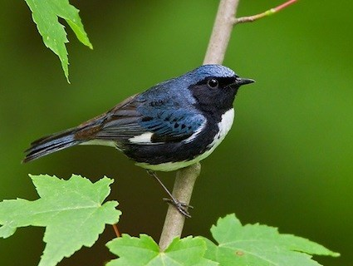
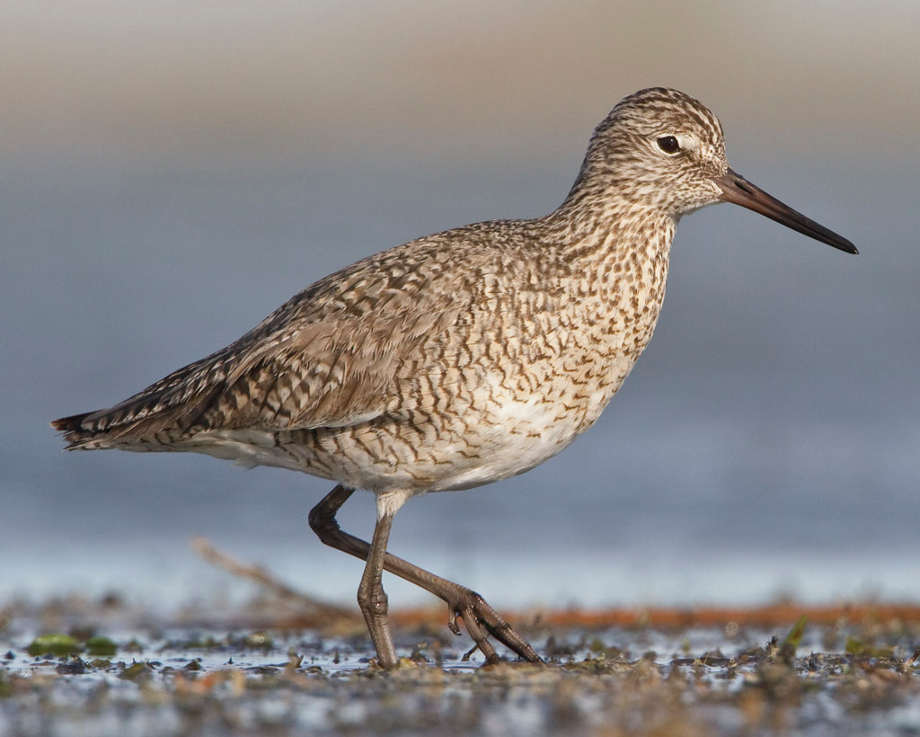
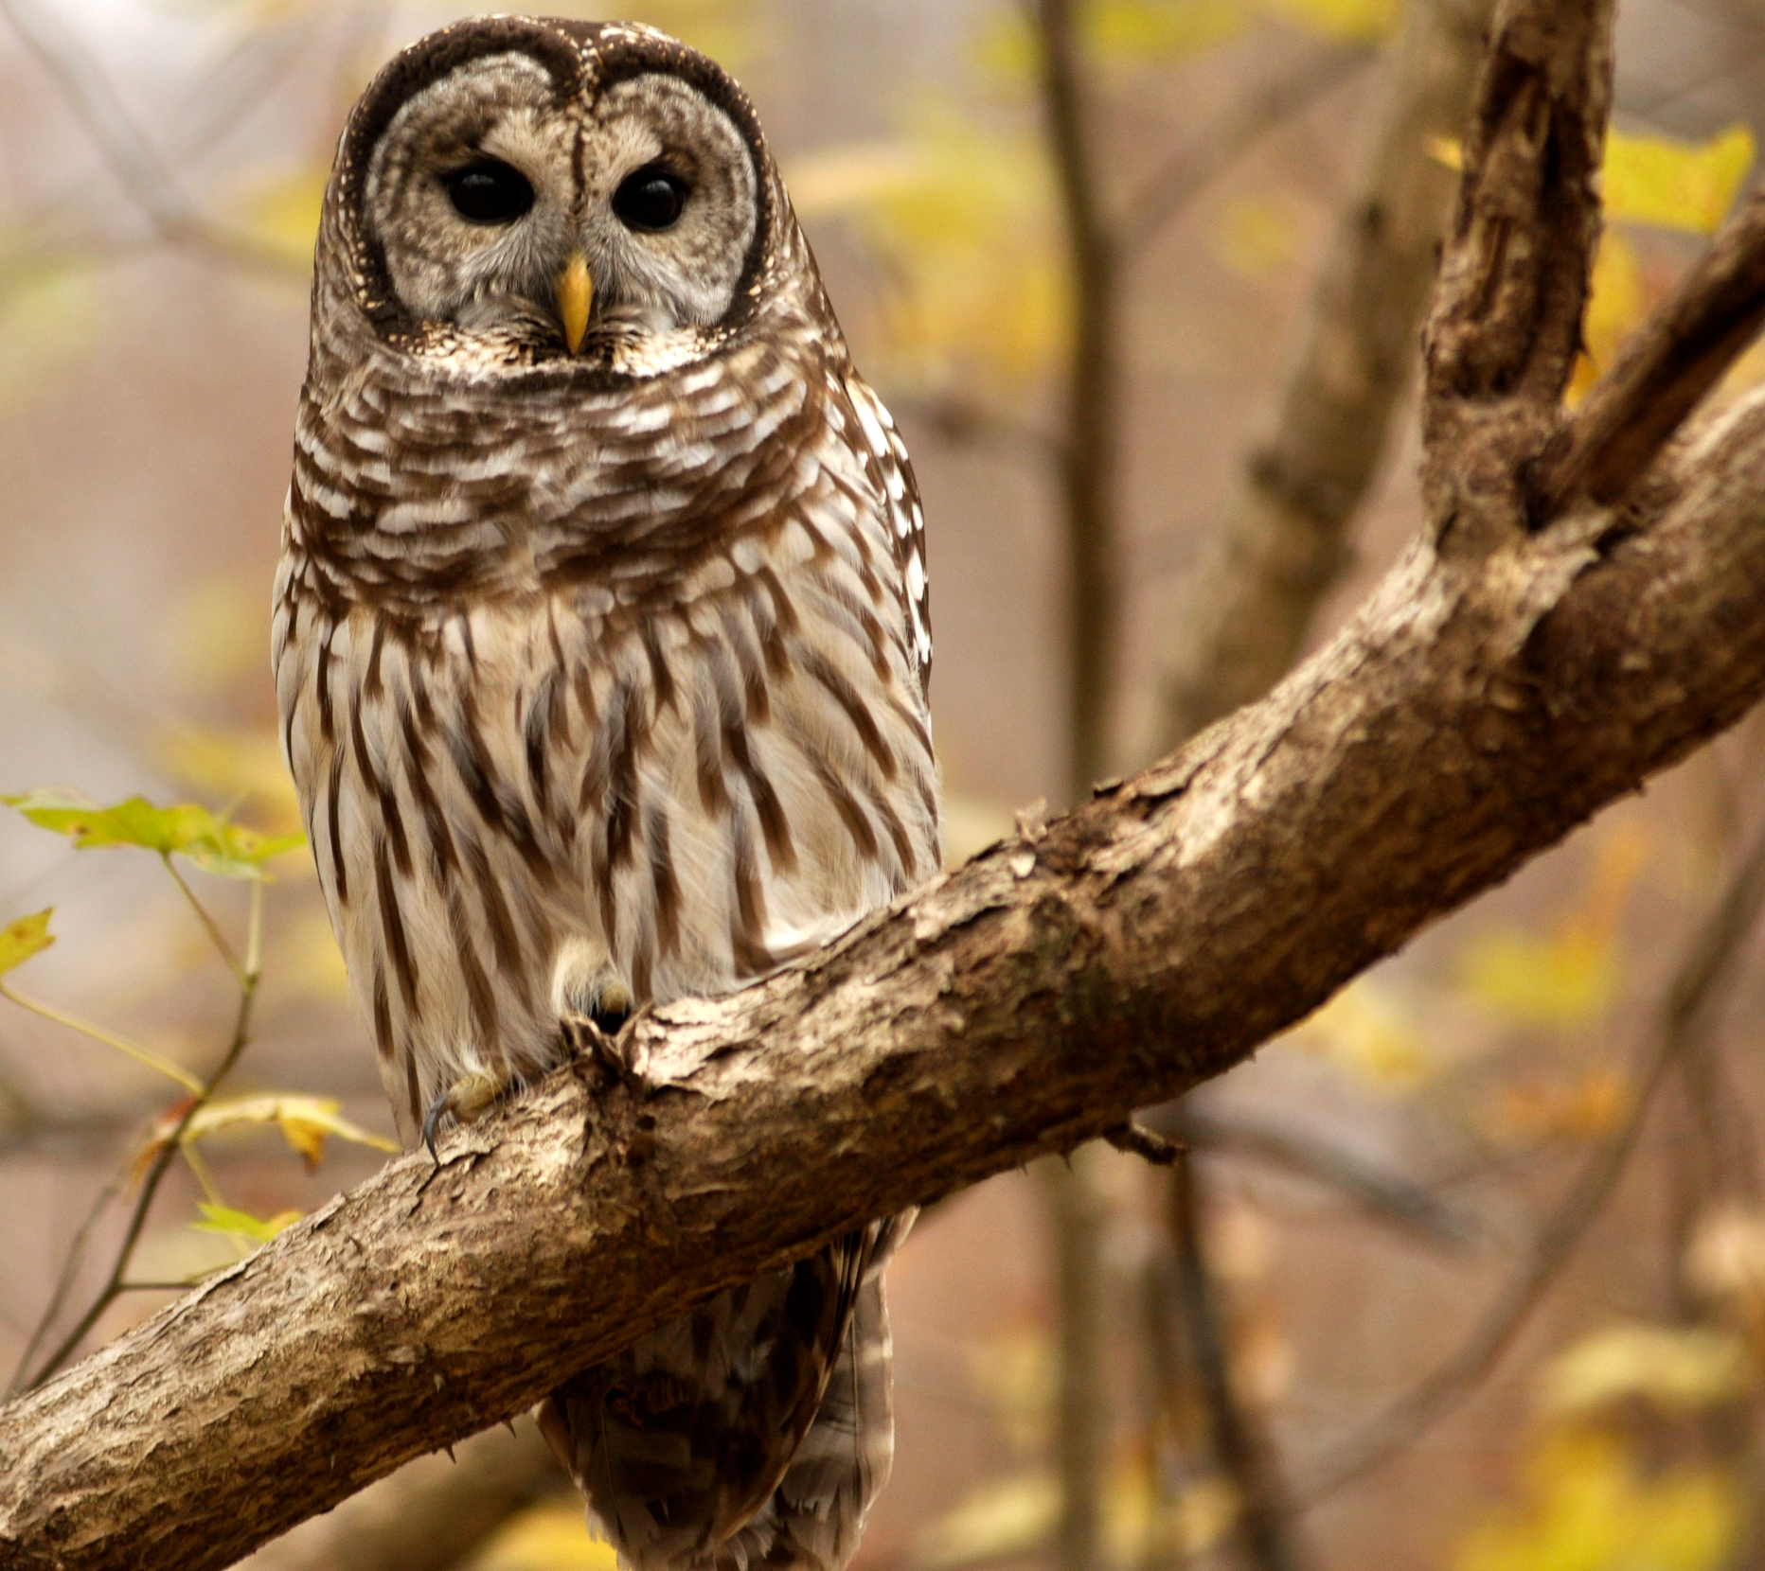
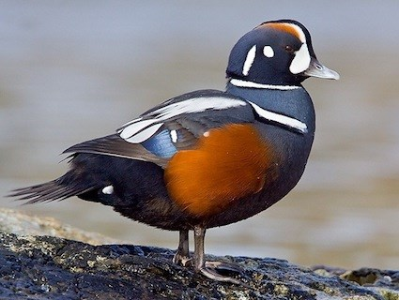
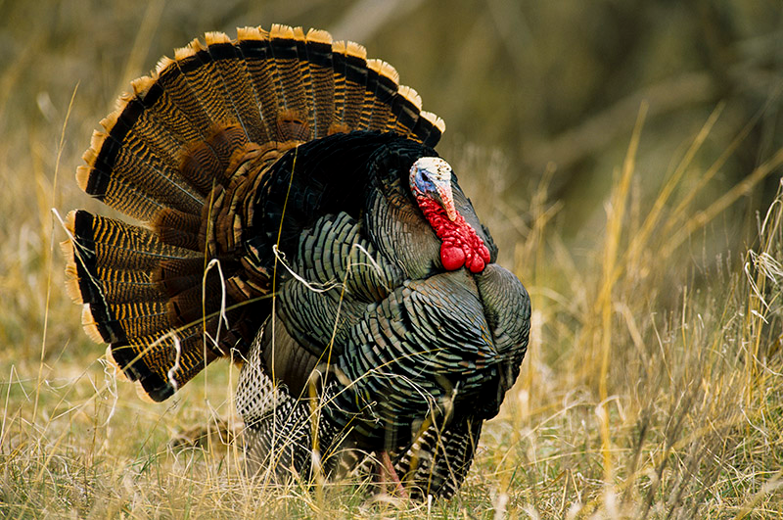
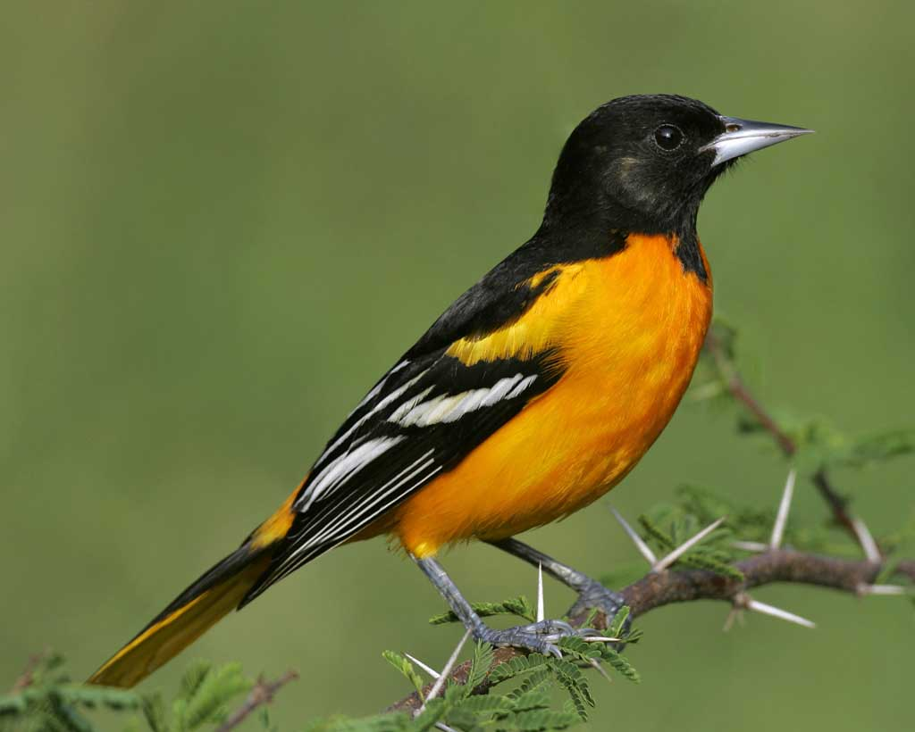
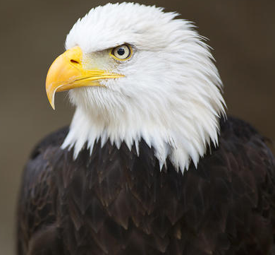
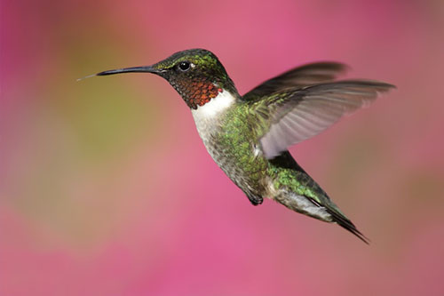
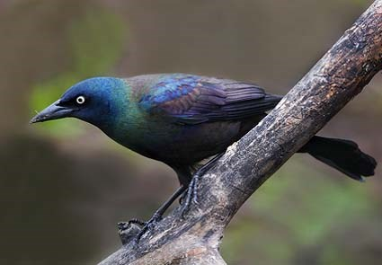
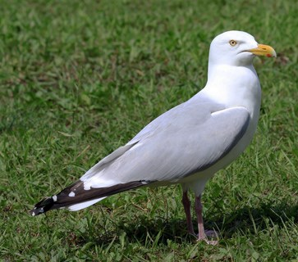
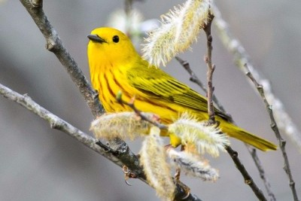
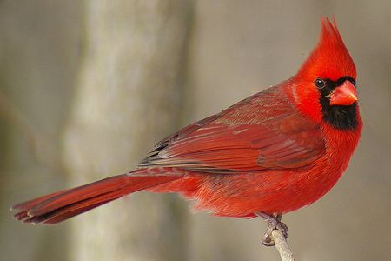
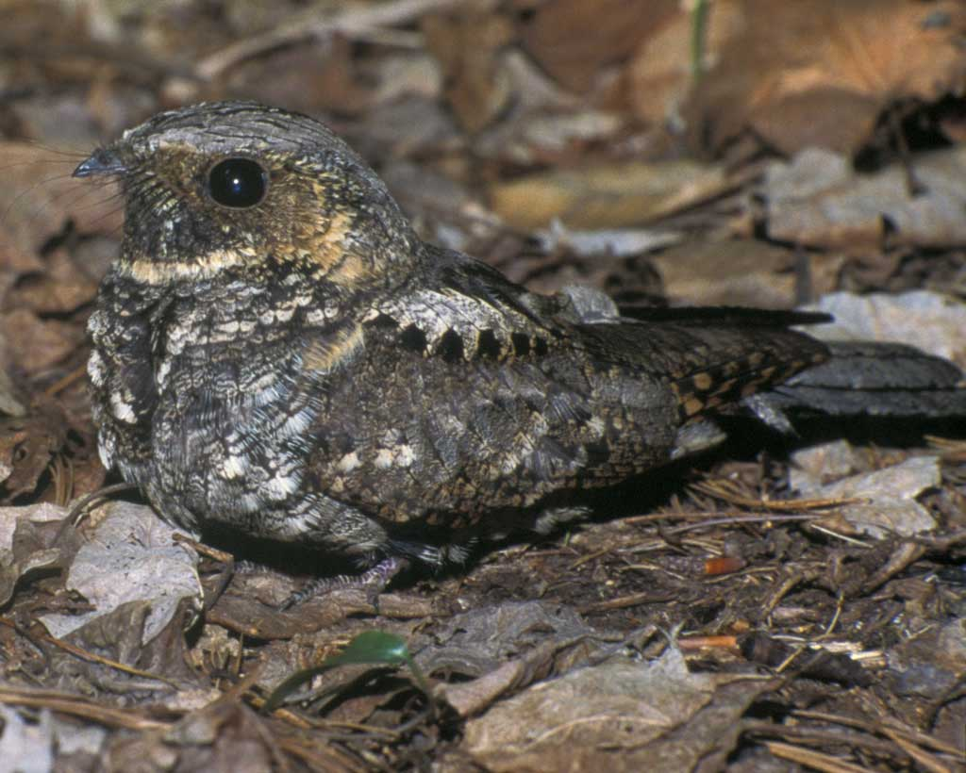
What makes a bird a bird?
Notes:
What makes birds different from other animals? Ask students to make some observations and offer ideas.

Slide 3
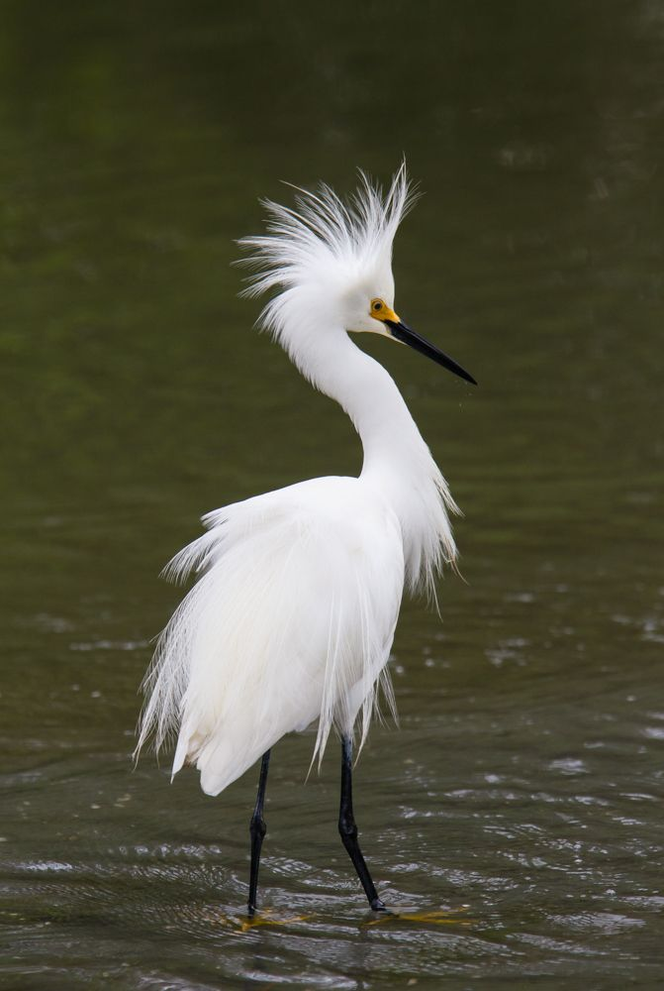
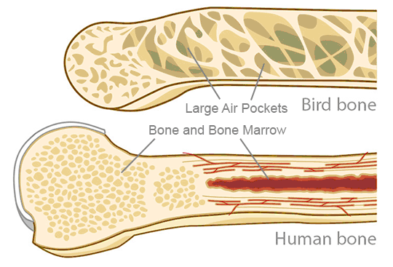
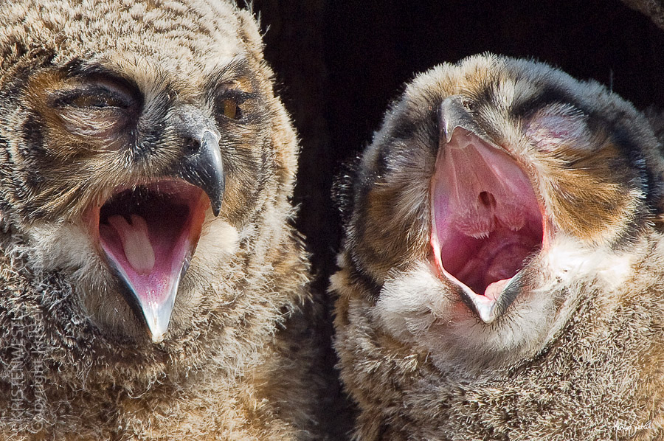
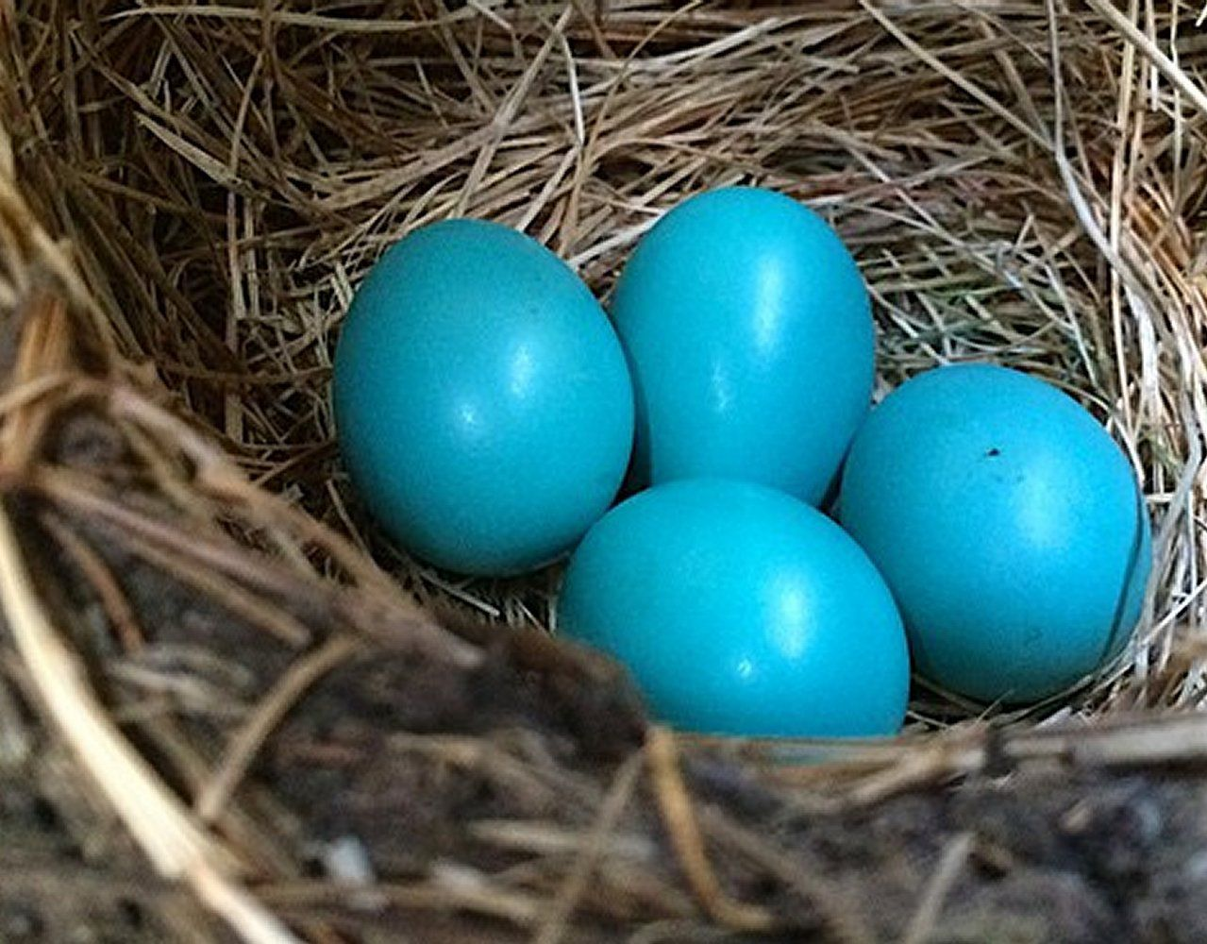
What makes a bird a bird?
Birds have feathers
Birds lay eggs
Birds are warm-blooded
Birds don’t have teeth
Birds have hollow bones
Notes:
Birds’ bones are partially hollow. They contain an internal lattice of bone that creates air pockets, resulting in a lightweight skeleton, perfect for flying. Birds don’t have teeth because teeth are heavy! They evolved different beak shapes to eat lots of different things without teeth, which further reduces their weight for flight. Birds also create their own body heat, just like mammals.

Slide 4
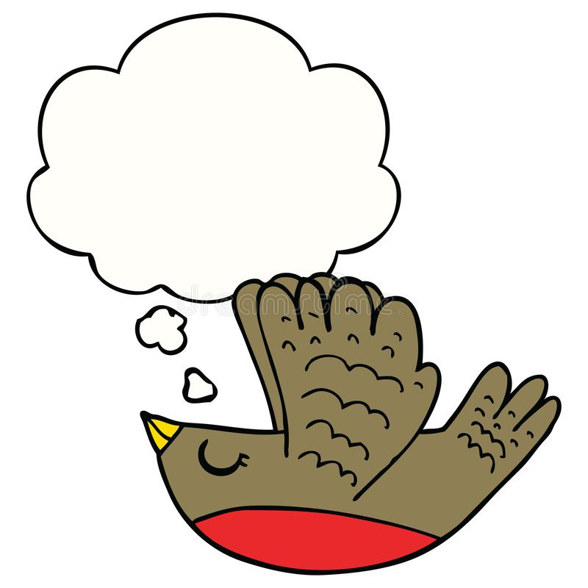
Why do birds
have feathers?
(Other than flying)
Notes:
Ask students to come up with some different ideas other than flying...

Slide 5
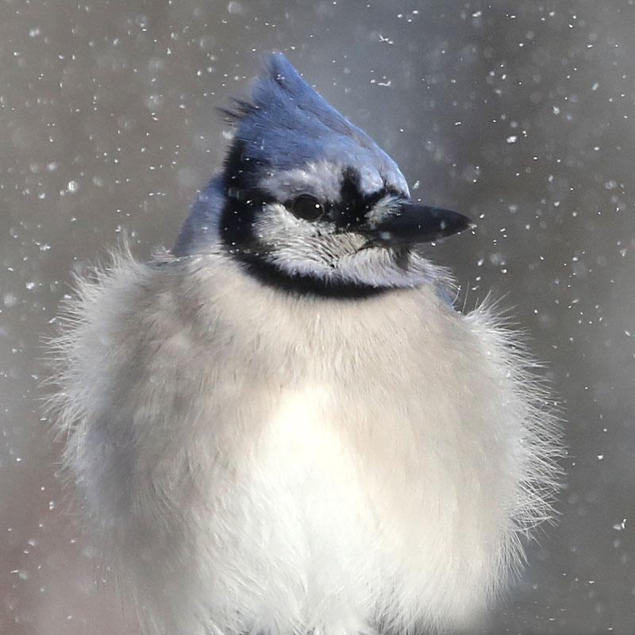
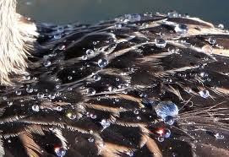
To stay warm and dry!
Notes:
Semiplumes and down feathers are very fluffy, which traps a lot of air close to the bird’s body, keeping it warm in cold weather. The outer body feathers (contour, wing, and tail feathers) are stiff and structured, which keeps water from seeping towards the rest of the body. Birds also preen their feathers, spreading oils through them with their beaks to clean, rezip, and waterproof them. Waterfowl have the most impressive waterproofing adaptations, perfect for life in the wetlands.

Slide 6
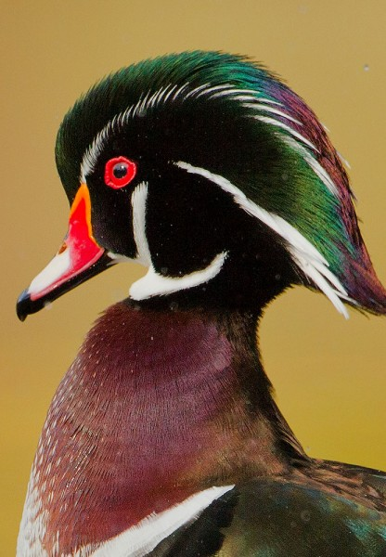
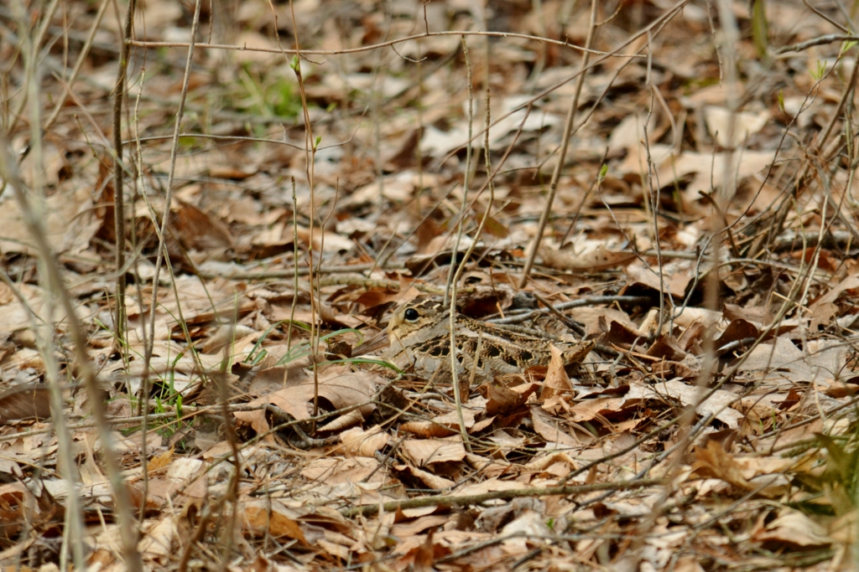
To get attention...or not!
Do you see a bird here?
Notes:
In many species of birds, the males are brighter and more colorful than the females. They use their colorful appearance to look their best to attract a mate. Many birds use their feathers in elaborate displays, dances, and annual rituals to say, “Look at me! I’m the best!” Most of the time, females are much less colorful, which helps them to attract less attention and avoid predators while they are sitting on their nest or looking for food for their chicks. Some species are incredibly good at camouflaging, especially birds that nest on the ground, like the American woodcock, hiding in the picture to the right.

Slide 7
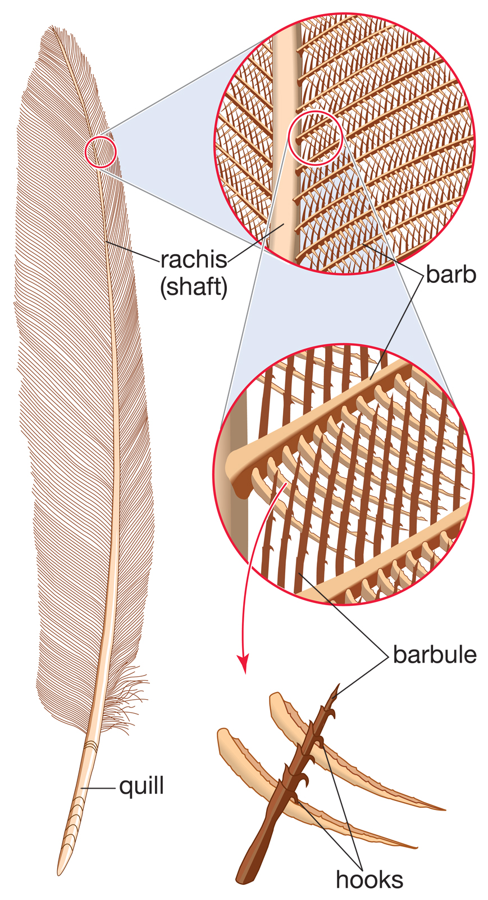
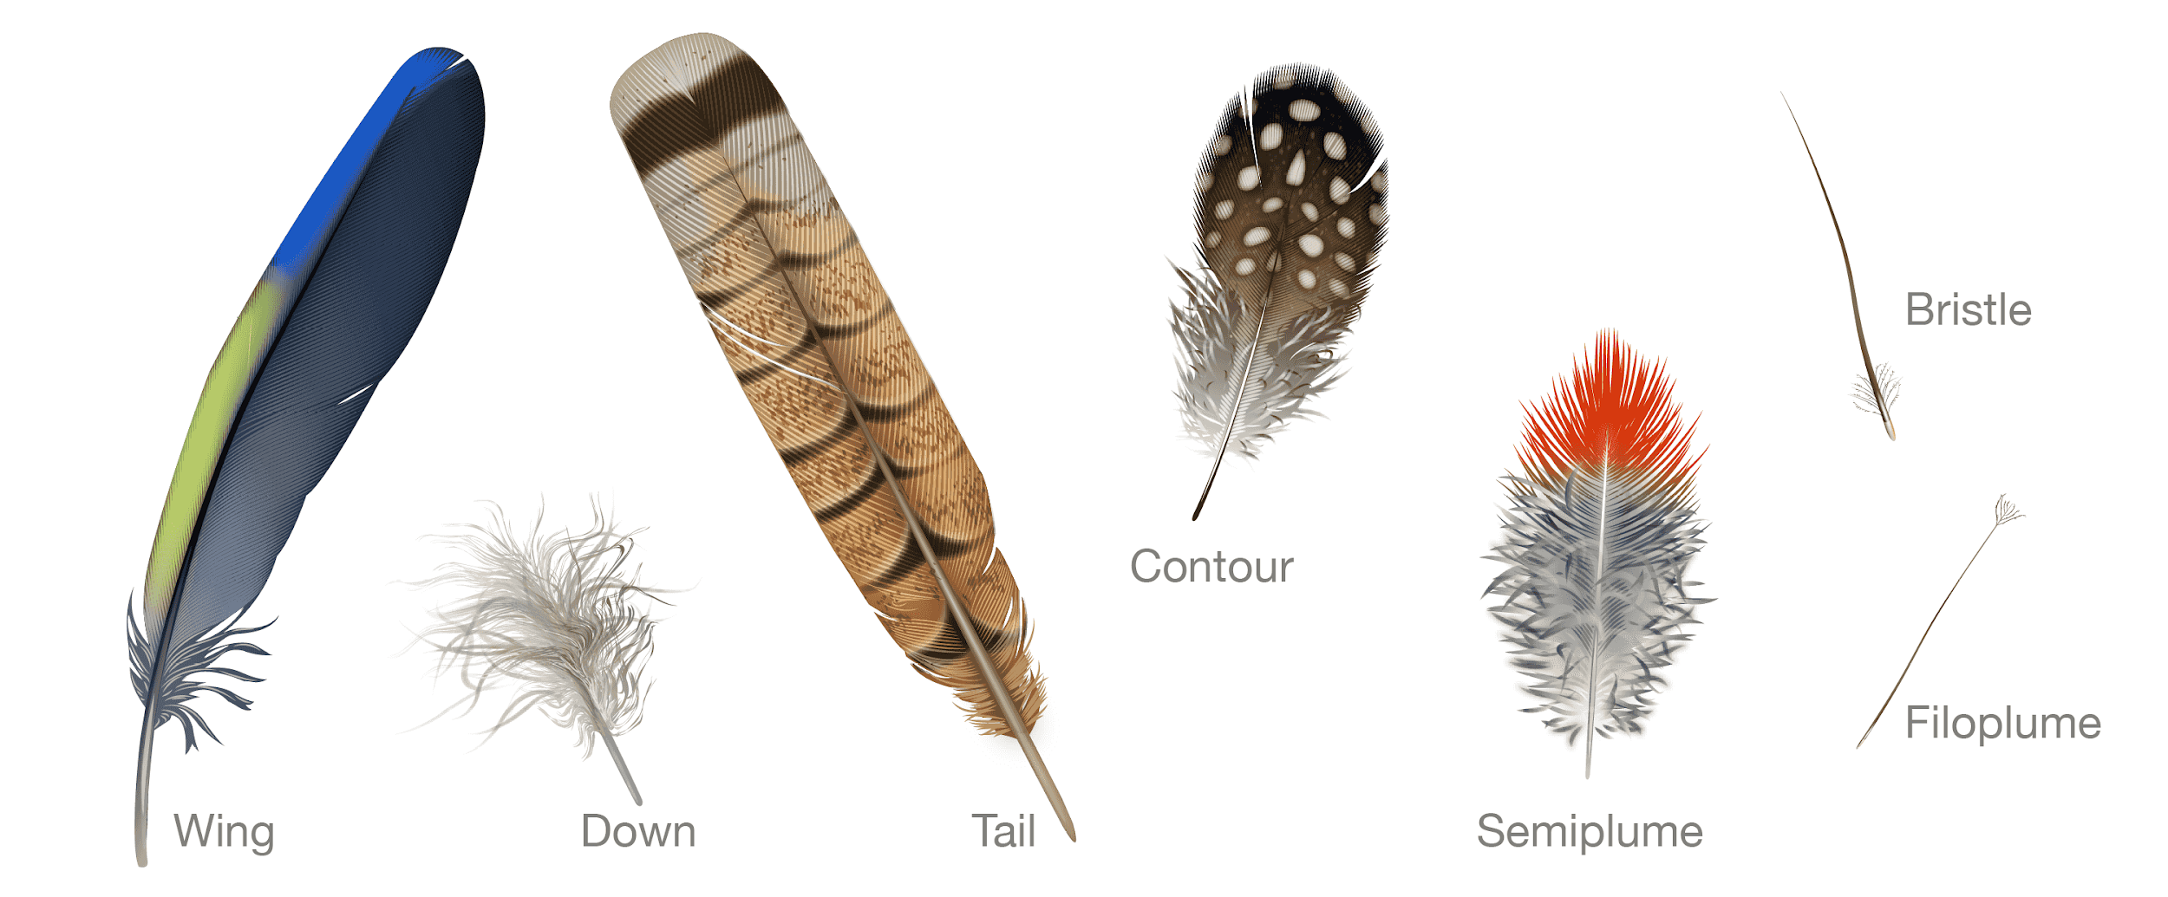
Different shapes for different jobs
Notes:
If you zoom way in on a feather, you can see that there are tiny hooks that connect together, helping the feathers stay “zipped” up. Think of how velcro sticks together, with all of the little hooks and fibers linking up! All feathers are not the same. Depending on where they are on the bird’s body, the feathers have different shapes, sizes, and textures, but essentially have the same structure of a quill at the end (attached to the bird’s skin), a rachis (shaft) in the middle, with barbs, barbules, and hooks.
Wing feathers are stiff and asymmetrical, which give birds lift and make them more aerodynamic.
Down feathers are loose and fluffy, and are located underneath the rest of the feathers, closest to the body. These keep the bird warm.
Tail feathers are symmetrical, and stiff like flight feathers. They act like a rudder, steering and slowing the bird while flying.
Contour feathers are the outer body feathers, and give a bird their overall shape.
Semiplumes are looser and fluffier than contour feathers, but not as loose as down. They act as the first layer of insulation underneath the outer feathers, but not as close to the body as down.
Bristles are usually found on a bird’s head/face, and can help protect the bird’s eyes/face.
Filoplumes act like whiskers, helping the bird sense the position of its other feathers.
For LOTS of info about feather structure, function, and evolution, visit: https://academy.allaboutbirds.org/feathers-article/

Slide 8
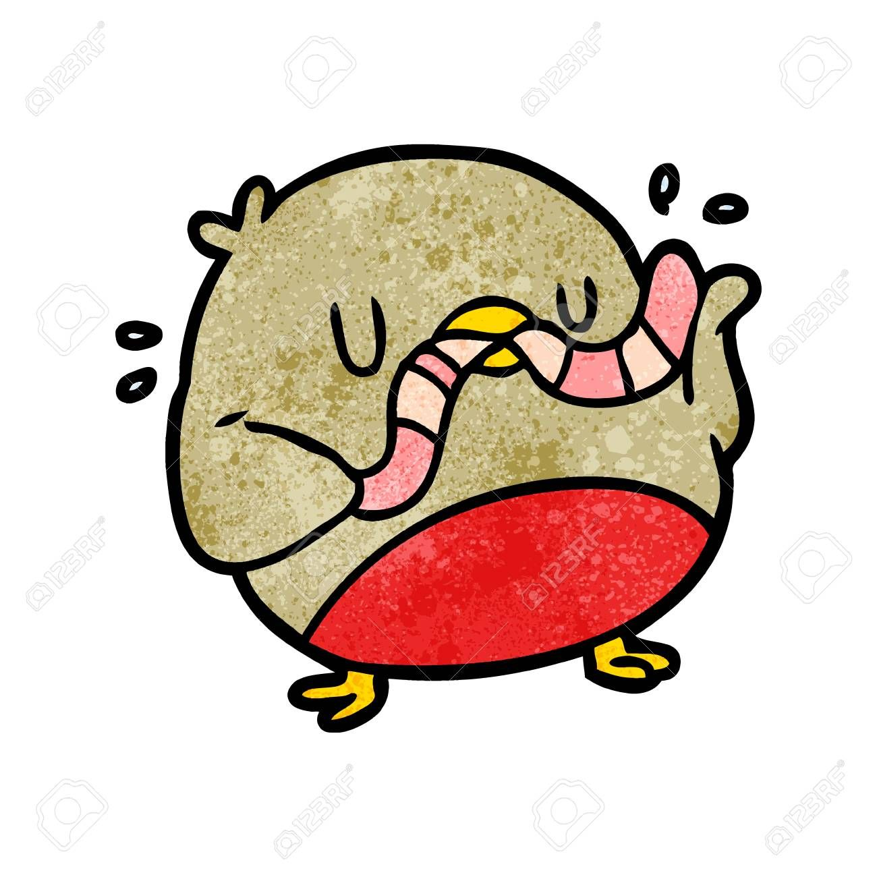
What do
birds eat?
Notes:
Ask students to come up with a list of things that birds eat. Encourage them to think about ALL sorts of birds, not just the ones that come to the backyard bird feeder.

Slide 9
All sorts of things!
Seeds
Bugs
Plants
Fish
Small mammals
Other birds
Dead animals (carrion)
Shellfish
Fruit
Flower nectar
Eggs
Snakes
Frogs

Slide 10
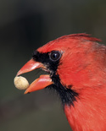
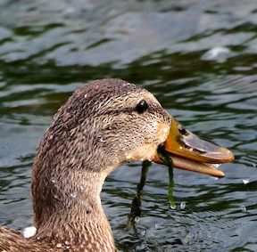
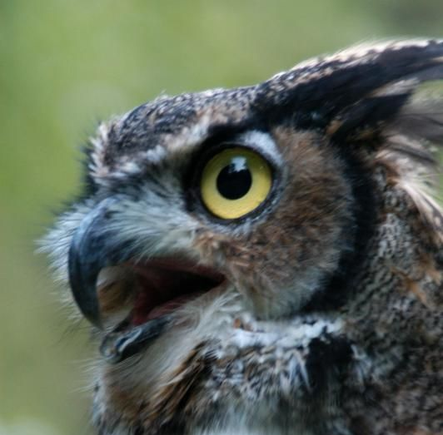
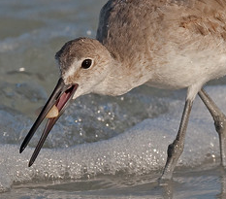
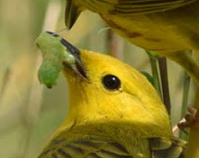
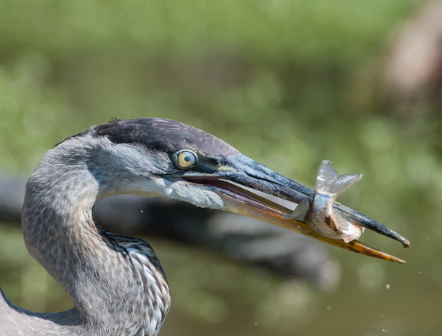
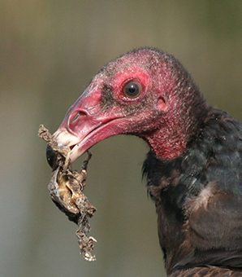
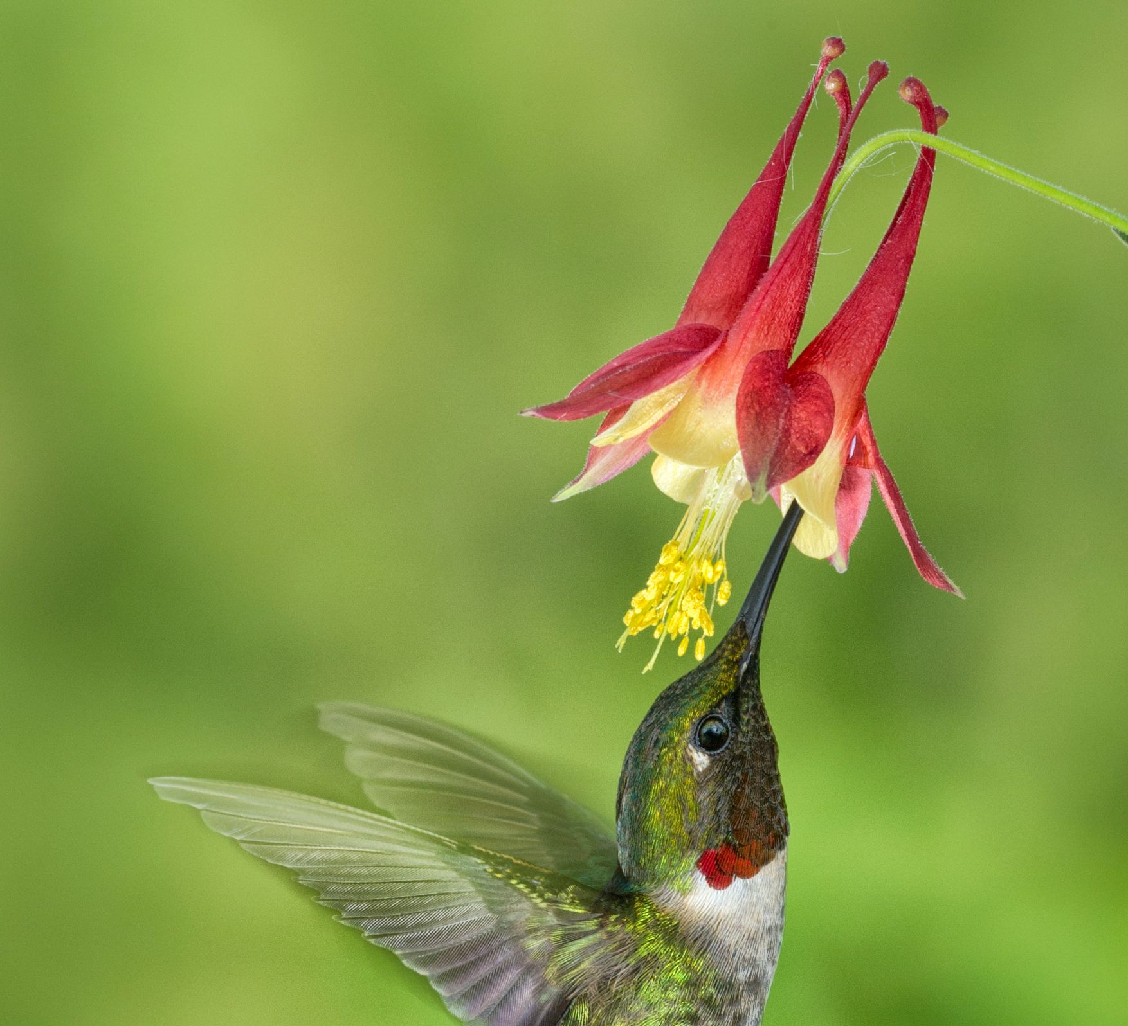
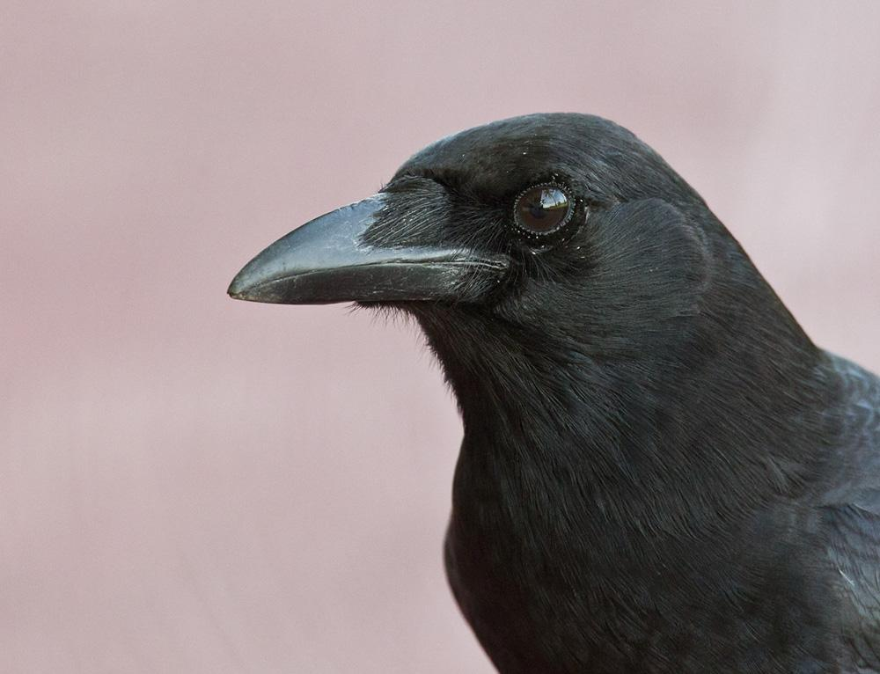
It all depends on their beak shape!
Northern Cardinal
Great Horned Owl
Mallard
Yellow Warbler
Willet
Great Blue Heron
Turkey Vulture
Ruby-throated Hummingbird
American Crow
Notes:
Birds do not have teeth. What they eat depends on their beak adaptations.
Top row, left to right:
Northern Cardinal - wide, short beak for crushing seeds
Yellow Warbler - thin, tweezer-like beak for picking up insects
Willet - Long, straight beak for probing in shallow water/beach sand for small invertebrates/tiny clams
Mallard - Wide beak with ridges inside for straining through mud for plants, aquatic seeds, and small critters
Great Horned Owl - sharp, hooked beak for catching mice, squirrels, and rabbits
Bottom row, left to right:
Great Blue Heron - long, spear-like beak for catching fish, frogs, snakes, and small mammals
Turkey vulture - smaller, sharp beak for picking/scavenging at carrion
Ruby-throated Hummingbird - tiny, thin beak for sipping nectar from flowers
American Crow - generalist (eats everything), beak is a good shape to eat a variety of things (think of this as the Swiss Army knife of the bird world!)

Slide 11
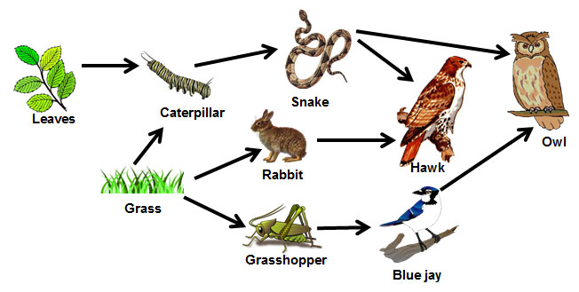

A niche is an animal’s job in the environment!
Notes:
A niche is an animal’s role, or job, in the environment. Each animal has a special role to play in a healthy ecosystem. In the food web on the left, birds are the predators, eating rabbits, snakes, and grasshoppers. This is a really simple representation, but it shows how animals interact in the environment. All of these niches fit together like puzzle pieces. Each individual piece uniquely fits into the big picture. If you’re missing a piece, then the puzzle is incomplete, and has ragged edges or holes in the middle. A healthy ecosystem is one where the niches remain in balance and function together.

Slide 12
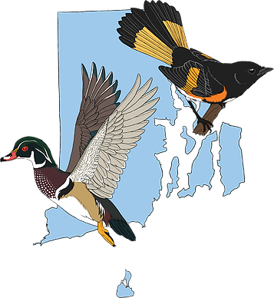
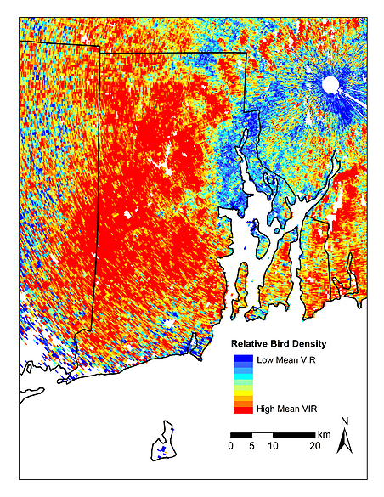
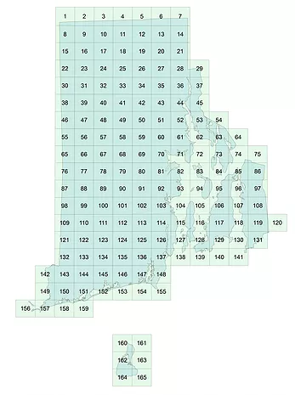
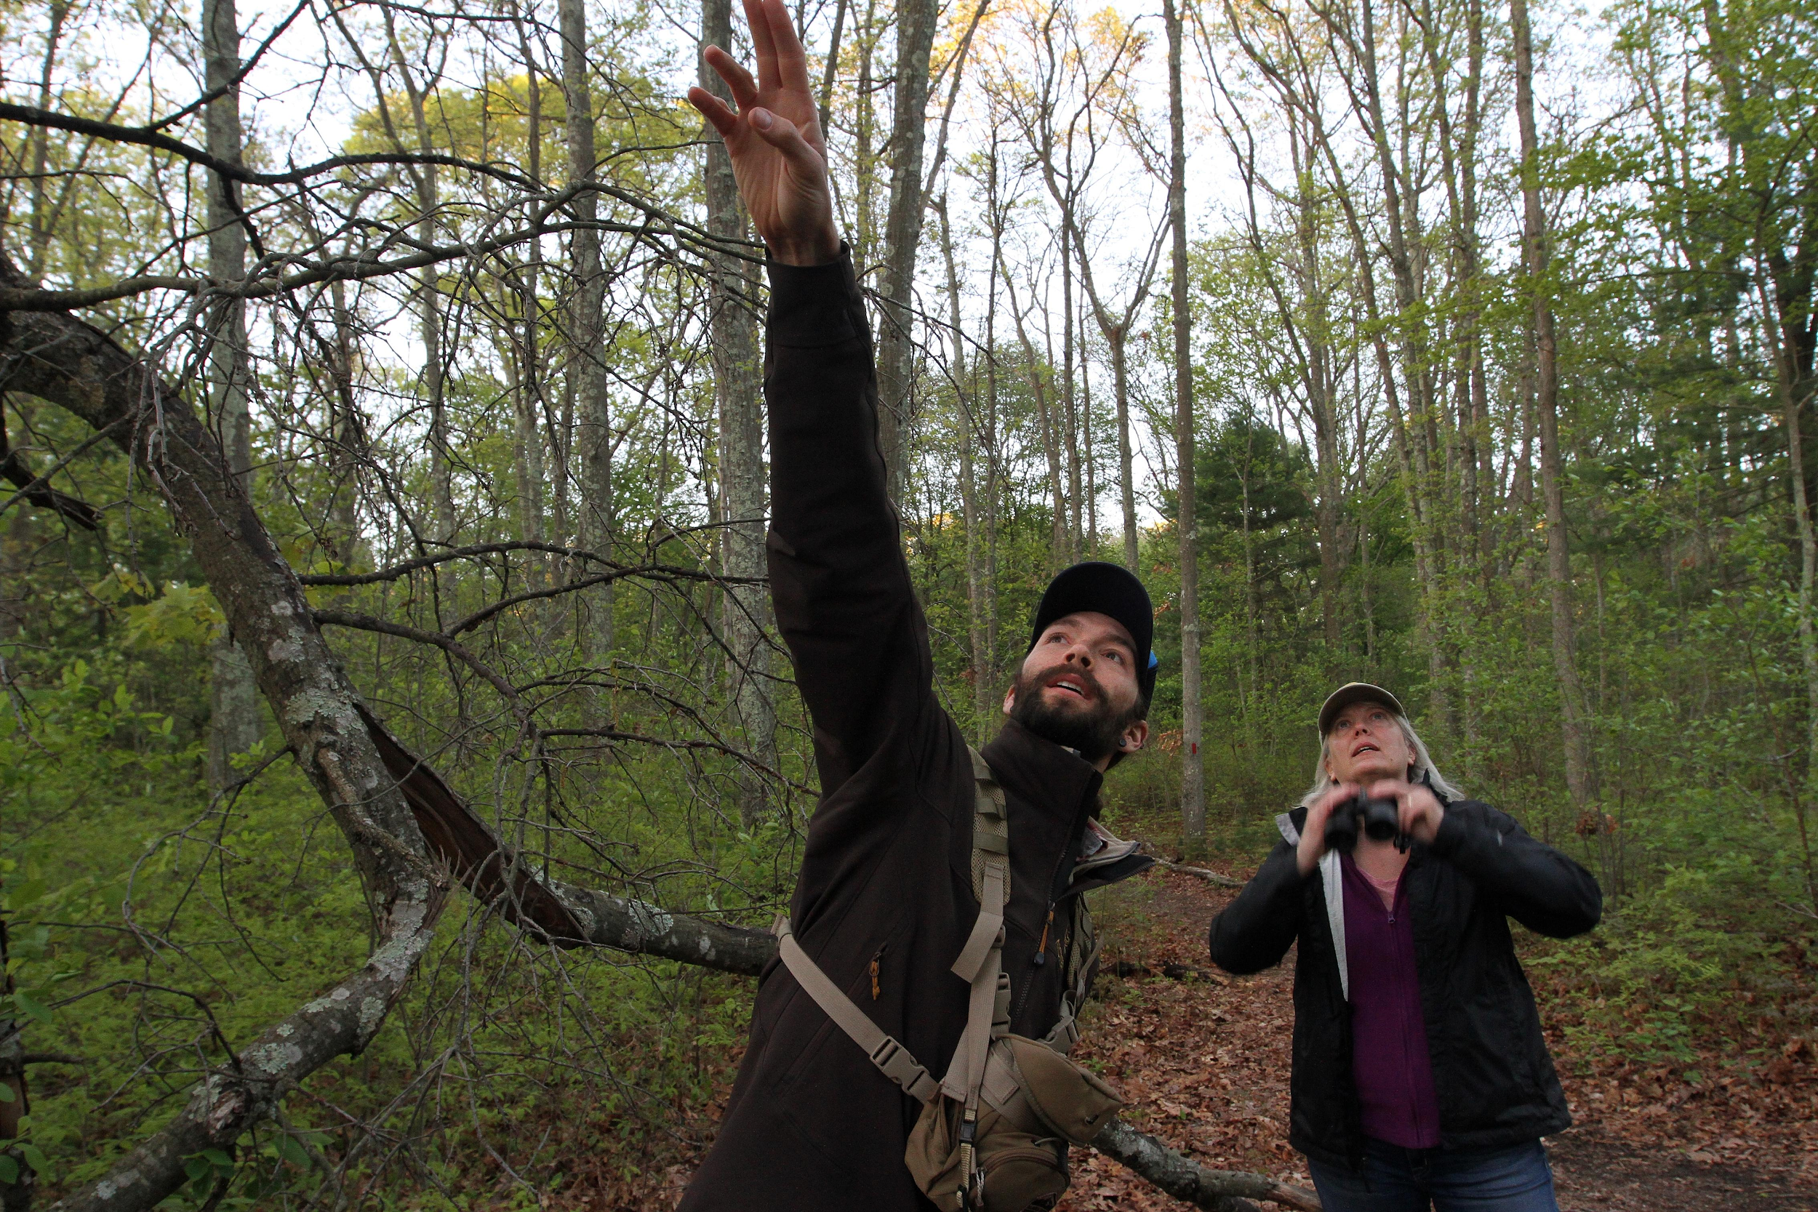
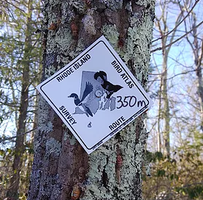
Rhode Island Bird Atlas 2.0 !
Notes:
What is the RI Bird Atlas 2.0?
This is a four year long project (2015-2019) run by the RI DFW in collaboration with URI and over 200 volunteers. The purpose of this project was to document all of the bird species in Rhode Island, and where they occur in the state. To do this, the state was split into 165 blocks, and volunteers were assigned to each block to collect data. This is the second bird atlas Rhode Island has produced; the first atlas ran from 1982-1987. Rhode Island’s habitats and bird populations have changed since then, so it was time to update our data!
What have we learned from the RI Bird Atlas 2.0?
The completion of this second bird atlas is very exciting, because we now have information on Rhode Island’s breeding birds, but also information about spring and fall migration, and winter birds. In this case, Rhode Island’s small size works to its advantage. Volunteers were able to cover the entire state and collect an enormous amount of data, making this the most complete and comprehensive bird atlas ever completed! The breeding atlas confirmed 173 breeding species in the state; across the breeding, migration, and winter atlases, a total of 242 species were documented in Rhode Island. The data for each species has three maps: presence/absence in each block, where each species has been confirmed breeding, and the hotspots for each species (where they seem to congregate the most). We also have information about the most important habitats for each species.
How will this help birds in Rhode Island?
Knowing all this information will help RI DFW make informed habitat management decisions with birds in mind. Knowing the hotspots for each species can guide our land conservation strategies. For example, if there is an opportunity to purchase and conserve land for the Management Area system, it will be useful to know the areas that are critically important for RI’s bird Species of Greatest Conservation Need. This data will also be available to the public, to be used by town land trusts and non-profit organizations for the benefit of birds on their properties. In short, the more we know, the better we can help RI’s amazing array of birds!
Photos (left to right):
The logo for the RI Bird Atlas 2.0, featuring a wood duck and an American redstart
Bird Atlas Coordinator, Charles Clarkson, points out a bird to DEM Director, Janet Coit
A map of Rhode Island, showing the 165 survey blocks.
A radar map of Rhode Island during peak bird migration time. The red portion of the map shows the high density of migrating birds passing through Rhode Island’s habitats. (Yes, birds can get picked up on radar!) Rhode Island is an important place year-round for birds, and offers valuable stopover (rest) sites for migrating birds. Many birds like to migrate along the coast, so Rhode Island’s coastal habitats, as well as our forests, are very important!
A marker along a transect for a Bird Atlas survey. As part of the data collection process, volunteers stopped at intervals along selected trails to look and listen for birds.

