Slide 1
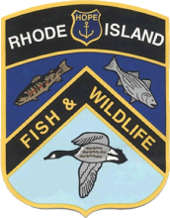
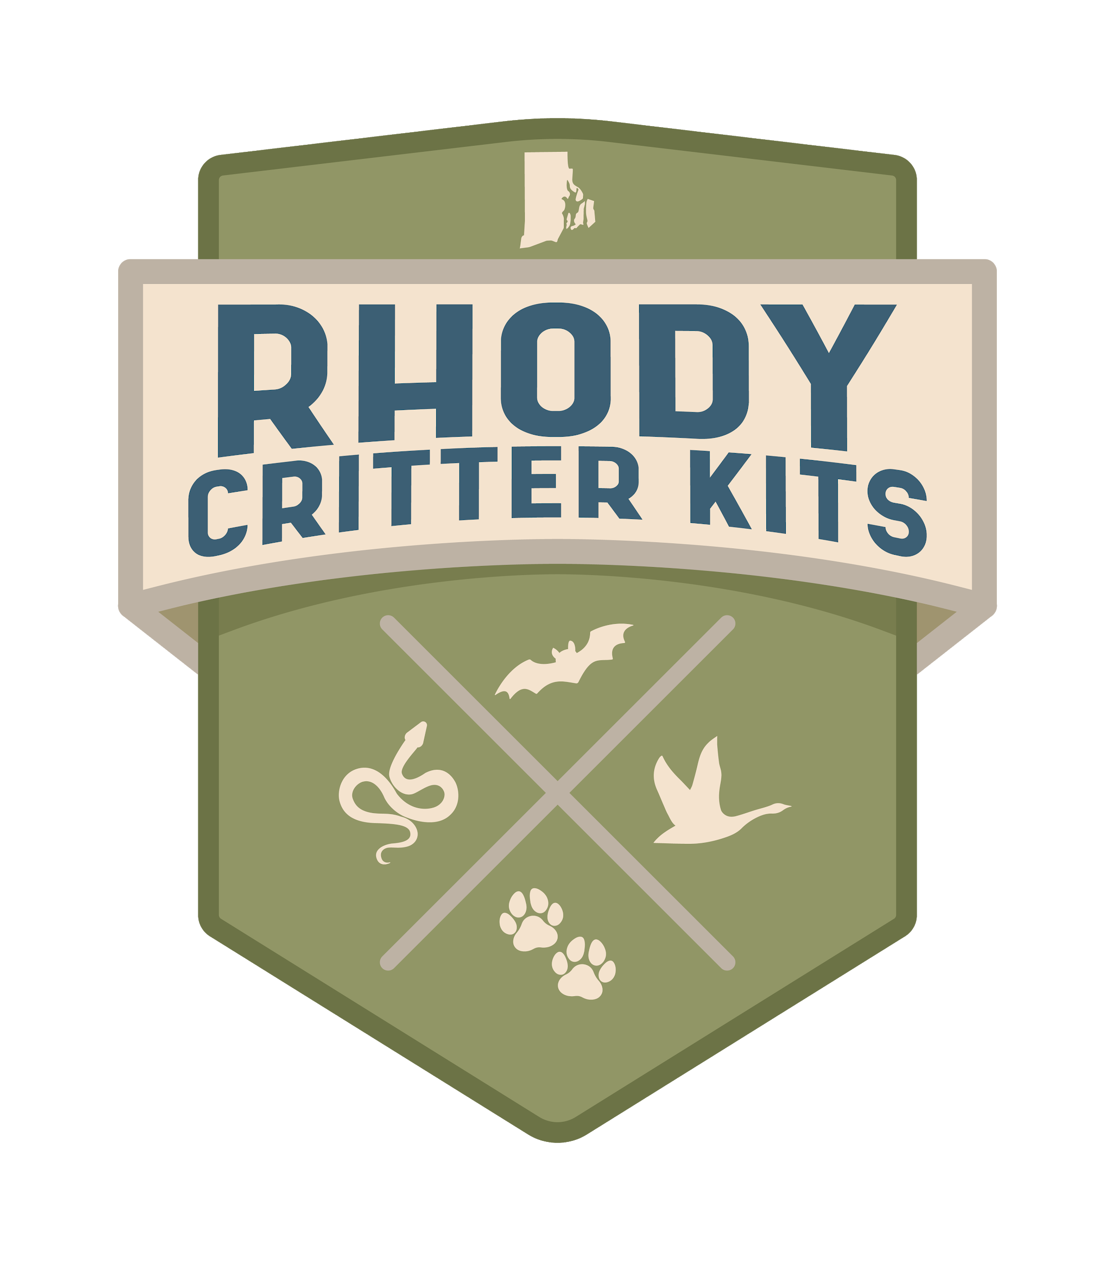

Bird Conservation History

Slide 2
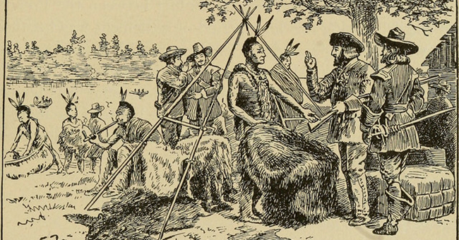
Early America → Lots of open space and wildlife
Notes:
Prior to Europeans’ arrival in America, the Native Americans hunted, trapped, and fished for survival. Wildlife was abundant, and habitats were relatively undisturbed. Native Americans did farm for food as well, and there is evidence that some tribes burned sections of habitat to manage the landscape. When the Europeans arrived, they saw a land of plenty! They thought that wildlife and land resources were endless, and hunted, trapped, and fished without worries for the future. They traded with the Native Americans and shipped a lot of furs back to Europe to sell. More and more people arrived from Europe, and more habitat was disturbed to create farmland. People continued to hunt, fish, and trap without any sort of rules or limits.

Slide 3
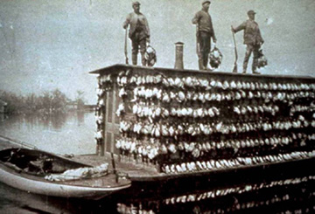
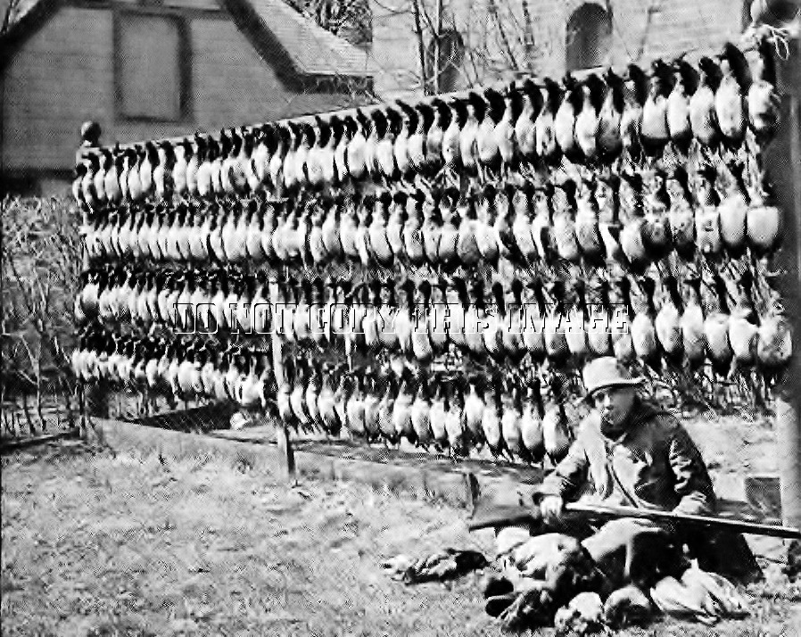
Market Hunting of the late 1800s to early 1900s
Notes:
Due to a lack of hunting regulations, hunting ducks for a living became a popular profession. Hunters would go out into wetlands and coastal areas to harvest 50-100 ducks each day to sell at markets for food. This method of hunting, while efficient in feeding people, was immensely unsustainable, and resulted in severe declines of waterfowl species across America. It is important to note that today’s hunting practices are designed to conserve our game populations and enable them to thrive, with limits on the number of animals harvested, the seasons we can harvest them, and conservation projects to help conserve important wildlife habitat.
For an interesting and detailed read on the history of market hunting in America, check out this article from Ducks Unlimited, one of the Division of Fish and Wildlife’s conservation partners: https://www.ducks.org/hunting/duck-hunting-stories/ducks-for-sale

Slide 4

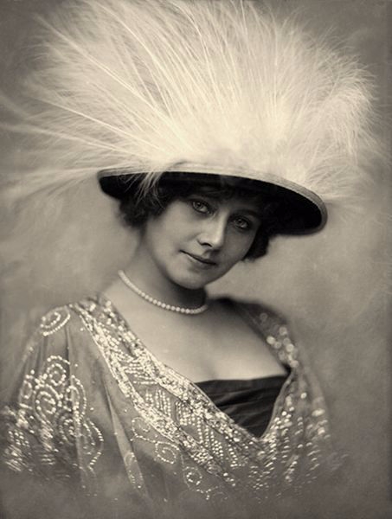
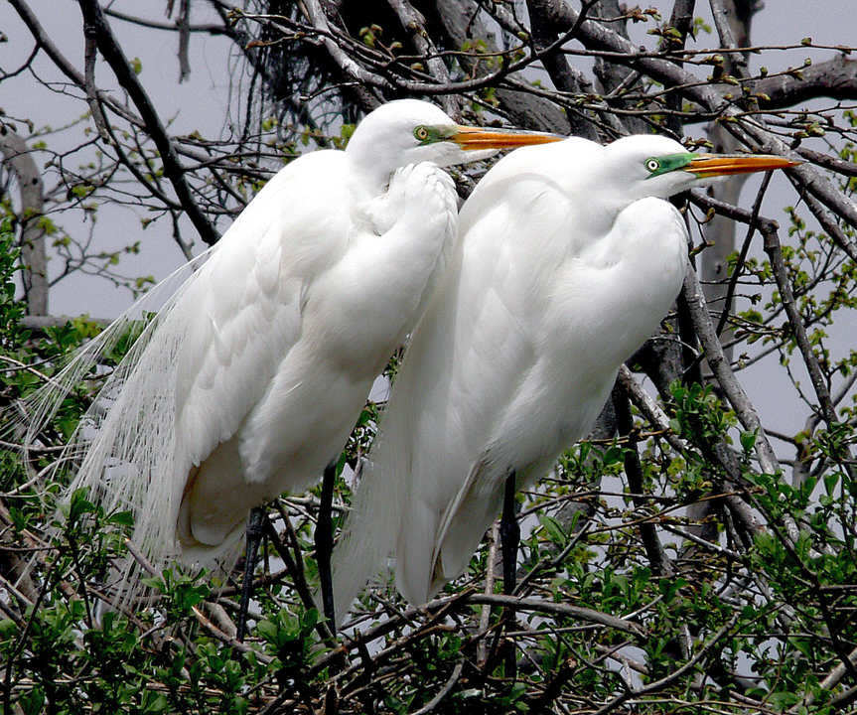
All sorts of birds were being killed in large numbers to decorate hats.
The Migratory Bird Treaty Act of 1918 put a stop to market hunting and the hat trade!
Notes:
Birds were killed in the millions to meet the demands of the fashion industry. Many different bird species suffered population declines because of this practice. Colonial nesting birds such as great egrets (pictured in the slide), gulls, terns, and herons were heavily targeted for their beautiful feathers, and also for the harvest of their eggs. These birds were easy to target because they nested in large groups, and in the case of gulls and terns, nests were located on the ground. Many Americans began to worry about the ethical and environmental consequences of this industry. The catalyst for the end of killing birds for the hat trade was the formation of state Audubon societies by women against this exploitation of wild birds (Massachusetts Audubon formed in 1896 --900 members!).
The Migratory Bird Treaty Act (1918) made it illegal to take, possess, import, export, transport, sell, purchase, barter, or offer for sale/purchase/barter any migratory birds, bird parts, nests, or eggs. Exceptions to this Act include the harvest of game birds (waterfowl, turkey, etc.) during defined, regulated hunting seasons (with limits on how many birds each hunter can harvest), handling birds for scientific research, and the use of feathers in Native American religious practices. This act also includes Mexico, Canada, Russia, and Japan. Migratory birds don’t know the difference between countries, and don’t follow a human-made map! Many of our birds from New England spend their winter in Central and South America. Some birds from the West Coast and Alaska fly across the Pacific. Some birds spend their summer in Canada and winter in New England. It makes sense that countries should work together towards bird conservation because we share birds!
Because of the Migratory Bird Treaty Act, both game and non-game bird populations have made an incredible comeback in Rhode Island and across America!

Slide 5
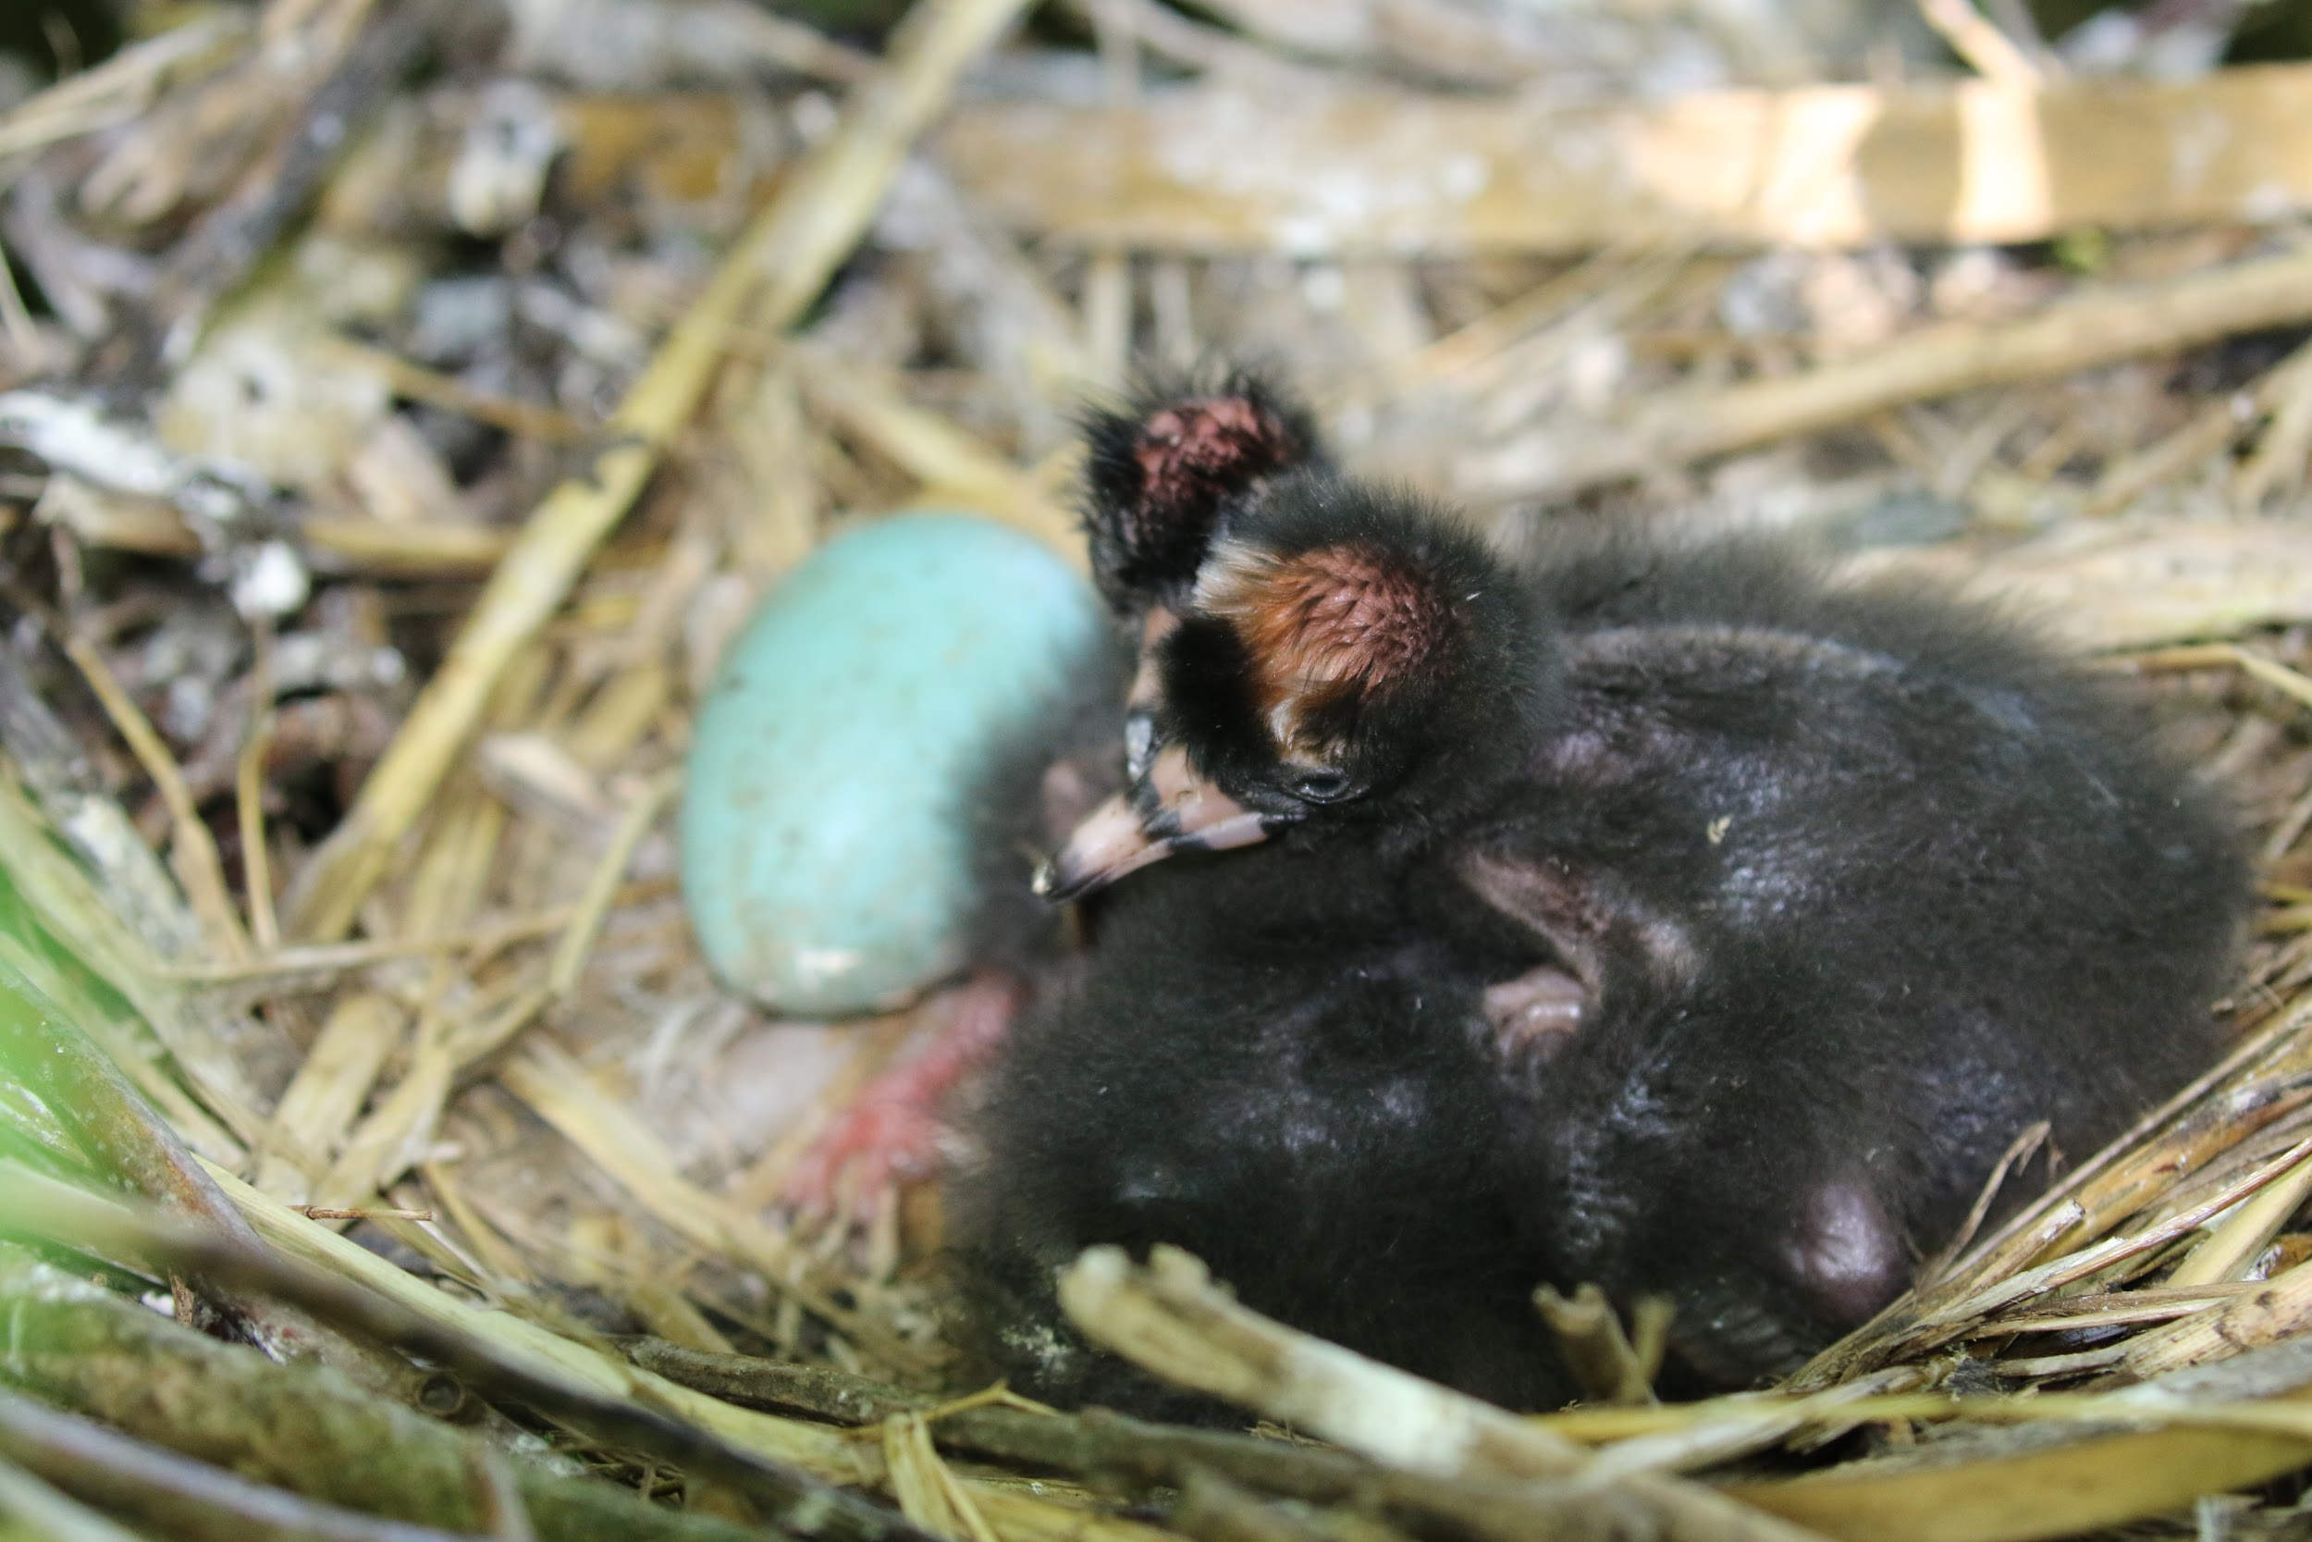
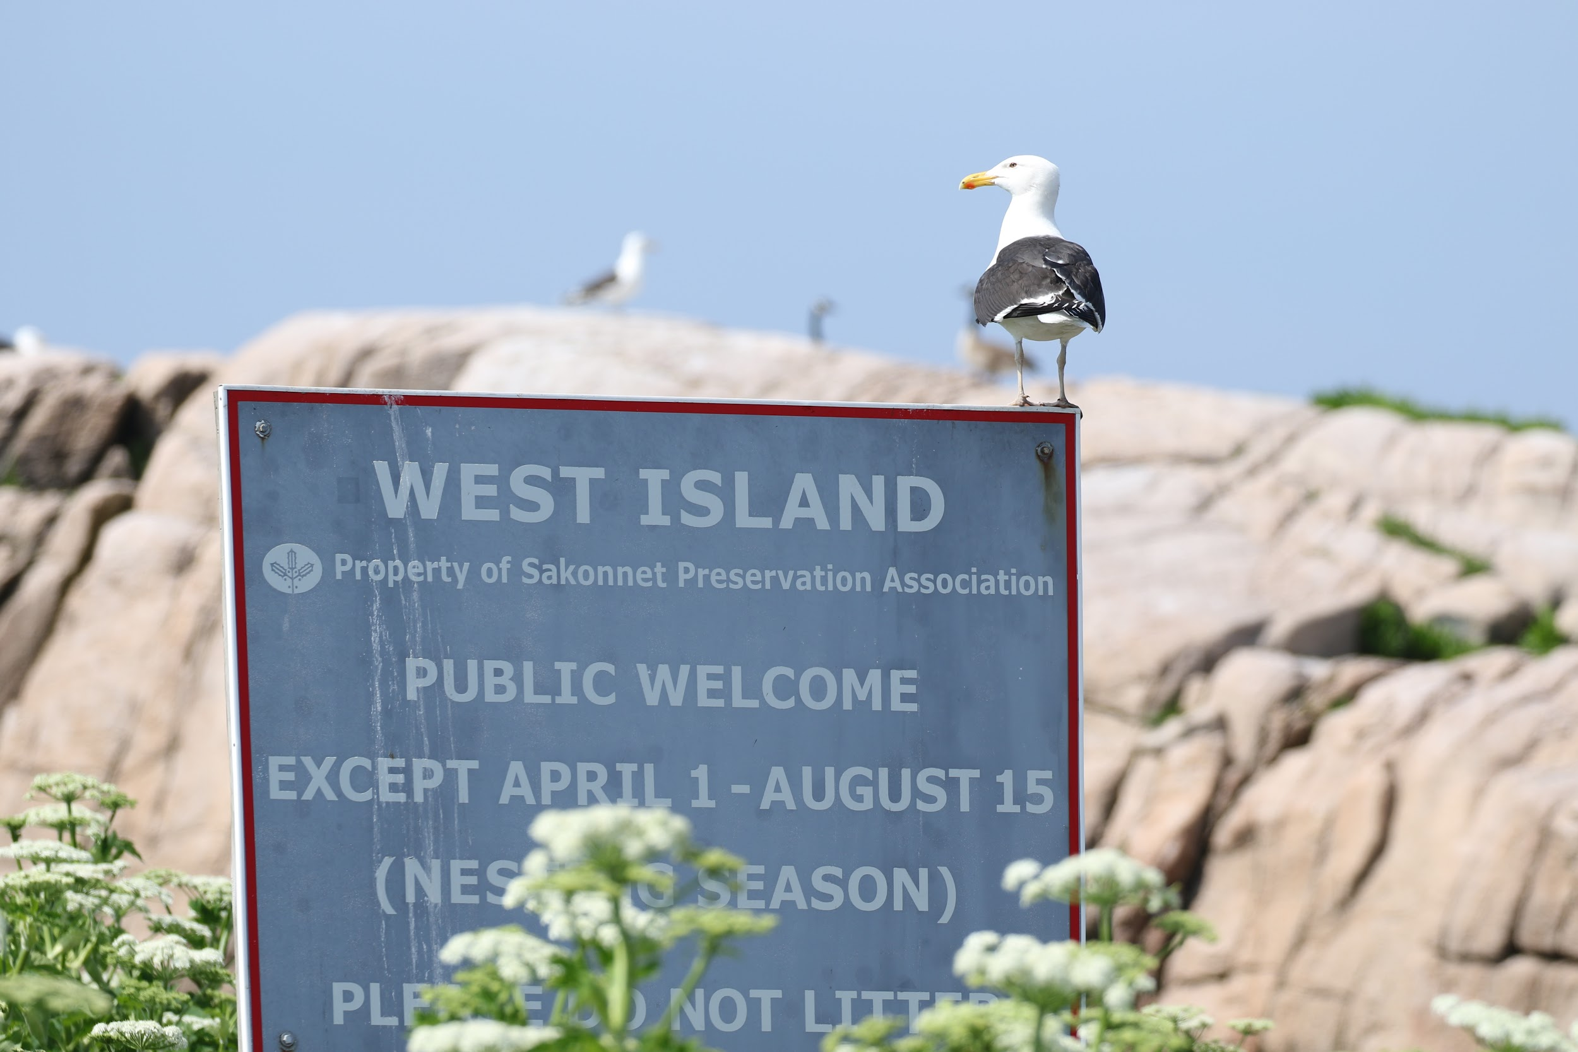
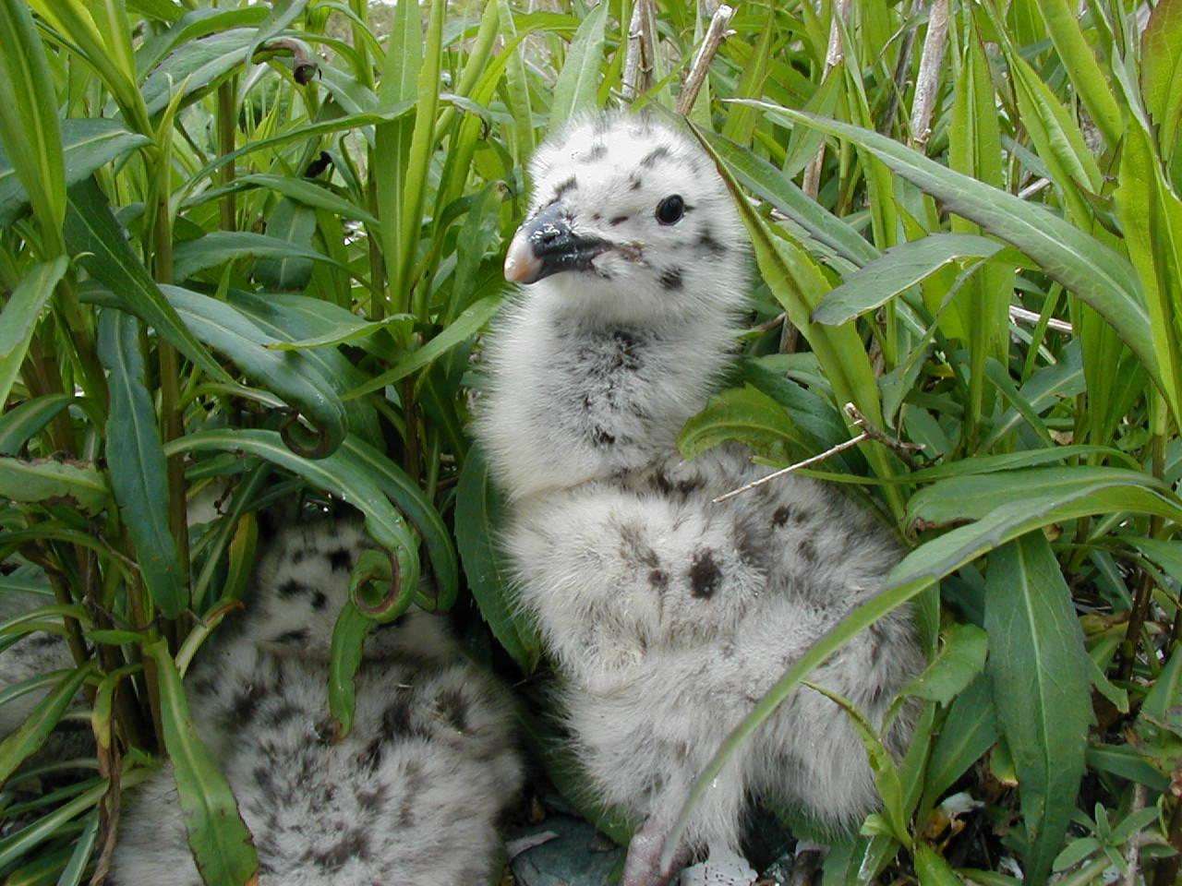
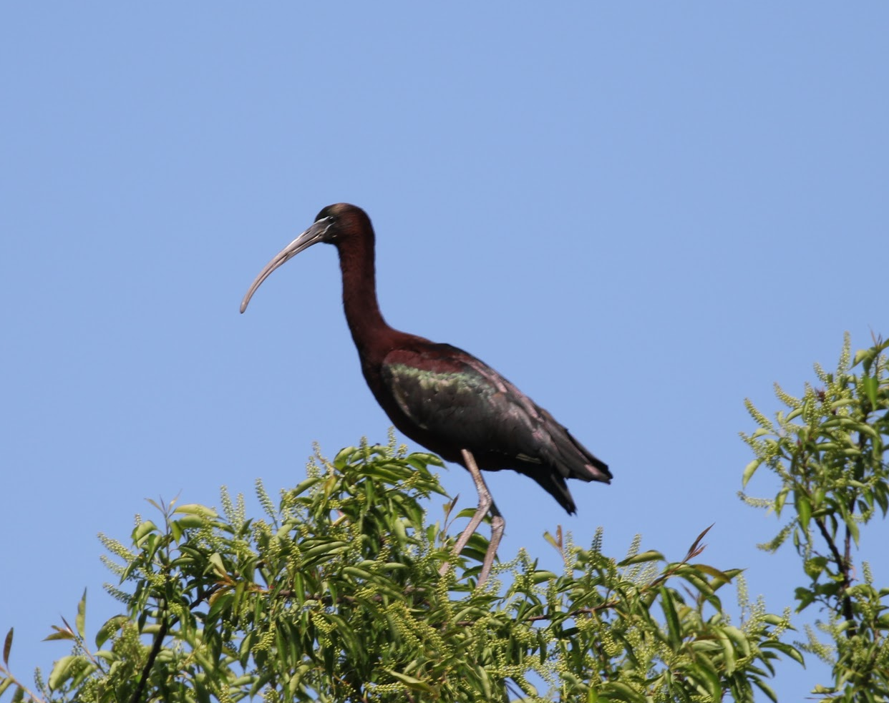
Today, we keep an eye on these birds!
Notes:
What is a colonial nesting bird?
A colonial nesting bird is any species of bird that nests in groups. In Rhode Island, we especially focus on colonial waterbirds. These are birds that nest in groups (or colonies) along the coast or on islands. Shorebirds, like plovers and oystercatchers, are territorial, solitary nesters. They do not share their nesting space with other birds of the same species, so their nests are generally hundreds of feet apart or more. There are a few benefits to this strategy: they don’t have to share their resources (like food) with other families and can rely on camouflage to avoid depredation of the nests and chicks. Conversely, colonial nesting waterbirds rely on numbers to avoid depredation. They also, like the shorebirds in Rhode Island, prefer nesting on islands which were historically separate from the mainland, and therefore less vulnerable to terrestrial predators. Examples of colonial waterbirds are gulls, cormorants, terns, and wading birds, like herons and egrets. By nesting in large groups, they overwhelm predators. If coyotes or crows make to the nesting colonies, these predators may eat some of the eggs, but they will fill up before they eat all of the eggs, so there will be many eggs and chicks that survive. Nesting in large numbers also allows colonial waterbirds to gang up on and harass predators within the colonies. Common terns are known for being especially vicious toward unwanted visitors, dive bombing, pecking, and pooping on intruders. Believe it or not, they have excellent aim!
How do we survey for these birds?
There are a few different strategies we use to survey these birds in Rhode Island. Least terns and cormorants are especially sensitive to disturbance. So we generally count the number of birds we see sitting on nests from a distance whenever possible. When we used to have colonies of several hundreds of birds, we also used a special strategy where we would estimate the total number: biologists select a small clump, count the number of nesting birds in that clump, and then count the number of clumps of that size within the colony. For common terns, gulls, and wading birds, biologists walk through the colony, marking the nests with popsicle sticks so that we can tell if we missed one or if one has already been counted.
Why are we gathering this information?
This information is gathered in Rhode Island and all along the Atlantic Coast of the United States so that we can monitor trends in the population. If we see obvious changes in the numbers of nesting birds or shifts in where birds are nesting along the coast, these become signals. The signals help us to address and research any environmental stressors which might be causing these changes. In some cases, these changes can also alert us to changes in the availability of fish or presence of environmental toxins. In these cases the birds become environmental indicators.
Photos (left to right):
Great black-backed gulls on West Island off Sakonnet Point. Many of the bay islands are closed to the public from April - August to minimize disturbance to the nesting birds.
A great black-backed gull chick
A glossy ibis nest with newly hatched chicks and one more egg to go
An adult glossy ibis

Slide 6
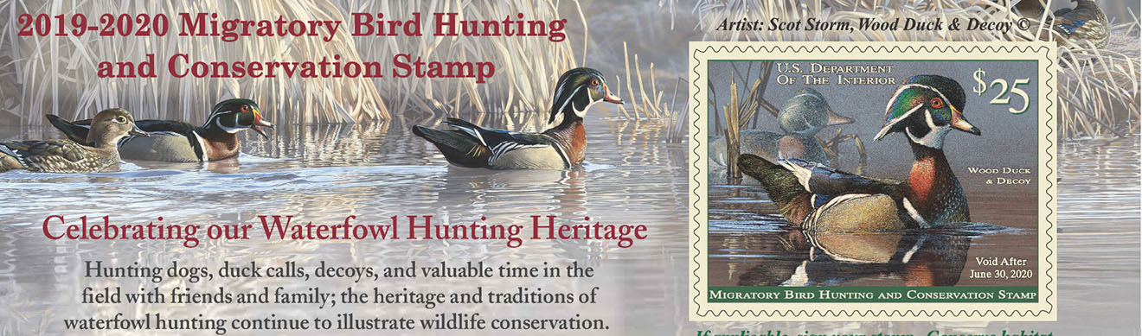
The Duck Stamp Act was signed in 1934.
Notes:
In the 1930s, the United States government made enormous strides in bird conservation legislation. In 1934, President Franklin D. Roosevelt signed the Duck Stamp Act. This act made it a requirement of all waterfowl hunters ages 16 and up to purchase a Federal Duck Stamp each year. The proceeds of Duck Stamp sales (98 cents out of every dollar), goes towards purchasing or leasing wetland habitat for the National Wildlife Refuge system. Professional artists submit their work each year to be selected for the Duck Stamp. There is also a Junior Duck Stamp program for young artists to submit their artwork for the State Duck Stamp. After winning the state competition, their artwork is submitted to the national Junior Duck Stamp competition. Proceeds from the sale of the Junior Duck Stamp go towards supporting this educational youth art program. In Rhode Island, waterfowl hunters are required to purchase both the Federal and State Duck Stamps. In its over 80 year history, the Federal Duck Stamp has contributed $800 million to habitat conservation across the country, protecting more than 5.7 million acres of wetland habitat! You don’t have to be a hunter to purchase a Duck Stamp; many people purchase them as collectors’ items, in appreciation for these miniature works of art.

Slide 7

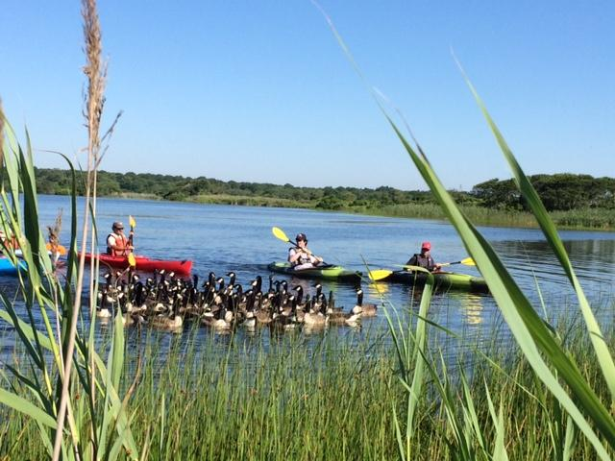
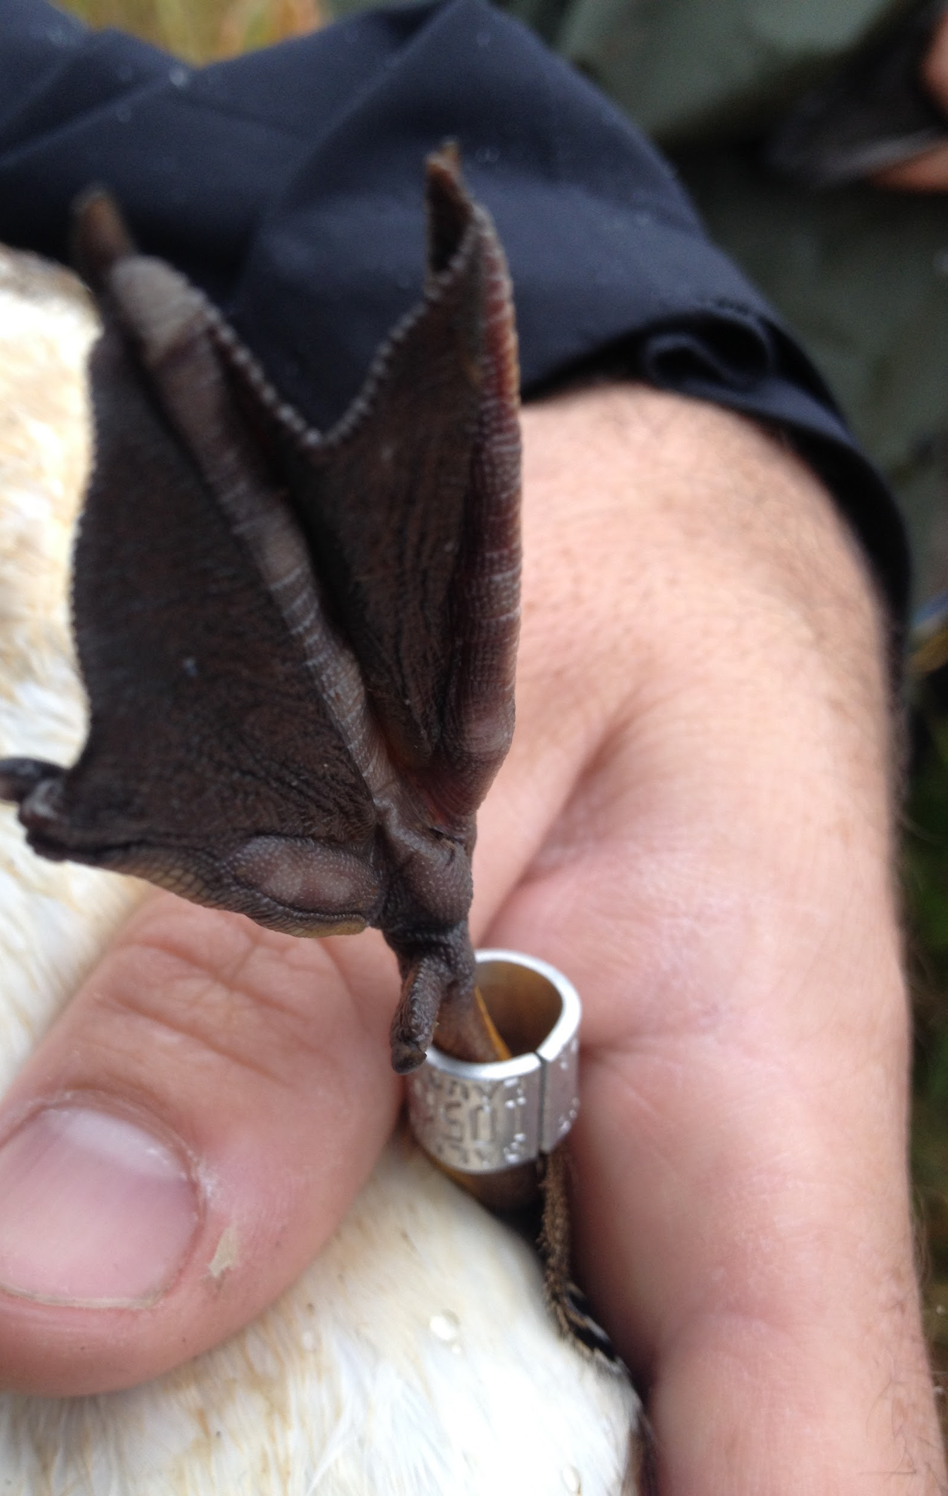
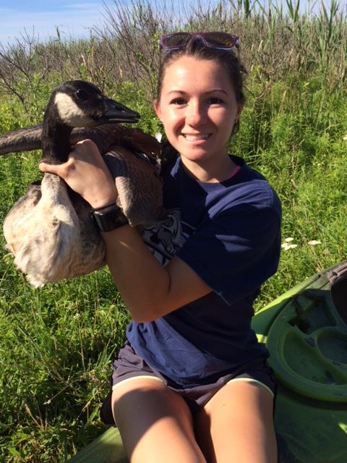
Annual Canada Goose Banding
We
Waterfowl!
Notes:
What is banding?
“Banding” is the term used to describe the capture, marking, and release of birds for scientific research. Birds are captured by biologists, and marked with a lightweight, aluminum band on their leg. Bird bands are made in different sizes appropriate for different groups of birds. They are designed to fit comfortably like a loose bracelet, and do not harm the bird. Each band manufactured has an individual and unique number on it that is registered with the United States Fish and Wildlife Service.
How do we band Canada geese in Rhode Island?
Canada goose banding happens during June and July. During this time, geese are molting their feathers, and are therefore flightless. Geese are herded by staff members paddling kayaks, and guided into a temporary pen. Data collection includes banding, determining the sex of the bird, and recording the bird’s age (hatch year or adult). We band geese all across the state for this project, in rural, suburban, and urban habitats. This project requires considerable staff time in the field, and requires the help of most of the staff.
We also band American black ducks during January and February. The ducks are captured before sunrise as they forage for food in coastal salt marshes. Biologists use a net that is fired above the flock with small rockets. Ducks are banded, and biologists determine their age and sex based on wing feather wear and beak color. Males have a bright yellow beak, and females have an olive-brown beak. The ducks are then released back onto the marsh. This is a very different field experience than goose banding. It is very cold out there on the marsh, at the crack of dawn!
Why do we band waterfowl?
Bird banding has a long and valuable history. Information gained through these efforts such as survival, number of offspring born, age, and sex distribution is used in models that guide the management and conservation of waterfowl. Hunters who harvest a banded bird are required to submit the band number to a database maintained by the United States Fish and Wildlife Service. This data helps us decide the length and timing of hunting seasons, and the number of birds each hunter is allowed to harvest (bag limit).
Photos (left to right):
A group of staff members and volunteers paddle in kayaks to round up the geese into a pen.
Say cheese! A goose is ready to be banded.
A completed leg band. Notice that the band is loose around the goose’s leg, so it will not cut into it or harm the goose.
*More photos of banding are located in the Photos and Videos folder of the Feathered Friends kit.

Slide 8
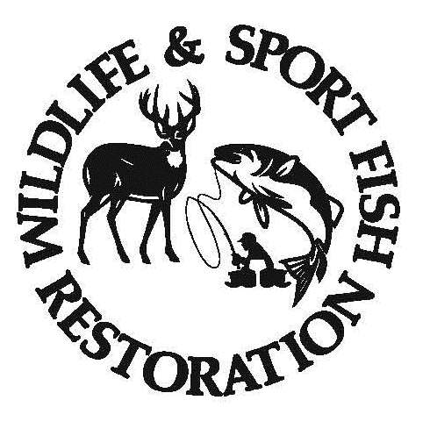
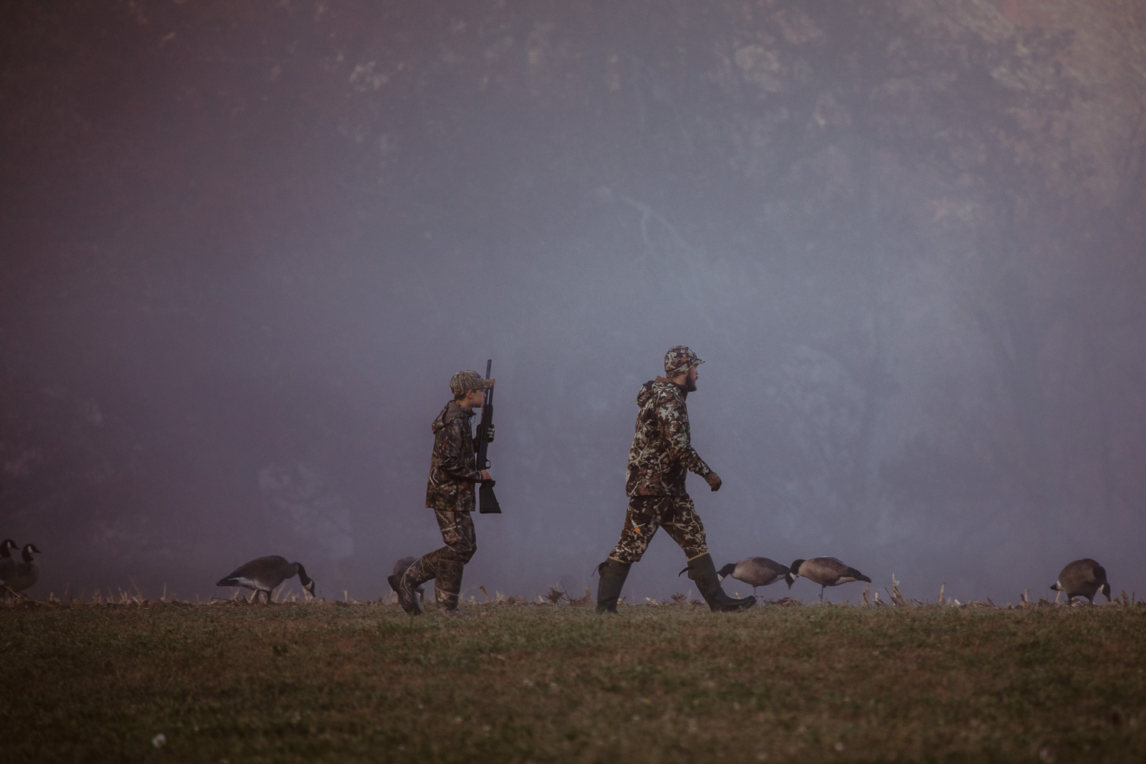
Today, we work with hunters to help our wildlife!
The Pittman-Robertson Act was signed in 1937.
Notes:
Following the Duck Stamp was a similar act in 1937, the Pittman-Robertson Act. Also signed by President Roosevelt, this act placed an excise tax on firearms and ammunition, with a later extension to archery equipment. This proceeds of this excise tax, paid by the manufacturers, are allocated to each state by the United States Fish and Wildlife Service. The funds acquired must be used for habitat acquisition, management, and restoration, research and monitoring of bird and mammal species, and hunter education. Today, this program is known as the Wildlife and Sport Fish Restoration Program, and has contributed millions of dollars to wildlife conservation across the country. In Rhode Island, this is how we fund the vast majority of our conservation programs. These funds are used for the conservation, management, monitoring, and habitat care for both game and non-game bird species in Rhode Island.

