Slide 1



Bat Mythbusters!
Rhode Island DEM Division of Fish and Wildlife

Slide 2
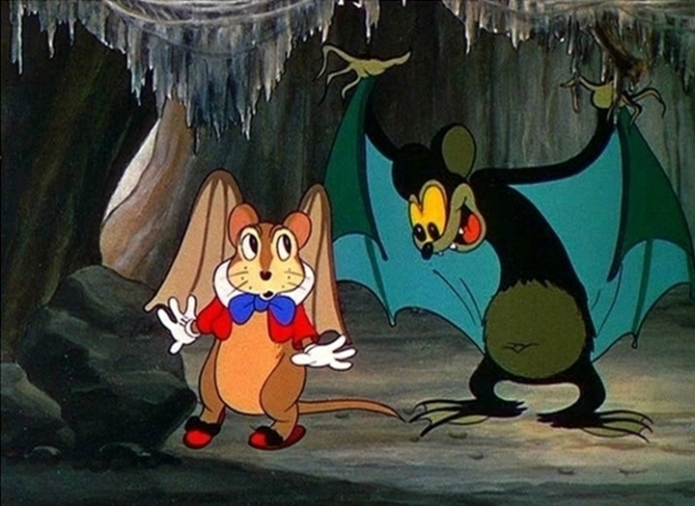
Myth: Bats are just mice with wings.
Notes:
Bats are not rodents, they are in their own mammalian order called Chiroptera, which means “hand-wing.”

Slide 3
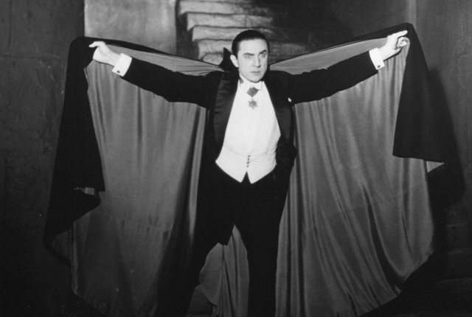
Myth: Bats are vampires!
Notes:
Only vampire bats, found in the tropics, drink blood. They make a small incision with their sharp teeth and lap up the blood with their tongues. Most vampire bats feed from sleeping mammals or birds. Vampire bats drink about one ounce of blood per meal. Most bat species eat fruit, insects, and flower nectar. Not so scary!

Slide 4
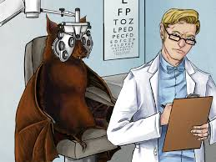
Myth: Bats are blind.
Notes:
Bats can definitely see, and most have pretty good eyesight! All bats also have a “super sense” called echolocation. Echolocation calls are so high pitched that humans cannot hear them. The sound waves of the call bounce off surrounding objects, and then back to the bat. The bat is able to sense how far away the object is!

Slide 5
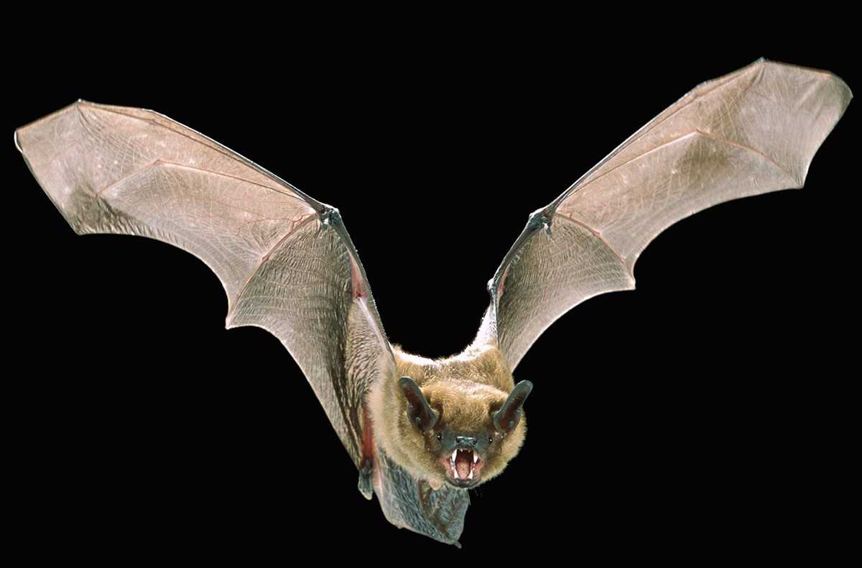
Myth: All bats have rabies.
Notes:
You cannot tell if a bat or other mammal has rabies just by looking at it. Rabies can only be confirmed by laboratory testing. In a given year, the Rhode Island Department of Health may test between 100 and 200 bats for rabies. The average infection rate in a given year, and over a ten year period is about 4 percent. If one bat tests positive for rabies it does not mean all the bats in the colony also have rabies. A bat that is found on the ground and can be easily captured may be sick or injured. Do not attempt to pick up or catch a bat with bare hands. Sick or injured bats are not aggressive but are likely to bite in self-defense if handled. If it is absolutely necessary to capture or secure the bat, only do so using leather work gloves or in such a way as the bat is not handled at all. When disturbed, whether sick or not, a bat will open its mouth and make a loud “clicking” or squeaking sound. Any bat that is found within a home, especially a bedroom, or where there are pets, or a person who is unable to communicate that they have had contact with the bat should be tested for rabies. Do not immediately release a bat which was captured or found within a home. Contact the Rhode Island Department of Health Rabies Hotline (401-222-2577) for instructions. Do not allow a bat to escape, particularly if in a situation as described above. Only if the bat tests positive for rabies will vaccine treatment be recommended.

Slide 6
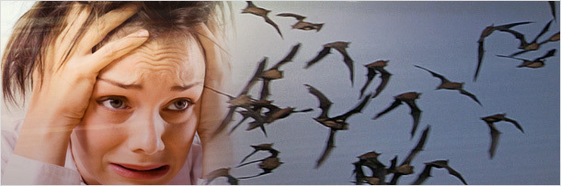
Myth: Bats want to fly into your hair. Yikes!
Notes:
Bats do not fly towards people with long hair on purpose. Bats are shy animals, and are probably pretty scared of you! They may swoop over you while foraging for insects at night. There may be some bugs flying over you that the bats are attracted to. The bats aren’t aiming for you!

Slide 7
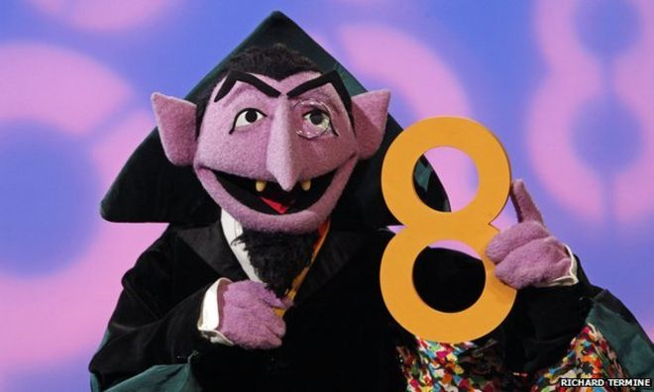
Myth: Bats are great at counting.
Notes:
Bats aren’t great at counting, but if “The Count” tried to count the number of bugs a bat ate in one night, he would get very tired! Insect-eating bats can munch between 2,000 and 6,000 bugs in one night! Ah, ah, ah!

Slide 8
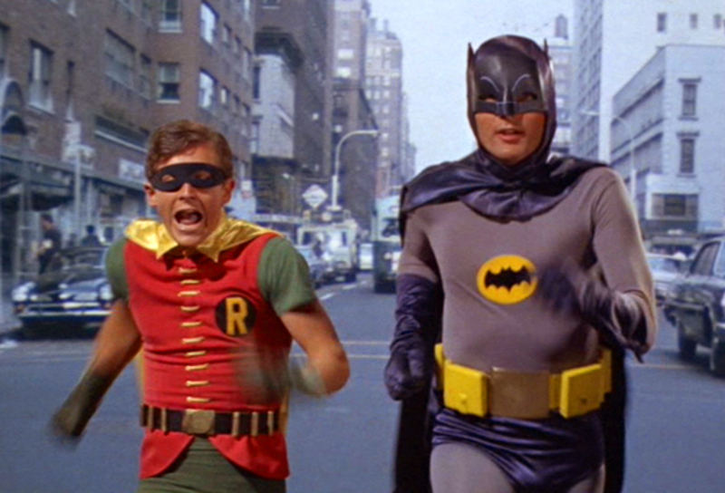
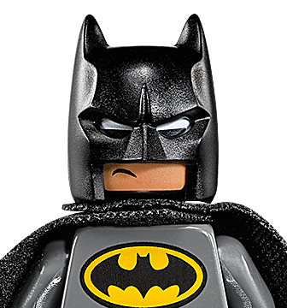
Myth: Bats fight crime.
(Na-na-nana-na-na-nana, BATMAN!)
Notes:
Bats don’t fight crime like Batman, but they are very beneficial to the environment and human populations. Bats fill lots of niches in the environment, and are important pollinators, seed dispersers, and critical insectivores. They can eat up to 1,000 insects per hour, and some eat half their body weight in one night! They eat lots of mosquitoes, moths, and beetles. They are a natural form of pest control. Bats are especially important to farmers because they eat moths and beetles that could damage food crops.

